Slide 1
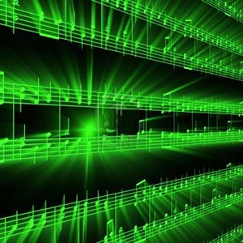


Lecture #2 – A2D
ESE 150 –
Digital Audio Basics

Slide 2
Lecture Topics
Where are we on course map?
Part 1: Sound / Sound Pressure
  Continuous, discrete, ADC, DAC
Part 2: Sampling & Quantization
  Infinite, Continuous signals → Finite, Discrete data in bits

Slide 3
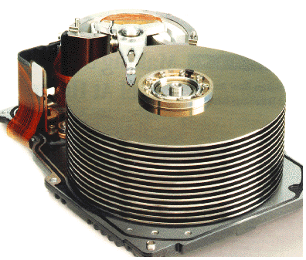










Course Map
7,8,9
10101001101
MIC
CPU
File-
System
A/D
10
10101001101
NIC
Music
1
domain
conversion
5,6
Numbers correspond to course weeks
compress
sample
freq
pyscho-
acoustics
3
2,3
4
13
11
EULA
----------------click
OK
D/A
NIC
speaker
MP3 Player / iPhone / Droid
12

Slide 4
Course Map – Week 1
MIC
A/D
10101001101
Music
1
Numbers correspond to course weeks
sample
2
D/A
10101001101
speaker
MP3 Player / iPhone / Droid

Slide 5
What we’ll Do in Lab
D/A
10101001101
speaker
MP3 Player / iPhone / Droid
Microphones / Speaker:
  Convert pressure waves to electric signal (and reverse)
Sound (in nature):
  a “pressure wave” that changes air molecules w/ respect to time
Sound (in our machine):
  a “voltage wave” that changes amplitude w/ respect to time
MP3 player converted digital signal back to an analog signal
  We will look at “voltage wave” on an oscilloscope

Slide 6
Sound Waves

Slide 7

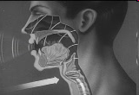
Introduction to Sound
Sound is a pressure wave
http://www.archive.org/details/SoundWavesAn

Slide 8
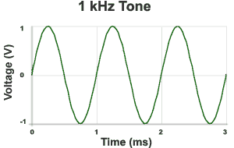

Week 1: Introduction to Sound Waves
Cycle = 1 iteration of sine wave
Hertz (Hz) = 1 cycle per second
1kHz = 1000 cycles/s
Source: http://www.mediacollege.com/audio/01/sound-waves.html

Slide 9
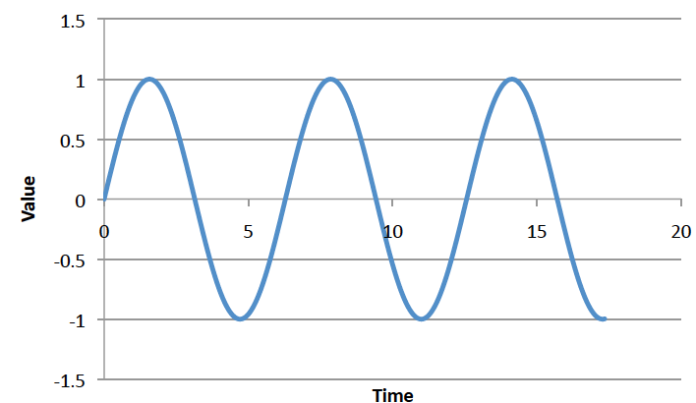
Preclass 1 and 2
Frequency of sine wave?
Relationship between period and frequency?
ms

Slide 10
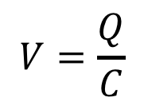

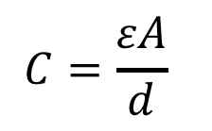
Week 1: Pressure to Voltage
Microphones convert pressure to voltage
  (speakers/headphones voltage to pressure)
  Physical position to voltage
Reason as parallel plate capacitor
  ESE 112 or PHYS 151
      Δd → ΔC → ΔV
V
d
$$C=\frac{εA}{d}$$
$$Q=CV$$
$$V=\frac{Q}{C}$$
Voltage is a function of
distance (pressure)
Notes:
Δd → ΔC → ΔV

Slide 11
Signals

Slide 12
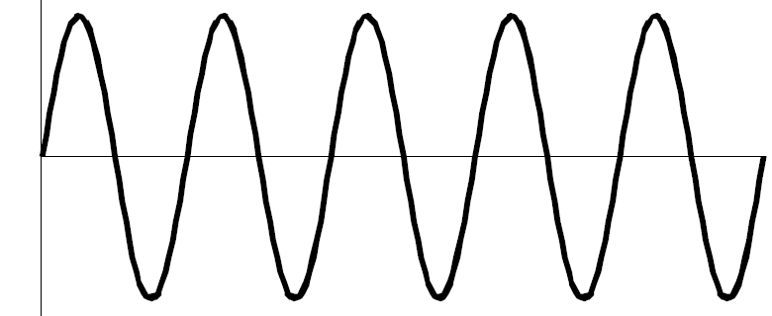
We need to define some terms
What is a signal?
  Something that carries information
  A description of how one parameter depends on another
    Common Engineering Example:
      Voltage that varies with time
        E.g. Amplitude of voltage changes as time moves forward
      Time = independent variable (x-axis): time
        Depends on nothing!
      Voltage = dependent variable (y-axis): v(t)
        Voltage’s amplitude depends on time
v(t)
time

Slide 13
We need to define some terms
Most signals encountered in nature…
  …are “continuous” / analog
    Continuous range of values (any real #)
    Examples: 1) Light intensity that changes with distance
    2) Voltage that varies over time v(t)
      We will see in lab this week: MUSIC signal represented with voltage
    3) Chemical reaction rate that depends on temperature
  as opposed to “non-continuous” / discrete signals
    Only a discrete range of values possible (limited subset of real #s)
    How a computer must represent signals
      Fundamental unit of information: bit
      Cannot represent all possible real #’s
      Uses binary digit (bit) to represent #’s:
        1-bit, represents 2 things…2-bits, represents 4 things
        What’s the generalization? (n-bits → how many things?)

Slide 14
Big Question
How represent and process continuous information on a digital computer with finite memory?
  Note: continuous means signal may take on infinite number of values between any T₁ and T₂
T₁
T₂

Slide 15
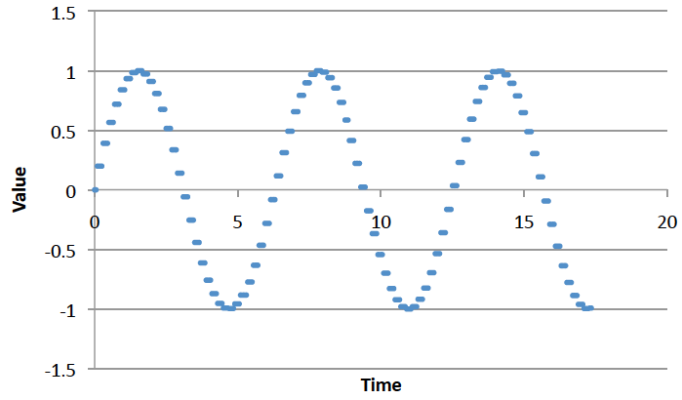
Connect the Dots
Intuition, with enough dots, not hard to “connect-the-dots” to reconstruct (understand) the continuous signal.
  What is the continuous signal here? (preclass 3)
  Assumes certain regularity conditions
  What is enough?
  Not unlike calculus
  Limit as △x→0
  Discrete sum
  approaches Integral

Slide 16
Definitions
Analog-to-Digital (ADC) Conversion
  Process of converting continuous signal to discrete signal
  Going from analog to digital “domain”
  Often called: digitization
  Use a subset of real #’s to represent all real #’s
    Involves a lot of approximation (lots of room for error!)
…collecting the dots

Slide 17
Definitions
Digital-to-Analog (DAC) Conversion
  Process of converting discrete signal to continuous signal
  Going from digital to analog “domain”
  Converting “bits” to a continuous waveform
    Our MP3/Music players do this all the time (will do in lab2)
(re)connecting
the dots

Slide 18
Sampling & Quantization
Part 2

Slide 19
ADC – Sampling & Quantization
Analog-to-Digital (ADC) Conversion
  Converting analog (continuous) signal to digital signal
  Digitization process has two important aspects:
    1) Sampling
      Converting independent variable of signal from continuous to discrete
      e.g.: breaking continuous time down into intervals
      Pick △x
      Look at value ever 1 ms
    2) Quantization
      Converting dependent variable of signal from continuous to discrete
      e.g.: breaking continuous voltage down into levels
      Round value to nearest 0.25 volts

Slide 20
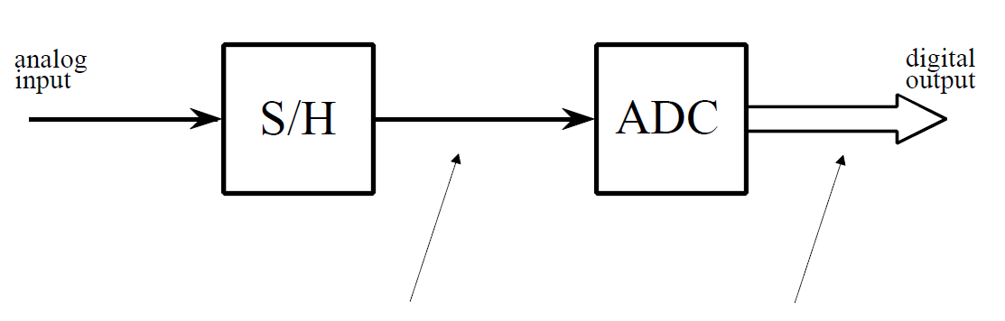
ADC – Broken into two parts
Sample/Hold
Performs sampling
Performs quantization
Figures from reading: The Scientist and Engineer's Guide to
Digital Signal Processing, By Steven W. Smith

Slide 21
ADC – Broken into two parts
Sample/Hold
Performs sampling
Performs quantization
Voltage
Voltage
Voltage
3
110
3
3
2
101
2
1
100
1
time (ms)
time (ms)
time (ms)
1
2
3
4
5
6
7
8
0
011
0
-1
1
2
3
4
5
6
7
8
1
2
3
4
5
6
7
8
010
-1
-3
-2
001
-2
-3
000
-3

Slide 22

ADC – Sampling
Analog-to-Digital (ADC) Conversion
  Sampling: breaking independent variable (time) into intervals
  Example: Let’s sample our continuous signal @ 1 ms intervals:
Voltage
What is our sampling rate?
(How many samples per second?)
3
1000 samples per second
1 kiloSamples / s
time (ms)
1
2
3
4
5
6
7
8
What is frequency of this signal?
$$freq =\frac{1}{period}=\frac{1}{8ms}=125 Hz$$
Spoiler alert:
Relationship between sample rate & frequency!
-3

Slide 23
ADC – Quantization
Analog-to-Digital (ADC) Conversion
  Quantization: breaking dependent variable (voltage) into levels
  Ex: Let’s quantize our range of voltages into 7 levels (1 Volt each)
Voltage
3
2
1
0
time (ms)
1
2
3
4
5
6
7
8
-1
-2
-3

Slide 24
ADC – Sampling & Quantization
Analog-to-Digital (ADC) Conversion
  Let’s collect our samples at the quantized levels
Voltage
Samples:
{ 0 ms, 0 Volts }
3
{ 1 ms, 2 Volts }
2
{ 2 ms, 3 Volts }
1
{ 3 ms, 2 Volts }
time (ms)
{ 4 ms, 0 Volts }
0
1
2
3
4
5
6
7
8
{ 5 ms, -2 Volts }
-1
{ 6 ms, -3 Volts }
-2
{ 7 ms, -2 Volts }
-3
{ 8 ms, 0 Volts }
Notice, we are rounding! Error is inherent in this process

Slide 25
ADC – Digital Conversion / Encoding
Analog-to-Digital (ADC) Conversion
  We’ve converted something continuous into discrete form
  How do we get it to “digital form”? We encode it…(map to another format)
Voltage
Samples:
{ 0 ms, 0 Volts }
3
{ 1 ms, 2 Volts }
2
{ 2 ms, 3 Volts }
1
{ 3 ms, 2 Volts }
time (ms)
{ 4 ms, 0 Volts }
0
1
2
3
4
5
6
7
8
{ 5 ms, -2 Volts }
-1
{ 6 ms, -3 Volts }
-2
{ 7 ms, -2 Volts }
-3
{ 8 ms, 0 Volts }

Slide 26
ADC – Digital Conversion / Encoding
Analog-to-Digital (ADC) Conversion
  We have 7 discrete voltages, # of bits to represent 7 things?
  3-bits! Why? 2^{3-bits} = 8 (1 unused state)
Binary
Encoding:
011
Voltage
Samples:
{ 0 ms, 0 Volts }
110
3
{ 1 ms, 2 Volts }
101
101
2
{ 2 ms, 3 Volts }
110
100
1
{ 3 ms, 2 Volts }
101
011
time (ms)
{ 4 ms, 0 Volts }
011
0
1
2
3
4
5
6
7
8
{ 5 ms, -2 Volts }
001
010
-1
{ 6 ms, -3 Volts }
000
001
-2
{ 7 ms, -2 Volts }
001
000
-3
{ 8 ms, 0 Volts }
011
Encoding: mapping data from one form to another (not always conversion)

Slide 27
ADC – Storing the Data
Analog-to-Digital (ADC) Conversion
  What do we store? Just the encoded bits:
    Our digitized signal: {011, 101, 110, 101, 011, 001, 000, 001, 011}
    It is now discrete & in digital format, store bits in MP3 player!
  Why can we avoid storing the time?
    It’s repetitive! Just store sampling rate: 1 kilo-samples/ sec
    Later, if we wish to restore signal, each “sample” occurred at 1ms
  In this example:
    Sampling rate: 1 k-samples/sec
    Resolution: 3-bits
    Our digitized signal: {011, 101, 110, 101, 011, 001, 000, 001, 011}

Slide 28
ADC – An approximation at Best
Analog-to-Digital (ADC) Conversion
  Continuous analog signal overlaid with discrete digital signal
  At best an approximation of original signal
Voltage
110
3
Ever heard an audiophile complain:
CDs/MP3s/Digital music doesn’t sound
as “real” or as good old records?
Now you know why!
101
2
100
1
011
0
time (ms)
1
2
3
4
5
6
7
8
010
-1
001
-2
000
-3

Slide 29
ADC – Broken into two parts
Sample/Hold
Performs sampling
Performs quantization
Voltage
Voltage
Voltage
3
110
3
3
2
101
2
1
100
1
time (ms)
time (ms)
time (ms)
1
2
3
4
5
6
7
8
0
011
0
-1
1
2
3
4
5
6
7
8
1
2
3
4
5
6
7
8
010
-1
-3
-2
001
-2
-3
000
-3

Slide 30
ADC – An approximation at Best
Digital-to-Analog (DAC) Conversion
  Process of converting discrete signal to continuous signal
    How to get back to original signal from bits?
Voltage
110
3
101
2
100
1
011
0
time (ms)
1
2
3
4
5
6
7
8
010
-1
001
-2
000
-3

Slide 31
ADC – An approximation at Best
Digital-to-Analog (DAC) Conversion
  Process of converting discrete signal to continuous signal
    How to get back to original signal from bits?
Voltage
110
3
Simplest – connect the dots
linear interpolation between points.
101
2
100
1
011
0
time (ms)
1
2
3
4
5
6
7
010
-1
With more sophistication
(and typical circuits)
can make smoother links.
001
-2
000
-3

Slide 32
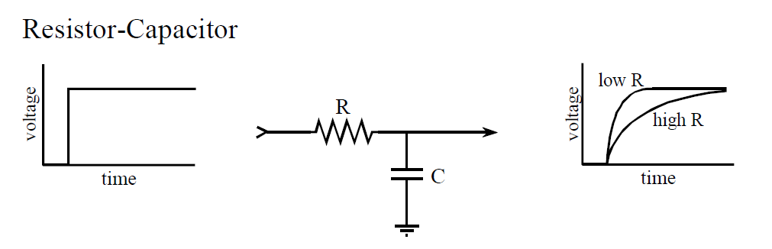
DAC - Filtering
Digital-to-Analog (DAC) Conversion
  What does a capacitor do?
  What happens when apply voltage across a resistor/capacitor?
  We call this filtering in EE, (RC delays are everything)
Voltage
110
3
101
2
100
1
011
0
time (ms)
1
2
3
4
5
6
7
8
output circuit of DAC
holds 7 discrete voltages for 1ms
each…applies it to RC filter,
output is “smooth” analog signal
010
-1
001
-2
000
-3
Notes:
Capacitors will come in ESE112/Physics151 (not had yet), and filtering to come in ESE215.
So, this story is more than we’re generally ready for in ESE 150.

Slide 33
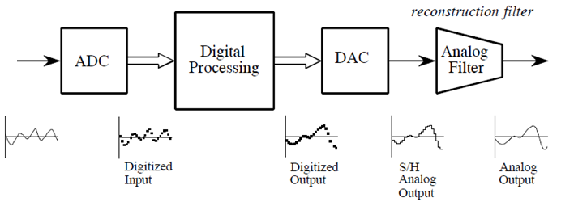
ADC / DAC – The full picture
Analog
Input
Figures from reading: The Scientist and Engineer's Guide to
Digital Signal Processing, By Steven W. Smith

Slide 34
PCM
Quantization & Sampling Technique described:
  Called Pulse-Code-Modulation (PCM)
    Patented in 1943
    PCM process is the ADC process
    Developed for telecommunications

Slide 35
Next Steps
Lab Today: sample sound waveforms
  Zoom link in canvas
Monday: look more formally and quantitatively at quantization and errors from quantization
Next Wednesday: Start looking at discrete sampling rates

Slide 36
Learn More
ESE215 – basic analog circuitry, RLC circuits, simple filters
  Including why typical circuits give smoother (not linear) connection of dots
ESE568 – Mixed Signal Integrated Circuits
  Build A2D, D2A

Slide 37
Big Ideas
Approximate continuous waveform on digital media by
  Discretize in all dimension
  For audio: in time and amplitude
    Sample in time; quantize voltage
Allows us to store audio signal as sequence of bits
Reconstruct by “connecting-the-dots”
  If our dots are frequent enough to represent the signal

Slide 38
Admin
Reading for today, Monday on syllabus
Lab Today
  Lab kit pickup today 5:30pm-6:45pm Levine Lobby
  Lab partners posted
    If you cannot pick up a kit, you have a partner who can
  Read lab, work prelab (includes download software)
Remember feedback
  Linked to course calendar on web (below lecture slides)
TA Office Hours this week
  Thurs. 2pm, Fri. 3-5pm, Sun. 2-4pm
TA Office Hours future weeks
  Complete poll posted on piazza

Slide 39
References
S. Smith, “The Scientists and Engineer’s Guide to Digital Signal Processing,” 1997.
Wikipedia, http://en.wikipedia.org/wiki/Analog-to-digital_converter
Wikipedia: http://en.wikipedia.org/wiki/Pulse-code_modulation

