Slide 1
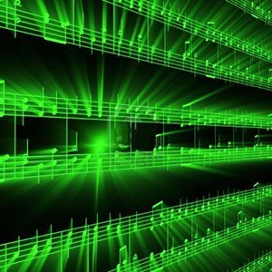


Lecture #5 – Anti-Aliasing
ESE 150 –
Digital Audio Basics

Slide 2
Lecture Topics
Part 1
  Where are we on course map?
  Review
    Nyquist-Shannon Sampling Rate
    Aliasing
  Multi-frequency signals
Part 2
  Anti-Alias Filtering
  References

Slide 3






Course Map – Week 2
MIC
A/D
10101001101
Music
1
Numbers correspond to course weeks
sample
2,4
D/A
10101001101
speaker
MP3 Player / iPhone / Droid

Slide 4
Nyquist Sampling
Sample at twice the maximum frequency
  Can reconstruct perfectly
If have frequencies > SampleRate/2
  Will get aliasing … as high frequencies fold

Slide 5
Sampling – What is the minimum?
Original Signal: 500 Hz
Aliased (Folded) Signal: 100 Hz
What frequency does aliasing occur?
  Original Signal’s Frequency: 500 Hz
    Sampling Rate: 600 Hz
  Aliasing occurs at: 600 Hz – 500 Hz = 100 Hz
    Also referred to as “Folding” – signal has “folds over” as if it were lower frequency

Slide 6
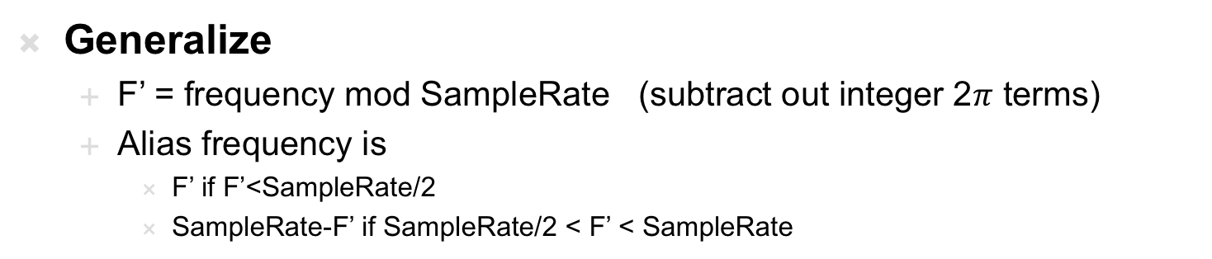
Sampling – What is the minimum?
Generalize
  F’ = frequency mod SampleRate (subtract out integer 2$π$ terms)
  Alias frequency is
    F’ if F’<SampleRate/2
    SampleRate-F’ if SampleRate/2 < F’ < SampleRate

Slide 7
What about Multirate Signals?
Fourier’s Theorem (week 4 preview!):
  We can decompose continuous signal in terms of a sum of sines and cosines at different frequencies

Slide 8
Preclass 1
 | 0 | 1 | 2 | 3 | 4 | 5 | 6 | 7 | 8 | 9 | 10 | f
L
M
R
Properly sampled? Relation?

Slide 9
What about Multirate Signals?
Fourier’s Theorem (week 4 preview!):
  We can decompose continuous signal in terms of a sum of sines and cosines at different frequencies
  This waveform: sum of sine waves at 100Hz and 250Hz
    What’s the Nyquist Sampling Rate then?

Slide 10
What about Multirate Signals?
Fourier’s Theorem & Nyquist Rate:
  Highest component’s frequency?
  What is Nyquist Sampling Rate?
    2 x highest frequency contained in the signal
    Sampling at this rate: avoids aliasing problem

Slide 11
Effects of Aliasing

Slide 12
Aliasing in Music…
Preclass 2
Multirate Signals and Aliasing
  Imagine the above is a music signal (100Hz + 750Hz)
    What happens if we undersample? Should sample at 1500 Hz, but instead 1000 Hz
    The 100 Hz signal will be sampled just fine (as 200 Hz is 2 x 100 Hz)
    What happens to 750 Hz Signal?

Slide 13
Aliasing in Music…
Multirate Signals and Aliasing
  Imagine the above is a music signal (100 Hz and 750 Hz chord)
  Where will 750Hz appear as?
    folding occurs at: 1000 Hz – 750 Hz = 250 Hz
    Sample rate – frequency = aliasing/folding frequency

Slide 14
Treat Frequencies Independently
For multi-frequency signals
  Can treat signals independently
Preclass 1 and 2 hints
  Form signal from sum
  Can reason about what happens to each frequency
    think about what happens to the 750Hz component of the wave independently
  Get a composite that is the fold/alias of each of the component frequencies

Slide 15
Anti-Aliasing
Part 2

Slide 16
How do we fix this?
It’s simple…sample at the Nyquist Rate
  But…what if your rate is fixed? Like 24 frames/sec?
  Or our eye’s sampling rate: 60 cycles/degree
    Spatial variations finer than this are undetectable!

Slide 17
Why do we need the antialias filter?
If we can’t hear anything above 20kHz…
  Why do we need to filter it out?
    Dog’s can hear from 40 Hz to 60 kHz
      so clearly there are sounds above 20 kHz
  Let’s imagine a high frequency noise in music studio
    Sampling at 40KHz to properly capture up to 20KHz
    Let’s say it’s a vibration occurring at 25 kHz
      No human can hear it, why filter it out?
    Because of aliasing:
      Frequency aliasing/folding will occur:
      Sample rate – frequency = aliasing/folding frequency
      40 kHz - 25 kHz = 15 kHz
      The 25 kHz vibration will fold-over to a 15 kHz “hum” or audible noise
        It will ruin our recording and source of noise wouldn’t be obvious!

Slide 18
Aliasing as Noise Source
The 25 kHz vibration will fold-over to a 15 kHz “hum” or audible noise
Aliasing provides another noise source
  Difference between our intended frequency and what we reconstruct or hear
  N(t) = R(t) – S(t)
If don’t do anything about it, can be arbitrarily large here
  If only waveform is the noise, 100% error
  Generally, depend on how large the alias signals are to the non-aliased

Slide 19
How to Avoid Aliasing with Digital Music?
If we simply sample at 2 x highest frequency of signal…
  (AKA: Nyquist Rate)
  …we won’t encounter aliasing!
But how do we guarantee highest frequency of our signal?
  Audio: this is easy!
    We know the range of human ear: 20 Hz to 20 kHz… (week 5)
    The highest frequency component in music is then: 20 kHz
    …so, before sound goes into ADC, we apply a filter!
      Blocks any frequency above 20 kHz from going into ADC
    Essentially, we are fixing our sampling rate & ‘blurring’ or filtering our incoming signal

Slide 20
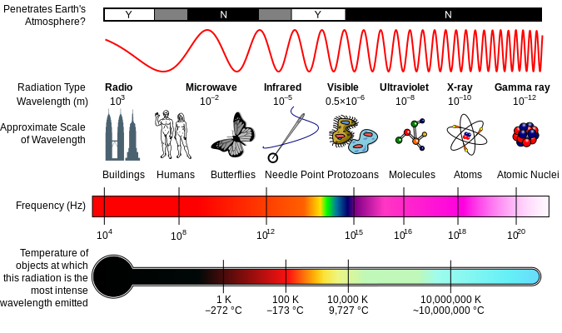

We know how to avoid aliasing…
What is a filter you ask?
  Imagine a coffee filter…
Signals ranging
in frequencies
from 20Hz to 40kHz
(100KHz, …)
go into filter
Water,
Ground coffee
beans go into
Filter…
WATER
grinds
grinds
Electronic
Filter
Called a “low pass” filter
Has a “cutoff” frequency
of 20 kHz
Coffee Filter
COFFEE
Only “delicious”
signals ranging
from 20Hz to 20kHz
pass through filter
(aka Audio Signals)
Only delicious
coffee passes
through filter…
“grinds” cannot pass

Slide 21
Low Pass Analog Filtering
Can limit rate of change (△V/ △T)
  Set a minimum time period for a value to charge output
If signal tries to move too fast (high frequency)
  The input change won’t be reflected in the output
E.g. limit to 1V/2ns
  Left (100Hz) can pass; right (750Hz) cannot

Slide 22
Low Pass Analog Filtering
Can limit rate of change (△V/ △T)
  Set a minimum time period for a value to charge output
If signal tries to move too fast (high frequency)
  The input change won’t be reflected in the output
Ideal: fast inputs “erased” from output
In practice: magnitude reduced
  Reduce noise level
Can engineer filters to get closer to ideal 215, 319

Slide 23
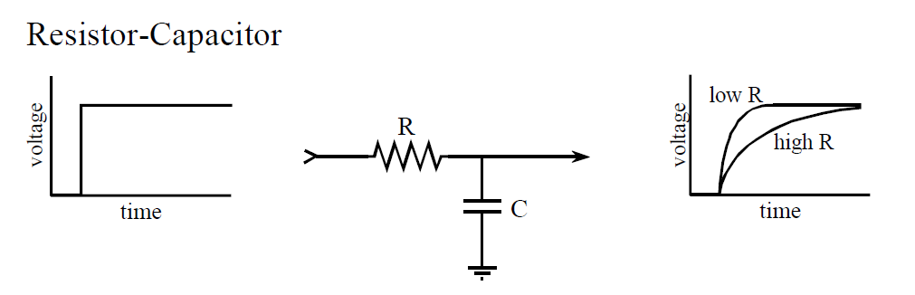
Low Pass Analog Filtering
Transfer Vin into Capacitor Vout
Think of Resistor as straw or hose
  Limits rate of electron flow into Capacitor
Think of Capacitor as a glass or bucket
  Must fill with electrons through Resistor to have
  Voltage (water) level rise
Circuit limits rate of change at Vout – limits frequency
Vin
Vout

Slide 24
Frequency and Signal Change
There’s a direct relationship between frequency of a signal and rate at which signal changes
  Related to period and frequency (period=1/f)
  Higher frequency → lower period → higher △V/ △T
  Limit rise time (△V/ △T)→ limit frequency pass through filter
  Maximum frequency → limits the rise-time will have
    Will rise over 1/2 of the period

Slide 25
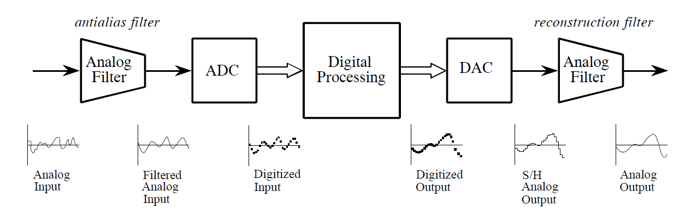
Full Block Diagram of DSP System
Before ADC, we put music signal through antialias filter
  Filter blocks any signals higher than 20 kHz (prevents aliasing!)
Figures from reading: The Scientist and Engineer's Guide to
Digital Signal Processing, By Steven W. Smith

Slide 26
Full Block Diagram of DSP System
Before ADC, we put music signal through antialias filter
  Filter blocks any signals higher than 20 kHz (prevents aliasing!)
  Then our ADC can safely sample at 2 x 20 kHz without aliasing
    What is our Nyquist Rate?
      f_{s}=2 x 20 kHz = 40 kHz, or 40 thousand samples per second!
    What is our Nyquist Frequency?
      ½ f_{s} = 20 kHz
  Cutoff frequency of our filter? Has to be the Nyquist Frequency

Slide 27
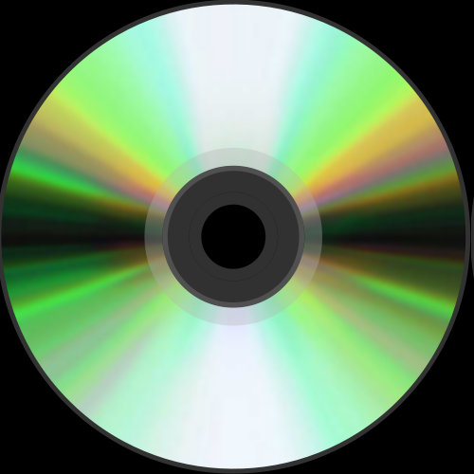
Compact Disc (CD)
CD (late 20th century)
  First form of digitized music
    ADC → DSP → DAC
  Up until this time, music was…
    …exact reproduction (record, tape)
  Nyquist Sampling Rate: 44.1 kHz
  Nyquist Frequency: ½ (44.1 kHz) = 22.05 kHz
    AKA – upper range of audio
    22.05 = cutoff frequency for low-pass antialias filter

Slide 28
Compact Disc (CD)
CD (late 20th century)
  Quick Math:
  Sampling Rate: 44.1 kHz
  Sampling Rate: 44,100 Hz
  That means we collect 44,100 Samples in 1 second!
    In 60 seconds, we collect: 2,646,000 samples
      (44,100 samples/sec * 60 sec) =2,646,000 samples/minute
    For a 3 minute song: 7,938,000 samples / song!
      (2,646,000 samples/minute) * (3 minutes) = 7,938,000 samples/song
    If each sample requires 16-bits to store:
      (7,938,000 samples/song) * (16 bits/sample) = 127,008,000 bits/song
      That’s 15,876,000 bytes per song
      15,504 kB = 15.14 MB per song!
    What about stereo recordings? Double that!
      30.28 MB per 3 minute stereo song!!
    This is why a CD can only hold about 80 minutes of digital audio!

Slide 29
Big Ideas
Sample at twice the maximum frequency
  Can reconstruct perfectly
If have frequencies > sample_freq/2
  Will get aliasing … as high frequencies fold
Avoid aliasing with analog Anti-Alias (low-pass) prefilter before sampling
  Eliminate high frequencies

Slide 30
Learn More
ESE215 – include analog filtering
ESE319 – active analog filtering
ESE224 – Signal Processing

Slide 31
Admin
Remember feedback
  Including on Lab 2
Lab 2 due today
Lab 3 posted
  Prelab contains a longer MATLAB tutorial
    And need to install MATLAB or use in Detkin/Ketterer
  Plan time for it

Slide 32
References
  S. Smith, “The Scientists and Engineer’s Guide to Digital Signal Processing,” 1997.
  http://en.wikipedia.org/wiki/Nyquist_frequency
  http://en.wikipedia.org/wiki/Nyquist_rate
  http://en.wikipedia.org/wiki/Oversampling
  http://en.wikipedia.org/wiki/Sampling_rate
  http://en.wikipedia.org/wiki/Hearing_range
  http://electronics.howstuffworks.com/telephone6.htm
  B. Olshausen, “Aliasing”, PSC 129 – Sensory Processes Course Notes, UC Davis

