Slide 1
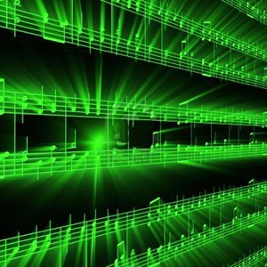


Lecture #07– Frequency Domain
ESE 150 –
Digital Audio Basics

Slide 2
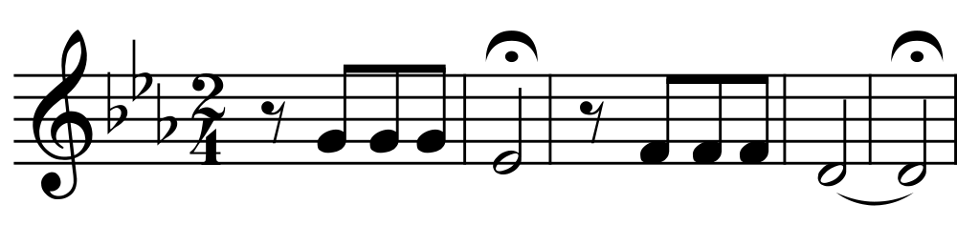
Teaser
Play this on piano:

Slide 3
Teaser
Play
3 eighth notes
1 half note
Cheat: G4 E4^{b} F4 D4
Notes:
A5, B5, G5, G4, D5

Slide 4
Information
1s / quarter note ➔ 10s of sound
How many bits to represent 10s of sound with 16b samples and 44KHz sampling?
  44K Hz x 16b/sample x 10s = 7040K =7Mbits

Slide 5
Representation
How does musical staff represent sound?
  What does vertical position represent?
  Note shape?

Slide 6
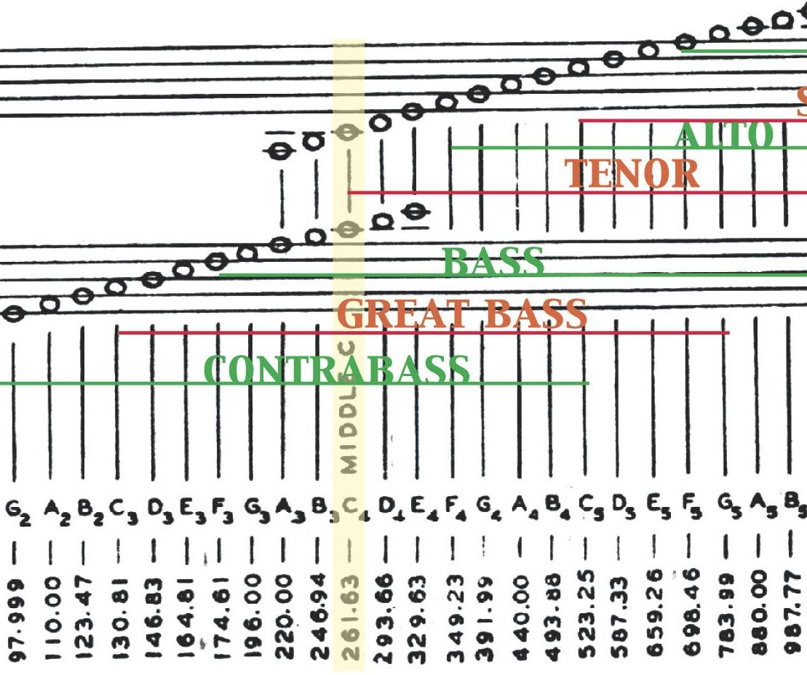
Musical Staff – Height = Frequency
Source: http://www.rochars.org/recorder_frequency_ranges_big

Slide 7
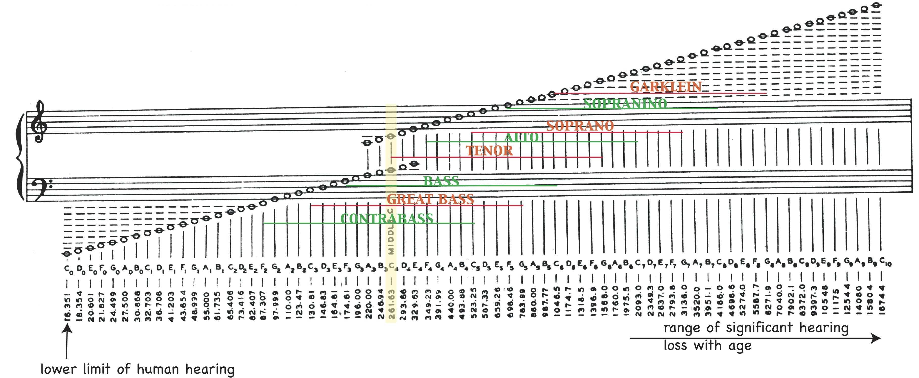
Musical Staff – Height = Frequency
Source: http://www.rochars.org/recorder_frequency_ranges_big

Slide 8
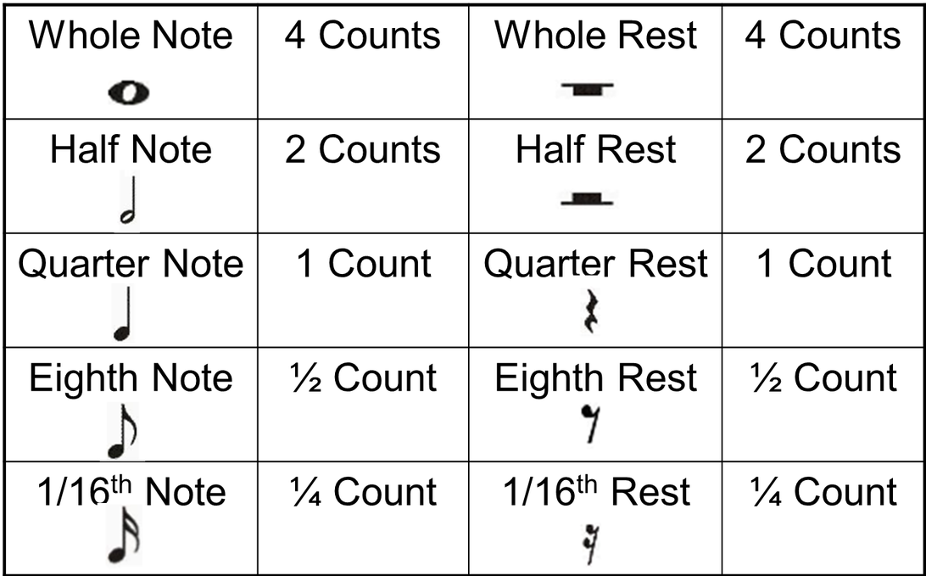
Musical Notation – Shape = Time
Source: https://www.pikpng.com/downpngs/hiJiwww_note-values-in-4-4-time-music-notes/

Slide 9
Frequency Representation
There are other ways to represent
  Frequency representation particularly efficient
392
311
348
294
Frequencies in Hertz

Slide 10
Frequency Representation
How much information is this musical staff communicating?
How many keys on piano? → bits/note

Slide 11
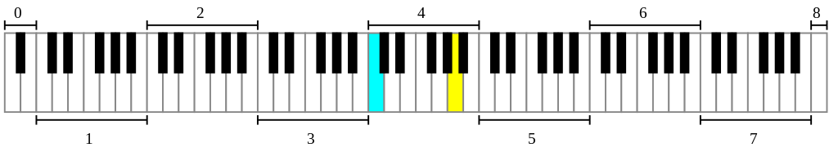
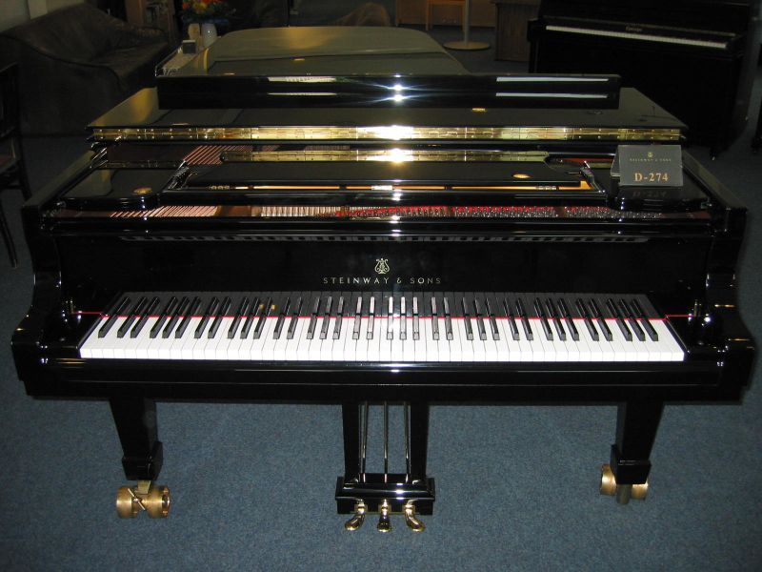
Hamburg Steinway D-274 Piano photo by Karl Kunde
https://commons.wikimedia.org/wiki/File:D274.jpg

Slide 12
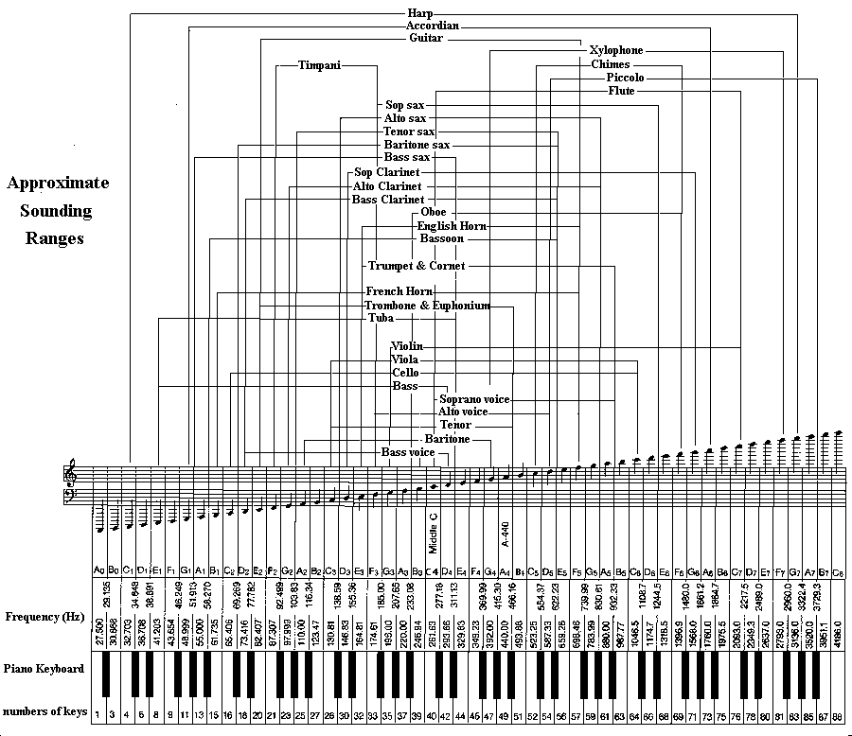
Larry Solomn: http://solomonsmusic.net/insrange.htm

Slide 13
Frequency Representation
How much information is this musical staff communicating?
How many keys on piano? → bits/note (or rest)
Let’s say 8b duration
How many bits for 10 notes, rests?
  (7b/note+8b/duration) x 10 note = 150 bits?

Slide 14
Conclude
Can represent common sounds much more compactly in frequency domain than in time-sample domain
  Frequency domain ~ 150b
  Time-sample domain ~ 7Mb

Slide 15
Lecture Topics
Part 1
  Teaser: frequency representation
  Where are we on course map?
  Frequency Domain
Part 2: Vector Background
Part 3: The Fourier Series
  can represent any signal in frequency domain
References
Notes:
http://toxicdump.org/stuff/FourierToy.swf
http://betterexplained.com/examples/fourier/
https://www.youtube.com/watch?v=QVuU2YCwHjw&feature=youtu.be (homer simpson drawn!)

Slide 16







Course Map – Week 5
MIC
A/D
10101001101
Music
1
domain
conversion
Numbers correspond to course weeks
compress
sample
freq
3
2
4
D/A
10101001101
speaker
MP3 Player / iPhone / Droid

Slide 17
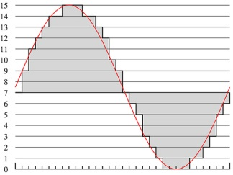
What we did in Lab…
Analog
input
ADC
Digital
Output
compress
Week 1: Converted Sound to analog voltage signal
    a “pressure wave” that changes air molecules w/ respect to time
    a “voltage wave” that changes amplitude w/ respect to time
Week 2: Sampled voltage, then quantized it to digital sig.
  Sample: Break up independent variable, take discrete ‘samples’
  Quantize: Break up dependent variable into n-levels (need 2^{n} bits to digitize)
Week 3: Compress digital signal
  Use even less bits without using sound quality!
Week 4 (upcoming): Before we compress…
  Put our ‘digital’ data into another form…BEFORE we compress…less stuff to compress!

Slide 18
What is the Frequency Domain?
Background

Slide 19
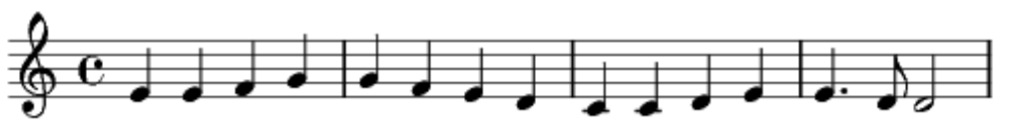
Musical Representation
With this compact notation
  Could communicate a sound to pianist
  Much more compact than 44KHz time-sample amplitudes (fewer bits to represent)
  Represent frequencies

Slide 20
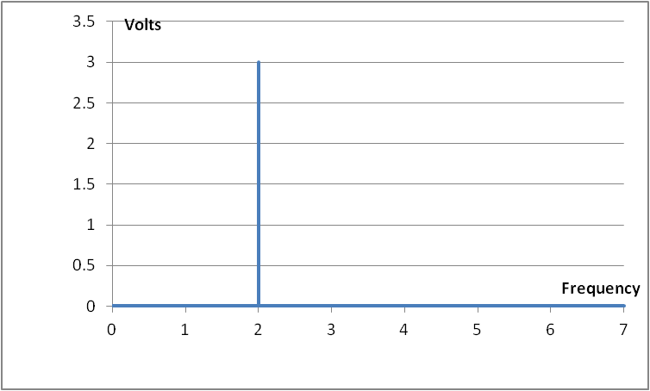


Time-Domain & Frequency-domain
As an example…let’s say we have a pure tone
  If period: T = $1/2$ and Amplitude = 3 Volts
  $s\left(t\right)=A sin\left(2πft\right)=$
$$3 sin\left(2π2t\right)$$
Time domain representation
Frequency domain representation

Slide 21
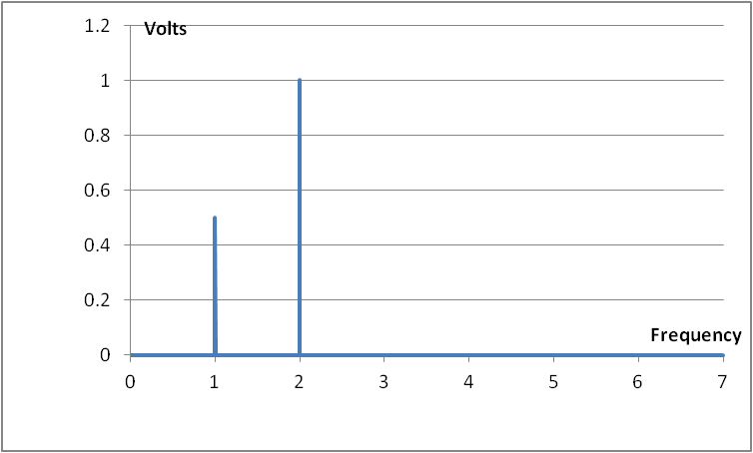

Frequency-domain
Of course, not all signals are this simple
For example: $s\left(t\right)=\sin\left(2×2π×t\right)+\frac{1}{2}sin\left(2π×t\right)$
Question: What will the frequency representation look like?

Slide 22
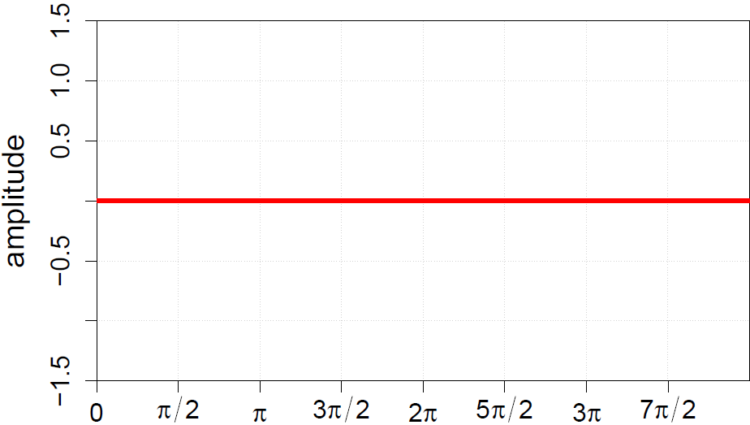
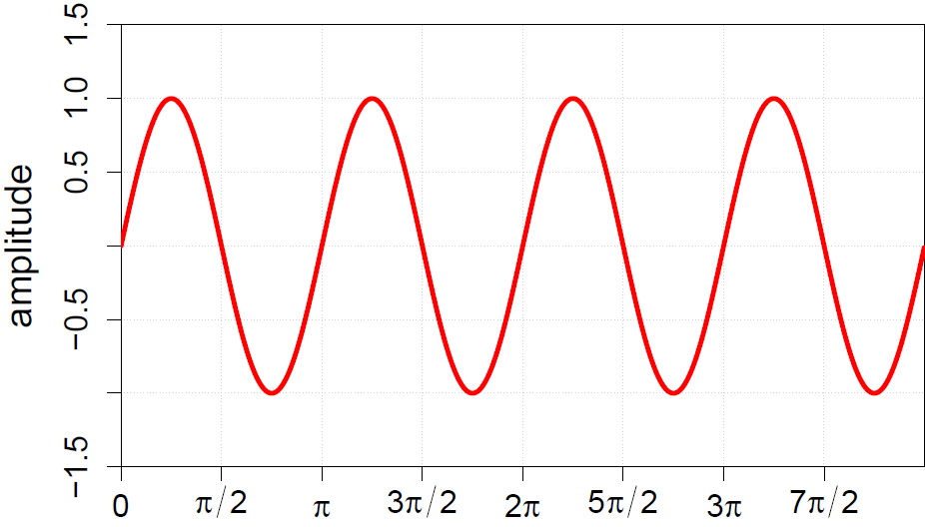
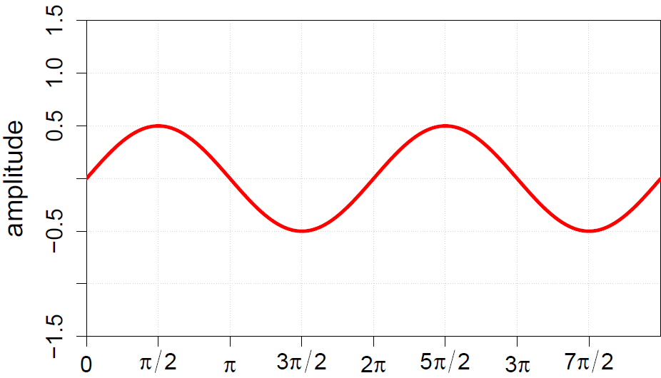
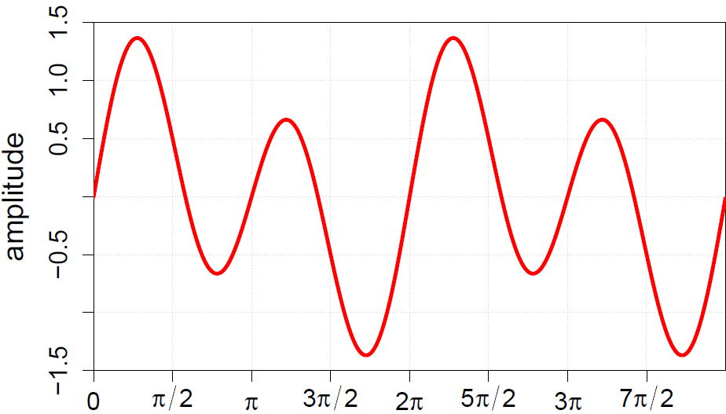
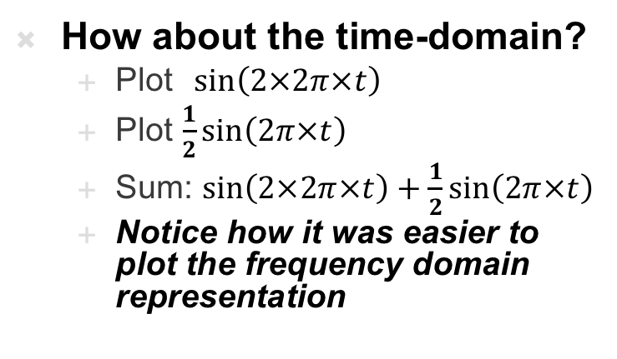
Frequency-domain
How about the time-domain?
  Plot$\sin\left(2×2π×t\right)$
  Plot $\frac{1}{2}sin\left(2π×t\right)$
  Sum: $\sin\left(2×2π×t\right)+\frac{1}{2}sin\left(2π×t\right)$
  Notice how it was easier to plot the frequency domain representation

Slide 23

Remember Lecture 5: Preclass 1
freq | 0 | 1 | 2 | 3 | 4 | 5 | 6 | 7 | 8 | 9 | 10
100 | 0 | 0.6 | 0.95 | 0.95 | 0.6 | 0 | -0.6 | -0.95 | -0.96 | -0.6 | 0
250 | 0 | 1.0 | 0 | -1 | 0 | 1 | 0 | -1 | 0 | 1 | 0
sum | 0 | 1.6 | 0.95 | -0.05 | 0.6 | 1 | -0.6 | -1/95 | -0.95 | 0.4 | 0
$$\sin\left(100×2π×t\right)+\sin\left(250×2π×t\right)$$

Slide 24
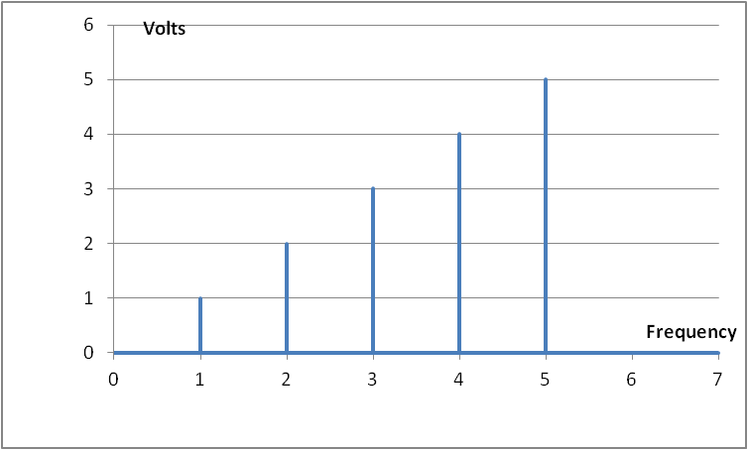
Frequency-domain
Another example
The time domain plot on the right is really the sum of 5 sinusoids,
where 5 Hz is the strongest component of the signal

Slide 25
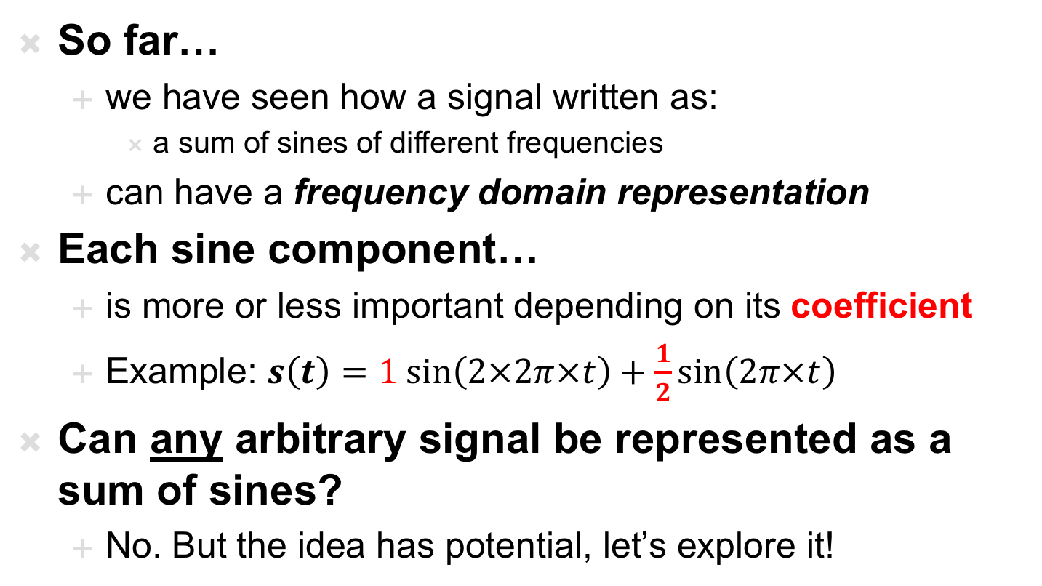
Frequency-domain
So far…
  we have seen how a signal written as:
    a sum of sines of different frequencies
  can have a frequency domain representation
Each sine component…
  is more or less important depending on its coefficient
  Example: $s\left(t\right)=1 sin\left(2×2π×t\right)+\frac{1}{2}sin\left(2π×t\right)$
Can any arbitrary signal be represented as a sum of sines?
  No. But the idea has potential, let’s explore it!

Slide 26
Vector Background
Part 2

Slide 27
Vector Space
We’re familiar with multi-dimensional spaces and vector representation
  E.g. Cartesian Coordinates in 2 Space
    2 dimensions X, Y
    Represent points as vector with 2 elements (x,y)
  Preclass 4a
    What is the (x,y) coordinate of
    the red dot?

Slide 28
Vector Space
We’re familiar with multi-dimensional spaces and vector representation
  E.g. Cartesian Coordinates in 2 Space
    2 dimensions X, Y
    Represent points as vector with 2 elements (x,y)
  Can easily extend to 3 Space
    (x,y,z)
  Harder to visualize, but could
  extend to any number of
  dimensions
    (d1,d2,d3,d4,d5,….)

Slide 29
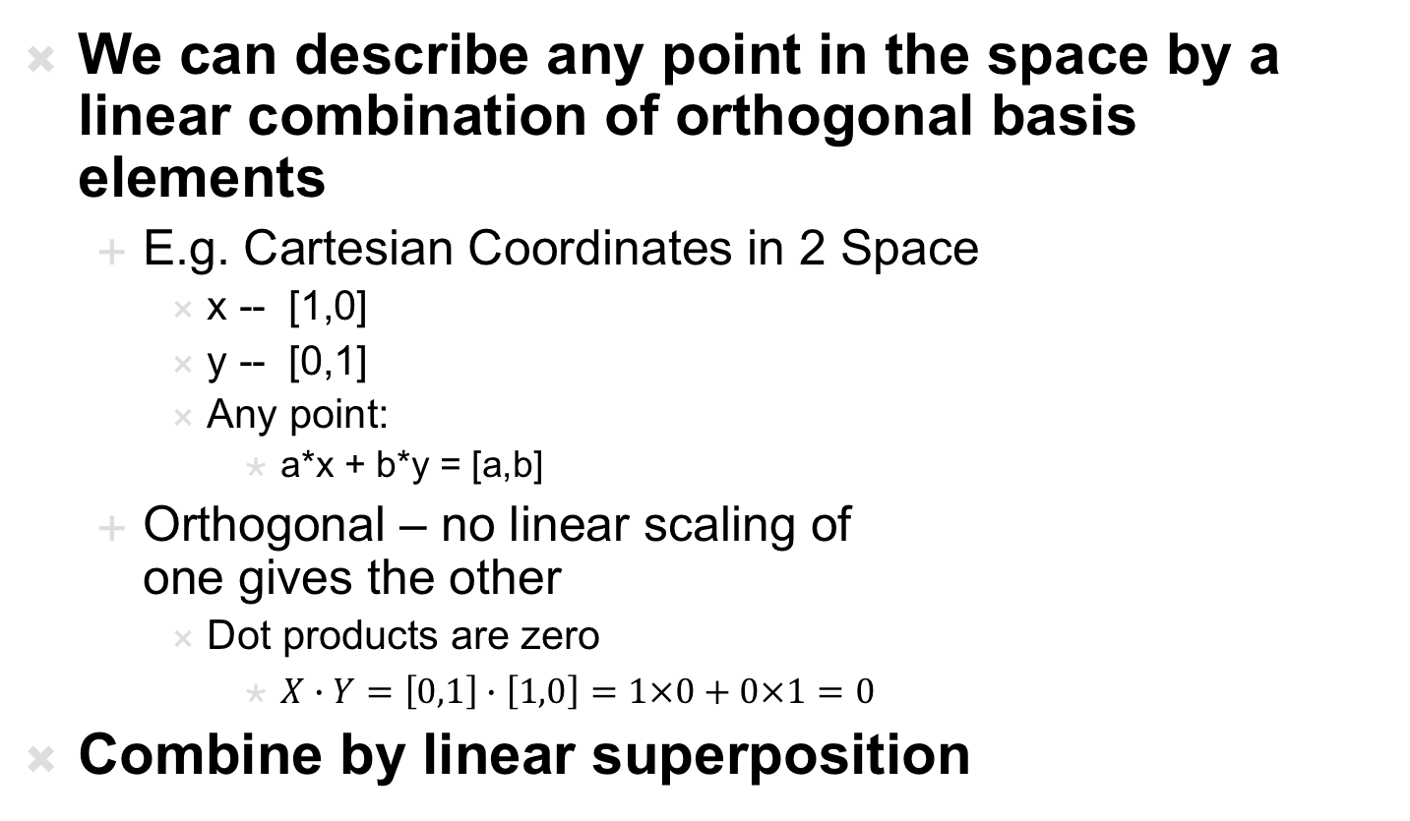
Orthogonal Basis
We can describe any point in the space by a linear combination of orthogonal basis elements
  E.g. Cartesian Coordinates in 2 Space
    x -- [1,0]
    y -- [0,1]
    Any point:
      a*x + b*y = [a,b]
  Orthogonal – no linear scaling of
  one gives the other
    Dot products are zero
      $X∙Y=\left[0,1\right]∙\left[1,0\right]=1×0+0×1=0$
Combine by linear superposition

Slide 30
Different Representations
We can also represent points in 2-space in polar coordinates
  A different orthogonal basis
    (magnitude, Θ)
What is the polar
coordinate of the
red dot? (4b)
  Note: fixed angle from
  original preclass

Slide 31
Can change Representations
Both Cartesian and Polar Coordinates can describe points in the same space.
  How do we change polar to Cartesian? (4c)
  What is the Cartesian coordinate for the red dot? (4d)

Slide 32
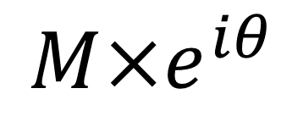
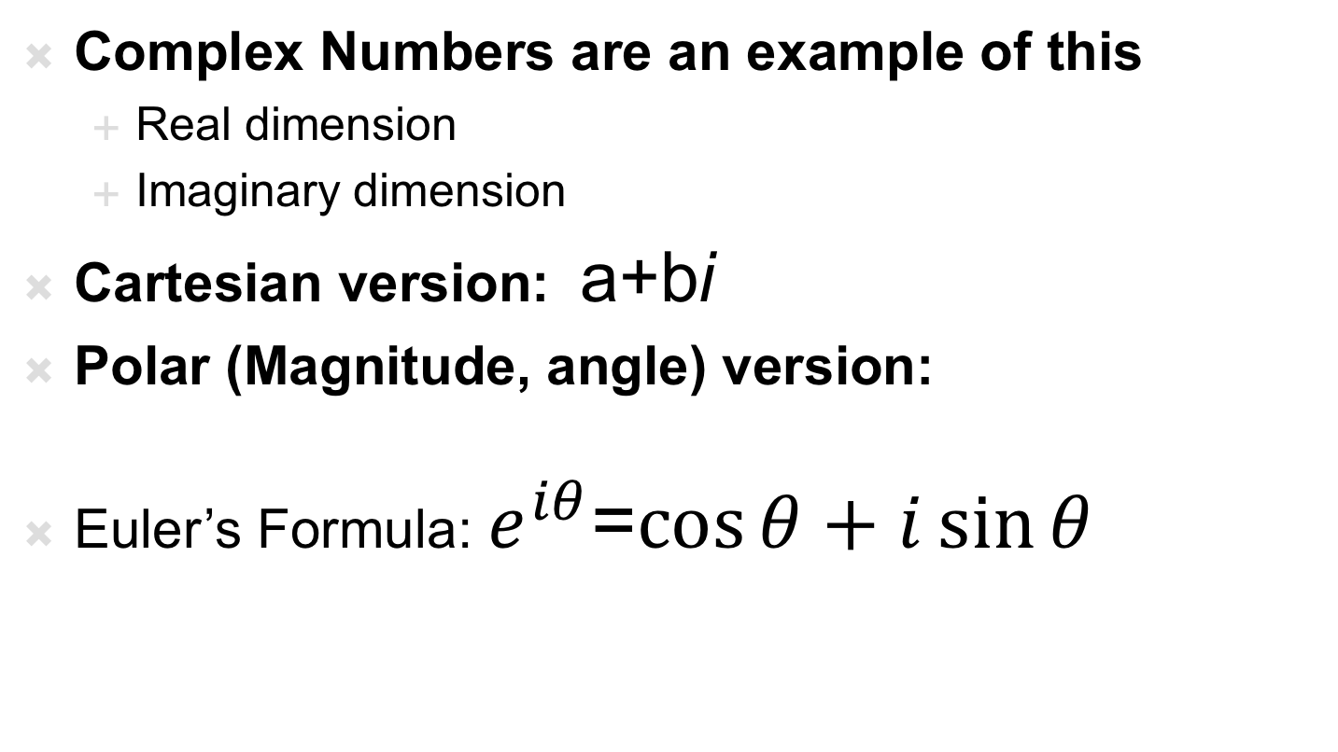
Complex Numbers
Complex Numbers are an example of this
  Real dimension
  Imaginary dimension
Cartesian version: a+bi
Polar (Magnitude, angle) version:
Euler’s Formula: $e^{iθ}$=$\cos{θ}+i\sin{θ}$
$$M×e^{iθ}$$

Slide 33
The Fourier Series
Part 3:

Slide 34
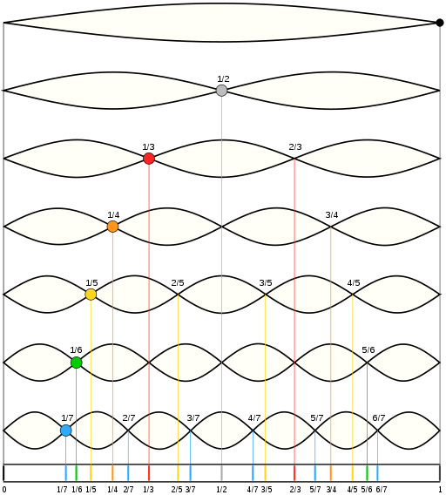
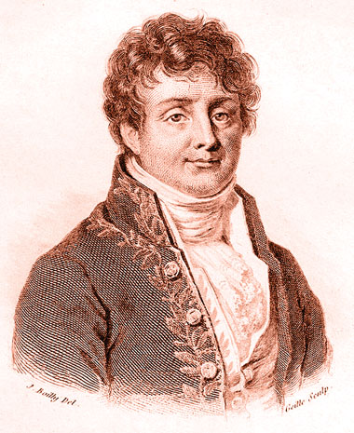
History…
Fourier series:
  Any periodic signal can be represented as a sum of simple periodic functions: sin and cos
  sin(nt) and cos(nt)
  where n = 1, 2, 3, …
  These are called the harmonics of the signal
Jean Baptiste Joseph Fourier, wikipedia

Slide 35
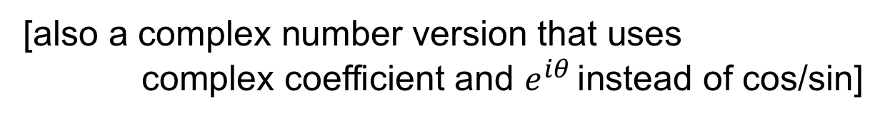
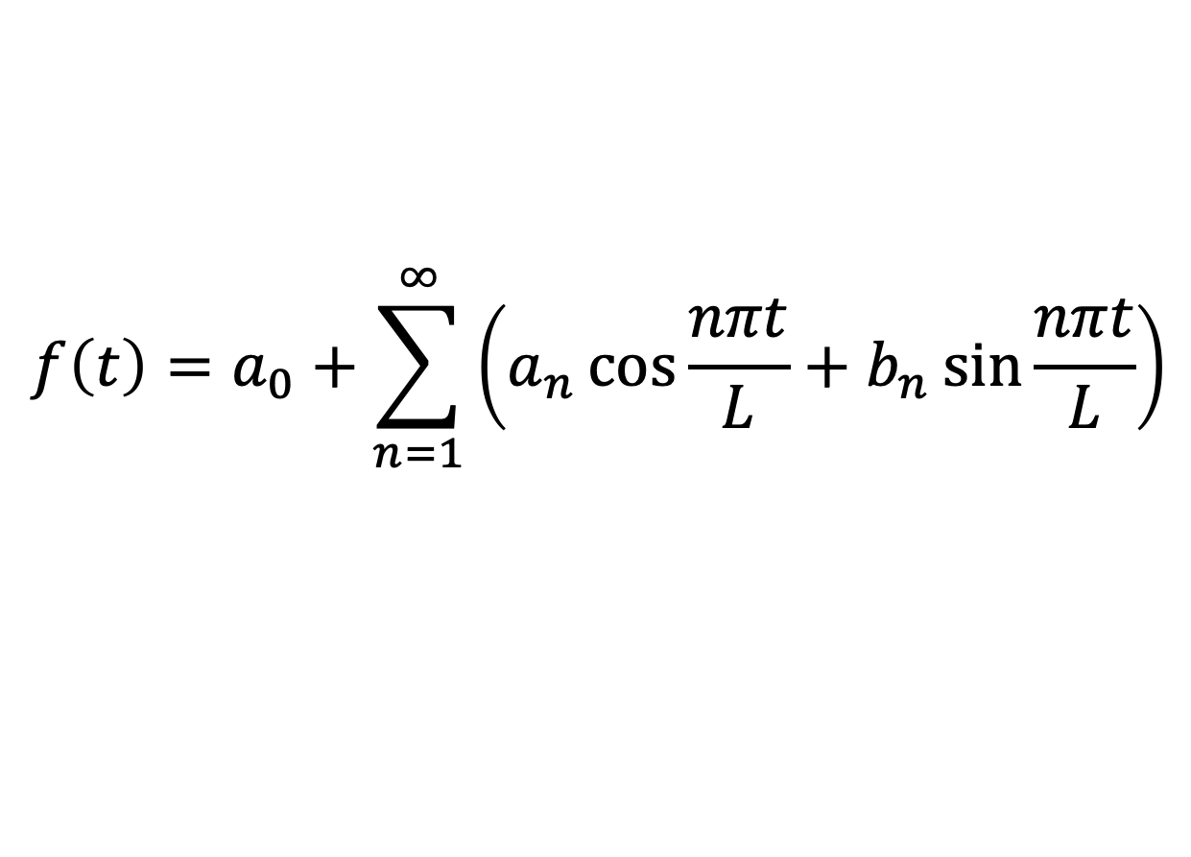
Fourier Series – more formally
The Fourier Theorem states that any periodic function f(t) of period L can be cast in the form:
$$f\left(t\right)=a_{0}+\sum_{n=1}^{∞}{\left(a_{n}\cos{\frac{nπt}{L}}+b_{n}\sin{\frac{nπt}{L}}\right)}$$
The constants: $a_{0}$, $a_{n}$ , and $b_{n}$ are called the Fourier coefficients of f(t)
[also a complex number version that uses
complex coefficient and $e^{iθ}$ instead of cos/sin]
Notes:
For more…
https://www.youtube.com/watch?v=ObklYbQaX24
A0 is the time-average value of f(t), its called the DC component of f(t) because the average values of the ac component are zero

Slide 36

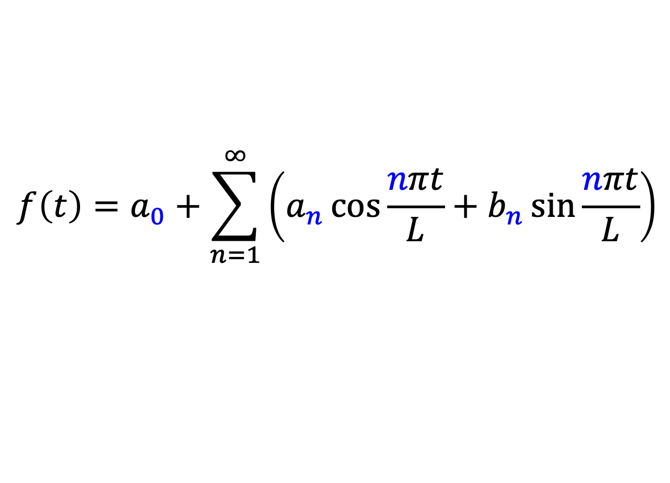
Fourier Series – more formally
The Fourier Theorem states that any periodic function f(t) of period L can be cast in the form:
$$f\left(t\right)=a_{0}+\sum_{n=1}^{∞}{\left(a_{n}\cos{\frac{nπt}{L}}+b_{n}\sin{\frac{nπt}{L}}\right)}$$
The constants: $a_{0}$, $a_{n}$ , and $b_{n}$ are called the Fourier coefficients of f(t)
The constants: $a_{0}$, $a_{n}$ , and $b_{n}$ become our vector
describing a signal in frequency space (domain)
Notes:
For more…
https://www.youtube.com/watch?v=ObklYbQaX24
A0 is the time-average value of f(t), its called the DC component of f(t) because the average values of the ac component are zero

Slide 37
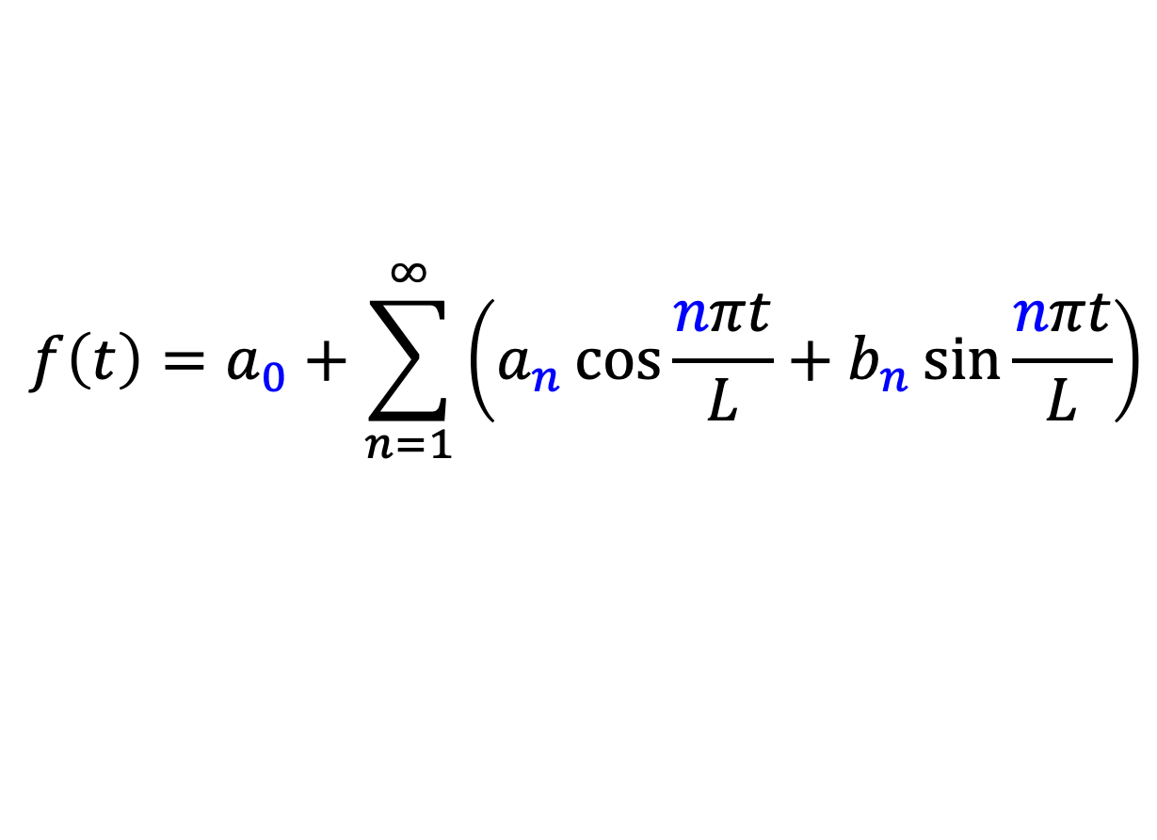
Frequency-domain
$$f\left(t\right)=a_{0}+\sum_{n=1}^{∞}{\left(a_{n}\cos{\frac{nπt}{L}}+b_{n}\sin{\frac{nπt}{L}}\right)}$$
Frequency Representation = [0,0,1,0,2,0,3,0,4,0,5,0,0,0,….]

Slide 38
Fourier Series – Why does it work?
  The cos(nx) and sin(nx) functions form an orthogonal basis:
    allow us to represent any periodic signal by taking a linear combination
    of the basis functions without interfering with one another
    AKA: superposition works!

Slide 39
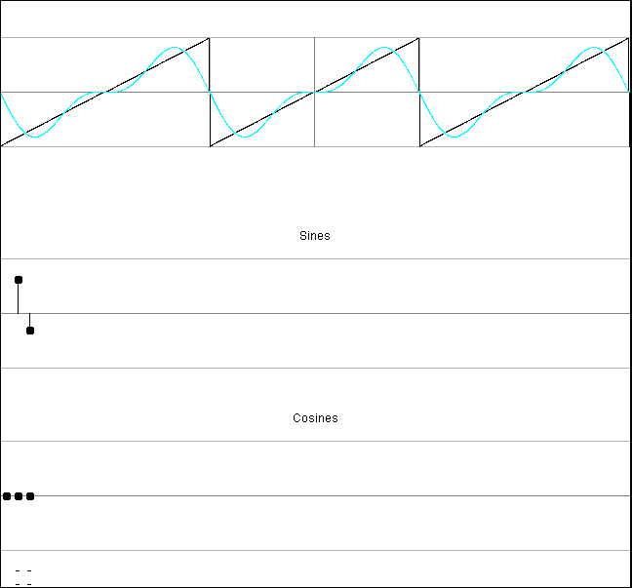
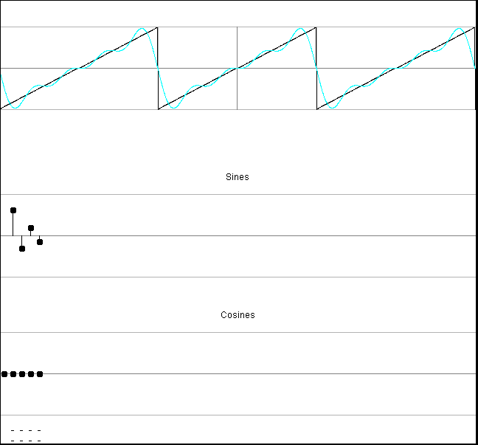
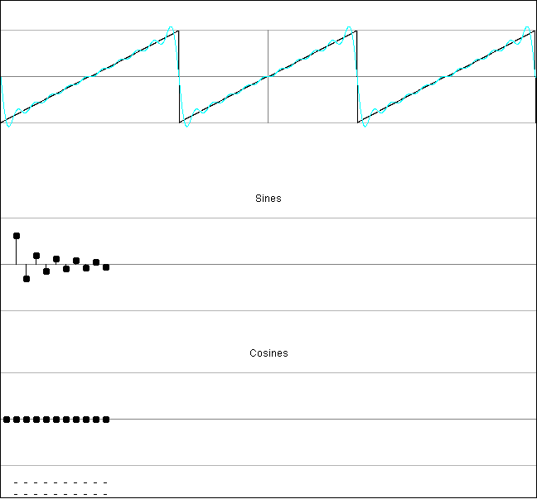
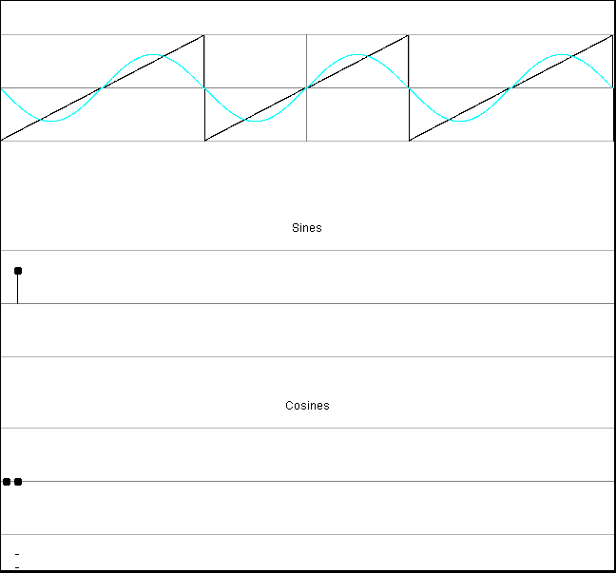
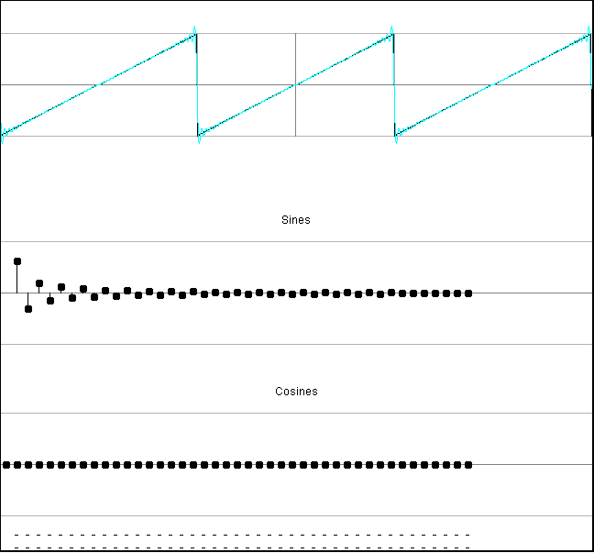
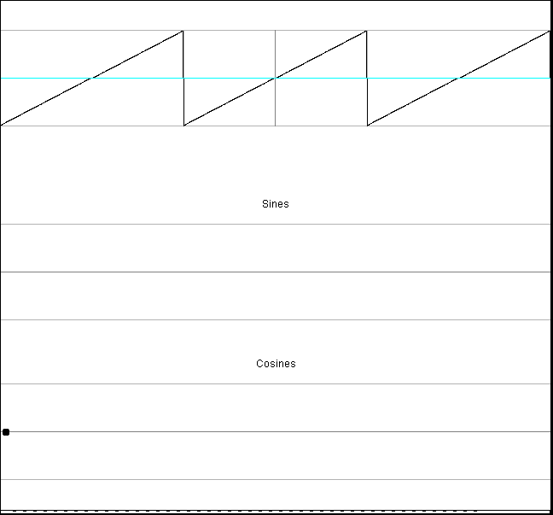
Fourier Series – Sawtooth wave
(falstad.com/fourier/)

Slide 40
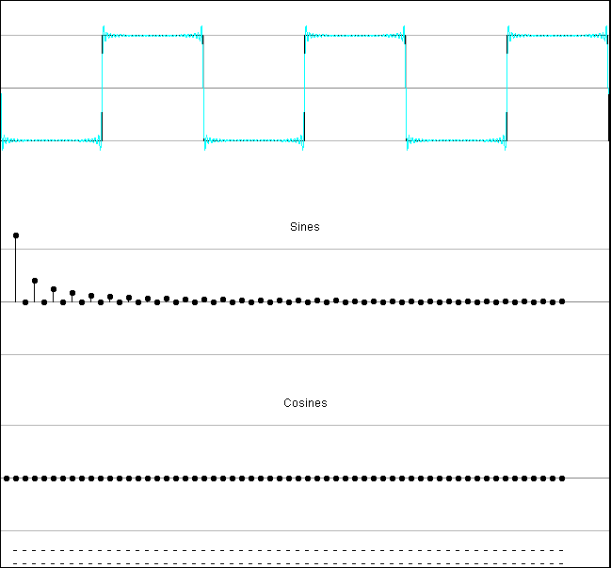

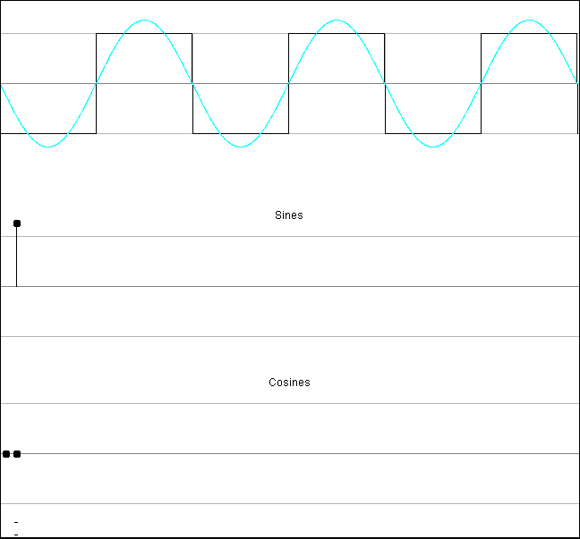
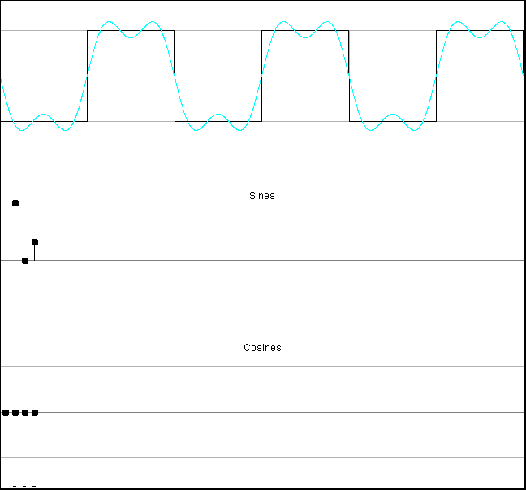
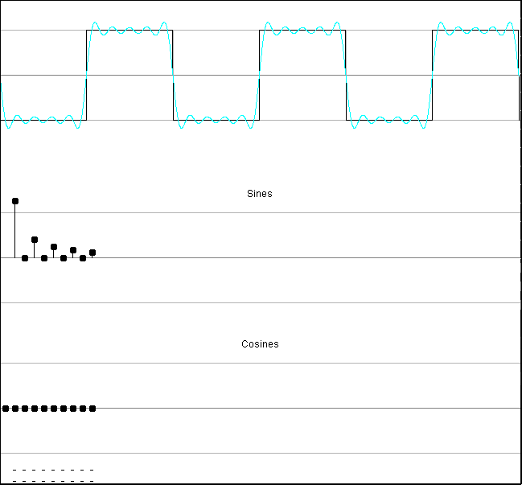
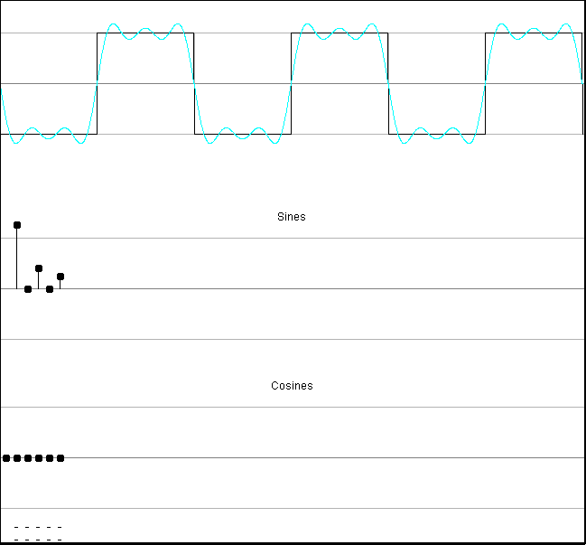
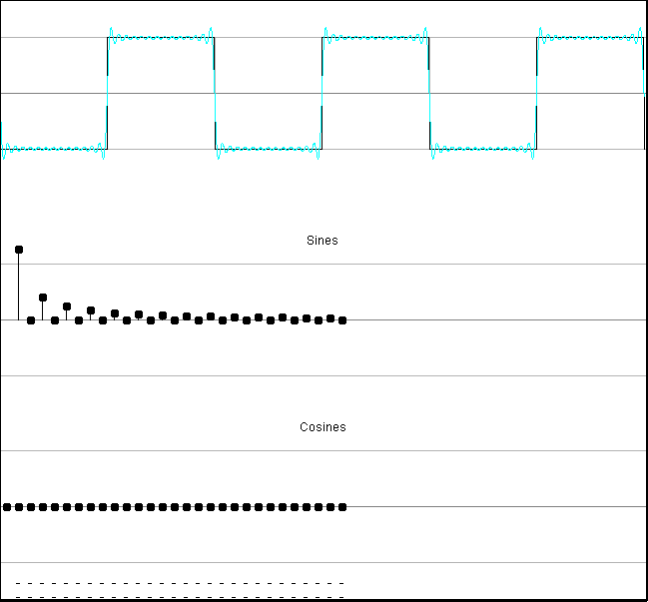
Fourier Series – Square Wave
(falstad.com/fourier/)

Slide 41
Fourier Series (Review of key points)
The idea of the series:
  Any PERIODIC wave can be represented as simple sum of sine and cosine waves
2 Caveats:
  Linearity:
    The series only holds while the system it is describing is linear because it relies on the superposition principle
    -aka – adding up all the sine waves is superposition in action
  Periodicity:
    The series only holds if the waves it is describing are periodic
    Non-periodic waves are dealt with by the Fourier Transform
      We will examine that in Lecture 9 (next Monday)

Slide 42
Nyquist
Remember we said we needed to sample at twice the maximum frequency
  Now see all signals can be represented as a linear sum of frequencies
  …and the frequency components are orthogonal
    Can be extracted and treated independently

Slide 43
Big Ideas
Can represent signals in frequency domain
  Different basis – basis vectors of sines and cosines
Often more convenient and efficient than time domain
  Remember musical staff

Slide 44
Learn More
ESE325 – whole course on Fourier Analysis
ESE224 – signal processing
ESE215, 319, 419 – reason about behavior of circuits in time and frequency domains

Slide 45
Reminder
Feedback
  Lecture and Lab
Lab 3 due today
Lab 4 out
  Use MATLAB to transform data into frequency domain
    Will use Complex form of Fourier Transform

Slide 46
References
S. Smith, “The Scientists and Engineer’s Guide to Digital Signal Processing,” 1997.
https://betterexplained.com/articles/an-interactive-guide-to-the-fourier-transform/

