Slide 1
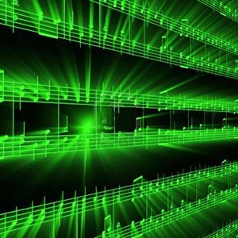


Lecture #10 – Psychoacoustics: Masking
ESE 150 –
Digital Audio Basics

Slide 2
Lecture Topics
Part 1
  Where are we on course map?
  Review
  Masking: Frequency or Simultaneous
Part 2
  Masking: Time-Domain or Temporal
  Preview Use in Compression
References

Slide 3






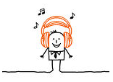

Course Map – Week 6
MIC
A/D
10101001101
Music
1
domain
conversion
5
Numbers correspond to course weeks
compress
sample
freq
pyscho-
acoustics
3
2
4
D/A
10101001101
speaker
MP3 Player / iPhone / Droid

Slide 4
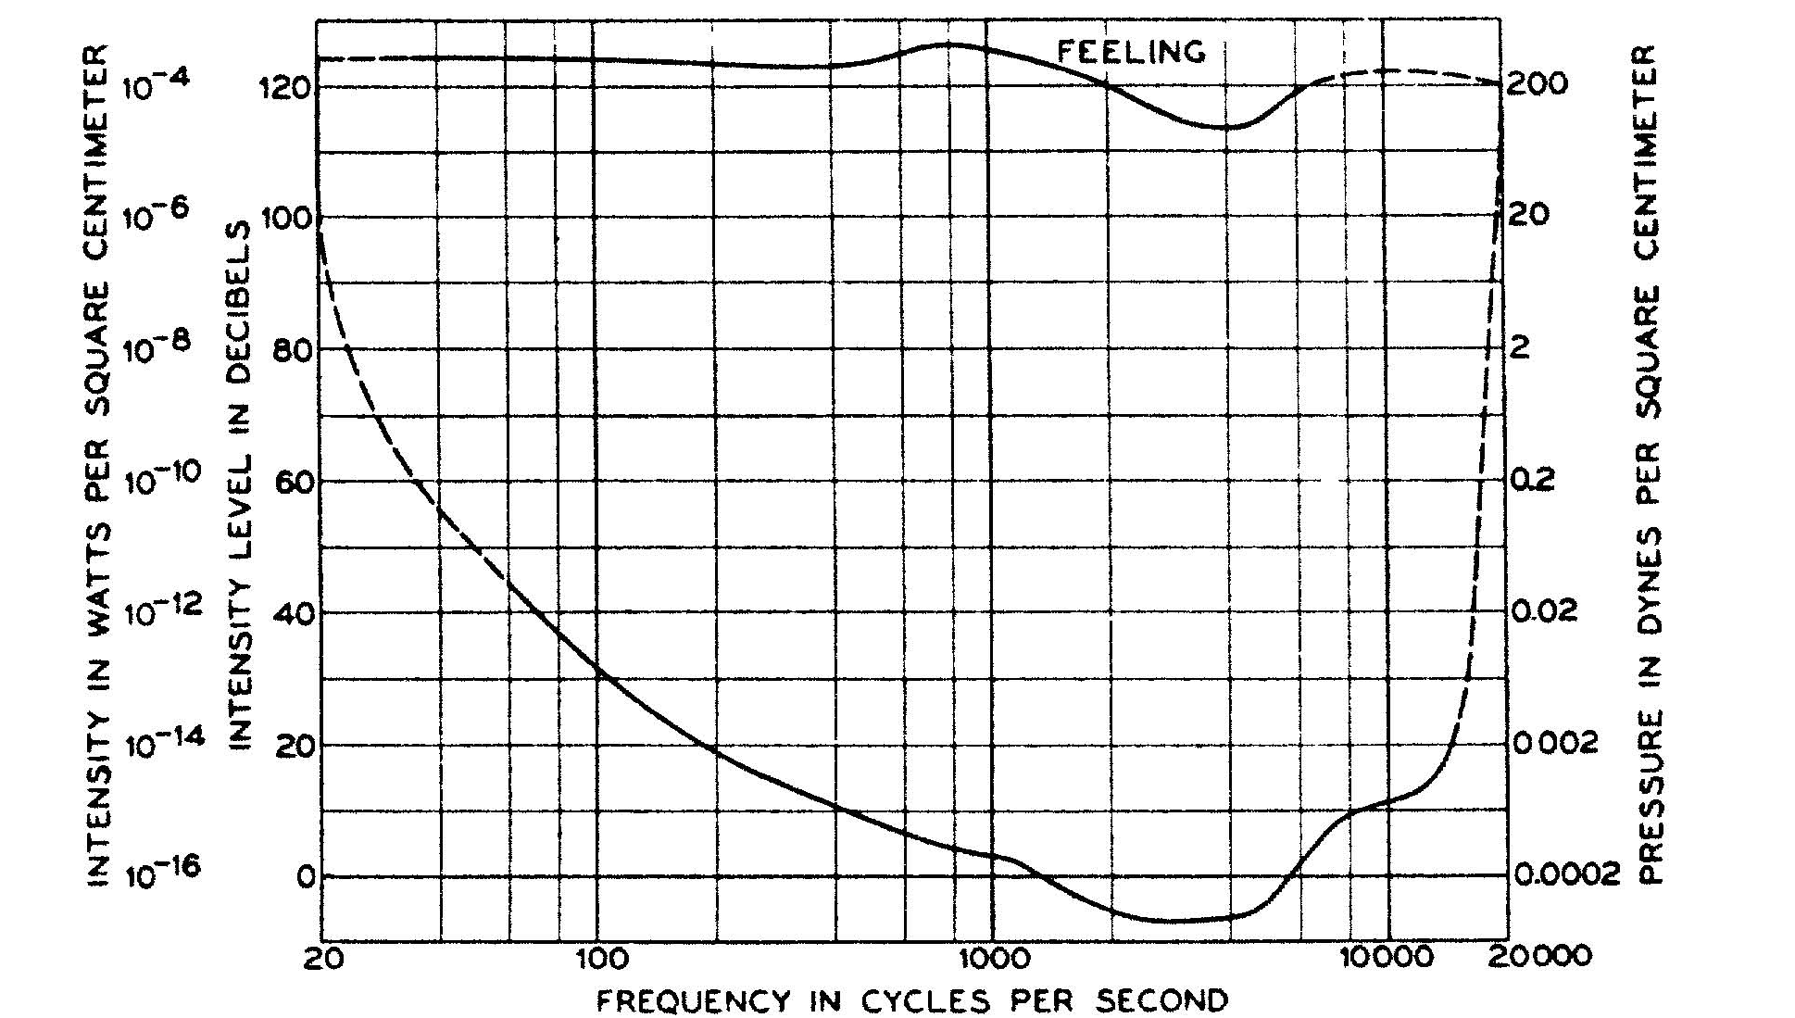
Lab 5: Measur own Fletcher Curve

Slide 5
Lab 5: Measure Masking
See (hear) that loud tones could mask softer, nearby frequencies.

Slide 6
Psychoacoustics

Slide 7
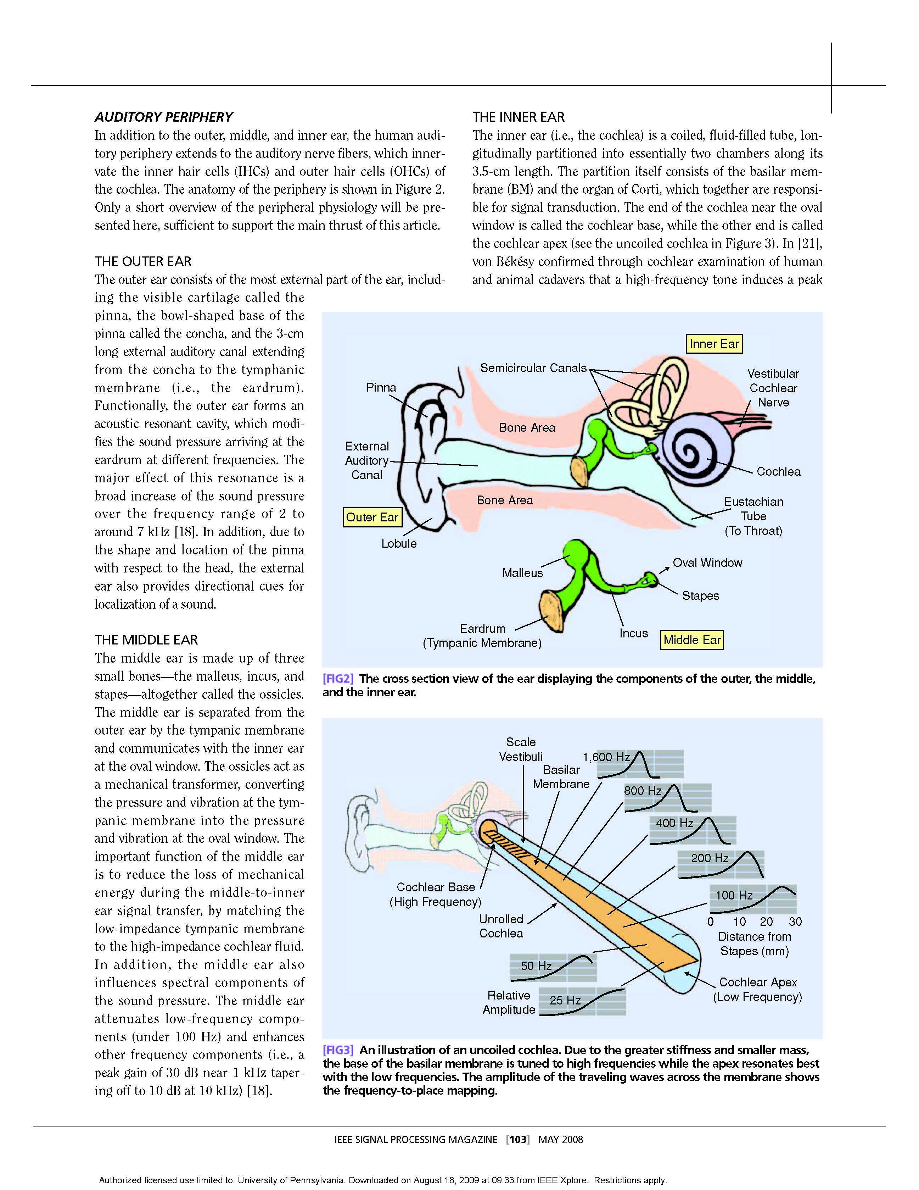
The Physical Ear – Take-away
Cochlea
  directly senses frequencies
  Captures frequency domain
  …not time domain
Frequency sensitive locations
  activated by sound waves
Neurons sense activation
Picture above – uncoiled cochlea…
-- different stereovilli (Hairs) resonate at different frequencies
-- our ear performs Fourier Transform!
Notes:
Snail shell is latin translation

Slide 8
Physical Ear to Engineering Model
Limits of Human Hearing…easy to see from Cochlea
  Cochlea only so long…
    lowest frequencies: 20 Hz
    Highest frequencies: 20 kHz
Also helps us understand ‘selectivity’
  Our brain can choose to ‘listen’ to output of various filters
  Example: At a party, but you can concentrate on conversation!
Notes:
Average length of choclea: 31.5mm long!

Slide 9
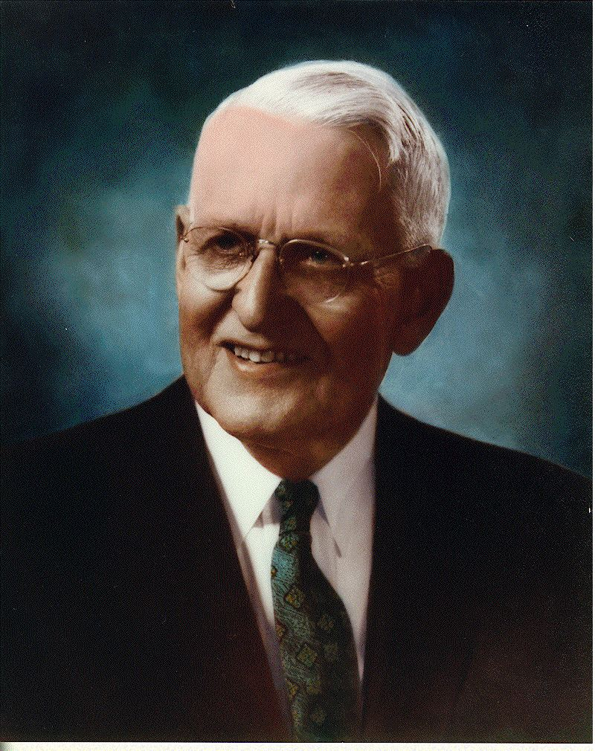
Auditory Thresholds – Measured by Fletcher
Low frequency & very high frequency sounds
must be intense for us to interpret them as
“loud” as sounds with frequencies in 1k to 5k range

Slide 10
Critical Frequency Bands
Number | Center Freq. (Hz) | Cut-off Freq. (Hz) | Bandwidth (Hz)
 |  | 20
1 | 50 | 100 | 80
2 | 150 | 200 | 100
3 | 250 | 300 | 100
4 | 350 | 400 | 100
5 | 450 | 510 | 110
6 | 570 | 630 | 120
7 | 700 | 770 | 140
8 | 840 | 920 | 150
9 | 1000 | 1080 | 160
10 | 1170 | 1270 | 190
11 | 1370 | 1480 | 210
12 | 1600 | 1720 | 240
Number | Center Freq. (Hz) | Cut-off Freq. (Hz) | Bandwidth (Hz)
13 | 1850 | 2000 | 280
14 | 2150 | 2320 | 320
15 | 2500 | 2700 | 380
16 | 2900 | 3150 | 450
17 | 3400 | 3700 | 550
18 | 4000 | 4400 | 700
19 | 4800 | 5300 | 900
20 | 5800 | 6400 | 1100
21 | 7000 | 7700 | 1300
22 | 8500 | 9500 | 1800
23 | 10500 | 12000 | 2500
24 | 13500 | 15500 | 3500
“Bark” scale –
  Maps frequency intervals into their respective critical band number

Slide 11
Auditory Masking

Slide 12
Masking
Auditory Masking
  When the perception of one sound is affected by the presence of another
    Remember…perception
Two types:
  Frequency Domain Based:
    Frequency Masking, simultaneous masking, spectral masking
  Time Domain Based:
    Temporal Masking / non-simultaneous masking

Slide 13
Frequency Domain Masking
Masking illustrates the limits of ear selectivity
  In fact, we measure ear selectivity using masking!
Vocabulary:
  Masker – The noise ‘masking’ the maskee
  Maskee – The signal being ‘masked’ by masker

Slide 14
On-Frequency Masking
Greatest/worst form of frequency masking
  Occurs when maskee & masker are the same frequency

Slide 15
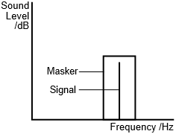
On-Frequency Masking
Greatest/worst form of frequency masking
  Occurs when maskee & masker are the same frequency
  Also strong when masker and signal are within same auditory band (filter)

Slide 16
On-Frequency Masking
Greatest/worst form of frequency masking
  Occurs when maskee & masker are the same frequency
  Also strong when masker and signal are within same auditory filter

Slide 17
On-Frequency Masking
Nearby hair cells vibrating
will cause some vibration.
Interpreted by brain as caused
by large vibration, not a separate
frequency.
Think about Cochlea vibrating.

Slide 18
On-Frequency Masking
Greatest/worst form of frequency masking
  Occurs when maskee & masker are the same frequency
  Also strong when masker and signal are within same auditory filter
  Think about Cochlea vibrating:
  Listener cannot distinguish between
  them, perceived as one sound
  Preclass 1: audience noise masks
  movie line

Slide 19
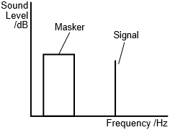
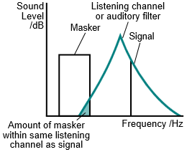
Off-Frequency Masking
Off-frequency masking
  Masker has different frequency than signal
  Masker still has effect…
    …if it’s in same auditory filter band as signal

Slide 20
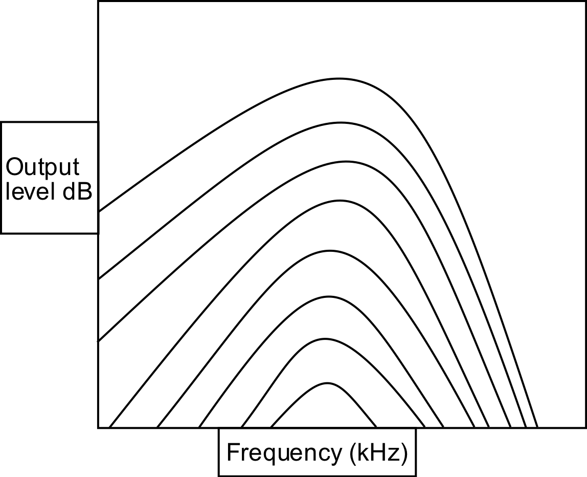
Frequency Masking
Given a signal at a frequency
How strong must a signal (or noise) at a difference frequency be in order to be heard?
General trend:
  Larger the frequency difference
  The less strong it must be (the less masking)
https://commons.wikimedia.org/wiki/File:OutputlevelMoore.svg

Slide 21
Frequency Masking Example
1000
2000
4000
80
Freq (Hz) | Strength (dB)
1000 | 80
2000 | 70
4000 | 20
70
20
https://commons.wikimedia.org/wiki/File:OutputlevelMoore.svg

Slide 22

Demonstration
Generate 900 Hz Tone (left channel) (maskee)
  Turn gain all the way down (-36 dB)
Generate 1000 Hz Tone (right channel) (masker)
  Keep gain at 0 dB
Play sound…
  Bring intensity of 900 Hz tone up so we can hear both tones
  Mute masker and play it again…
    Maskee was always there, just couldn’t hear it
    Even though it was at different frequency of masker
Notes:
Used audacity for these demos

Slide 23
Demonstration
Generate 1000 Hz Tone (masker) [band 9]
Sweep frequency 700Hz to 1600 Hz (masked)
  About 20% of level of masker
  Bands 7--11
Both constant loudness
Reference without Masker
Play sound…
  When hear second signal?
See diminished masking effects as frequencies get further apart
Notes:
Used audacity for these demos

Slide 24
Frequency Masking Example
1000
2000
4000
80
Freq | Strength
1000 | 80
2000 | 70
4000 | 20
70
20
https://commons.wikimedia.org/wiki/File:OutputlevelMoore.svg

Slide 25
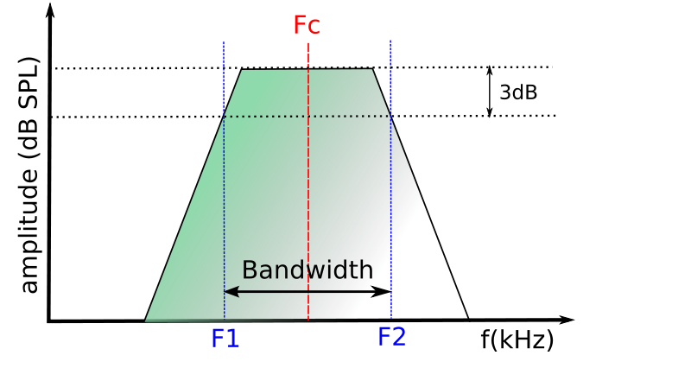
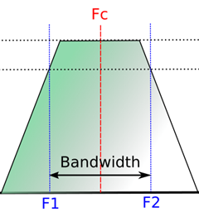
Physical Ear – Limits of Human Perception
Critical Frequency Bands
  Refers to ‘frequency bandwidth’ of each regions in the ear
    A ‘sharply tuned’ filter has good frequency resolution
      Allows frequencies in band pass well, but not others
      Brain can then ‘resolve’ different frequencies

Slide 26
Frequency Masking Example
1000
2000
4000
80
Freq | Strength
1000 | 80
2000 | 70
4000 | 20
70
20
https://commons.wikimedia.org/wiki/File:OutputlevelMoore.svg

Slide 27
Frequency Masking Example
1000
2000
4000
80
Freq | Strength
1000 | 80
2000 | 70
4000 | 20
70
20
Which of A, B, C are masked
by 1000Hz (red) signal?
https://commons.wikimedia.org/wiki/File:OutputlevelMoore.svg

Slide 28
Preclass 2
Which frequencies should we keep?

Slide 29
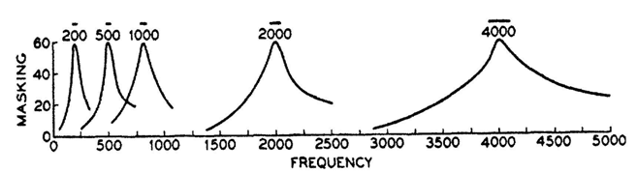
Frequency Masking @ Higher Frequencies
Plots of masking at several different frequencies:
  Effect of masking is ‘worse’ at higher frequencies
  Masking band gets wider at higher frequencies

Slide 30
Critical Frequency Bands – How many?
Number | Center Freq. (Hz) | Cut-off Freq. (Hz) | Bandwidth (Hz)
 |  | 20
1 | 50 | 100 | 80
2 | 150 | 200 | 100
3 | 250 | 300 | 100
4 | 350 | 400 | 100
5 | 450 | 510 | 110
6 | 570 | 630 | 120
7 | 700 | 770 | 140
8 | 840 | 920 | 150
9 | 1000 | 1080 | 160
10 | 1170 | 1270 | 190
11 | 1370 | 1480 | 210
12 | 1600 | 1720 | 240
Number | Center Freq. (Hz) | Cut-off Freq. (Hz) | Bandwidth (Hz)
13 | 1850 | 2000 | 280
14 | 2150 | 2320 | 320
15 | 2500 | 2700 | 380
16 | 2900 | 3150 | 450
17 | 3400 | 3700 | 550
18 | 4000 | 4400 | 700
19 | 4800 | 5300 | 900
20 | 5800 | 6400 | 1100
21 | 7000 | 7700 | 1300
22 | 8500 | 9500 | 1800
23 | 10500 | 12000 | 2500
24 | 13500 | 15500 | 3500
“Bark” scale –
  Maps frequency intervals into their respective critical band number
  24 frequency bins (or “barks”), get wider as frequency increases!

Slide 31
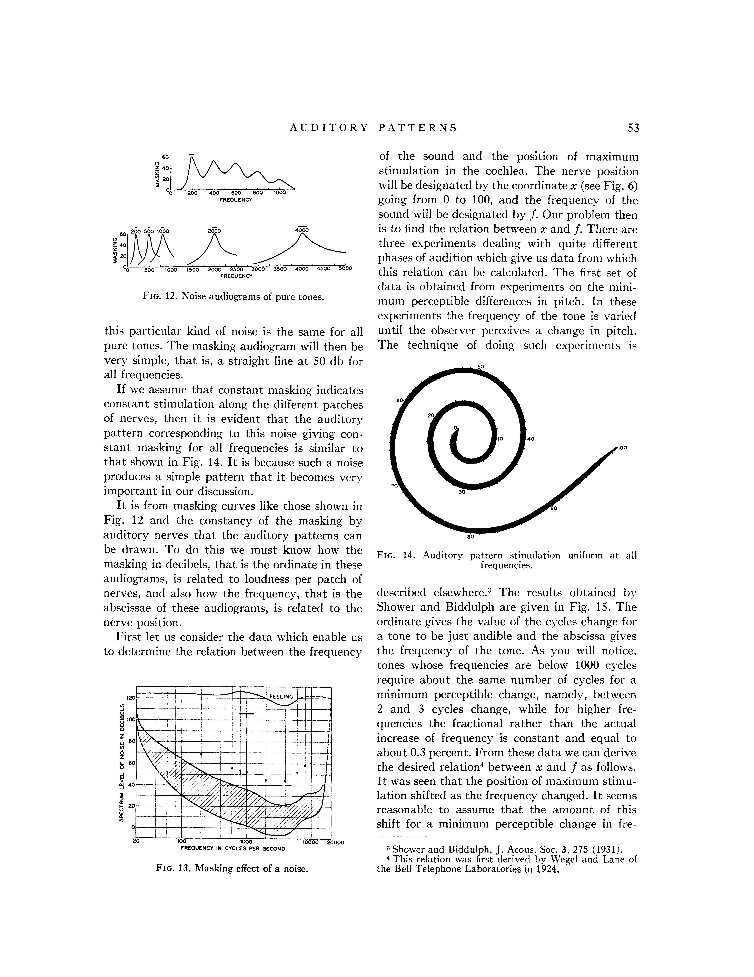
Frequency Masking and Harmonics
Masking can also occur at the harmonics of masker…
  Example has a masker at 200 Hz
  While effect of masker is greatest at 200 Hz…
    Also effects harmonics of masker signal!

Slide 32
Temporal Masking
Part 2

Slide 33
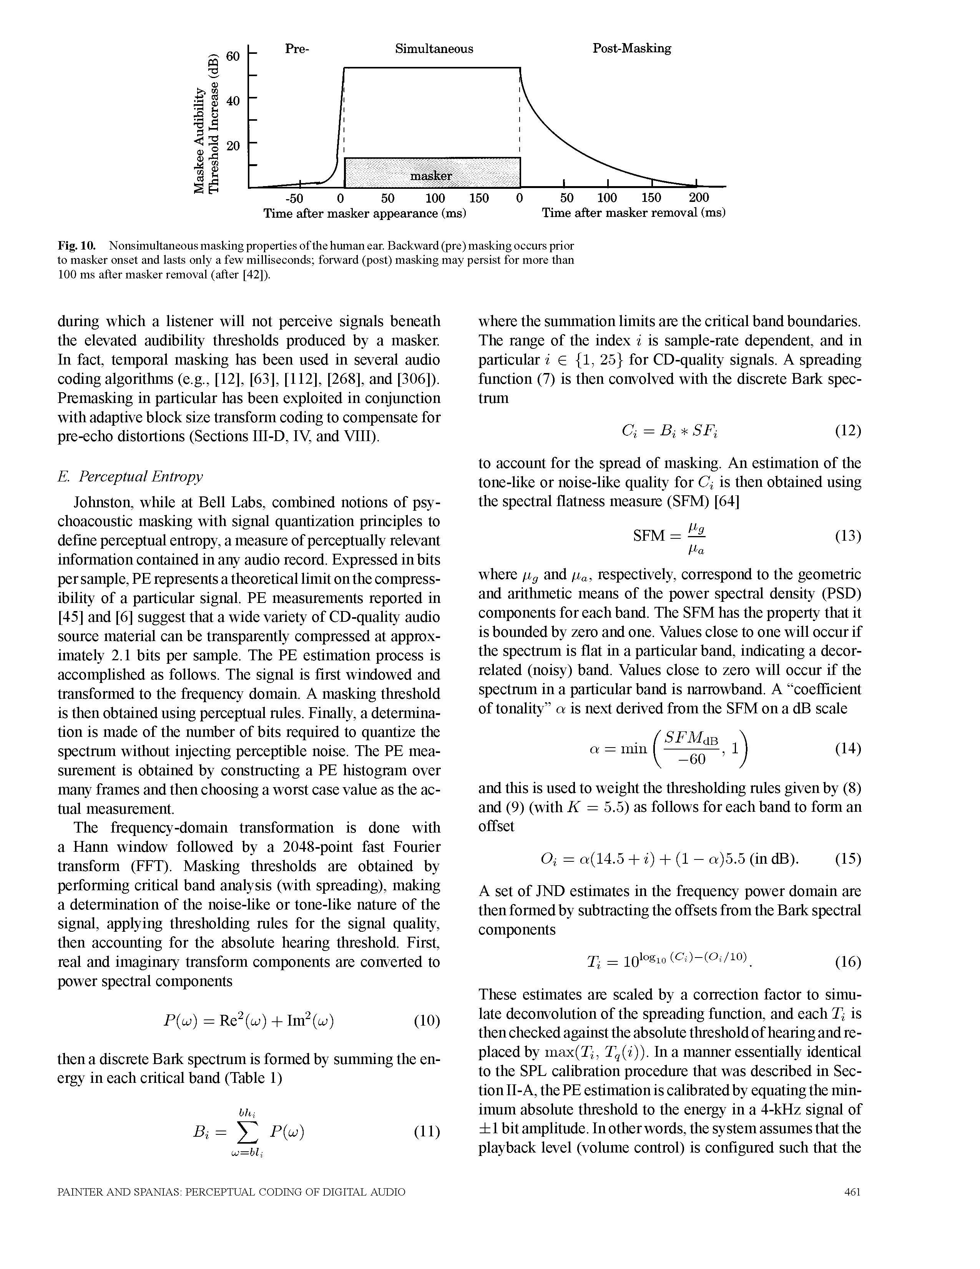
Time-Domain Masking (Temporal)
Two types:
  pre-masking (backwards)
  post-masking (forwards)

Slide 34
Temporal Masking - Forwards
Easier to understand…
  A sudden masker noise…
    Makes inaudible other sounds following noise…for up to 200ms
      Physical: hair cells in Cochlea don’t stop vibrating instantly
        Brain accounts for the fact their vibration will decay over time after incident sound goes away

Slide 35
Temporal Masking - Forwards
  A sudden masker noise…
    Makes inaudible other sounds following noise…for up to 200ms
      Physical: hair cells in Cochlea don’t stop vibrating instantly
        Brain accounts for the fact their vibration will decay over time after incident sound goes away

Slide 36
Temporal Masking - Backwards
Not as intuitive an explanation…
  A sudden masker noise…
    Makes inaudible other sounds preceding noise!
    Why does this happen?
      One thought: takes time for your brain to interpret sound
      Think of it like a buffer…
      Throws out contents of buffer when a loud sound comes in
        to concentrate on only the loud sound (masker in this case)
      Also, hair vibrations likely take time to come up to full amplitude

Slide 37
Using Psychoacoustics in Digital Audio

Slide 38
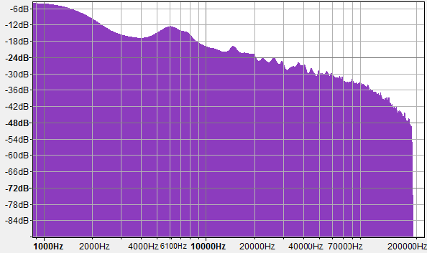
How do we use psychoacoustics in digital music compression? (range)

Slide 39
How do we use psychoacoustics in digital music compression? (masking)
120
dB
100
80
60
40
20
Masked
0
Frequency
193 194 196 197 198 199 201 202 203 204 206 207 208

Slide 40
How do we use psychoacoustics in digital music compression? (masking)
120
dB
100
80
60
40
20
0
Frequency
193 194 196 197 198 199 201 202 203 204 206 207 208

Slide 41
Preclass 3
Same A, B, C, D, E from preclass 2
  With same masking effects
8b per frequency, 10 frequencies → bits?
Non-zero, non-masked frequencies?
Lossless encode Bits?
  Encode 0s/masked with 1-bit
  Encode keep/non-0 with 9-bit

Slide 42
Basic Freq/masking Compression Idea
Convert to frequency domain
If few frequencies
  Cheaper to only represent those
Masking means can drop frequencies that are present, but not dominant
  Save by leaving those out

Slide 43
Big Ideas
Human hearing mechanism directly encodes frequency
  By position on Cochlea
Differential sensitivity by frequency
  Hear some frequencies louder than others
Frequency Masking
  Limit to what we can simultaneously perceive in critical bands – loud frequencies can hide others
Temporal Masking
  Loud signals can hide sounds that come after (or before) them

Slide 44
Learn More
BIBB417 – Visual Processing
  Same kind of look at physiology, but for vision
LING520 – Phonetics 1
  Focus on speech, includes both hearing and production

Slide 45
Admin / Coming up
Feedback
Lab today: psychoacoustics
Next Lecture
  Put this together to compress audio
  Start deriving key features of MP3 (finish next Friday)

Slide 46
References
Physical Ear:
  R. Munkong and B.-H. Juang. IEEE Sig. Proc. Mag., 25(3):98–117, 2008
Filter Bank:
  http://www.ugr.es/~atv/web_ci_SIM/en/seccion_4_en.htm
Bark Scale:
  [E. Zwicker. J. Acoust. Soc.Am., 33(2):248, February 1961]
DB Chart:
  http://www.dspguide.com/ch22/1.htm
Masking Discussion:
  Wikipedia: PsychoAcoustics Article

