Slide 1
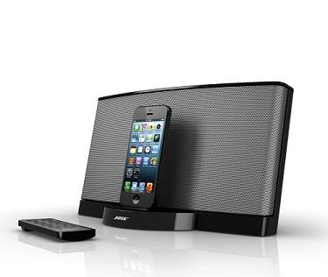
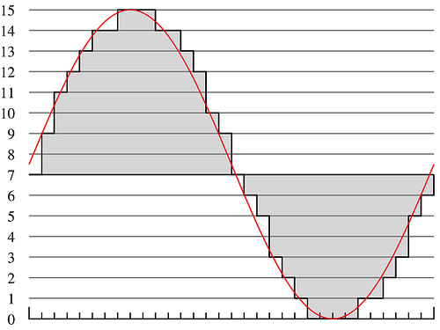
Lecture #12 – Psychoacoustic Compression Algorithm
ESE 150 – Digital Audio Basics
Based on slides © 2009—2022 DeHon, Koditschek
Additional Material © 2014 Farmer

Slide 2
Lecture Topics
Review and preclass
How do we take advantage of psychoacoustics in MP3 Achieve this 6—12x reduction from CD Audio
Review Tricks
Formulate Optimization
Algorithm for Adaptation
Midterm
References

Slide 3
Review and Preclass Setup/Reminder

Slide 4
Knobs we can turn
Amplitude quantization
Per band
Frequency quantization
Per band?
Frequencies kept (per critical band)
Per band
…and can perform lossless compression

Slide 5
Preclass 1
44,300 samples/s
16b
26ms window
a) How many bits?
128Kb/s stereo → 64Kb/s per audio channel
b) How many bits per 26ms window?
c) ratio?

Slide 6
MP3 Encoding Process
All MP3 files broken into “Frames”
Each frame stores 1152 Audio Samples
Lasts for 26 ms
Frame also divided further into 2 “granuels”
Each granuel contains 576 samples

Slide 7
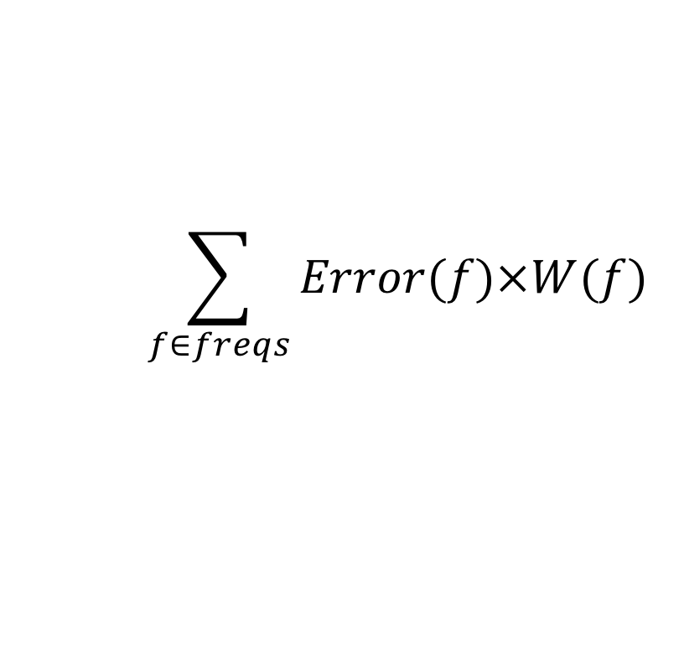
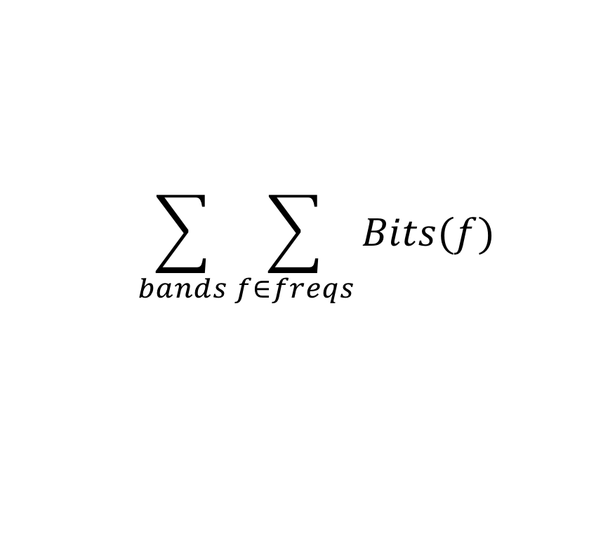
Optimization Problem
How fit in the resource constraints (128Kb/s) while maximizing goodness (sound quality)?
Quantify bits used:
Cannot exceed 128Kb/s
= 1,704 b / 26ms frame / channel
Quantify goodness: minimize
$$\sum_{bands}{\sum_{f∈freqs}{Bits(f)}}$$
$$\sum_{f∈freqs}{Error(f)×W(f)}$$

Slide 8
Preclass 2
576 frequencies
16b amplitude
1704b budget
(frequency,amplitude) pairs to represent
How many frequencies can we keep?
Conclude: cannot keep all frequencies and hit budget

Slide 9
Preclass 3
Bits if only have 3 non-masked, non-zero frequencies?
Conclude: some frames won’t use all their bits

Slide 10
Preclass 4
If all frequencies equally likely, how many bits to represent 80 non-zero/non-masked frequencies?

Slide 11
Preclass 5
60dB, 42dB, 30dB each are 25% of amplitudes
Other magnitudes remaining 25%
Equally likely
How many bits to represent each of the 3 25% cases?
How many bits to represent other cases?
On average many bits to represent 80 non-zero/non-masked frequencies?
Conclude: number of frequencies can keep depends on compressibility

Slide 12
Seen
May want to do something smarter than
Allocating fixed number of frequencies per band
Allocating fixed quantization to a band
Like to adapt our encoding to the data
If more Huffman compressible, we get more frequencies
If fewer frequencies suffice for one band,
Allow more frequencies for another
…or allocate less quantization

Slide 13
Optimization Problem
How fit in the resource constraints (128Kb/s) while maximizing goodness (sound quality)?
Optimization problems central to engineering

Slide 14
Optimization Problem
How fit in the resource constraints (128Kb/s) while maximizing goodness (sound quality)?
Quantify bits used:
Cannot exceed 128Kb/s
= 1,704 b / 26ms frame / channel
Quantify goodness: minimize
$$\sum_{bands}{\sum_{f∈freqs}{Bits(f)}}$$
$$\sum_{f∈freqs}{Error(f)×W(f)}$$

Slide 15
Goodness/Sound Quality
Error(Amp) = |Orig Amplitude – Encoded|
Whole OrigAmplitude if dropped
|Orig Amplitude-Quantize(OrigAmplitude,bits)| if quantized
W(freq)
0 if below hearing threshold
0 if masked
Value between 0 and 5 if partially masked in critical band
Really depend on what already encoded
$$\sum_{f∈freqs}{Error(f)×W(f)}$$

Slide 16
Example Weight Function W(f)
W(f)=CBWeight*Mask
Mask = 0 if MaxAmp-FreqAmp>3
1 otherwise

Slide 17
Encodingn Algorithms
Part 2

Slide 18
Greedy Incremental Frequency Selection
EncodeFreq=0
UnencodedFreqs=AllFreqs
Error=ErrorCalc(AllFreqs)
While((EncodeFreq<NumFreqs) && Error>0)
dErr,newFreq=MaxDeltaError(UnencodedFreqs)
FrameFreq.add(newFreq)
UnencodedFreqs.remove(newFreq)
Error-=dErr
numFreqs++

Slide 19
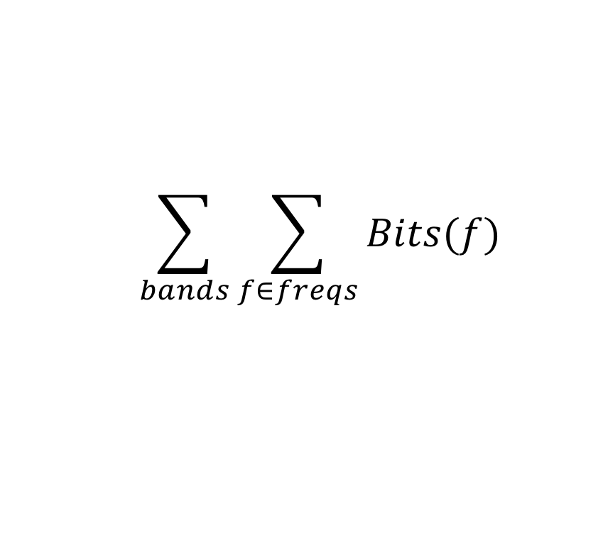
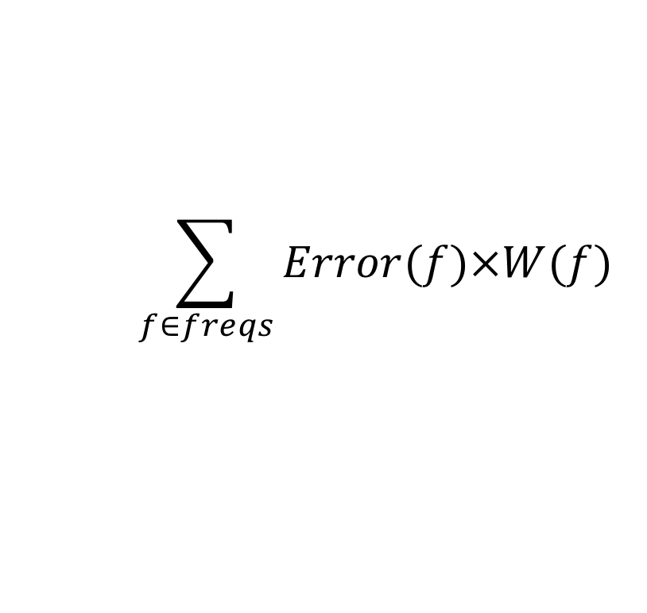
Approach
$$\sum_{bands}{\sum_{f∈freqs}{Bits(f)}}$$
Start with nothing
Start with bitbudget
$$\sum_{f∈freqs}{Error(f)×W(f)}$$

Slide 20
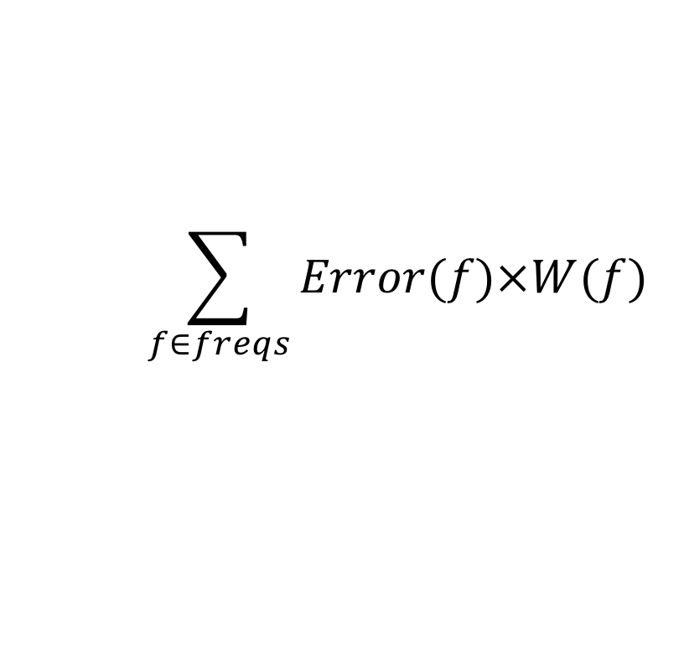
Approach
$$\sum_{bands}{\sum_{f∈freqs}{Bits(f)}}$$
Start with nothing
Start with bitbudget
$$\sum_{f∈freqs}{Error(f)×W(f)}$$
Bits = 0
Error = 190

Slide 21
Approach
$$\sum_{bands}{\sum_{f∈freqs}{Bits(f)}}$$
Start with nothing
Start with bitbudget
While(bitbudget>0)
Identify Largest Error reduction component: Error(freq)×W(freq)
$$\sum_{f∈freqs}{Error(f)×W(f)}$$
Bits = 0
Error = 190

Slide 22
Approach
$$\sum_{bands}{\sum_{f∈freqs}{Bits(f)}}$$
Start with nothing
Start with bitbudget
$$\sum_{f∈freqs}{Error(f)×W(f)}$$
Bits = 3+6=9
Error = 125

Slide 23
Approach
$$\sum_{bands}{\sum_{f∈freqs}{Bits(f)}}$$
Start with nothing
Start with bitbudget
$$\sum_{f∈freqs}{Error(f)×W(f)}$$
Bits = 18
Error = 60

Slide 24
Approach
$$\sum_{bands}{\sum_{f∈freqs}{Bits(f)}}$$
Start with nothing
Start with bitbudget
$$\sum_{f∈freqs}{Error(f)×W(f)}$$
Bits = 27
Error = 18

Slide 25
Also Quantization
$$\sum_{bands}{\sum_{f∈freqs}{Bits(f)}}$$
To keep simple, assumed fixed quant.
Incrementally assign bits
While(bitbudget>0)
Identify Largest Error component: Error(freq)×W(freq)
Assign more bits to that frequency
Go from 0 bits to 1 bit
1 bit to 2 bits
$$\sum_{f∈freqs}{Error(f)×W(f)}$$

Slide 26
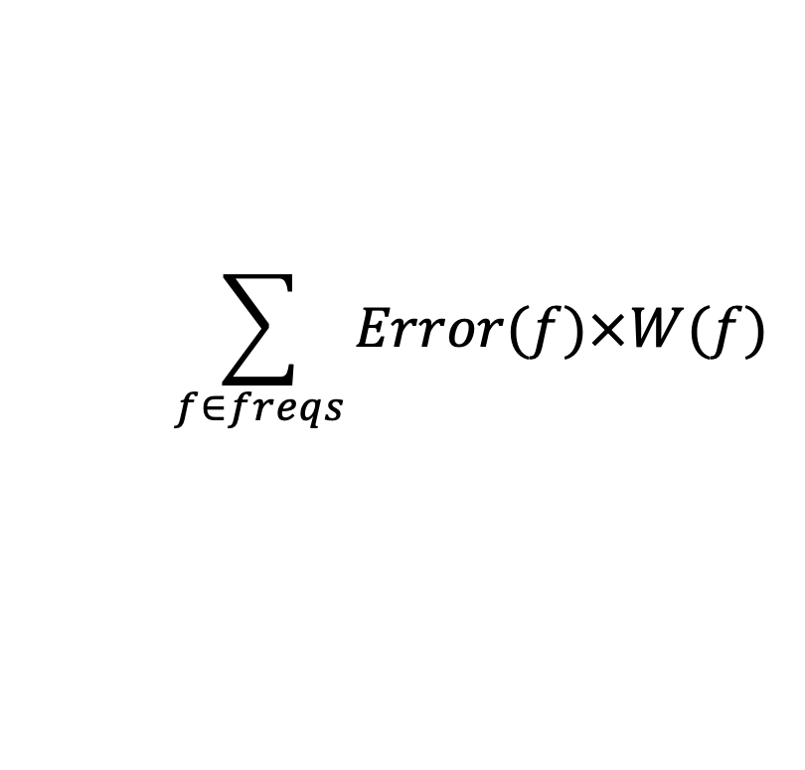
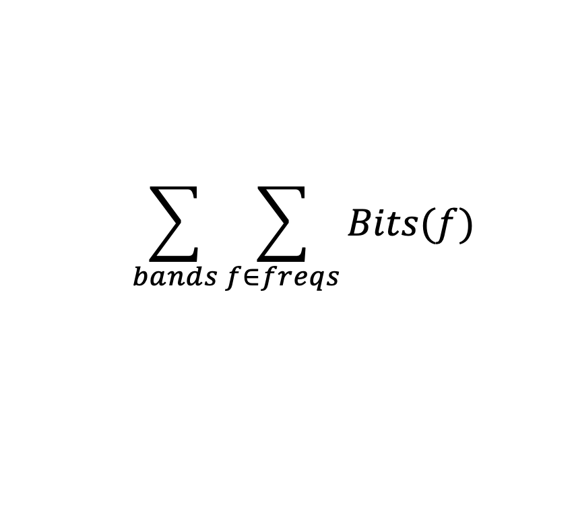
Also Quantization
$$\sum_{bands}{\sum_{f∈freqs}{Bits(f)}}$$
While(bitbudget>0)
Identify Largest Error component: Error(freq)×W(freq)
Assign more bits to that frequency
Go from 0 bits to 1 bit
1 bit to 2 bits
$$\sum_{f∈freqs}{Error(f)×W(f)}$$
1b quant -- error=1
(1+6) encode
3b quant -- error=0
(3+9) encode
0b -- error=7

Slide 27
Approach (Greedy)
Start with nothing
Start with bitbudget
While(bitbudget>0)
Identify Largest Error component
Allocate some bits to reduce error
Add frequency or Add quantization bits to band
Pick one to most reduce the error

Slide 28
Approach (Greedy)
Start with nothing
Start with bitbudget
While(bitbudget>0)
Identify Largest Error component
Allocate some bits to reduce error
Add frequency or Add quantization bits to band
Pick one to most reduce the error
Re-Huffman encode and update bitbudget

Slide 29
Adaptive Refinement
Rediscovering where to allocate everything every time may be laborious
Often same frequencies persist for more than 26ms
Maybe we can get close and adjust?
Use critical band allocation from previous frames as a starting point guess
bits, frequencies, quantization
Try initial encoding with that

Slide 30
Approach (Adaptive)
Start with budget guess
Quantization in bands
Frequencies to keep in each band
Encode, compress
What can we do if takes up > 1704 bits?
What can we do if takes up < 1704 bits?

Slide 31
Finish with Adaptive Fine Tuning
<previous slide>
FrameBits=Huffman(FrameFreq)
While ((FrameBits>1704) | (FrameBits<(1704-26))
If (FrameBits>1704)
NumFreqs—
FrameFreq←RemoveLeastImportant(FrameFreq)
Else if (FrameBits<(1704-26))
NumFreqs++
FrameFreq←AddNextImportant(FrameFreq)
FrameBits=Huffman(FrameFreq)

Slide 32
Finish with Adaptive Fine Tuning
Could add/subtract more than one freq at a time.
Could keep track of high and low encodings.
<previous slide>
FrameBits=Huffman(FrameFreq)
While ((FrameBits>1704) | (FrameBits<(1704-26))
If (FrameBits>1704)
NumFreqs—
FrameFreq←RemoveLeastImportant(FrameFreq)
Else if (FrameBits<(1704-26))
NumFreqs++
FrameFreq←AddNextImportant(FrameFreq)
FrameBits=Huffman(FrameFreq)

Slide 33
PERCEPTUAL CODING & MP3
Roundup

Slide 34
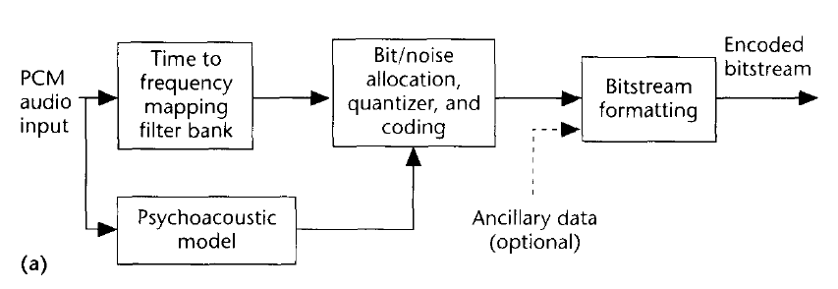
MP3 Flow Chart (Encoding/Decoding)
Basic MP3 Encoding Scheme
A type of DFT is performed
Data is
stored in
frequency domain rep.
Even Huffman coded too!
We use psychoacoustic
model to control quantization!
(how we achieve compression)
MP3 Decoding Scheme
Notice: Psychoacoustics is embedded
Your brain is involved in decoding!

Slide 35
Midterm – Monday in lecture
Closed book, notes
Calculators allowed
50 minutes
Shorter than previous years
5% of grade
prepare for final
Last 4 year’s midterm and answers
on 2018, 2019, 2020 syllabus
Were all in-person, closed book (75 minutes)
2021 was online, open book, also on syllabus
(120 minutes)
Topics
Data representation in bits
Sounds waves
Sampling
Quantization
Nyquist
Lossy/lossless compression
Common case
Frequency domain
Psychoacoustics
Perceptual coding

Slide 36
Compare to Lab
Lecture 11 & 12 (this week)
Help understand more what real MP3 encoding looks like
Thinking about fixed rate
And adaptation for variable rate encoding from Huffman
Formulating masking explicitly
But simplistic
Illustrating Optimization Approaches
Lab 6
Capture spirit of reducing frequencies
Simplified – only taking loudest fraction in each band
Rather than being rigorous about masking
Or trying to hit some fixed rate

Slide 37
Big Ideas
Can use pyschoacoustics to compress audio
Eliminate portions of signal that human’s don’t notice
Optimization
Identify Design Space (knobs)
Identify Costs and Constraints
Formulate quantitatively
Algorithms to approach
Iterative/adaptive approach
Deal with effects that aren’t completely predictable

Slide 38
Learn More
Optimization –
continuous mathematical optimization ESE204, ESE504, ESE605
discrete optimization CIS121, CIS320
Signal processing – ESE224

Slide 39
Coming Up
Feedback
Lab 6 start today
2 week lab
Brings together first half of course
Formal report
Midterm on Monday
Lab 6 continue next Wednesday

Slide 40
References
Tutorials on Psychoacoustic Coding (in increasing order of abstraction and generality)
D. Pan, M. Inc, and I. L. Schaumburg. A tutorial on MPEG/audio compression. IEEE multimedia, 2(2):60–74, 1995.
Nikil Jayant, James Johnston, and Robert Safranek. Signal compression based on models of human perception. Proceedings of the IEEE, 81(10):1385–1422, 1993.
V. K. Goyal. Theoretical foundations of transform coding. IEEE Signal Processing Magazine, 18(5):9–21, 2001.
Lightweight Overview of MP3
Rassol Raissi. The theory behind mp3. Technical report, MP3’ Tech, December 2002.
Scientific Basis of MP3 Coding Standard
J. D. Johnston. Transform coding of audio signals using perceptual noise criteria. IEEE Journal on selected areas in communications, 6(2):314–323, 1988.

