Slide 1



Lecture #13 – Combinational Logic
ESE 150 –
Digital Audio Basics
Based on slides © 2009--2022 DeHon
Notes:
Background: 4004 die photo

Slide 2








So far
MIC
A/D
10101001101
DFT
Identify Masking
Huffman encoding
Music
1
domain
conversion
5,6
Numbers correspond to course weeks
compress
sample
freq
pyscho-
acoustics
3
2
4
Huffman Decode
IDFT
EULA
----------------click
OK
D/A
10101001101
speaker
MP3 Player / iPhone / Droid

Slide 3
How Process
How do we build a machine to perform these operations?
  From Digital Samples → compressed digital data → Digital Samples
Down to bottom
  If we can build one kind of primitive element (maybe 2),
    …and connect together large collections of them
  can build a machine to perform any digital computation

Slide 4
Lecture Topics
Setup
Where are we?
Combinational Logic
Arithmetic (Part 2)
Accumulator (Part 3)
Next Lab

Slide 5
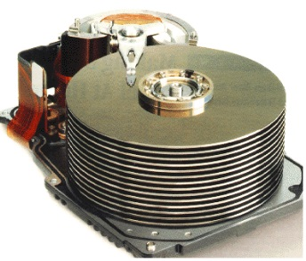


Course Map
7,8,9
10101001101
MIC
CPU
File-
System
A/D
10
10101001101
NIC
Music
1
domain
conversion
5,6
Numbers correspond to course weeks
compress
sample
freq
pyscho-
acoustics
3
2
4
13
11
EULA
----------------click
OK
D/A
NIC
speaker
MP3 Player / iPhone / Droid
12

Slide 6

Course Map – Week 8
MIC
A/D
10101
Music
1
domain
conversion
5,6
Numbers correspond to course weeks
compress
sample
freq
pyscho-
acoustics
3
2
4
EULA
----------------click
OK
D/A
10101001101
speaker
MP3 Player / iPhone / Droid

Slide 7
Combinational Logic

Slide 8
Gate
Primitive binary function
  Computes a binary output from a small number of binary inputs
Can specify function with a Truth Table
  Defines the output for each input combination
Input 0 | Input 1 | Output
0 | 0
0 | 1
1 | 0
1 | 1

Slide 9
AND Gate
AND
  Output is 1 (true) when all inputs are 1 (true)
Input 0 | Input 1 | AND
0 | 0 | 0
0 | 1 | 0
1 | 0 | 0
1 | 1 | 1

Slide 10
NOT Gate
Not
  Output is opposite of input
input | NOT
0 | 1
1 | 0

Slide 11
OR Gate
OR
  Output is 1 (true) when any input is 1 (true)
  (fillin truth table for OR)
Input 0 | Input 1 | OR
0 | 0
0 | 1
1 | 0
1 | 1

Slide 12
Claim
Can compute any Boolean Function from AND, OR, NOT
  (actually from NAND)

Slide 13
Model: Combinational Logic
Compute some “function”
  f(i₀,i₁,…i_{n}) → o₀,o₁,…o_{m}
Each unique input vector
  implies a particular, deterministic, output vector

Slide 14
Big AND
AND
  Output is 1 (true) when all inputs are 1 (true)
How build n-input AND from AND2 gates?

Slide 15
Big OR
OR
  Output is 1 (true) when any input is 1 (true)
How build n-input OR from OR2?

Slide 16
Input Case
How can we create an expression that is true for a specific input case?
  E.g. have a function of 4 inputs: a, b, c, d
    Want identify case a=0, b=1, c=1, d=0
How many potential values for a, b, c, d?
  Rows in our truth table
How create an expression (in and and not) that is true for the a=0, b=1, c=1, d=0 case?

Slide 17
Single Output Digital Function
Given have logic to identify each input case where output is a 1:
How implement entire function?
a | b | c | F(a,b,c)
0 | 0 | 0 | 1
0 | 0 | 1 | 0
0 | 1 | 0 | 0
0 | 1 | 1 | 0
1 | 0 | 0 | 0
1 | 0 | 1 | 0
1 | 1 | 0 | 0
1 | 1 | 1 | 1

Slide 18
Multiple Output Function
What do you do if your Digital Function needs multiple output bits?

Slide 19
Combinational Logic as Gates
Start with truth table
Single output {0, 1}
  Use inverters to produce complements of inputs
  For each input case
    If output is a 1
      Develop an AND to detect that case
        Decompose AND into gates
  OR together the output of all such AND functions
    Decompose OR into gates
Multiple outputs
  Repeat for each output
This solution won’t typically be the smallest or fastest…

Slide 20
Conclude
Can implement any combinational logic function out of a collection of
  OR2, AND2, NOT gates

Slide 21
Arithmetic
Part 2

Slide 22
Arithmetic
Addition is also a digital (combinational) logic function
  Maps set of inputs (a3 a2 a1 a0 b3 b2 b1 b0)
  To an output bit vector (c4 c3 c2 c1 c0)
…as is subtraction, multiplication, division, square root….

Slide 23
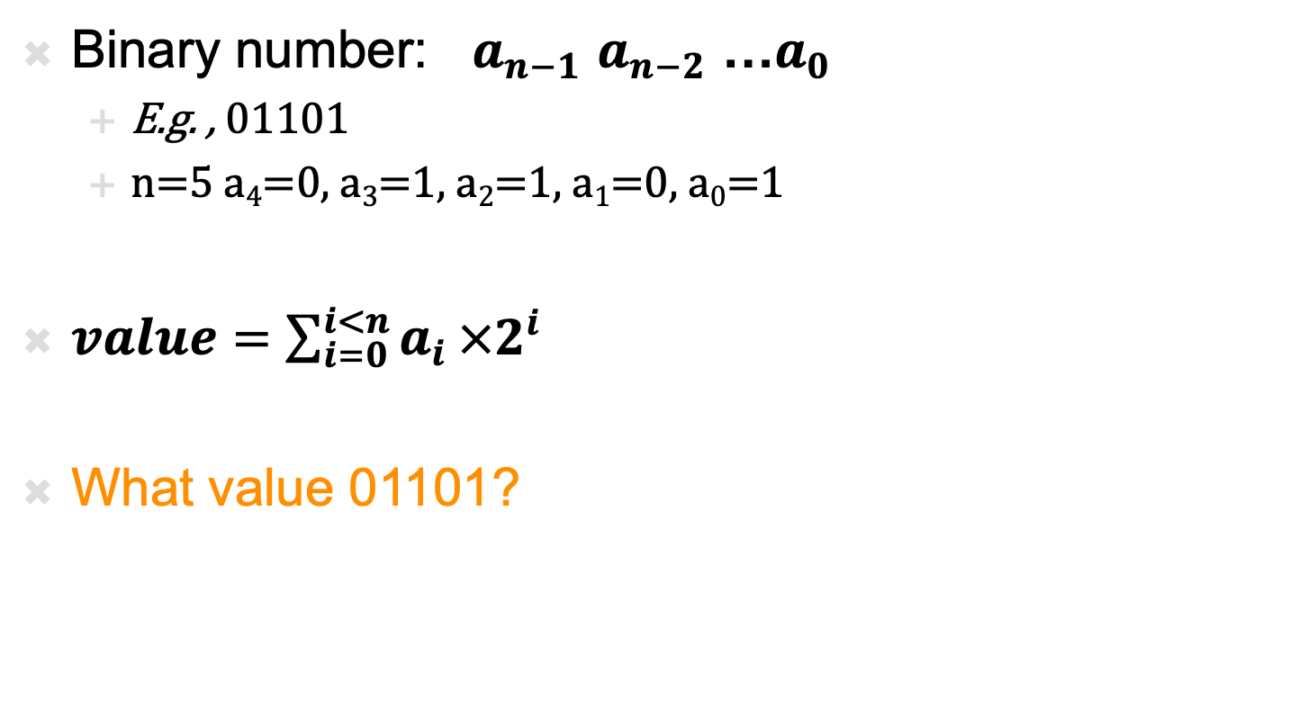
Positional Binary Numbers
Binary number: $a_{n−1}$ $a_{n−2}$ …$a_{0}$
  E.g. , 01101
  n=5 a₄=0, a₃=1, a₂=1, a₁=0, a₀=1
$value=\sum_{i=0}^{i<n}{a_{i}}×2^{i}$
What value 01101?

Slide 24
Addition
Add two binary digits, what do we get?
  0 + 0 =
  0 + 1 =
  1 + 0 =
  1 + 1 =
Conclude: May get two-bit result

Slide 25
Addition
Add three binary digits, what’s largest binary result?
  1 + 1 + 1 =
Conclude: Also get two-bit result adding 3 bits

Slide 26
Full Adder
Adds 3 inputs to produce 2b output
  Binary inputs: a, b, c
  Binary outputs: carry, sum
  Two bit result:
  carry*2 +sum = a+b+c
  It’s just another gate we can define
  Can produce truth table and logic (Lab)

Slide 27
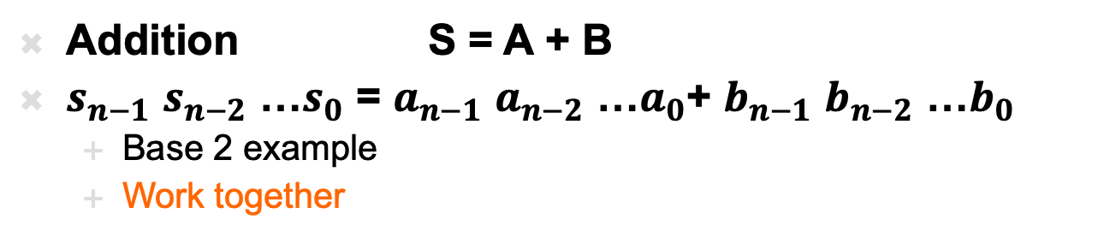
Example: Bit-Level Addition
Addition S = A + B
$s_{n−1}$ $s_{n−2}$ …$s_{0}$ = $a_{n−1}$ $a_{n−2}$ …$a_{0}$+ $b_{n−1}$ $b_{n−2}$ …$b_{0}$
  Base 2 example
  Work together
1
1
1
1
1
1
0
0
C
A | 0 | 1 | 1 | 1 | 0 | 1 | 1 | 1 | 0
B | 0 | 0 | 1 | 1 | 1 | 0 | 1 | 0 | 0
S
0
1
0
1
1
0
0
0
1
0

Slide 28
Full Adder
Adds 3 inputs to produce 2b output
  Binary inputs: a, b, c
  Binary outputs: carry, sum
  Two bit result:
  carry*2 +sum = a+b+c
  Can produce truth table and logic (Lab)
Natural primitive for bit-level
addition with carry

Slide 29
N-Bit Adder
Given Full Adders
  Can build N-bit adder by connecting N full adders

Slide 30
Accumulator
Part 3

Slide 31
Register
Clock
  Defines the rate of the computation
  Typically a square wave
  Rising clock edge defines beginning of new cycle
State Element – Flip-Flop (FF) or Register
  Returns the value it was given
  on previous cycle =
  before the last rising clock edge
More Details next time

Slide 32
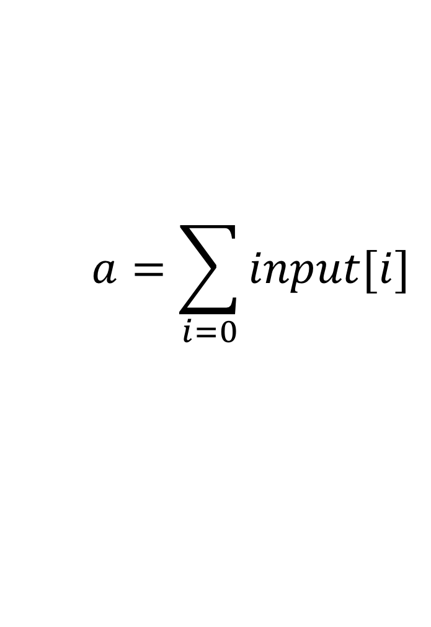
Accumulator
Sum a sequence of values
a=0
while (true)
  a=a+getInput();
Input[i] | a
 | 0
1
 | 1
3
 | 4
1
 | 5
$$a=\sum_{i=0}{input[i]}$$

Slide 33
Accumulator
Start with an Adder

Slide 34
Accumulator
Store running sum
as state in registers
Sum up new values provided on successive cycles
Input[i] | a
 | 0
1
 | 1
3
 | 4
1
 | 5

Slide 35
Accumulator
Wrap register outputs
back to inputs

Slide 36
Accumulator
Maybe extend accumulator bits to hold larger sum
Maybe more…

Slide 37
Accumulator
Maybe extend accumulator bits to hold larger sum
Why want more?
Input[i] | a
 | 0
15
 | 15
15
 | 30
15
 | 45
15
 | 60
15
 | 75

Slide 38
Accumulator
What happens:
  Start with a3:a0 at 0
  CLK low
  I3:i0=2 (0010)
  FF inputs?

Slide 39
Accumulator
What happens:
  Start with a3:a0 at 0
  CLK low
  I3:i0=2 (0010)
  FF inputs?
  CLK goes high: a3:a0?

Slide 40
Accumulator
What happens:
  Start with a3:a0 at 0
  CLK low
  I3:i0=2 (0010)
  CLK goes high: a3:a0?
  I3:0=3 (0011)
  FF inputs?

Slide 41
Accumulator
What happens:
  Start with a3:a0 at 0
  CLK low
  I3:i0=2 (0010)
  CLK goes high: a3:a0?
  I3:0=3 (0011)
  FF inputs?
  CLK goes high: a3:a0?

Slide 42
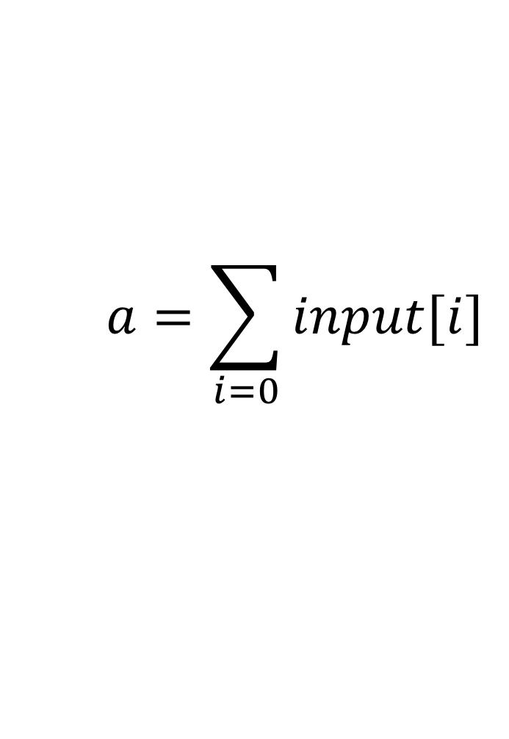
Accumulator
a=0
while (true)
  a=a+getInput();
$$a=\sum_{i=0}{input[i]}$$

Slide 43
Next Lab (after Spring Break)
Lab 7 posted on web
Program an FPGA in Verilog
  Build an adder
  Build an accumulator

Slide 44
Big Ideas
Can implement any combinational digital logic function from (and, or, not) gates
Can store previous values
  Flip-flops or registers
Enough to perform math we need for audio processing (…and much more…)

Slide 45
Learn More
CIS240 – do a bit more logic
ESE370 – how to implement gates, latches, and memories from transistors
ESE532 – how to build large-scale computations from logic

Slide 46
Reminder
Feedback including lab
Spring Break next week
Lab today
Formal Lab Report Due Monday after break
  Office hours Thursday and Friday this week
  Office hours Sunday 3/13 (after Spring Break)

