Slide 1
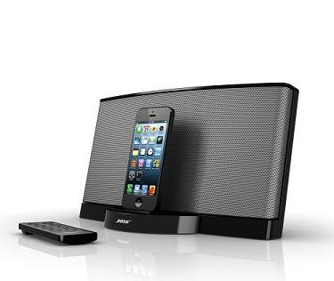
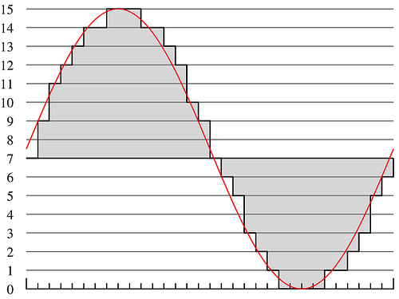
Lecture #14 – Sequential Logic, FPGAs
ESE 150 – Digital Audio Basics
Based on slides © 2009--2022 DeHon

Slide 2
Lecture Topics
Setup
Where are we?
Part 1:
Review: Combinational Logic
Registers
Part 2:
FPGAs
Part 3:
Finite-State Machines (FSM)

Slide 3
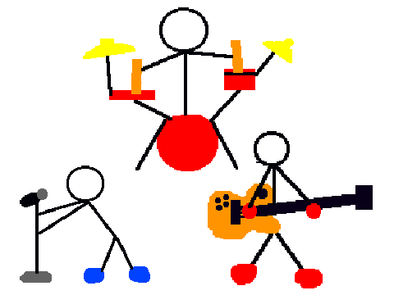
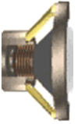
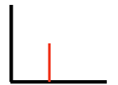
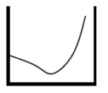
Course Map – Week 8
MIC
A/D
10101
Music
1
domain
conversion
5,6
Numbers correspond to course weeks
compress
sample
freq
pyscho-
acoustics
3
2
4
EULA
----------------click
OK
D/A
10101001101
speaker
MP3 Player / iPhone / Droid

Slide 4
Combinational Logic

Slide 5
Gate
Primitive binary function
Computes a binary output from a small number of binary inputs
Can specify function with a Truth Table
Defines the output for each input combination
Input 0 | Input 1 | Output
0 | 0
0 | 1
1 | 0
1 | 1

Slide 6
Conclude
Can implement any combinational logic function out of a collection of
OR2, AND2, NOT gates

Slide 7
Arithmetic
Addition is also a digital logic function
Maps set of inputs (a3 a2 a1 a0 b3 b2 b1 b0)
To an output bit vector (c4 c3 c2 c1 c0)
…as is subtraction, multiplication, division, square root….

Slide 8
Multiplexer Gate
MUX
When S=0, output=i0
When S=1, output=i1
S | i0 | i1 | Mux2(S,i0,i1)
0 | 0 | 0
0 | 0 | 1
0 | 1 | 0
0 | 1 | 1
1 | 0 | 0
1 | 0 | 1
1 | 1 | 0
1 | 1 | 1
Truth Table?

Slide 9
Preclass 3
How build 4-input mux from 2-input muxes?

Slide 10
Registers and Clocking

Slide 11
Mux with Feedback
What happens when S=0?
What happens when S=1?

Slide 12
Mux with Feedback
Assuming i0 doesn’t change what happens when S goes from 0 to 1?

Slide 13
Latch
Element that can hold a previous value of an input

Slide 14
Register
Clock
Defines the rate of the computation
Typically a square wave
Rising clock edge defines beginning of new cycle
State Element – Flip-Flop (FF) or Register
Returns the value it was given on previous cycle = before the last rising clock edge

Slide 15
Flip-Flop (FF)
Use a pair of latches to create a flip-flop
Also call register

Slide 16
Flip-Flop (FF)
Use a pair to create a flip-flop
Also call register
What happens when
CLK is low (0) ?

Slide 17
Flip-Flop (FF)
Use a pair to create a flip-flop
Also call register
What happens when
CLK is high (1) ?

Slide 18
Flip-Flop (FF)
Use a pair to create a flip-flop
Also call register
What happens when
CLK transitions from 0 to 1?

Slide 19
Flip-Flop (FF)
Use a pair to create a flip-flop
Also call register
Sample D input on 0→1 transition of clock (CLK)
Never an open path from D→Q
One of the mux latches always in hold state

Slide 20
State Element
Latch or Register is a state element
Allows circuit to remember a value
Build computations that
Depend on past inputs
Reuse hardware in time

Slide 21
Accumulator Revisited
Maybe extend accumulator bits to hold larger sum
Maybe more…

Slide 22
Programmable Logic
Part 2

Slide 23
Preclass 2
How build 4-input mux from 2-input muxes?

Slide 24
Preclass 4
What function of s0, s1 is this circuit configuration computing?

Slide 25
Mux can be a programmable Gate
Programmable Gate
Can be programmed to act as any gate
Use state (e.g. FF) to “program” truth table of a gate
Input 0 | Input 1 | Output
0 | 0
0 | 1
1 | 0
1 | 1

Slide 26
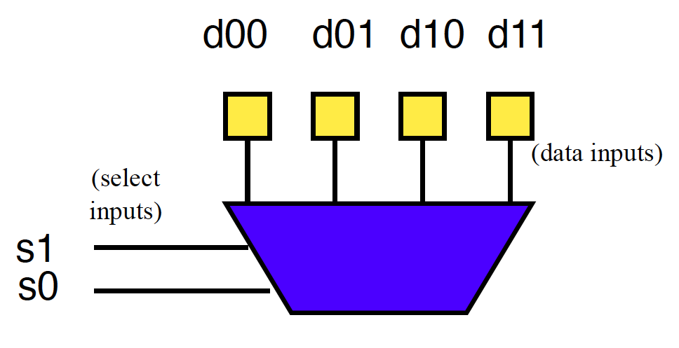
Example: OR (preclass 5)
How do we program to behave as OR2?

Slide 27
Look-Up Table (LUT)
Can generalize to any number of inputs

Slide 28
Connecting Gates
Once we can build gates
…still need to connect the gates together.
Select which gate outputs become inputs to other gates.

Slide 29
Mux can be Programmable Interconnect
Trick: Use multiplexer
to programmably
select gate input.

Slide 30
Programmable Blocks

Slide 31
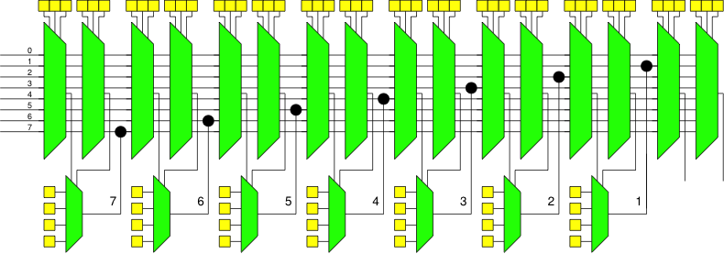
Programmable Gates and Interconnect
Preclass 6:
How program (fill in yellow programmable cells) to implement a full adder?

Slide 32
Field-Programmable Gate Array (FPGA)
Collection of Programmable Gates
Can “program” by setting state bits
LUTs that can be programmed to be any gate
With optional Flip-Flops to use for state
Programmable interconnect to “wire” the gates together

Slide 33
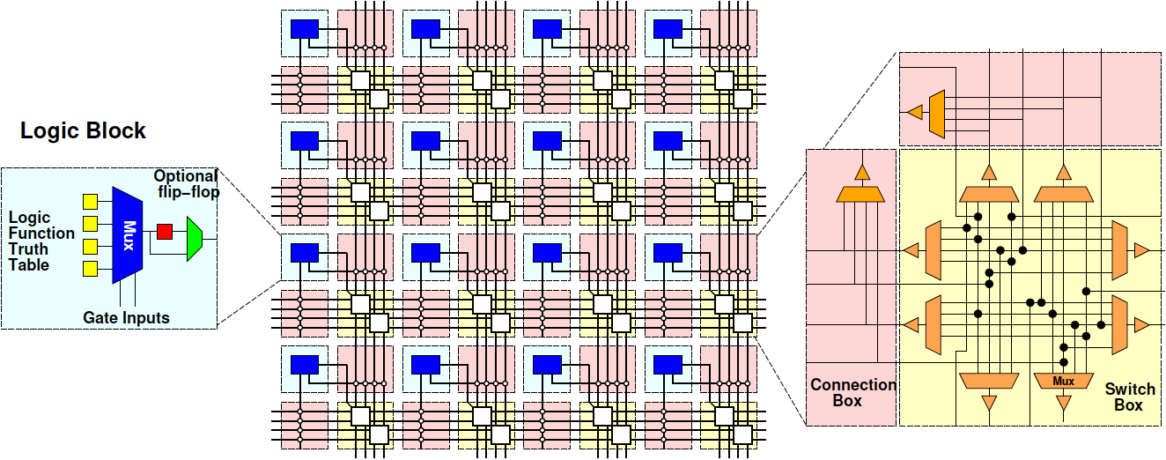
Field-Programmable Gate Array (FPGA)

Slide 34
Finite State Machines (FSMs)
Part 3

Slide 35
State for Sequencing and Control
Useful when trying to control things
E.g. Perform a sequence of operations
Robot
Open-gripper
Move-forward
Close-gripper
Lift

Slide 36
State for Conditional Control
Useful when need to behave differently based on something in the past
Remember if elevator going up or down
Remember/count coins from consumer
Remember some mode set by user
Displaying in Centigrade or Fahrenheit
Idea
Store state
Use as input to logic

Slide 37
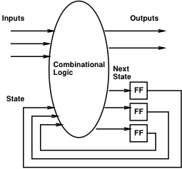
Finite-State Machine (FSM)
Sequential model of computation
State (in registers) + combinational logic
Compute outputs and next state from inputs and state

Slide 38
FSM Example
Simplified Vending Machine
Only input quarters
Only vend one item (output signal to indicate vending)
Item costs 2 quarters
Coin Return request and control
Two states: waiting, one-quarter (one)
Two inputs: quarter, coin-return (creturn)
Two outputs: vend, return-quarter (qreturn)

Slide 39
Truth Table Model
Complete together
state | quarter | creturn | vend | qreturn | next
waiting | 0 | 0 | 0 | 0 | waiting
waiting | 0 | 1
waiting | 1 | 0 | 0 | 0 | one
waiting | 1 | 1
one | 0 | 0
one | 0 | 1
one | 1 | 0
one | 1 | 1

Slide 40
Truth Table Model
Complete together
state | quarter | creturn | vend | qreturn | next
waiting | 0 | 0 | 0 | 0 | waiting
waiting | 0 | 1 | 0 | 0 | waiting
waiting | 1 | 0 | 0 | 0 | one
waiting | 1 | 1
one | 0 | 0
one | 0 | 1
one | 1 | 0
one | 1 | 1

Slide 41
Truth Table Model
Complete together
state | quarter | creturn | vend | qreturn | next
waiting | 0 | 0 | 0 | 0 | waiting
waiting | 0 | 1 | 0 | 0 | waiting
waiting | 1 | 0 | 0 | 0 | one
waiting | 1 | 1 | 0 | 1 | waiting
one | 0 | 0
one | 0 | 1
one | 1 | 0
one | 1 | 1

Slide 42
Truth Table Model
Complete together
state | quarter | creturn | vend | qreturn | next
waiting | 0 | 0 | 0 | 0 | waiting
waiting | 0 | 1 | 0 | 0 | waiting
waiting | 1 | 0 | 0 | 0 | one
waiting | 1 | 1 | 0 | 1 | waiting
one | 0 | 0 | 0 | 0 | one
one | 0 | 1
one | 1 | 0
one | 1 | 1

Slide 43
Truth Table Model
Complete together
state | quarter | creturn | vend | qreturn | next
waiting | 0 | 0 | 0 | 0 | waiting
waiting | 0 | 1 | 0 | 0 | waiting
waiting | 1 | 0 | 0 | 0 | one
waiting | 1 | 1 | 0 | 1 | waiting
one | 0 | 0 | 0 | 0 | one
one | 0 | 1 | 0 | 1 | waiting
one | 1 | 0
one | 1 | 1

Slide 44
Truth Table Model
Complete together
state | quarter | creturn | vend | qreturn | next
waiting | 0 | 0 | 0 | 0 | waiting
waiting | 0 | 1 | 0 | 0 | waiting
waiting | 1 | 0 | 0 | 0 | one
waiting | 1 | 1 | 0 | 1 | waiting
one | 0 | 0 | 0 | 0 | one
one | 0 | 1 | 0 | 1 | waiting
one | 1 | 0 | 1 | 0 | waiting
one | 1 | 1

Slide 45
Truth Table Model
state | quarter | creturn | vend | qreturn | next
waiting | 0 | 0 | 0 | 0 | waiting
waiting | 0 | 1 | 0 | 0 | waiting
waiting | 1 | 0 | 0 | 0 | one
waiting | 1 | 1 | 0 | 1 | waiting
one | 0 | 0 | 0 | 0 | one
one | 0 | 1 | 0 | 1 | waiting
one | 1 | 0 | 1 | 0 | waiting
one | 1 | 1 | 0 | 1 | one

Slide 46
Switch-Statement Model
While (true)
switch (state) {
case waiting:
if (quarter && !creturn)
state=one;
else
state=waiting;
qreturn=quarter && creturn;
vend=0;
break;

Slide 47
Switch-Statement Model (cont.)
case one:
if ((quarter && !creturn)||
(!quarter&&creturn))
state=waiting;
else
state=one;
qreturn=creturn;
vend=quarter&& !creturn;
break;
} // switch
} // while

Slide 48
FSM Graph Model
!quarter/
vend=0, qreturn=0
quarter&creturn/
vend=0, qreturn=1
waiting
quarter&!creturn/
vend=1, qreturn=0
quarter&!creturn/
vend=0, qreturn=0
!quarter&creturn/
vend=0, qreturn=1
one
!quarter&!creturn/
vend=0, qreturn=0
!quarter&!creturn/
vend=0, qreturn=0

Slide 49
Big Ideas
Can implement any combinational digital logic function from:
and, or, not gates
Can implement any FSM from:
and, or, not gates and registers
Can build a single chip that can be programmed to behave as any collection of gates
As long as don’t need more gates than it provides

Slide 50
Learn More
CIS240 – do a bit more logic
ESE370 – how to implement gates, latches, and memories from transistors
CIS471 – implement processor (next time) using Verilog mapped to FPGAs
ESE532 – how to build large-scale computations from logic

Slide 51
Reminder
Feedback including Lab
Lab 6 Report/formal writeup due tonight
Before midnight
Lab 7 on Wednesday
Prelab (with canvas/quiz turnin)

