Slide 1



Lecture #19 – Networking
ESE 150 –
Digital Audio Basics

Slide 2
Lecture Topics
Where are we on course map?
Networks
  Communicating Between Machines
  Bandwidth Requirements
  Technology Costs
  Network Layering (Part 2)
    Transport
    Network (get started)
    More…on Monday

Slide 3










Course Map – Week 11
7,8,9
10101001101
MIC
CPU
A/D
10101001101
NIC
Music
1
domain
conversion
6
Numbers correspond to course weeks
compress
compress
sample
freq
pyscho-
acoustics
3
3
2,5
4
10
D/A
NIC
speaker
MP3 Player / iPhone / Droid

Slide 4
What We’ll Cover Today…
Device A
Device B
NIC
NIC
Established can
  represent things (sound, computations, images, movies, 3D objects…) as bits
  Store and reconstruct from bits
If we can send bits between machines…
  Communicate (from MP3 player to Cell Phone)
  Transport (from scanner and 3D printer to a transporter?)

Slide 5
Communicating between Machines
Fundamentals of Networks

Slide 6
Networked Systems
Today
  We expect our computers to be networked
    Google, wikipedia, Email, IM, …
  Can work stand alone
    Airplane mode?
  But, are crippled when not connected
  Phone isn’t a phone unless its networked

Slide 7
Minimal Setup
Have two computers
  think raw processors for the moment
Want them to communicate
  Send an mp3 file from A to B
.MP3

Slide 8
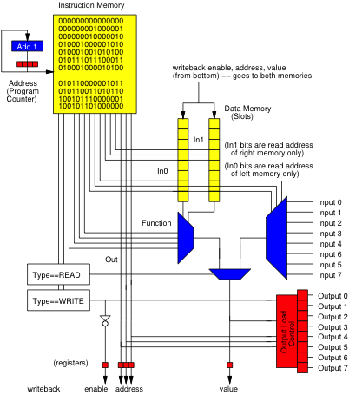
Physical Connection
Place an I/O datapath in each computer
String wire between computer’s IO ports
  E.g. one wire from A→B, another B→A

Slide 9
Physical Connection
Place an I/O datapath in each computer
String wire between computer’s IO peripheral
  E.g. one wire from A→B, another B→A

Slide 10
Signaling
Communicate with Voltage pulses
  A pulls line low (0)
  B senses low (0) line
Data encoded as series of pulses/voltages on line
Oscilloscope/
Logic Analyzer

Slide 11
Communication Basic Steps
Start program on B to receive data (file)
Start program on A to send data (file)
B waits for valid symbols
A sends data
B receives
A sends out-of-band signal to end transmission
(as we did to communicate
between Laptop/workstation
and Arduino)

Slide 12
Preclass 1
How many computers does your laptop communicate with?
  E-mail
  Weather
  Canvas, Piazza
  Source code repositories (svn, git, …)
  eniac
  Web servers
    Seas, news, facebook, youtube, wikipedia, google, ….
  Spotify, iTunes, Windows Update

Slide 13
Multiple Tasks – Multiple Wires?
Back to wired connections
E.g. download song and browse
  Could have a separate interface/wire for each application
  Process allocates hardware when needs to communicate
  Holds exclusive access during transfer

Slide 14
Connect to Multiple Machines
Add interface/wire for every machine want to talk to
  Talk to machine through its dedicated wire

Slide 15
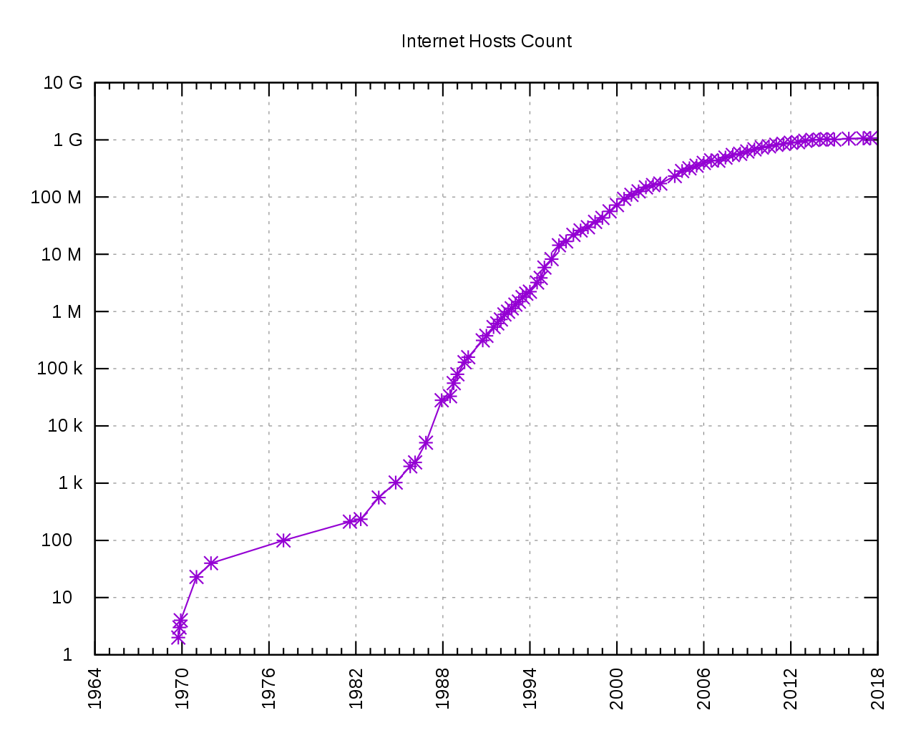
Scalability
[Source: Kopiesperre CC Share-alike 3.0
https://wikivisually.com/wiki/File:Internet_Hosts_Count_log.svg]
Do we like where this
is going?
Hosts on Internet
How many things are connected to Internet?
  Estimate 30--50 Billion connected devices!
  And growing …https://techjury.net/blog/how-many-iot-devices-are-there

Slide 16
How many connections?
Conclusion: Single wire (or radio) per host or application we want to communicate with is not going to scale
  need to look scalability of a network solution
Do we have capacity to share wires?

Slide 17
Bandwidth Requirements and Costs

Slide 18
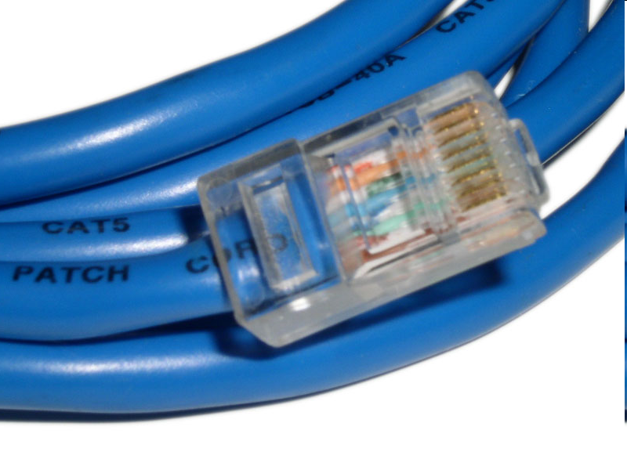
Wires
How fast can I send data over a wire?
Consider a Category-5 Ethernet cable
  Bandwidth (bits/s)
    1Gbit/s – 1000Base-T (Gigabit ethernet)
  Latency or transit time (distance/time)
    0.64 c [c=speed of light = 3×10⁸ m/s]
    0.192 m/ns or roughly 5ns/m
[image: http://en.wikipedia.org/wiki/File:Cat_5.jpg]

Slide 19
Comparison: Audio (Preclass 3)
Real-Time stereo (2-channel) MP3
  128Kbits/s
  How many can share 1Gbit/s link?
How long to download 3 minute song at full rate?
How long for first bit to travel across 4000km wire at 0.6 × speed-of-light?

Slide 20
Comparison: Video (Preclass 3)
HDTV compressed
  Around 36Mbits/s
  How many can share 1 Gbit/s link?

Slide 21
Costs (Preclass 4)
Cat 5e per foot ~ $0.20/foot
  Say $0.60/m
  Raw wire
    Ignoring handling to run
    Ignoring rent/lease/buy land to run
  Philly → San Francisco: ~4,000km
  Wire cost?

Slide 22
Implications?
Today’s wire bandwidth exceeds the throughput needs of any real-time single-stream data
  Can afford to share the wire
Wires are not cheap
  Cannot afford not to share the wire

Slide 23

Simulation 0
Do data stream (pipeline) simulation as warmup
Think bucket brigade
  Everyone picking up from one side and handing to next
  One item (packet) at a time
  All working concurrently
  Multiple things working way through the pipeline/brigade at a time
Graphic: Christoph Roser https://www.allaboutlean.com/bucket-brigade-1/bucket-brigade-2/

Slide 24
Sharing (Virtualizing) Connections
Part 2

Slide 25
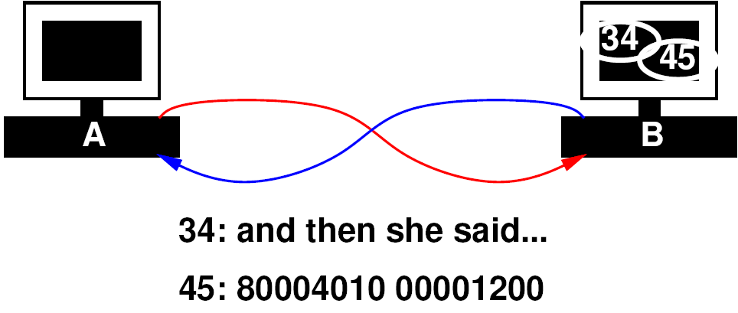
Sharing Link
Idea: Tag data with target
  “this is for process 34”
  “this is for process 45”
Have transport layer deal with…
  Mixing data from separate streams
  Separating data out into individual streams
  Delivering to individual processes

Slide 26
Packet
Begin to form a packet
  Header: says where to go
  Payload: the data to send
Header:
  Added, consumed by network handling in routing
Payload:
  Only thing seen by the application processes

Slide 27
Packets

Slide 28
Transport Layer
Call this the “Transport” Layer
  responsible for delivering data to the individual application process on the computer

Slide 29
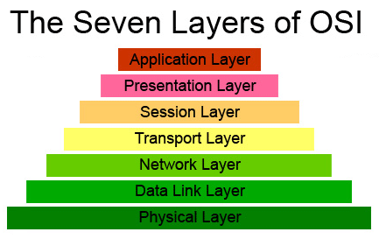
OSI Model of a Network
Layer we just
discussed
OSI – Open Systems Interconnection Reference Model
  Developed in 1980’s; maintained by ISO
  Abstract different functions of a network into layers
    Each layer only knows about layer above and below (at the interface level)
  Think of it like this: your “Application” doesn’t know if its on a wired or wireless network (physical layer)…but it knows it needs a network!

Slide 30
Possible Role Assignment
SA1
SA2
SA3
SA4
T1
T3
N1
N3
W1/R2
R1
R3
T2
N4
N2
T4
CA1
CA2
CA3
CA4

Slide 31
Possible Role Assignment
SA1
SA2
SA3
SA4
T1
N1
N3
T3
W1/R2
R1
R3
T2
N2
N4
T4
CA1
CA2
CA3
CA4

Slide 32
Simulation 1
Server
Send 4 verses or digits from each
  from song-server-app, even-server-app
  to song-listener-app, even-consumer
All go through one wire W1
T1 – Transport tagging
T2 – Transport sorting
SA1
SA2
T1
Host
W1
Host
T2
CA1
CA2
Client

Slide 33
Virtualize Physical Wires

Slide 34
Start Simple
Add more computers to same pair of wires
  All computers on wire see all the data on the wire
  How do computers know who the message is for?

Slide 35
Extended Packet
Extend our packet header:
  Destination computer
  Process on destination computer
  Sending computer
  Process on sending computer

Slide 36
Network Layer
responsible for end-to-end (source to destination) packet delivery

Slide 37
Virtualization Effect
Each pair of processes on different computers
  Has the view of a point-to-point connection
  Each process, thinks it “owns the network” and has a dedicated connection to the other node

Slide 38
[Device Driver]

Slide 39
Simulation 2
Send 4 verses or digits from each
  from song server serving 2 verses
  And digit-server serving 2 fundamental constants (or number sequence)
  To two physical clients

Slide 40
Simulation 2
SA1
Server
SA2
SA3
Server
SA4
T1
T3
N1
N3
Host
Host
W1
N2
Host
Host
N4
T2
T4
CA1
CA2
CA3
CA4
Client
Client

Slide 41
Simulation 2
SA1
Server
SA2
SA3
Server
SA4
T1
T3
N1
N3
Host
Host
W1
N2
Host
Host
N4
T2
T4
CA1
CA2
CA3
CA4
Client
Client

Slide 42
Simulation 2
N1, N3
  Add network-layer source/destination packet headers
W1 – Wire
  Duplicate packets to both destinations
  Simulate shared wire
N2, N4
  Look at network-layer source/destination header
  Discard packets not destined for this computer

Slide 43
Simulation 2
SA1
Server
SA2
SA3
Server
SA4
T1
T3
N1
N3
Host
Host
W1
N2
Host
Host
N4
T2
T4
CA1
CA2
CA3
CA4
Client
Client

Slide 44
More to Come (Next Time)
Routing – machines not directly connected
Routing Delays
Data Ordering
(Un)Reliability
  Data corruption
  Packet Loss
  Data Duplication
TCP/IP

Slide 45
Big Ideas
Sharing – Network interface, wires
  Previously gates, processor, memory
Virtualization – datastream abstracts physical point-to-point link
Layering
  Abstracts media and implementation
  Decomposes functionality

Slide 46
Next Week In Lab
Lab 10:
  Look at naming, addressing, network diagnostics, …
  Including a packet sniffer!
    …see all the bits on the network you aren’t supposed to see!
    Get an appreciation for what is going on, on the lower network layers

Slide 47
Learn More @ Penn
Courses
  ESE407 – Intro Networks and Protocols
  CIS553 – Networked Systems
  CIS549 – Wireless Mobile Communications
CIS553
ESE407
CIS549

Slide 48
Remember
Feedback
Lab 9 tonight
Lab 10 out

