Slide 1



Lecture #23 – User Interface 2
ESE 150 –
Digital Audio Basics

Slide 2
Lecture Topics
Where are we on course map?
User Interface
  Motivation
  Issues and Principals
  Developer vs. User
  Design Choices
  Approaches and Prototyping
  Advancing/Enabling Technology
Next Lab

Slide 3










Course Map
7,8,9
10101001101
MIC
CPU
A/D
10101001101
NIC
Music
1
domain
conversion
6
10
Numbers correspond to course weeks
compress
sample
freq
pyscho-
acoustics
3
2,5
4
14
EULA
----------------click
OK
D/A
NIC
11
speaker
MP3 Player / iPhone / Droid
13

Slide 4
Review

Slide 5
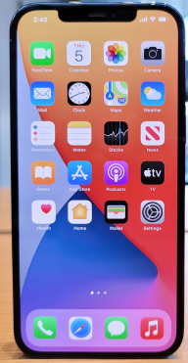
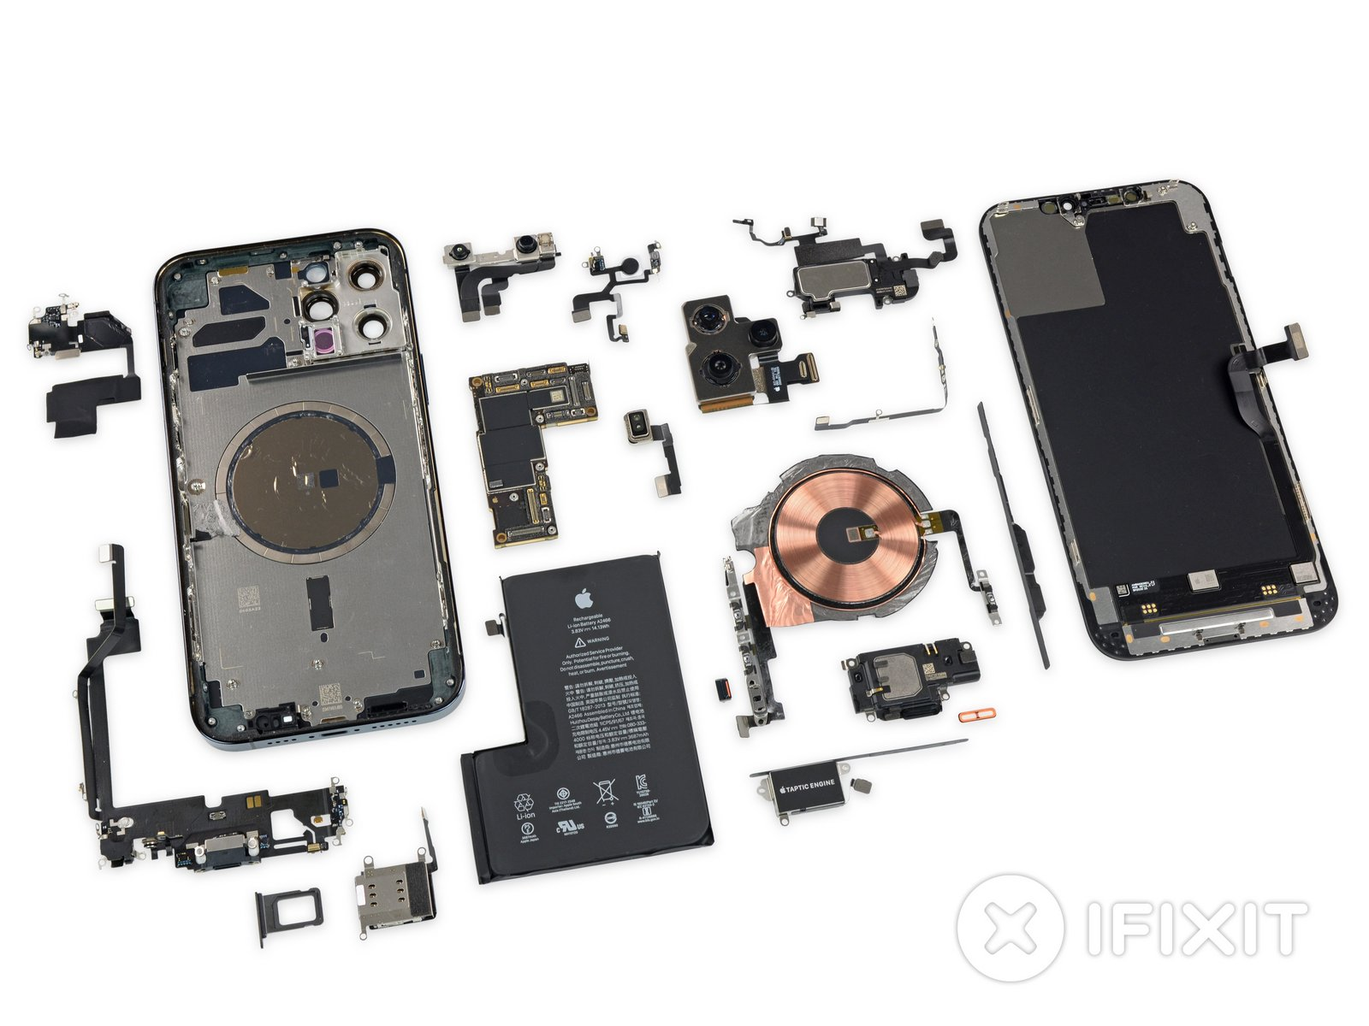
User Interface
When a user sees a product
  See the interface
  Not the underlying design
    ….and that’s the way it should be
Interface determines if the user
can get job done
  …or will walk away frustrated
Successful interface
  Make it easy, pleasant to use
  Hide all the complexity that makes it work

Slide 6
Most product returns are usability failures
Most Returned Products Work Fine: Study Says Only 5 percent of returned products are genuinely defective: Yardena Arar, PC World, June 2, 2008 4:00 pm
Only 5 percent of consumer electronics products returned to retailers are malfunctioning --yet many people who return working products think they are broken, a new study indicates.
The report by technology consulting and outsourcing firm Accenture pegs the costs of consumer electronics returns in 2007 at $13.8 billion in the United States alone, with return rates ranging from 11 percent to 20 percent, depending on the type of product.
http://www.pcworld.com/article/146576/most_returned_products_work_fine_study_says.html

Slide 7
User vs. Implementer
Thesis: Engineer who implements something is seldom the right person to judge the goodness of the user interface
  Knows how should work
  Has a mental model of inner workings
  Motivated to reduce implementation complexity
Contrast user
  Doesn’t know how works – shouldn’t have to!
  Benefit from reduced use complexity
    Reduced cognitive load

Slide 8
Approach

Slide 9
Issues need to address (goals)
Time to learn
Easy to figure out how to use
Time to perform task
Safety
Clarity of what happened
  Why something didn’t happen
Ease of recovery
User stress

Slide 10
How use Principles and Goals?
Principles are generally:
Descriptive, comparative and analytical (i.e., how alternatives compare; test and refine paradigm)
  Give us some idea how to evaluate a UI
Not constructive (i.e., do not define the process of developing user interface design)
  No automated (good) interface design tools exist (e.g., that could have predicted the iPod user interface design)

Slide 11
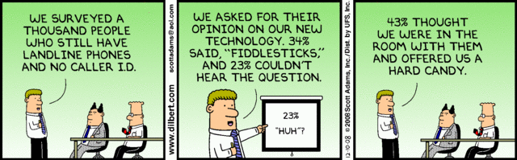
Principles Must Be Considered in the Context of User Population
Principles define an optimization problem where the (target) user population is not uniform in skill, cognitive ability, needs, experience, learning style, or motivation.
http://dilbert.com/strip/2008-12-10

Slide 12
Preclass 1
How did servo know when it needed to rotate right or left?

Slide 13
Design Iterative
Design is usually an iterative process based on feedback
If we have goals/metrics,
  Can, at least, evaluate how doing relative to metric
Then refine design (hopefully to improve)
  And re-evaluate metrics
Like servo feedback
  Could measure if we were
  above/below target
  Apply adjustment, remeasure, adapt

Slide 14
Task-Centered Design
Identify users
Analysis
Note ESSENTIAL iterative loops!
Choose tasks
Look at other
systems
Turn tasks
into scenarios
Design
Turn scenarios
into storyboards
Evaluate
Make sure testers are REAL
users from REPRESENTATIVE user populations, not just SELF!
Build the design
Evaluate
Relate to thesis about relation of implementer and user?
Implementation
http://www.comp.rgu.ac.uk/staff/sw/materials/cm2006/Interface%20design.L4.ppt
Notes:
We briefly looked at task-centred design a couple of weeks earlier, in Lecture 02. Now we’re going to look at the method in a bit more detail, and try to turn it into a complete design method that you can use to transform ideas into a complete and effective interface design. If you want, you can even implement it!!
The animation shows how you can consider the different parts of the interface design process. It is worth noting that there isn’t usually a clear boundary between analysis and design in this kind of task-centred process. We’ll look at why in a moment. There is definitely a blurred boundary between design and implementation, because evaluation refines the design even as the implementation progresses.

Slide 15
User Analysis
If you don’t understand what the users want to do with a system, you have no realistic prospect of designing an effective interface.
User analyses must be described in terms that users and other designers can understand.
  E.g. -- Scenarios where you describe typical episodes of use
Ian Sommerville: Software Engineering, 7th Ed., 2004

Slide 16
Analysis Techniques
Identify users
Task analysis
  Models the steps involved in
  completing a task.
Interviewing and questionnaires
  Asks the users about the work they do.
Ethnography
  Observes the user at work.
Choose tasks
Look at other
systems
Turn tasks
into scenarios
Ian Sommerville: Software Engineering, 7th Ed., 2004

Slide 17
Task Analysis
Need to determine what tasks must be accomplished.
Understand user’s intentions: What user wants (or needs) to do, not necessarily how to do it.
Task analysis breaks problem into individual task components.
Top-down task analysis.
Tasks still need to be wrapped in a UI.

Slide 18
Example Task Analysis: Using PowerPoint
0 Prepare a slide
using PowerPoint
Plan 0:
1-2-3-4
1 Start
PowerPoint
2 Enter text
3 Draw
diagrams
4 Save slide
Plan 2: According
to requirements
Further redescribed
Further redescribed
1 Enter text
using keyboard
2 Copy text
from a slide
3 Add text to
existing slide
Plan 2.2:
1-2-3-4
Further redescribed
1 Select text block
2 Choose copy
command
3 Choose insert
position
4 Choose paste
command
Further redescribed
http://www.comp.rgu.ac.uk/staff/sw/materials/cm2006/Interface%20design.L4.ppt
Notes:
Task analysis

Slide 19
Interviewing
Design semi-structured interviews based on open-ended questions.
Users can then provide information that they think is essential; not just information that you have thought of collecting.
Group interviews or focus groups allow users to discuss with each other what they do.
Ian Sommerville: Software Engineering, 7th Ed., 2004

Slide 20
Ethnography
Involves an external observer watching users at work and questioning them in an unscripted way about their work.
Valuable because many user tasks are intuitive and users find these very difficult to describe and explain.
Also helps understand the role of social and organizational influences on work.
Ian Sommerville: Software Engineering, 7th Ed., 2004

Slide 21
Ethnographic Records
Air traffic control involves a number of control ‘suites’ where the suites controlling adjacent sectors of airspace are physically located next to each other. Flights in a sector are represented by paper strips that are fitted into wooden racks in an order that reflects their position in the sector. If there are not enough slots in the rack (i.e. when the airspace is very busy), controllers spread the strips out on the desk in front of the rack.
When we were observing controllers, we noticed that controllers regularly glanced at the strip racks in the adjacent sector. We pointed this out to them and asked them why they did this. They replied that, if the adjacent controller has strips on their desk, then this meant that they would have a lot of flights entering their sector. They therefore tried to increase the speed of aircraft in the sector to ‘clear space’ for the incoming aircraft.
Ian Sommerville: Software Engineering, 7th Ed., 2004

Slide 22
Insights from Ethnography
Controllers had to see all flights in a sector. Therefore, scrolling displays where flights disappeared off the top or bottom of the display should be avoided.
The interface had to have some way of telling controllers how many flights were in adjacent sectors so that they could plan their workload.
Ian Sommerville: Software Engineering, 7th Ed., 2004

Slide 23
Prototyping and User Testing
Turn scenarios
into storyboards
Evaluate
Build the design
Evaluate

Slide 24
User Interface Prototyping
Aim: allow users to experience the interface.
Without direct experience,
  it is impossible to judge the usability of an interface.
Prototyping often a two-stage process:
  Early: paper prototypes
    Don’t wait until have completely implemented to start getting feedback!
  Refine to increasingly sophisticated automated prototypes
Ian Sommerville: Software Engineering, 7th Ed., 2004

Slide 25
Paper Prototyping
Work through scenarios using sketches of the interface.
Use a storyboard to present a series of interactions with the system.
Paper prototyping to get user reactions to a design proposal.
If you cannot draw it, you cannot build it.
Ian Sommerville: Software Engineering, 7th Ed., 2004

Slide 26
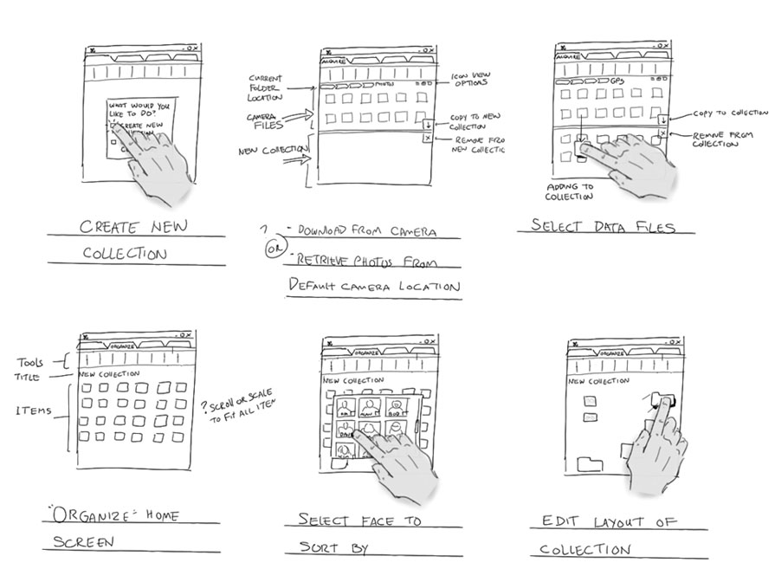
Storyboard
From Microsoft Hilo Chapter 4:
https://msdn.microsoft.com/en-us/library/windows/desktop/ff800706.aspx

Slide 27
Storyboard
Arctouch arctouch.com

Slide 28
Prototyping Techniques
Use PowerPoint as a substitute for an editable script.
  Can include links to different slides/displays
Internet-based prototyping
  Use a web browser and associated scripts.
Script-driven prototyping
  Develop a set of scripts and screens using a UI design tool. When the user interacts with these, the screen changes to the next display.
Visual programming
  Language designed for rapid development such as Visual Basic.
  Python+GTK ← will use in lab
Ian Sommerville: Software Engineering, 7th Ed., 2004

Slide 29
User Interface Evaluation
Turn scenarios
into storyboards
Evaluate
Evaluate user interface design to assess
its suitability.
Full scale evaluation is very expensive and
impractical for most systems.
Ideally, an interface should be evaluated against a usability specification.
  However, it is rare for such specifications to be produced.
Can evaluate against a “design principles” or goals list.
Ian Sommerville: Software Engineering, 7th Ed., 2004

Slide 30
Issues
Time to learn
Easy to figure out how to use
Time to perform task
Safety
Clarity of what happened
  Why something didn’t happen
Ease of recovery
User stress

Slide 31
Issues → Quantitative Goals
Ideally create concrete, quantitative metrics for each relative to the product and user base:
Time to learn
Easy to figure out how to use
Time to perform task
Safety
Clarity of what happened
  Why something didn’t happen
Ease of recovery
User stress

Slide 32
Preclass 2
How can we use a focus group to evaluate if met user interface goals?
  E.g. new user accomplish task in 30s

Slide 33
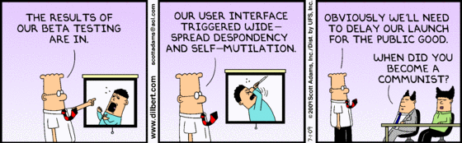
User Testing

Slide 34
Task-Centered Design
Identify users
Analysis
Note ESSENTIAL iterative loops!
Choose tasks
Look at other
systems
Turn tasks
into scenarios
Design
Turn scenarios
into storyboards
Evaluate
Make sure testers are REAL
users from REPRESENTATIVE user populations, not just SELF!
Build the design
Evaluate
Implementation
http://www.comp.rgu.ac.uk/staff/sw/materials/cm2006/Interface%20design.L4.ppt
Notes:
We briefly looked at task-centred design a couple of weeks earlier, in Lecture 02. Now we’re going to look at the method in a bit more detail, and try to turn it into a complete design method that you can use to transform ideas into a complete and effective interface design. If you want, you can even implement it!!
The animation shows how you can consider the different parts of the interface design process. It is worth noting that there isn’t usually a clear boundary between analysis and design in this kind of task-centred process. We’ll look at why in a moment. There is definitely a blurred boundary between design and implementation, because evaluation refines the design even as the implementation progresses.

Slide 35
Technology Change
Part 2

Slide 36
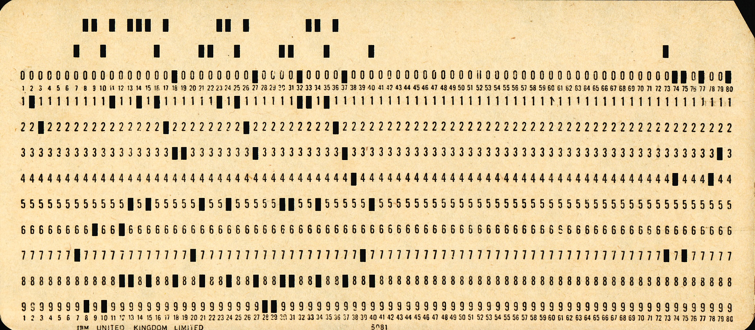
UI and Moore’s Law
Theme: We should spend computation to ease human interaction
  Past: had to ask human to accommodate computer
    Give it input in a way it could understand
      E.g. punched cards
      (pix from https://commons.wikimedia.org/wiki/File:Used_Punchcard_(5151286161).jpg)
  Future: should have computer do more to accommodate human in interaction
    Reduce what human needs to do
    Move interface closer to natural interaction for user

Slide 37
Preclass 3
How many instructions should we be willing to execute to save a second of human time?
  Cost of second of human time?
    Assume $300K/yr., 250 days/yr, 8 hours/day
  Given Energy cost:
    10⁻¹⁵ cents per instruction
  Number of instructions cost same as human-second?

Slide 38
Impact
Can afford to spend computation to bridge between natural user view (interaction) and underlying implementation view
Energy/op has reduced over time
  Increasing this ratio
Can afford to spend more computation now than in past

Slide 39
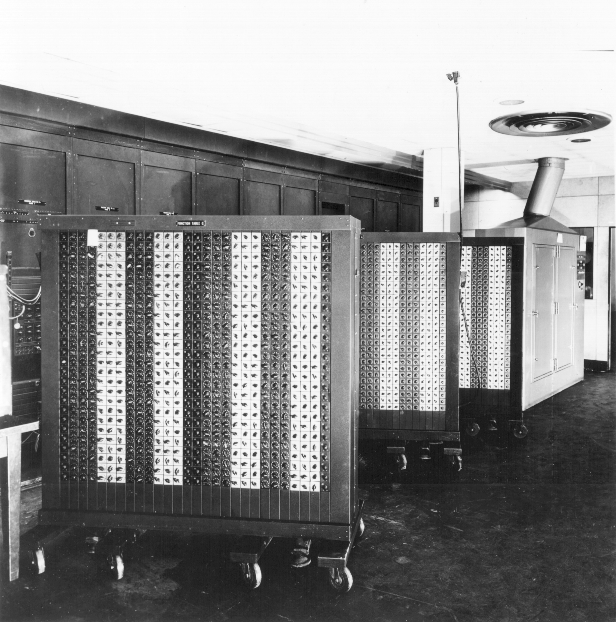
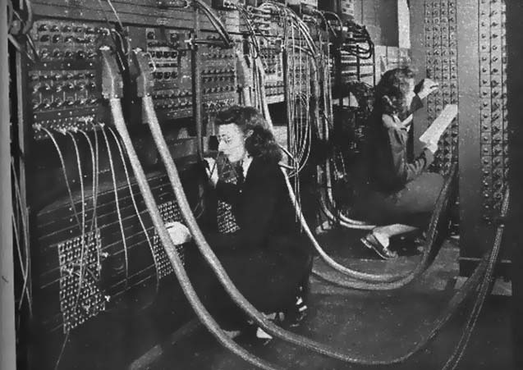
Evolution of Interaction
Dedicated Buttons and Knobs

Slide 40
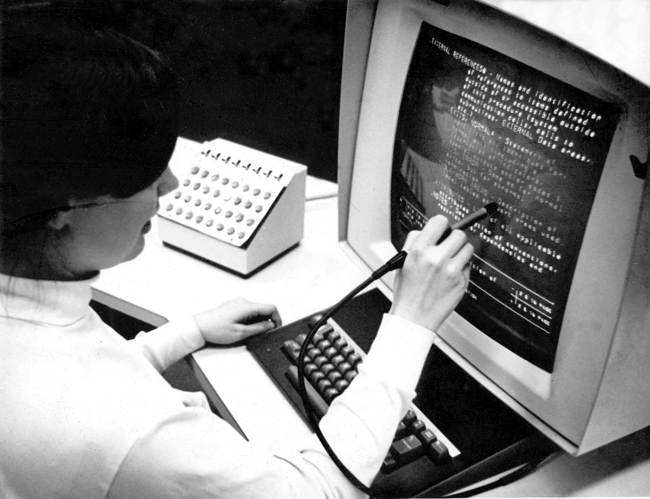
Evolution of Interaction
Dedicated Buttons and Knobs
Keyboard
  With character display
Image source: https://commons.wikimedia.org/wiki/File:HypertextEditingSystemConsoleBrownUniv1969.jpg

Slide 41
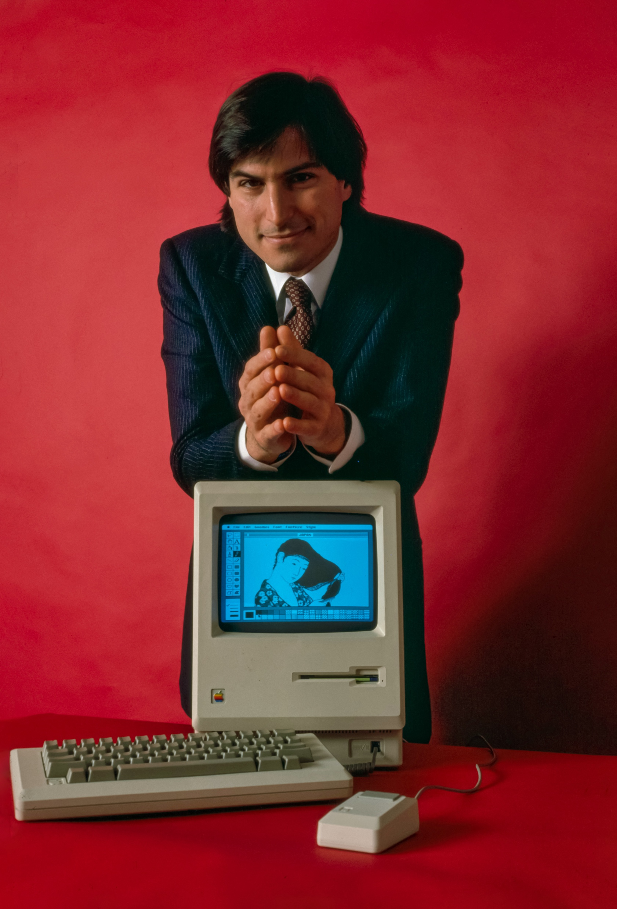
Evolution of Interaction
Dedicated Buttons and Knobs
Keyboard
  With character display
Mouse, graphics
Image Src: https://en.wikipedia.org/wiki/Macintosh#/media/File:Steve_Jobs_and_Macintosh_computer,_January_1984,_by_Bernard_Gotfryd_-_edited.jpg

Slide 42
Evolution of Interaction
Dedicated Buttons and Knobs
Keyboard
  With character display
Mouse, graphics
Touch Screens

Slide 43
Evolution of Interaction
Dedicated Buttons and Knobs
Keyboard
  With character display
Mouse, graphics
Touch Screens
Accelerometers
Audio, video, …
Augmented Reality

Slide 44
Evolution of Platforms
Dedicated Buttons and Knobs
Keyboard
  With character display
Mouse, graphics
Touch Screens
Accelerometers
Audio, video, …
Augmented Reality
Platforms shrinking
What’s the implication of smaller platforms?
  How is it driving the evolution on the left?
  E.g. What size limit does a full-size mechanical keyboard impose?

Slide 45
Evolution of Platforms
Dedicated Buttons and Knobs
Keyboard
  With character display
Mouse, graphics
Touch Screens
Accelerometers
Audio, video, …
Augmented Reality
Platforms shrinking
Rooms and Racks
Desktops
Laptops
Tablets/phones
  No physical keyboard
Watch
Glasses?

Slide 46
Demand and Opportunity
Demand
  Shrinking platforms demand move beyond full-sized keyboard
  Portability also demands less bulky inputs
Opportunity
  New sensors
  …with cheap processing to ”understand” complex/noisy signals
  Direct computer with movement, voice, direct interaction with world

Slide 47
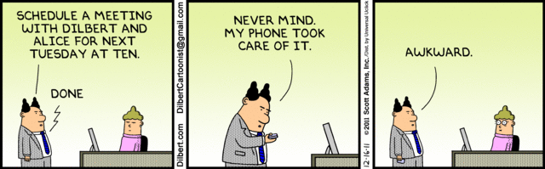
Rise of voice control
Siri
Ok Google
Alexa
Voice Remote
Locally recognize “wake words”
  Ship off to server farm for bulk speech recognition

Slide 48
Preclass 4
How GPS data ease data lookup for bus stop, schedule?
Compared to what must do without GPS data?
  (what does Google Maps do?)

Slide 49
Context Awareness
Sense context
  Can reduce information need to explicitly gather from user
  Prioritize/reorder data presented
    Know more about likely common case
Principle: don’t ask user for information can obtain automatically.
Other context examples?

Slide 50
Natural(?) Input
Audio and Voice processing
Vision, Radar
Location
Motion (e.g. fitbit, iWatch)
Biometrics
Coupled with signal processing, cheap computation
Opportunity to take input from natural interactions

Slide 51
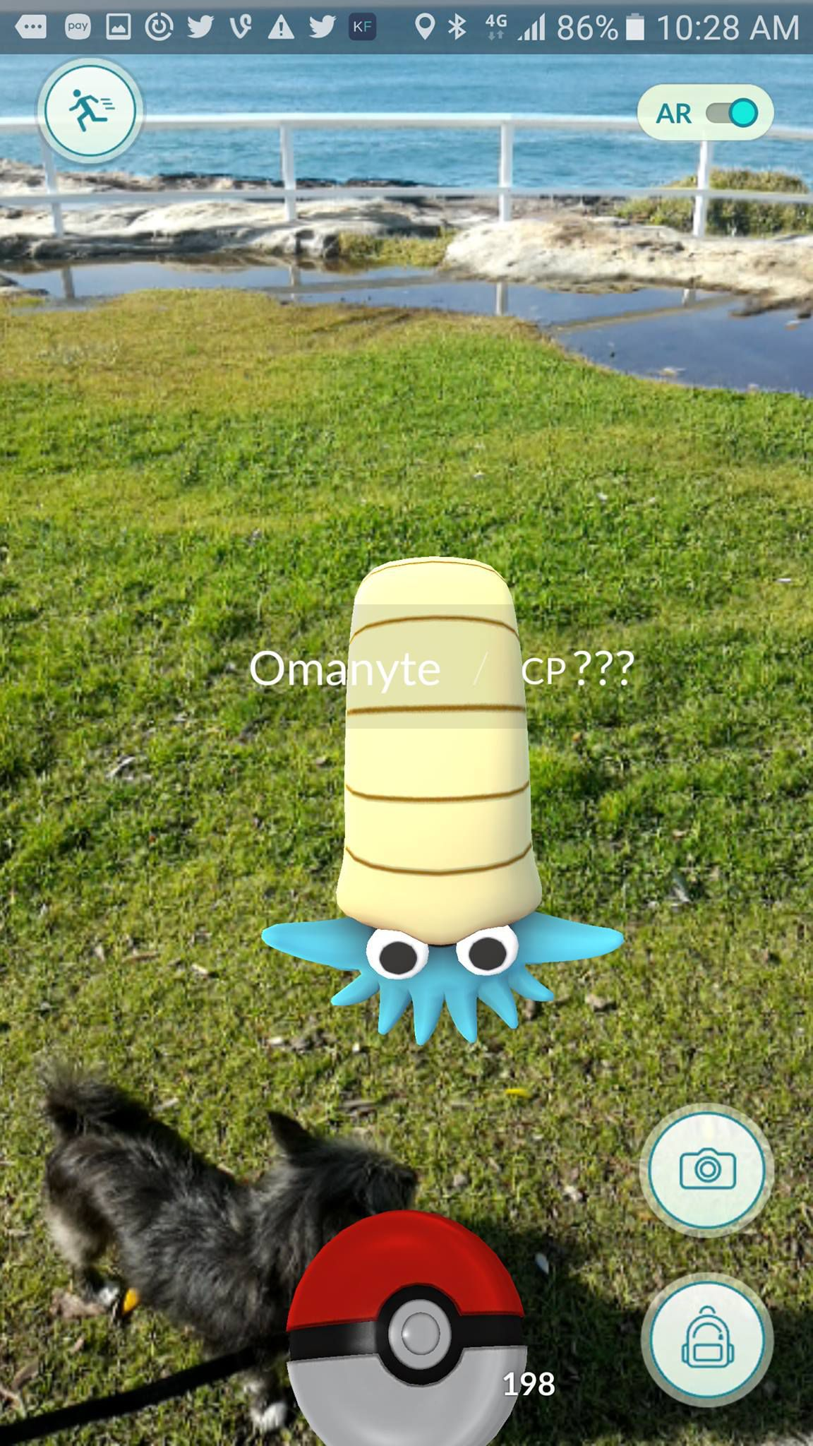
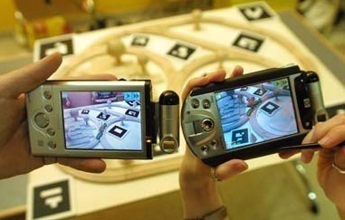
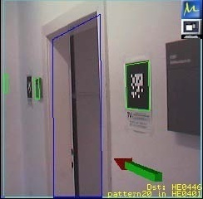
Augmented Reality with Portable Devices (Smartphone)
https://mashable.com/2016/07/10/john-hanke-pokemon-go/#edHFGDBS1kql
Use the embedded camera and overlap synthesized images and animation.
Pokemon Go
Need real-time feature tracking for
registration.
  “Invisible Train”:
  Schmalstieg and
  Reitmayr, 2004
Overlaid
Directions
http://www.youtube.com/watch?v=zOS5Mbk_Iuc

Slide 52
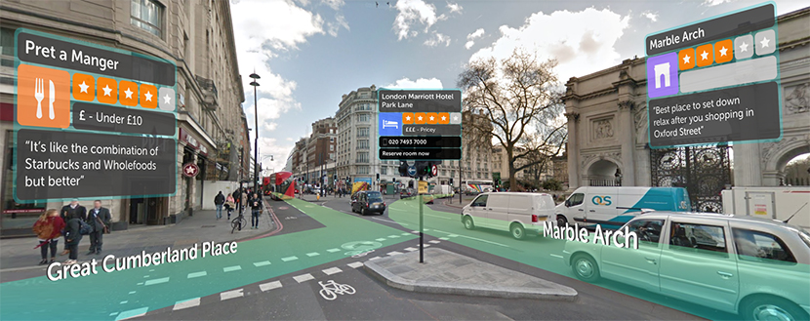
Augmented Reality
(Doctor Who fans: search for augmented reality tardis)
https://blippar.com/en/resources/blog/2017/11/06/welcome-ar-city-future-maps-and-navigation/

Slide 53
UI and Moore’s Law
Theme: We should spend computation to ease human interaction
  Past: had to ask human to accommodate computer
    Give it input in a way it could understand
      E.g. punched cards
      (pix from https://commons.wikimedia.org/wiki/File:Used_Punchcard_(5151286161).jpg)
  Future: should have computer do more to accommodate human in interaction
    Reduce what human needs to do
    Move interface closer to natural interaction for user
      Voice, movement, vision, ….

Slide 54
Big Ideas
User Interface essential
  And worth designing carefully and deliberately
View should match user goals, not internal design
  Spend computing cycles to ease human interaction
  Make simple, safe, intuitive
Implementer seldom a good judge of interface goodness
  Knows too much about how should work
  Conflict of goals
Important to test and get representative user feedback

Slide 55
Next Labs
Lab 11 – today
  Actuators and WiFi
  Prelab to get setup; including on AirPennNet-Device
Lab 12 – following Wednesday
  Develop and analyze User Interface(s) for internet-connected devices
    Networking to control
    Develop GUI
  More user-friendly interface than the engineer-friendly one we will use for Lab 11

Slide 56
Learn More @ Penn
Courses
  ESE543 – Human Factors Engineering

Slide 57
Remember
Feedback
Lab today
  Bring kit
  AirPennNet-Device

Slide 58
Reading
The Design of Everyday Things, Donald Norman -- a classic book on design for usability (broader than just hardware and software)
The Inmates are Running the Asylum, Alan Cooper -- a manifesto calling out computer/software industry for poor design
Set Phasers on Stun: And Other True Tales of Design, Technology, and Human Error, Steven M. Casey -- a series of anecdotes (case-studies) on how bad design and interfaces can go wrong, perhaps even killing people.

