Slide 1
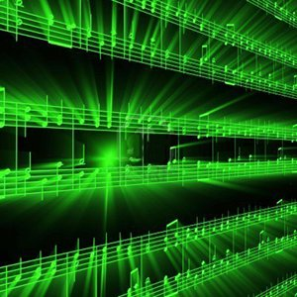
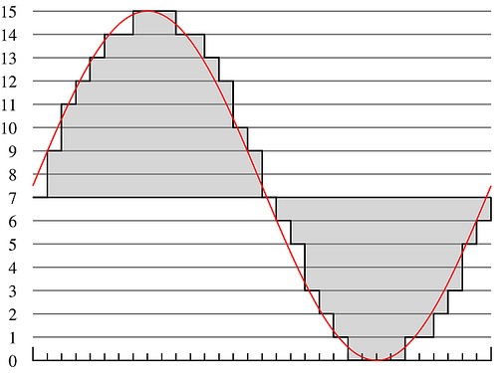
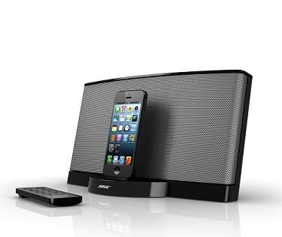
Lecture #25 – Intellectual Property 2
ESE 150 – Digital Audio Basics
Slides 2018--2022 DeHon

Slide 2
Outline
Setup Need / Opportunity – What is IP
Where are we
Rationale for IP Protection – Why Protect
How protect?
Patents (review and preclass)
Copyrights (review and preclass)
Licensing
Open Source
NDA
Patent Ownership

Slide 3
Review

Slide 4
Intellectual Property Creators
As Engineers
Program, develop algorithms, design circuits
Almost everything we create will have this property
Value added is intellectual
Can be represented digitally in bits
Can (increasingly) be copied/reproduced cheaply
Easy to have impact
Our solutions can reach millions, billions
Decreasing physical barriers to propagation of solutions
Challenge to protect and reward IP creators

Slide 5
Mechanisms (To support)
Patents
Cover inventions
E.g., Flying Machine (US 821,393), ENIAC (US 3,120,606),
Copyrights
Creative expression
E.g., novel, song, movie
Article 1, Section 8, Clause 8:
To promote the Progress of Science and useful Arts, by securing for limited Times to Authors and Inventors the exclusive Right to their respective Writings and Discoveries

Slide 6
Patent
Inventions
Non-obvious to one “ordinary skill in art”
Reduced to practice
Cannot patent
Abstract ideas
Laws of nature
US: First to file
(prior to 2013 was first to invent)
Exclusive rights 20 years from filing
(previously 17 years from issue)

Slide 7
Xilinx FPGA US 4,870,302
https://patents.google.com/patent/US4870302A/en?oq=us+4870302

Slide 8
Xilinx FPGA Patent
When expire?

Slide 9
Patents
Who owns patent on GIF?
When did/will it expire?

Slide 10
Copyright

Slide 11
Copyright
Cover particular, original expression
Including software
Technically don’t need to register
But should…
Must register before sue for infringement
$45
https://www.copyright.gov/about/fees.html
No review, just registration
Life of author + 70 years
Work for hire: 95 years from publication

Slide 12
Copyright Terms
Why are there so many Sherlock Holmes related movies and series these days?
Sherlock (BBC), Elementary, Irregulars
Enola Holmes
Sherlock Holmes movies (w/ Robert Downey Jr.)
When does Mickey Mouse copyright expire?

Slide 13
Teaser
South Park: Human CenitPad
https://southpark.cc.com/clips/382781/business-casual-g-men

Slide 14
Licensing

Slide 15
License
Where have you seen licenses?

Slide 16
Licenses
How get right to use
Something patented, copyrighted by someone else
Between companies
Get IP need to build a product
To consumers
Technically, most software is licensed, not sold
…shrink-wrap/click-through licensing agreements…
Define terms of use
What you are paying for (one copy, many, resale…)
What uses (dis)allowed

Slide 17
Direct Licensing/Sales

Slide 18
Past
Selling a product require huge infrastructure and up-front capital costs
Manufacture (physical things)
Marketing
Distribution
Sales
Demand large business to support infrastructure
Not easy for individual

Slide 19
Today (emerging)
Eliminate infrastructure needs with ubiquitous networking, IP products, service businesses
Manufacture (physical things) → not issue for IP
…or licensed manufacturing
Marketing → still need to get the word out
…can use web at low cost
Distribution → not an issue for IP
…leverage common carriers
Sales
Handle online, eBusiness support
Becomes possible for individuals/small businesses to sell IP directly to consumers

Slide 20
Direct IP Businesses today
Examples?

Slide 21
Direct IP Businesses today
Kindle Direct Publishing
App Store / Google Play
AWS Marketplace
Café Press
Shapeways

Slide 22
Open Source / Creative Commons
Part 2

Slide 23
Sharing
Sometimes we want to share
Isn’t it great doesn’t cost us anything to give away digital products?
Isn’t it great can build on work of others without necessary cost?
Cooperation on standards create opportunities for everyone, for an industry

Slide 24
Challenge
Patents cost money
Business (people making money) will spend money to patent things
…and typically incentivized to patent everything they can
Company (individual) could patent something and grant free license
How does individual, non-profit, etc.
Create something and protect right to share?
Variety of Open-Source/Public Domain licenses

Slide 25
Creative Commons
Framework and set of licenses for clearly expressing intent
Issues
Attribution
Share-Alike
(Non-)commercial
(No)Derivatives
Apps to choose, logos to show, legal backing to define precisely
https://creativecommons.org/share-your-work/licensing-types-examples/

Slide 26
Non-Disclosure Agreement (NDA)

Slide 27
NDA
Tool for protecting IP
Legal agreement that you won’t disclose information shared with you
Prevent loss of IP
Typical for collaborating companies
Typical for employers
In part to make sure sharing with you doesn’t count as “disclosure” to preclude patents
Define scope of disclosure

Slide 28
Who Owns IP?

Slide 30
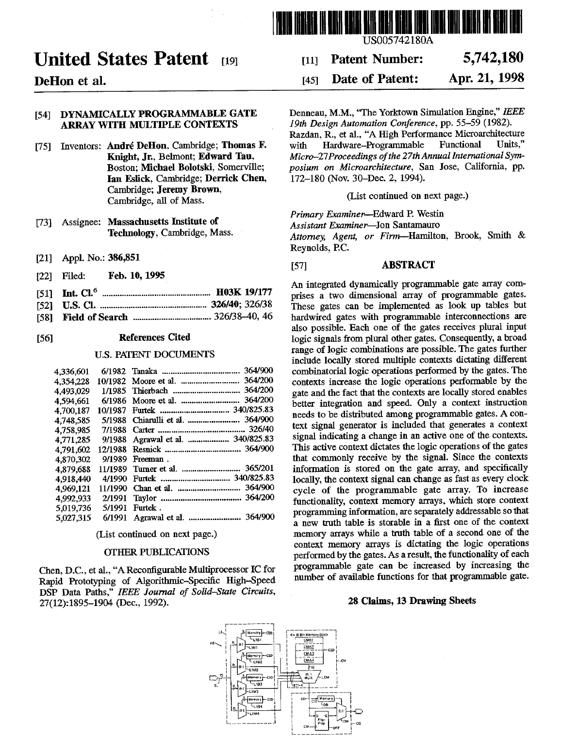

Slide 31
Work Scenarios
Hired/paid by company to invent
Belongs to company
Invent on side on free time
…may depend on employment agreement
…whether or not subject matter overlaps with company
Consultant
By default yours, but consulting agreement may define

Slide 32
University
Based on grant funds and resources
Typically goes to university and funding source
Right of first refusal…won’t always pursue
Undergraduate
Invent in class, senior-design → yours
Graduate students paid RA from grant
Typically funded by grant and go to University
Undergraduate paid research (employee)
Typically funded by grant and go to University
Graduate students in class, using class resources
Goes to University

Slide 33
Big Ideas
We (engineers…particularly in computing space) are knowledge workers, producing IP
IP carries great value
That is less and less tied to physical objects
Need to equitably reward and encourage IP creation
Patents, Copyrights, Licenses …
Attempts to provide framework for IP ownership, sharing, monetization
…probably not the final answer, particularly as technology landscape continues to evolve.

Slide 34
Learn More
EAS 507 – IP and Business Law for Engineers
EAS 545 – Engineering Entrepreneurship
Has sections on IP

Slide 35
Remember
Feedback
Lab 12 today

