Slide 1
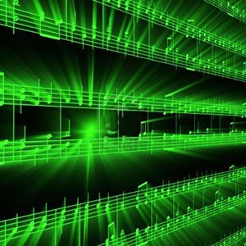


Lecture #3 – Quantization
ESE 1500 –
Digital Audio Basics

Slide 2
Lecture Topics
Part 1
  Reminder: Sampling and Quantization
  Expressing Mathematically
<interlude: image resolution>
Part 2
  Effects of Quantization
    Discrete
    Continuous (time permitting)
    Engineering
Part 3
  System Capacity
  Summary
References

Slide 3
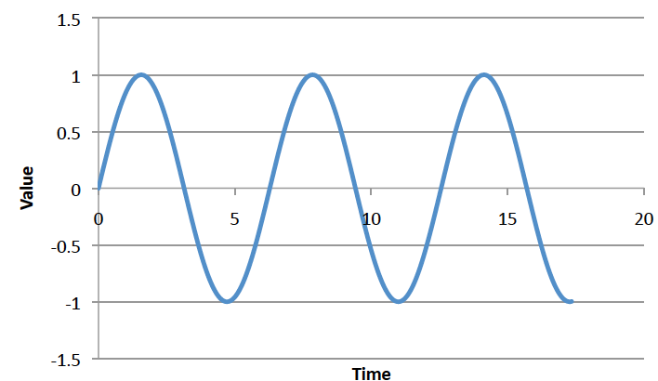
Big Question
How represent and process continuous information on a digital computer with finite memory?
  Note: continuous means signal may take on infinite number of values between any T₁ and T₂
T₁
T₂

Slide 4
Strategy
Sample at periodic time intervals
  Discretize independent variable
Quantize to discrete levels
  Discretize the value of the dependent variable

Slide 5
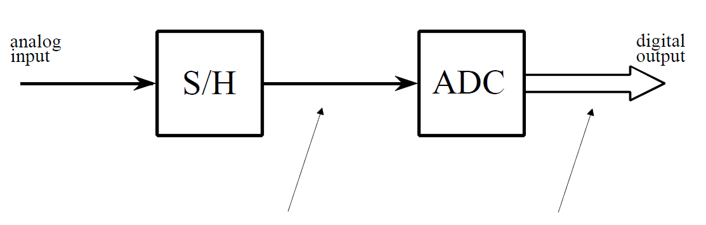
ADC – Broken into two parts
Sample/Hold
Performs sampling
Performs quantization
Voltage
Voltage
Voltage
3
110
3
3
2
101
2
1
100
1
time (ms)
time (ms)
time (ms)
1
2
3
4
5
6
7
8
0
011
0
-1
1
2
3
4
5
6
7
8
1
2
3
4
5
6
7
8
010
-1
-3
-2
001
-2
-3
000
-3

Slide 6
Problem Decomposition
Powerful Engineering technique
  Formulate a parameterized solution strategy
  Then identify the right parameters
Divides the problem
Here
  Strategy of sampling and quantization
  Then identify the right sampling rate, quantization level
Convergent: limit of infinite samples, levels
Once have strategy, reduces to a well-defined optimization problem
Parameterization admits to tuning for tradeoffs

Slide 7
Mathematical Expression

Slide 8
Round
Rounding – select nearest discrete value as approximation of continuous value
For sake of concreteness, we will define:
  Round(x) – nearest integer to real number x
    Round(0.7) = 1
    Round(-0.1) = 0
    Round(2.4999) = 2
    Round(1.50001) = 2
What is Round(3.3) ?

Slide 9
Quantize
We will quantize to some level L
Define as number of values between integers
So, we have L steps of 1/L between integers
  (or only represent every L’th integer if L<1)
In terms of Round
  Quantize_{L}(x) = Round(L*x)/L
  E.g. Quantize₈(0.7)=Round(8*0.7)/8=6/8=0.75

Slide 10
Preclass 1
 |  | 0.333 | 1.246 | -1.123
L=4 | Quantize_{L}(x)
 | QuantizationError_{L}(x)
L=16 | Quantize_{L}(x)
 | QuantizationError_{L}(x)
Quantize_{L}(x) = Round(L*x)/L

Slide 11
Bits
If we quantize to L levels per integer
Represent values between integers
  Max
  Min
How many bits required per quantized value?

Slide 12
Bits per Quantized Value
Bits = ⌈log₂((Max-Min)*L+1)⌉

Slide 13
Sample Values
Voltage
3
When sample at time interval T
  (for frequency = 1/T)
We collect the points at times:
  0, T, 2T, 3T, 4T, …
For signal f(t), we are collecting values:
  f(0), f(T), f(2T), f(3T), f(4T), …
Or in general, we are collecting the points
  f(i*T) for i=0 to MaxSamples (or MaxTime/T)
time (ms)
1
2
3
4
5
6
7
8
-3

Slide 14
Sample and Quantize Values
Voltage
3
When sample at time interval T
  (for frequency = 1/T)
We collect the points at times:
  0, T, 2T, 3T, 4T, …
For signal f(t), we are collecting:
  f(0), f(T), f(2T), f(3T), f(4T), …
If we then Quantize the values to level L
  Quantize_{L}(f(0)), Quantize_{L}(f(T)), Quantize_{L}(f(2T)), …
time (ms)
1
2
3
4
5
6
7
8
-3

Slide 15
Sample and Quantize Values
If we then Quantize the values to level L
  Quantize_{L}(f(0)), Quantize_{L}(f(T)), Quantize_{L}(f(2T)), …
Or in general, we are collecting the points
  Quantize_{L}(f(i*T)) for i=0 to MaxSamples (or MaxTime/T)
We store them in an array (or vector) F of MaxSamples+1
  For i from 0 to MaxSamples: F[i]= Quantize_{L}(f(i*T))
  This is what you will collect in lab today!

Slide 16
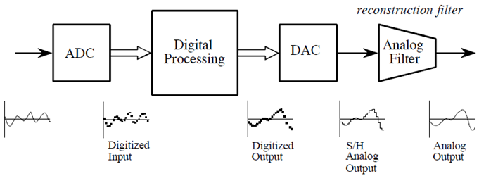
ADC / DAC – The full picture
Analog
Input
Formally:
  Analog input signal that varies with time: s(t)
  Signal processing algorithm to digitize analog input signal:
    F[i]=Round(s(i*T)*L)/L
      T is sample period
  Digitized signal produced by F[ ]: s_{f} (t)

Slide 17
Preclass 2
Sample f(t)=sin(2π*110*t) at T=0.3ms, quantize L=10
i | 0 | 1 | 2 | 3 | 4
i*T | 0 | 0.3ms
Value f(i*T) | 0
F[i] | 0
Sine goes -1 to 1: how many bits for these 5 samples?

Slide 18
ADC / DAC – The full picture
Analog
Input
Formally:
  Analog input signal that varies with time: s(t)
  Signal processing algorithm to digitize analog input signal:
    F[i]=Round(s(i*T)*L)/L
      T is sample period
  Digitized signal produced by F[ ]: s_{f} (t)

Slide 19
Interlude: 2D Images

Slide 20

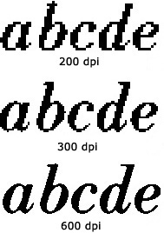
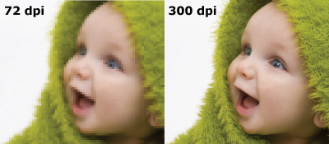
Same phenomena in Images
World continuous
Digital images on Zoom, TV, paper (even photographs) are discretized – limited resolution
  Zoom…
http://www.morefill.com/wpver/wp-content/uploads/2015/08/DPI-abcde.jpg
http://dslrphotographytutorials.com/wp-content/uploads/2014/05/PPI-Compare.png
http://blog.inkjetwholesale.com.au/wp-content/uploads/2015/07/DPI-comparison.png

Slide 21
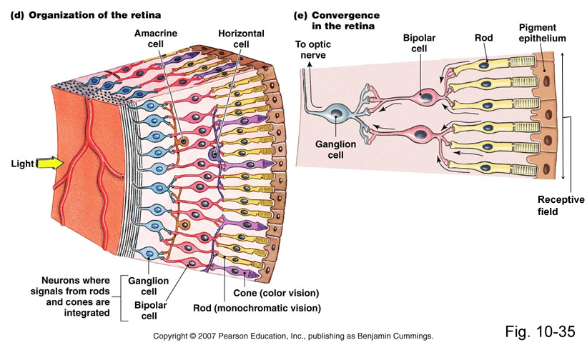
Apple Retina Display
Why called retina?
Claim (goal): as much resolution as you have in your retina (at typical viewing distance)
We cannot see pixels, because our eyes are themselves
discrete!

Slide 22
Apple Retina Display
Why called retina?
Claim (goal): as much resolution as you have in your retina (at typical viewing distance)
We cannot see pixels, because our eyes have discrete photo receptors (rods, cones)
Human eye resolution 0.5 arc-minute (0.02 degrees)
  Around 300 DPI (Dots-Per-Inch) at 20 inches

Slide 23
Part 2: Effects of Quantization

Slide 24
Noise -- ``Formal” Definition
Noise – difference between our ideal signal and the actual signal
  The one that we actually hear
  The one that shows up when we transmit data
  The one we store or reconstruct
Sometimes will see
  R(t) = S(t) + n(t)
    Noise n(t) is added to the ideal signal S(t)
    R(t) what we receive
  Or, equivalently:
    n(t)=S(t)-R(t)

Slide 25
Quantization Error
In example, quantization algorithm required us to round
  At sample time, t=1ms, input signal was: 2.2V
  It was lower than 2.5V, we rounded down to quantized level of 2.0V
    Side effect of quantization: the introduction of error in digital signal
Voltage
110
3
101
2.2
2.0
100
1
Quantization
Error
011
0
time (ms)
1
2
3
4
5
6
7
8
010
-1
Difference between sampled value
and quantized level
001
-2
000
-3

Slide 26
Quantization Error
How much error?
  In our case, we round up if equal to or above ½ a level…
    …round down if below ½ a level
  Generally, our input signal has 50/50 chance of being above/below
    Error becomes “uniformly distributed”
Voltage
L=2
Error
110
3
Quantize₁=Round(1*x)/1
QuantizeError₁=x-Round(x)
101
2.2
0.5
2.0
time (ms)
100
1
0.2
011
0
0
1
2
3
4
5
6
7
8
-0.2
1
2
3
4
5
6
7
8
010
-1
001
-2
-0.5
000
-3

Slide 27
Quantization Error / Noise
How much error?
  Looking at the plot of error, looks random
  Sets up a way for us to model quantization error as noisy signal
    Noise due to quantization = sampled signal (red dots) – quantized signal (red line)
    Quantization introduces noise to our sampled signal
Voltage
Error
110
3
101
2.2
0.5
2.0
time (ms)
100
1
0.2
011
0
0
1
2
3
4
5
6
7
8
-0.2
1
2
3
4
5
6
7
8
010
-1
001
-2
-0.5
000
-3

Slide 28
Preclass 2
Sample f(t)=sin(2π*110*t) at T=0.3ms, quantize L=10
i | 0 | 1 | 2 | 3 | 4
i*T | 0 | 0.3ms
Value f(i*T) | 0
F[i] | 0
Quantization Error | 0

Slide 29
Part 2B: Effects of Quantization
Engineering

Slide 30
Quantization Error / Design
Why model quantization error as noise?
There is always noise present
  Something other than the signal we intend
  Wires, electronics, background
  Not gaining much if quantization noise < other noise
Quantization adds noise
  Reduce by increasing sampling, increasing resolution
  More levels →(L) bits → makes more expensive
    Bits = ⌈log₂((Max-Min)*L+1)⌉
  Increase L until reach desired noise level
    Until other sources dominate quantization noise
SNR = Signal-to-Noise Ratio
  How much larger is the signal compare to noise?
  Mean (average) value of signal / std. dev. of noise
  Usually what we are optimizing in the system (including ADC)

Slide 31
Engineering
“An Engineer can do for a dime what anyone else can do for a dollar.”
Engineering is about optimization and efficiency
Bits are costly
Anyone: Sample frequently with high resolution
Engineer ask: how few bits can I use without sacrificing quality?
Engineering is about tradeoffs
  Quality vs. Cost

Slide 32
Problem Decomposition
Powerful Engineering technique
  Formulate a parameterized solution strategy
  Then identify the right parameters
Divides the problem
Here
  Strategy of sampling and quantization
  Then identify the right sampling rate, quantization level
Once have strategy, reduces to a well-defined optimization problem
Parameterization admits to tuning for tradeoffs

Slide 33
Part 3: System Capacity and Limits

Slide 34
Quantization, Sampling, Capacity
Quantization and Sampling
  Play enormous role in determining storage capacity of digital system
  # of quantization levels ➔ # of bits per sample
    Increasing resolution of ADC, reduces quantization noise…
    But also increases amount of data we must store for each sample
    Bits/sample = ⌈log₂((Max-Min)*L+1)⌉
  Sampling rate = how often we collect # of bits per sample
    Typically sampling rate = twice frequency of signal (next week)
    Increasing the rate, increases the amount of data to store!

Slide 35
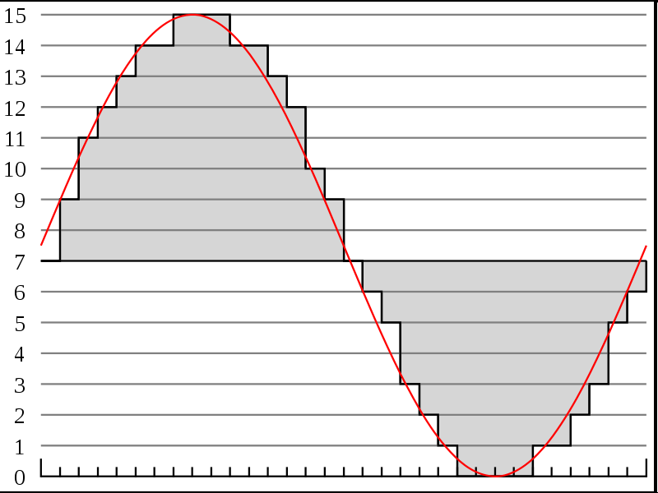




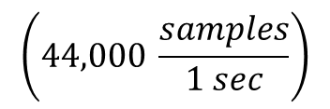

Recall # of bits for typical song
http://en.wikipedia.org/wiki/File:Pcm.svg
Discrete
Voltage
Levels
http://en.wikipedia.org/wiki/File:Compact_disc.svg
Sampling rate & resolution effect on storage
  Compact Disks: 16bits at 44KHz
    How many bits is a typical 3-minute song?
$$\left(44,000 \frac{samples}{1 sec}\right)$$
$$\left(16 \frac{bits}{sample}\right)$$
$$\left(60 \frac{sec}{1 min}\right)$$
$$\left(3 \frac{min}{song}\right)$$
$$=15.1 \frac{MB}{song}$$
Notes:
44,000/s x 2B x 3 m x 60s/m
15,840,000 Bytes
15.8 MB or almost 128Mbits

Slide 36
Limits of Sampling

Slide 37
Sampling
Definition of proper sampling
  If you can exactly reconstruct analog signal from samples,
  you have done the sampling properly
    Essentially: you have captured the key information from the signal to process can be reversed
Milestone of digital signal processing (DSP):
  Nyquist-Shannon Theorem (Wednesday)
    Tells us our sampling rate should be:
      twice the frequency of the signal!

Slide 38
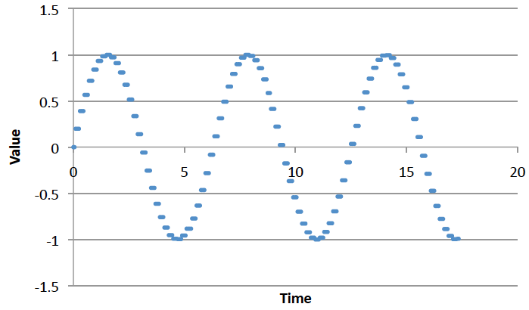
Big Ideas
Approximate continuous waveform on digital media by
  Discretize in all dimension
  For audio: in time and amplitude
    Sample in time; quantize voltage
Allows us to store audio signal as sequence of bits
Reconstruct by “connecting-the-dots”
  If our dots are frequent enough to represent the signal
Introduce error → noise
  Reason about tolerable (or noticeable) noise

Slide 39
Admin
Reading for Wednesday on syllabus
Office Hours
  Complete poll
Lab 1 Today in Detkin
  Prelab

Slide 40
References
S. Smith, “The Scientists and Engineer’s Guide to Digital Signal Processing,” 1997.
Wikipedia, http://en.wikipedia.org/wiki/Analog-to-digital_converter
Wikipedia: http://en.wikipedia.org/wiki/Pulse-code_modulation

