Slide 1
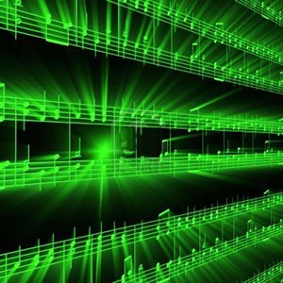


Lecture #4 – Nyquist-Shannon Sampling Theorem
ESE 1500 –
Digital Audio Basics

Slide 2
Lecture Topics
Part 1:
  Where are we on course map?
  Sampling/Quantization Review
  Impact of Sampling Rates
  Aliasing
Interlude: Wagon Wheel Effect
  (Motion Video Visual Aliasing)
Part 2:
  Aliasing Math
  Nyquist-Shannon Sampling Rate
  References

Slide 3






Course Map – Week 3
MIC
A/D
10101001101
Music
1
Numbers correspond to course weeks
sample
2,4
D/A
10101001101
speaker
MP3 Player / iPhone / Droid

Slide 4
Sampling vs Quantization Review

Slide 5
ADC – Sampling
Sampling: breaking independent variable (time) into intervals
  Quantization: breaking dependent variable (voltage) into levels
Voltage
Samples
@ 1ms intervals:
Quantized
into 7 levels
Levels digitized
into 3-bits
3
{ 0 ms, 0 Volts }
{ 0 ms, 0 Volts }
011
{ 1 ms, 2.2 Volts }
{ 1 ms, 2 Volts }
101
2
{ 2 ms, 3 Volts }
{ 2 ms, 3 Volts }
110
1
time (ms)
{ 3 ms, 2.2 Volts }
{ 3 ms, 2 Volts }
101
0
{ 4 ms, 0 Volts }
{ 4 ms, 0 Volts }
011
1
2
3
4
5
6
7
8
{ 5 ms, -2.2 Volts }
{ 5 ms, -2 Volts }
001
-1
{ 6 ms, -3 Volts }
{ 6 ms, -3 Volts }
000
-2
{ 7 ms, -2.2 Volts }
{ 7 ms, -2 Volts }
001
-3
{ 8 ms, 0 Volts }
{ 8 ms, 0 Volts }
011

Slide 6
Two Knobs
Quantization level (bits/sample)
Sampling rate (samples/second)
Impact Quality of sound
  Potential error introduced in reconstruction → noise
Impact costs (resources -- #bits needs to store)

Slide 7
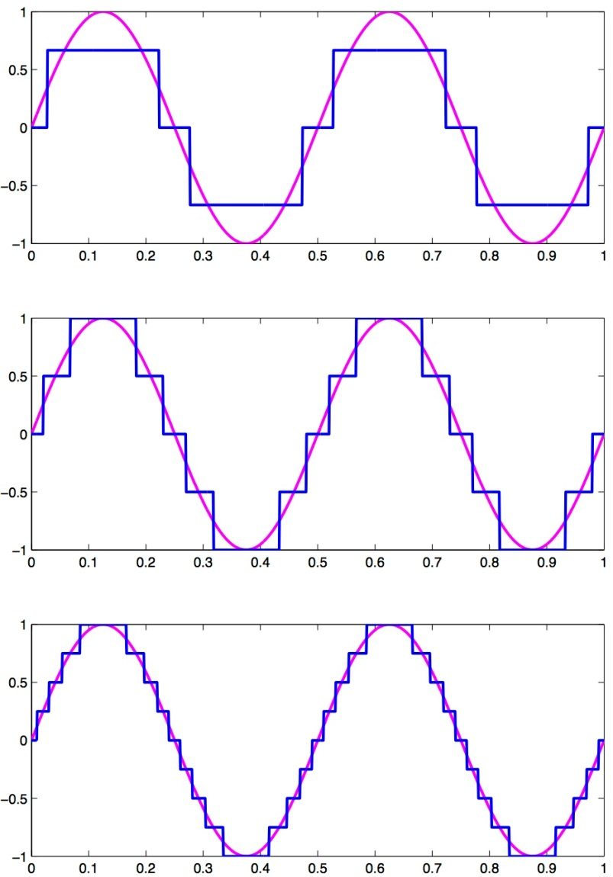
Effect of increasing Quantization
Dividing dependent variable up into more levels
  Increasing resolution at each sample
  Doesn’t change the # of samples itself!

Slide 8
Effect of increasing Sampling Rate
Increasing how often we take samples also helps
  Much like quantization…
    1 bit was too few, 16 bits was more than enough
    Is there a sweet spot for the sampling rate?
      Focus for this week.

Slide 9
Both (Quantization, Sampling) impact storage
How many bytes for a 3 minute song sampled at 8b precision and 1000 samples/s?
at 2000 samples/s?
16b precision at 2000 samples/s?

Slide 10
Key Question
What sampling rate should we use?

Slide 11
Definition of Good Sampling
Definition of proper sampling:
  Let’s say you’ve sampled an analog signal…
  If you can exactly reconstruct the analog signal from the samples
    You have done the sampling properly!
  Essentially: if you can reverse the process…
    You’ve capture enough information about the signal
Can we formalize this a bit more?
  Yes, next few slides will try….

Slide 12
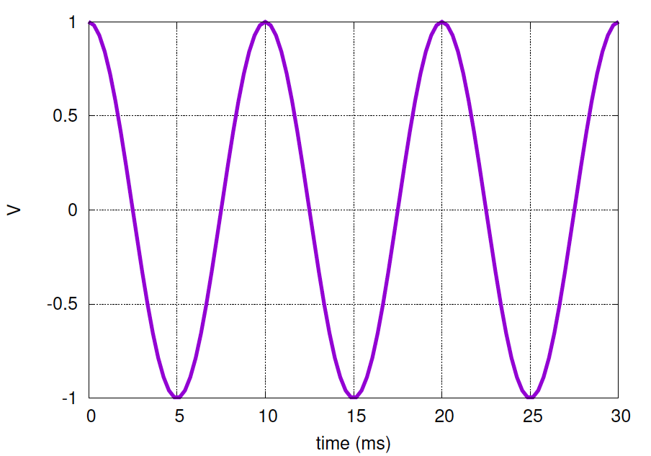
Sample at Frequency
Preclass 1: What happens if we sample 100Hz signal at 100Hz?
  What do we get for our sample values?

Slide 13
Sampling – What is the minimum?
Sampling at frequency doesn’t work.

Slide 14
Preclass 2 – Sample at 200Hz
 | 0 ms | 5 ms | 10 ms | 15 ms | 20 ms | 25 ms | 36 ms | Freq.
left
right

Slide 15
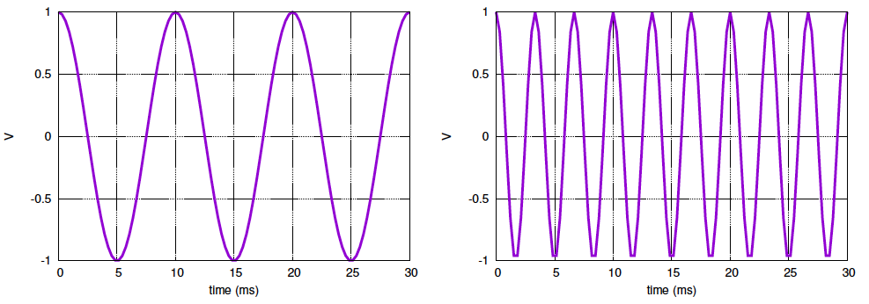
200 Hz Sample
What happened here?
  What did we get for the two cases?
  Why?

Slide 16
Indistinguishable at Sample Points

Slide 17
200 Hz Sample
Sampling below frequency doesn’t work
Cannot let signal “wiggle” around between samples
  Change direction
Sample too infrequently, can miss signal behavior

Slide 18
Sampling – What is the minimum?
Observation:
  If we sample at 200 Hz, capture peaks & troughs of signal
  Sample rate: 2 x frequency = 200 Hz
  Must sample at 2x frequency so doesn’t wiggle/change-direction between samples

Slide 19
Initial Observation
Observe: we must, at least, sample at twice the frequency of the signal we are trying to capture
  If sample at a lower frequency,
  signal may change directions between samples
  This gives us a
  lower bound
  on sample rate

Slide 20
Preclass 3 – Sample 600 Hz
 | 0 ms | 1.66 ms | 3.32 ms | 4.99 ms | 6.66 ms | 8.33 ms | 9.99 ms | freq
left
middle
right

Slide 21
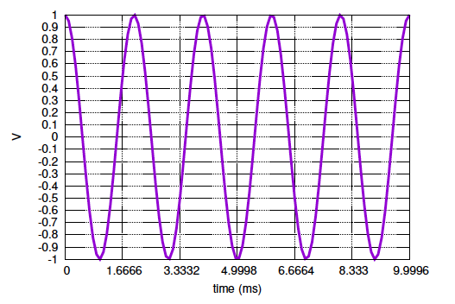
Preclass 3 – 500Hz
Is this properly sampled?
What did we get?
How does sample rate relate to frequency?

Slide 22
Sampling – What is the minimum?
Sampling below 2x frequency doesn’t work.
Also leads to reconstruction error
  We not only lose information…
    …but when we ‘reconstruct’ the signal from the samples alone…
    We will reconstruct at a lower frequency!
    This phenomenon is called: aliasing

Slide 23
Interlude

Slide 24
Video
How many frames/second for video (TV, Film?)
http://www.youtube.com/watch?v=jHS9JGkEOmA

Slide 25
Aliasing in Movies
Called visual aliasing
  See it all the time on TV/Film
    Wheels tend to move backwards on moving cars…why?
  What is it?
    Primer: Movies are just pictures (frames) flying by quickly
    Movies “sample” real life at roughly 24 frames per second
  What did we just see?
    When changes occur faster than ½ f_{s} , may get aliasing.
    Film Example:
      If light to dark transitions occur faster than ½ f_{s} aka: 12 frame/sec
      Aliasing will occur…

Slide 26
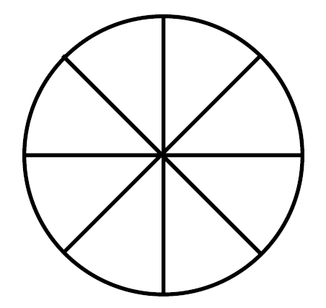
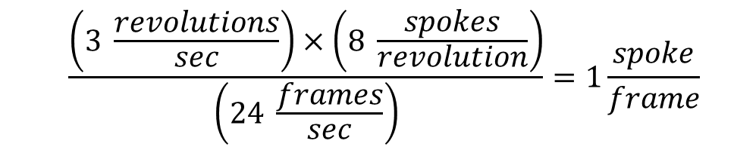
The “Wagon Wheel” Effect
Consider a wagon wheel with 8 spokes:
  Let’s say it turns at a rate of 3 revolutions per second clockwise
    That’s 180 rpm
  On film this wheel will appear to stand still! Why?
  $$\frac{\left(3 \frac{revolutions}{sec}\right)×\left(8 \frac{spokes}{revolution}\right)}{\left(24 \frac{frames}{sec}\right)}=1\frac{spoke}{frame}$$

Slide 27
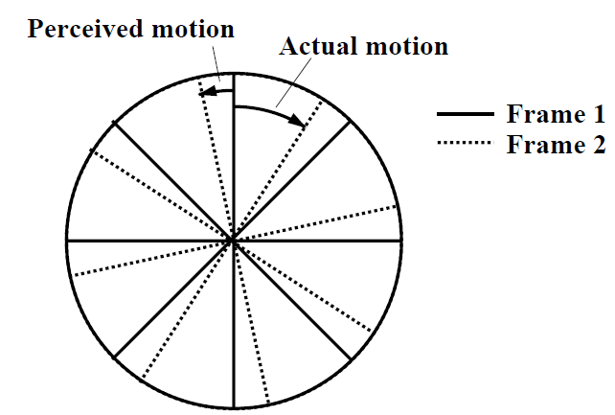
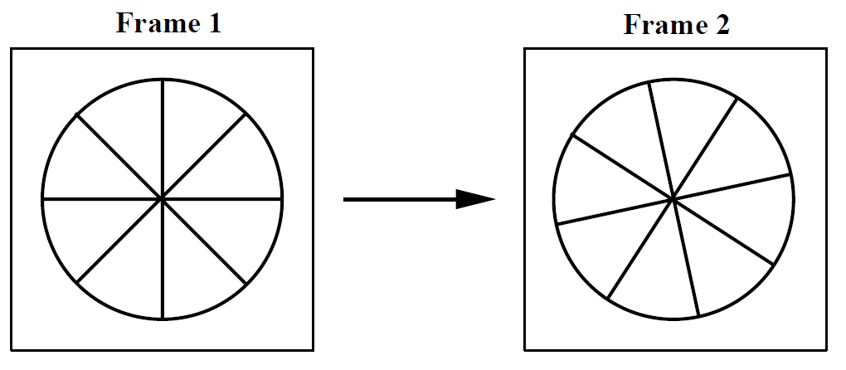
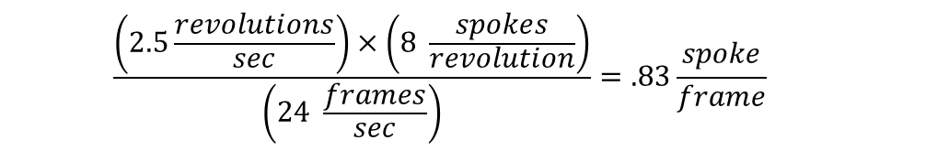
The “Wagon Wheel” Effect
What if it moved a little slower?
  Let’s say it turns at a rate of 2.5 revolutions per second clockwise
  Our brain could interpret this in two possible ways:
    Wheel has moved clockwise by 83% of spoke interval in clockwise direction
    OR: wheel has moved counter-clockwise by 17%
      Our brains prefer this view! So we see the wheel moving backwards! (thanks aliasing!)
  $$\frac{\left(2.5\frac{revolutions}{sec}\right)×\left(8 \frac{spokes}{revolution}\right)}{\left(24 \frac{frames}{sec}\right)}=.83\frac{spoke}{frame}$$
Fool your brain: http://www.youtube.com/watch?v=jHS9JGkEOmA

Slide 28
Aliasing Math
Nyquist-Shannon Sampling
Part 2

Slide 29
Sampling – What is the minimum?
Sampling below 2x frequency doesn’t work.
Also leads to reconstruction error
  We not only lose information…
    …but when we ‘reconstruct’ the signal from the samples alone…
    We will reconstruct at a lower frequency!
    This phenomenon is called: aliasing

Slide 30
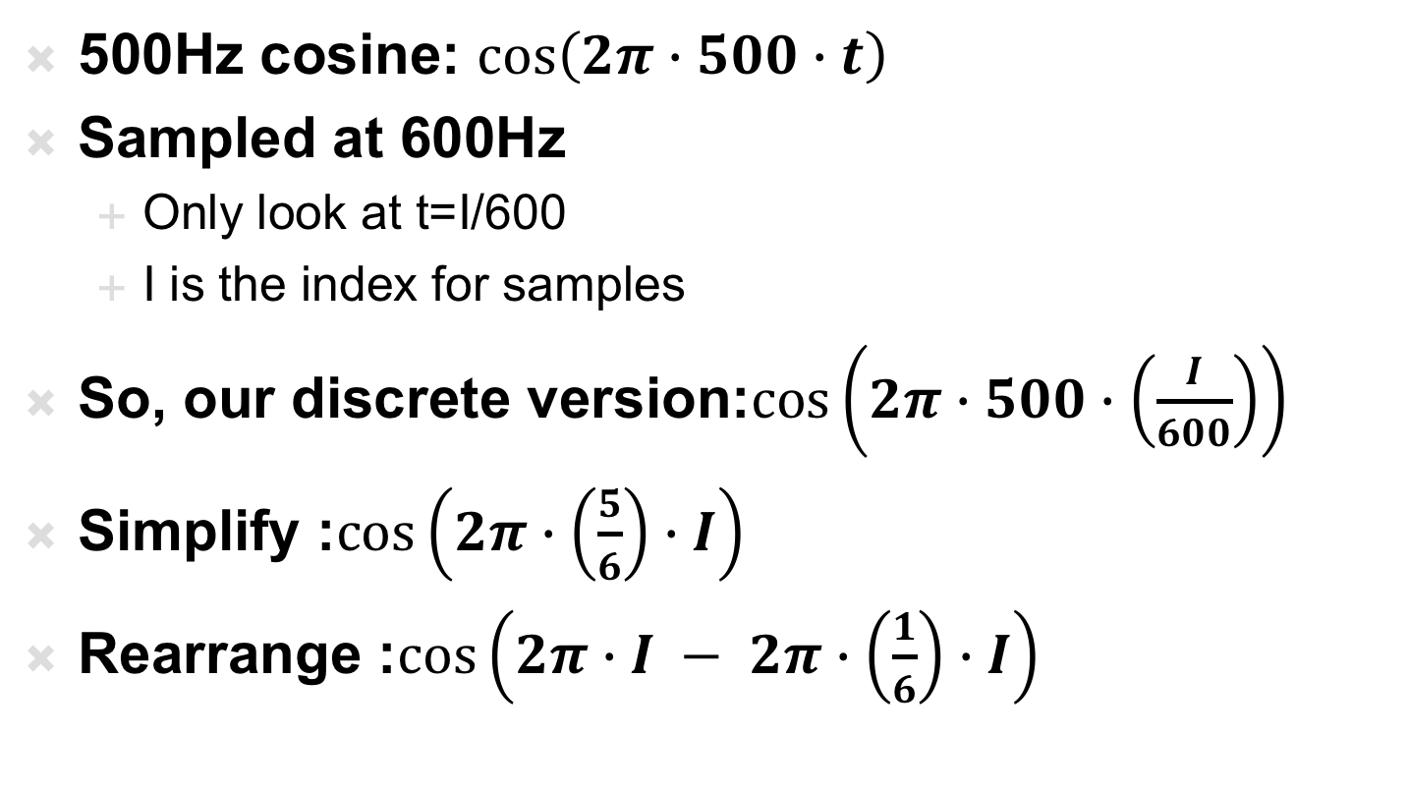
Aliasing Mathematical Derivation
500Hz cosine: $\cos\left(2π∙500∙t\right)$
Sampled at 600Hz
  Only look at t=I/600
  I is the index for samples
So, our discrete version:$\cos\left(2π∙500∙\left(\frac{I}{600}\right)\right)$
Simplify :$\cos\left(2π∙\left(\frac{5}{6}\right)∙I\right)$
Rearrange :$\cos\left(2π∙I − 2π∙\left(\frac{1}{6}\right)∙I\right)$

Slide 31
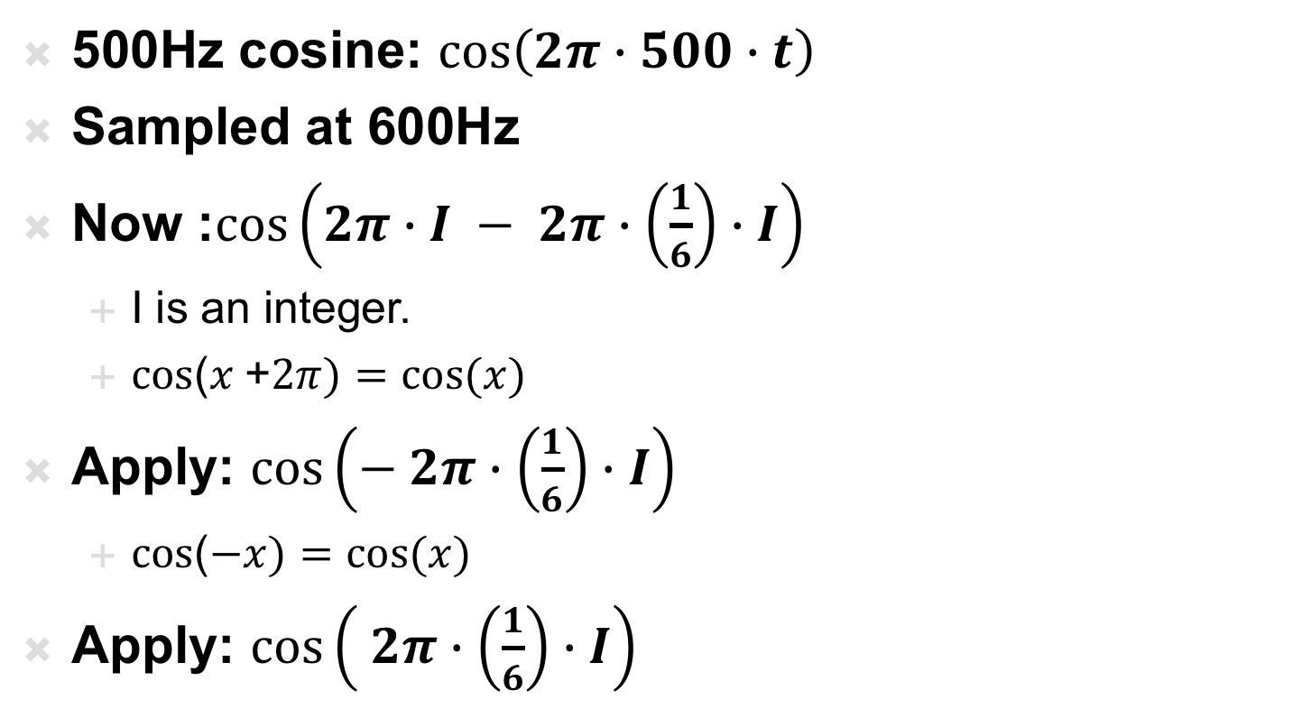
Mathematical Manipulation
500Hz cosine: $\cos\left(2π∙500∙t\right)$
Sampled at 600Hz
Now :$\cos\left(2π∙I − 2π∙\left(\frac{1}{6}\right)∙I\right)$
  I is an integer.
  $cos$($x$+$2π)=cos⁡(x)$
Apply: $\cos\left(− 2π∙\left(\frac{1}{6}\right)∙I\right)$
  $cos$($−x)=cos⁡(x)$
Apply: $\cos\left( 2π∙\left(\frac{1}{6}\right)∙I\right)$

Slide 32
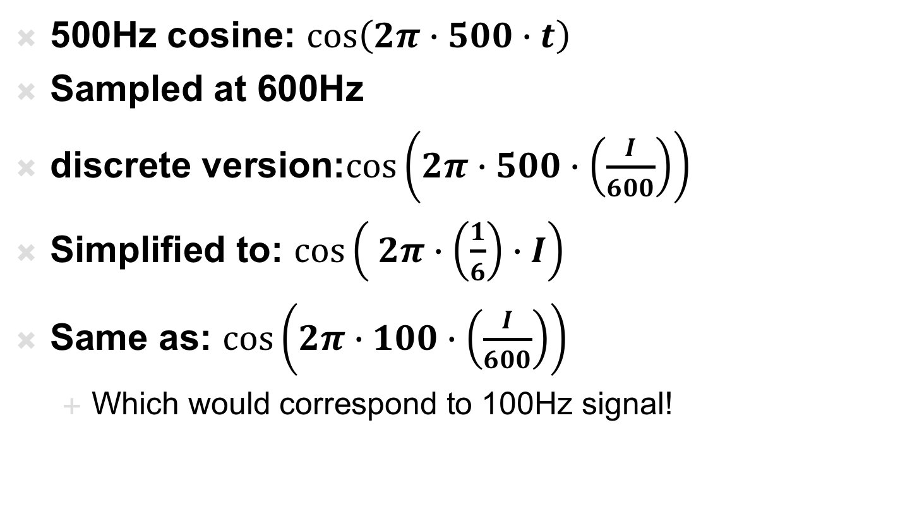
Aliasing Derivation
500Hz cosine: $\cos\left(2π∙500∙t\right)$
Sampled at 600Hz
discrete version:$\cos\left(2π∙500∙\left(\frac{I}{600}\right)\right)$
Simplified to: $\cos\left( 2π∙\left(\frac{1}{6}\right)∙I\right)$
Same as: $\cos\left(2π∙100∙\left(\frac{I}{600}\right)\right)$
  Which would correspond to 100Hz signal!

Slide 33
Sampling – What is the minimum?
Original Signal: 500 Hz
Aliased (Folded) Signal: 100 Hz
What frequency does aliasing occur?
  Original Signal’s Frequency: 500 Hz
    Sampling Rate: 600 Hz
  Aliasing occurs at: 600 Hz – 500 Hz = 100 Hz
    Also referred to as “Folding” – signal has “folds over” as if it were lower frequency

Slide 34
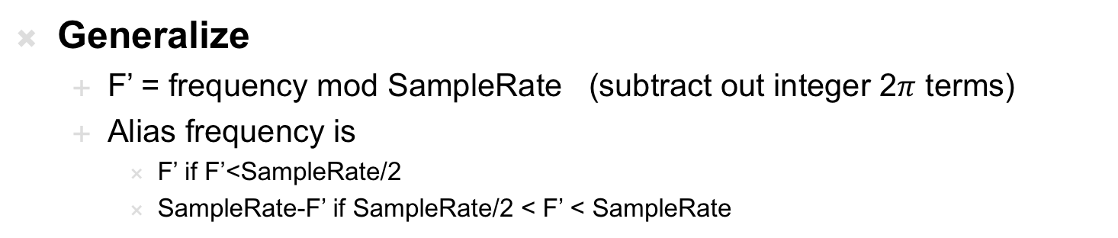
Sampling – What is the minimum?
Original Signal: 500 Hz
Aliased (Folded) Signal: 100 Hz
Generalize
  F’ = frequency mod SampleRate (subtract out integer 2$π$ terms)
  Alias frequency is
    F’ if F’<SampleRate/2
    SampleRate-F’ if SampleRate/2 < F’ < SampleRate

Slide 35

Sampling – What is the minimum?
Generalize
  F’ = frequency mod SampleRate (subtract out integer 2$π$ terms)
  Alias frequency is
    F’ if F’<SampleRate/2
    SampleRate-F’ if SampleRate/2 < F’ < SampleRate

Slide 36
Next Observation
Observation: sampling at less than twice the frequency of the signal can lead to aliasing
  Reinforces will need to sample at, at least, twice the frequency of our sample

Slide 37
Sampling Rate
Established (by counterexamples) that we can sample too infrequently
  Necessary to sample at 2x highest frequency present
Haven’t shown clearly that 2x is sufficient
  (won’t in this class)
  Just giving you intuition
    Capture all the peaks and troughs
    Sufficient to guarantee signal doesn’t
    ”wiggle” between samples

Slide 38
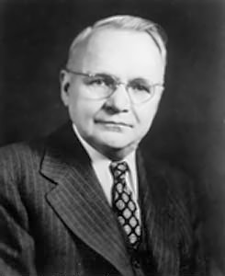
Sampling – What is the minimum?
Harry Nyquist
  Electronic Engineer for AT&T from 1917 to 1954
  Published paper in 1928 defining the: Sampling Theorem
    Nyquist Sampling Rate = 2 x frequency of signal
      Anything less: under-sampling – leads to aliasing
      Anything more: over-sampling – waste of space?

Slide 39
Possibly open questions (so far)
Do all signals have frequency?
  Is this issue of 2x frequency of signal well defined?
Are pure tones an adequate model of frequencies in signals?
Will be solidifying this in 2 weeks.

Slide 40
Big Ideas
Sample at twice the maximum frequency
  Can reconstruct perfectly
If have frequencies > SampleRate/2
  Will get aliasing … as high frequencies fold

Slide 41
Learn More
ESE224 – Signal Processing
ESE531 – Digital Signal Processing

Slide 42
Admin
Remember feedback
Lab Writeup Due Monday
Next Lab on Monday
  Prelab (bit longer this time)
  Lab out this afternoon
Office Hours
  DeHon: W4:30pm-5:30pm
  Peter: W6-7pm (location TBD)
  Sunday 8-9pm (Detkin)

Slide 43
References
  S. Smith, “The Scientists and Engineer’s Guide to Digital Signal Processing,” 1997.
  http://en.wikipedia.org/wiki/Nyquist_frequency
  http://en.wikipedia.org/wiki/Nyquist_rate
  http://en.wikipedia.org/wiki/Oversampling
  http://en.wikipedia.org/wiki/Sampling_rate
  http://en.wikipedia.org/wiki/Hearing_range
  http://electronics.howstuffworks.com/telephone6.htm
  B. Olshausen, “Aliasing”, PSC 129 – Sensory Processes Course Notes, UC Davis

