Slide 1



Lecture #6 – Compression
ESE 1500 –
Digital Audio Basics

Slide 2
Lecture Topics
Where are we on course map?
Preclass
Compression: Lossy and Lossless
Lossless Compression
  Probability-based lossless compression
    Huffman Encoding
Part 2:
  Common case
  Entropy
    Shannon Limits
Next Lab
References

Slide 3






Course Map – Week 3
MIC
CPU
A/D
10101001101
Music
1
Numbers correspond to course weeks
compress
sample
3
2,4
D/A
10101001101
speaker

Slide 4
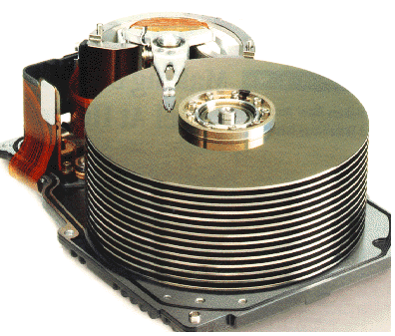




Course Map
7,8,9
10101001101
MIC
CPU
File-
System
A/D
10
10101001101
NIC
Music
1
domain
conversion
5
Numbers correspond to course weeks
compress
sample
freq
pyscho-
acoustics
4
2,3
4
13
11
EULA
----------------click
OK
D/A
NIC
speaker
MP3 Player / iPhone / Droid
12

Slide 5
Preclass

Slide 6
Preclass
Tell me and I forget, teach me and I may remember, involve me and I learn
  -- Benjamin Franklin
73 symbols (fancy, more general term for letters)
19 unique (ignoring case)
  (A, B, C, D, E, F, G, H, I, L, M, N, O, R, T, V, Y, space, comma)
  How many bits to represent each symbol?
How many bits to encode quote?

Slide 7
Preclass
Tell me and I forget, teach me and I may remember, involve me and I learn
  -- Benjamin Franklin
73 symbols
19 unique (ignoring case)
If symbols occurrence equally likely, how many occurrences of each symbol should we expect in quote?
How many E’s are there in the quote?

Slide 8
Preclass
Tell me and I forget, teach me and I may remember, involve me and I learn
  -- Benjamin Franklin
73 symbols
19 unique (ignoring case)
Conclude
  Symbols do not occur equally
  Symbol occurrence is not uniformly random

Slide 9
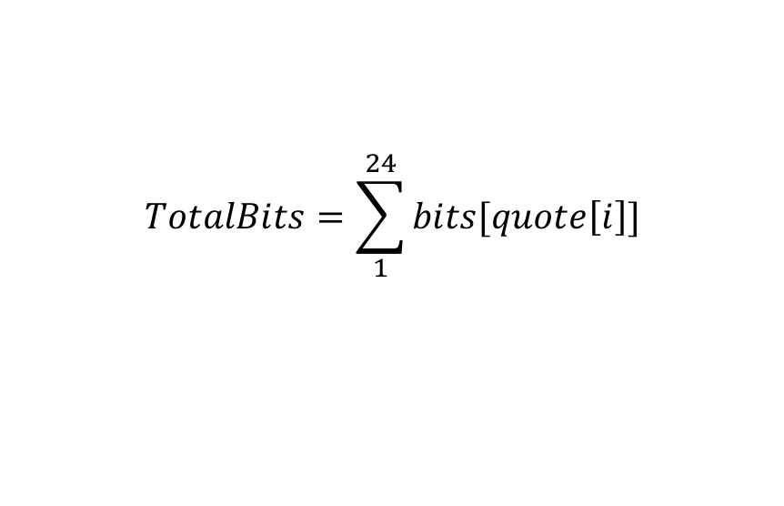
Preclass
Tell me and I forget, teach me and I may remember, involve me and I learn
  -- Benjamin Franklin
Using uniform encoding (from question 1)
  How many bits to encode first 24 symbols?
How many bits using encoding given (Q5a)?
$$TotalBits=\sum_{1}^{24}{bits[quote\left[i\right]]}$$

Slide 10
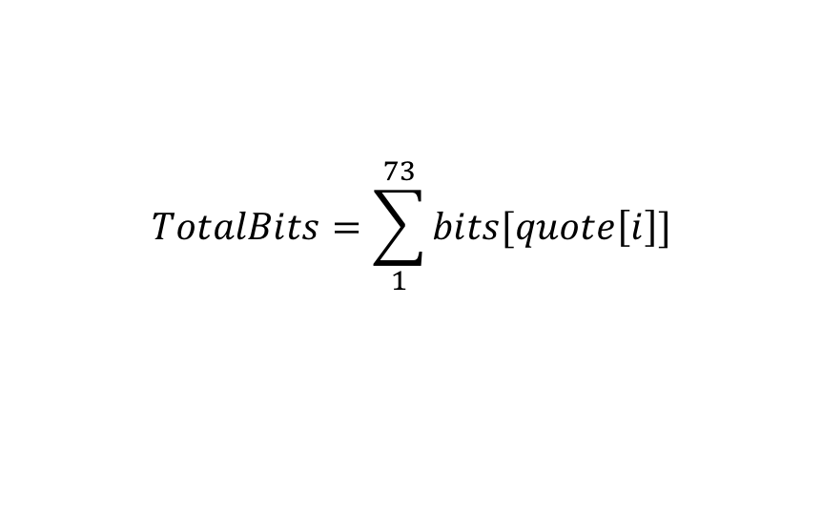
Preclass
Tell me and I forget, teach me and I may remember, involve me and I learn
  -- Benjamin Franklin
Using uniform encoding (question 1)
  How many bits to encode all 73 symbols?
How many bits using encoding given (Q5c)?
$$TotalBits=\sum_{1}^{73}{bits[quote\left[i\right]]}$$

Slide 11
Conclude
Can encode with (on average) fewer bits than log₂(unique-symbols)

Slide 12
Intro to Compression

Slide 13
Data Compression
What is compression?
  Encoding information using fewer bits than the original representation
Why do we need compression?
  Most digital data is not sampled/quantized/represented in the most compact form
    It takes up more space on a hard drive/memory
    It takes longer to transmit over a network
  Why? Because data is represented so that it is easiest to use
Two broad categories of compression algorithms:
  Lossless – when data is un-compressed, data is its original form
    No data is lost or distorted
  Lossy – when data is un-compressed, data is in approximate form
    Some of the original data is lost

Slide 14
Recall ADC Process?
Analog-to-Digital (ADC) Conversion
  We have 7 discrete voltages, # of bits to represent 7 things?
  3-bits! Why? 2^{3-bits} = 8 (1 unused state)
Binary
Encoding:
011
Voltage
Samples:
{ 0 ms, 0 Volts }
110
3
{ 1 ms, 2 Volts }
101
101
2
{ 2 ms, 3 Volts }
110
100
1
{ 3 ms, 2 Volts }
101
011
time (ms)
{ 4 ms, 0 Volts }
011
0
1
2
3
4
5
6
7
8
{ 5 ms, -2 Volts }
001
010
-1
{ 6 ms, -3 Volts }
000
001
-2
{ 7 ms, -2 Volts }
001
000
-3
{ 8 ms, 0 Volts }
011
Encoding: mapping data from one form to another (not always conversion)

Slide 15
Example of Lossy Compression
    Sample Rate: 1000 samples/sec, Resolution: 3-bits per sample
    Our Sampled Signal: {0, 2.2V, 3V, 2.2V, 0, -2.2V, -3, -2.2V, 0}
    Our Quantized Signal: {0, 2V, 3, 2V, 0, -2, -3, -2, 0}
    Our 3-bit Digitized Data: {011, 101, 110, 101, 011, 001, 000, 001, 011}
      space required to store/transmit: 27 bits
ADC related compression algorithm:
  CS&Q (Coarser Sampling AND/OR Quantization)
    Either reduce number of bits per sample AND/OR discard a sample completely
  Example with our digitized data:
  Our 3-bit Digitized Data: {011, 101, 110, 101, 011, 001, 000, 001, 011}
  If we drop the sampling rate by a factor of 2, how impact number of bits needed?
  Lossy because we cannot restore exact original

Slide 16
De-Compression of Signal:
Decompression & DAC Process
  Original digital signal: {011, 101, 110, 101, 011, 001, 000, 001, 011}
  Original Sampling Rate: 1000 samples/sec
Voltage
110
3
101
2
100
1
011
0
time (ms)
1
2
3
4
5
6
7
8
010
-1
001
-2
000
-3
Original Signal (recall ADC/DAC is approximation at best anyway!)

Slide 17
De-Compression of Signal:
Decompression & DAC Process
  Original compressed signal: {011, , 110, , 011, , 000, , 011}
  New Sampling Rate Due to Compression: 500 samples/sec
Effect of CS&Q compression:
Lowered Sampling Rate
Added “noise” to signal
Listeners might not notice!
Lossy Compression:
One can achieve high
Compression ratios
Frequently used for Audio:
MP3 format uses lossy
compression algorithm
Voltage
110
3
101
2
100
1
011
0
time (ms)
1
2
3
4
5
6
7
8
010
-1
001
-2
000
-3
Lossy: Compression removed every other sample

Slide 18
Two forms of classification
Compression Algorithms
Lossy
Lossless
Compression Algorithms
Fixed Group Size
Variable Group Size
Examples of Fixed Group Size:
Take in 2 samples: (6-bits) always spit out: (3-bits)
Take in 8-bit ASCII character (group), spit out 7-bit ASCII character (group)

Slide 19
Probability-Based Lossless Compression

Slide 20
Information Content
Does each character contain the same amount of “information”?
Notes:
20

Slide 21
Statistics
How often does each character occur?
  Capital letters versus non-capitals?
  How many e’s in preclass quote?
  How many z’s?
  How many q’s?
Notes:
21

Slide 22
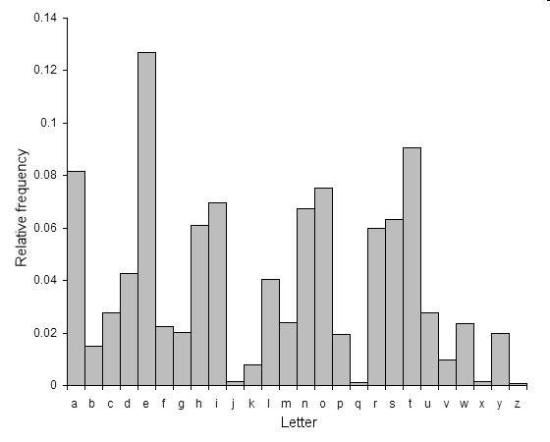
English Letter Frequency
http://en.wikipedia.org/wiki/File:English-slf.png
Notes:
22

Slide 23
Huffman Encoding
Developed in 1950’s (D.A. Huffman)
Takes advantage of frequency of stream of bits occurrence in data
  Can be done for ASCII (8-bits per character)
    Characters do not occur with equal frequency.
    How can we exploit statistics (frequency) to pick character encodings?
  But can also be used for anything with symbols occurring frequently
    E.g., Music (drum beats…frequently occurring data)
  Example of variable length compression algorithm
    Takes in fixed size group – spits out variable size replacement

Slide 24
How many Bits to represent all letters?
Letter | Binary Encoding
A | 00000
B | 00001
C | 00010
D | 00011
E | 00100
F | 00101
G | 00110
H | 00111
I | 01000
J | 01001
K | 01010
L | 01011
M | 01100
Letter | Binary Encoding
N | 01101
O | 01110
P | 01111
Q | 10000
R | 10001
S | 10010
T | 10011
U | 10100
V | 10101
W | 10110
X | 10111
Y | 11000
Z | 11001
Including upper and lower case?
…and numbers, how many bits?

Slide 25
ASCII Encoding (7-bit encoding)
Letter | ASCII Code | Binary | Letter | ASCII Code | Binary
a | 097 | 01100001 | A | 065 | 01000001
b | 098 | 01100010 | B | 066 | 01000010
c | 099 | 01100011 | C | 067 | 01000011
d | 100 | 01100100 | D | 068 | 01000100
e | 101 | 01100101 | E | 069 | 01000101
f | 102 | 01100110 | F | 070 | 01000110
g | 103 | 01100111 | G | 071 | 01000111
h | 104 | 01101000 | H | 072 | 01001000
i | 105 | 01101001 | I | 073 | 01001001
j | 106 | 01101010 | J | 074 | 01001010
k | 107 | 01101011 | K | 075 | 01001011
l | 108 | 01101100 | L | 076 | 01001100
m | 109 | 01101101 | M | 077 | 01001101
n | 110 | 01101110 | N | 078 | 01001110
o | 111 | 01101111 | O | 079 | 01001111
p | 112 | 01110000 | P | 080 | 01010000
q | 113 | 01110001 | Q | 081 | 01010001
r | 114 | 01110010 | R | 082 | 01010010
s | 115 | 01110011 | S | 083 | 01010011
t | 116 | 01110100 | T | 084 | 01010100
u | 117 | 01110101 | U | 085 | 01010101
v | 118 | 01110110 | V | 086 | 01010110
w | 119 | 01110111 | W | 087 | 01010111
x | 120 | 01111000 | X | 088 | 01011000
y | 121 | 01111001 | Y | 089 | 01011001
z | 122 | 01111010 | Z | 090 | 01011010
ASCII:
American Standard
Code for Information
Interchange
2⁷=128 combinations
Standard encoding,
developed in the 1960’s
Didn’t take into account
international standards!
UNICODE
8-bit encoding
2⁸=256 possibilities!

Slide 26
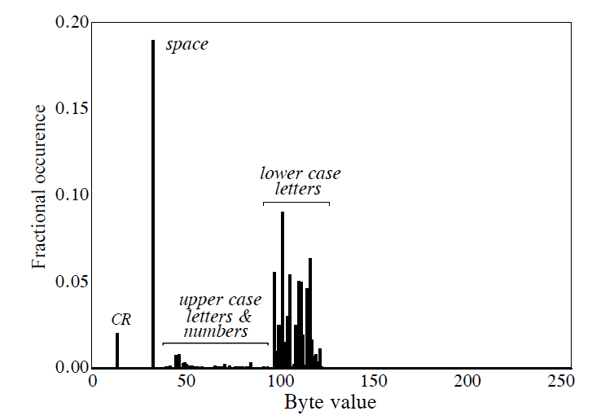
Huffman Encoding – The Basics
Example: more than 96% of file consists of 31 characters
Idea: Assign frequently used characters fewer bits
  31 common characters get 5b codes 00000--11110
  Rest get 13b: 11111+original 8b code
How many bits do we need on average per original byte?

Slide 27
Calculation
Bits = #5b-characters * 5 + #13b-character * 13
Bits=#bytes*0.96*5 + #bytes*0.04*13
Bits/original-byte = 0.96*5+0.04*13
Bits/original-byte = 5.32

Slide 28
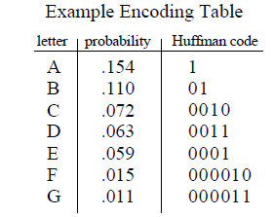
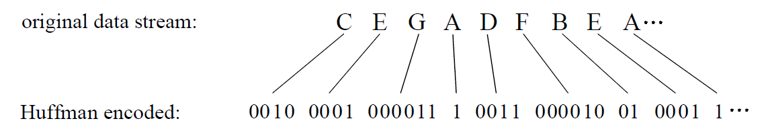
Huffman Encoding – More Advanced
Huffman goes further: Assign MOST used characters least # of bits:
  Most frequent: A= 1, least frequent: G=00011, etc.
  Example:

Slide 29
Preclass Encoding
symbol | encode | occur
(space) | 00 | 15
A | 1110
B | 100100
C | 100101
D | 10110
E | 110 | 11
F | 011010
G | 011011
H | 011000
I | 0111
symbol | encode | occur
L | 0100
M | 1111
N | 1010
O | 10011
R | 0101
T | 10111
V | 10000
Y | 011001
, | 10001

Slide 30
Preclass Encoding
symbol | encode | occur
(space) | 00 | 15
A | 1110 | 6
B | 100100
C | 100101
D | 10110
E | 110 | 11
F | 011010
G | 011011
H | 011000
I | 0111 | 4
symbol | encode | occur
L | 0100 | 4
M | 1111 | 6
N | 1010 | 5
O | 10011
R | 0101 | 4
T | 10111
V | 10000
Y | 011001
, | 10001

Slide 31
Preclass Encoding
symbol | encode | occur
(space) | 00 | 15
A | 1110 | 6
B | 100100
C | 100101
D | 10110 | 3
E | 110 | 11
F | 011010
G | 011011
H | 011000
I | 0111 | 4
symbol | encode | occur
L | 0100 | 4
M | 1111 | 6
N | 1010 | 5
O | 10011 | 2
R | 0101 | 4
T | 10111 | 3
V | 10000 | 2
Y | 011001
, | 10001 | 2

Slide 32
Preclass Encoding
symbol | encode | occur
(space) | 00 | 15
A | 1110 | 6
B | 100100 | 1
C | 100101 | 1
D | 10110 | 3
E | 110 | 11
F | 011010 | 1
G | 011011 | 1
H | 011000 | 1
I | 0111 | 4
symbol | encode | occur
L | 0100 | 4
M | 1111 | 6
N | 1010 | 5
O | 10011 | 2
R | 0101 | 4
T | 10111 | 3
V | 10000 | 2
Y | 011001 | 1
, | 10001 | 2
See how variable length encoding saved bits?
Questions?

Slide 33
Preclass Encoding
Prefix decodable on tree

Slide 34
Preclass Encoding
Prefix decodable on tree
    Cannot have 4 length 2 codes and longer codes
    Each length 2 code consumes 25% of code space
    Each length n code consumes 2^{-n} of space
    Having some short codes means some things get longer encodings

Slide 35
Prefix Decodable
Consider small 4 symbol case
  Uniform 2b each
  Can give one symbol 1b code: say 0
  But then must code remaining 3 cases start with 1
    3 cases left – need at least 2 more bits for some to differentiate

Slide 36
Preclass Encoding
Probability, encoding, length

Slide 37
Interlude

Slide 38
Interlude
SNL – 5 minute University
  Father Guido Sarducci
https://www.youtube.com/watch?v=kO8x8eoU3L4
What form of compression here?

Slide 39
For Computer Engineering?
Make the common case fast
Make the frequent case small

Slide 40
Part 2

Slide 41
Common Case
Big idea in optimization engineering
  Make the common case inexpensive
Shows up throughout computer systems
  Computer architecture
    Caching, instruction selection, branch prediction, …
  Networking and communication, data storage
    Compression, error-correction/retransmission
  Algorithms and software optimization
  User Interfaces
    Where things live on menus, shortcuts, …
    How you organize your apps on screens

Slide 42
Entropy
Is there a lower bound for compression?

Slide 43
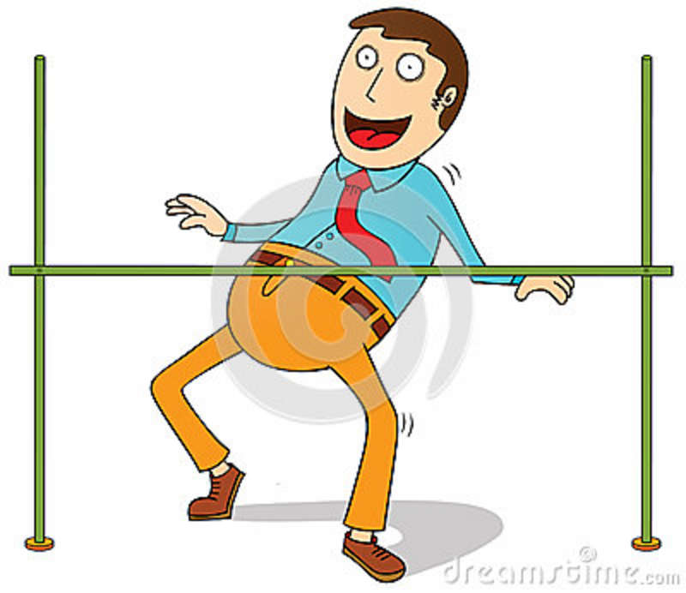
How low can we go with compression?
What is the least # of bits required to encode information?

Slide 44
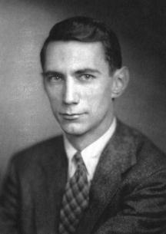
Claude Shannon
Father of Information Theory, brilliant mathematician
While at AT&T Bell Labs, landmark paper in 1948
Determined exactly how low we can go with compression!

Slide 45
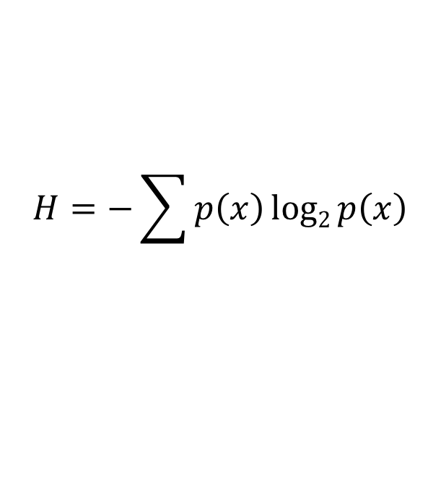
Shannon’s Entropy
What is entropy?
  Chaos/Disorganization/Randomness/Uncertainty
Shannon’s Famous Entropy Formula:
$$H=−\sum{p\left(x\right)log2{p\left(x\right)}}$$
Shannon’s
Entropy
(measured in bits)
Probability of each outcome
X
log₂ of (probability of each outcome)
Negative Sum Of:

Slide 46
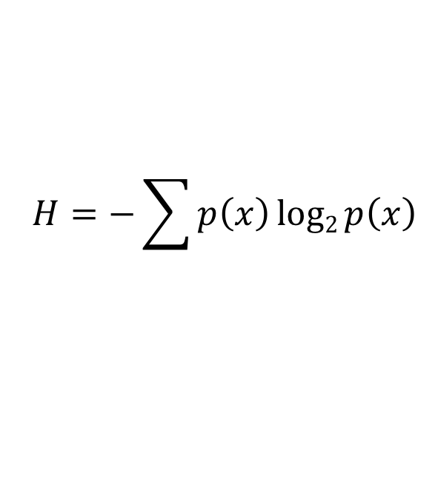

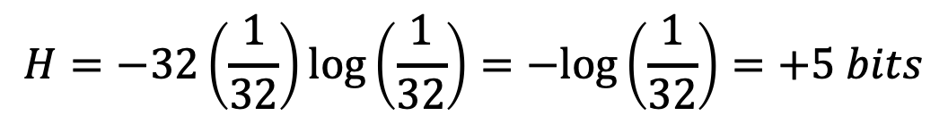
Estimating Entropy of English Language
Example: 32 Characters
If we assume all characters are equally probable:
$p\left(each character\right)=\frac{1}{32}$
Information Entropy per character:
$$H=−\sum{p\left(x\right)log2{p\left(x\right)}}$$
$$H=−32\left(\frac{1}{32}\right)\log\left(\frac{1}{32}\right)=−log\left(\frac{1}{32}\right)=+5 bits$$
Same thing we got when we said we needed log₂(unique_things) bits

Slide 47
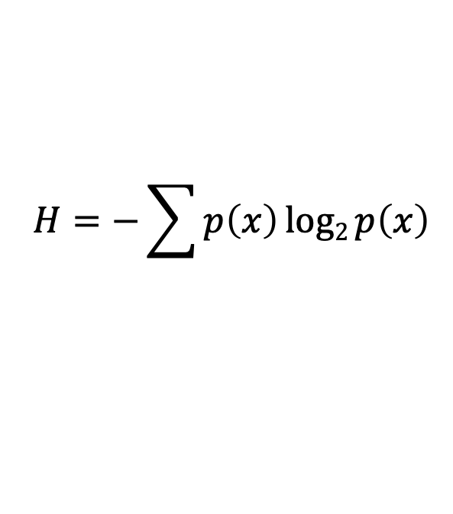

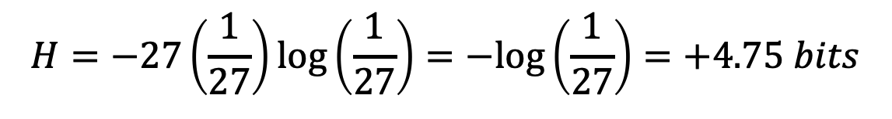
Estimating Entropy of English Language
27 Characters (26 letters + space)
If we assume all characters are equally probable:
$p\left(each character\right)=\frac{1}{27}$
Information Entropy per character:
$$H=−\sum{p\left(x\right)log2{p\left(x\right)}}$$
$$H=−27\left(\frac{1}{27}\right)\log\left(\frac{1}{27}\right)=−log\left(\frac{1}{27}\right)=+4.75 bits$$
Same thing we got when we said we needed log₂(unique_things) bits

Slide 48
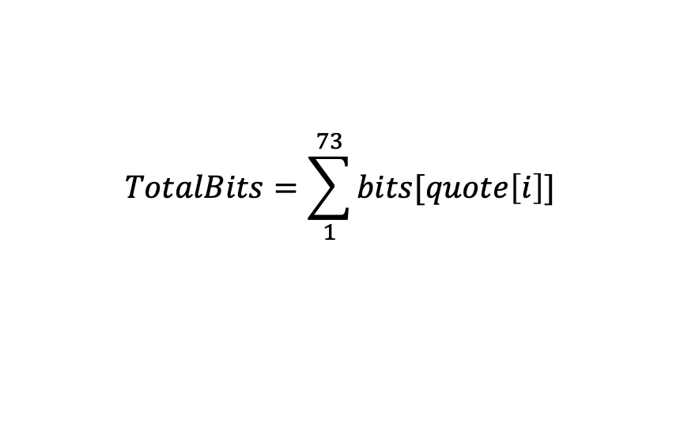
Preclass 5c
Computed total bits as sum of bits
Per character
  Divide by total characters
  Group by same symbols
  p_{i} = #occurrences/total_characters
$$TotalBits=\sum_{1}^{73}{bits[quote\left[i\right]]}$$

Slide 49
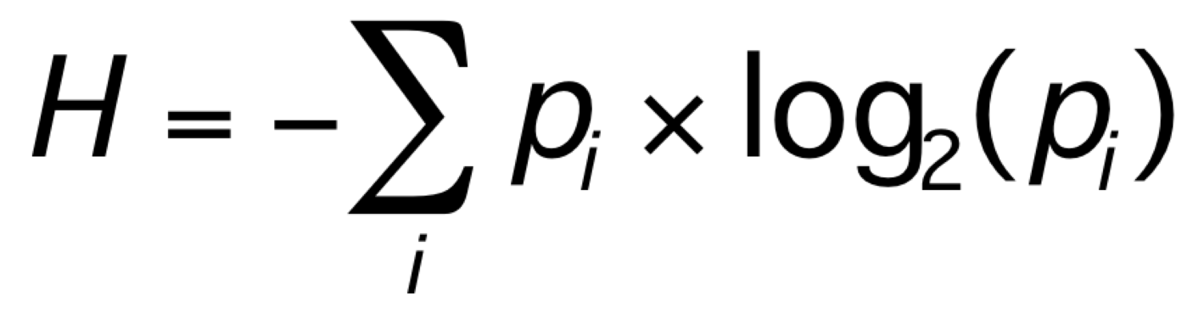
Shannon Entropy
Essentially says
  Should be able to encode symbol with log(1/p) bits

Slide 50
Recall:
Not all letters are equally probable
in English Language
http://en.wikipedia.org/wiki/File:English-slf.png
Notes:
50

Slide 51
Shannon Entropy English Letters
letter | p | -log₂(p) | -p*log₂(p)
a | 8.17% | 3.61 | 0.30
b | 1.49% | 6.07 | 0.09
c | 2.78% | 5.17 | 0.14
d | 4.25% | 4.56 | 0.19
e | 12.70% | 2.98 | 0.38
f | 2.23% | 5.49 | 0.12
z | 0.07% | 10.40 | 0.01
sum | 100.00% |  | 4.18

Slide 52
Shannon Entropy Preclass Quote
Symbol | Bits | Occur | P | -log₂(p) | -p*log₂(p) | p*bits
(space) | 2 | 15 | 0.21 | 2.28 | 0.47 | 0.41
A | 4 | 6 | 0.08 | 3.60 | 0.30 | 0.33
B | 6 | 1 | 0.01 | 6.19 | 0.08 | 0.08
C | 6 | 1 | 0.01 | 6.19 | 0.08 | 0.08
D | 5 | 3 | 0.04 | 4.60 | 0.19 | 0.21
E | 3 | 11 | 0.15 | 2.73 | 0.41 | 0.45
, | 5 | 2 | 0.03 | 5.19 | 0.14 | 0.14
 |  |  |  | sum | 3.74 | 3.77

Slide 53
Encoding Target
Right bits target is:
  Bits(i) = -log₂(p_{i})
  2^{-Bits(i)}= p_{i}
Symbol should take up fraction of encoding space matching probability of occurrence

Slide 54
Preclass Encoding
Probability, encoding, length

Slide 55
Summing it up: Shannon & Compression
Shannon’s Entropy represents a lower limit for lossless data compression
  It tells us the minimum number of bits that can be used to encode a message without loss (according to a particular model)
Shannon’s Source Coding Theorem:
  A lossless data compression algorithm cannot compress messages to have (on average) more than 1 bit of Shannon’s Entropy per bit of encoded message

Slide 56
Learn More
ESE 3010– Probability
  Central to understanding probabilities
    What cases are common and how common they are
ESE 6740 – Information Theory
Most all computer engineering courses
  Deal with common-case optimizations
  CIS2400, CIS4710, CIS3800, ESE4070, ….

Slide 57
Big Ideas
Lossless Compression
  Exploit non-uniform statistics of data
  Given short encoding to most common items
Common Case
  Make the common case inexpensive
Shannon’s Entropy
  Gives us a formal tool to define lower bound for compressibility of data

Slide 58
Monday in Lab
Implement Compression!
  Implement Huffman Compression
  Note: longer prelab with MATLAB intro; plan accordingly
    Budget a few hours
Remember
  Feedback

Slide 59
References
S. Smith, “The Scientists and Engineer’s Guide to Digital Signal Processing,” 1997.
Shannon’s Entropy (excellent video) http://www.youtube.com/watch?v=JnJq3Py0dyM
  Used heavily in the creation of entropy slides

