Slide 1
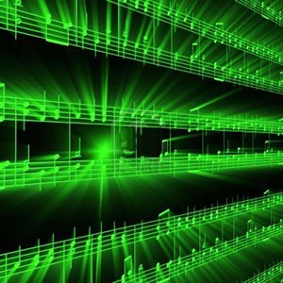


Lecture #11 – Psychoacoustic Model/Compression/MP3
ESE 1500 –
Digital Audio Basics
Based on slides © 2009—2023 DeHon, Koditschek
Additional Material © 2014 Farmer

Slide 2
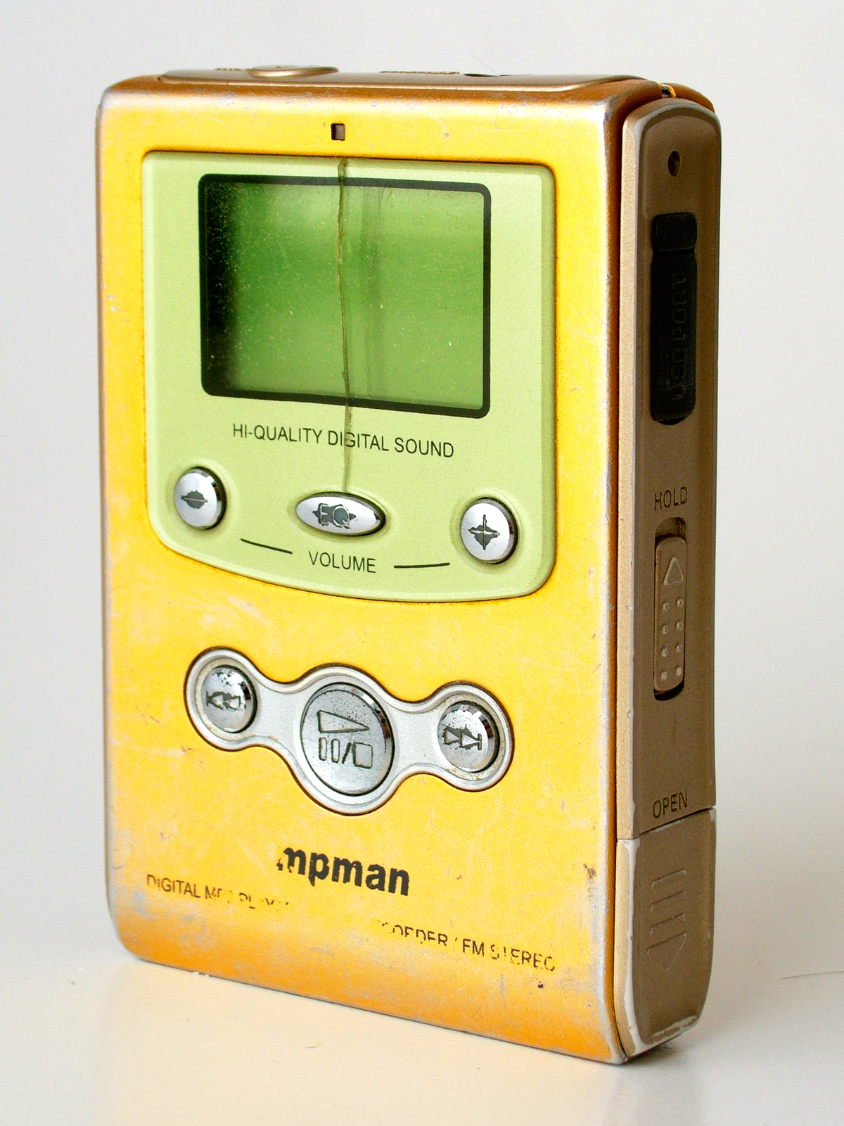
First MP3 Player
MpMan -- 1998
SaeHan Information Systems
  South Korea
32MB of Flash memory

Slide 3
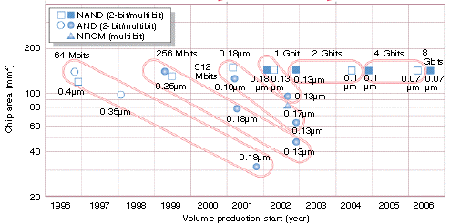
Flash Scaling

Slide 4
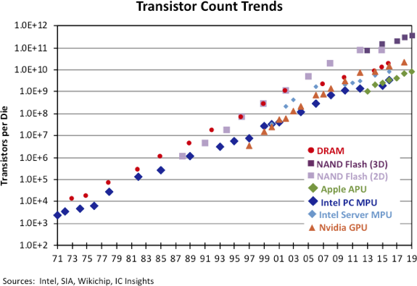
Flash Scaling
https://www.icinsights.com/news/bulletins/Transistor-Count-Trends-Continue-To-Track-With-Moores-Law/

Slide 5

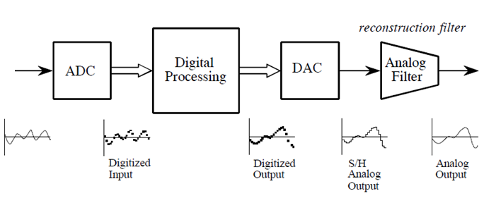
PCM and CD Audio
antialias filter
reconstruction filter
PCM – Pulse Code Modulation
  CD-Quality Audio – state-of-the-art 1990s
    Filtering/Sampling/Quantizing/Encoding using ADC
    DAC/Reconstruction Filter
  CD Quality Digital Audio uses PCM (uncompressed, lots of storage!)
    44,100 samples per second, each sample 16-bits
    1 sec. of music: 44,100 x 16bits = 705,600 bits or 86 kB
    60 seconds of music: 705,600 x 60 = 42,336,000 bits = 5167 kB = 5 MB
    3 minute song: 42,336,000 x 3 = 127,008,000 bits = 15 MB !
    You want it in stereo??? 15 MB x 2 = 30 MB! (no compression!)

Slide 6
Observe
If we kept the CD Audio encoding format
  Could hold one song on the 1998 MpMan
  (maybe 2 on the 64MB version)
For solid-state audio to be viable
  Needed more compact encoding for music

Slide 7
First MP3 Player
MpMan -- 1998
SaeHan Information Systems
  South Korea
32MB of Flash memory
Held 6 songs (MP3)
(12 on 64MB version)
3 years before Apple iPod
  October 2001
  Initially hard disk
Diamond Rio later 1998

Slide 8
Lecture Topics
Teaser
Where are we?
Preclass
How do we take advantage of psychoacoustics in MP3
Achieve this 6—12x reduction from CD Audio
  Review Tricks
  Formulate Optimization
  Adaptation (Monday 3/13)
Next Lab
References

Slide 9






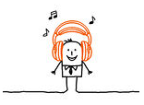

Course Map – Week 7
MIC
A/D
10101001101
Music
1
domain
conversion
5,6
Numbers correspond to course weeks
compress
sample
freq
pyscho-
acoustics
3
2
4
EULA
----------------click
OK
D/A
10101001101
speaker
MP3 Player / iPhone / Droid

Slide 10
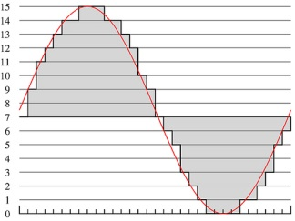
What we did in Lab…
Analog
input
ADC
Digital
Output
compress
Week 1: Converted analog sound to Digital
  Sample: Break up independent variable, take discrete ‘samples’
  Quantize: Break up dependent variable into n-levels (need 2^{n} bits to digitize)
Week 2: Reconstructed analog sound from Digital
Week 3: Compress digital signal
  Use even less bits without using sound quality!
Week 4: Before we compress…
  Put our ‘digital’ data into another form…BEFORE we compress…less stuff to compress!
Week 5: Psychoacoustics
  Measured limits of human hearing; measured masking

Slide 11
Compare to Lab
Lab 6
  Capture spirit of reducing frequencies
  Simplified – only taking loudest fraction in each band
    Rather than being rigorous about masking
    Or trying to hit some fixed rate
Lecture 11 & 12 (this week and after spring break)
  Help understand more what real MP3 encoding looks like
  Thinking about fixed rate
    And adaptation for variable rate encoding from Huffman
  Formulating masking more explicitly
    But still simplistic
  Illustrating Optimization Approaches

Slide 12
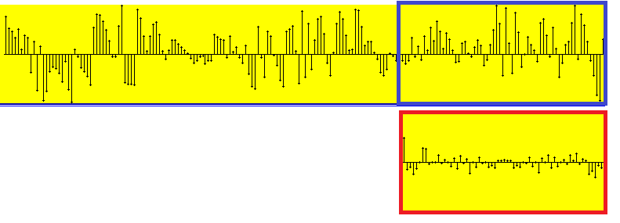
MP3 Encoding Process
All MP3 files broken into “Frames”
  Each frame stores 1152 Audio Samples
  Lasts for 26 ms
  Frame also divided further into 2 “granuels”
    Each granuel contains 576 samples
Time
Freq

Slide 13
Preclass

Slide 14
Preclass 1
44,300 samples/s
16b
26ms window
a) How many bits?
128Kb/s stereo → 64Kb/s per audio channel
b) How many bits per 26ms window?
c) ratio?

Slide 15
Preclass 2
16b amplitude
1704b budget
Quantize frequency
How many quantized frequencies?
Conclude: cannot keep all frequencies and hit budget

Slide 16
Preclass 3
576 frequencies
16b amplitude
1704b budget
(frequency,amplitude) pairs to represent
How many frequencies can we keep?
Conclude: cannot keep all frequencies and hit budget

Slide 17
Preclass 4
576 frequencies
1704b budget
(frequency,amplitude) pairs to represent
24 human critical bands
How many bits per band? (evenly divided)
Quantization required to keep 5 frequencies per band?
Conclude: can tradeoff frequencies and amplitude quantization

Slide 18
Tricks for Compression
Amplitude Quantization
Sampling Rate / Frequency Quantization
Critical Band Masking
  Selective frequency dropping

Slide 19
Background

Slide 20

The MPEG-1 Standard
ISO (International Standards Organization)
  Looking for ways to reduce transmission requirements for digital video and audio (low bandwidth transmission of digital media)
  1988 – establishes a sub-committee of ISO:
    Moving Picture Experts Group (MPEG)
    Goal: Develop common standard for coding/compressing audio/video
      To reduce size of data to transmit without sacrificing quality
      Fraunhofer Institute and German University of Erlangen
        Lots of basic research in Digital Audio Broadcast, tapped to be MPEG
  Result: 1992: Finalized Standard called: MPEG-1 (Phase I)
    3 Parts: Audio/Video/System
    Audio component: defined 3 layers: 1, 2, 3
      Increasing levels of compression and complexity
      MPEG-1, layer 3 achieves 12:1 compression ratio! (for short MP3)

Slide 21
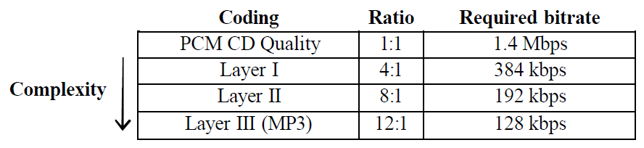
The MPEG-1 Standard
MPEG-1, (3) Layers for Audio Coding:
Why is PCM CD Quality 1.4 Mbps?
  Recall: 1 sec. of music: 44,100 x 16bits = 705,600 bits
  Don’t forget stereo (R/L): 2 x 706,600 = 1,413,200 (1.4Mbs)
    Defines bandwidth requirements of network
  Notice: 128 kbps was just about double modem speed in 1992
    Enables transmission of audio (MP3) via modem!

Slide 22
The MPEG-1 Standard
How did MP3 achieve a 12:1 compression ratio?
  Psychoacoustics was the key
    Becomes a scheme for lossy encoding
    But we don’t lose things human’s can actually here!
    Makes human a part of the “decompression” scheme
  CD Audio PCM is lossless coding of digital audio
    But human beings can’t hear all sounds
  MP3 Encoding is lossy coding scheme
    But we don’t lose things average human’s can actually here!
    We don’t sacrifice high frequencies (sampling rate preserved)
    The trick: drop quantization level when it doesn’t matter!
      The key is taking advantage of masking (frequency/temporal)
  MP3 Combines: Psychoacoustics (lossy compression)
    and Huffman coding (lossless compression)

Slide 23
They kept on going: MPEG-1, 2, 4, 7
MPEG is actually family of encoding standards for digital multimedia information
  They all use Psychoacoustics to achieve high compression
MPEG-1: a standard for storage and retrieval of moving pictures and audio on storage media (e.g., CD-ROM).
    MPEG-1 Layer 3: (MP3)
MPEG-2: standard for digital television, including high-definition television (HDTV), and for addressing multimedia applications.
    Advanced Audio Coding (AAC)
MPEG-4: a standard for multimedia applications, with very low bit-rate audio-visual compression for those channels with very limited bandwidths (e.g., wireless channels).
MPEG-7: a content representation standard for information search
Notes:
“.mp3”, originally the file extension created by Windows MPEG-1 Layer III encoder and decoder, has become the name for an entire line technology.
MPEG-3 is not MP3.
(Click)
In fact, I can’t find any MPEG-3. The standards go from MPEG-1 to MPEG-2 and jumps to MPEG-4, then MPEG-7.
(Click)
MPEG-1 Audio (ISO/IEC 11172-3)
provides single-channel ('mono') and two-channel ('stereo' or 'dual mono') coding at 32, 44.1, and 48 kHz sampling rate.
MPEG-2 Audio (ISO/IEC 13818-3)
provides a backwards compatible multi-channel extension to MPEG-1; up to 5 main channels plus a 'low frequent enhancement' (LFE) channel can be coded.
MPEG-2 AAC (ISO/IEC 13818-7)
Provides a very high-quality audio coding standard for 1 to 48 channels at sampling rates of 8 to 96 kHz, with multi-channel, multi-lingual, and multi-program capabilities.
MPEG-4 Audio (ISO/IEC 14496-3)
Provides coding and composition of natural and synthetic audio objects at a very wide range of bit rates.
MPEG-7
Nowadays, more and more audiovisual information is available, from many sources around the world. Also, there are people who want to use this audiovisual information for various purposes. However, before the information can be used, it must be located. MPEG-7 will be a standardized description of various types of multimedia information. This description will be associated with the content itself, to allow fast and efficient searching for material that is of interest to the user. MPEG-7 is formally called ‘Multimedia Content Description Interface’.

Slide 24
Some Knowledge of Digital Audio Formats
.WAV & .AIFF
  Uncompressed PCM (lossless) CD-Audio Quality
.MPA
  MPEG-1 Layer 2
  Compressed PCM using Psychoacoustics (lossy)
.MP3
  MPEG-1 Layer 3
  Compressed PCM using Psychoacoustics (lossy)
.M4A (Audio only Apple’s iTunes format)
  MPEG-4 Part 14 (MP4)
  Compressed PCM using Psychoacoustics

Slide 25
Some Terminology
Psychoacoustics
  Research into how brain interprets sounds from ear
Perceptual Coding
  An audio encoding technique that takes advantage of psychoacoustics
  CD delivers all recorded sounds to your ear…
    …but your brain can’t actually interpret them
  Perceptual coded audio delivers sounds to your ear…
    …that your brain can actually interpret!
CODEC
  Coder/Decoder
MP3 is a standard for a perceptual audio codec…
  That takes advantage of frequency/time masking to encode audio data!

Slide 26
Big Picture: Why Care
MP3 shows
  We can reduce bits needed to adequately represent music by 12x over PCM samples
1998
  Necessary to make MP3 player viable at all on 32MB Flash memory
    Small, affordable by masses
  Also meant lower bandwidth to stream
2006
  Necessary to make Spotify streaming viable
2023
  With 256GB phones, maybe not essential for music on iPhone, but…

Slide 27
Big Picture: Why Care
Networks / Internet bandwidth / Cell capacity
  Allows us to reduce bandwidth needed for audio
  Alternative is
    Building out more wires and capacity
    Fewer cell calls supported simultaneously in a region
  Being efficient with bits
    Reduces physical investment needed in wires
Same ideas enable video
  Viable to store (many) hours of video on phone/tablet
    Of increasing resolution: HD, 4K….
  Viable to stream video into homes
  Zoom, Netflix, Disney+, AppleTV, … all enabled by compression

Slide 28
Midterm – Wednesday in lecture
Closed book, notes
Calculators allowed
50 minutes
  Same as last year
  Shorter than previous years
5% of grade
  prepare for final
Last 5 year’s midterm and answers
  On 2022 syllabus
    like this year
    (50 minutes, closed book)
  on 2018, 2019, 2020 syllabus
    Were all in-person, closed book (75 minutes)
  2021 was online, open book, also on syllabus
    (120 minutes)
Topics
Data representation in bits
Sounds waves
Sampling
Quantization
Nyquist
Lossy/lossless compression
Common case
Time and Frequency domain
Psychoacoustics
Perceptual coding

Slide 29
Optimizing Encoding
Part 2

Slide 30
Goal
Fit in bit budget
Maximize quality of sound

Slide 31
Knobs we can turn
Amplitude quantization
Frequency quantization
Frequencies kept (per critical band)
  Too soft
  Masked
…and can perform lossless compression

Slide 32
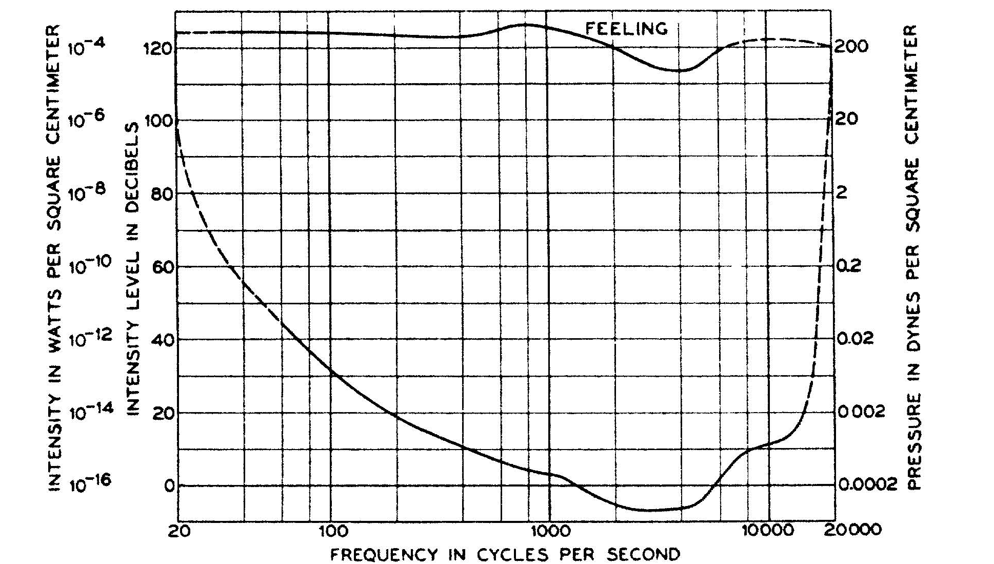
Bands vary in importance
Not equally sensitive across bands
If quantize bands
differently, where
want finer
resolution?
Where tolerate more
quantization?

Slide 33
Knobs we can turn
Amplitude quantization
  Per band
Frequency quantization
  Per band?
Frequencies kept (per critical band)
  Per band
…and can perform lossless compression

Slide 34
Quantifying Bit cost
Fixed frequencies per Band:
  Bands × (Frequencies/Band) × Bits/freq

Slide 35
Preclass 5
Bits if only have 1 non-masked, non-zero frequency in a critical band?
Conclude: given fixed band allocation, some bands won’t use all their bits

Slide 36
Opportunities/Challenges
Trying to hit fixed bit rate, what challenge does lossless compression impose?
  Encounter many common frequencies, amplitudes?
  Encounter many uncommon frequencies, amplitudes?
  Hint: what did we see in Lab 3 for time samples?

Slide 37
Suggest
May want to do something smarter than
  Allocating fixed number of frequencies per band
  Allocating fixed quantization to a band
Like to adapt our encoding to the data
  If more Huffman compressible, we get more frequencies
  If fewer frequencies suffice for one band,
    Allow more frequencies for another
    …or allocate less quantization

Slide 38
Optimization Problem
How fit in the resource constraints (128Kb/s) while maximizing goodness (sound quality)?
  128K/s * 0.026 s = 3408 bits per 26ms frame
  3408/2 = 1704b per stereo channel

Slide 39
Optimization Problem
How fit in the resource constraints (128Kb/s) while maximizing goodness (sound quality)?
  128K/s * 0.026 s = 3408 bits per 26ms frame
  3408/2 = 1704b per stereo channel
Optimization problems central to engineering

Slide 40
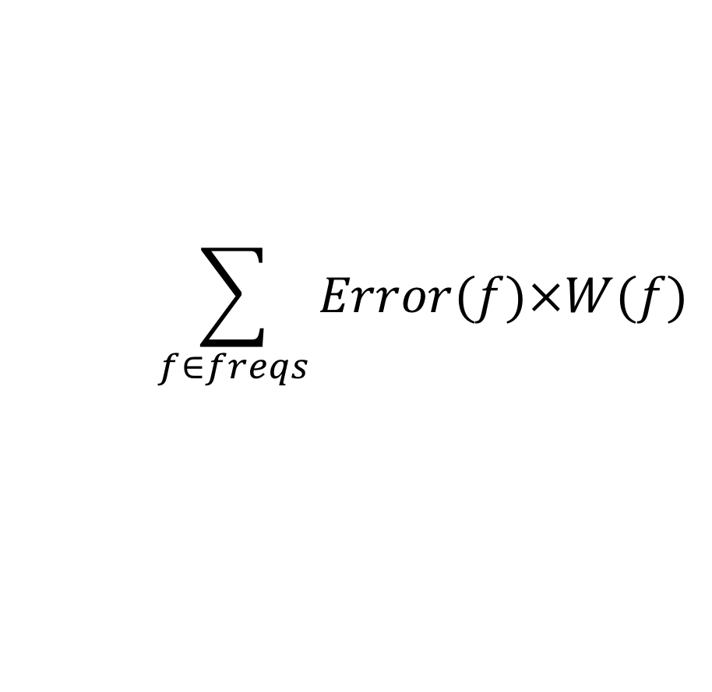
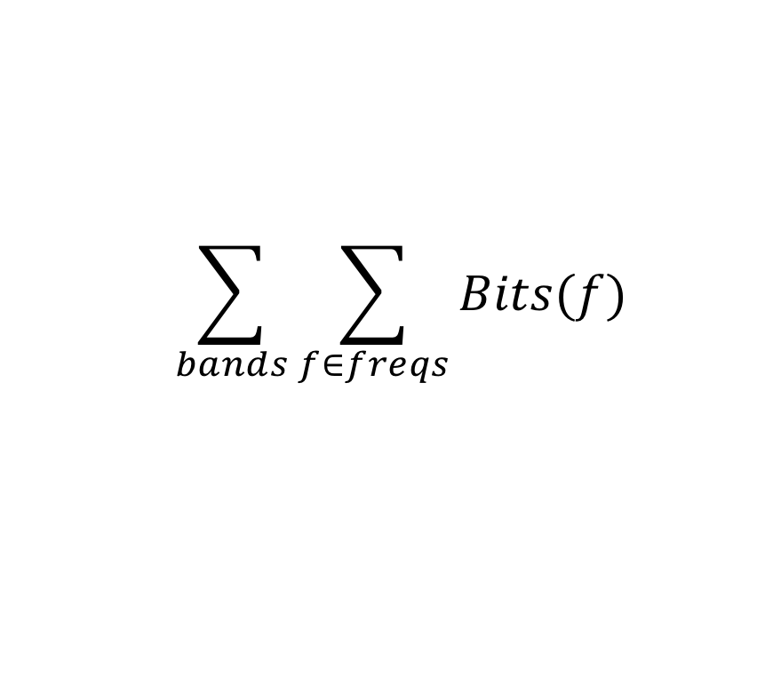
Optimization Problem
How fit in the resource constraints (128Kb/s = 3408 bits/frame) while maximizing goodness (sound quality)?
Quantify bits used
Quantify quality
$$\sum_{bands}{\sum_{f∈freqs}{Bits(f)}}$$
$$\sum_{f∈freqs}{Error(f)×W(f)}$$

Slide 41
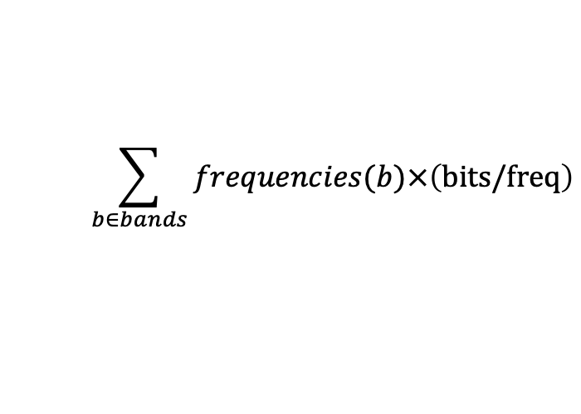
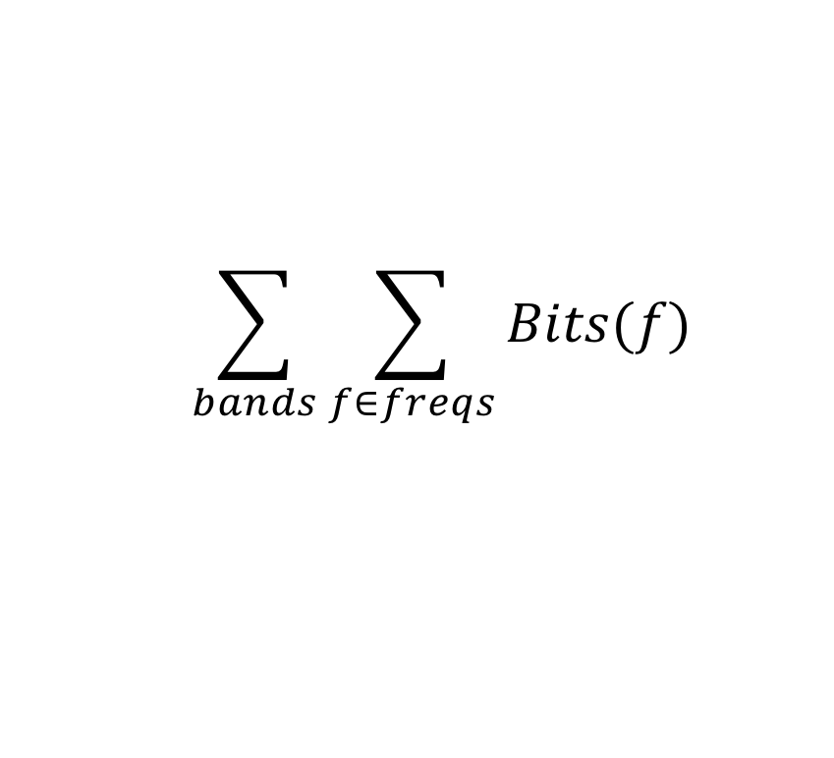
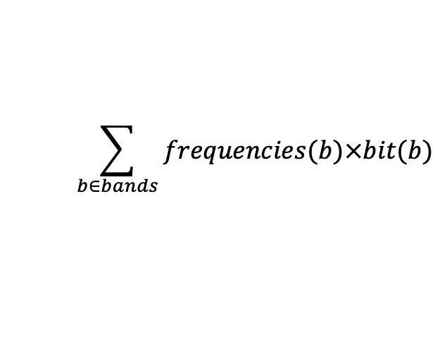
Quantifying Bit cost
Fixed frequencies per Band:
  Bands × (Frequencies/Band) × Bits/freq
Variable Frequencies per Band:
Variable Frequencies and quantization per Band:
Huffman means different
bits/frequency
$$\sum_{b∈bands}{frequencies(b)×\left(bits/freq\right)}$$
$$\sum_{b∈bands}{frequencies(b)×bit(b)}$$
$$\sum_{bands}{\sum_{f∈freqs}{Bits(f)}}$$

Slide 42
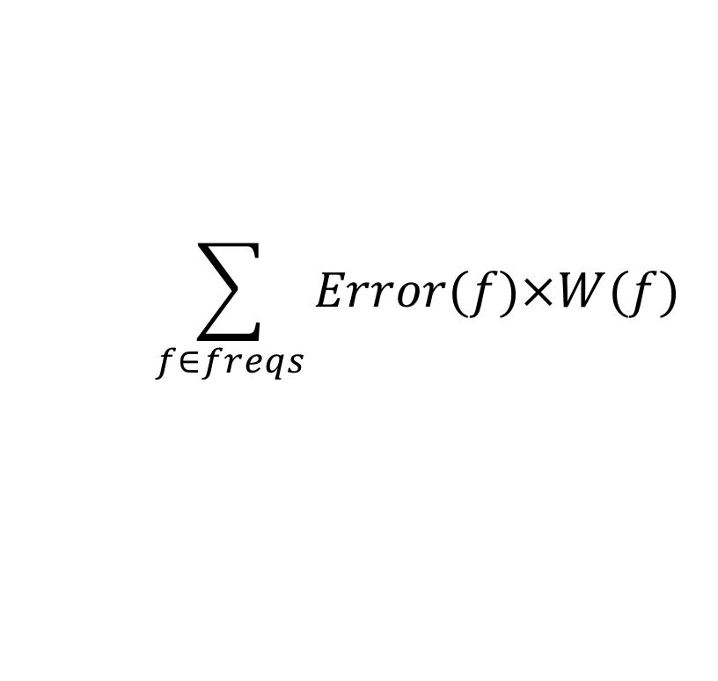
Goodness/Sound Quality
Error(Amp) = |Orig Amplitude – Encoded|
  Whole OrigAmplitude if dropped
  |Orig Amplitude-Quantize(OrigAmplitude,bits)| if quantized
W(freq)
  0 if below hearing threshold
  0 if masked
  Value between 0 and 5 if partially masked in critical band
    More critical bands, higher
  Really depend on what
  already encoded
$$\sum_{f∈freqs}{Error(f)×W(f)}$$

Slide 43
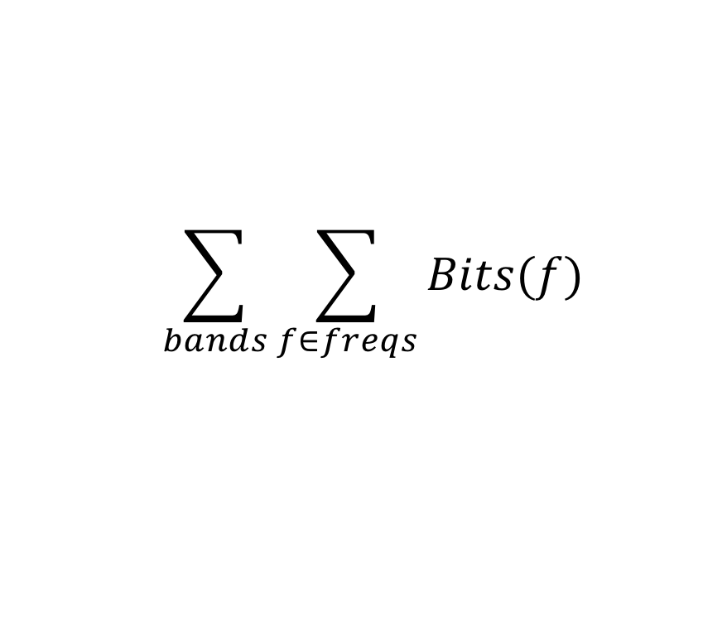
Optimization Problem
How fit in the resource constraints (128Kb/s) while maximizing goodness (sound quality)?
Quantify bits used:
  Cannot exceed 128Kb/s
  = 3,408 b / 26ms frame
Quantify goodness: minimize
$$\sum_{bands}{\sum_{f∈freqs}{Bits(f)}}$$
$$\sum_{f∈freqs}{Error(f)×W(f)}$$

Slide 44
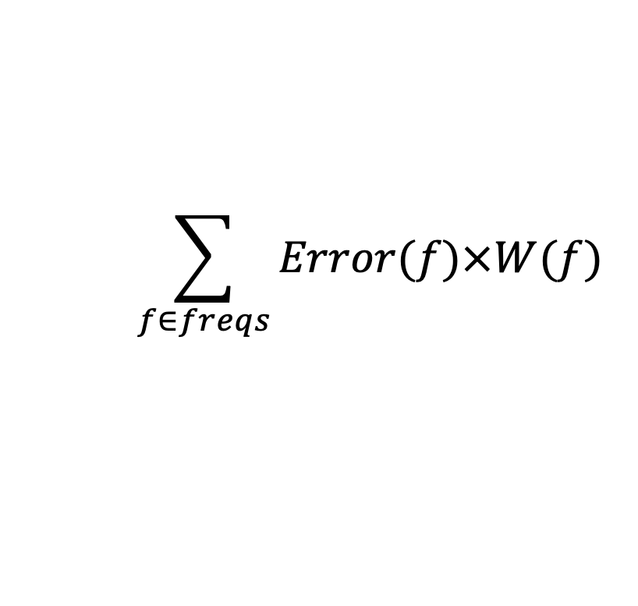
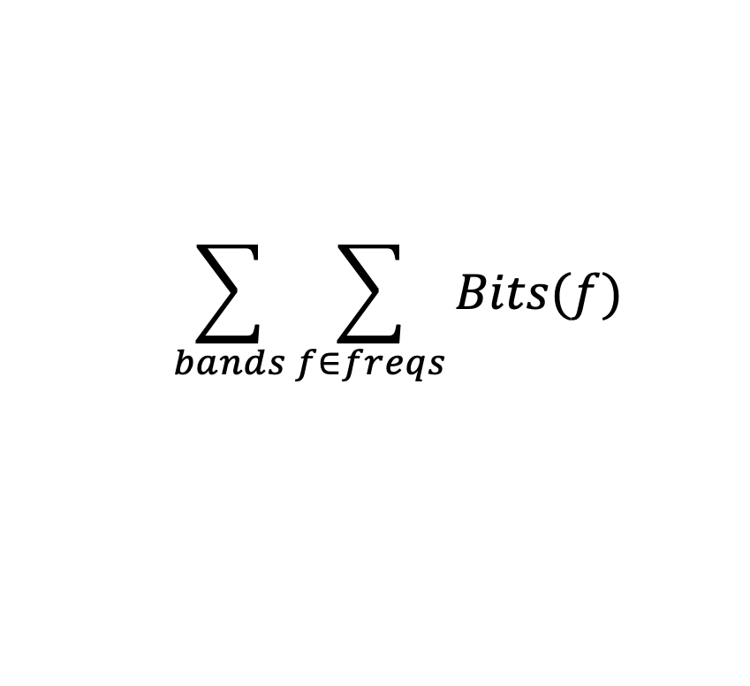
Problem Formulation
How fit in the resource constraints (128Kb/s) while maximizing goodness (sound quality)?
Quantify bits used:
  Cannot exceed 128Kb/s
  = 3,408 b / 26ms frame
Quantify goodness: minimize
$$\sum_{bands}{\sum_{f∈freqs}{Bits(f)}}$$
$$\sum_{f∈freqs}{Error(f)×W(f)}$$

Slide 45
Formulation vs. Solution
Formulation – goal – formally what want to achieve
  Today’s focus
Solution – how go about solving it
  How achieve (minimize) constraints (costs) in formulation
  More lecture 12 (Monday 3/13)

Slide 46
Approach
(as time permits)

Slide 47
Example
Simplified example with 4 critical bands

Slide 48
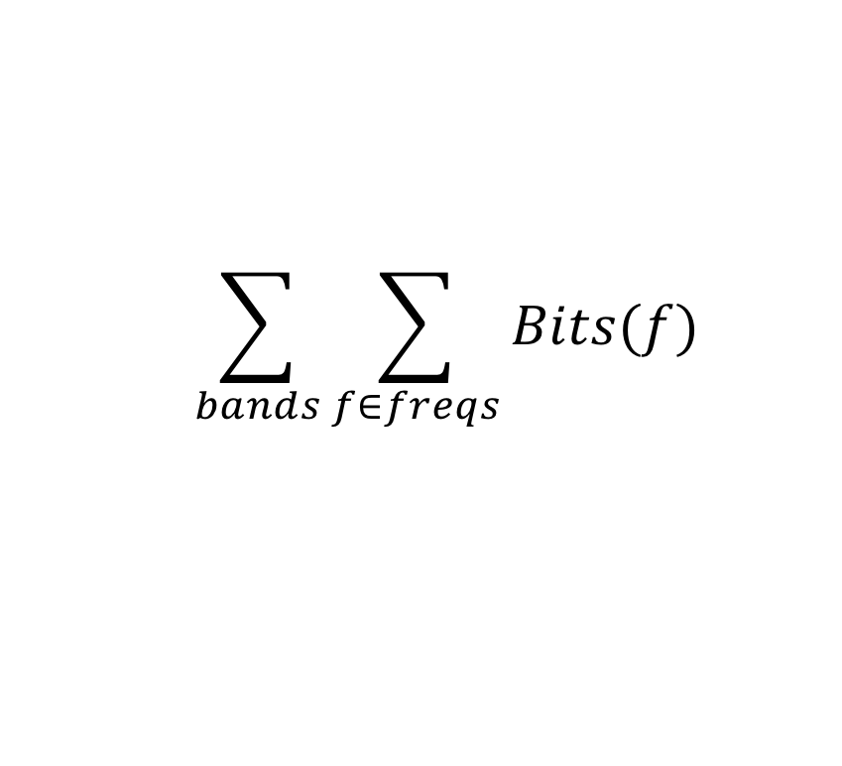
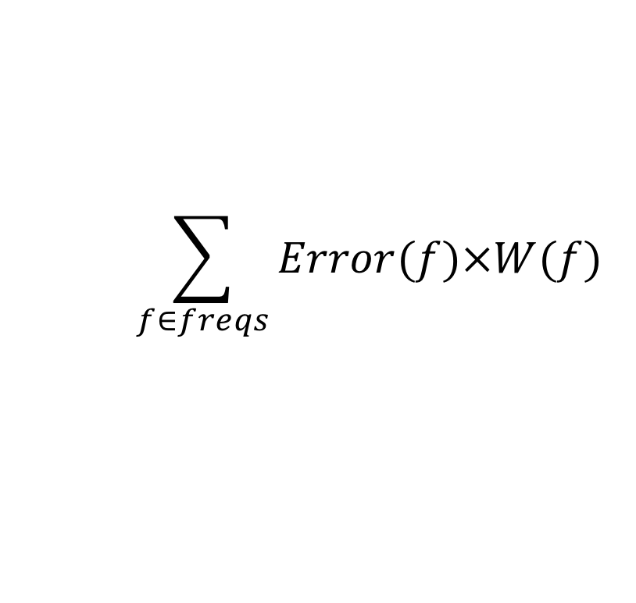
Approach
$$\sum_{bands}{\sum_{f∈freqs}{Bits(f)}}$$
Start with nothing
Start with bitbudget
Incremental moves
to improve
$$\sum_{f∈freqs}{Error(f)×W(f)}$$

Slide 49
Moves
Select a frequency to encode
  Main example today
Assign more bits to a band for quantization

Slide 50
Example Weight Function W(f)
W(f)=CBWeight*Mask
Mask = 0 if MaxAmp-FreqAmp>3
  1 otherwise

Slide 51
Greedy Incremental Frequency Selection
Start with nothing encoded
Start with bits=0
While (bits<bitbudget)
  Identify frequency with maximum current error
  Identify bits required to encode frequency (encode_bits)
  If (bits+encode_bits<bitbudget)
    Add frequency to encoding
    Update bits (bits+=encode_bits)
  Else break

Slide 52
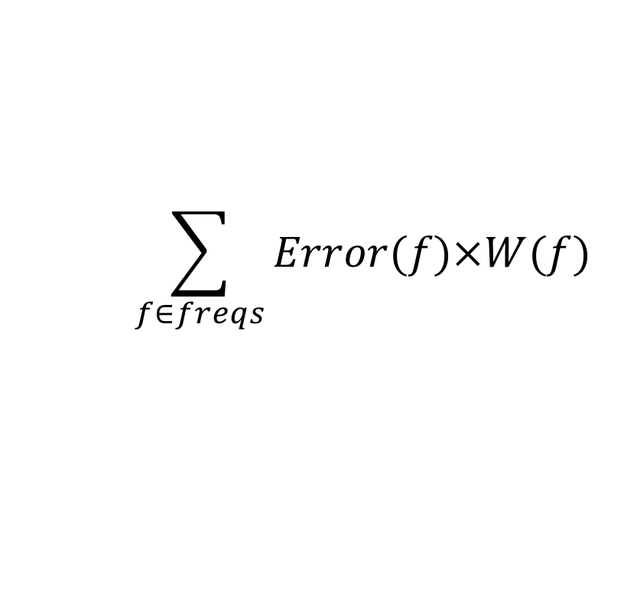
Approach
$$\sum_{bands}{\sum_{f∈freqs}{Bits(f)}}$$
Start with nothing
Start with bitbudget
$$\sum_{f∈freqs}{Error(f)×W(f)}$$
Bits = 0
Error = 190

Slide 53
Approach
$$\sum_{bands}{\sum_{f∈freqs}{Bits(f)}}$$
Start with nothing
Start with bitbudget
While(bitbudget>0)
  Identify Largest Error component: Error(freq)×W(freq)
  What do to reduce error?
$$\sum_{f∈freqs}{Error(f)×W(f)}$$
Bits = 0
Error = 190

Slide 54
Approach
$$\sum_{bands}{\sum_{f∈freqs}{Bits(f)}}$$
Start with nothing
Start with bitbudget
$$\sum_{f∈freqs}{Error(f)×W(f)}$$
Assume 8 levels
Bits = 3+6=9
Error = 125

Slide 55
Approach
$$\sum_{bands}{\sum_{f∈freqs}{Bits(f)}}$$
Start with nothing
Start with bitbudget
While(bitbudget>0)
  Identify Largest Error component: Error(freq)×W(freq)
  What do to reduce error?
$$\sum_{f∈freqs}{Error(f)×W(f)}$$

Slide 56
Approach
$$\sum_{bands}{\sum_{f∈freqs}{Bits(f)}}$$
Start with nothing
Start with bitbudget
$$\sum_{f∈freqs}{Error(f)×W(f)}$$
Bits = 18
Error = 60

Slide 57
Approach
$$\sum_{bands}{\sum_{f∈freqs}{Bits(f)}}$$
Start with nothing
Start with bitbudget
While(bitbudget>0)
  Identify Largest Error component: Error(freq)×W(freq)
  What do to reduce error?
$$\sum_{f∈freqs}{Error(f)×W(f)}$$

Slide 58
Approach
$$\sum_{bands}{\sum_{f∈freqs}{Bits(f)}}$$
Start with nothing
Start with bitbudget
$$\sum_{f∈freqs}{Error(f)×W(f)}$$
Bits = 27
Error = 18

Slide 59
Next Time (Monday 3/13)
Continue to refine into algorithm / solution

Slide 60
Big Ideas
Can use pyschoacoustics to compress audio
  Eliminate portions of signal that human’s don’t notice
Optimization
  Identify Design Space (knobs)
  Identify Costs and Constraints
  Formulate quantitatively

Slide 61
Coming Up
Feedback including Lab
Lab 5 writeup today
Lab 6 start on today
  On syllabus
  Start of 2 week lab
    Simplified version compression algorithm
Midterm Wednesday

Slide 62
References
Tutorials on Psychoacoustic Coding (in increasing order of abstraction and generality)
  D. Pan, M. Inc, and I. L. Schaumburg. A tutorial on MPEG/audio compression. IEEE multimedia, 2(2):60–74, 1995.
  Nikil Jayant, James Johnston, and Robert Safranek. Signal compression based on models of human perception. Proceedings of the IEEE, 81(10):1385–1422, 1993.
  V. K. Goyal. Theoretical foundations of transform coding. IEEE Signal Processing Magazine, 18(5):9–21, 2001.
Lightweight Overview of MP3
  Rassol Raissi. The theory behind mp3. Technical report, MP3’ Tech, December 2002.
Scientific Basis of MP3 Coding Standard
  J. D. Johnston. Transform coding of audio signals using perceptual noise criteria. IEEE Journal on selected areas in communications, 6(2):314–323, 1988.

