Slide 1



Lecture #12 – Psychoacoustic Compression Algorithm
ESE 1500 –
Digital Audio Basics
Based on slides © 2009—2023 DeHon, Koditschek
Additional Material © 2014 Farmer

Slide 2
Lecture Topics
Review
Exploiting psychoacoustics in MP3
  Review Tricks
  Formulate Optimization
  Algorithm for Adaptation
    Basic (part 2)
    Refinements (part 3)
References

Slide 3
Review and Preclass Setup/Reminder

Slide 4
Knobs we can turn
Amplitude quantization
  Per band
Frequency quantization
  Per band
Frequencies kept
  Per band
…and can perform lossless compression

Slide 5
MP3 Encoding Process
All MP3 files broken into “Frames”
  Each frame stores 1152 Audio Samples
  Lasts for 26 ms
  Frame also divided further into 2 “granuels”
    Each granuel contains 576 samples

Slide 6
PCM → MP3
44,300 samples/s
16b
26ms window (frame)
→ 18,429 bits/frame
MP3: 128Kb/s stereo → 64Kb/s per audio channel
→ 1704 bits/frame

Slide 7
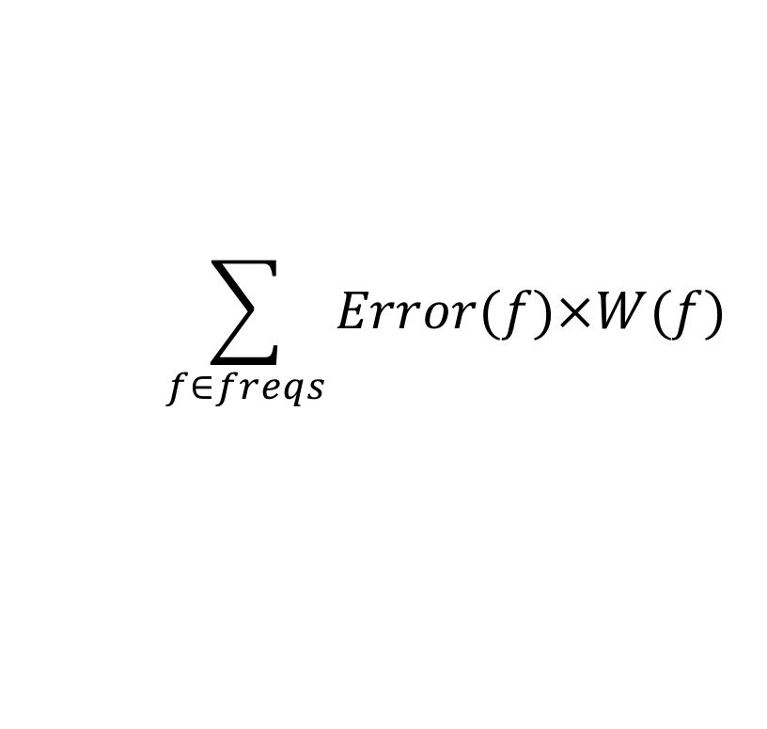
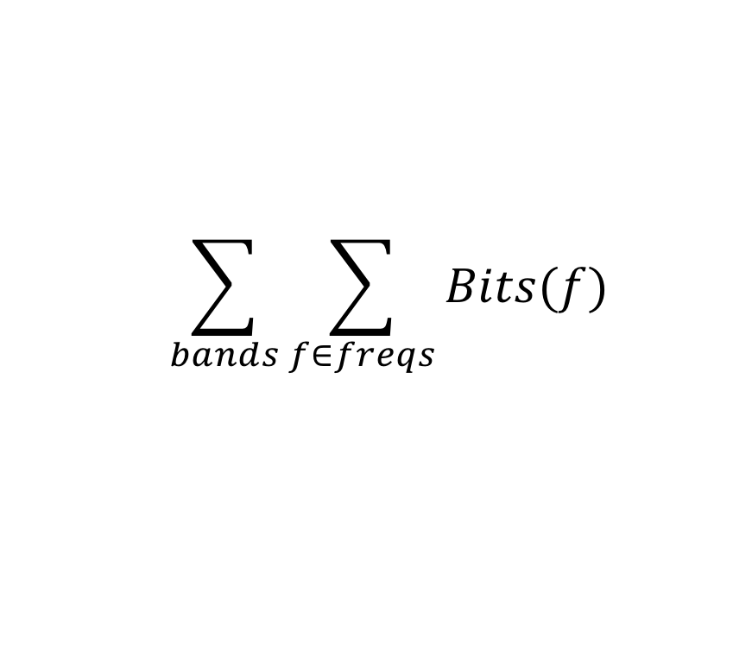
Optimization Problem
How fit in the resource constraints (128Kb/s) while maximizing goodness (sound quality)?
Quantify bits used:
  Cannot exceed 128Kb/s
  = 1,704 b / 26ms frame / channel
Quantify goodness: minimize
$$\sum_{bands}{\sum_{f∈freqs}{Bits(f)}}$$
$$\sum_{f∈freqs}{Error(f)×W(f)}$$

Slide 8
Seen
May want to do something smarter than
  Allocating fixed number of frequencies per band
  Allocating fixed quantization to a band
Like to adapt our encoding to the data
  If more Huffman compressible, we get more frequencies
  If fewer frequencies suffice for one band,
    Allow more frequencies for another
    …or allocate less quantization

Slide 9
Optimization Problem
How fit in the resource constraints (128Kb/s) while maximizing goodness (sound quality)?
Optimization problems central to engineering

Slide 10
Optimization Problem
How fit in the resource constraints (128Kb/s) while maximizing goodness (sound quality)?
Quantify bits used:
  Cannot exceed 128Kb/s
  = 1,704 b / 26ms frame / channel
Quantify goodness: minimize
$$\sum_{bands}{\sum_{f∈freqs}{Bits(f)}}$$
$$\sum_{f∈freqs}{Error(f)×W(f)}$$

Slide 11
Goodness/Sound Quality
Error(Amp) = |Orig Amplitude – Encoded|
  Whole OrigAmplitude if dropped
  |Orig Amplitude-Quantize(OrigAmplitude,bits)| if quantized
W(freq)
  0 if below hearing threshold
  0 if masked
  Value between 0 and 5 if partially masked in critical band
  Really depend on what
  already encoded
$$\sum_{f∈freqs}{Error(f)×W(f)}$$

Slide 12
Example Weight Function W(f)
W(f)=CBWeight*Mask
Mask = 0 if MaxAmp-FreqAmp>3
  1 otherwise

Slide 13
Basic Incremental Encoding Algorithm
Part 2

Slide 14
Example
Simplified example with 4 critical bands

Slide 15
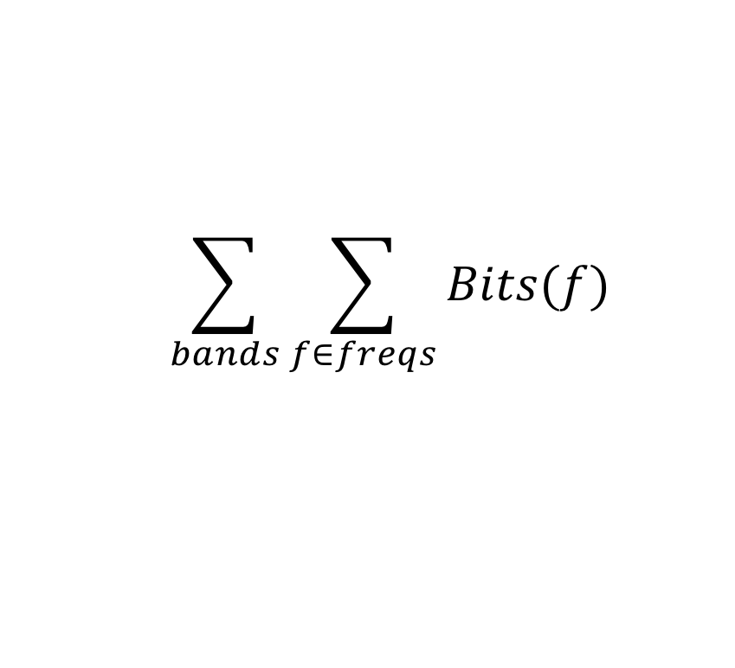
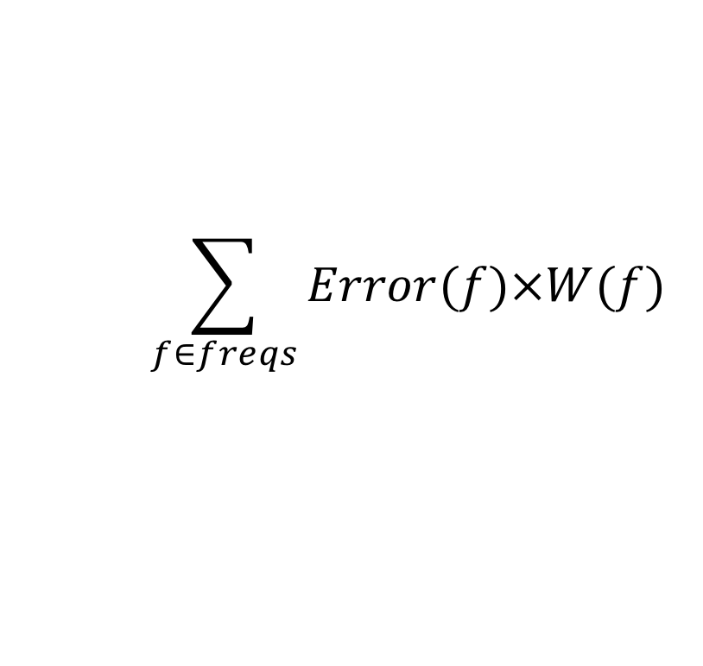
Approach
$$\sum_{bands}{\sum_{f∈freqs}{Bits(f)}}$$
Start with nothing
Start with bitbudget
Incremental moves
to improve
$$\sum_{f∈freqs}{Error(f)×W(f)}$$

Slide 16
Moves
Select a frequency to encode
  Look at first
Assign more bits to a band for quantization
  Add in second

Slide 17
Greedy Incremental Frequency Selection
Start with nothing encoded
Start with bits=0
While (bits<bitbudget)
  Identify frequency with maximum current error
  Identify bits required to encode frequency (encode_bits)
  If (bits+encode_bits<bitbudget)
    Add frequency to encoding
    Update bits (bits+=encode_bits)
  Else break

Slide 18
Approach
$$\sum_{bands}{\sum_{f∈freqs}{Bits(f)}}$$
Start with nothing
Start with bitbudget
$$\sum_{f∈freqs}{Error(f)×W(f)}$$

Slide 19
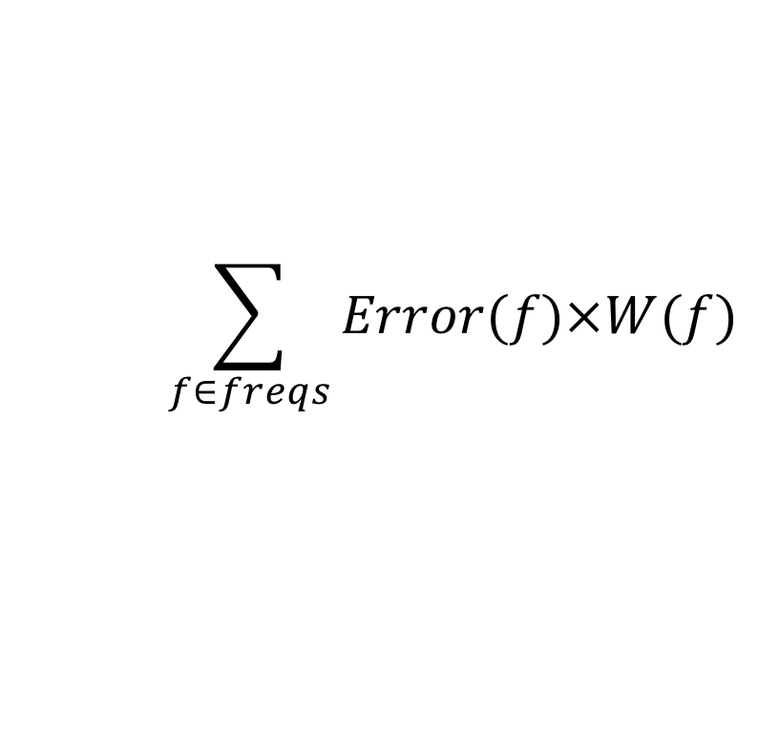
Approach
$$\sum_{bands}{\sum_{f∈freqs}{Bits(f)}}$$
Start with nothing
Start with bitbudget
$$\sum_{f∈freqs}{Error(f)×W(f)}$$
Bits = 0
Error = 190

Slide 20
Approach
$$\sum_{bands}{\sum_{f∈freqs}{Bits(f)}}$$
Start with nothing
Start with bitbudget
While(bits<bitbudget)
  Identify Largest Error reduction component: Error(freq)×W(freq)
$$\sum_{f∈freqs}{Error(f)×W(f)}$$
Bits = 0
Error = 190

Slide 21
Approach
$$\sum_{bands}{\sum_{f∈freqs}{Bits(f)}}$$
Start with nothing
Start with bitbudget
While(bits<bitbudget)
  Identify Largest Error component: Error(freq)×W(freq)
  What do to reduce error?
$$\sum_{f∈freqs}{Error(f)×W(f)}$$
Bits = 0
Error = 190

Slide 22
Approach
$$\sum_{bands}{\sum_{f∈freqs}{Bits(f)}}$$
Start with nothing
Start with bitbudget
$$\sum_{f∈freqs}{Error(f)×W(f)}$$
Bits = 3+6=9
Error = 125

Slide 23
Approach
$$\sum_{bands}{\sum_{f∈freqs}{Bits(f)}}$$
Start with nothing
Start with bitbudget
While(bits<bitbudget)
  Identify Largest Error component: Error(freq)×W(freq)
  What do to reduce error?
$$\sum_{f∈freqs}{Error(f)×W(f)}$$

Slide 24
Approach
$$\sum_{bands}{\sum_{f∈freqs}{Bits(f)}}$$
Start with nothing
Start with bitbudget
$$\sum_{f∈freqs}{Error(f)×W(f)}$$
Bits = 18
Error = 60

Slide 25
Approach
$$\sum_{bands}{\sum_{f∈freqs}{Bits(f)}}$$
Start with nothing
Start with bitbudget
While(bits<bitbudget)
  Identify Largest Error component: Error(freq)×W(freq)
  What do to reduce error?
$$\sum_{f∈freqs}{Error(f)×W(f)}$$

Slide 26
Approach
$$\sum_{bands}{\sum_{f∈freqs}{Bits(f)}}$$
Start with nothing
Start with bitbudget
(still using 3b/band)
$$\sum_{f∈freqs}{Error(f)×W(f)}$$
Bits = 27
Error = 18

Slide 27
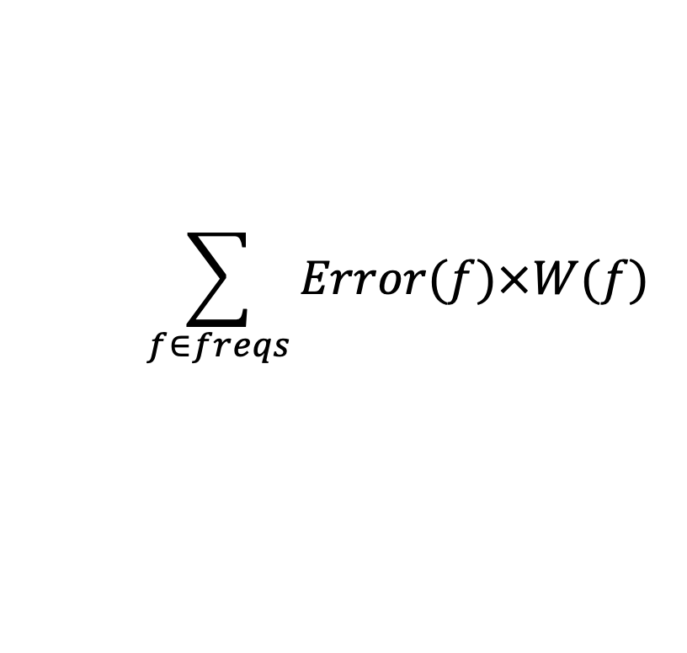
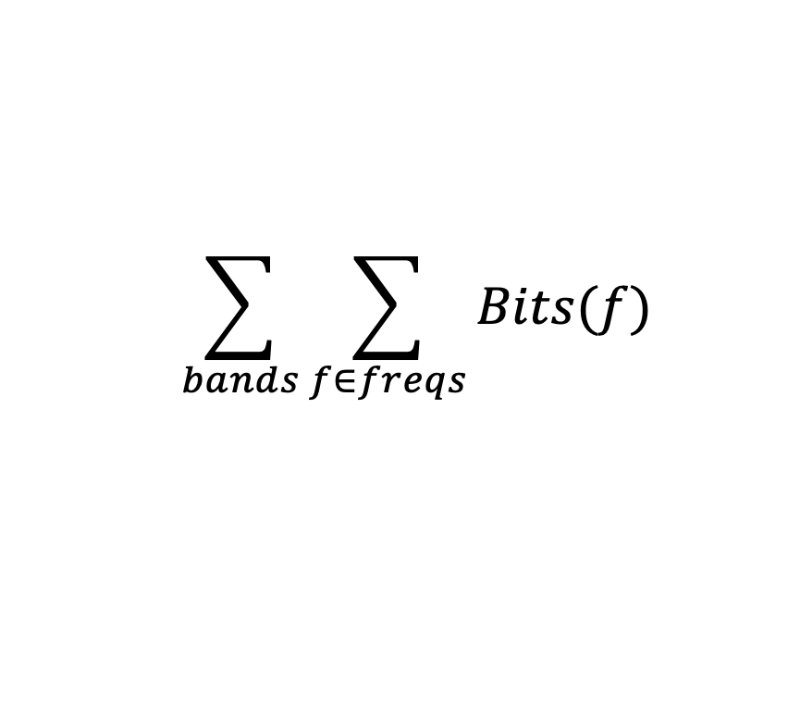
Approach
$$\sum_{bands}{\sum_{f∈freqs}{Bits(f)}}$$
Start with nothing
Start with bitbudget
While(bits<bitbudget)
  Identify Largest Error component: Error(freq)×W(freq)
  What do to reduce error?
$$\sum_{f∈freqs}{Error(f)×W(f)}$$
Bits = 27
Error = 18

Slide 28
Approach
$$\sum_{bands}{\sum_{f∈freqs}{Bits(f)}}$$
$$\sum_{f∈freqs}{Error(f)×W(f)}$$
(still with 3b in all bands)
Bits = 36
Error = 0

Slide 29
Approach
$$\sum_{bands}{\sum_{f∈freqs}{Bits(f)}}$$
$$\sum_{f∈freqs}{Error(f)×W(f)}$$
With 2b in bands 0 and 3?
Bits = ?
Error = 0

Slide 30
Approach
$$\sum_{bands}{\sum_{f∈freqs}{Bits(f)}}$$
$$\sum_{f∈freqs}{Error(f)×W(f)}$$
With 2b in bands 0 and 3:
(lucky here 2b captures maskees)
Bits = 34
Error = 0

Slide 31
Refine Encoding Algorithms
Part 3

Slide 32
Also Quantization
$$\sum_{bands}{\sum_{f∈freqs}{Bits(f)}}$$
To keep simple,
assumed fixed quant.
Incrementally assign
bits
While(bits<bitbudget)
  Identify Largest Error component: Error(freq)×W(freq)
  Assign more bits to that frequency
    Go from 0 bits to 1 bit
      1 bit to 2 bits
$$\sum_{f∈freqs}{Error(f)×W(f)}$$

Slide 33
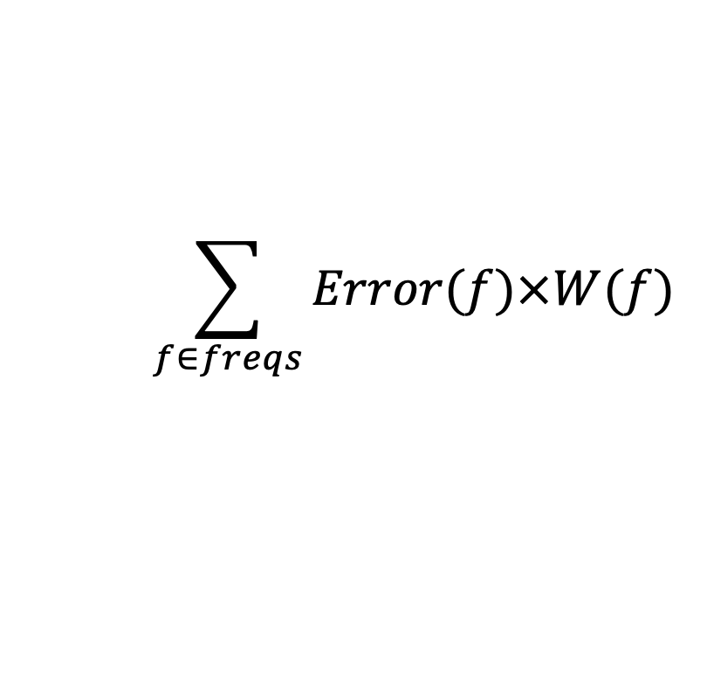
Also Quantization
$$\sum_{bands}{\sum_{f∈freqs}{Bits(f)}}$$
While(bits<bitbudget)
  Identify Largest Error component: Error(freq)×W(freq)
  Assign more bits to that frequency
    Go from 0 bits to 1 bit
      1 bit to 2 bits
$$\sum_{f∈freqs}{Error(f)×W(f)}$$
1b quant -- error=1
(1+6) encode
3b quant -- error=0
(3+9) encode
0b -- error=7

Slide 34
Greedy Incremental Frequency Selection
Start with nothing encoded
Start with bits=0
While (bits<bitbudget)
  Identify frequency with maximum current error
  Identify bits required to encode frequency (encode_bits)
  If (bits+encode_bits<bitbudget)
    Add frequency to encoding
    Update bits (bits+=encode_bits)
  Else break

Slide 35
Greedy Incremental Frequency Selection
(recover Huffman)
Start with nothing encoded
Start with bits=0
While (bits<bitbudget)
  Identify frequency with maximum current error
  Identify bits required to encode frequency (encode_bits)
  If (bits+encode_bits<bitbudget)
    Add frequency to encoding
    Re-Huffman encode and update bitbudget
  Else break

Slide 36
Greedy Incremental Frequency Selection
(recover Huffman)
Start with nothing encoded
Start with bits=0
While (bits<bitbudget)
  Identify frequency with maximum current error
  Allocate some bits to reduce error
    Add frequency or Add quantization bits to band
    Pick one to most reduce the error
    Re-Huffman encode and update bitbudget
  If (Huffman_encoded_bits<bitbudget)
    Add frequency to encoding
  Else break

Slide 37
Adaptive Refinement
Rediscovering where to allocate everything every time may be laborious
  Often same frequencies persist for more than 26ms
Maybe we can get close and adjust?
  Use critical band allocation from previous frames as a starting point guess
    bits, frequencies, quantization
  Try initial encoding with that

Slide 38
Approach (Adaptive)
Start with budget guess
  Quantization in bands
  Frequencies to keep in each band
Encode, compress
What can we do if takes up < 1704 bits?
What can we do if takes up > 1704 bits?

Slide 39
Finish with Adaptive Fine Tuning
<previous slide>
FrameBits=Huffman(FrameFreq)
While ((FrameBits>1704) | (FrameBits<(1704-26))
  If (FrameBits>1704)
    NumFreqs—
    FrameFreq←RemoveLeastImportant(FrameFreq)
  Else if (FrameBits<(1704-26))
    NumFreqs++
    FrameFreq←AddNextImportant(FrameFreq)
  FrameBits=Huffman(FrameFreq)

Slide 40
Finish with Adaptive Fine Tuning
Could add/subtract more than one freq at a time.
Could keep track of high and low encodings.
<previous slide>
FrameBits=Huffman(FrameFreq)
While ((FrameBits>1704) | (FrameBits<(1704-26))
  If (FrameBits>1704)
    NumFreqs—
    FrameFreq←RemoveLeastImportant(FrameFreq)
  Else if (FrameBits<(1704-26))
    NumFreqs++
    FrameFreq←AddNextImportant(FrameFreq)
  FrameBits=Huffman(FrameFreq)

Slide 41
PERCEPTUAL CODING & MP3
Roundup

Slide 42
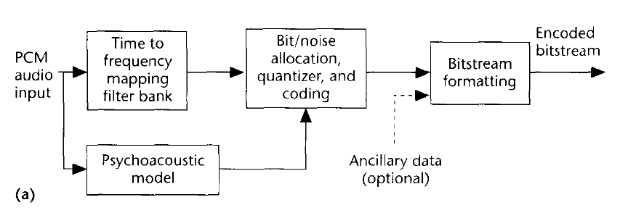
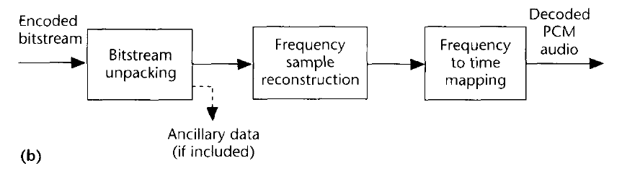
MP3 Flow Chart (Encoding/Decoding)
Basic MP3 Encoding Scheme
A type of DFT is performed
Data is
stored in
frequency domain rep.
Even Huffman coded too!
We use psychoacoustic
model to control quantization!
(how we achieve compression)
MP3 Decoding Scheme
Notice: Psychoacoustics is embedded
Your brain is involved in decoding!

Slide 43
Compare to Lab
Lecture 11 & 12 (last time, this time)
  Help understand more what real MP3 encoding looks like
  Thinking about fixed rate
    And adaptation for variable rate encoding from Huffman
  Formulating masking explicitly
    But simplistic
  Illustrating Optimization Approaches
Lab 6
  Capture spirit of reducing frequencies
  Simplified – only taking loudest fraction in each band
    Rather than being rigorous about masking
    Or trying to hit some fixed rate

Slide 44
Big Ideas
Can use pyschoacoustics to compress audio
  Eliminate portions of signal that human’s don’t notice
Optimization
  Identify Design Space (knobs)
  Identify Costs and Constraints
  Formulate quantitatively
  Algorithms to approach
  Iterative/adaptive approach
    Deal with effects that aren’t completely predictable

Slide 45
Learn More
Optimization –
  continuous mathematical optimization ESE2040, ESE5040, ESE6050
  discrete optimization CIS1210, CIS3200
Signal processing – ESE2240

Slide 46
Coming Up
Feedback
  including first part of lab 6 from Monday before break
Lab 6 continue today
  2 week lab
  Brings together first half of course
  Formal report due next Monday
On to logic on Wednesday

Slide 47
References
Tutorials on Psychoacoustic Coding (in increasing order of abstraction and generality)
  D. Pan, M. Inc, and I. L. Schaumburg. A tutorial on MPEG/audio compression. IEEE multimedia, 2(2):60–74, 1995.
  Nikil Jayant, James Johnston, and Robert Safranek. Signal compression based on models of human perception. Proceedings of the IEEE, 81(10):1385–1422, 1993.
  V. K. Goyal. Theoretical foundations of transform coding. IEEE Signal Processing Magazine, 18(5):9–21, 2001.
Lightweight Overview of MP3
  Rassol Raissi. The theory behind mp3. Technical report, MP3’ Tech, December 2002.
Scientific Basis of MP3 Coding Standard
  J. D. Johnston. Transform coding of audio signals using perceptual noise criteria. IEEE Journal on selected areas in communications, 6(2):314–323, 1988.

