Slide 1



Lecture #14 – Sequential Logic, FPGAs
ESE 1500 –
Digital Audio Basics
Based on slides © 2009--2023 DeHon

Slide 2
Lecture Topics
Setup
Where are we?
Part 1:
  Review: Combinational Logic
  FPGAs
Part 2: (as time permits)
  Finite-State Machines (FSM)

Slide 3









Course Map – Week 8
MIC
A/D
10101
Music
1
domain
conversion
5,6
Numbers correspond to course weeks
compress
sample
freq
pyscho-
acoustics
3
2
4
EULA
----------------click
OK
D/A
10101001101
speaker
MP3 Player / iPhone / Droid

Slide 4
Combinational Logic

Slide 5
Gate
Primitive binary function
  Computes a binary output from a small number of binary inputs
Can specify function with a Truth Table
  Defines the output for each input combination
Input 0 | Input 1 | Output
0 | 0
0 | 1
1 | 0
1 | 1

Slide 6
Conclude
Can implement any combinational logic function out of a collection of
  OR2, AND2, NOT gates

Slide 7
Arithmetic
Addition is also a digital logic function
  Maps set of inputs (a3 a2 a1 a0 b3 b2 b1 b0)
  To an output bit vector (c4 c3 c2 c1 c0)
…as is subtraction, multiplication, division, square root….

Slide 8
Multiplexer Gate
MUX
  When S=0, output=i0
  When S=1, output=i1
S | i0 | i1 | Mux2(S,i0,i1)
0 | 0 | 0
0 | 0 | 1
0 | 1 | 0
0 | 1 | 1
1 | 0 | 0
1 | 0 | 1
1 | 1 | 0
1 | 1 | 1
Truth Table?

Slide 9
Preclass 2
How build 4-input mux from 2-input muxes?

Slide 10
Preclass 2
How build 4-input mux from 2-input muxes?

Slide 11
Register
Clock
  Defines the rate of the computation
  Typically a square wave
  Rising clock edge defines beginning of new cycle
State Element – Flip-Flop (FF) or Register
  Returns the value it was given
  on previous cycle =
  before the last rising clock edge

Slide 12
Accumulator Revisited
Maybe extend accumulator bits to hold larger sum
Maybe more…

Slide 13
Programmable Logic

Slide 14
Programmable Logic
Demonstrated can build any combinational logic function from AND, OR, NOT gates.
…but, it’s a different circuit for each logic function.
Can we build one circuit that can act as any logic function?

Slide 15
Preclass 3
What function of s0, s1 is this circuit configuration computing?

Slide 16
Mux can be a programmable Gate
Programmable Gate
  Can be programmed to act as any gate
  Use state (e.g. FF) to “program” truth table of a gate
Input 0 | Input 1 | Output
0 | 0
0 | 1
1 | 0
1 | 1

Slide 17
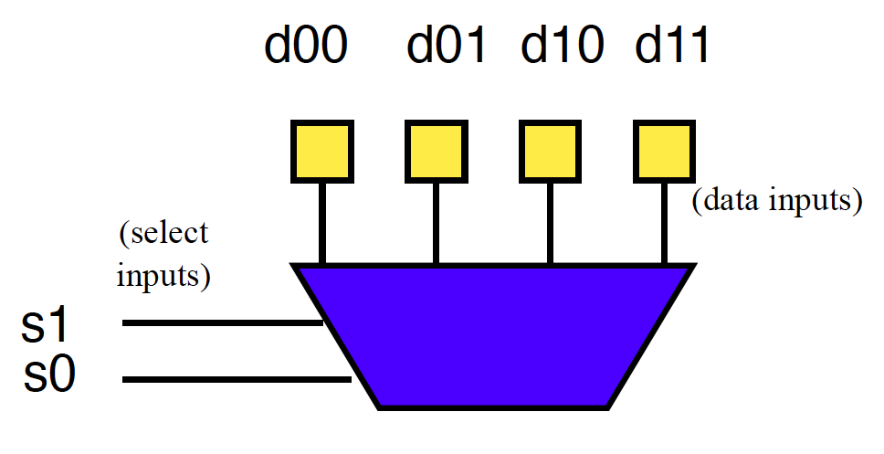
Example: OR (preclass 4)
How do we program to behave as OR2?

Slide 18
Look-Up Table (LUT)
Can generalize to any number of inputs

Slide 19
Connecting Gates
Once we can build gates
…still need to connect the gates together.
Select which gate outputs become inputs to other gates.

Slide 20
Mux can be Programmable Interconnect
Trick: Use multiplexer
to programmably
select gate input.

Slide 21
Programmable Blocks

Slide 22
Programmable Gates and Interconnect
Preclass 5:
How program (fill in yellow programmable cells) to implement a full adder?
Note: Work on Google Docs

Slide 23
Field-Programmable Gate Array (FPGA)
Collection of Programmable Gates
  Can “program” by setting state bits
  LUTs that can be programmed to be any gate
    With optional Flip-Flops to use for state
  Programmable interconnect to “wire” the gates together

Slide 24
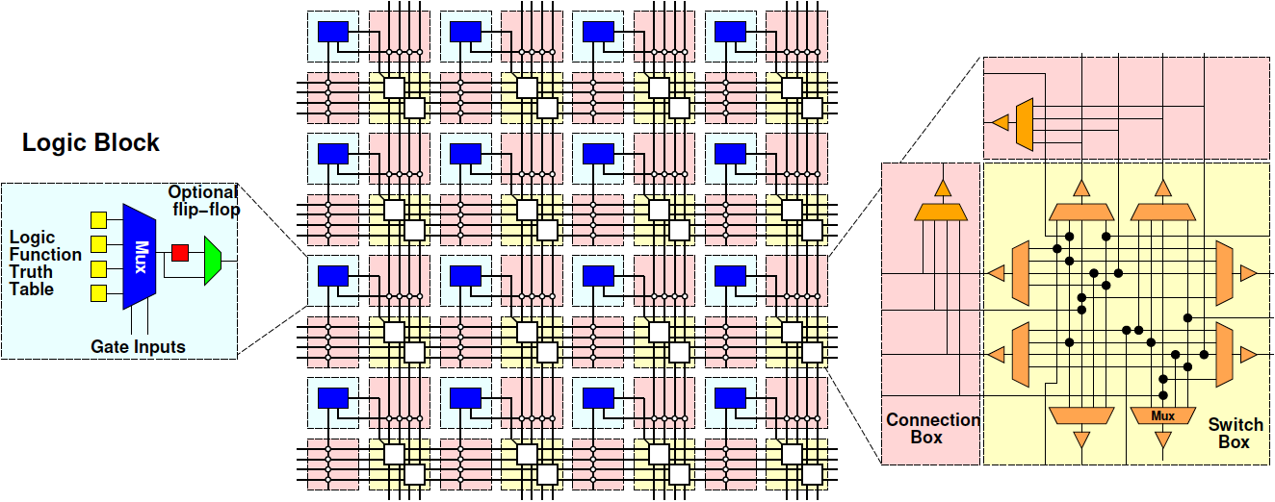
Field-Programmable Gate Array (FPGA)

Slide 25
Finite State Machines (FSMs)
Part 3

Slide 26
State for Sequencing and Control
Useful when trying to control things
  E.g. Perform a sequence of operations
Robot
  Open-gripper
  Move-forward
  Close-gripper
  Lift

Slide 27
State for Conditional Control
Useful when need to behave differently based on something in the past
  Remember if elevator going up or down
  Remember/count coins from consumer
  Remember some mode set by user
    Displaying in Centigrade or Fahrenheit
Idea
  Store state
  Use as input to logic

Slide 28
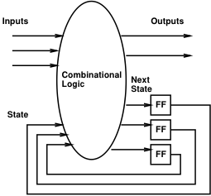
Finite-State Machine (FSM)
Sequential model of computation
State (in registers) + combinational logic
Compute outputs and next state
from inputs and state

Slide 29
FSM Example
Simplified Vending Machine
  Only input quarters
  Only vend one item (output signal to indicate vending)
  Item costs 2 quarters
  Coin Return request and control
Two states: waiting, one-quarter (one)
Two inputs: quarter, coin-return (creturn)
Two outputs: vend, return-quarter (qreturn)

Slide 30
Truth Table Model
Complete together
state | quarter | creturn | vend | qreturn | next
waiting | 0 | 0 | 0 | 0 | waiting
waiting | 0 | 1
waiting | 1 | 0 | 0 | 0 | one
waiting | 1 | 1
one | 0 | 0
one | 0 | 1
one | 1 | 0
one | 1 | 1

Slide 31
Truth Table Model
Complete together
state | quarter | creturn | vend | qreturn | next
waiting | 0 | 0 | 0 | 0 | waiting
waiting | 0 | 1 | 0 | 0 | waiting
waiting | 1 | 0 | 0 | 0 | one
waiting | 1 | 1
one | 0 | 0
one | 0 | 1
one | 1 | 0
one | 1 | 1

Slide 32
Truth Table Model
Complete together
state | quarter | creturn | vend | qreturn | next
waiting | 0 | 0 | 0 | 0 | waiting
waiting | 0 | 1 | 0 | 0 | waiting
waiting | 1 | 0 | 0 | 0 | one
waiting | 1 | 1 | 0 | 1 | waiting
one | 0 | 0
one | 0 | 1
one | 1 | 0
one | 1 | 1

Slide 33
Truth Table Model
Complete together
state | quarter | creturn | vend | qreturn | next
waiting | 0 | 0 | 0 | 0 | waiting
waiting | 0 | 1 | 0 | 0 | waiting
waiting | 1 | 0 | 0 | 0 | one
waiting | 1 | 1 | 0 | 1 | waiting
one | 0 | 0 | 0 | 0 | one
one | 0 | 1
one | 1 | 0
one | 1 | 1

Slide 34
Truth Table Model
Complete together
state | quarter | creturn | vend | qreturn | next
waiting | 0 | 0 | 0 | 0 | waiting
waiting | 0 | 1 | 0 | 0 | waiting
waiting | 1 | 0 | 0 | 0 | one
waiting | 1 | 1 | 0 | 1 | waiting
one | 0 | 0 | 0 | 0 | one
one | 0 | 1 | 0 | 1 | waiting
one | 1 | 0
one | 1 | 1

Slide 35
Truth Table Model
Complete together
state | quarter | creturn | vend | qreturn | next
waiting | 0 | 0 | 0 | 0 | waiting
waiting | 0 | 1 | 0 | 0 | waiting
waiting | 1 | 0 | 0 | 0 | one
waiting | 1 | 1 | 0 | 1 | waiting
one | 0 | 0 | 0 | 0 | one
one | 0 | 1 | 0 | 1 | waiting
one | 1 | 0 | 1 | 0 | waiting
one | 1 | 1

Slide 36
Truth Table Model
state | quarter | creturn | vend | qreturn | next
waiting | 0 | 0 | 0 | 0 | waiting
waiting | 0 | 1 | 0 | 0 | waiting
waiting | 1 | 0 | 0 | 0 | one
waiting | 1 | 1 | 0 | 1 | waiting
one | 0 | 0 | 0 | 0 | one
one | 0 | 1 | 0 | 1 | waiting
one | 1 | 0 | 1 | 0 | waiting
one | 1 | 1 | 0 | 1 | one

Slide 37
Switch-Statement Model
While (true)
switch (state) {
case waiting:
if (quarter && !creturn)
state=one;
else
state=waiting;
qreturn=quarter && creturn;
vend=0;
break;

Slide 38
Switch-Statement Model (cont.)
case one:
if ((quarter && !creturn)||
(!quarter&&creturn))
state=waiting;
else
state=one;
qreturn=creturn;
vend=quarter&& !creturn;
break;
} // switch
} // while

Slide 39
FSM Graph Model
!quarter/
vend=0, qreturn=0
quarter&creturn/
vend=0, qreturn=1
waiting
quarter&!creturn/
vend=1, qreturn=0
quarter&!creturn/
vend=0, qreturn=0
!quarter&creturn/
vend=0, qreturn=1
one
!quarter&!creturn/
vend=0, qreturn=0
!quarter&!creturn/
vend=0, qreturn=0

Slide 40
Big Ideas
Can implement any combinational digital logic function from:
  and, or, not gates
Can implement any FSM from:
  and, or, not gates and registers
Can build a single chip that can be programmed to behave as any collection of gates
  As long as don’t need more gates than it provides

Slide 41
Learn More
CIS2400 – do a bit more logic
ESE3700 – how to implement gates, latches, and memories from transistors
CIS4710 – implement processor (next time) using Verilog mapped to FPGAs
ESE5320 – how to build large-scale computations from logic

Slide 42
Reminder
Feedback
Lab 6 Report/formal writeup due today
Lab 7 this afternoon
  Prelab (with canvas/quiz turnin)
  Implement Full Adder, 4-bit adder, 8b-accumulator on FPGA using Verilog

