Slide 1



Lecture #17 – Operating Systems (OS)
ESE 1500 –
Digital Audio Basics
Based on slides © 2009--2023 DeHon

Slide 2
Motivation
What things can your phone do while you are listening to an MP3?

Slide 3
Observation
We want our devices (including our phones) to do many things at once.

Slide 4
Multiple tasks
We could…
  Dedicate a separate processor for every task we want to perform
How many would we need?
Maybe
  Need dozen processors for our Phone

Slide 5
But….
MP3 Play
  44,000 samples per second decoded
  500 cycles to decode a sample
  How many instructions per second require?
What fraction of a 10⁹ instruction per second processor does this use?

Slide 6
Observation
If we dedicate a processor to MP3 decoding
  It will sit idle most of the time
MP3 decoding (and many other things) do not consume a modern processor
Idea: Maybe we can share the processor among tasks?

Slide 7
Outline
Setup Need / Opportunity
Where are we
Role of Operating System
Virtualization (part 2)

Slide 8



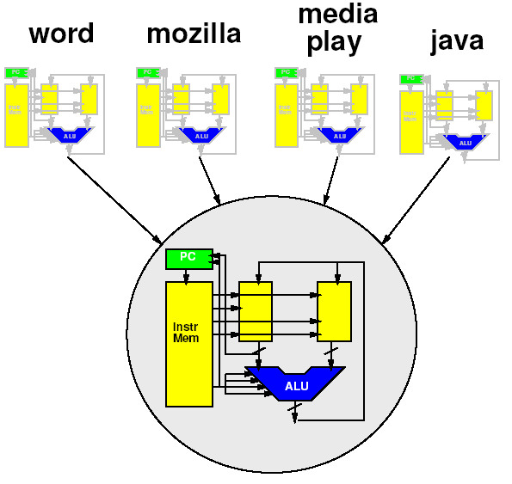








Course Map – Week 10
MIC
A/D
Music
1
domain
conversion
5,6
Numbers correspond to course weeks
compress
sample
freq
pyscho-
acoustics
3
2
4
EULA
----------------click
OK
D/A
10101001101
speaker
MP3 Player / iPhone / Droid

Slide 9
“Stored-Program” Processor
By filling in memory, can program to perform any computation

Slide 10
Role of Operating System

Slide 11
Programming the Processor
Think about: How do we change the program in the memory
  What if had to reboot machine… for every application?
  Change flash card
  Download over USB
    …that is what we have to do for the Arduino…

Slide 12
More than one Program?
How could we have multiple applications?
  (just run one at a time for now)

Slide 13
More than one Program Actively Running?
How could we run multiple applications concurrently?
  Start some programs/apps before earlier ones end
  Have all started applications able to respond and make progress

Slide 14
More than one Program Actively Running
Idea: share processor in time
Programs take turns running instructions on processor
Break program into pieces
  Run piece of program then change to next
How could we define pieces?

Slide 15
Coordination?
Does every program need to
know about every other
program?
Is that viable?
IoT device that runs
3 unchanging tasks?
Smart phone that allows
3rd party apps
  Think: AppStore, Google Play
    Millions of apps available

Slide 16
Role of Operating System
Higher-level, shared support for all programs
  Could put it in program, but most programs need it!
  Needs to be abstracted from program
Resource sharing
  Processor, memory, “devices” (net, printer, audio)
Polite sharing
  Isolation and protection
  Fences make Good Neighbors – R. Frost
Idea: Expensive/limited resources can be shared in time – OS manages this sharing

Slide 17
Virtualization
Part 2

Slide 18
Virtualization
Providing an abstract view separate from the physical view
Hides physical view
Provides abstract view to software
  Abstract from physical resource limits

Slide 19
Idea
Virtualize the processor
  Make it look like we have multiple processors
  With each program running on its own processor
“Own” processor
  Can put data in memory where it wants
  Doesn’t have to worry about another program scribbling over its memory
  Its state is preserved and isolated
  Looks like it runs all the time on the processor
    Doesn’t need to be programmed to allow other programs to run

Slide 20
Terminology: Process
Process
  A virtualization of the physical processor
    an instance of a program in execution
  Virtual processor

Slide 21
What does our program see?
Physically
  One processor
    One PC
    One data memory
    One instruction memory
  These are its state
    Terminology: context

Slide 22
Executing the Program
To execute program
  Keep track of state of machine
    Value of counter
    Contents of instruction memory
    Contents of data memory
(Program counter)

Slide 23
One Processor, One Program
On the physical machine, can only run one program
  One PC
  One memory
Why is this a limitation
when want
to run multiple
programs?

Slide 24
Virtualization
Make it look like we have multiple resources
  Multiple processors
Provide abstraction of large* number of processors
  Each program gets its own processor
    Each program gets its own machine state
  * “large” enough to approximate infinite

Slide 25
Virtualization

Slide 26
Key Idea
Can capture state of a processor
  All the information that defines the current point in the computation

Slide 27
Remember
State of the processor
  Value of Program Counter (PC)
  Contents of instruction memory
  Contents of data memory

Slide 28
Key Idea
Can capture state of a processor
  All the information that defines the current point in the computation
  i.e. program counter, data and instruction memory
Can save that somewhere*
Fully represents the running program
Can restore that from <where-saved> to the processor
Can save/restore without affecting the functional behavior of the program

Slide 29
Somewhere? -- Memories
Distinguish
  Memory-seen-by-process (virtualized processor)
  All Memory used
    Physical memory available
    Holds state of all processes
How might we divide up physical memory among processes?
  How much each get?
  How define what memory goes to which process?

Slide 30
State in Memory

Slide 31
Sharing Processor
Now that we can save/restore the state
Can share processor among processes
  (Restore state; run for time; save state)
Isolation: none of the processes need to know about each other
  Each thinks it has the whole machine
  Just need to restore/save state
  around epochs where the process
  gets to run on the processor

Slide 32
Saving Memory?
Each program has view that it owns machine
  Each may put program in same place?
  Shouldn’t have to know about other programs, where their stacks are…
Could:
  Have programs operate 0…max_process_mem
  Copy data in and out of this range
  Keep in larger physical memory
    not visible to program (process)

Slide 33
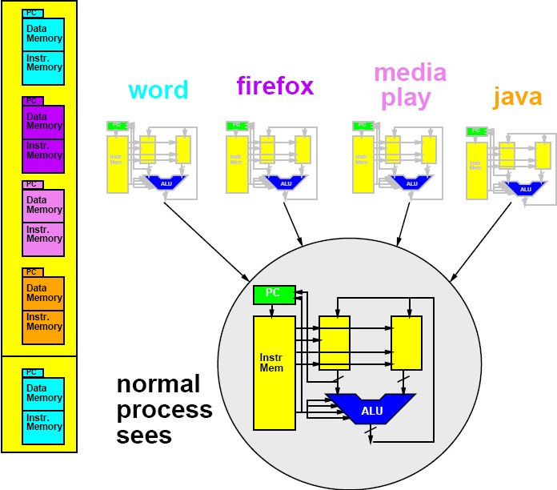
Memory Save/Restore
Memory Save/Restore

Slide 34
Memory Save/Restore
Memory Save/Restore
Save

Slide 35
Memory Save/Restore

Slide 36
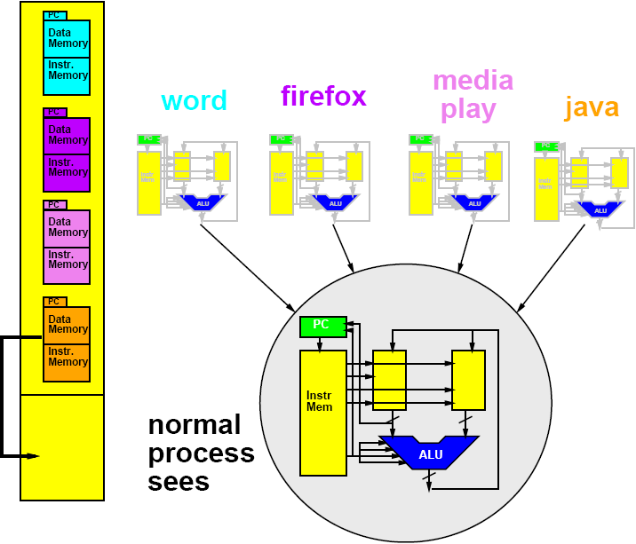
Memory Save/Restore
Restore

Slide 37
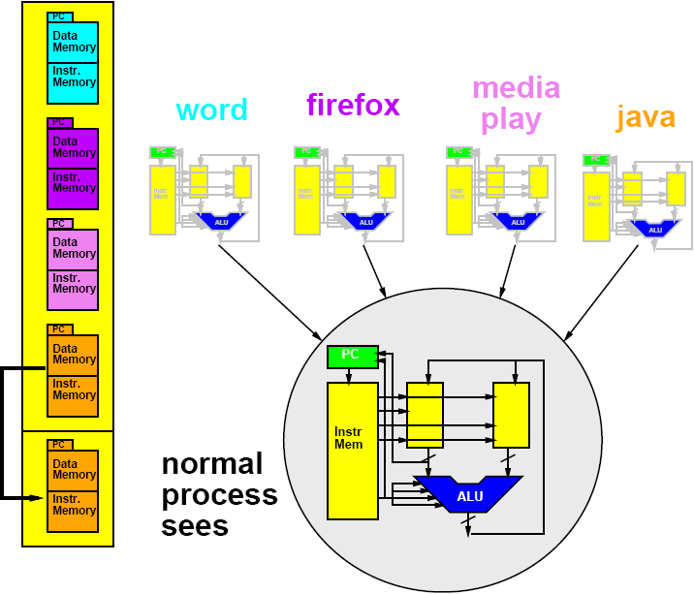
Memory Save/Restore
Restore

Slide 38
Saving Memory?
Each program has view of it owns machine
  Each may put program in same place
  Shouldn’t have to know about other programs…
    where their stacks are…etc.
Can do better
  Assume physical memory is larger than process memory
  How could we avoid copying?
  Virtualizing Memory as well
    Translate processor addresses

Slide 39
Process Base Offset Register
Add Offset Register
  Holds base of memory space for process
Add this to all memory references
Change memory seen by process by changing offset register

Slide 40
Management Program
Need another program → process
  Manage swap of running processes
  Decide what to run next
  Decide when to stop a process
…process manager/scheduler

Slide 41
Time-Sliced Sharing
Simplest version:
  Run each process for 10,000 cycles
  Then swap to next process
  Looks like each of n process runs on a processor 1/n-th the speed of the real processor
More sophisticated:
  Assign uneven time to processes
  Also change when process…
    waits for input
  What are cases where
    Uneven time appropriate?
    Valuable to switch on input?

Slide 42
Review: Key Idea
Can capture state of a processor
  All the information that defines the current point in the computation
  i.e. program counter, data and instruction memory…
Can save that in memory
  A different memory from what the process sees
  (could be different range of addresses)
State fully represents the running program
Can restore that from memory to the processor
Can save/restore without affecting the functional behavior of the program

Slide 43
Lab 9
Explore Linux OS and processes on Linux
  See processes sharing processors
  Lab available now

Slide 44
Big Ideas
Virtualize hardware
  Identify state; save/restore from memory
Program view: owns complete machine
Allows programs to share limited physical hardware (e.g. processor)
  Provide illusion of unlimited hardware
Operating System is the program that manages this sharing

Slide 45
Learn More
CIS3800 – Operating Systems

Slide 46
Remember
Feedback, including lab
Lab 9 on Monday

