Slide 1
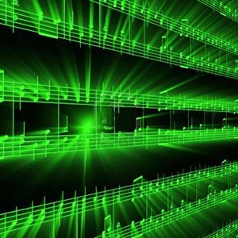


Lecture #22 – User Interface 1
ESE 1500 –
Digital Audio Basics

Slide 2
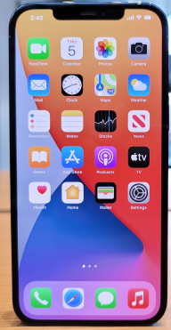
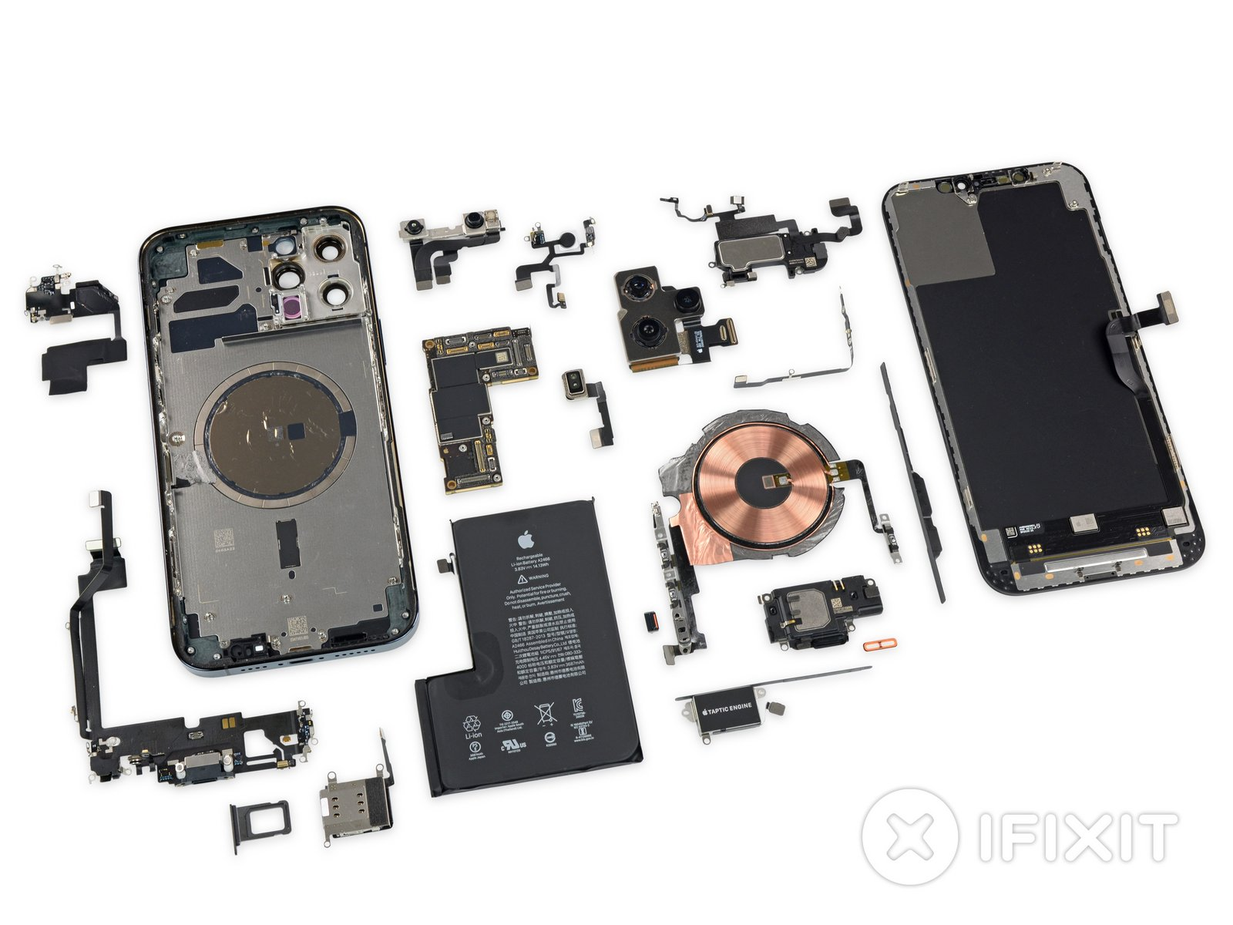
User Interface
When a user sees a product
  See the interface
  Not the underlying design
    ….and that’s the way it should be
Brian Heater
https://techcrunch.com/2020/11/05/a-better-look-at-apples-iphone-12-pro-max-and-iphone/

Slide 3
User Interface
When a user sees a product
  See the interface
  Not the underlying design
    ….and that’s the way it should be
Interface determines if the user
can get job done
  …or will walk away frustrated
Successful interface
  Make it easy, pleasant to use
  Hide all the complexity that makes it work

Slide 4
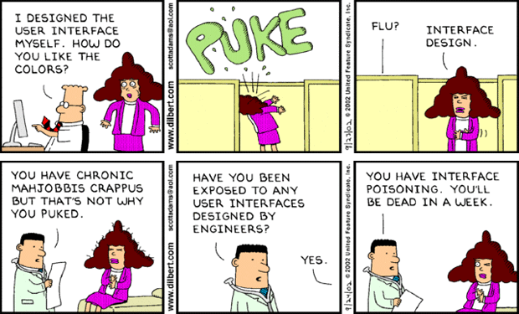
Dilbert Diagnosis
http://dilbert.com/strip/2002-09-23
http://dilbert.com/strip/2002-09-24

Slide 5
Lecture Topics
Where are we on course map?
User Interface
  Motivation
  Issues and Principles (Part 2)
  Design Choices
  Developer vs. User (Part 3)
  Approaches and Prototyping
  Advancing/Enabling Technology

Slide 6










Course Map
7,8,9
10101001101
MIC
CPU
A/D
10101001101
NIC
Music
1
domain
conversion
6
10
Numbers correspond to course weeks
compress
sample
freq
pyscho-
acoustics
3
2,5
4
13
EULA
----------------click
OK
D/A
NIC
11
speaker
MP3 Player / iPhone / Droid
12

Slide 7
Dilbert Diagnosis
http://dilbert.com/strip/2002-09-23
http://dilbert.com/strip/2002-09-24

Slide 8
Self Awareness
I’m an Engineer
I have a different perspective and understanding of technology than lay public
My view of what’s obvious/non-obvious probably not representative of intended user base
…how do I (or team I’m in) compensate for that?
These lectures, I’m talking about my weakness
  And need for help
  Not my strength
  Won’t do justice with solution…but maybe in raising issues, need for help
Nonetheless, I am frustrated by bad design from others as much as anyone else…
  I want “us” to do better.

Slide 9
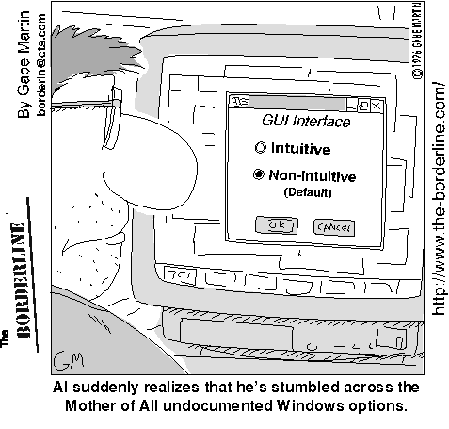
The Problem is that Humans are Half of the User Interface
http://www.nevtron.si/borderline/archive2/intuiti.gif

Slide 10
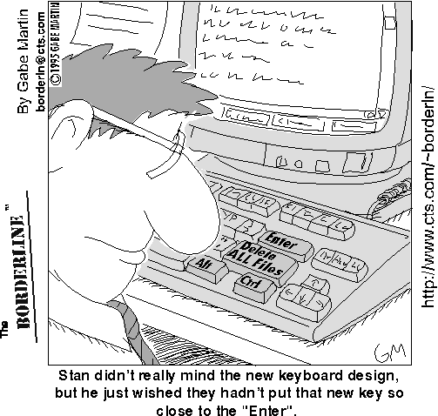
And Even if Intuitive and Clear, User Interface Might not be so Good…
http://www.nevtron.si/borderline/delete.gif

Slide 11
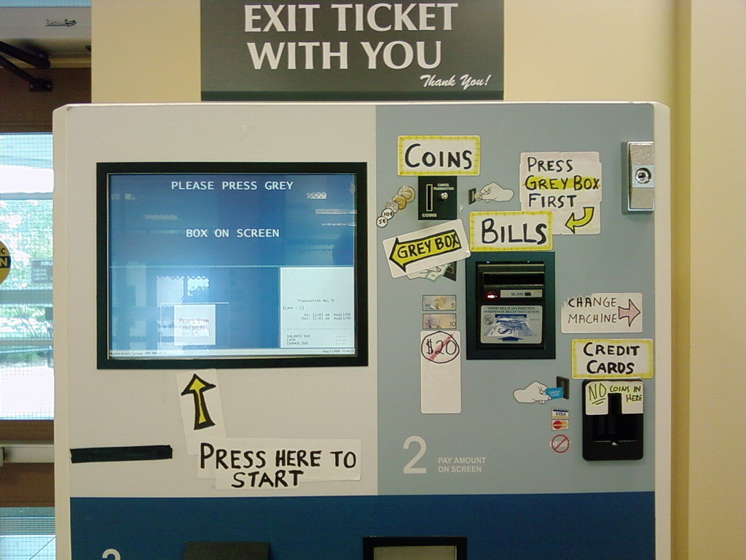
And it’s not just about our Workstation Interfaces…
http://www.uselog.com/2008/11/users-fix-parking-ticket-machine-ui.html

Slide 12
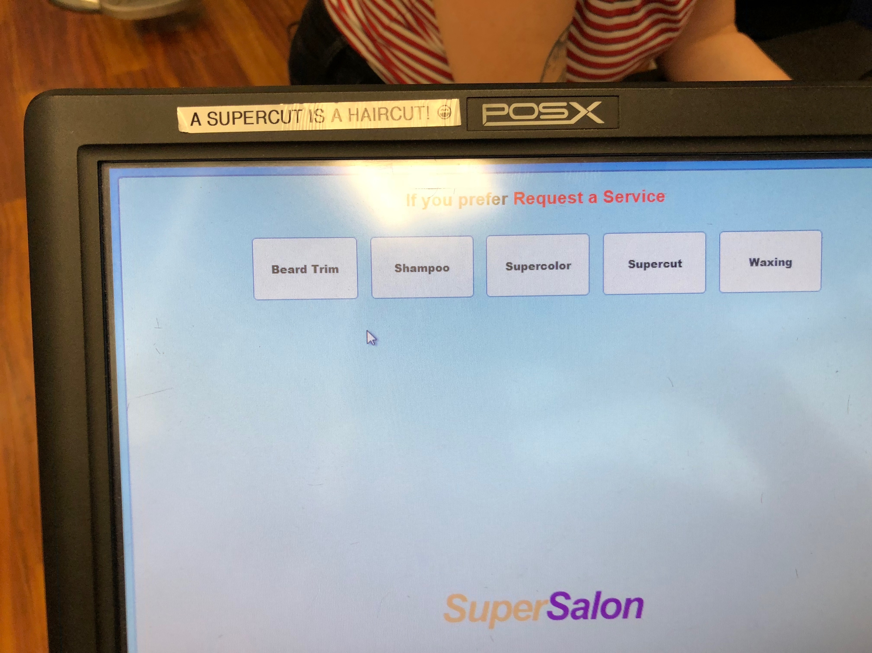
Local Example

Slide 13
Who’s to Blame for Usability Failures?
Most Returned Products Work Fine: Study Says Only 5 percent of returned products are genuinely defective: Yardena Arar, PC World, June 2, 2008 4:00 pm
Only 5 percent of consumer electronics products returned to retailers are malfunctioning --yet many people who return working products think they are broken, a new study indicates.
The report by technology consulting and outsourcing firm Accenture pegs the costs of consumer electronics returns in 2007 at $13.8 billion in the United States alone, with return rates ranging from 11 percent to 20 percent, depending on the type of product.
http://www.pcworld.com/article/146576/most_returned_products_work_fine_study_says.html

Slide 14
UI Examples: BAD
Examples of infuriating / bad UIs?

Slide 15
UI Examples: Good
Examples of pleasant/good UIs?

Slide 16
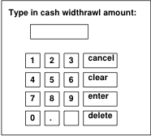
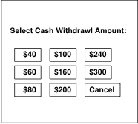
Preclass 2
Which interface easier? Why?
  Limit to vend $20, $300/day
How much do you use ATMs today?
  Why not?
  What’s replaced it? What’s better?

Slide 17
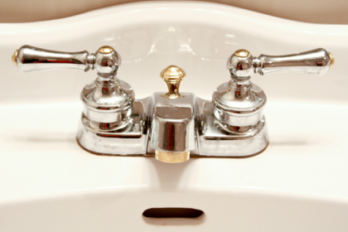
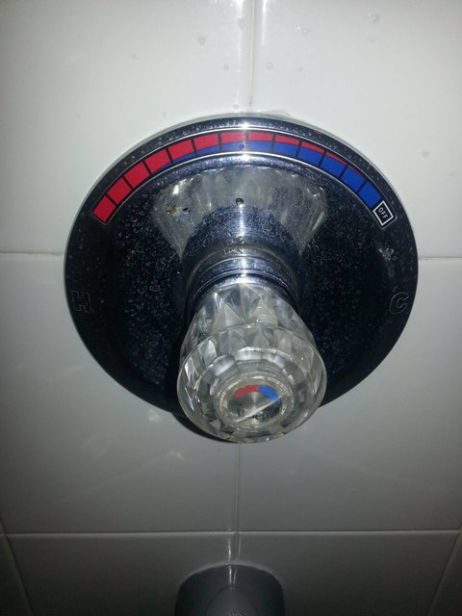
Hot/Cold Water Interface
Old: two knobs
  Hot
  Cold
Newer: one knob
  Tune heat
  (maybe also volume)
Why built this way?

Slide 18
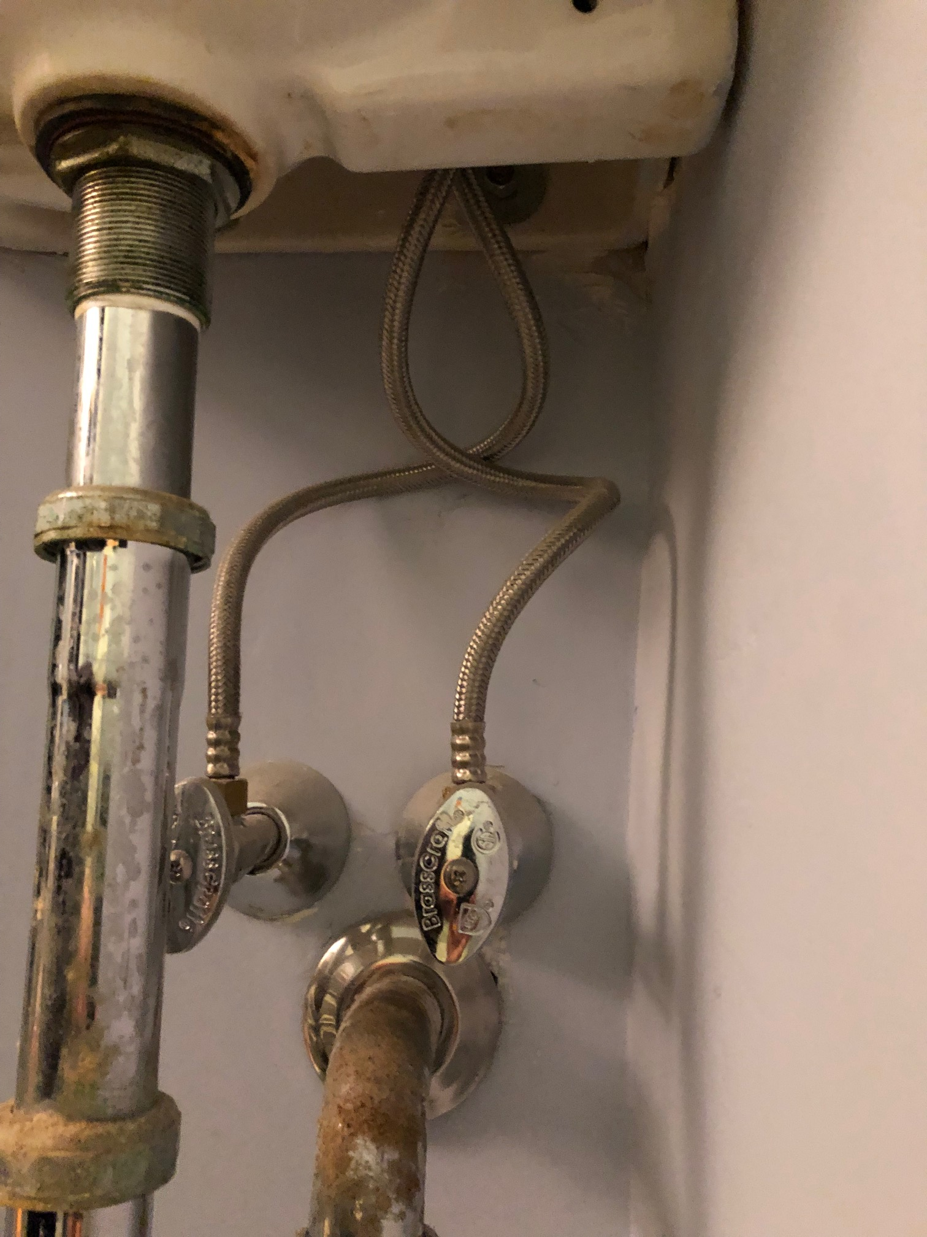
Hot/Cold Water Interface
Newer: one knob
  Tune heat
  (maybe also volume)
Old: two knobs
  Hot
  Cold

Slide 19
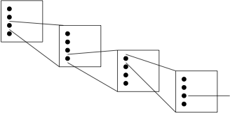
Make common case fast
…not buried deep in menus
  Minimize mouse clicks?
  Modern examples?

Slide 20
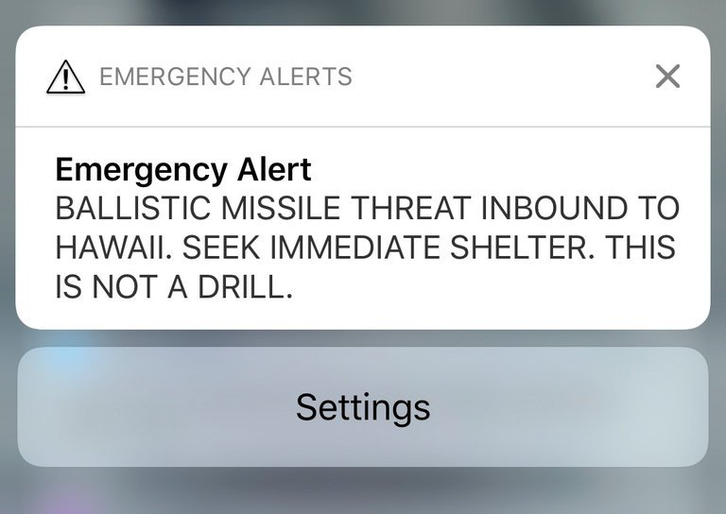
Hawaii Missle Warning January 2018
https://commons.wikimedia.org/wiki/File:2018_Hawaii_missile_alert.jpg

Slide 21
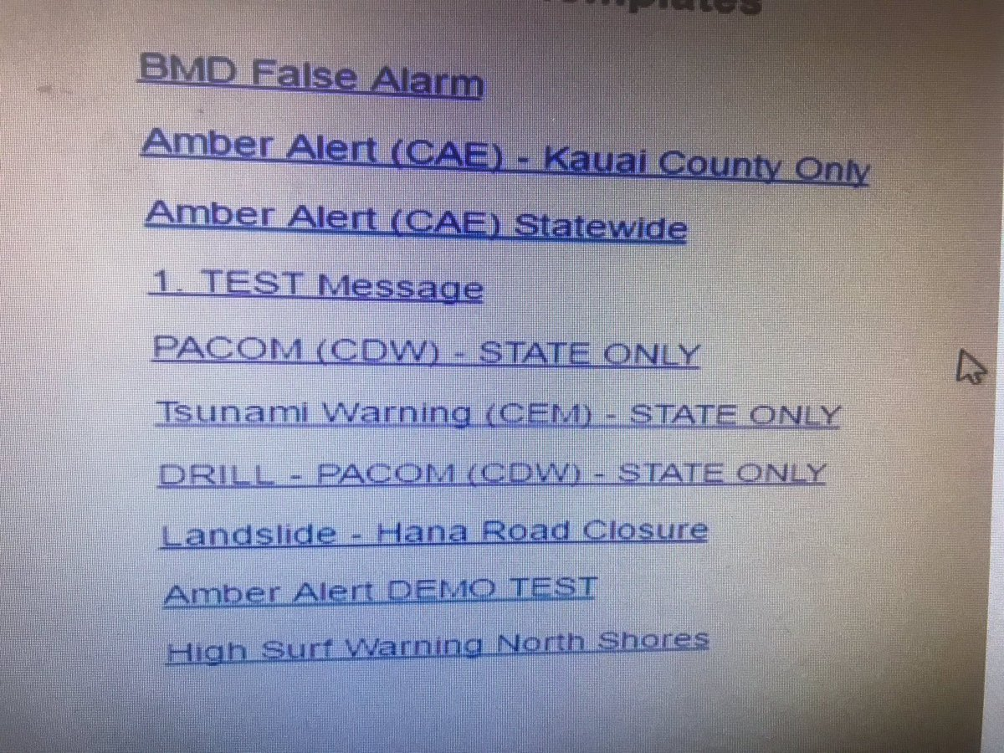
Hawaii Missle Warning False Alarm
Added after
incident
What selected
What intended
https://www.theverge.com/2018/1/16/16896368/hawaii-false-missile-alert-system-confusing-interface-poor-design

Slide 22
Issues
Part 2

Slide 23
Issues to be concerned with?
(goals, things-to-optimize)

Slide 24
Issues
Time to learn
Easy to figure out how to use
Time to perform task
Safety
Clarity of what happened
  Why something didn’t happen
Ease of recovery
User stress

Slide 25
Donald Norman: UI Guru
Referring to Norman’s book: Design of Everyday Things
Visibility – visible functions aid user awareness; invisible functions are more difficult to find and know how to use.
Feedback – return information about what action has been done and what has been accomplished.
Constraints – restricting the kind of user interaction that can take place at a given moment.
Mapping – the (functional, geometric, appearance) relationship between controls and their effects in the world.
http://twobenches.wordpress.com/2008/06/05/don-normans-design-principles/

Slide 26
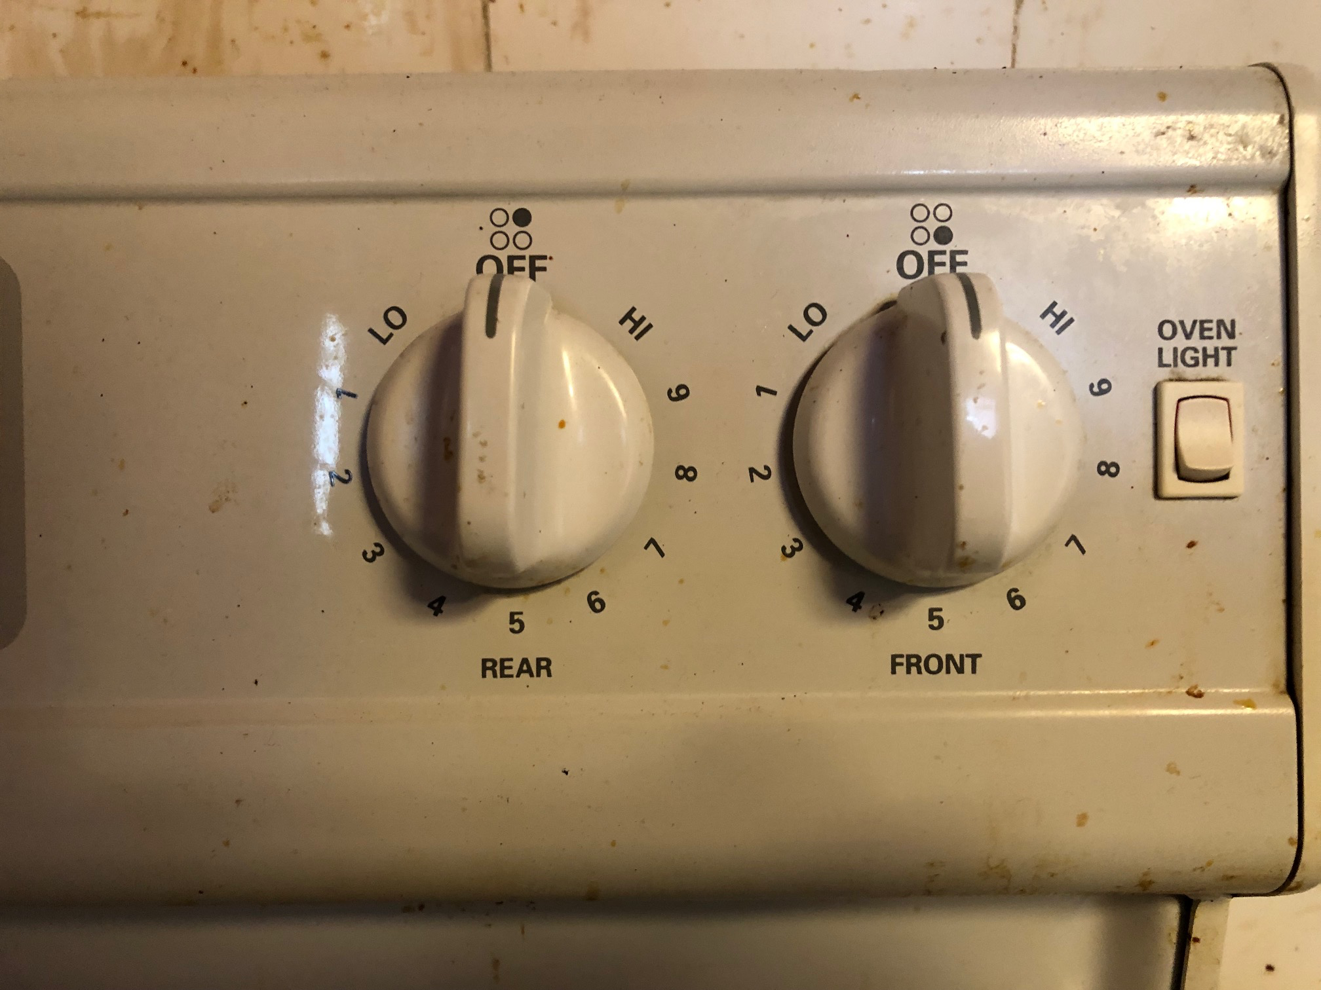
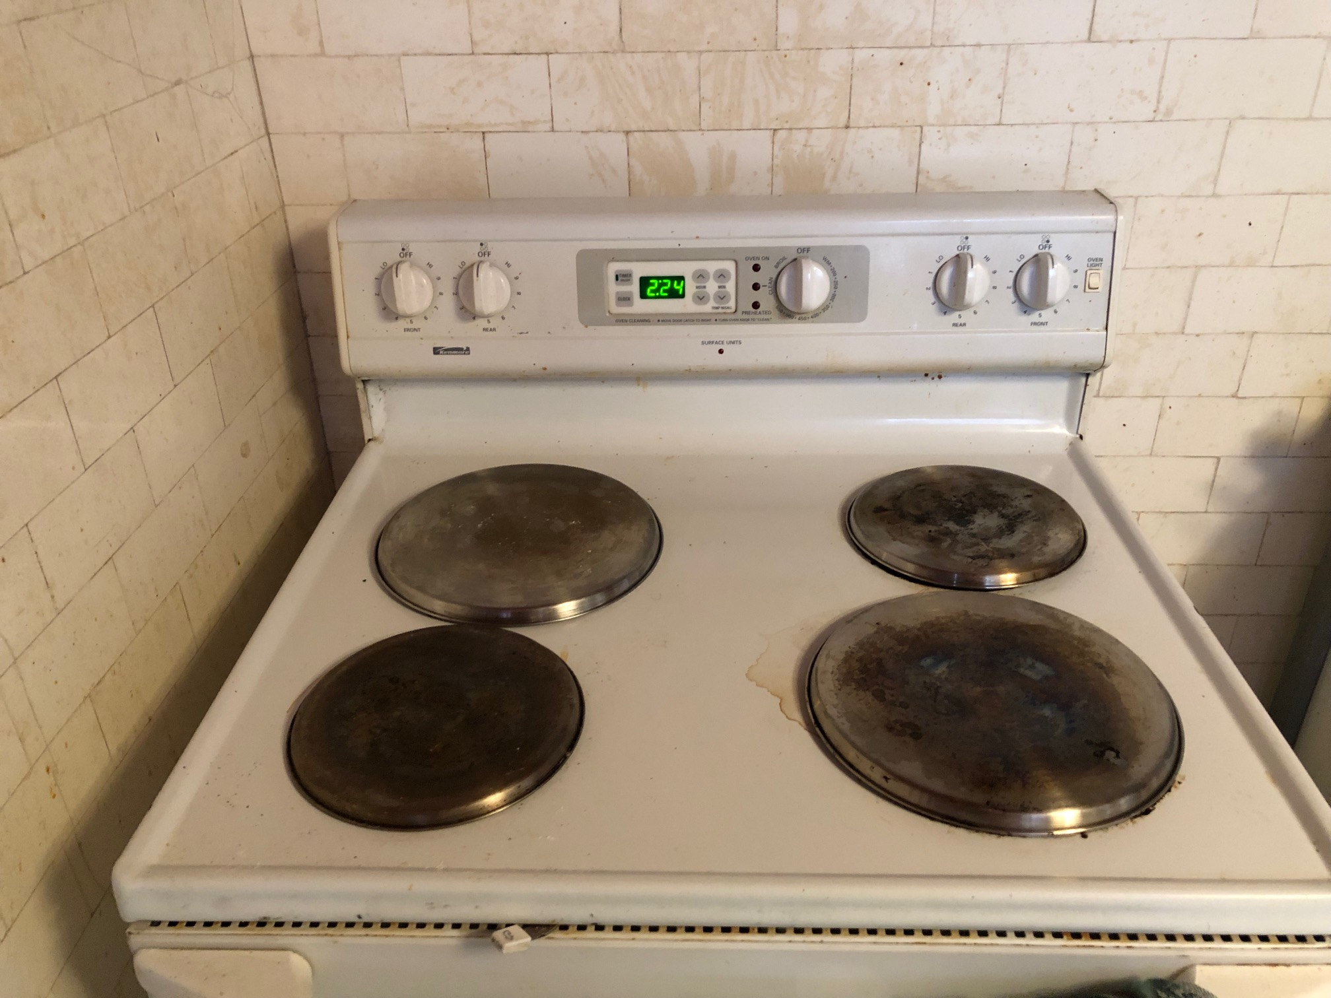
Mapping: Stove burners

Slide 27
Donald Norman: UI Guru
Referring to Norman’s book: Design of Everyday Things
Visibility – visible functions aid user awareness; invisible functions are more difficult to find and know how to use.
Feedback – return information about what action has been done and what has been accomplished.
Constraints – restricting the kind of user interaction that can take place at a given moment.
Mapping – the (functional, geometric, appearance) relationship between controls and their effects in the world.
Consistency – use similar operations and use similar elements for achieving similar tasks.
Affordance – an attribute of an object that allows people to know how to use it.
Add: Tolerance – reducing cost of mistakes, allowing recovery.
http://twobenches.wordpress.com/2008/06/05/don-normans-design-principles/

Slide 28
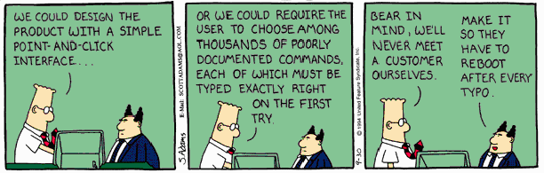
Interface Design

Slide 29
Constantine and Lockwood
The structure principle. Your design should organize the user interface purposefully, in meaningful and useful ways based on clear, consistent models that are apparent and recognizable to users, putting related things together and separating unrelated things, differentiating dissimilar things and making similar things resemble one another. The structure principle is concerned with your overall user interface architecture.
The simplicity principle. Your design should make simple, common tasks simple to do, communicating clearly and simply in the user’s own language, and providing good shortcuts that are meaningfully related to longer procedures.
The visibility principle. Your design should keep all needed options and materials for a given task visible without distracting the user with extraneous or redundant information. Good designs don’t overwhelm users with too many alternatives or confuse them with unneeded information.
The feedback principle. Your design should keep users informed of actions or interpretations, changes of state or condition, and errors or exceptions that are relevant and of interest to the user through clear, concise, and unambiguous language familiar to users.
The tolerance principle. Your design should be flexible and tolerant, reducing the cost of mistakes and misuse by allowing undoing and redoing, while also preventing errors wherever possible by tolerating varied inputs and sequences and by interpreting all reasonable actions reasonable.
The reuse principle. Your design should reuse internal and external components and behaviors, maintaining consistency with purpose rather than merely arbitrary consistency, thus reducing the need for users to rethink and remember.
http://www.ambysoft.com/essays/userInterfaceDesign.html

Slide 30
Interaction Styles
Style | Main Advantages | Main Disadvantages | Applications
Direct manipulation | Fast and intuitive interaction; easy to learn | Only suitable where there is a visual metaphor for tasks and objects | Video games; CAD systems
Menu selection | Avoids user error; little typing required | Slow for experienced user; can become complex if many menu options | Most general-purpose systems e.g. ATM, Word
Form fill-in | Simple data entry; easy to learn; checkable | Takes up much screen space; causes problems where user options do not match the form fields | Ordering
Command language | Powerful and flexible | Hard to learn; poor error management | Operating systems, command and control systems; e.g. Linux
Natural language | Accessible to casual user; easily extended | Requires typing; NL understanding was unreliable, improving | Information retrieval and Q/A systems; e.g. Google, ChatGPT
Voice with NL | Hands-free, no size constraint | Some unreliability; can’t do quietly | Digital Assistants, Dialing, remote control e.g. Alexa, Siri
Ian Sommerville: Software Engineering, 7th Ed., 2004

Slide 31
Implementer vs. User
Part 3

Slide 32
User vs. Implementer
Thesis: Engineer who implements something is seldom the right person to judge the goodness of the user interface
  Knows how should work
  Has a mental model of inner workings
  Motivated to reduce implementation complexity
Contrast user
  Doesn’t know how works – shouldn’t have to!
  Benefit from reduced use complexity
    Reduced cognitive load

Slide 33
Foolproof quote
You cannot make something foolproof,
because fools are so ingenious!
  George Cox

Slide 34
example (Foolproof)
Coders: The Making of a New Tribe and the Remaking of the World
  Clive Thompson
  "It turns out a user had made a mistake. Someone out there had used the service to find their balance, as is normal. But instead of inputting their card [phone] number—which is what they were supposed to do—the user had accidentally sent in the number of the phonebot service itself. So the software got stuck in a loop. “The service was texting itself back and forth, back and forth, back and forth,” Guarino says. It was, he admits, ultimately his mistake, a flaw in how he’d written the code for the textbot. He could have easily written a rule checking to make sure that someone didn’t accidentally text the bot its own phone number. But it never occurred to him that a real live person would ever do that. “Users,” he says ruefully, “will find a way.” You might think you’ve stamped out your bugs, but they find new ones."

Slide 35
Issue
Hard to put aside what you know and see how it will look to an uninitiated user
How could anyone not know?
  When program crashes, it leaves a lock file around that needs to be cleaned up…
    Happens to ESE150 students in Detkin!
  Naming a variable “foo-bar” might be interpreted as subtraction
  “NC” means not connected
    (user named their next state variables NA NB NC ND)
Why would anyone
  Put a ’ in a name?
    Andre’ before international characters allow: André

Slide 36
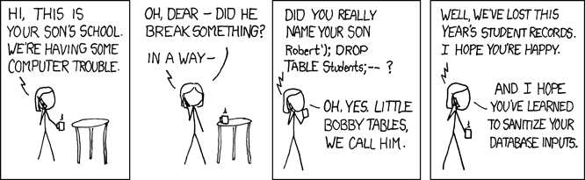
Why would anyone
https://xkcd.com/327/

Slide 37
Big Ideas
User Interface essential
  And worth designing carefully and deliberately
View should match user goals, not internal design
  Spend computing cycles to bridge
  Make simple, safe, intuitive
Implementer seldom a good judge of interface goodness
  Knows too much about how should work
  Conflict of goals

Slide 38
Reading
The Design of Everyday Things, Donald Norman -- a classic book on design for usability (broader than just hardware and software)
The Inmates are Running the Asylum, Alan Cooper -- a manifesto calling out computer/software industry for poor design
Set Phasers on Stun: And Other True Tales of Design, Technology, and Human Error, Steven M. Casey -- a series of anecdotes (case-studies) on how bad design and interfaces can go wrong, perhaps even killing people.

Slide 39
Learn More @ Penn
Courses
  Nothing required in CMPE program
  ESE5430 – Human Factors Engineering
  …maybe new HCI courses coming?...

Slide 40
Remember
Feedback
Lab 10 due today
Lab 11 this afternoon
  Does have some prelab
  Bring lab kits

