Slide 1
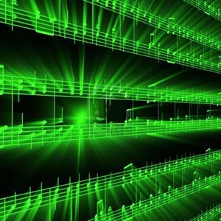


Lecture #25 – Wrap Up! (final lecture)
ESE 1500 –
Digital Audio Basics

Slide 2
Lecture Topics
Review
Generalize
Final
Engineering Disciplines
What’s Next?

Slide 3
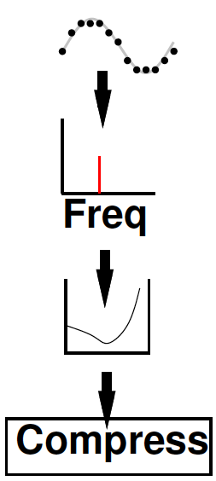
Class Story: One Slide
Sound can be converted to/from bits
  And compressed
  Without loss of information
More information can be discarded without humans noticing → fewer bits
Process this information with inexpensive machines
Store it for retrieval
Send it between machines
  Even if not directly connected

Slide 4
In the Process
Processing Requirements
Hardware (gates)
Sharing hardware (OS)
Networking
Sensing and Actuation
User Interfaces
Intellectual Property
Sampling
Signal Processing
Frequency Domain
Compression
Human Hearing
Optimization

Slide 5










Course Map
7,8,9
10101001101
MIC
CPU
A/D
10101001101
NIC
Music
1
domain
conversion
6
10
Numbers correspond to course weeks
compress
sample
freq
pyscho-
acoustics
3
2,5
4
13
EULA
----------------click
OK
D/A
NIC
11
speaker
MP3 Player / iPhone / Droid
12

Slide 7
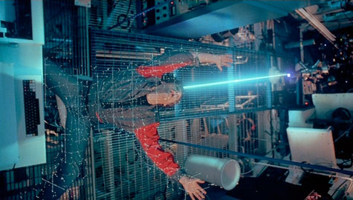

Virtualization of the
World
Can represent things as bits
  Sound, pictures, movies
  Location, situation, …
  shapes, circuits, drugs, DNA
Cheap/powerful ways to
automatically manipulate
  …and reproduce
TRON 1982

Slide 8
Audio
Told detail story in terms of Audio
1D signal
Sample in time
Quantize amplitude
Quantize fine enough
  Lose no information that humans can perceive

Slide 9

Images
2D signal
Quantize in space into pixels
Quantize amplitude of pixels
Quantize fine enough
  Lose no information human can perceive
  0.1 mm at 30cm (50 cycles per degree)
  “Retina” Display 57 pixels per degree
    128 pixels/cm

Slide 10
Image Processing One Slide
Images can be converted to/from bits
  And compressed
  Without loss of information
More information can be discarded without humans noticing → fewer bits
Process this information with inexpensive machines
Store it for retrieval
Send it between machines
  Even if not directly connected

Slide 11
Compress Images
How do we compress images?
  Lossy?
  Lossless?

Slide 12
Motion Pictures
3D signal
Sample in time
Quantize in space into pixels
Quantize amplitude of pixels
Sample fine enough
  Lose no information human can perceive
  30 frames per second

Slide 13
Video Processing One Slide
Motion can be converted to/from bits
  And compressed
  Without loss of information
More information can be discarded without humans noticing → fewer bits
Process this information with inexpensive machines
Store it for retrieval
Send it between machines
  Even if not directly connected

Slide 14
Compress Videos
How do we compress videos?
  Lossy?
  Lossless?

Slide 15
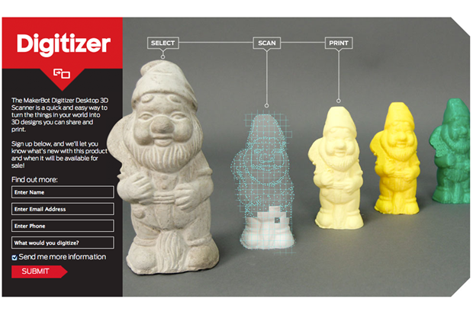
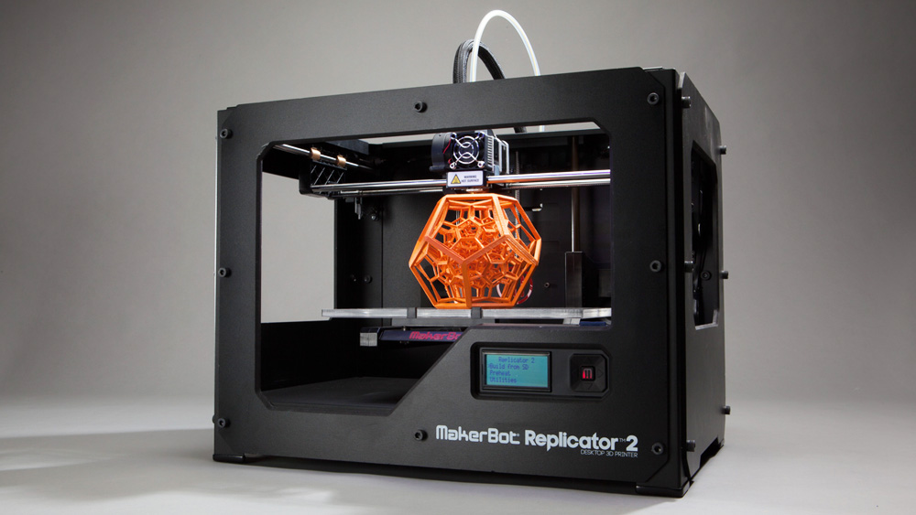
3D Object Capture and Reproduction
makerbot.com

Slide 16
Virtualization of the
World
Can represent things as bits
  Sound, pictures, movies
  Location, situation, …
  shapes, circuits, drugs, DNA
Cheap/powerful ways to
automatically manipulate
  …and reproduce
TRON 1982

Slide 17
World of Bits
What else can we capture as bits?
Reproduce from bits?

Slide 18
http://news.cnet.com/8301-27083_3-20079504-247/prosthetic-dentistry-print-your-own-teeth/
http://phys.org/news/2011-02-3d-bio-printers-skin-body.html
https://www.nbcnews.com/mach/science/digital-smell-technology-could-let-us-transmit-odors-online-chats-ncna940121
https://www.makepartsfast.com/3d-printed-circuit-boards-how-theyre-made-and-why-they-matter/
https://time.com/6162775/tiktok-3d-printed-houses/
https://cen.acs.org/food/food-science/3D-printed-foods-enter-kitchen/100/i5
https://www.3dnatives.com/en/3d-printed-drugs-personalized-medicine-140520204/

Slide 19
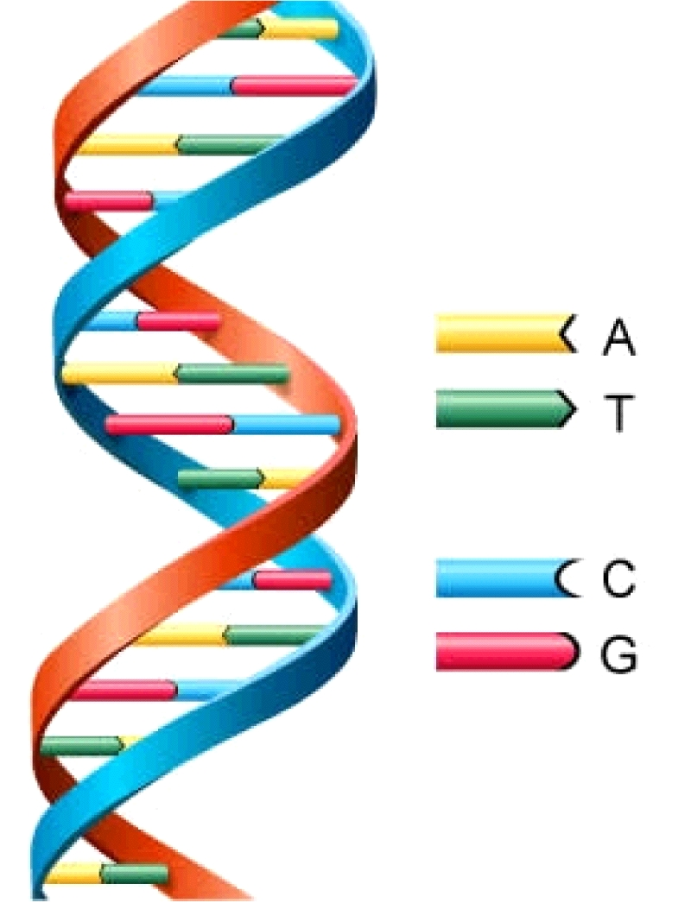
DNA
Nature’s bitstream
Can read into bits
Can reproduce from bits
Digitize organisms….
Those bits control behavior
Control function of cells
  Even what the cells manufacture and produce
http://www.astrochem.org/sci_img/dna.jpg

Slide 20

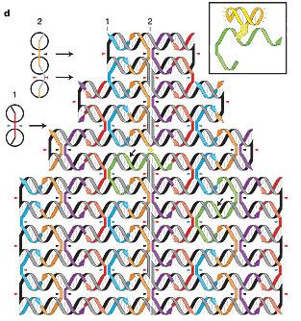
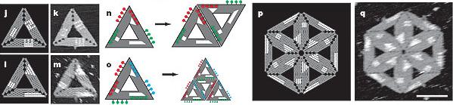
Programming the Physical World (DNA)
How do we program DNA?
  Self-assemble into arbitrary useful structures?
  Perform specific functions in cells?
  …becoming a problem of information and computation
[Winfree & Rothemund,
CALTECH]

Slide 21
It gets Easier
3D Printing, contract manufacturing
  Low volume production, mechanical things
Processors – deploy code
FPGAs, FPAA, PSoC – deploy circuits
Internet – transfer designs, orders, advertise
FedEx – global shipment
Lowering Barriers
  Production, distribution, deployment

Slide 22
Limits?
What can’t we capture and reproduce from bits?

Slide 23
Clarke’s Laws
When a distinguished but elderly scientist states that something is possible, he is almost certainly right.
When he states that something is impossible, he is very probably wrong. The only way of discovering the limits of the possible is to venture a little way past them into the impossible.
Any sufficiently advanced technology is indistinguishable from magic.

Slide 24
Administrative Interlude: Final
Part 2

Slide 25
Final
Final Office Hours: (see Ed Discuss)
  Wednesday (5/3) review, Thursday (5/4)
Final: Friday (5/5)
  Like Midterm (but 2 hours, so longer)
    Closed book; bring calculator
  15% of grade
  Comprehensive (intent…does tend to weight 2nd half)
    Probably mix ideas from first and second half
  Last few years final and answers linked to syllabus
    2020, 2021 were online/open-book (so less representative)

Slide 26
Final Topics
Pre Midterm
Data representation in bits
Sounds waves
Sampling
Quantization
Nyquist
Lossy/lossless compression
Common case
Frequency domain
Psychoacoustics
Perceptual coding
Post midterm
Combinational Logic
Finite-State Machines
Stored-Program Processors
Processing Requirements
Process Virtualization
Networking
Sensing, Actuation, Control
User Interface
Intellectual Property

Slide 27
Engineering Disciplines

Slide 28
Understanding
Computer Engineering
Electrical Engineering
Computer Science
Systems Science and Engineering

Slide 29
Information as Unifier
EE
  Signal processing, control
  Electrical systems to process; electrical and optical to communicate
CIS
  Algorithms, software, strategy
MEAM
  Capture, reproduce, control
BE
  Cellular behavior, synthetic Biology
SSE
  Resuable math and information processing

Slide 30
Data Science and Machine Learning
How do we make sense of raw data?
Turn it into useful information?
Use it to control things?
Automate the processing and adaptation (learning)
Mathematics developed in
  EE, Systems, Statistics, Operations Management, …
Implemented in
  Programming languages and algorithms – CSCI, CMPE
Implemented on and enabled by
  Computer hardware and systems designed and optimized by CMPEs
Enables
  Autonomous Vehicles, Robots, Assistance, Business, Science, Engineering, ….

Slide 31
Processing for Machine Learning
At core Linear Algebra
  Dot Products
  Matrix Operations
    matrix-vector multiplication, matrix-matrix multiplication
Same computation we have been using for Audio processing
  Dot Products, Fourier Transforms
Learn more: ESE5390

Slide 32
Topic | CSCI | CMPE | EE | SSE
Analog Circuits |  | ESE2150 | ESE2150
Compress | CIS1210 | CIS1210
Nyquist, Fourier |  |  | ESE2240, ESE3250 | ESE2240, ESE3250
Optimization | CIS3200 | (many) |  | ESE2040
Digital Logic | CIS2400 | CIS2400, ESE3700, ESE5320
Processor | CIS4710 | CIS4710
OS | CIS3800 | CIS3800
Embedded, Actuation | ESE3500 | ESE3500 ESE4210 CIS4410 | ESE3500 ESE4210 | ESE3500 ESE4210
IP |  | EAS5450 | ESE5450 | ESE5450
Networking | CIS5530 | ESE4070 or CIS5530 | ESE4070 | ESE4070
UI |  |  |  | ESE5430

Slide 33
(Notes for previous slide)
Bold – required
Not bold – restricted elective
Simplified to fit on one slide
  (e.g. should show many more analog circuits courses as restricted-electives for EE)

Slide 34
Holistic/Unified Engineering
Today’s devices and products crosscutting
Fewer that fit in one silo
Harder to draw boundary

Slide 35
No Boundaries: HW/SW
Hardware/software divide is artificial, antiquated, and harmful
Computer engineers understand computation
  hardware and software are just tools and design options
Computational system design (co-design)
  Decide what goes in hardware, software
  With FPGAs, hardware is programmable, too
  Can describe both HW and SW in C

Slide 36
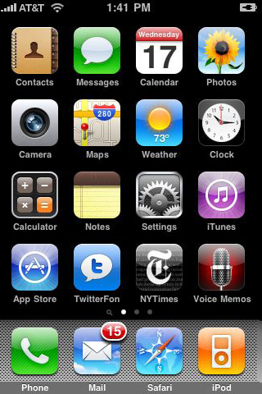
No Boundaries: product
Who owns a product like a smart phone or tablet?
  Hardware platform
  Energy budget, heat budget
  Substantial software
  Plays with world-wide
  communication infrastructure
Seen how this comes together
in this course

Slide 37
No Boundaries: Chips/systems
Computer engineering is about the computing system
  Can be a single chip
  Can be a board or box with 10s to 100s of chips
  Can be an autonomous car with 100s of processing chips
  Can be datacenter with 10,000 processors, Petabits of network bandwidth, and zettabytes of storage
  Can be the global Internet

Slide 38
What’s Next?

Slide 39
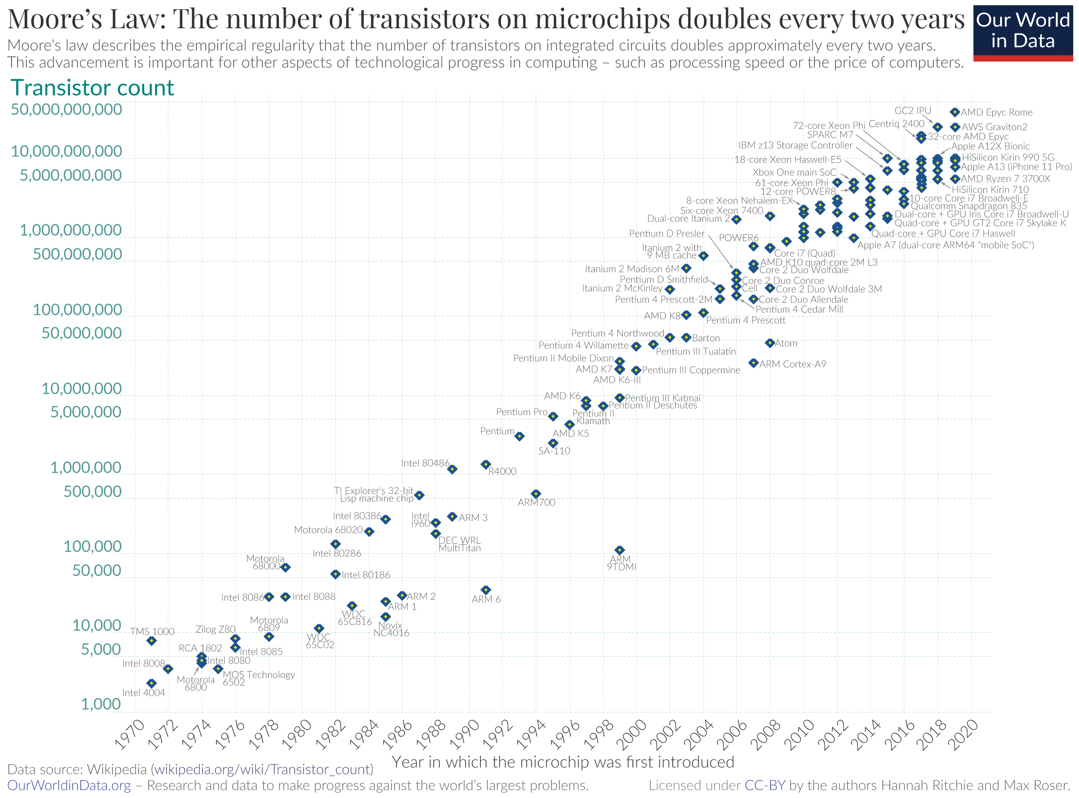
“Moore’s Law” Today
Exponential growth in Integrated Circuit (IC) capacity
Driven by a geometric shrink in transistor feature size
Pitch
Gate

Slide 40
Moore’s Law Enabled
MP3 players
Smart phones and tablets
Digital cameras
Digital video recorders and players
Realistic Games
Skype, Zoom
DNA sequencing
Autonomous Vehicles, Drones
Alexa, Siri
Ubiquitous Machine Learning, Data Analytics

Slide 41
Continued Scaling
What will continued Moore’s Law Scaling enable next?

Slide 42
Parting Thought
From 1st computer to PCs in 30 years
  Eniac 1946→ Apple 1976
From first PCs to iPhone next 30 years
  Apple 1976→iPhone 2007
What will next 30 years hold?
  Beginning of your career
What will you imagine, create, enable?

Slide 43
Remember
Lecture and Lab feedback form
This is last lecture
Last day of term
  Lab 12 and DQ25 due today
Final Friday (5/5) 3pm – Towne 305

