Slide 1

ESE370: Circuit-Level Modeling, Design, and Optimization for Digital Systems
Lec 10: September 27, 2021
MOS Transistor Variation

Slide 2
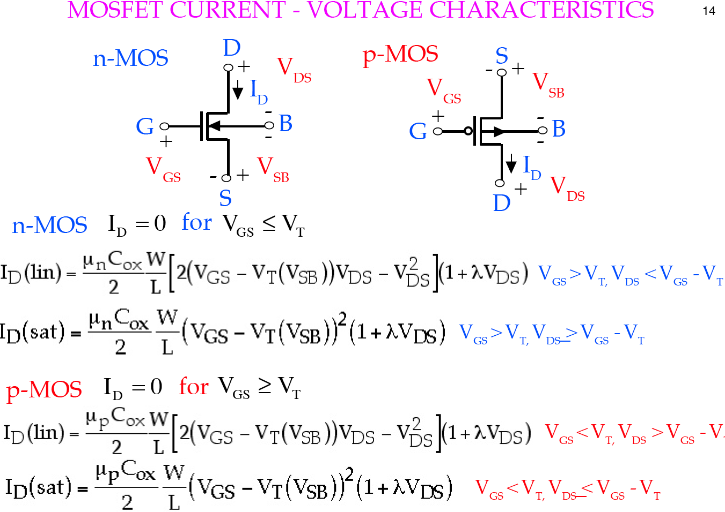
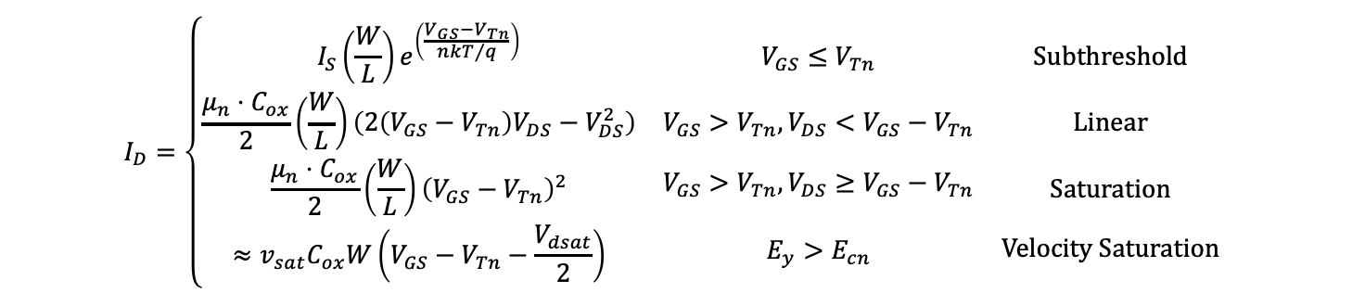
Review: nMOS IV Model
$$I_{D}=\left\{\begin{matrix}I_{S}\left(\frac{W}{L}\right)e^{\left(\frac{V_{GS}−V_{Tn}}{{nkT}/q}\right)} & V_{GS}≤V_{Tn} & Subthreshold \\ \frac{μ_{n}⋅C_{ox}}{2}\left(\frac{W}{L}\right)\left(2\left(V_{GS}−V_{Tn}\right)V_{DS}−V_{DS}^{2}\right) & V_{GS}>V_{Tn},V_{DS}<V_{GS}−V_{Tn} & Linear \\ \begin{aligned}\frac{μ_{n}⋅C_{ox}}{2}\left(\frac{W}{L}\right){\left(V_{GS}−V_{Tn}\right)}^{2} \\ ≈v_{sat}C_{ox}W\left(V_{GS}−V_{Tn}−\frac{V_{dsat}}{2}\right)\end{aligned} & \begin{aligned}V_{GS}>V_{Tn},V_{DS}≥V_{GS}−V_{Tn} \\ \\ E_{y}>E_{cn}\end{aligned} & \begin{aligned}\begin{aligned}Saturation \\ \end{aligned} \\ Velocity Saturation\end{aligned}\end{matrix}\right.$$

Slide 3
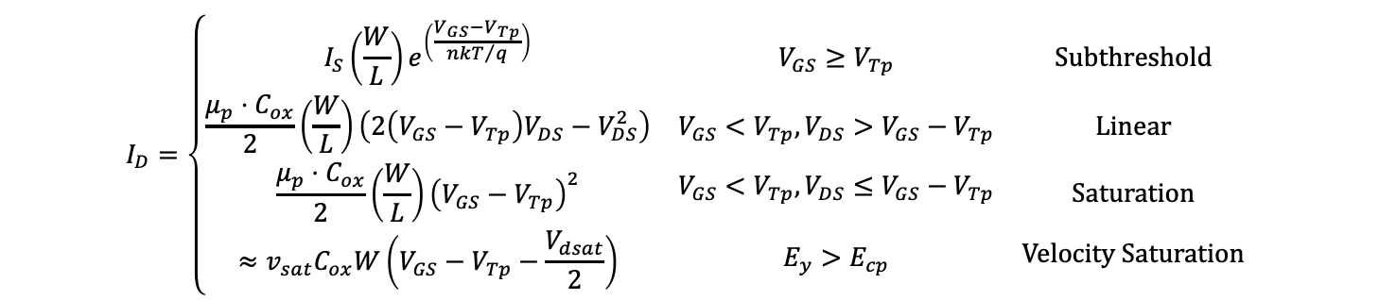
Review: pMOS IV Model
$$I_{D}=\left\{\begin{matrix}I_{S}\left(\frac{W}{L}\right)e^{\left(\frac{V_{GS}−V_{Tp}}{{nkT}/q}\right)} & V_{GS}≥V_{Tp} & Subthreshold \\ \frac{μ_{p}⋅C_{ox}}{2}\left(\frac{W}{L}\right)\left(2\left(V_{GS}−V_{Tp}\right)V_{DS}−V_{DS}^{2}\right) & V_{GS}<V_{Tp},V_{DS}>V_{GS}−V_{Tp} & Linear \\ \begin{aligned}\frac{μ_{p}⋅C_{ox}}{2}\left(\frac{W}{L}\right){\left(V_{GS}−V_{Tp}\right)}^{2} \\ ≈v_{sat}C_{ox}W\left(V_{GS}−V_{Tp}−\frac{V_{dsat}}{2}\right)\end{aligned} & \begin{aligned}V_{GS}<V_{Tp},V_{DS}≤V_{GS}−V_{Tp} \\ \\ E_{y}>E_{cp}\end{aligned} & \begin{aligned}\begin{aligned}Saturation \\ \end{aligned} \\ Velocity Saturation\end{aligned}\end{matrix}\right.$$

Slide 4
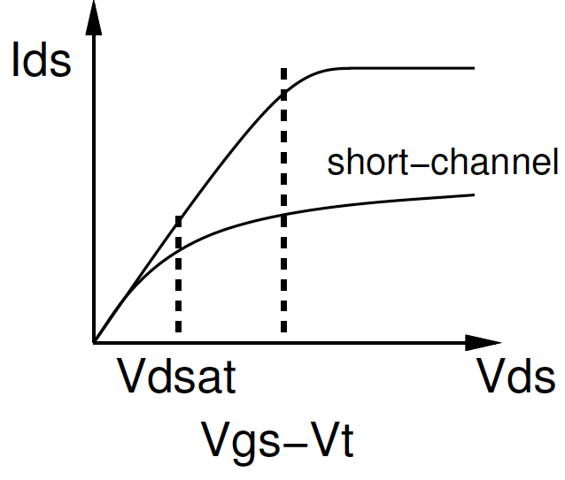
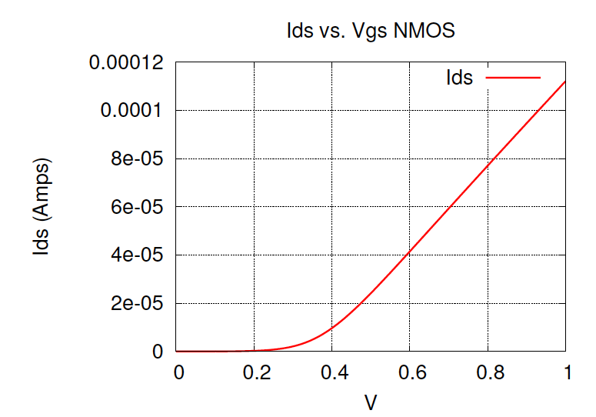
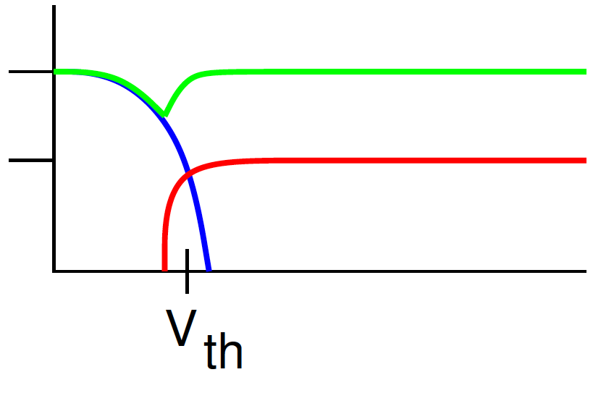
Thus far…
Understand how to model
transistor behavior
Given that we know its parameters
  V_{dd}, V_{th}, C_{OX}, W, L, μ …
C_{GC}
C_{GCS}
C_{GCB}

Slide 5
But…
We don’t know its parameters (perfectly)
  Fabrication parameters have nominal values and error range
  Impact on I_{ds}?
Identically drawn devices differ because of fabrication techniques (e.g. process mismatch)
Parameters change with environment (e.g. Temperature)
Parameters change with time (aging)

Slide 6
Today
Sources of Variation
  Fabrication
  Operation
  Aging
Designing to Account for Variation
  Margin
  Corners
  Binning

Slide 7
Fabrication
7

Slide 8
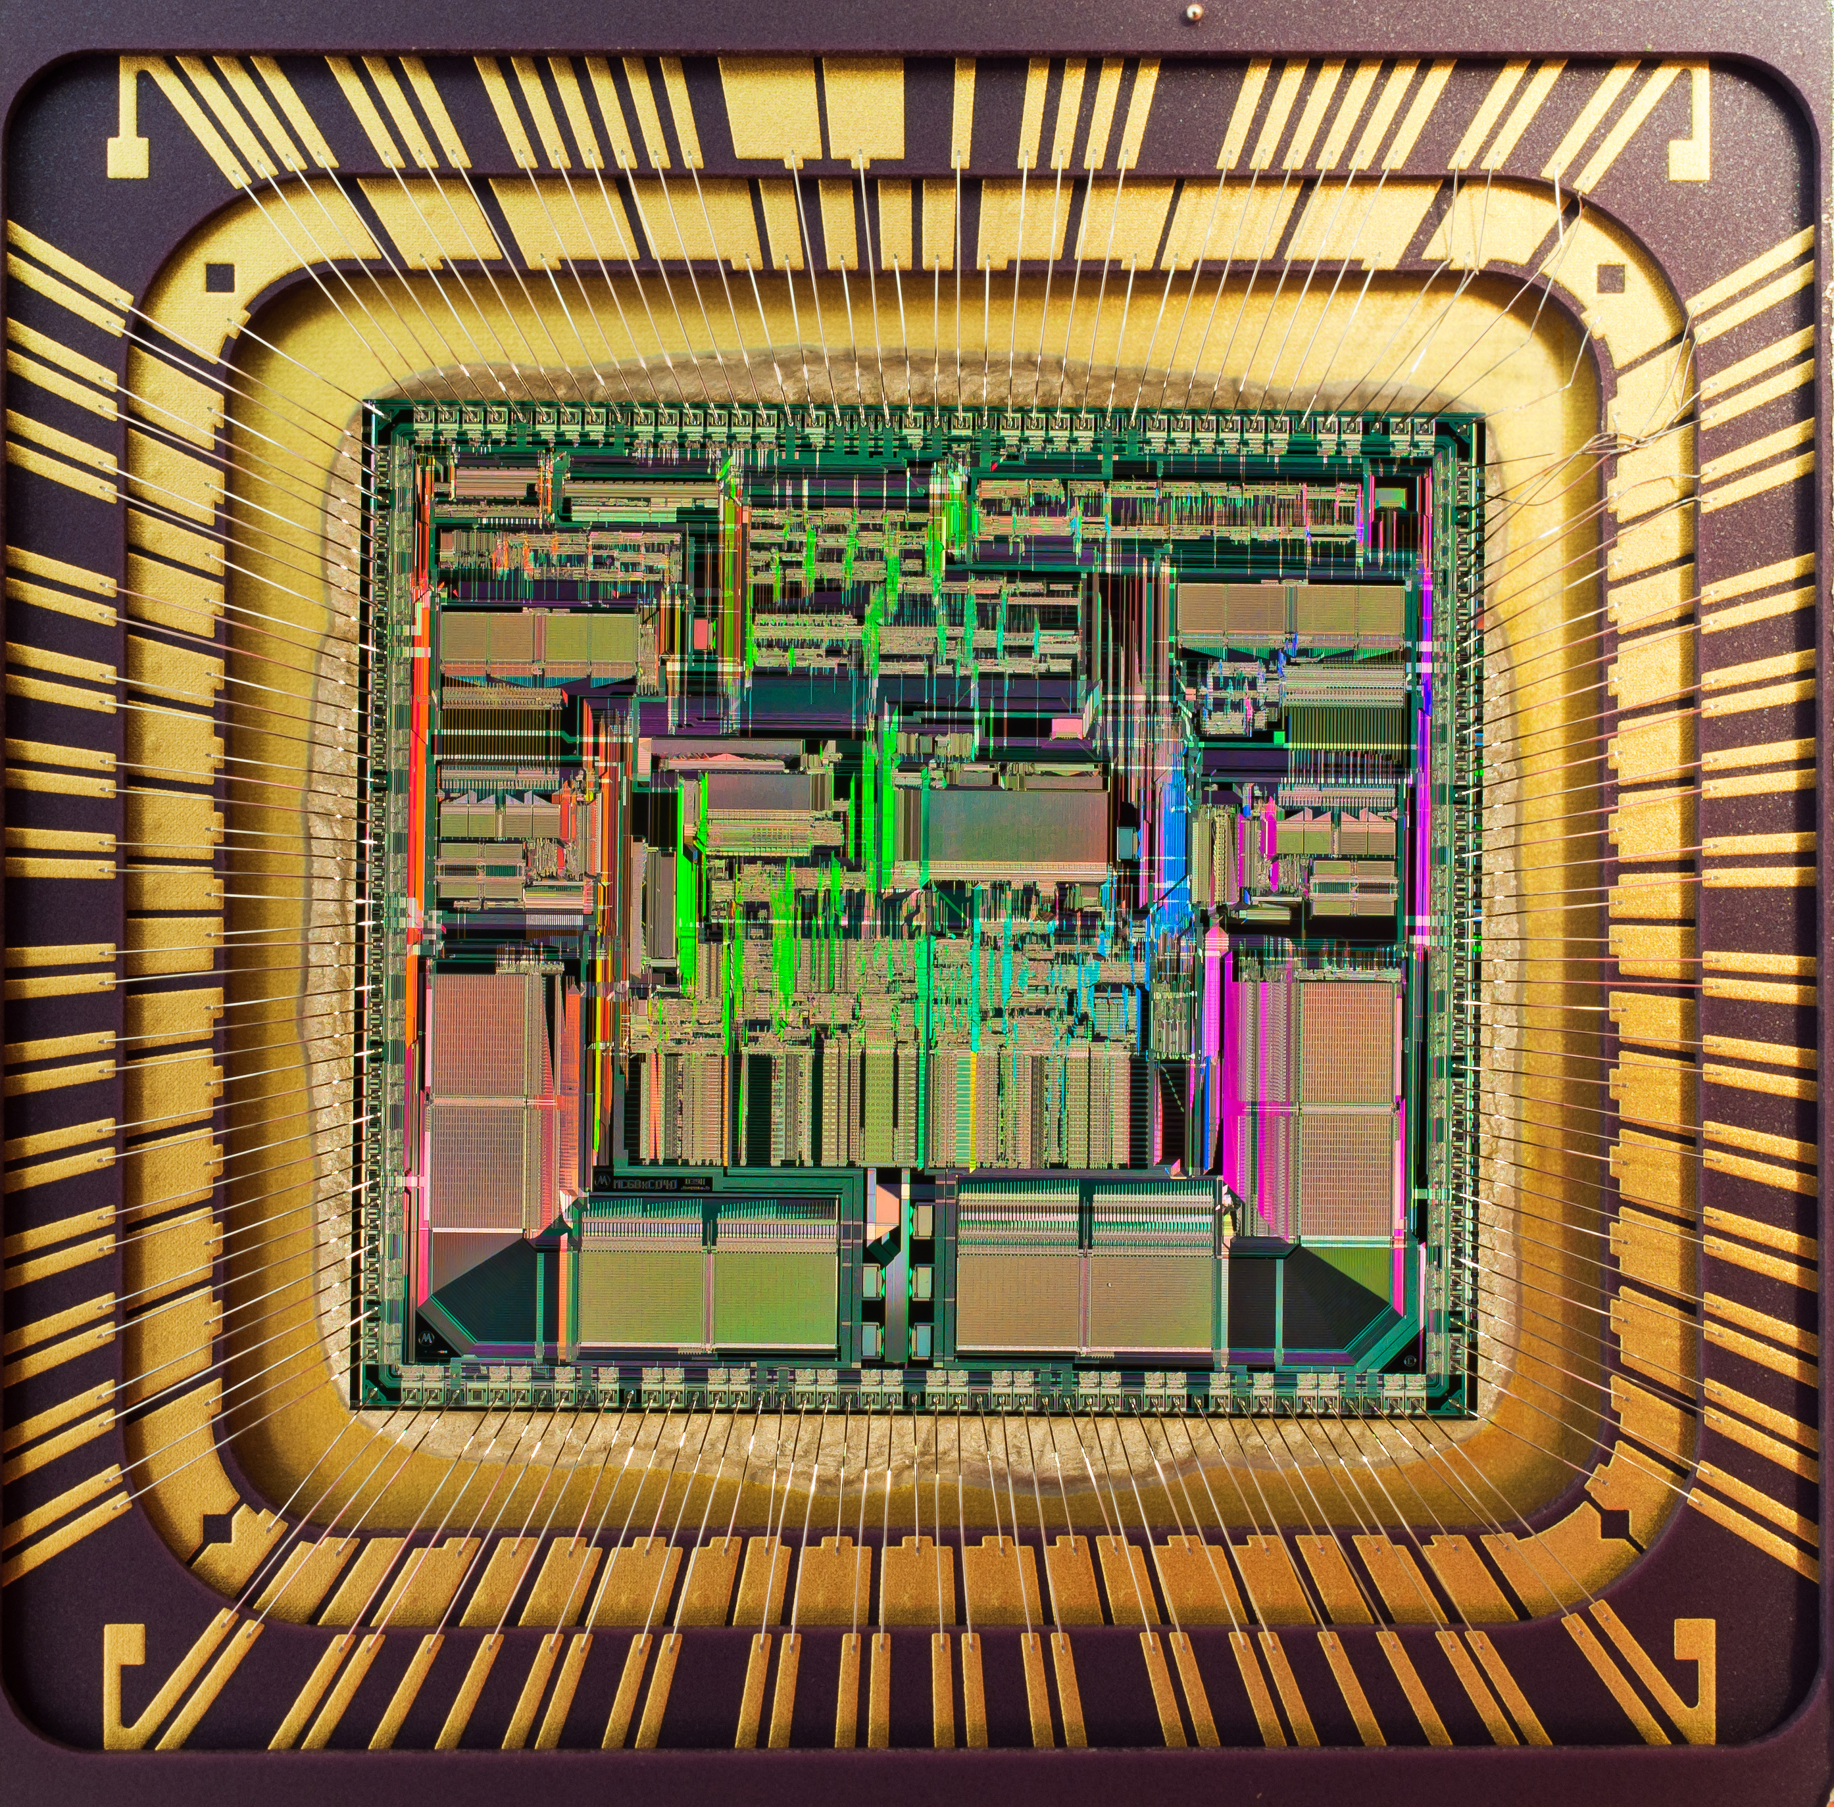
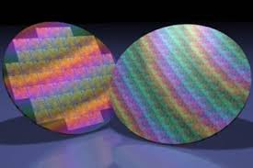

Variation Types
Many reasons why variation occurs and shows up in different ways
Scales of variation
  Wafer-to-wafer, die-to-die, transistor-to-transistor
Correlations of variation
  Systematic, spatial, random (uncorrelated)

Slide 9
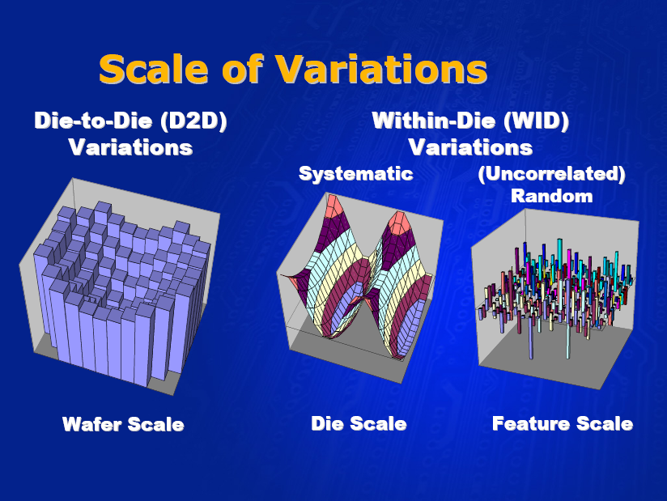
Source: Noel Menezes, Intel ISPD2007

Slide 10
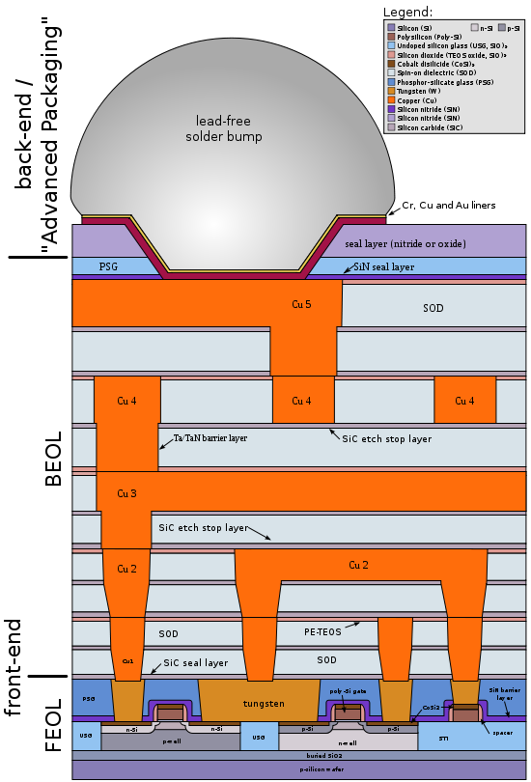
Basic Fabrication: Two Steps
(1) Transfer an image of the design to the wafer
(2) Using that image (mask) as a guide, create the desired layers on silicon
  Diffusion (add dopants to the silicon)
  Oxide (create an insulating layer)
  Metal (create a wire layer)

Slide 11
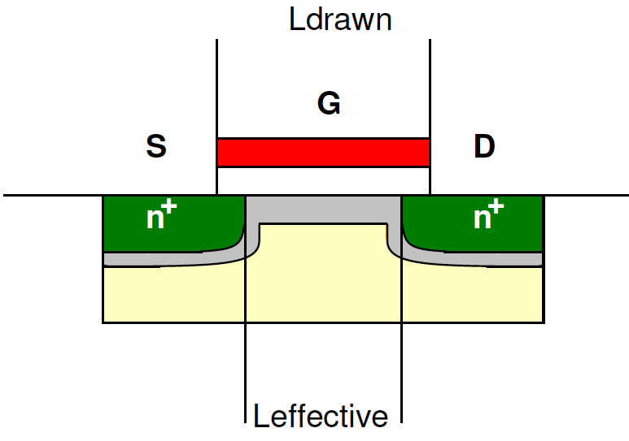
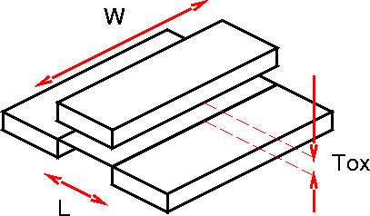
Wafer Scale: Process Shift
Oxide thickness
Doping level
Layer alignment
Growth and Etch rates and times
  Depend on chemical concentrations
    How precisely can we control those?
Vary machine-to-machine, day-to-day
Impact all transistors on wafer

Slide 12
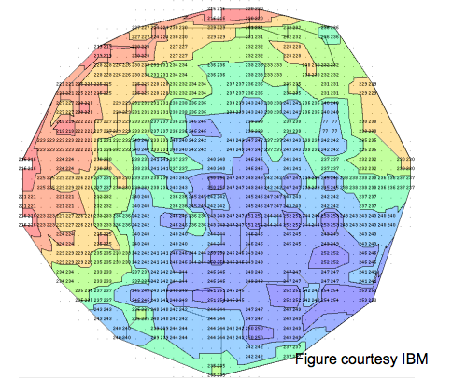
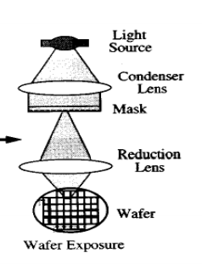
Systematic Spatial Variation
Parameters change consistently across wafer or chip based on location
Sources
  Chemical-Mechanical Polishing (CMP)
    Dishing
  Lens distortion

Slide 13
Random Transistor-to-Transistor
Random dopant fluctuation
Local oxide variation
Line edge roughness
Etch and growth rates
Transistors differ from each other in random ways

Slide 14
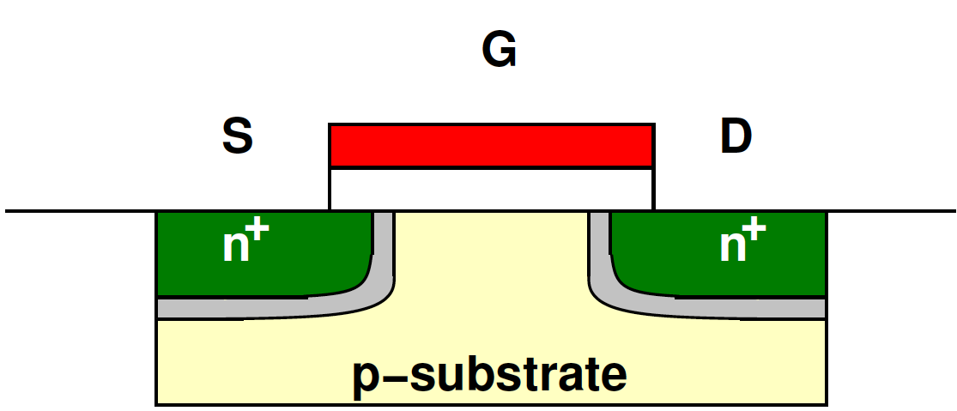
Statistical Dopant Placement
[Bernstein et al, IBM JRD 2006]

Slide 15
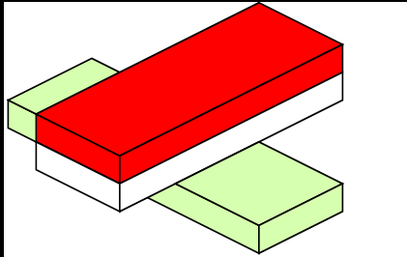
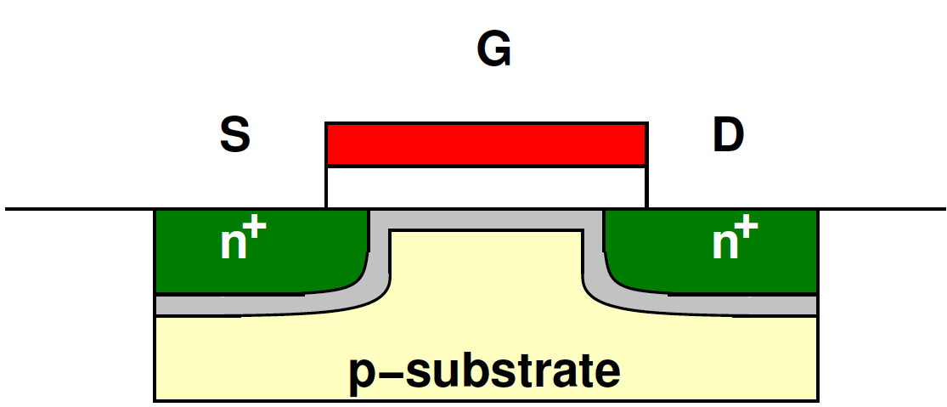
Oxide Thickness and Interface roughness
[Asenov et al. TRED 2002]

Slide 16
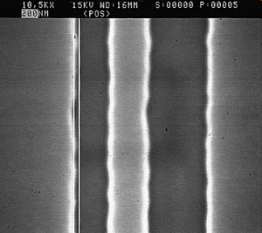
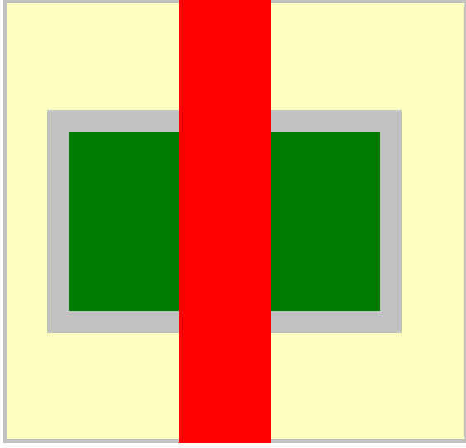
Line Edge Roughness
From:
http://www.microtechweb.com/2d/lw_pict.htm

Slide 17
Line Edge & Line-Width Roughness
LER = lines of device features are not straight
LWR = distance between lines is not uniform
LER & LWR arise from the lithography and etching processes
They are most pronounced in poly-gate patterning
LWR
LER
Source: Kuhn et al.

Slide 18
Source: Noel Menezes, Intel ISPD2007

Slide 19
Impact on I_{d} (preclass 1)
Changes parameters
  W, L, t_{OX}, V_{th,} etc.
Change transistor behavior
  W increase?
  L increase?
  t_{OX} increase?
  V_{th} increase?

Slide 20
Example: V_{th}
Many physical effects impact V_{th}
  Doping, dimensions, roughness
Behavior highly dependent on V_{th}

Slide 21
V_{th} Variability @ 65nm
[Bernstein et al, IBM JRD 2006]

Slide 22
Impact of V_{th} Variation?
Higher V_{th}?
  Not drive as strongly
  I_{d,vsat}∝ (V_{gs}-V_{th})
  Performance?

Slide 23
Impact Performance
Higher V_{th} → lower I_{ds} → Delay (R_{on} * C_{load})?

Slide 24
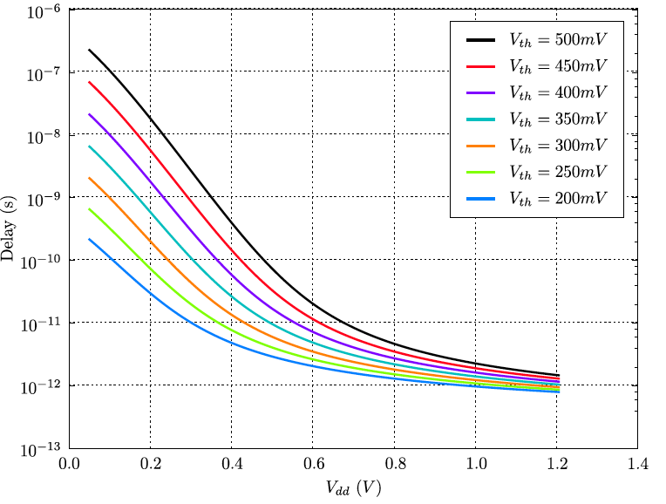
Impact Performance
Higher V_{th} → lower I_{ds} → Delay (R_{on} * C_{load})?
V_{th} increasing

Slide 25
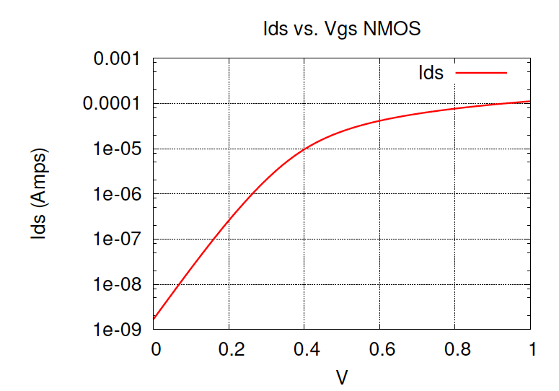
Impact of V_{th} Variation?
Lower V_{th}?
  Not turn off as well → leaks more

Slide 26
Operation
Temperature
Voltage
26

Slide 27
Temperature Changes
Different ambient environments
  January in Maine
  July in Philly
  Air conditioned machine room
Self heat from activity of chip
Quality of heat sink (attachment thereof)
  E.g cooling fan

Slide 28
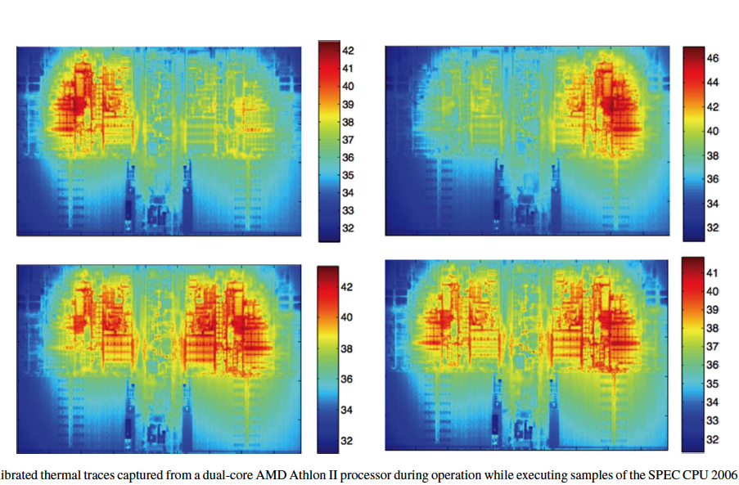
Thermal Profile for Processor
[Reda/IEEE Tr Emerging CAS v1n2 2011]

Slide 29
How does temperature impact on-current?
High temperature
  More free thermal energy
    Easier to conduct
    Lowers V_{th}
  Increase rate of collision
    Lower saturation velocity
    Lower saturation voltage
    Lower peak I_{ds} → slows down
One reason don’t want chips to run hot

Slide 30
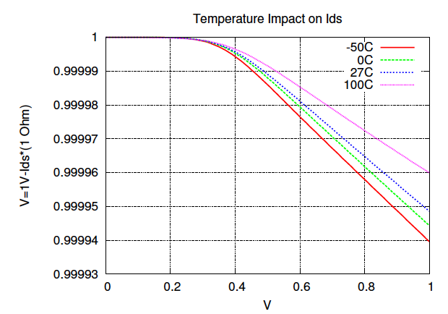
Temperature and I_{ds}
I_{ds} decreasing

Slide 31
Temperature and I_{ds}
I_{ds} decreasing
T increasing

Slide 32
How does temp impact leakage current?
High temperature lowers V_{th}

Slide 33
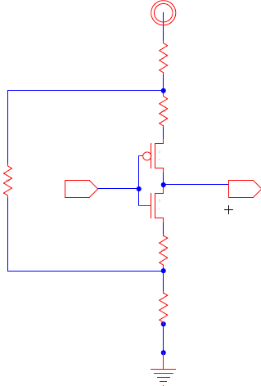
Voltage
Power supply isn’t perfect
Differs from design to design
  Board to board?
  How precise is regulator?
IR-drop in distribution
Bounce with current spikes

Slide 34
Aging
Hot Carrier Injection
Negative Bias Temperature Instability (NBTI)
34

Slide 35
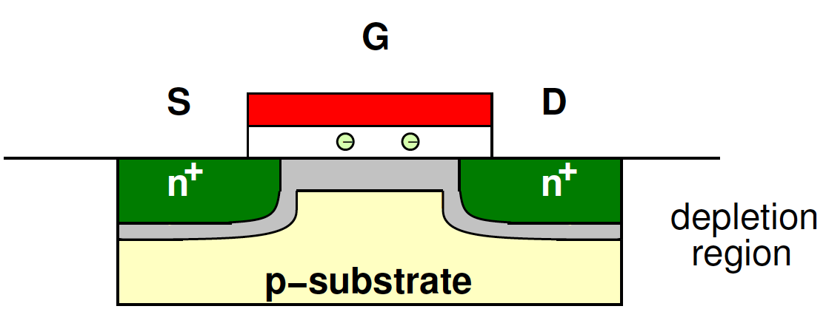
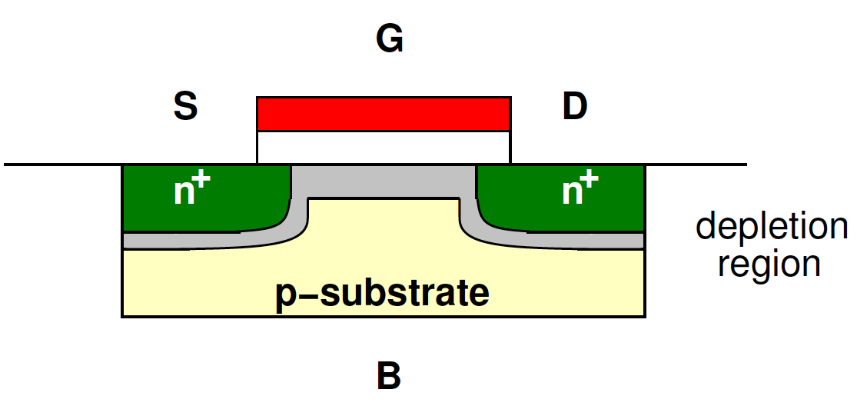
Hot Carrier Injection
Trap electrons in oxide
  increases V_{th}

Slide 36
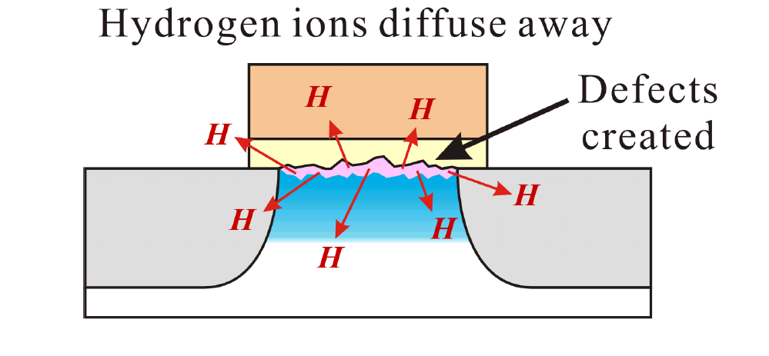

NBTI
Negative Bias Temperature Instability
  Interface traps, Holes
Long-term negative gate-source voltage
  Affects PFET most
Increase V_{th}
Temperature dependent
[Stott, FPGA2010]

Slide 37
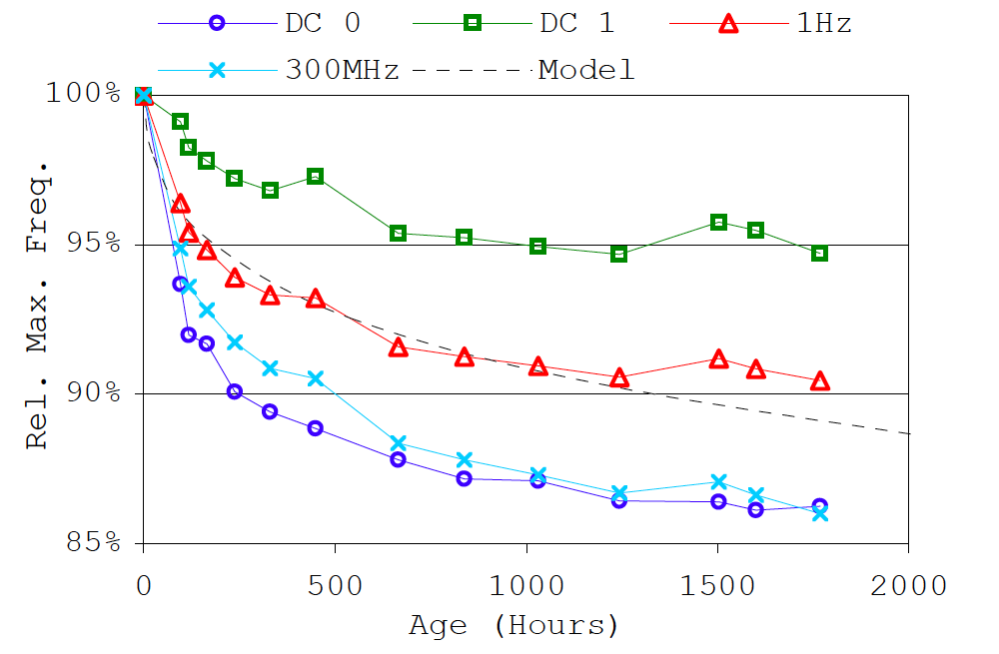
Measured Accelerated Aging
(Cyclone III, 65nm FPGA)
[Stott, FPGA2010]

Slide 38
Coping with Variation
38

Slide 39
Variation
See a range of parameters
  L: L_{min} – L_{max}
  V_{th}: V_{th,min} – V_{th,max}

Slide 40
Impact of V_{th} Variation
Higher V_{th}
  Not drive as strongly
  I_{d,vsat}∝ (V_{gs}-V_{TH})
Lower V_{th}
  Not turn off as well → leaks more

Slide 41
Variation
Margin for expected variation
Must assume V_{th} can be any value in range
  Speed → assume V_{th} slowest value
I_{on,min}=I_{on}(V_{th,max})
  I_{d,vsat}∝ (V_{gs}-V_{th})
Probability Distribution
V_{TH}

Slide 42

Gaussian Distribution
From: http://en.wikipedia.org/wiki/File:Standard_deviation_diagram.svg

Slide 43
Impact (preclass 2&3)
Given
  V_{th,nom} = 250mV
  Standard deviation: σ= 25mV
Probability of 100 transistor circuit having all transistors with threshold in range 200mV<V_{th}<300mV
  When each transistors has 96% prob of being in range?
  When each has 99.8% probability?

Slide 44
Variation
See a range of parameters
  L: L_{min} – L_{max}
  V_{th}: V_{th,min} – V_{th,max}
Validate design at extremes
  Work for both V_{th,min} and V_{th,max} ?
  Design for worst-case scenario

Slide 45
Margining
Also margin for
  Temperature
  Voltage
  Aging: end-of-life

Slide 46
Process Corners (preclass 4)
Many effects independent
Many parameters
With N parameters,
  Look only at extreme ends (low, high)
  How many cases?
Try to identify the {worst,best} set of parameters
  Slow corner of design space, fast corner
Use corners to bracket behavior

Slide 47
Simple Corner Example
What happens
at various
corners?
350mV
1
2
Vthp
150mV
3
4
150mV
350mV
Vthn

Slide 48
Process Corners
Many effects independent
Many parameters
Try to identify the {worst,best} set of parameters
  E.g. Lump together things that make slow
    Vtn, Vtp, temperature, Voltage
    Try to reduce number of unique corners
  Slow corner of design space
Use corners to bracket behavior

Slide 49
Worst-case Corner Model
corners for analog applications
  For modeling worst-case speed
    Slow NMOS and slow PMOS(SS) corner
  For modeling worst-case power
    Fast NMOS and fast PMOS(FF) corner
corners for digital applications
  For modeling worst-case 1
    Fast NMOS and slow PMOS(FS) corner
  For modeling worst-case 0
    Slow NMOS and fast PMOS(SF) corner

Slide 50
Worst-case Corner Model
Advantages
  Worst case corner models give designers the capability to simulate the pass/fail results of a typical design and are usually pessimistic.
Disadvantages
  The fixed-corner method is too wide
  Some valid designs can not be accepted in worst-case corner model
  The correlations between the device parameters are ignored

Slide 51
Statistical Corner Model
For more realistic modeling for process variability than worst-case corner model.
  Using data from different dies, wafers, and wafer lots collected over a long enough period of time to represents realistic process variability of the target technology
The difference between statistical corner model and worst-case corner-model
  Statistical corner model use the realistic PDF of the corresponding model parameter of its typical model
    PDF is obtained from the distribution of a large set of production data
  Statistical models can pass a valid design, which were rejected in worst-corner model

Slide 52
Range of Behavior
Still get range of performances
Any way to exploit the fact some are faster?
Probability Distribution
Delay

Slide 53
Speed Binning
Sell
nominal
Sell
cheap
Sell
Premium
Discard
Probability Distribution
Delay

Slide 54
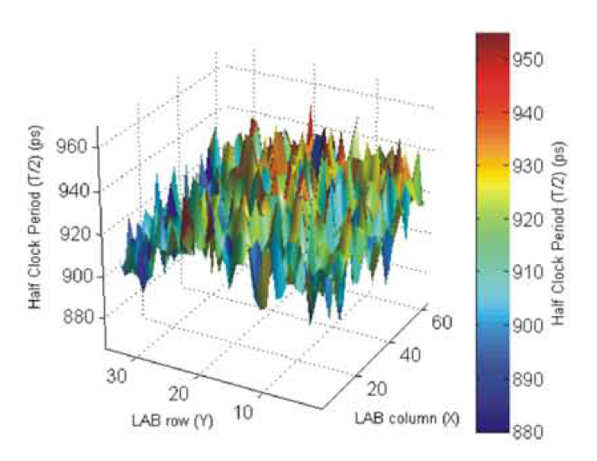
Big Idea
Parameters Approximate
Differ
  Chip-to-chip, transistor-to-transistor, over time
Robust design accommodates
  Tolerance and Margins
  Doesn’t depend on precise behavior

Slide 55
Admin
HW 3 due tonight @midnight
Midterm 1 Friday 10/1 (next week)
  7-9pm in Towne 309
  No Lecture, virtual office hours
  Virtual review session on Wednesday, will be recorded
    See Piazza for updates
HW 4 posted Friday 10/1 after midterm
  Due following Friday 10/8 @midnight

