Slide 1

ESE370: Circuit-Level Modeling, Design, and Optimization for Digital Systems
Lec 12: October 4, 2021
Scaling

Slide 2
Today
Layout Roundup
  Extraction
VLSI Scaling Trends/Disciplines
Effects
Alternatives (cheating)

Slide 3
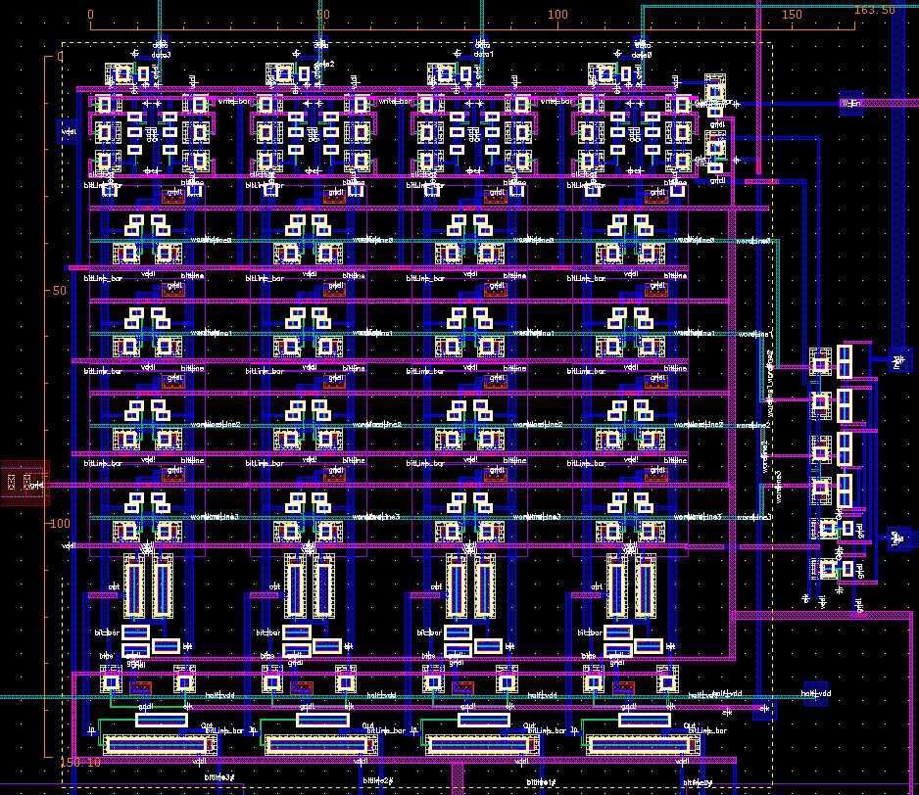
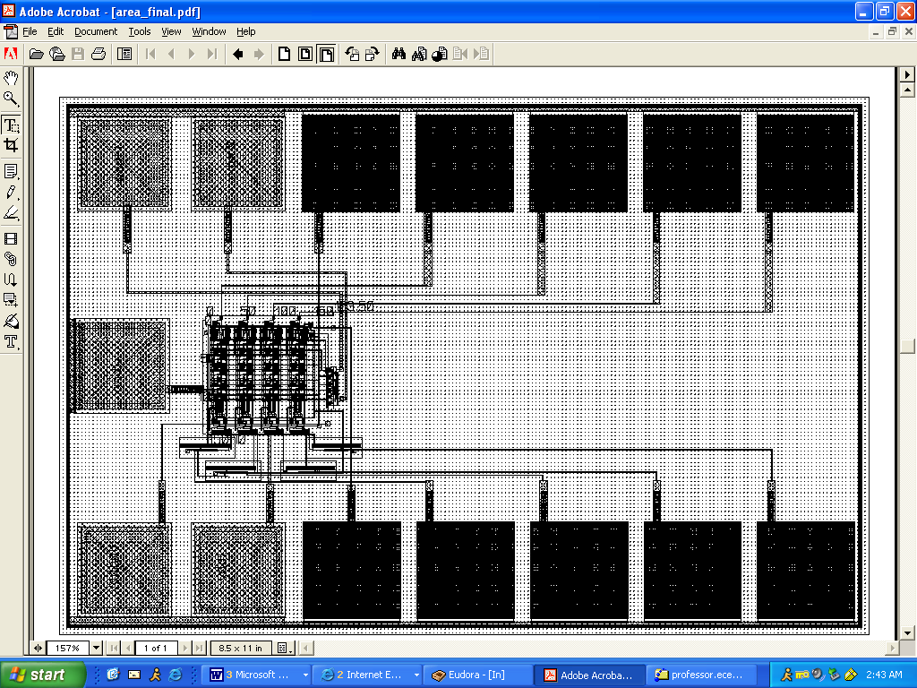
4x4 6T SRAM Memory

Slide 4
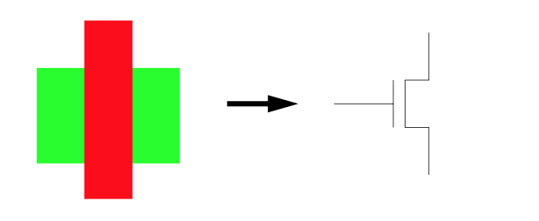
Circuit Extraction
Circuit extraction extracts a schematic representation of a layout, including transistors, wires, and possibly wire and device resistance and capacitance.
Circuit extraction is used for LVS, and for spice simulation of layouts

Slide 5
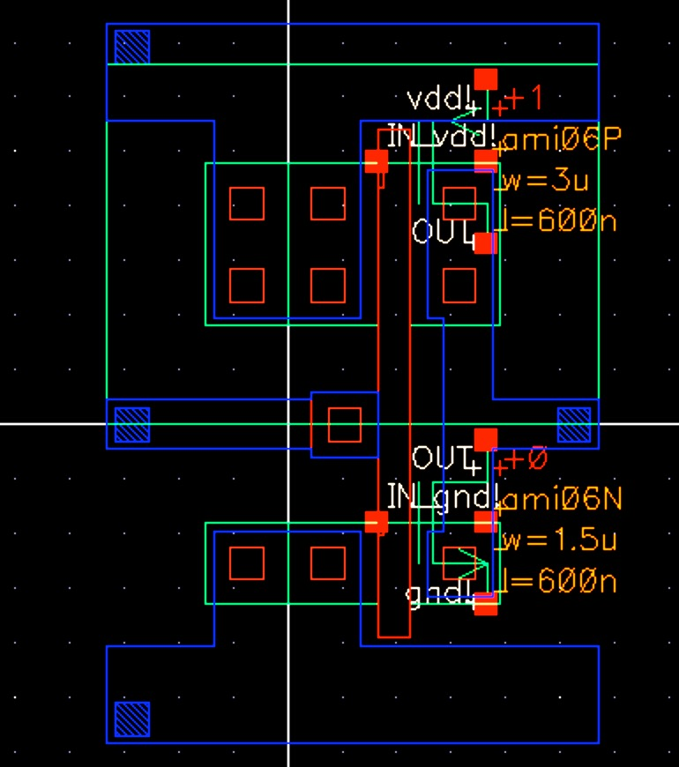
Circuit Extraction

Slide 6
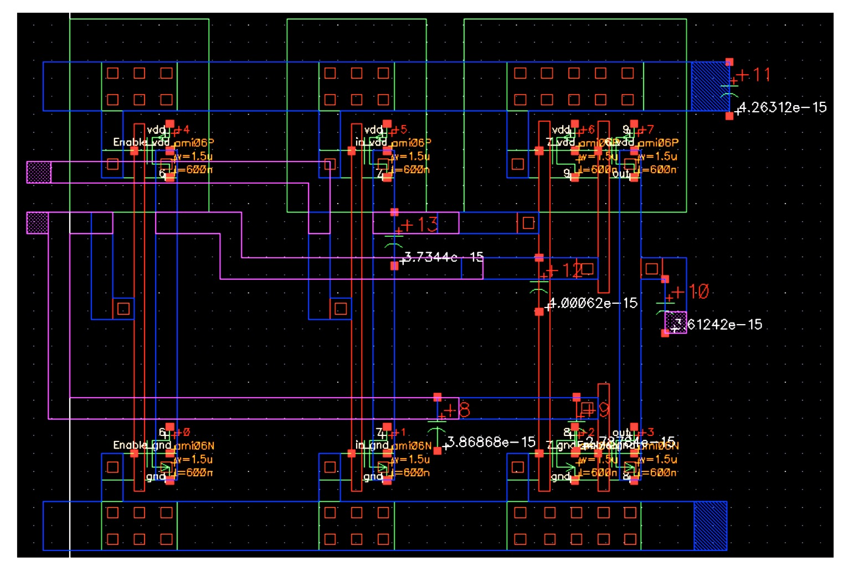
Circuit Extraction

Slide 7
Scaling

Slide 8
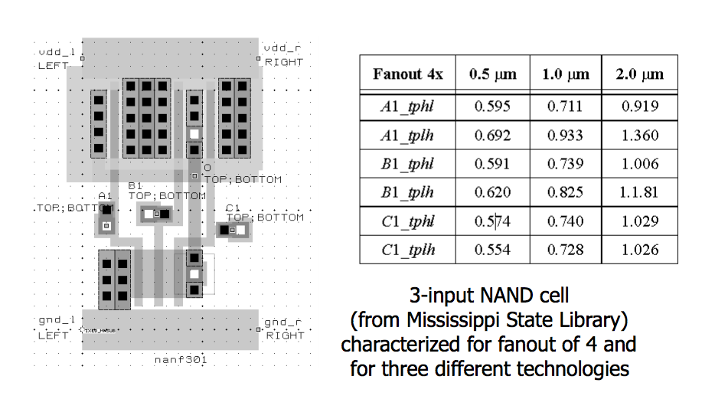
Standard Cells

Slide 9
Scaling Technology
Premise: features scale “uniformly”
  everything gets better in a predictable manner
Parameters:
  λ (lambda) -- Mead and Conway (L=2λ)
  F -- Half pitch – ITRS (F=2λ=L)
  S – scale factor – Rabaey
    F’=F/S
      S>1
Metal
Pitch
(Typical
DRAM)

Slide 10
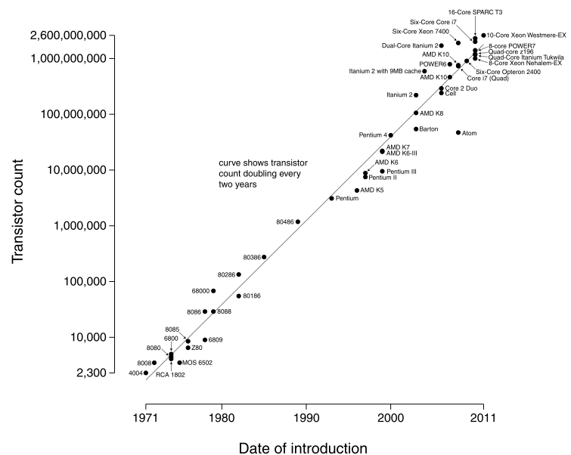
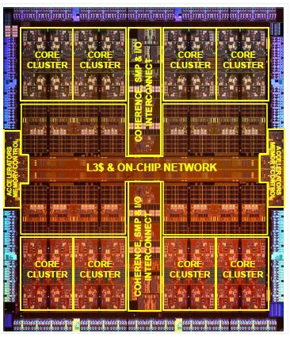
Microprocessor Trans Count 1971-2015
16-Core SPARC T3
6-Core i7
10-Core Xenon
6-Core i7
2-Core Itanium 2
IBM 4-Core z196
IBM 8-Core POWER7
4-Core Itanium Tukwilla
Curve shows transistor count doubling every two years
AMD K10
AMD 6-Core Opteron 2400
4-Core i7
AMD K8
Pentium 4
AMD K7
Pentium III
Pentium
Pentium II
AMD K5
80486
80386
80286
Mot 68000
80186
8086
Mot 6800
8080
Zilog Z80
2015: Oracle SPARC M7, 20 nm CMOS,
32-Core, 10B 3-D FinFET transistors.
8006
MOS 6502
4004
2015
Penn ESE 370 Fall 2021 - Khanna

Slide 11
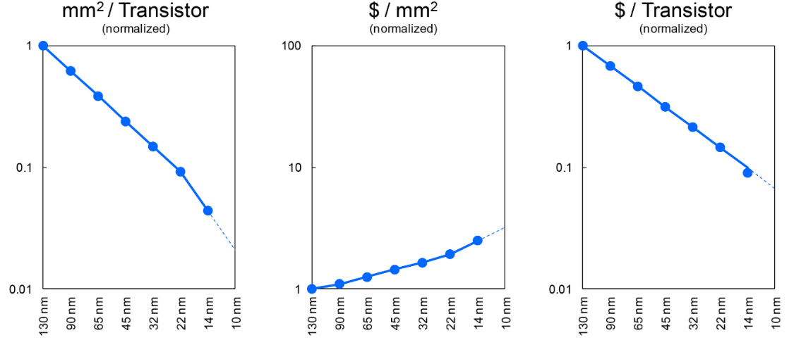
Intel Cost Scaling
http://www.anandtech.com/show/8367/intels-14nm-technology-in-detail

Slide 12
More Moore → Scaling
Geometrical Scaling
  continued shrinking of horizontal and vertical physical feature sizes
Design Equivalent Scaling
  design technologies that enable high performance, low power, high reliability, low cost, and high design productivity even if neither geometrical nor equivalent scaling can be used

Slide 13
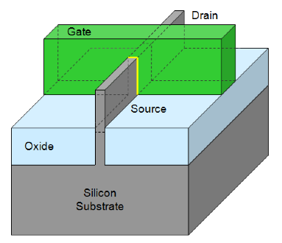
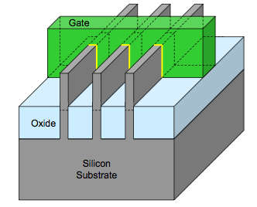
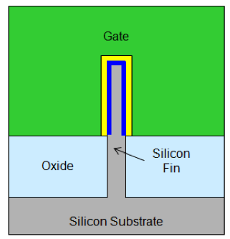
22nm 3D FinFET Transistor
High-k gate dielectric
Tri-Gate transistors with multiple fins connected together increases total drive strength for higher performance
http://download.intel.com/newsroom/kits/22nm/pdfs/22nm-Details_Presentation.pdf

Slide 14
ITRS Roadmap
International Technology Roadmap for Semiconductors
  Try to predict where industry going
ITRS 2.0 started in 2015 with new focus
  System Integration, Heterogeneous Integration, Heterogeneous Components, Outside System Connectiviy, More Moore, Beyond CMOS and Factory Integartion.
http://www.itrs2.net/

Slide 15
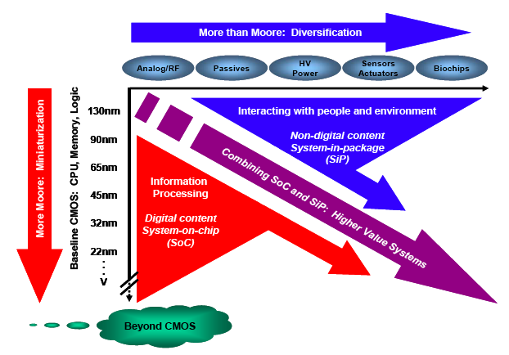
More-than-Moore
Scaling
“More-than-Moore”, International Road Map (IRC) White Paper, 2011.
International Technology Road Map for Semiconductors

Slide 16
Preclass 1
Scaling from 32nm → 22nm, what is 1/S?
  Scaling minimum gate length
  And pitch distance

Slide 17
MOS Transistor Scaling - (1974 to present)
1/S=0.7
per technology node
[0.5x per 2 nodes]
Pitch
Gate
Source: 2001 ITRS - Exec. Summary, ORTC Figure, Andrew Kahng

Slide 18
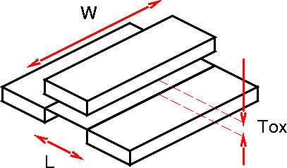
Scaling
Channel Length (L)
Channel Width (W)
Oxide Thickness (t_{ox})
Doping (N_{a})
Voltage (V_{DD},V_{t},)

Slide 19
Full Scaling (Ideal Scaling)
Channel Length (L) 1/S
Channel Width (W) 1/S
Oxide Thickness (t_{ox}) 1/S
Doping (N_{a}) S
Voltage (V_{DD},V_{t},) 1/S

Slide 20
Effects on Physical Properties and Specs?
Area
Capacitance
  C_{ox} and C_{gate}
Resistance
Current (I_{d})
Gate Delay (τ_{gd})
Wire Delay (τ_{wire})
Power
  Same frequency
  Scaled frequency
Power Density
  Same frequency
  Scaled frequency
Preclass 2 - table

Slide 21
Area
λ’ ➔ λ/S
Area impact?
Α = L × W
L
W

Slide 22
Area
λ’ ➔ λ/S
Area impact?
Α = L × W
Α’ ➔ Α/S²
32nm ➔ 22nm
50% area
2 × transistor capacity for same area
L
1/S=0.7
W

Slide 23
Capacitance
Capacitance per unit area scaling?
  C_{ox}= ε_{SiO2}/t_{ox}
  t’_{ox}➔ t_{ox}/S

Slide 24
Capacitance
Capacitance per unit area scaling?
  C_{ox}= ε_{SiO2}/t_{ox}
  t’_{ox}➔ t_{ox}/S
  C’_{ox} ➔ C_{ox}×S

Slide 25
Capacitance
Gate Capacitance scaling?
  C_{gate}= A×C_{ox}
  Α’ ➔ Α/S²
  C’_{ox} ➔ C_{ox}×S

Slide 26
Capacitance
Gate Capacitance scaling?
  C_{gate}= A×C_{ox}
  Α’ ➔ Α/S²
  C’_{ox} ➔ C_{ox}×S
  C’_{gate} ➔ C_{gate}/S

Slide 27
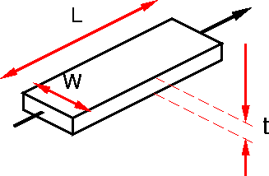
Wire Resistance
Resistance scaling?
R=ρL/(W*t)
  L, t remain similar (not scaled)
W→ W/S

Slide 28
Wire Resistance
Resistance scaling?
R=ρL/(W*t)
  L, t remain similar (not scaled)
W→ W/S
R’ → R×S

Slide 29
Current
Which Voltages matters here? (V_{gs},V_{ds},V_{th}…)
Transistor charging looks like
voltage-controlled current source
Saturation Current scaling?
  I_{d}=(μC_{OX}/2)(W/L)(V_{gs}-V_{TH})²
  V_{gs},V_{TH}: V’→ V/S
  W’→ W/S
  L’→ L/S
  C’_{ox} → C_{ox}×S

Slide 30
Current
Which Voltages matters here? (V_{gs},V_{ds},V_{th}…)
Transistor charging looks like
voltage-controlled current source
Saturation Current scaling?
  I_{d}=(μC_{OX}/2)(W/L)(V_{gs}-V_{TH})²
  V_{gs},V_{TH}: V’→ V/S
  W’→ W/S
  L’→ L/S
  C’_{ox} → C_{ox}×S
  I’_{d}=(μC_{OX}S/2)((W/S)/(L/S))(V_{gs}/S-V_{TH}/S)²

Slide 31
Current
Which Voltages matters here? (V_{gs},V_{ds},V_{th}…)
Transistor charging looks like
voltage-controlled current source
Saturation Current scaling?
  I_{d}=(μC_{OX}/2)(W/L)(V_{gs}-V_{TH})²
  V_{gs},V_{TH}: V’→ V/S
  W’→ W/S
  L’→ L/S
  C’_{ox} → C_{ox}×S
  I’_{d}→I_{d}/S

Slide 32
Current
Velocity Saturation Current scaling?
  V_{gs},V_{TH}: V’→ V/S
  L’→ L/S
  W’→ W/S
  C’_{ox} → C_{ox}S

Slide 33
Current
Velocity Saturation Current scaling?
  V_{gs},V_{TH}: V’→ V/S
  L’→ L/S
  W’→ W/S
  C’_{ox} → C_{ox}S
  I’_{d}→ I_{d}/S

Slide 34
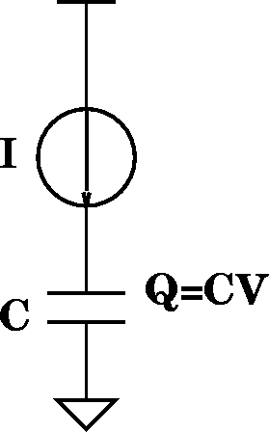
Gate Delay
Gate Delay scaling?
τ_{gd}=Q/I=(CV)/I
V’→ V/S
I’_{d} → I_{d}/S
C_{g}’ → C_{g}/S

Slide 35
Gate Delay
Gate Delay scaling?
τ_{gd}=Q/I=(CV)/I
V’→ V/S
I’_{d} → I_{d}/S
C_{g}’ → C_{g}/S
τ’_{gd} → τ_{gd}/S

Slide 36
Wire Delay
Wire delay scaling?
τ_{wire}=R×C
R’ → R×S
C’ → C/S
Again assuming (logical) wire lengths remain constant

Slide 37
Wire Delay
Wire delay scaling?
τ_{wire}=R×C
R’ → R×S
C’ → C/S
τ’_{wire} → τ_{wire}
Again assuming (logical) wire lengths remain constant

Slide 38
Power Dissipation (Dynamic)
Capacitive (Dis)charging scaling?
  P=(1/2)CV²f
  V’→ V/S
  C’ → C/S

Slide 39
Power Dissipation (Dynamic)
Capacitive (Dis)charging scaling?
  P=(1/2)CV²f
  V’→ V/S
  C’ → C/S
  P’→ P/S³

Slide 40
Power Dissipation (Dynamic)
Capacitive (Dis)charging scaling?
  P=(1/2)CV²f
  V’→ V/S
  C’ → C/S
  P’→ P/S³
Increase Frequency?
  τ_{gd} → τ_{gd}/S
  So: f → f×S

Slide 41
Power Dissipation (Dynamic)
Capacitive (Dis)charging scaling?
  P=(1/2)CV²f
  V’→ V/S
  C’ → C/S
  P’→ P/S³
Increase Frequency?
  τ_{gd} → τ_{gd}/S
  So: f → f×S
  P → P/S²

Slide 42
Effects? (Preclass 2)
Area 1/S²
Capacitance (C_{ox}, C_{g}) S, 1/S
Resistance S
Threshold (V_{th}) 1/S
Current (I_{d}) 1/S
Gate Delay (τ_{gd}) 1/S
Wire Delay (τ_{wire}) 1
Power 1/S³, 1/S²
1/S=0.7

Slide 43
Power Density
P’ ➔ P/S² (increased frequency)
P’ ➔ P/S³ (same frequency)
A’ ➔ A/S²
Power Density: P/A two cases?

Slide 44
Power Density
P’ ➔ P/S² (increased frequency)
P’ ➔ P/S³ (same frequency)
A’ ➔ A/S²
Power Density: P/A two cases?
  P/A ➔ P/A increase freq.
  P/A ➔ (P/A)/S same freq.

Slide 45
But…
Don’t like some of the implications
  High resistance wires
  Higher gate oxide capacitance with atomic-scale dimensions
    …. Quantum tunneling
  Need for more wiring
  Not scale speed fast enough

Slide 46
Improving Resistance
R=ρL/(W×t)
W’→ W/S
  L, t similar
R’ → R×S

Slide 47
Improving Resistance
R=ρL/(W×t)
W’→ W/S
  L, t similar
R’ → R×S
What might we do?
Decrease ρ (copper) – introduced 1997
http://www.ibm.com/ibm100/us/en/icons/copperchip/

Slide 48
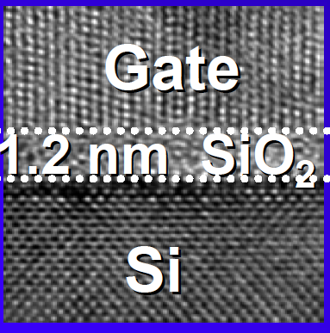
Capacitance and Leakage
Capacitance per unit area
  C_{ox}= ε_{SiO2}/t_{ox}
  t’_{ox}➔ t_{ox}/S
  C’_{ox} ➔ C_{ox}×S
What’s wrong with t_{ox} = 1.2nm?
source: Borkar/Micro 2004

Slide 49
Capacitance and Leakage
Capacitance per unit area
  C_{ox}= ε_{SiO2}/t_{ox}
  t’_{ox}➔ t_{ox}/S
  C’_{ox} ➔ C_{ox}×S
What might we do?
Reduce dielectric constant, ε, and not scale thickness to mimic t_{ox} scaling.

Slide 50
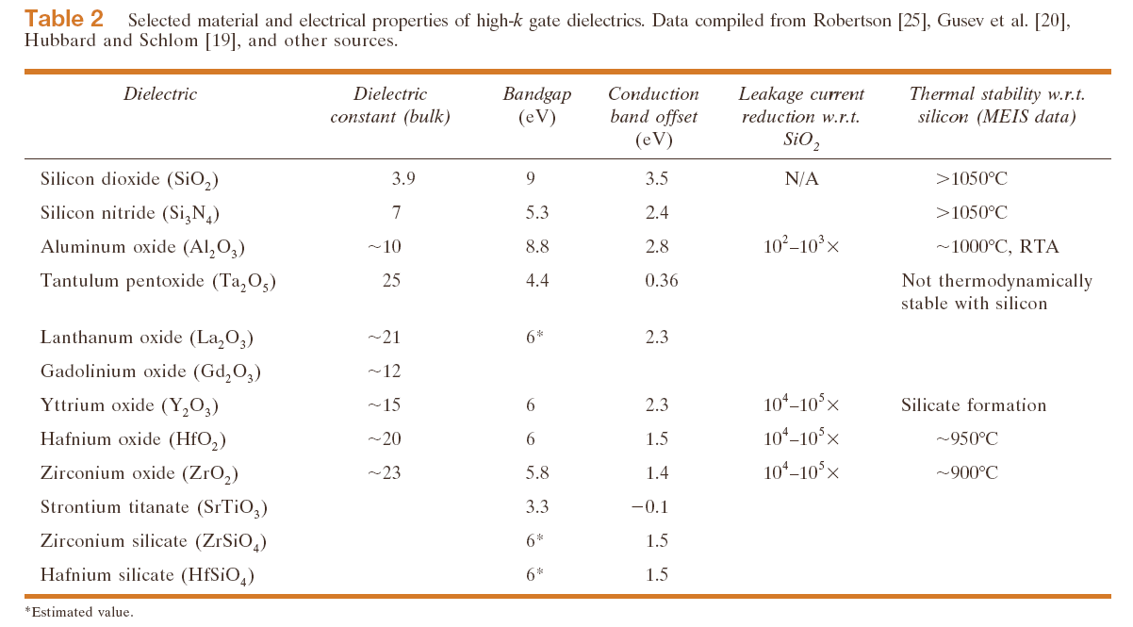
High-K dielectric Survey
Wong/IBM J. of R&D, V46N2/3P133—168, 2002

Slide 51
Wire Layers = More Wiring

Slide 52
Gate Delay
τ_{gd}=Q/I=(CV)/I
V’→ V/S
I’_{d} → I_{d}/S
C_{g}’ → C_{g}/S
τ’_{gd} → τ_{gd}/S
How might we
accelerate speed up?

Slide 53
Gate Delay
τ_{gd}=Q/I=(CV)/I
V’→ V
  I’_{d}=(μC_{OX}S/2)((W/S)/(L/S))(V_{gs}-V_{TH})²
I’_{d} → I_{d}×S
How might we
accelerate speed up?
Don’t scale V!

Slide 54
Gate Delay
τ_{gd}=Q/I=(CV)/I
V’→ V
  I’_{d}=(μC_{OX}S/2)((W/S)/(L/S))(V_{gs}-V_{TH})²
I’_{d} → I_{d}×S
C_{g}’ → C_{g}/S
τ’_{gd} → τ_{gd}/S²
How might we
accelerate speed up?
Don’t scale V!

Slide 55
But… Power Dissipation (Dynamic)
Capacitive (Dis)charging
  P=(1/2)CV²f
  V’→ V
  C’ → C/S
  P’→ P/S

Slide 56
But… Power Dissipation (Dynamic)
Capacitive (Dis)charging
  P=(1/2)CV²f
  V’→ V
  C’ → C/S
  P’→ P/S
Increase Frequency?
  τ’_{gd} → τ_{gd}/S²
  f’ → f×S²
  P’ → P×S
If don’t scale V, power dissipation doesn’t scale down!

Slide 57
…And Power Density
P’→ P×S (increase frequency)
Α’ → Α/S²
What happens to power density?

Slide 58
…And Power Density
P’→ P×S (increase frequency)
Α’ → Α/S²
What happens to power density?
P/A → S³×P
Power Density Increases!

Slide 59
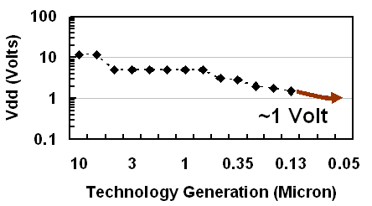
Historical Voltage Scaling
http://software.intel.com/en-us/articles/gigascale-integration-challenges-and-opportunities/
Frequency impact?
Power Density impact?

Slide 60
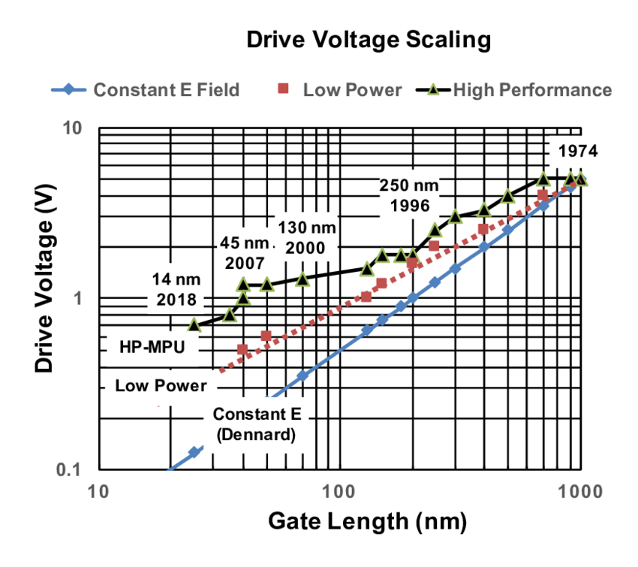
Historical Voltage Scaling
http://software.intel.com/en-us/articles/gigascale-integration-challenges-and-opportunities/
Frequency impact?
Power Density impact?

Slide 61
Scale V separately with Factor U, (U<S)
τ_{gd}=Q/I=(CV)/I
V’→V/U

Slide 62
Scale V separately with Factor U
τ_{gd}=Q/I=(CV)/I
V’→V/U
  I’_{d}=(μC_{OX}S/2)((W/S)/(L/S)(V_{gs}/U-V_{TH}/U)²
I’_{d} → S/U²×I_{d}
C’ → C/S

Slide 63
Scale V separately with Factor U
τ_{gd}=Q/I=(CV)/I
V’→V/U
  I’_{d}=(μC_{OX}S/2)((W/S)/(L/S)(V_{gs}/U-V_{TH}/U)²
I’_{d} → S/U²×I_{d}
C’ → C/S
τ’_{gd} → ( (1/(SU)) / (S/U²) )×τ_{gd}
τ’_{gd} → (U/S²)×τ_{gd}

Slide 64
Scale V separately with Factor U
τ_{gd}=Q/I=(CV)/I
V’→V/U
  I’_{d}=(μC_{OX}S/2)((W/S)/(L/S)(V_{gs}/U-V_{TH}/U)²
I’_{d} → S/U²×I_{d}
C’ → C/S
τ’_{gd} → ( (1/(SU)) / (S/U²) )×τ_{gd}
τ’_{gd} → (U/S²)×τ_{gd}
f’ → (S²/U)×f

Slide 65
Scale V separately with Factor U
Ideal scale
factors:
S=100
U=100
τ=1/100
f_{ideal}=100
τ_{gd}=Q/I=(CV)/I
V’→V/U
  I’_{d}=(μC_{OX}S/2)((W/S)/(L/S)(V_{gs}/U-V_{TH}/U)²
I’_{d} → S/U²×I_{d}
C’ → C/S
τ’_{gd} → ( (1/(SU)) / (S/U²) )×τ_{gd}
τ’_{gd} → (U/S²)×τ_{gd}
f’ → (S²/U)×f

Slide 66
Preclass 3
Assuming V_{dd}=10V in a 10μm process and V_{dd}=1V in a 100nm process, what are S and U? (assume everything else scales according to ideal scaling.)
  S =
  U =

Slide 67
Scale V separately with Factor U
Ideal scale
factors:
S=100
U=100
τ=1/100
f_{ideal}=100
τ_{gd}=Q/I=(CV)/I
V’→V/U
  I’_{d}=(μC_{OX}S/2)((W/S)/(L/S)(V_{gs}/U-V_{TH}/U)²
I’_{d} → S/U²×I_{d}
C’ → C/S
τ’_{gd} → τ’_{gd} → ( (1/(SU)) / (S/U²) )×τ_{gd}
τ’_{gd} → (U/S²)×τ_{gd}
f’ → (S²/U)×f
Cheating
factors:
S=100
U=10
How much faster are gates?

Slide 68
Scale V separately with Factor U
Ideal scale
factors:
S=100
U=100
τ=1/100
f_{ideal}=100
τ_{gd}=Q/I=(CV)/I
V’→V/U
  I’_{d}=(μC_{OX}S/2)((W/S)/(L/S)(V_{gs}/U-V_{TH}/U)²
I’_{d} → S/U²×I_{d}
C’ → C/S
τ’_{gd} → τ’_{gd} → ( (1/(SU)) / (S/U²) )×τ_{gd}
τ’_{gd} → (U/S²)×τ_{gd}
f’ → (S²/U)×f
Cheating
factors:
S=100
U=10
τ=1/1000
f_{new}=1000
How much faster are gates?

Slide 69
Scale V separately with Factor U
Ideal scale
factors:
S=100
U=100
τ=1/100
f_{ideal}=100
τ_{gd}=Q/I=(CV)/I
V’→V/U
  I’_{d}=(μC_{OX}S/2)((W/S)/(L/S)(V_{gs}/U-V_{TH}/U)²
I’_{d} → S/U²×I_{d}
C’ → C/S
τ’_{gd} → ( (1/(SU)) / (S/U²) )×τ_{gd}
τ’_{gd} → (U/S²)×τ_{gd}
f’ → (S²/U)×f
Cheating
factors:
S=100
U=10
τ=1/1000
f_{new}=1000
f_{new}/f_{ideal}=10

Slide 70
Power Density Impact
P = (1/2)CV² f
P → (1/S) (1/U²) (S²/U) = S/U³
P/A → (S/U³) / (1/S²) = S³/U³

Slide 71
Power Density Impact
P = (1/2)CV² f
P → (1/S) (1/U²) (S²/U) = S/U³
P/A → (S/U³) / (1/S²) = S³/U³
U=10 S=100
P/A → 1000 (P/A)

Slide 72
Power Density Impact
P = (1/2)CV² f
P → (1/S) (1/U²) (S²/U) = S/U³
P/A → (S/U³) / (1/S²) = S³/U³
U=10 S=100
P/A → 1000 (P/A)
Compare with ideal scaling:
P/A → S³×P (ideal scaling)
P/A → 1,000,000 (P/A) (ideal scaling)

Slide 73
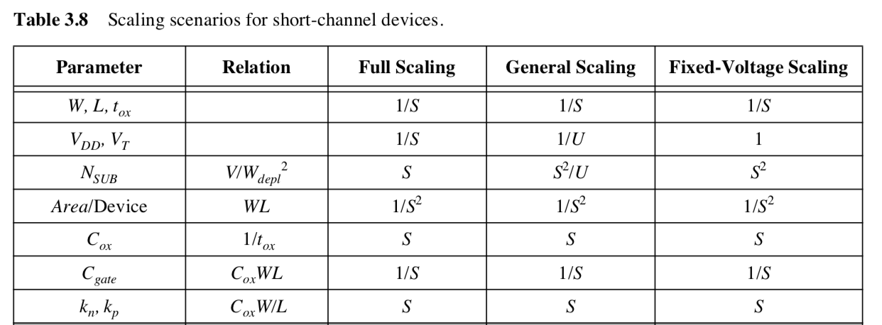
Scaling Methods
Constant Field
Constant Voltage
U<S

Slide 74
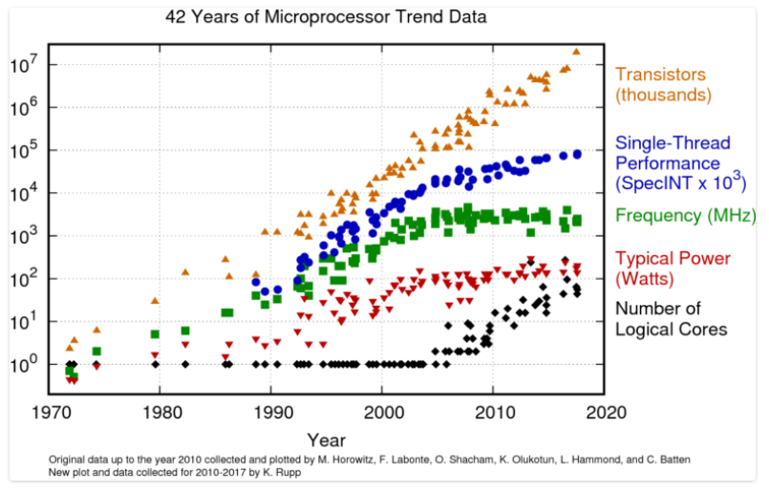
42 Years of uP Trend Data

Slide 75
Conventional Scaling
Ends in your lifetime
Perhaps already:
  "Basically, this is the end of scaling.”
    May 2005, Bernard Meyerson, V.P. and chief technologist for IBM's systems and technology group

Slide 76
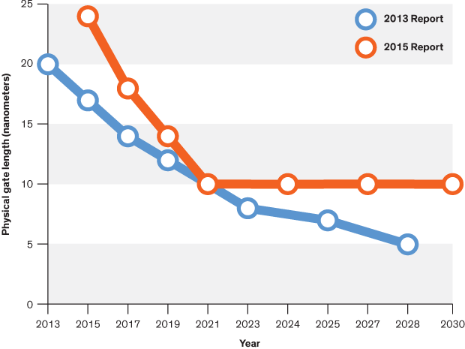
ITRS 2.0 Report 2015
    “After 2021, the report forecasts, it will no longer be economically desirable for companies to continue traditional transistor miniaturization in microprocessors.”

Slide 77
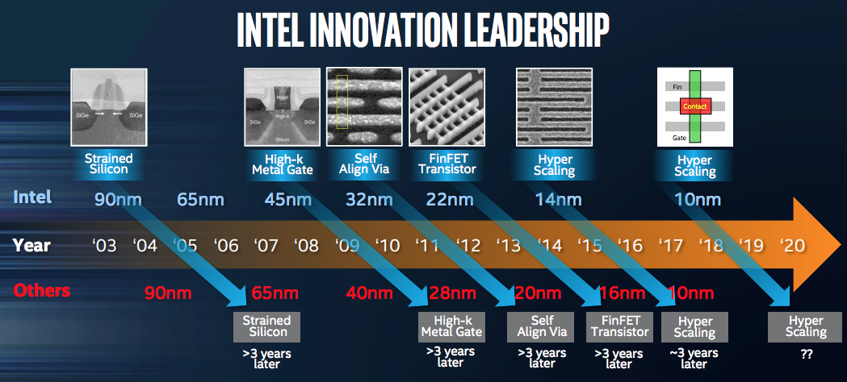
BUT…
Source:https://newsroom.intel.com/newsroom/wp-content/uploads/sites/11/2017/09/mark-bohr-on-continuing-moores-law.pdf

Slide 78
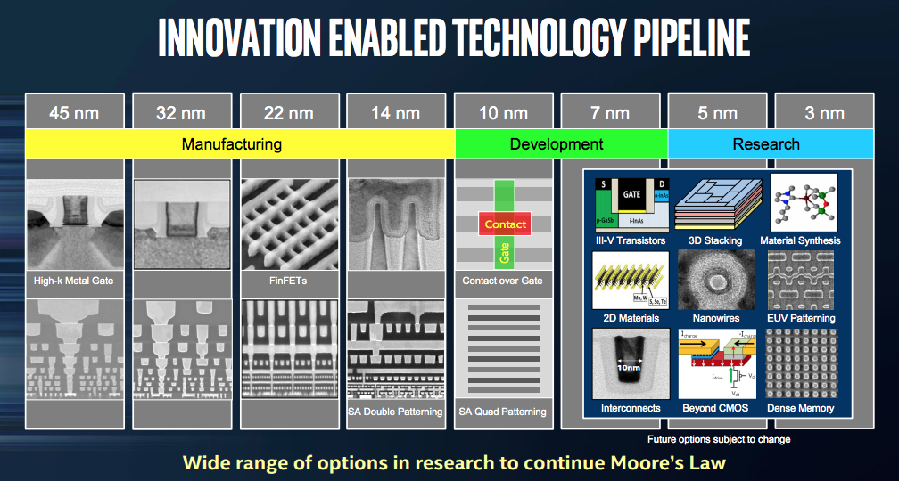
BUT…
Source:https://newsroom.intel.com/newsroom/wp-content/uploads/sites/11/2017/09/mark-bohr-on-continuing-moores-law.pdf

Slide 79
Big Ideas
Moderately predictable VLSI Scaling
  unprecedented capacities/capability growth for engineered systems
  …but not for much longer

Slide 80
Admin
HW 4 due Friday 10/8

