Slide 1

ESE370: Circuit-Level Modeling, Design, and Optimization for Digital Systems
Lec 13: October 6, 2021
Inverter Performance

Slide 2
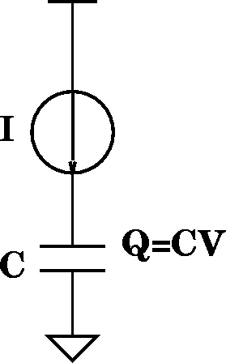
Scale V separately with Factor U
Ideal scale
factors:
S=100
U=100
τ=1/100
f_{ideal}=100
τ_{gd}=Q/I=(CV)/I
V’→V/U
  I’_{d}=(μC_{OX}S/2)((W/S)/(L/S)(V_{gs}/U-V_{TH}/U)²
I’_{d} → S/U²×I_{d}
C’ → C/S
τ’_{gd} → ( (1/(SU)) / (S/U²) )×τ_{gd}
τ’_{gd} → (U/S²)×τ_{gd}
f’ → (S²/U)×f
Cheating
factors:
S=100
U=10
τ=1/1000
f_{new}=1000
f_{new}/f_{ideal}=10

Slide 3
Power Density Impact
P = (1/2)CV² f
P → (1/S) (1/U²) (S²/U) = S/U³
P/A → (S/U³) / (1/S²) = S³/U³
U=10 S=100
P/A → 1000 (P/A)

Slide 4
Power Density Impact
P = (1/2)CV² f
P → (1/S) (1/U²) (S²/U) = S/U³
P/A → (S/U³) / (1/S²) = S³/U³
U=10 S=100
P/A → 1000 (P/A)
Compare with ideal scaling:
P/A → S³×P (ideal scaling)
P/A → 1,000,000 (P/A) (ideal scaling)

Slide 5
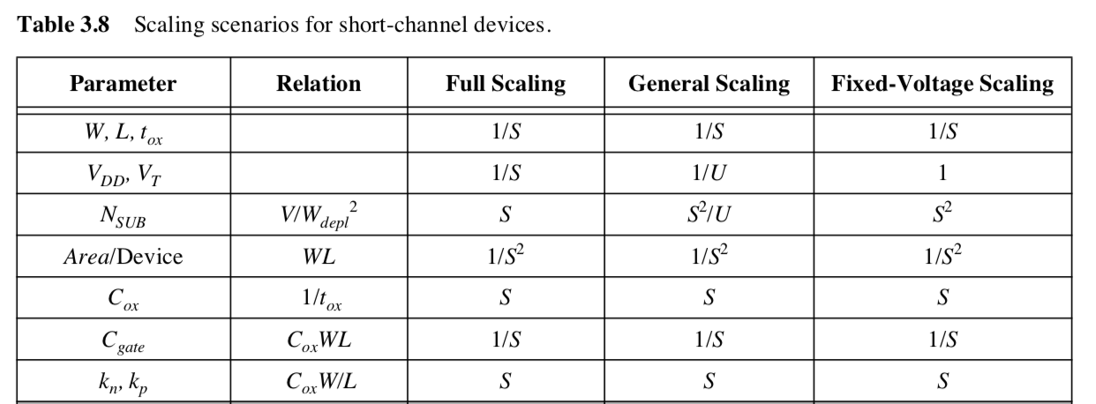
Scaling Methods
Constant Field
Constant Voltage
U<S

Slide 6
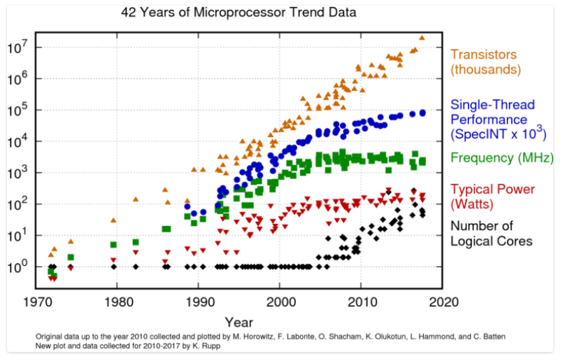
42 Years of uP Trend Data

Slide 7
Conventional Scaling
Ends in your lifetime
Perhaps already:
  "Basically, this is the end of scaling.”
    May 2005, Bernard Meyerson, V.P. and chief technologist for IBM's systems and technology group

Slide 8
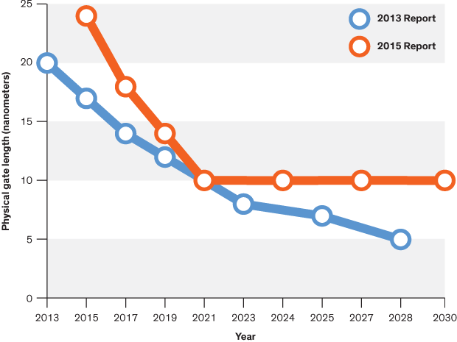
ITRS 2.0 Report 2015
    “After 2021, the report forecasts, it will no longer be economically desirable for companies to continue traditional transistor miniaturization in microprocessors.”

Slide 9
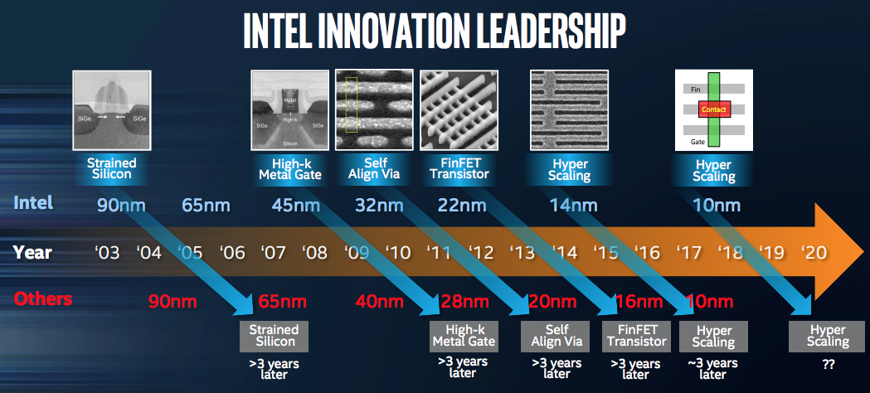
BUT…
Source:https://newsroom.intel.com/newsroom/wp-content/uploads/sites/11/2017/09/mark-bohr-on-continuing-moores-law.pdf

Slide 10
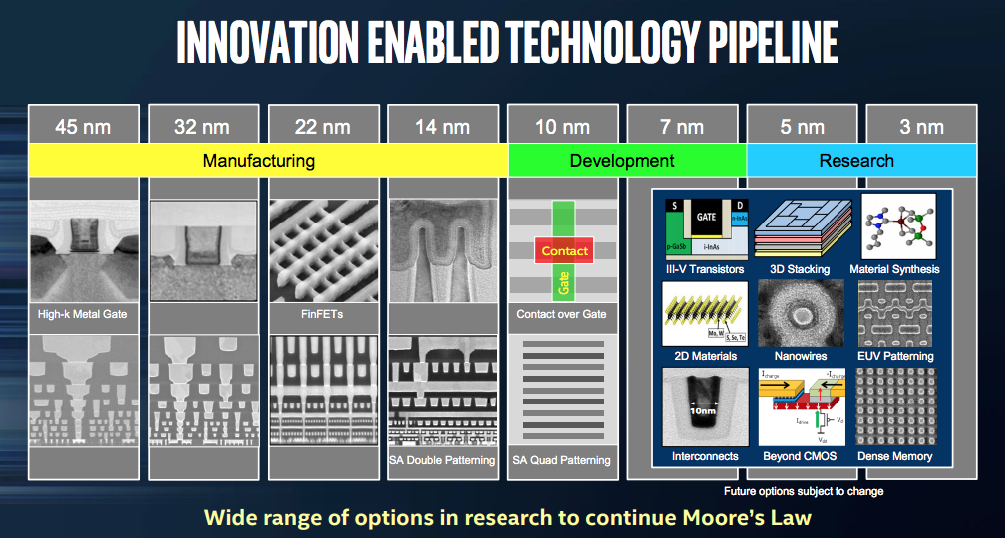
BUT…
Source:https://newsroom.intel.com/newsroom/wp-content/uploads/sites/11/2017/09/mark-bohr-on-continuing-moores-law.pdf

Slide 11
Previously
Delay as RC-charging
Transistor
  Capacitance
  Drive Current
  Function of geometry (W/L)

Slide 12
Today
τ-model
Sizing
Large Fanout
Capacitance Revisited
  Miller Effect

Slide 13
Transistor Sizing
What happens to I_{ds} as a function of W?
What happens to C_{g} as a function of W?

Slide 14
Transistor Sizing
What happens to I_{ds} as a function of W?
What happens to C_{g} as a function of W?
Conclude: faster transistors present more load on their inputs

Slide 15
First Order Delay (preclass 1)
I₀ = I_{ds} of minimum size NMOS device
C₀ = gate capacitance of minimum size NMOS device
I_{drive} = WI₀
C_{g} = WC₀

Slide 16
First Order Delay (preclass 1)
R₀ = Resistance of minimum size NMOS device
C₀ = gate capacitance of minimum size NMOS device
R_{drive} = R₀/W
C_{g} = WC₀

Slide 17
τ model
All delays are RC delays
Always have an R₀C₀ term
τ = R₀C₀
Express all delays in τ units
Like λ units for measurement
  Separate delay into
    Technology dependent term τ = R₀C₀
    Technology independent coefficient

Slide 18
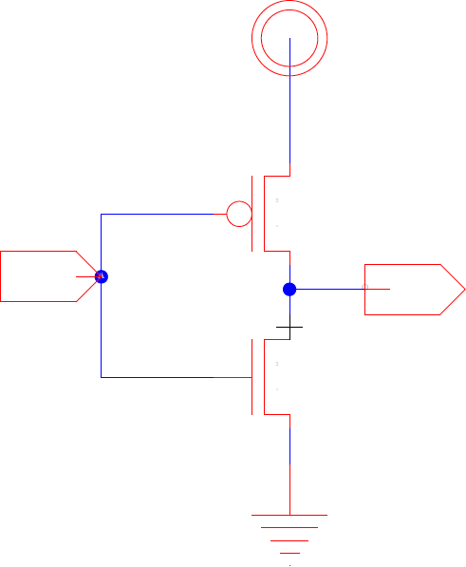
How to Size Transistors (preclass 2)
How should we size to equalize Rise and Fall?
  Given:
  μ_{n}=500cm²/Vs, μ_{p}=200cm²/Vs
  R_{drive}=R₀/2 (I_{drive}=2I₀)

Slide 19
How to Size Transistors (preclass 2)
How should we size to equalize Rise and Fall?
  Given:
  μ_{n}=500cm²/Vs, μ_{p}=200cm²/Vs
  R_{drive}=R₀/2 (I_{drive}=2I₀)
  What is input capacitance for sized devices?

Slide 20
Size Transistors – Minimum Avg Delay
x 10⁻¹¹
t_{pLH}
t_{pHL}
β of 2.4 (= 31 kΩ/13 kΩ) gives symmetrical response
β of 1.6 to 1.9 gives optimal performance
t_{p}
t_{p}(sec)
β = W_{p}/W_{n}

Slide 21
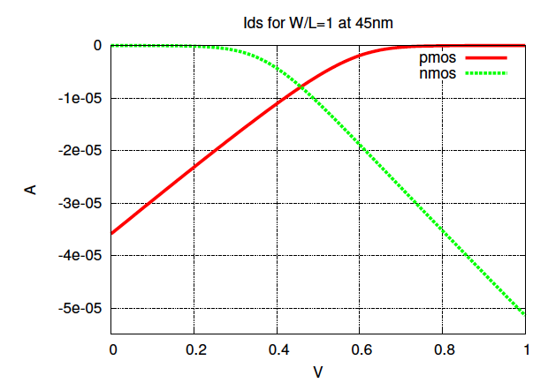
SPICE Simulation 45nm

Slide 22
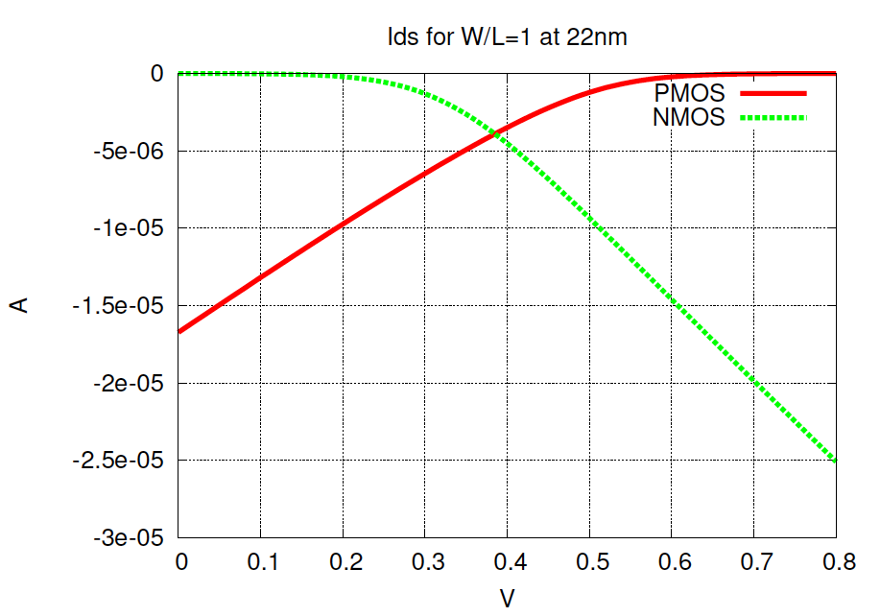
SPICE Simulation 22nm

Slide 23
Equalizing Delay
For simplicity, for today
  Assume W_{p}=W_{n} equalizes I_{ds}
    I.e I_{0,n}=I_{0,p}

Slide 24
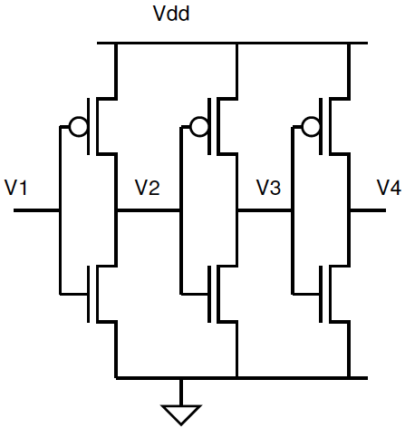
Inverter Sizing
What is the impact of the delay if we double size of all the transistors?

Slide 25
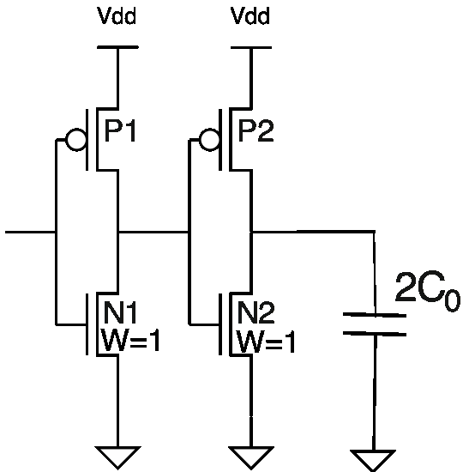
Multistage Delay
Total delay = sum of stage delays
What is delay here?
  From (P1,N1) to final capacitive load

Slide 26
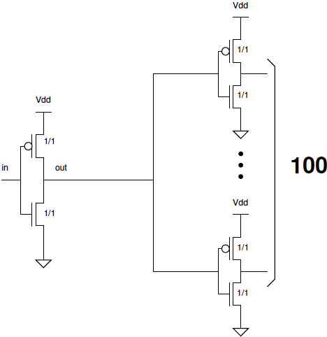
Large Fanout Delay (preclass 3)
What is delay if must
drive fanout of 100?

Slide 27
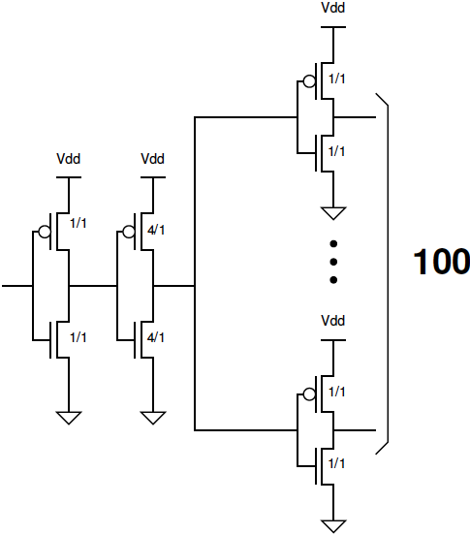
Graduated Fanout Delay (preclass 3)
What is delay here?

Slide 28
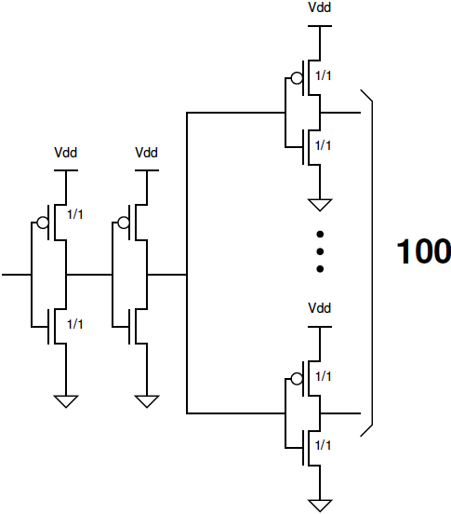
Optimize Fanout Delay (preclass 4)
How can we size transistors to
minimize delay?
W_{mid}/1
W_{mid}/1

Slide 29
Optimizing (preclass 4)
Derivate to minimize

Slide 30
Delay? (preclass 4)
Delay at optimal W_{mid}?
W_{mid}/1
W_{mid}/1

Slide 31
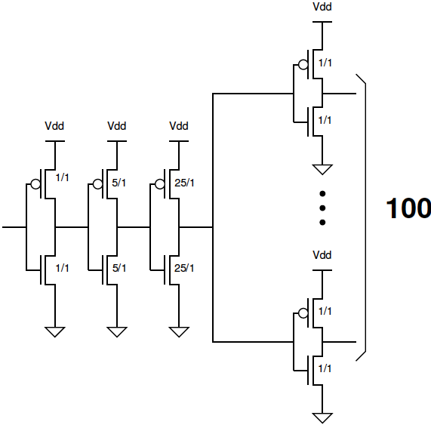
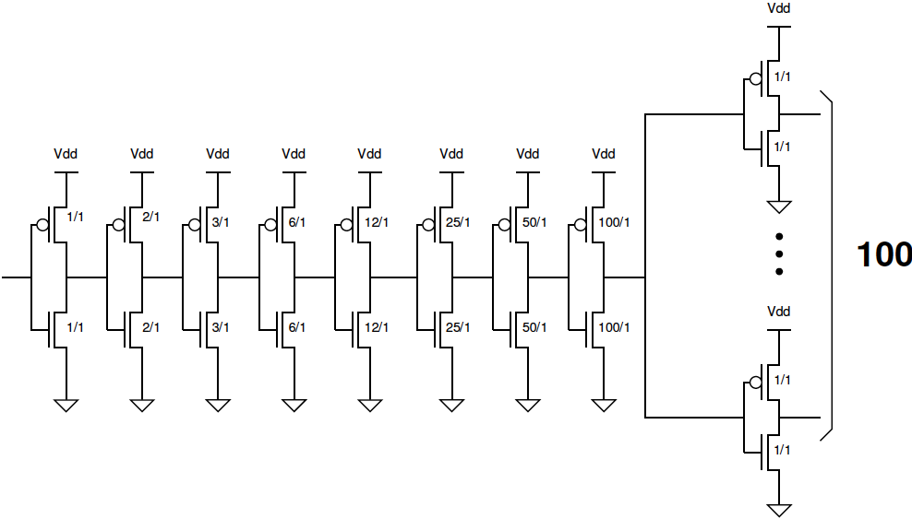
Try Again with More Stages (preclass 5)
What is the delay here?

Slide 32
Try Again with More Stages (preclass 5)
What is the delay here?

Slide 33
…and Again (preclass 5)
Delay here?

Slide 34
Delay Summary

Slide 35
Lesson
Don’t drive large fanout with a single stage
Must scale up over a number of stages
…but not too many
Exact number will be technology dependent

Slide 36
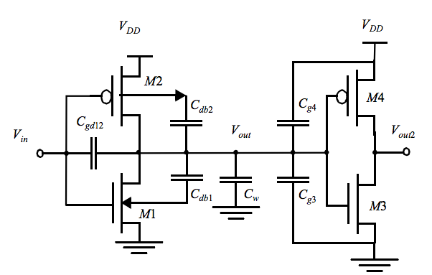
Capacitance Reminder

Slide 37
Charge on Capacitors (preclass 6)
V_{DD}
V_{DD}
What is charge, Q, on each of the capacitors when Vin=Vdd and
Vin=Gnd?
Vin = Vdd
C_{gdp}
Vout = Gnd
Vin = Gnd
C_{gdp}
Vout = Vdd
IN
C_{gdn}
OUT
IN
C_{gdn}
OUT
 | PMOS | NMOS
Vin | C_{gdp} | C_{gdn}
Vdd
Gnd
Gnd
Gnd

Slide 38
Questions
What is ΔQ on each C_{gd} when input switched?
Assuming ΔV=Vdd, what is equivalent capacitance?
 | PMOS | NMOS
Vin | C_{gdp} | C_{gdn}
Vdd
Gnd

Slide 39
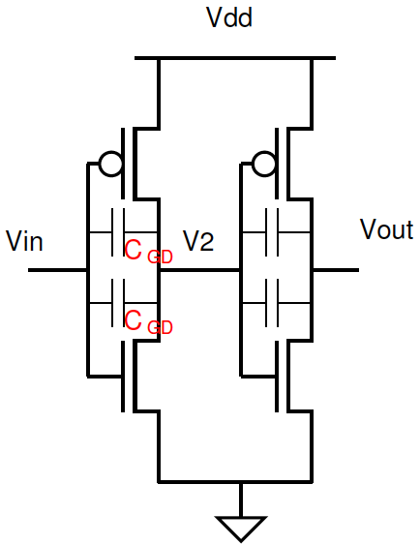
Miller Effect For an Inverter
Feedback capacitance (C_{gd}) between input and output must swing 2 V_{dd}
Or…behaves same as a double-sized capacitor on the output

Slide 40
Miller Effect For an Inverter

Slide 41
Ideas
First order delay reason in τ=R₀C₀ units
Scaling everything up doesn’t help
Drive large capacitive loads in stages
  But not too many

Slide 42
Admin
HW4 due Friday
Drop date is on Monday
  Email me if you want to talk about your standing in the class

