Slide 1

ESE370: Circuit-Level Modeling, Design, and Optimization for Digital Systems
Lec 14: October 8, 2021
Performance: Gates

Slide 2
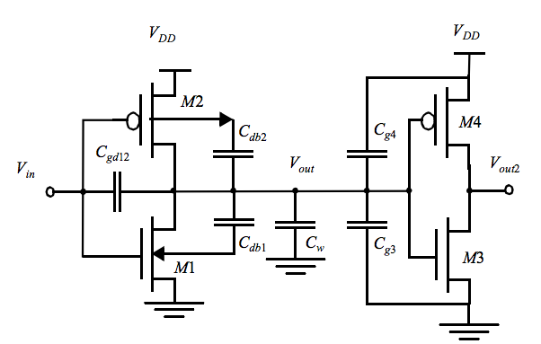
Capacitance Reminder

Slide 3
Charge on Capacitors (preclass 6)
V_{DD}
What is charge, Q, on each of the capacitors when Vin=Vdd and
Vin=Gnd?
Vin = Vdd
C_{gdp}
Vout = Gnd
IN
C_{gdn}
OUT
 | PMOS | NMOS
Vin | C_{gdp} | C_{gdn}
Vdd
Gnd
Gnd

Slide 4
Charge on Capacitors (preclass 6)
V_{DD}
What is charge, Q, on each of the capacitors when Vin=Vdd and
Vin=Gnd?
Vin = Gnd
C_{gdp}
Vout = Vdd
IN
C_{gdn}
OUT
 | PMOS | NMOS
Vin | C_{gdp} | C_{gdn}
Vdd
Gnd
Gnd

Slide 5
Questions
What is ΔQ on each C_{gd} when input switched?
Assuming ΔV=Vdd, what is equivalent capacitance?
 | PMOS | NMOS
Vin | C_{gdp} | C_{gdn}
Vdd
Gnd

Slide 6
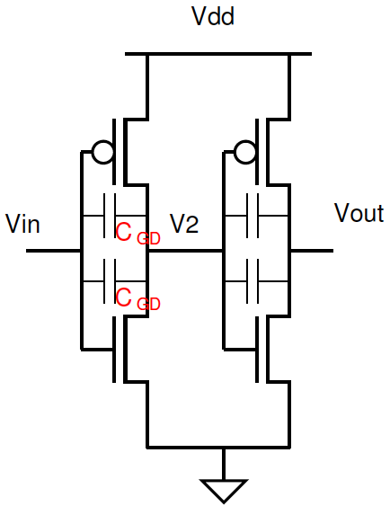
Miller Effect For an Inverter
Feedback capacitance (C_{gd}) between input and output must swing 2 V_{dd}
Or…behaves same as a double-sized capacitor on the output

Slide 7
Miller Effect For an Inverter

Slide 8
Previously: First Order Delay
R₀ = Resistance of minimum size NMOS device
I₀ = I_{ds} of minimum size NMOS device
C₀ = gate capacitance of minimum size NMOS device
R_{drive} = R₀/W_{n} I_{drive} = W_{n}I₀ C_{g} = W_{n}C₀
Technology independent relative delay
  τ = R₀C₀ = C₀/I₀
Large fanout results in large delays
  Drive in stages to reduce delay

Slide 9
Today
Delay in Gates
Data Dependent Delay
Large Fanin
Analyze everything for two cases:
  Ratio to minimize average delay: R_{p0} = 2R_{n0} = 2R₀
  Extreme velocity saturation: R_{p0} = R_{n0} = R₀
    Simplified case from Monday in analyzing fanout delays

Slide 10
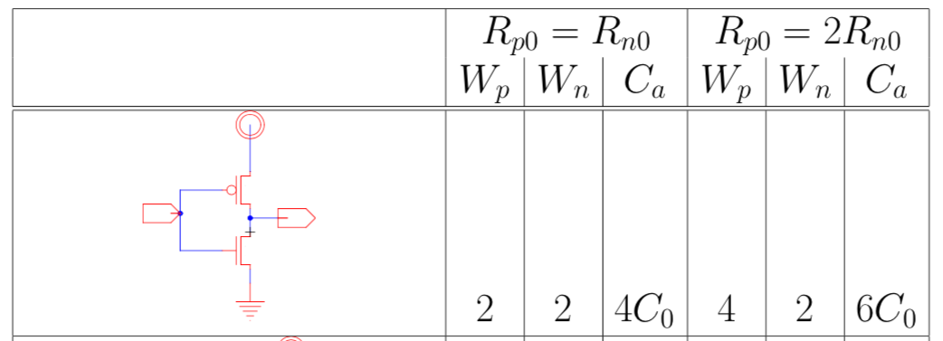
Inverter Performance (preclass 1, row 1)
Sized for R₀/2 drive resistance, (R₀=R_{n0})

Slide 11
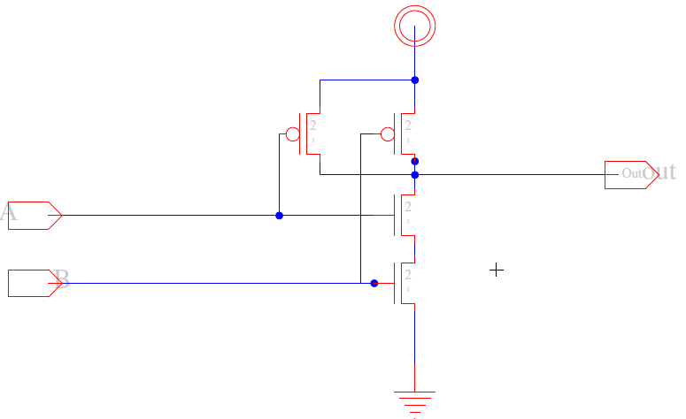
Data Dependent Delay
Drive resistance depends on input values
  Delay depends on input data
  Analyze using worst case delay

Slide 12
Transistor Sizing (preclass 1, row 2)
How should we size to equalize worst-case rise/fall times for R_{drive}=R₀/2?

Slide 13
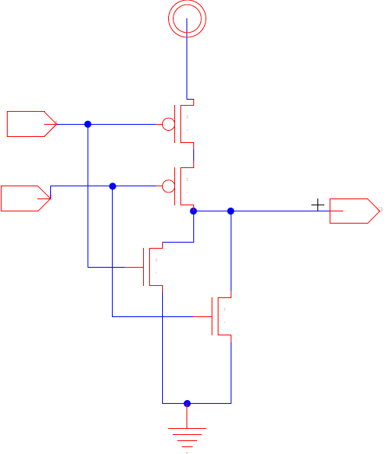
Transistor Sizing (preclass 1, row 3)
How size for equal rise/fall
for R_{drive}=R₀/2?

Slide 14
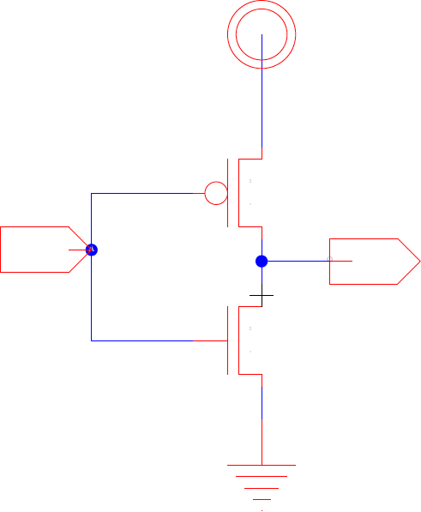
Input Load
Input capacitance per input in each case?

Slide 15
Observe
Ratio of Input Load Capacitance to Output Drive Strength: C_{InLoad}/I_{ds}
  Differs with gate function
  Gate efficiency

Slide 16
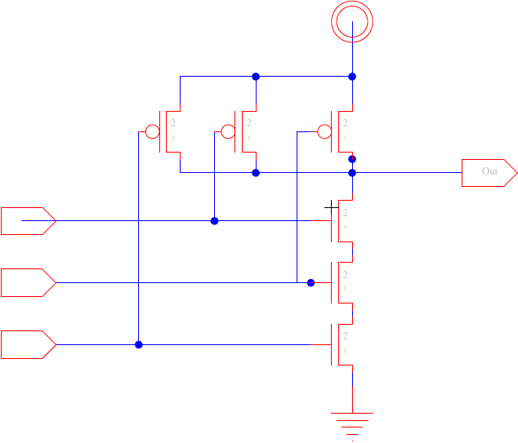
Transistor Sizing (preclass 1, row 4)
Size equalize rise/fall
times R_{drive}=R₀/2?

Slide 17
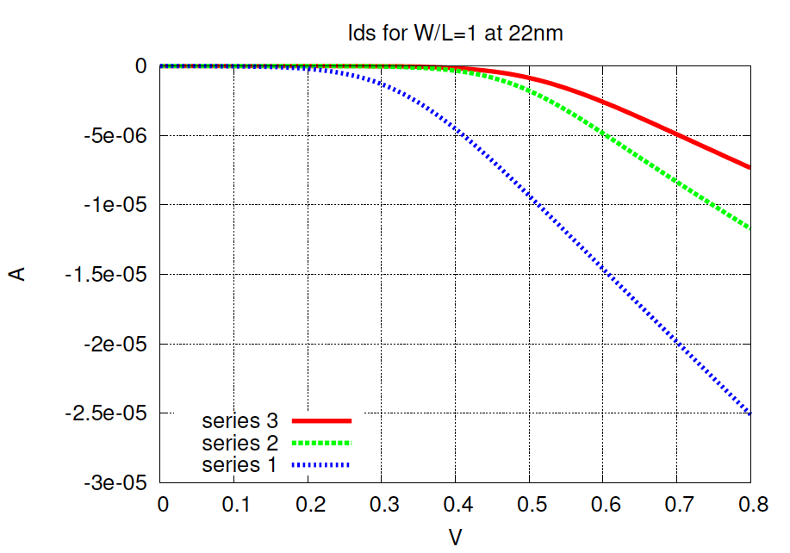
Series Transistors
106kΩ
66kΩ
32kΩ

Slide 18
Increasing Fanin (preclass 2)
What happens to input capacitance as fanin (k) increases
  Keeping output drive the same
    E.g. R_{drive}=R₀/2
k-input nand gate has what input capacitance?

Slide 19
Fanin
Conclude: gates slow down with fanin
  Less drive per input capacitance
  C_{InLoad}/I_{ds} increases

Slide 20
nand32 (preclass 3, row 1)
single-stage nand32
  Delay with R₀/2 input drive and 4C₀ load?
R_{n0}=R_{p0} case only

Slide 21
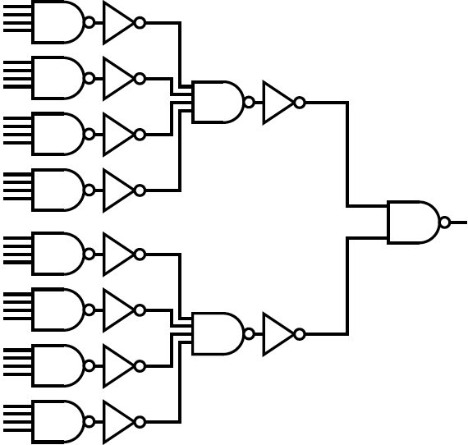
nand32 (preclass 3, row 1)
nand32
  Delay with R₀/2 input drive and 4C₀ load?
R_{n0}=R_{p0} case only
4C₀

Slide 22
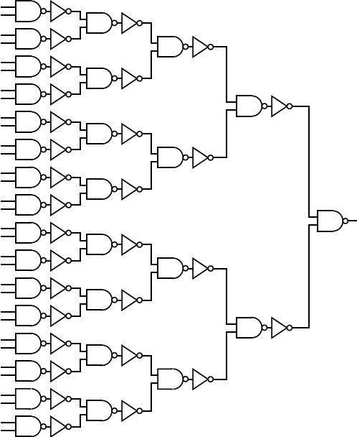
Which is Faster? (preclass 3, rows 2&3)
nand32
R_{n0}=R_{p0} case only
nand4-inv-nand4-inv-nand2
(nand2-inv)⁴-nand2

Slide 23
Lesson
Large gates are slow / inefficient
  High capacitive load / drive current
Small gates can be inefficient
  Need many stages
Staging over moderate size gates minimizes delay
Exact size will be technology dependent

Slide 24
And-Or Chain

Slide 25
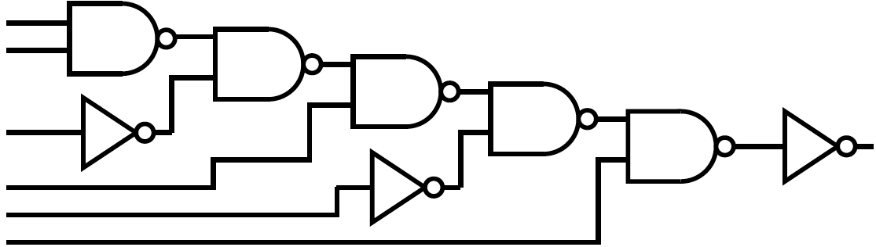
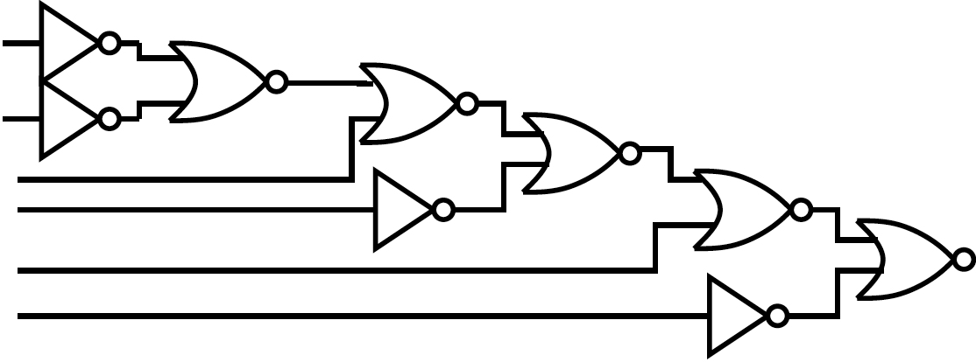
Delay of each implementation? (preclass 4)
R_{n0}=R_{p0} and 2R_{n0}=R_{p0} cases

Slide 26
Take Away?
nor vs. nand

Slide 27
Ideas
First order reason in τ = R₀C₀ units
Gates have different efficiencies
  Drive strength per unit input capacitance
Without velocity saturation
  Reason to prefer nand over nor
With velocity saturation
  nands and nors are similar efficiency
Large fanin and fanout slow gates
  Decompose into stages
  …but not too many

Slide 28
Admin
HW 4
  Due tonight at midnight
HW 5 out now
  Is long and will take time, start today
  Due during fall break 10/15

