Slide 1

ESE370: Circuit-Level Modeling, Design, and Optimization for Digital Systems
Lec 15: October 11, 2021
Energy and Power Basics
Notes:
----- Meeting Notes (10/13/17 12:57) -----
10
----- Meeting Notes (10/12/18 12:53) -----
16

Slide 2
Previously
Where capacitance arises
  Device materials
What drives delay
  Equivalent drive resistance and load capacitance
Optimize delay
  τ-estimate
  Transistor sizing
  Fanin/fanout
  Drive in stages

Slide 3
And-Or Chain

Slide 4
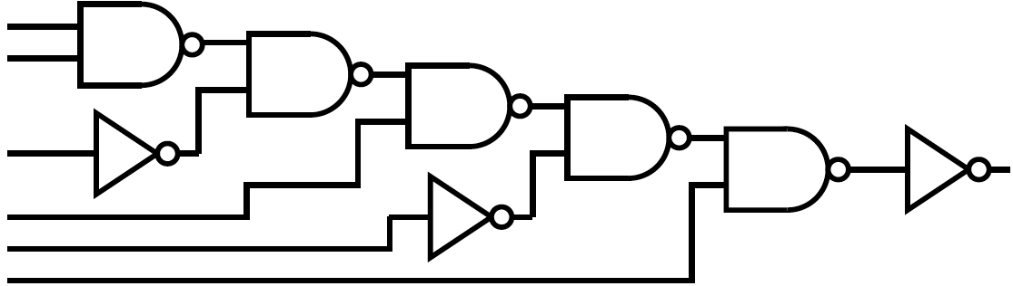
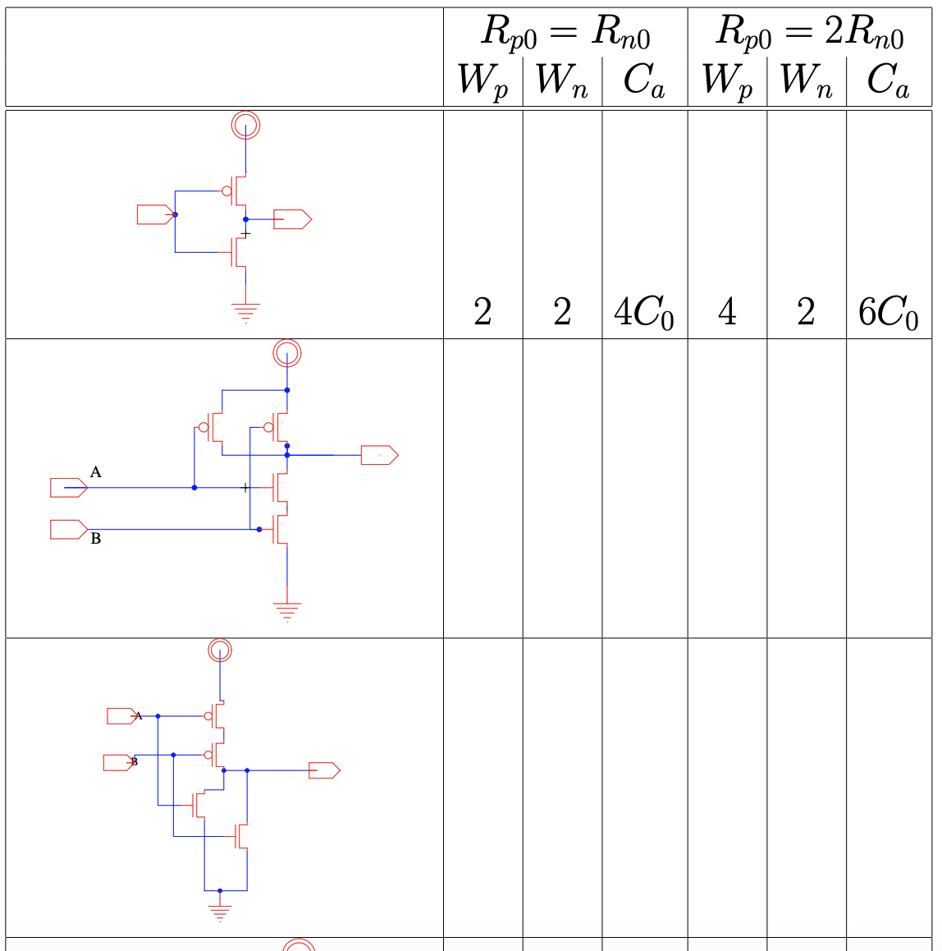
Delay of each implementation? (lec 14, preclass 4)
R_{n0}=R_{p0} and 2R_{n0}=R_{p0} cases
R_{drive}=R₀/2
2
4
6C₀
4
4
8C₀

Slide 5
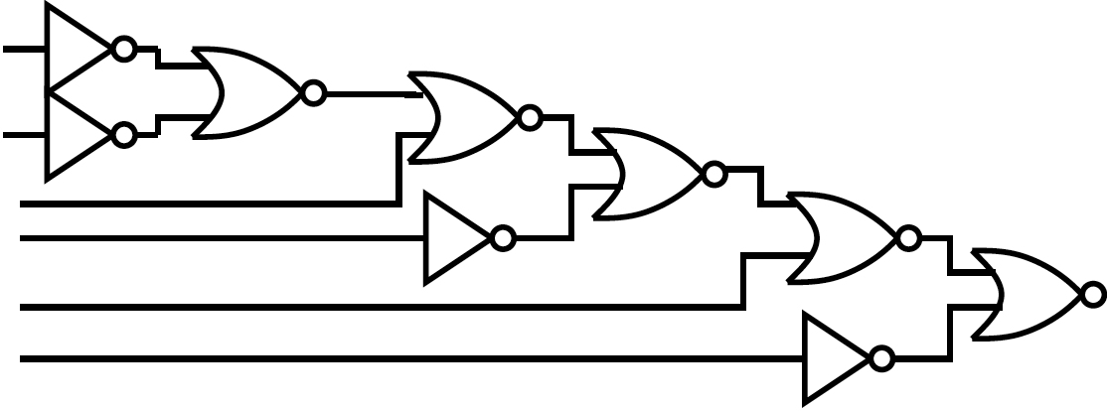
Delay of each implementation? (lec 14, preclass 4)
R_{drive}=R₀/2
4
2
6C₀
8
2
10C₀
R_{n0}=R_{p0} and 2R_{n0}=R_{p0} cases

Slide 6
Delay of each implementation? (lec 14, preclass 4)
R_{n0}=R_{p0} and 2R_{n0}=R_{p0} cases

Slide 7
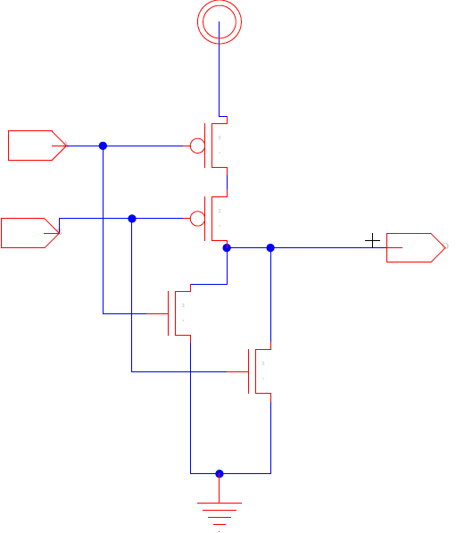
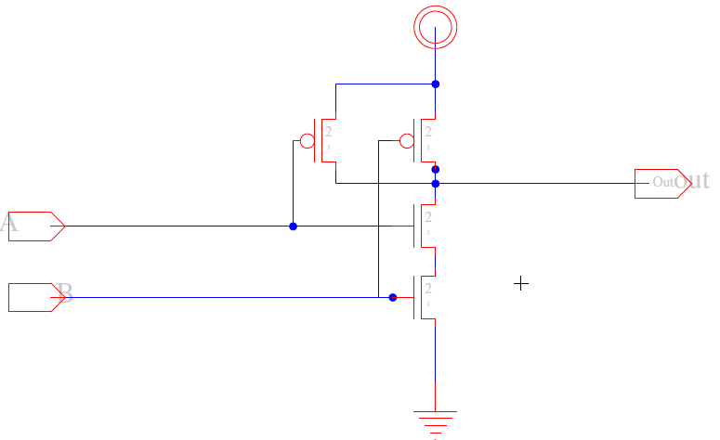
Take Away?
nor vs. nand
Notes:
Prefer nand over nor without extreme velocity saturation

Slide 8
Today
Power Sources
  Static power
  Switching power
    Dynamic switching power
    Short circuit power (if time)
Notes:
Might not get to short circuit power today…

Slide 9
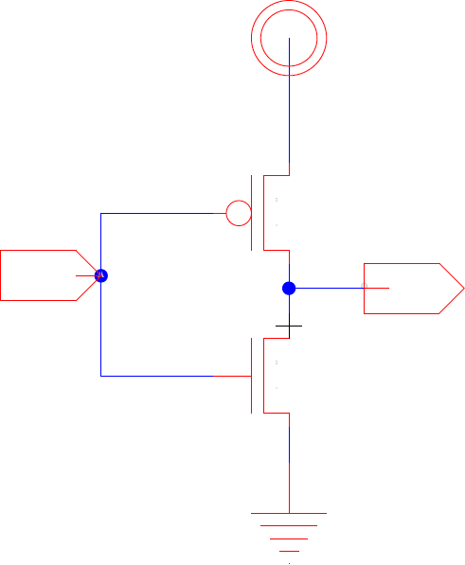
Power
P = I×V
Tricky part:
  Understanding I
  (pairing with correct V)

Slide 10
Inverter Current Simplification (preclass)
What is I_{pwr,gnd}?
  0V
  140mV
  400mV
  500mV
  600mV
  860mV
  1V
  From preclass – see next two slides

Slide 11
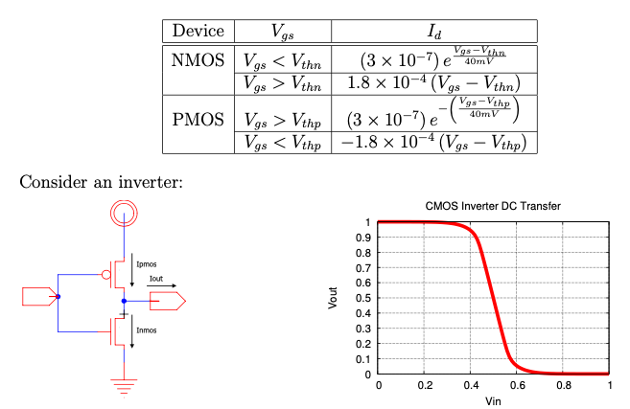
Preclass 1

Slide 12
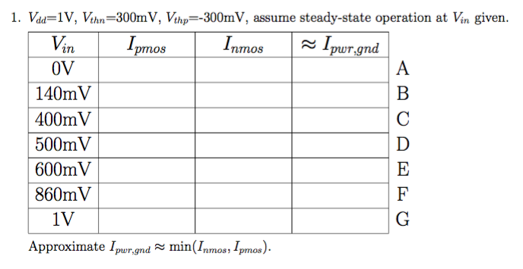
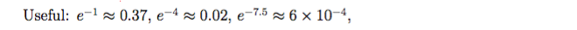
Preclass 1

Slide 13
Preclass 1

Slide 14
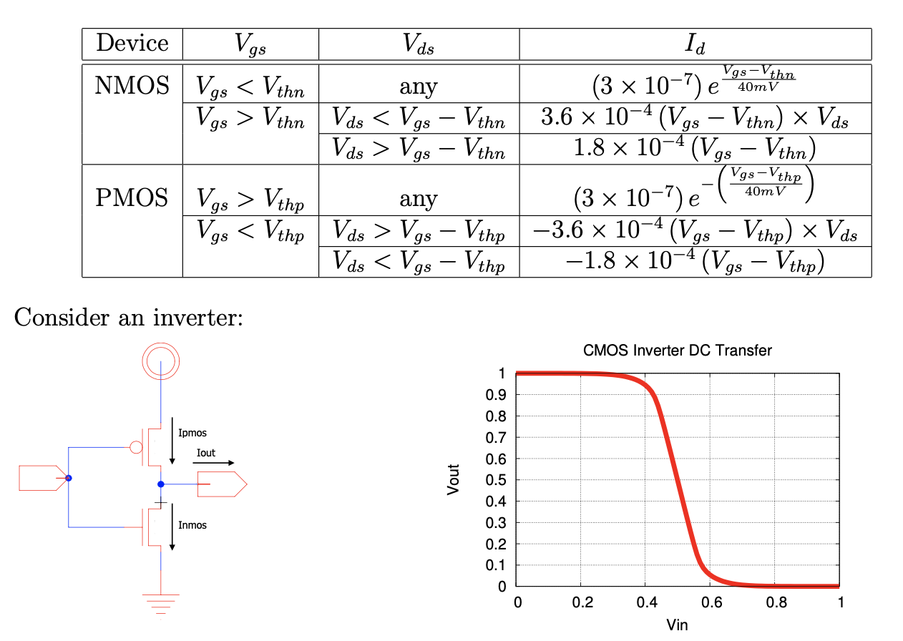
Preclass 2

Slide 15
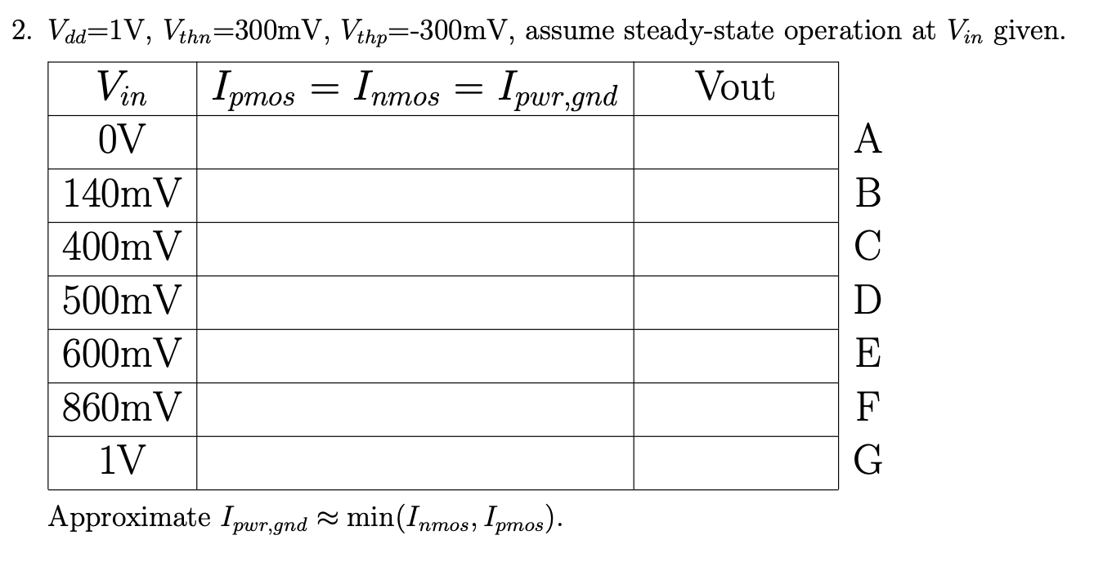
Preclass 2

Slide 16
Understanding Currents
Static Power

Slide 17
Operating Modes
Steady-State: What modes are the transistors in?
  V_{in}=V_{dd}
  V_{in}=Gnd
What current flows
in steady state?

Slide 18
Operating Modes
Steady-State: V_{in}=V_{dd}
  PMOS: subthreshold
  NMOS: resistive

Slide 19
Operating Modes
Steady-State: V_{in}=V_{dd}
  PMOS: subthreshold
  NMOS: resistive

Slide 20
Operating Modes
Steady-State: V_{in}=V_{dd}
  PMOS: subthreshold
  NMOS: resistive
Which current determines I_{static} ?

Slide 21
Static Power
P = I×V
What V should we use?
  Where is the static current flowing?
Notes:
Vdd

Slide 22
Data Dependent?
How does the binary value of the input impact I_{static}?

Slide 23
Data Dependent?
How does the binary value of the input impact I_{static}?

Slide 24
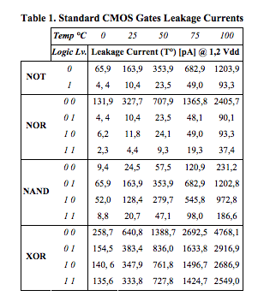
Data Dependent Leakage Current
ACM Great Lakes Symposium on VLSI Stresa, I. (n.d.). Analysis of data dependence of leakage current in CMOS cryptographic hardware. In GLSVLSI ’07 proceedings of the 2007 ACM Great Lakes Symposium on VLSI : Stresa - Lago Maggiore, Italy, March 11-13, 2007 /. New York, N.Y. :: Association for Computing Machinery. https://doi.org/10.1145/1228784.1228808

Slide 25
Data Dependent Leakage Current
ACM Great Lakes Symposium on VLSI Stresa, I. (n.d.). Analysis of data dependence of leakage current in CMOS cryptographic hardware. In GLSVLSI ’07 proceedings of the 2007 ACM Great Lakes Symposium on VLSI : Stresa - Lago Maggiore, Italy, March 11-13, 2007 /. New York, N.Y. :: Association for Computing Machinery. https://doi.org/10.1145/1228784.1228808

Slide 26
Understanding Currents
Dynamic Switching Currents

Slide 27
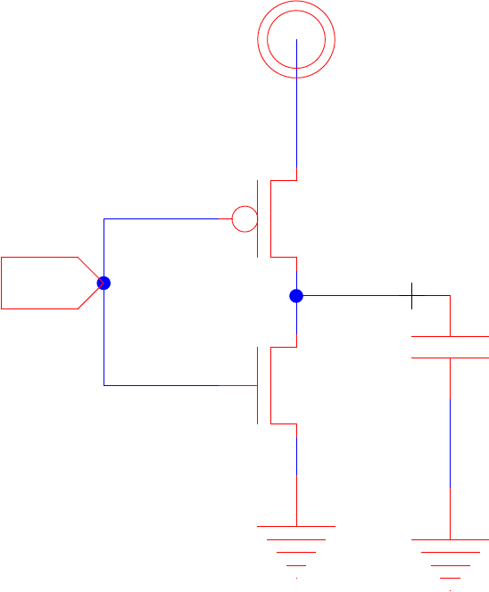
Power: During Switching
P = IV
Input switch: 1→0
Where does I go?
  V_{in}=Gnd

Slide 28
Power: During Switching
P = IV
Input switch: 1→0
Where does I go?
  V_{in}=Gnd
I_{dyn} (Saturation/Linear)
Subtheshold Leakage

Slide 29
Power: During Switching
P = IV
Input switch 0→1
Where does I go?
  V_{in}=V_{dd}

Slide 30
Power: During Switching
P = IV
Input switch 0→1
Where does I go?
  V_{in}=V_{dd}
Subtheshold Leakage
I_{dyn} (Saturation/Linear)

Slide 31
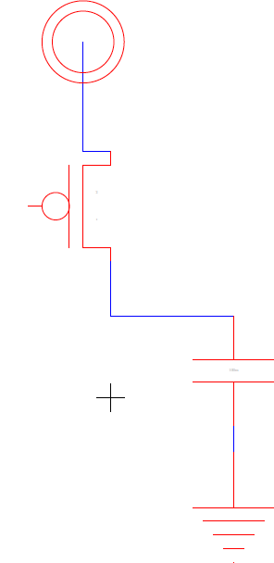
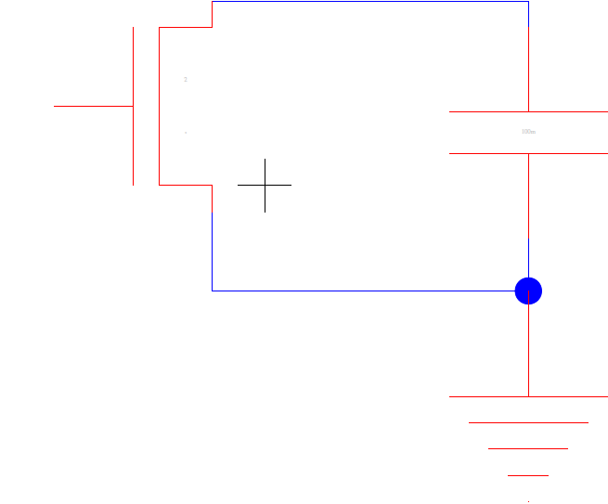
Switching Currents
Dynamic current flow:

Slide 32
Understanding Currents
Short Circuit Currents

Slide 33
Power: During Switching
P = IV
Where does I go?
  V_{in}=V_{dd}/2
    And V_{dd}>V_{thn}+|V_{thp}|
Notes:
Vdd>vthn+vthp → Both transistors able to be above threshold

Slide 34
Power: During Switching
P = IV
Where does I go?
  V_{in}=V_{dd}/2
    And V_{dd}>V_{thn}+|V_{thp}|
Linear/Saturation
Linear/Saturation
Notes:
Vdd>vthn+vthp → Both transistors able to be above threshold

Slide 35

Switching Currents
Dynamic current flow:
If both transistor on:
  Current path from V_{dd} to Gnd
  Short circuit current

Slide 36
Currents Summary
Current (I) changes over time
At least two components
  I_{static} – no switching
  I_{switch} – when switching
    I_{dyn} and I_{sc}
CLK
φ

Slide 37
Switching
Dynamic Power

Slide 38
Switching Currents
I_{total}(t) = I_{static}(t)+I_{switch}(t)
I_{switch}(t) = I_{sc}(t) + I_{dyn}(t)
I_{dyn}
I_{static}
I_{sc}

Slide 39
Charging
I_{dyn}(t) – why is it changing?
  I_{ds} = f(V_{ds},V_{gs})
  and V_{gs}, V_{ds} changing

Slide 40
Switching Energy – focus on I_{dyn}(t)
I_{dyn}
I_{static}
I_{sc}

Slide 41
Switching Energy – focus on I_{dyn}(t)
I_{dyn}

Slide 42
Switching Energy
Do we know what this is?
I_{dyn}

Slide 43
Switching Energy
Do we know what this is?
I_{dyn}
Capacitor charging energy

Slide 44
Switching Power
Every time output switches 0→1 pay:
  E = CV²
P_{dyn} = (# 0→1 trans) × CV² / time
# 0→1 trans = ½ # of transitions
P_{dyn} = (# trans) × ½CV² / time
Notes:
Energy is integral of power
Power is derivative of energy

Slide 45
Charging Power
P_{dyn} = (#0→1 trans) × CV² / time
Often like to think about switching frequency
Useful to consider per clock cycle
  Frequency f = 1/clock-period = clock-cycles/time
P_{dyn} = (#0→1 trans/clock-cycle) CV² f

Slide 46
Data Dependent Activity
Consider an 8b counter
  How often do each of the following switch?
    Low bit?
    High bit?
Assuming random inputs
  Activity at output of nand2?
  Activity at output of xor2?

Slide 47
Gate Output Switching (random inputs)
Output states
0
1
i
i+1
P(out_{i}!=out_{i+1})=P(out_{i}=0)*P(out_{i+1}=1)+P(out_{i}=1)*P(out_{i+1}=0)
  Probablity of output switch of nand2?
  Probablity of output switch of xor2?

Slide 48
Gate Output Switching (random inputs)
Output states
0
1
i
i+1
P(out_{i}→out_{i+1}=0→1)=P(out_{i}=0)*P(out_{i+1}=1)

Slide 49
Dynamic Power
P_{dyn} = (#0→1 trans/clock-cycle) CV² f
Let a = activity factor
  a = average #tran_{0→1}/clock
  a = probability of #tran_{0→1}
P_{dyn} = aCV² f

Slide 50
Activity Factor
Let a = activity factor
  a = average #tran_{0→1}/clock
  a = probability of #tran_{0→1}

Slide 51
Ideas
Three components of power
  Static
  Dynamic
  Short-circuit (next time)
P_{tot} = P_{static} + P_{dyn}+ P_{sc}

Slide 52
Admin
HW 5 out now
  A lot of SPICE
  Start early
  Create your schematics, icons and test schematics with care to minimize the time spent
  Q 6 and 7 are extra credit

