Slide 1

ESE370: Circuit-Level Modeling, Design, and Optimization for Digital Systems
Lec 16: October 13, 2021
Energy and Power Tradeoffs

Slide 2
Previously
Three components of power
  Static
  Dynamic
  Short circuit
P_{tot} = P_{static} + P_{dyn} + P_{sc}

Slide 3
Switching
Dynamic Power

Slide 4
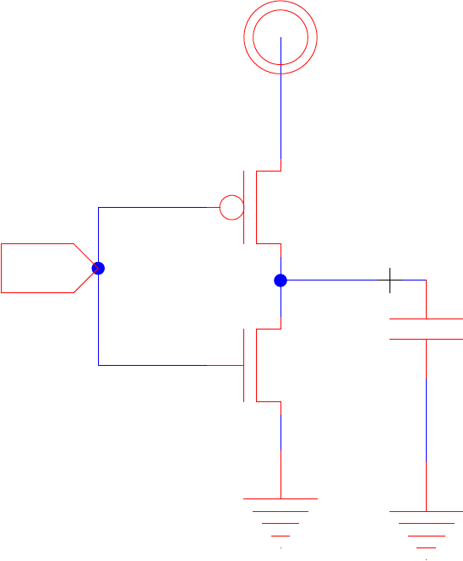
Switching Currents
I_{total}(t) = I_{static}(t)+I_{switch}(t)
I_{switch}(t) = I_{sc}(t) + I_{dyn}(t)
I_{dyn}
I_{static}
I_{sc}

Slide 5
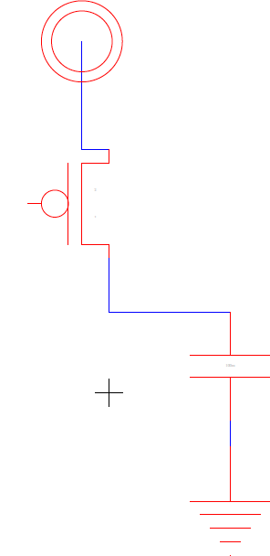
Charging
I_{dyn}(t) – why is it changing?
  I_{ds} = f(V_{ds},V_{gs})
  and V_{gs}, V_{ds} changing

Slide 6
Switching Energy – focus on I_{dyn}(t)
I_{dyn}
I_{static}
I_{sc}

Slide 7
Switching (Dynamic)
CMOS circuit switching output from 0→1
  Spends energy CV_{dd}² charging load
  CV_{dd}² energy is pulled from the energy source

Slide 8
Switching Power
Every time output switches 0→1 pay:
  E = CV²
P_{dyn} = (# 0→1 trans) × CV² / time

Slide 9
Charging Power
P_{dyn} = (#0→1 trans) × CV² / time
Often like to think about switching frequency
Useful to consider per clock cycle
  Frequency f = 1/clock-period = clock-cycles/time
P_{dyn} = (#0→1 trans/clock-cycle) CV² f

Slide 10
Data Dependent Activity
Consider an 8b counter
  How often do each of the following switch?
    Low bit?
    High bit?
Assuming random inputs
  Activity at output of nand2?
  Activity at output of xor2?

Slide 11
Gate Output Switching (random inputs)
Output states
0
1
i
i+1
P(out_{i}!=out_{i+1})=P(out_{i}=0)*P(out_{i+1}=1)+P(out_{i}=1)*P(out_{i+1}=0)
  Probablity of output switch of nand2?
  Probablity of output switch of xor2?

Slide 12
Gate Output Switching (random inputs)
Output states
0
1
i
i+1
P(out_{i}→out_{i+1}=0→1)=P(out_{i}=0)*P(out_{i+1}=1)

Slide 13
Dynamic Power
P_{dyn} = (#0→1 trans/clock-cycle) CV² f
Let a = activity factor
  a = average #tran_{0→1}/clock
  a = probability of #tran_{0→1}
P_{dyn} = aCV² f

Slide 14
Activity Factor
Let a = activity factor
  a = average #tran_{0→1}/clock
  a = probability of #tran_{0→1}

Slide 15
Switching
Short Circuit Power

Slide 16
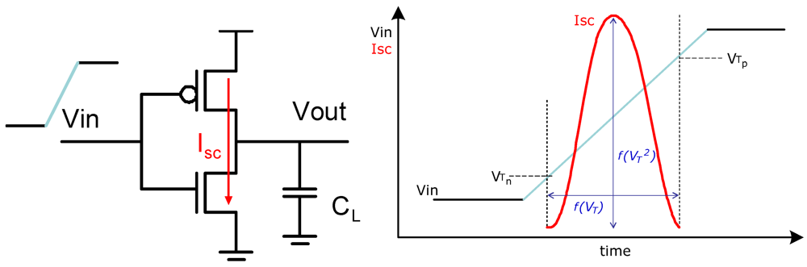
Short Circuit Power
Between V_{TN} and V_{dd} - V_{TP}
  Both N and P devices conducting

Slide 17

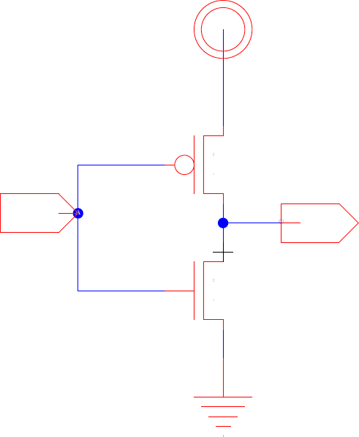
Short Circuit Power
Between V_{TN} and V_{dd} - V_{TP}
  Both N and P devices conducting
Roughly:
I_{sc}
Vdd-Vthp
Isc
tsc
tsc

Slide 18
Peak Current
I_{peak} around V_{dd}/2
  If |V_{TN}|=|V_{TP}| and sized equal rise/fall
Vdd-Vthp
Isc
tsc
tsc

Slide 19
Peak Current
I_{peak} around V_{dd}/2
  If |V_{TN}|=|V_{TP}| and sized equal rise/fall
Vdd-Vthp
Isc
tsc
tsc

Slide 20
Peak Current
I_{peak} around V_{dd}/2
  If |V_{TN}|=|V_{TP}| and sized equal rise/fall
Vdd-Vthp
Isc
tsc
tsc

Slide 21
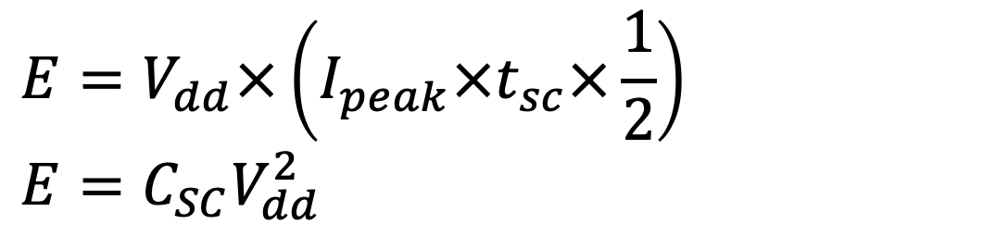
Short Circuit Energy
Make it look like switching an equivalent capacitance, C_{SC}
$$E=V_{dd}×\left(I_{peak}×t_{sc}×\frac{1}{2}\right)$$
$$E=C_{SC}V_{dd}^{2}$$

Slide 22
Short Circuit Energy
Make it look like switching an equivalent capacitance, C_{SC}
$$E=V_{dd}×\left(I_{peak}×t_{sc}×\frac{1}{2}\right)$$
$$E=C_{SC}V_{dd}^{2}$$

Slide 23
Short Circuit Energy
Every time switch (0→1 and 1→0)
  Also dissipate short-circuit energy: E = C_{sc}V²
  C_{cs} “fake” capacitance (for accounting)

Slide 24
Total Power
P_{tot} = P_{static} + P_{sc} + P_{dyn}
P_{dyn} + P_{sc} = aC_{load}V²f + 2aC_{sc}V²f
P_{tot} ≈ a(C_{load} + 2C_{sc})V²f + VI’_{s}(W/L)e^{-Vt/(nkT/q)}

Slide 25
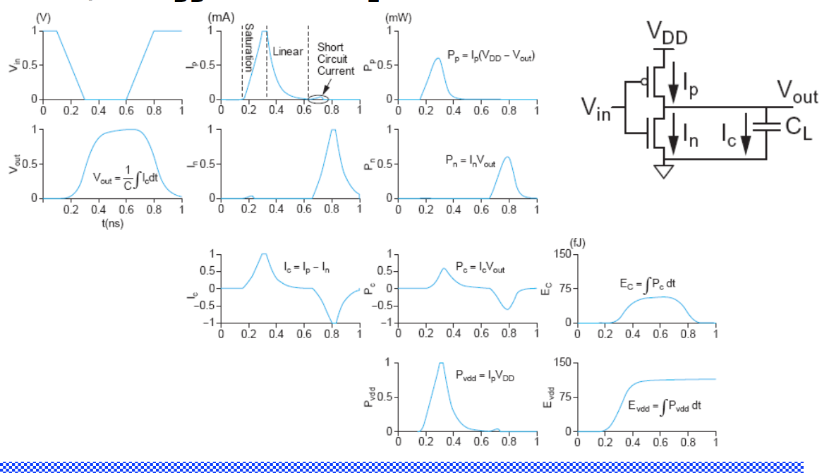
Switching Waveforms

Slide 26
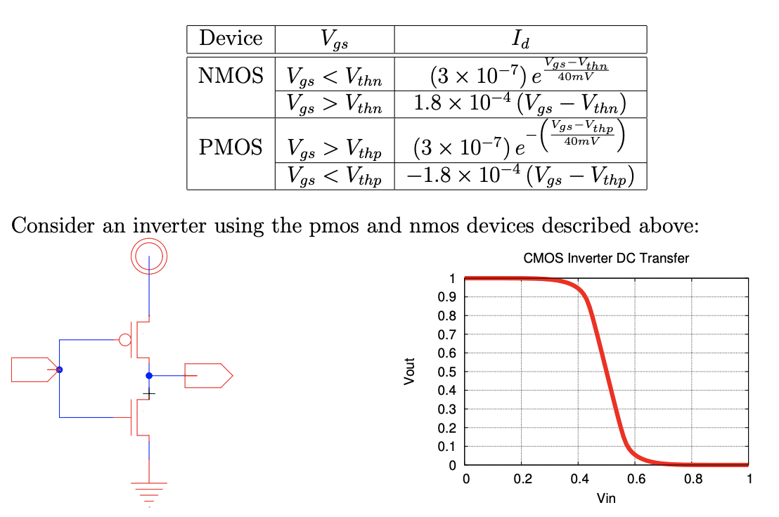
Preclass 1

Slide 27
Preclass 1
V_{in} | I_{static} | I_{dynamic} | I_{sc}
0V
140mV
400mV
500mV
600mV
860mV
1V

Slide 28
Design Tradeoffs

Slide 29
Reduce Dynamic Power?
P_{dyn} = aCV² f
How do we reduce dynamic power?

Slide 30
Reduce Activity Factor
Tree
Chain
A
O₁
A
B
B
O₁
F
C
O₂
C
D
O₂
F
D

Slide 31
Reduce Activity Factor
Tree
Chain
A
O₁
A
B
15/256
B
O₁
F
C
O₂
15/256
C
D
O₂
F
D

Slide 32
Reduce Activity Factor
Tree
Chain
3/16
3/16
A
O₁
A
B
15/256
B
O₁
7/64
F
C
O₂
15/256
C
D
O₂
F
D
3/16

Slide 33
Reduce V_{dd} (Preclass 2)
V_{dd}=520mV, V_{thn}=|V_{thp}|=300mV
V_{in} | I_{static} | I_{dynamic} | I_{sc}
0V
140mV
260mV
380mV
520mV

Slide 34
Reduce V_{dd}
What happens as reduce V?
  Energy?
    Static
    Switching
  Delay?

Slide 35
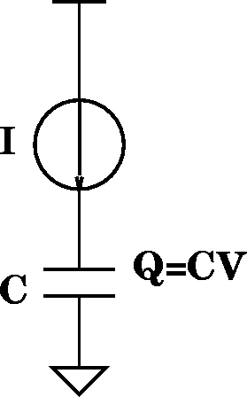
Reduce V_{dd}:
τ_{gd}=Q/I=(CV)/I
I_{d}=(μC_{OX}/2)(W/L)(V_{gs}-V_{TH})²
τ_{gd} impact?
τ_{gd}

Slide 36
Reduce V_{dd}:
τ_{gd}=Q/I=(CV)/I
I_{d}=(μC_{OX}/2)(W/L)(V_{gs}-V_{TH})²
τ_{gd} impact?
τ_{gd}
Ignoring leakage:

Slide 37
Reduce V_{dd}:
τ_{gd}=Q/I=(CV)/I
I_{d}=(μC_{OX}/2)(W/L)(V_{gs}-V_{TH})²
τ_{gd} impact?
τ_{gd}
Ignoring leakage:

Slide 38
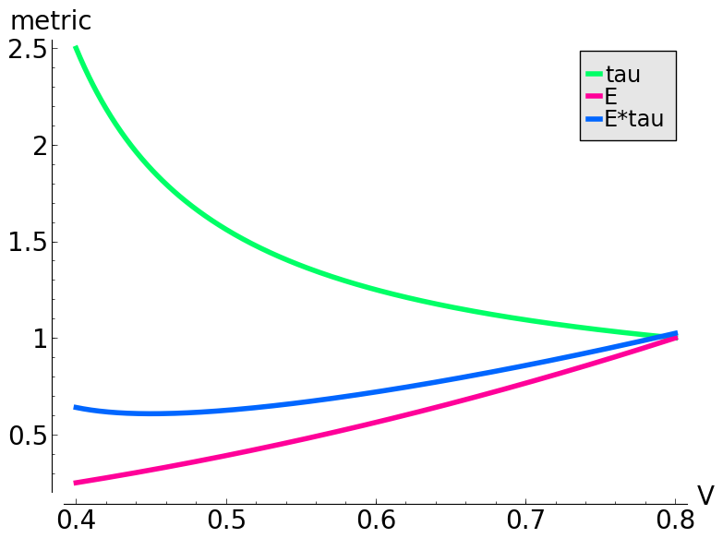
Reduce V_{dd}: Velocity Saturation
τ_{gd}=Q/I=(CV)/I
I_{d}=(ν_{sat}C_{OX})(W)(V_{gs}-V_{TH}-V_{DSAT}/2)
τ_{gd} impact?

Slide 39
Reduce V_{dd} (Preclass 3)
V_{thn}=|V_{thp}|=300mV, V_{in}=V_{dd}, estimate Eτ
V_{dd} | I_{dyn} | τ/(τ@V_{dd}=1) | E_{switch}/(E_{switch}@V_{dd}=1) | Eτ
1V
700mV
500mV
350mV
260mV

Slide 40
Increase V_{th} (Preclass 4)
What is impact of increasing threshold on
  Delay?
  Leakage?
V_{dd}=1V, V_{in}=V_{dd}
V_{thn}= -V_{thp} | I_{dyn} | τ/(τ@V_{th}=300mV) | I_{static} | I_{stat}/(I_{stat}@V_{th}=300mV)
300mV
460mV
600mV

Slide 41
Big Ideas
Three components of power
  Static
  Dynamic
  Short-circuit
P_{tot} = P_{static} + P_{dyn}+ P_{sc}
Tradeoff between energy and speed
  Want to look at the energy-delay product for optimality

Slide 42
Admin
HW 5 due Friday
Proj 1 posted Friday
  Design 8-bit adder (baseline design)
  Milestone due following Friday 10/22
  Will get feedback by Sunday morning
    If you turn in on time
    If you turn in late, you get feedback late

