Slide 1
ESE370: Circuit-Level Modeling, Design, and Optimization for Digital Systems
Lec 17: October 18, 2021
Energy Optimization
Ratioed Logic

Slide 2
Today
Energy Tradeoffs
Reduce dynamic power
Ratioed Logic
Break all the rules… (lose our nice properties)
Not rail-to-rail signals, steady-state-current…
Correctness

Slide 3
Previously
Three components of power
P_{tot} = P_{static} + P_{dyn}+ P_{sc}
P_{tot} ≈ a(C_{load} + 2C_{sc})V²f + VI’_{s}(W/L)e^{-Vt/(nkT/q)}

Slide 4
Reminder:
Vdd=1V, Vthn=|Vthp|=300mV
V_{in} | I_{static} | I_{dynamic} | I_{sc}
0V | 180pA | 126uA
140mV | 6nA | 100uA
400mV |  | 36uA | 18uA
500mV |  |  | 36uA
600mV |  | 36uA | 18uA
860mV | 6nA | 100uA
1V | 180pA | 126uA

Slide 5
Reduce V_{dd}
What happens as reduce V?
Energy?
Static
Switching
Delay?

Slide 6
Reduce V_{dd} (Preclass 2)
V_{dd}=520mV, V_{thn}=|V_{thp}|=300mV
V_{in} | I_{static} | I_{dynamic} | I_{sc}
0V
140mV
260mV
380mV
520mV

Slide 7
Reduce V_{dd} (Preclass 2)
V_{dd}=520mV, V_{thn}=|V_{thp}|=300mV
V_{in} | I_{static} | I_{dynamic} | I_{sc}
0V | 180pA | 39.6uA
140mV | 6nA | 14.4uA
260mV | 111nA
380mV | 6nA | 14.4uA
520mV | 180pA | 39.6uA

Slide 8
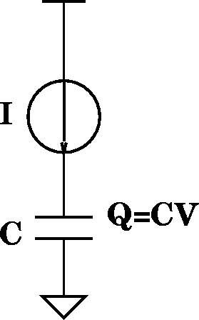
Reduce V (no velocity saturation)
τ_{gd}=Q/I=(CV)/I
I_{d}=(μC_{OX}/2)(W/L)(V_{gs}-V_{TH})²
τ_{gd} impact?
τ_{gd}

Slide 9
Reduce V (no velocity saturation)
τ_{gd}=Q/I=(CV)/I
I_{d}=(μC_{OX}/2)(W/L)(V_{gs}-V_{TH})²
τ_{gd} impact?
τ_{gd}
Ignoring leakage:

Slide 10
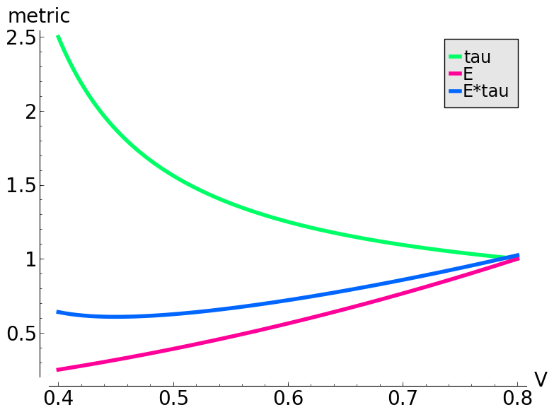
Reduce V (velocity saturation)
τ_{gd}=Q/I=(CV)/I
I_{d}=(ν_{sat}C_{OX})(W)(V_{gs}-V_{TH}-V_{DSAT}/2)

Slide 11
Reduce V_{dd} (Preclass 3)
V_{thn}=|V_{thp}|=300mV, V_{in}=V_{dd}, estimate Eτ
V_{dd} | I_{dyn} | τ/(τ@V_{dd}=1) | E_{switch}/(E_{switch}@V_{dd}=1) | Eτ
1V |  | 1 | 1 | 1
700mV
500mV
350mV
260mV

Slide 12
Increase V_{th}?
What is impact of increasing threshold on
Delay?
Leakage?
Notes:
-Exponential increase in leakage power

Slide 13
Increase V_{th}
τ_{gd}=Q/I=(CV)/I
I_{ds}=(ν_{sat}C_{OX})(W)(V_{gs}-V_{TH}-V_{DSAT}/2)

Slide 14
Increase V_{th} (Preclass 4)
What is impact of increasing threshold on
Delay?
Leakage?
V_{dd}=1V, V_{in}=V_{dd}
V_{thn}= -V_{thp} | I_{dyn} | τ/(τ@V_{th}=300mV) | I_{static} | I_{stat}/(I_{stat}@V_{th}=300mV)
300mV |  | 1 |  | 1
460mV
600mV
Notes:
-Exponential increase in leakage power

Slide 15
Idea
Tradeoff (knobs: V_{dd}, V_{th}, a, etc.)
Speed
Switching energy
Leakage energy
Energy-Delay tradeoff: Eτ², Eτ

Slide 16
Ratioed Logic

Slide 17
Previously
Restoration and Noise Margins
Allows for gate abstraction
CMOS Gates
Drive outputs rail-to-rail
Only one PDN/PUN turned on in steady state
Only subthreshold leakage current in steady state

Slide 18
Today
Ratioed Gates
Break all the rules… (nice properties)
No rail-to-rail outputs, steady-state-current is not subthreshold…
Logic correctness
Performance
Power implications
Notes:
Not clear win
Should be able to analyze
Chance to exercise analysis
Kind of thing you want to be able to analyze
Pattern should recognize
Stepping stone to more interesting things to come

Slide 19
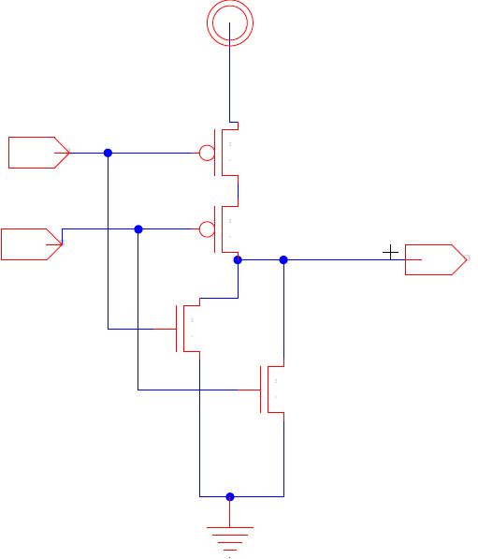
Idea
Building both pull-up and pull-down can be expensive – many gates
Seems wasteful to build logic function twice
Once in pullup, once in pulldown
Large gate capacitance

Slide 20
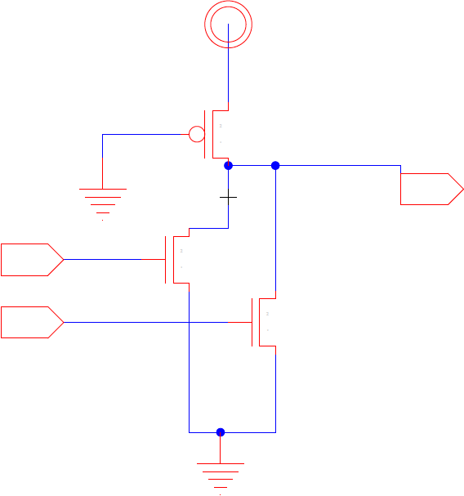
Idea
Maybe only need to build one
Build NFET pulldown
Exploit high N mobility
traditional

Slide 21
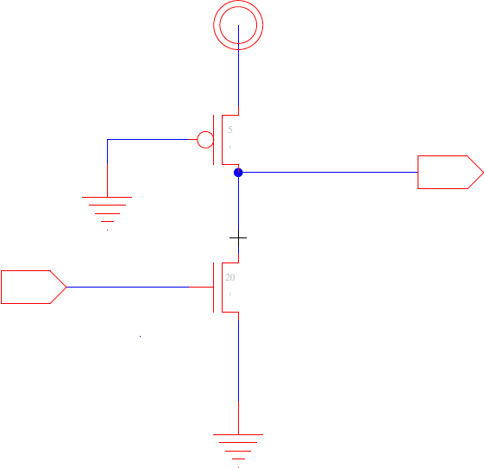
Ratioed Inverter
Does this work?
What is V_{out} for V_{in}=Gnd ?
What is V_{out} for V_{in}=V_{dd} ?
W_{P}=1
W_{N}=1

Slide 22
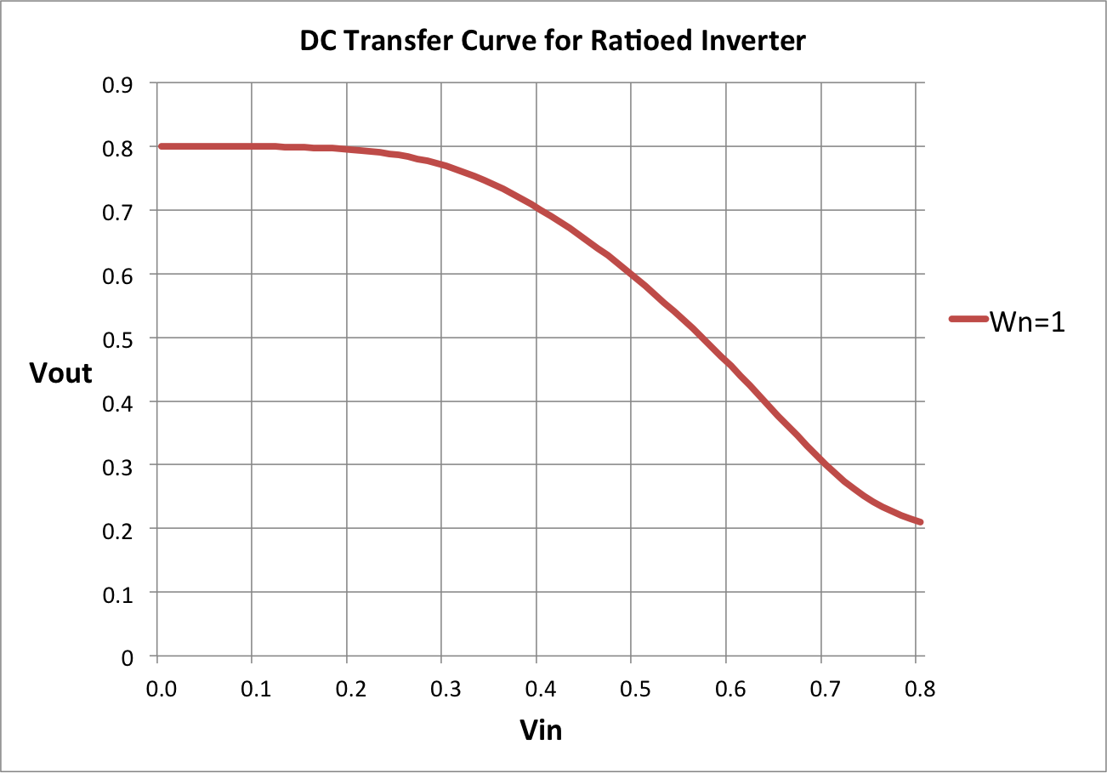
Ratioed Inverter in 22nm

Slide 23
Ratioed Inverter (Preclass 5)
How do we need to size N to make it “work”?
V_{DD}=0.8
W_{P}=1
W_{N}=?

Slide 24
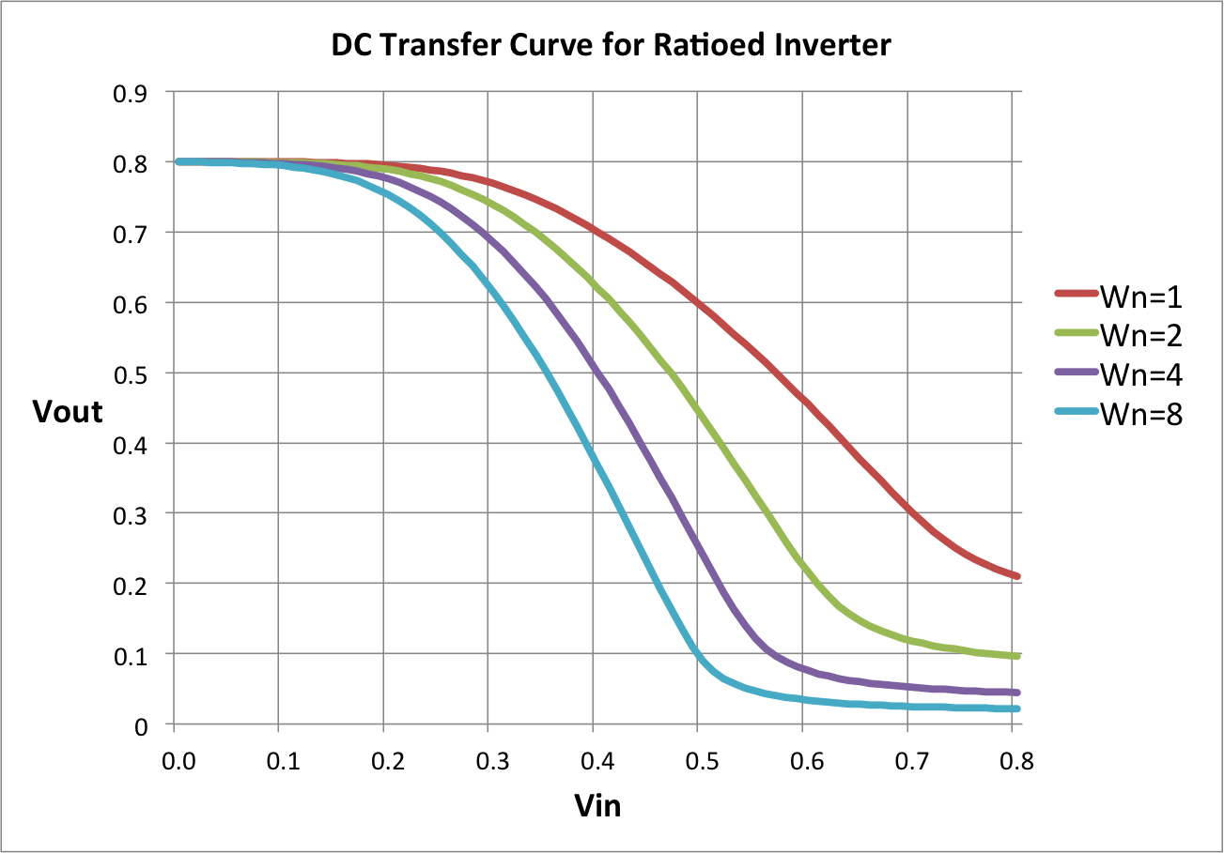
Ratioed Inverter in 22nm

Slide 25
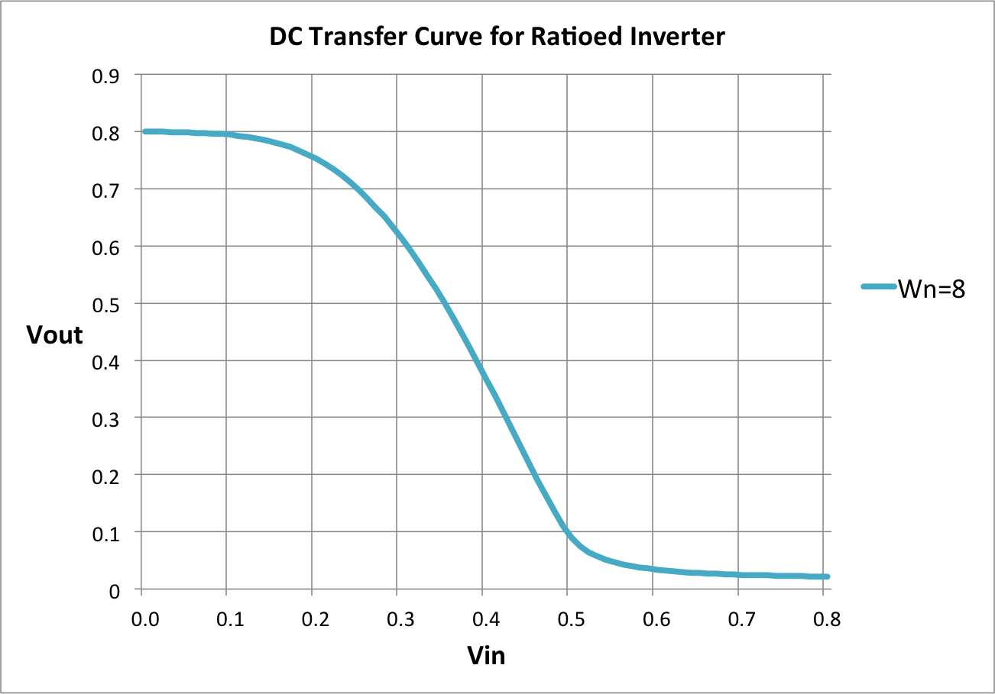
DC Transfer Function

Slide 26
DC Transfer Function

Slide 27
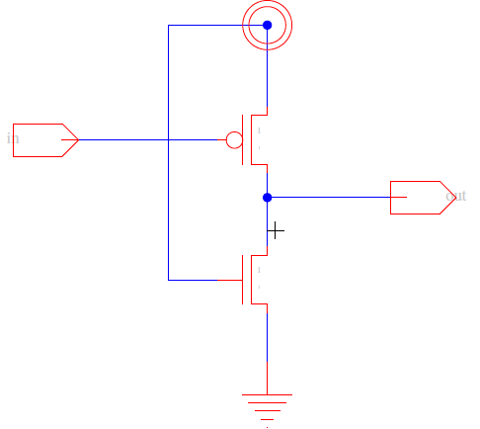
Ratioed Inverter (Preclass 5)
How do we need to size P to make it work?
V_{DD}=0.8
W_{N}=1

Slide 28
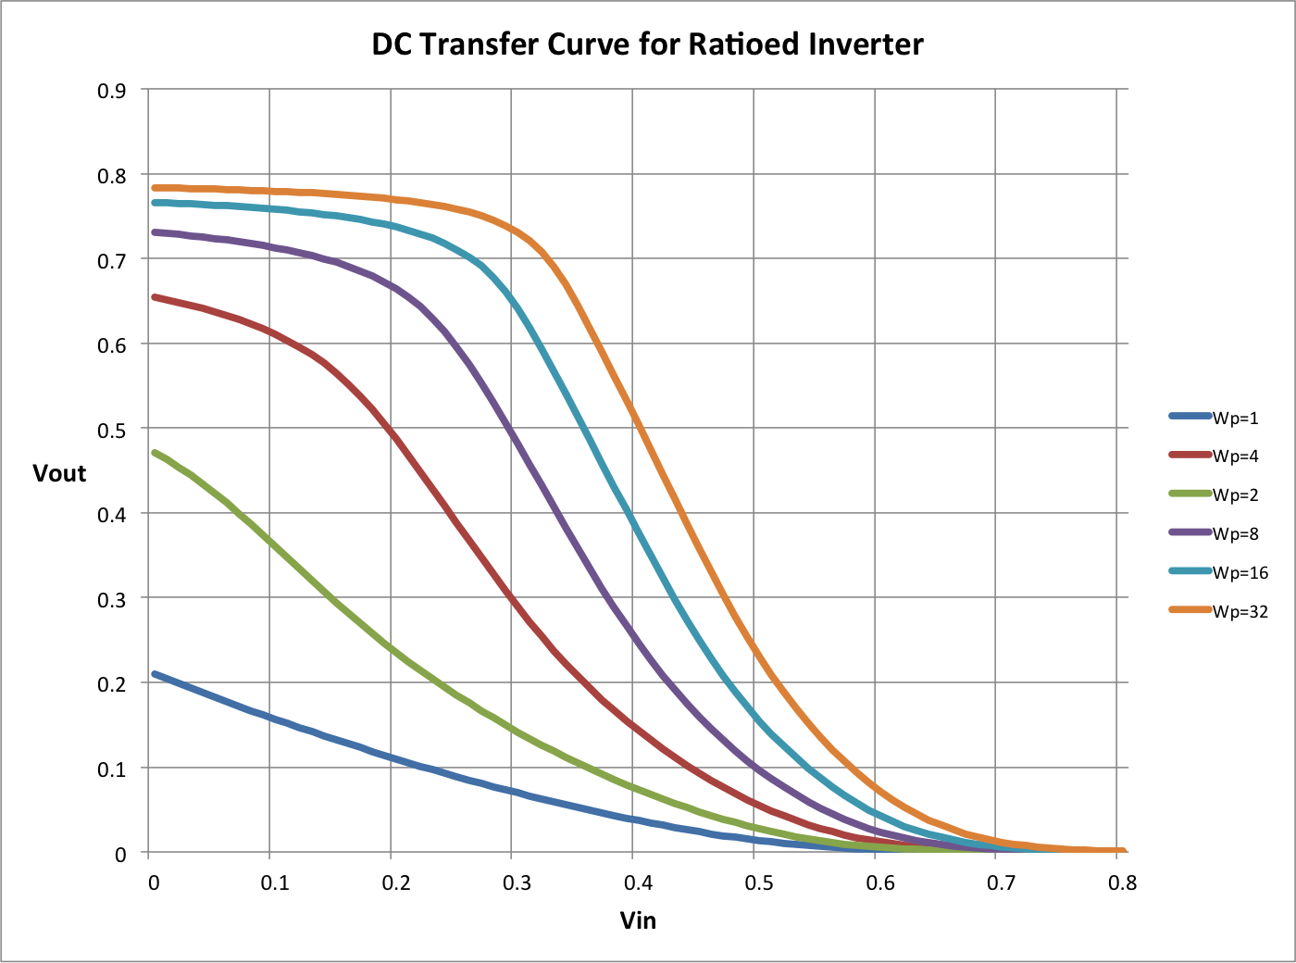
Ratioed Inverter in 22nm

Slide 29
Ratioed Inverter in 22nm

Slide 30
P vs. N
Conclude: still prefer N to P for ratioed logic

Slide 31
Noise Margin Tradeoff
What is impact of increasing noise margin?
On size
On input capacitance
Notes:
Cue, for what is the equivalent output resistance of designed inverter? R₀
How do we design for larger drive strength?

Slide 32
Size for R₀/2 drive?
How do we size for R₀/2 drive?
(assume R_{0p}=R_{0n} for CMOS)
Notes:
Input low: r_drive = Rop/Wp = 2Ron/Wp = Ro/2 → Wp = 4
Wn > 8*Wp → Wn = 32

Slide 33
Static Power
I_{static} ?
Input low-Output high?
I_{leak}
Input high-Output low?
I_{pmos_on}
~V_{dd}/(R₀/2) -- for our sample case

Slide 34
Total Power
P_{tot} ≈ a(C_{load} + 2C_{sc})V²f

Slide 35
Total Power
P_{tot} ≈ a(C_{load} + 2C_{sc})V²f
+ p(V_{out}=low)V²/R_{pon}
+ p(V_{out}=high)VI’_{s}(W/L)e^{-Vt/(nkT/q)}
p(V_{out}=low) – probability the output is low
p(V_{out}=high) – probability the output is high
p(V_{out}=high)=1-p(V_{out}=low)

Slide 36
Compare Static CMOS
For R_{drive}=R₀/2 inverter (assume R_{0p}=R_{0n} for CMOS)
Total Transistor Width?
Input capacitance load?
Notes:
Ratioed: Wp = 2, Wn = 16, Cin = 16C0
Static CMOS: Wp=2, Wn=2, Cin=4C0

Slide 37
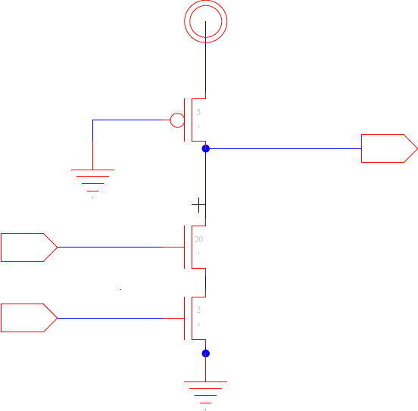
How do we size for R₀/2 drive?
2-input nand?

Slide 38
How do we size for R₀/2 drive?
2-input nor?

Slide 39
How do we size for R₀/2 drive?
k-input nor?
What is the input capacitance for k-input nor?
…
Notes:
Ratioed: 16C0
Static cmos: (2+2k)C0
Ratioed cap<cmos cap
K>=7

Slide 40
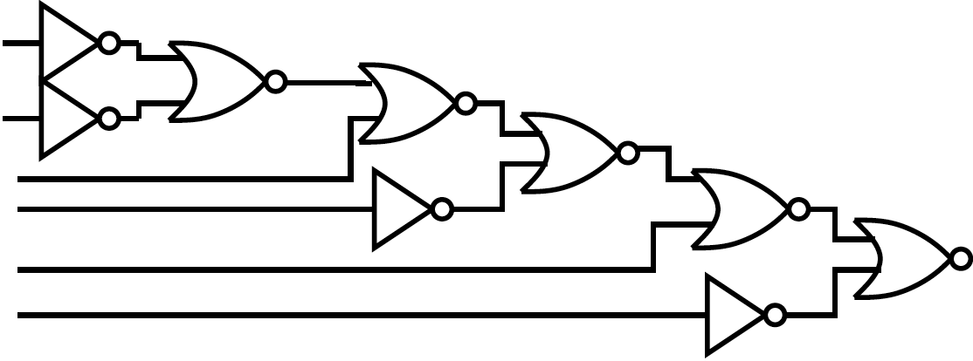
Which Implementation is faster in ratioed logic?
Notes:
Preferred gate:
CMOS – nand gate
Ratioed – nor gate

Slide 41
Ideas
There are other logic disciplines
You have the tools to analyze
Ratioed Logic
Tradeoff noise margin for
Reduced area? Capacitive load?
Dissipates non-leakage static power in one input case

Slide 42
Admin
Project 1 out now
Milestone due Friday (10/22)
Baseline is bare minimum, but can start thinking/working on optimizations before
Will give you feedback by Sunday morning
Design 8-bit ripple-carry adder
You already know how to do this
Refresh yourself on binary addition of 2 bits
Work individually
Full Report in two weeks (F 10/29)

