Slide 1
ESE370: Circuit-Level Modeling, Design, and Optimization for Digital Systems
Lec 18: October 20, 2021
Ratioed Logic, Design Space Exploration

Slide 2
Today
Finish Ratioed Gates
Example to discuss and illustrate design space
You will want to be exploring design space for Project 2
Chance to talk about trends
Quantitatively not just qualitatively

Slide 3
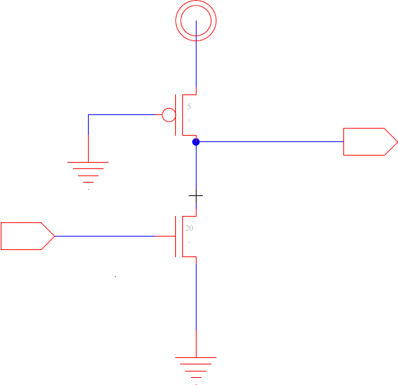
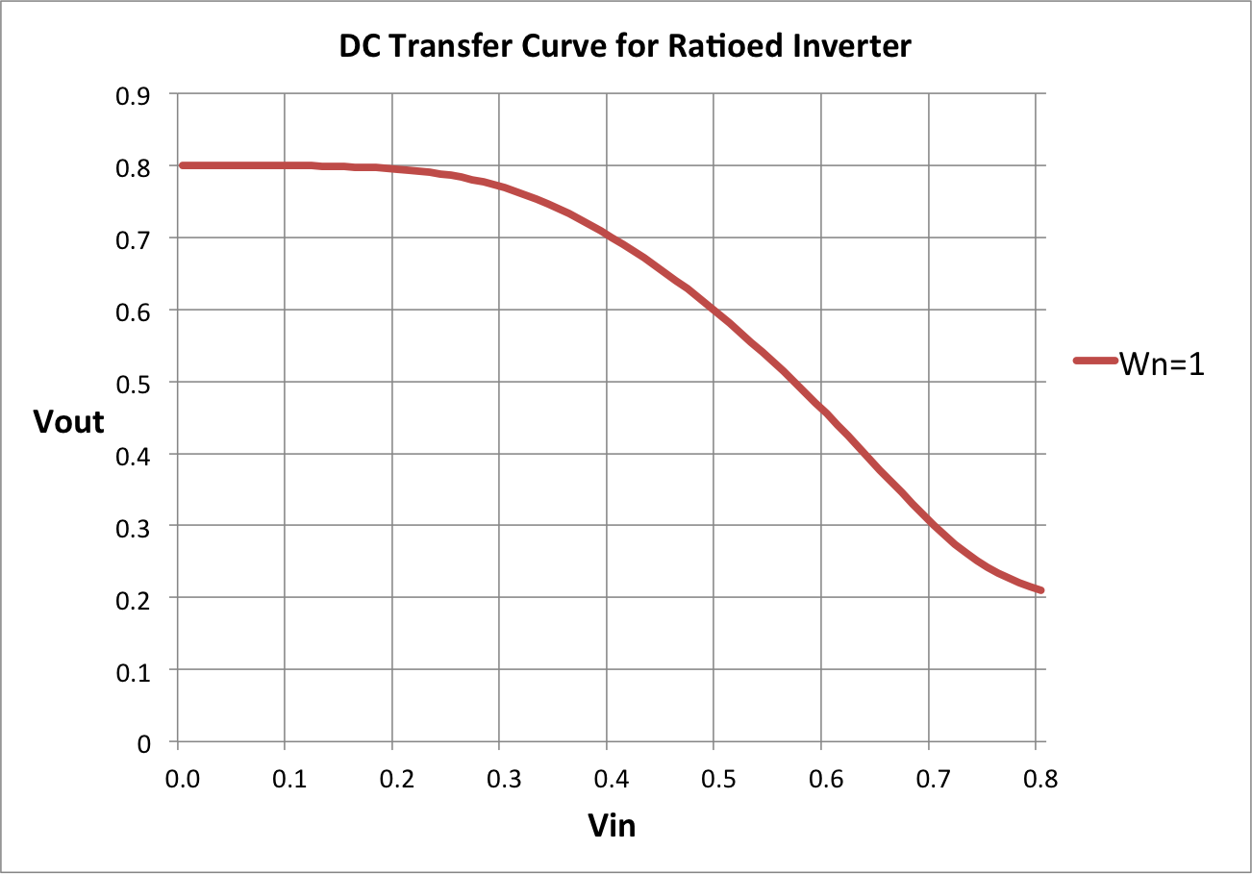
Ratioed Inverter
Build NFET pulldown
Exploit high N mobility
traditional
W_{P}=1
W_{N}=1

Slide 4
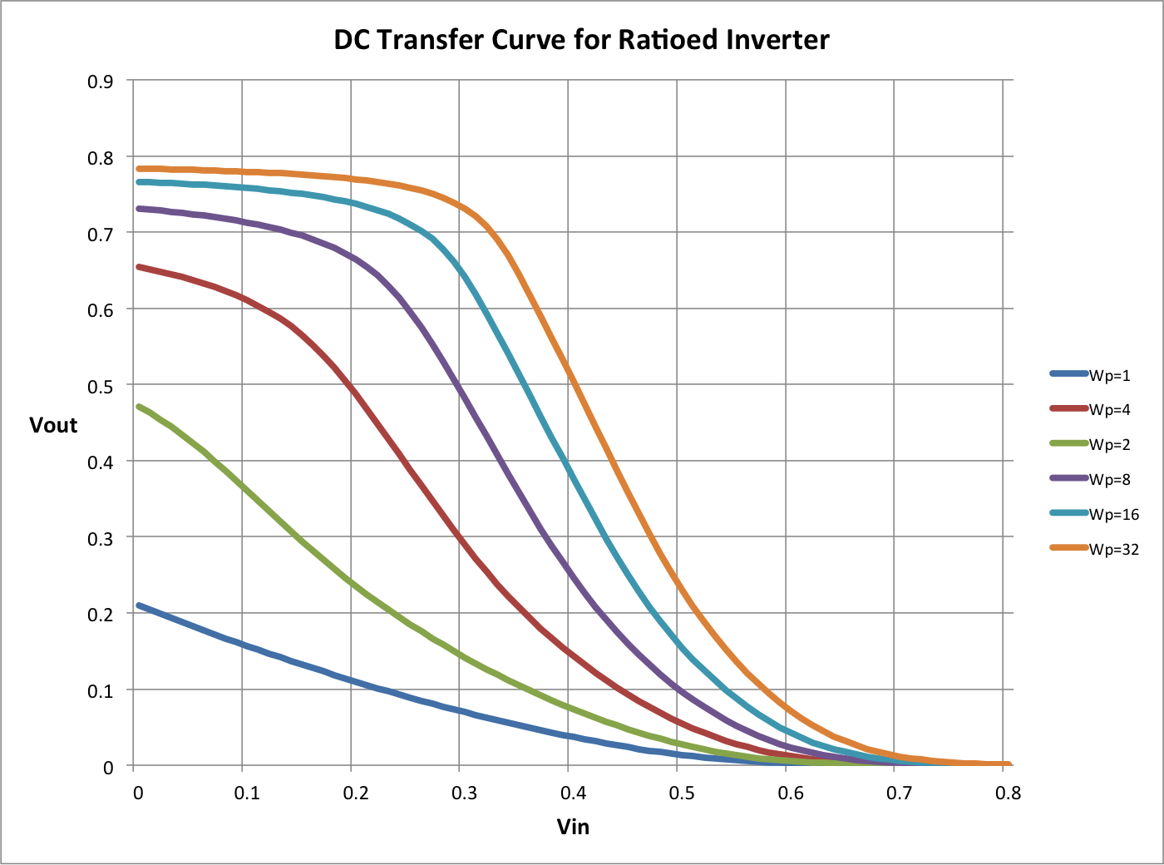
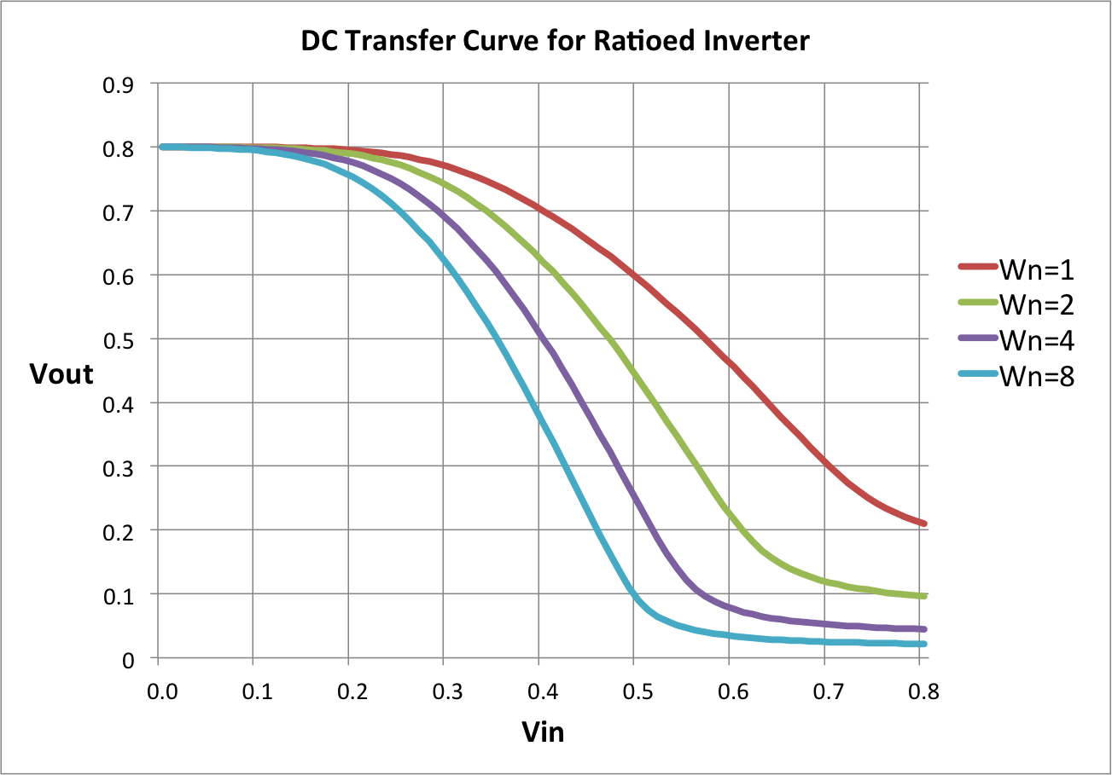
Noise Margin Tradeoff
What is impact of increasing noise margin?
On size
On input capacitance

Slide 5
Size for R₀/2 drive? (Preclass 2)
How do we size for R₀/2 drive?
(assume R_{0p}=R_{0n} for CMOS)
Notes:
Input low: r_drive = Rop/Wp = 2Ron/Wp = Ro/2 → Wp = 4
Wn > 8*Wp → Wn = 32

Slide 6
Size for R₀/2 drive? (Preclass 2)
How do we size for R₀/2 drive?
(assume R_{0p}=R_{0n} for CMOS)

Slide 7
Static Power
I_{static} ?
Input low-Output high?
I_{leak}
Input high-Output low?
I_{pmos_on}
~V_{dd}/(R₀/2) -- for our sample case

Slide 8
Total Power
P_{tot} ≈ a(C_{load}+2C_{sc})V²f

Slide 9
Total Power
P_{tot} ≈ a(C_{load}+2C_{sc})V²f
+p(V_{out}=low)V²/R_{pon}
+p(V_{out}=high)VI’_{s}(W/L)e^{-Vt/(nkT/q)}
p(V_{out}=low) – probability the output is low
p(V_{out}=high) – probability the output is high
p(V_{out}=high)=1-p(V_{out}=low)

Slide 10
Compare Static CMOS
For R_{drive}=R₀/2 inverter (assume R_{0p}=R_{0n} for CMOS)
Total Transistor Width?
Input capacitance load?

Slide 11
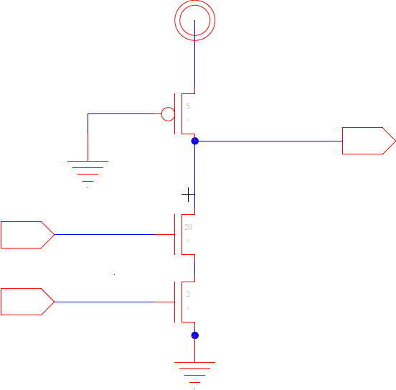
Size for R₀/2 drive? (Preclass 2)

Slide 12
Size for R₀/2 drive? (Preclass 2)

Slide 13
Size for R₀/2 drive? (Preclass 2)

Slide 14
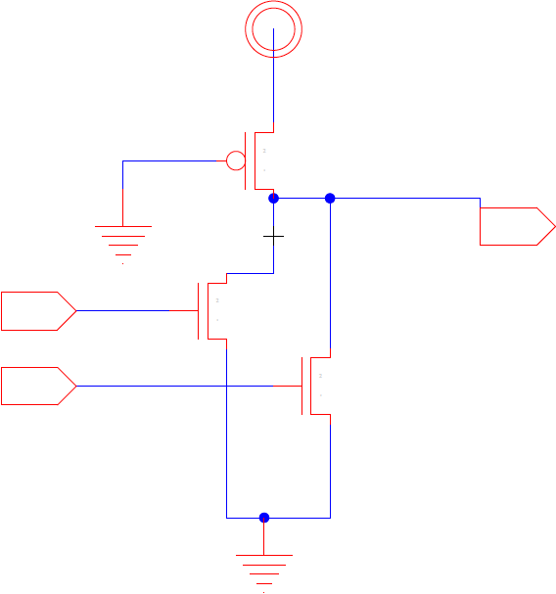
Size for R₀/2 drive? (Preclass 2)
2-input nor?

Slide 15
Size for R₀/2 drive? (Preclass 2)
2-input nor?

Slide 16
Size for R₀/2 drive? (Preclass 3)
k-input nor?
What is the input capacitance for k-input nor?
…

Slide 17
Size for R₀/2 drive? (Preclass 4)
k-input nor?
What is the input capacitance for k-input nor?
For what k does ratioed gate have lower C_{in}?
…

Slide 18
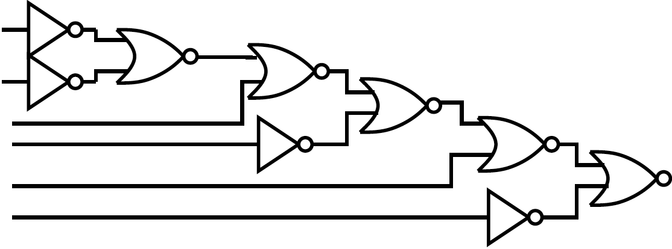
Which implementation is faster in ratioed logic?

Slide 19
Ideas
There are other logic disciplines
You have the tools to analyze
Ratioed Logic
Tradeoff noise margin for
Reduced area? Capacitive load?
Dissipates non-leakage static power in one input case

Slide 20
Design Space Exploration

Slide 21
Design Problem
Function: Identify equivalence of two 32bit inputs
Optimize: Minimize total energy
Assumptions: Match case uncommon
Ie. Most of the time, the inputs won’t be matched
Deliberately focus on Energy to complement project
…but will still talk about delay
Last page of preclass

Slide 22
Idea: Design Space Explore
Identify options
All the knobs you can turn
Explore space systematically
Formulate continuum where possible
i.e. formulate trends and tradeoffs quantitatively

Slide 23
Problem Solvable (preclass 1)
Is it feasible?
First, make sure we have a solution so we know our main goal is optimization
How do we decompose the problem?

Slide 24
Problem Solvable (preclass 2)
Is it feasible?
First, make sure we have a solution so we know our main goal is optimization
How do we decompose the problem?
What look like built out of nand2 gates and inverters?

Slide 25
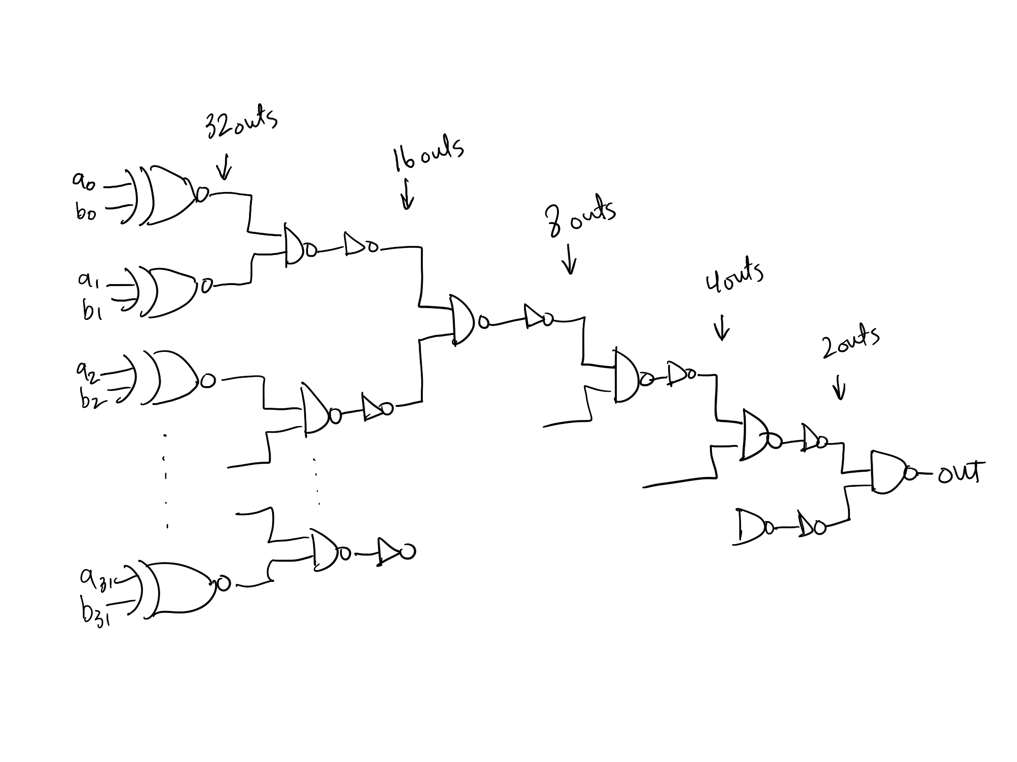
Nand2 and inverter implementation

Slide 26
Single Gate Match Condition (preclass 3)
Design a single gate for match comparison

Slide 27
Total Power
Static CMOS:
P_{tot} ≈ a(C_{load}+2C_{sc})V²f+VI’_{s}(W/L)e^{-Vt/(nkT/q)}
Ratioed Logic:
P_{tot} ≈ a(C_{load}+2C_{sc})V²f
+p(V_{out}=low)V²/R_{pon}
+(1-p(V_{out}=low))VI’_{s}(W/L)e^{-Vt/(nkT/q)}
What can we do to reduce power?

Slide 28
Knobs (preclass 4)
What are the options and knobs we can turn?

Slide 29
Design Space Dimensions
Topology
(A) Gate choice, logical optimization
(B) Fanin, fanout, (C) Serial vs. parallel
Gate style / logic family
(D) CMOS, Ratioed (N load, P load)
(E) Transistor Sizing
(F) Vdd
(G) Vth

Slide 30
Gate
(A) What gates might we build?

Slide 31
Gate
(B) High fanin?

Slide 32
Gate
(C) Serial-Parallel?

Slide 33
(D) Logic Family
Considerations for each logic family?
CMOS
Ratioed with PMOS load
Ratioed with NMOS load
Ratioed Logic
Reduced C_{loads} result in lower switching power (P_{dyn} ⬇)
Increased static power

Slide 34
(E) Sizing
How do we want to size gates?
Sizing transistors up will reduce delay →
Reduces short circuit power
Increases dynamic power

Slide 35
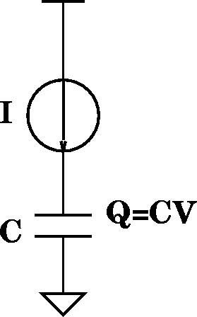
(F) Reduce Vdd
What happens as reduce V?
Energy?
Dynamic ⬇
Static ⬇
Switching Delay? ⬆
τ_{gd}=Q/I=(CV)/I
I_{d}=(μC_{OX}/2)(W/L)(V_{gs}-V_{TH})²
τ_{gd} impact?
τ_{gd} α 1/V
Limit on Vdd?

Slide 36
(G) Increase V_{th}?
What is impact of increasing threshold on
Dynamic Energy? ⬇
Leakage Energy? ⬇
Delay? ⬆
τ_{gd}=Q/I=(CV)/I
I_{ds}=(ν_{sat}C_{OX})(W)(V_{gs}-V_{TH}-V_{DSAT}/2)

Slide 37
Ideas
We know many things we can do to our circuits
Design space is large
Systematically identify dimensions
Identify continuum (trends) tuning when possible
Watch tradeoffs
…don’t over-tune

Slide 38
Admin
Project out now
Milestone due 10/22
baseline is a bare minimum
Really should be into exploring optimizations to try
Final report due 10/29
Final report should be single document typed with all figures, schematics, graphs, equations, etc. computer generated. Anything handwritten will not be looked at. Anything outside of that document won’t be looked at.
YOUR OWN WORK!
You should understand everything you turn in, and I reserve the right to test you on that

