Slide 1
ESE370: Circuit-Level Modeling, Design, and Optimization for Digital Systems
Lec 20: October 25, 2021
Pass Transistor Logic, Pt2

Slide 2
Today
Pass Transistor Circuit
C_{diff}>0
Output levels
Cascading
Series pass transistors?
Delay
Start on Distributed RC
Analyzing delay for pass-tr designs

Slide 3
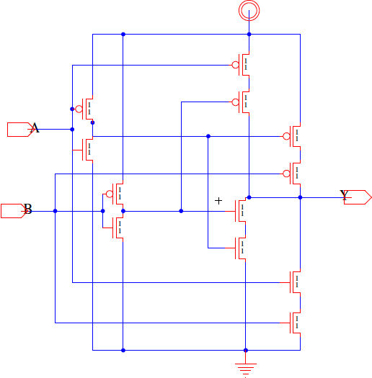
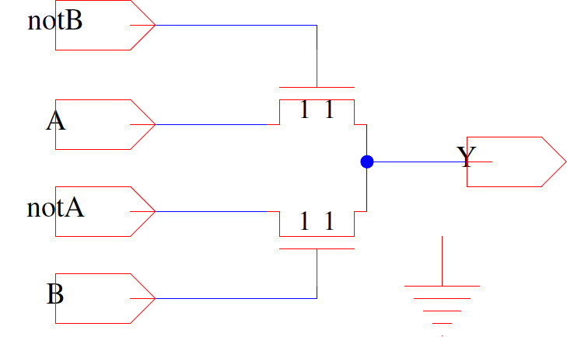
Previously: Two XOR Gates

Slide 4
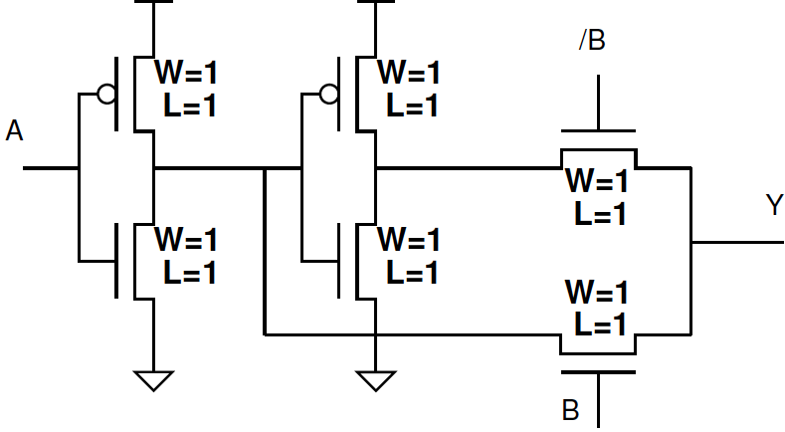
Cascaded Pass Gates

Slide 5
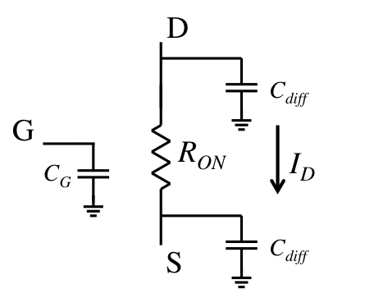
First Order Delay
R₀ = Resistance of minimum size NMOS device
C₀ = gate capacitance of minimum size NMOS device
C_{diff0} = diffusion capacitance on minimum size NMOS
C_{diff0} =γC₀
R_{drive} = R₀/W
C_{g} = WC₀
C_{diff} = WC_{diff0}
C_{diff0}
R₀
C₀
C_{diff0}

Slide 6
Delay A=1, B=0, C_{diff0}=γC₀? (Preclass 1)
What’s the equivalent RC circuit?
2C₀

Slide 7
Delay A=1, B=0, C_{diff0}=γC₀? (Preclass 1)
What’s the equivalent RC circuit?
What is the total delay?
From A to Y
2C_{g}
3C_{diff0}
2C_{diff0}+2C₀

Slide 8
Delay A=1, B=1, C_{diff0}=γC₀? (Preclass 1)
2C₀

Slide 9
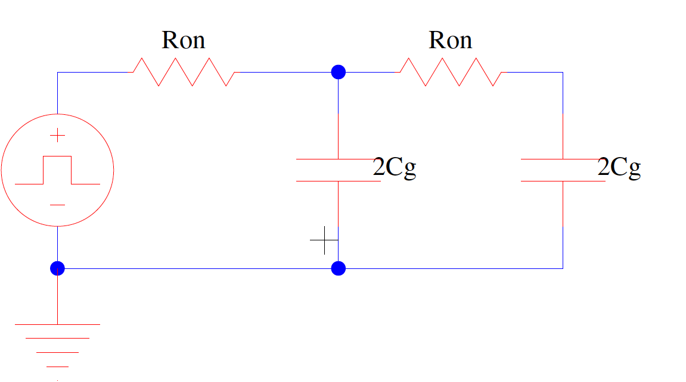
Delay A=1, B=1, C_{diff0}=γC₀? (Preclass 1)
What’s the equivalent RC circuit?
2C₀
2C₀+3C_{diff0}
2C₀+2C_{diff0}

Slide 10
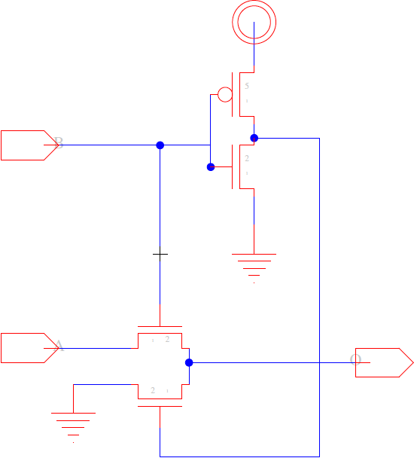
Bonus
What does this do?
A | B | Y
0 | 0
0 | 1
1 | 0
1 | 1
B
A

Slide 11
Bonus
What does this do?
A | B | Y
0 | 0 | 0
0 | 1 | 0
1 | 0 | 0
1 | 1 | 1
B
A
More examples in the text

Slide 12
Cascading Pass Transistors

Slide 13
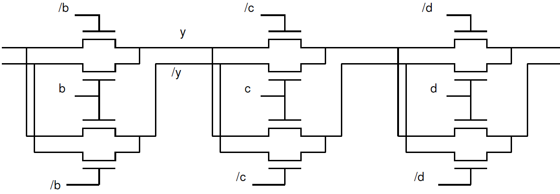
Chain without Inverters
What if we did this?
/a
a

Slide 14
Chain without Inverters
Extract key path
/a
a

Slide 15
Voltage of Chain (Preclass 2)
What is voltage at output?
V_{dd}=1V
V_{thn}=-V_{thp}=0.3V

Slide 16
Voltage of Chain (Preclass 2)
What is voltage at output?
V_{dd}=1V
V_{thn}=-V_{thp}=0.3V

Slide 17
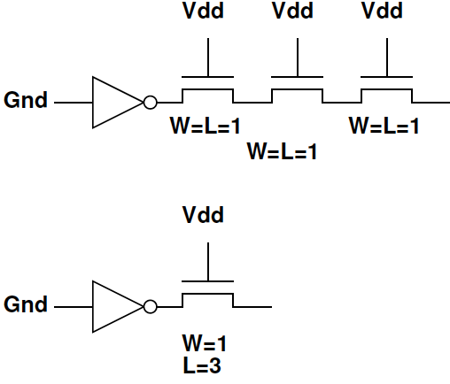
How compare (Preclass 2)
Compare
V_{dd}=1V
V_{thn}=-V_{thp}=0.3V

Slide 18
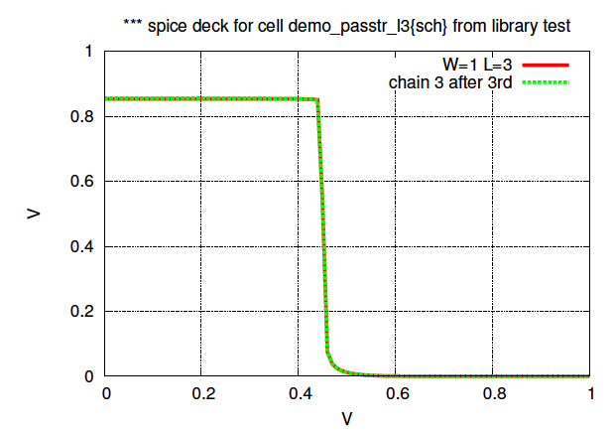
DC Analysis – chain of 3 vs length of 3

Slide 19
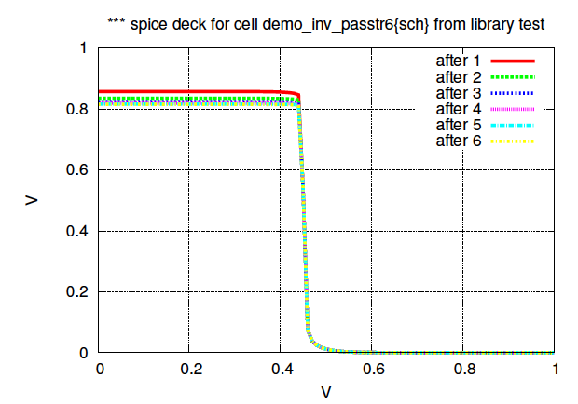
Conclude
Can chain any number of pass transistors and only drop a single V_{th}
…

Slide 20
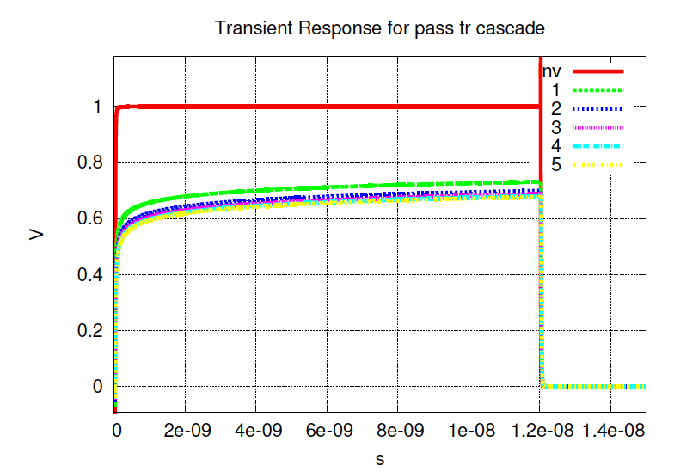
Transient

Slide 21
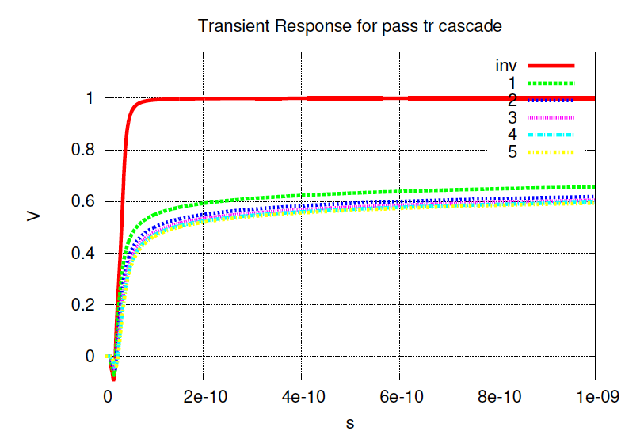
Transient: Zoomed Closeup

Slide 22
Capacitance
What is output capacitance per stage?
I.e. What is the capacitance at output y?
/a
a

Slide 23
Delay Setup
What does RC circuit look like?
/a
a

Slide 24
Gate Cascade? (Preclass 3)
What are the voltages?
V_{dd}=1V
V_{thn}=-V_{thp}=0.3V

Slide 25
Conclude
Cannot cascade degraded inputs into gates.

Slide 26
Distributed RC (setup)

Slide 27
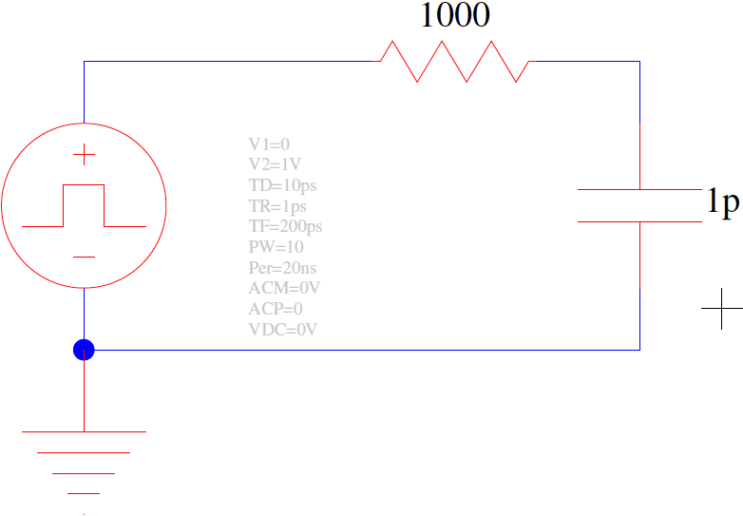
What is response? (Preclass 4)

Slide 28
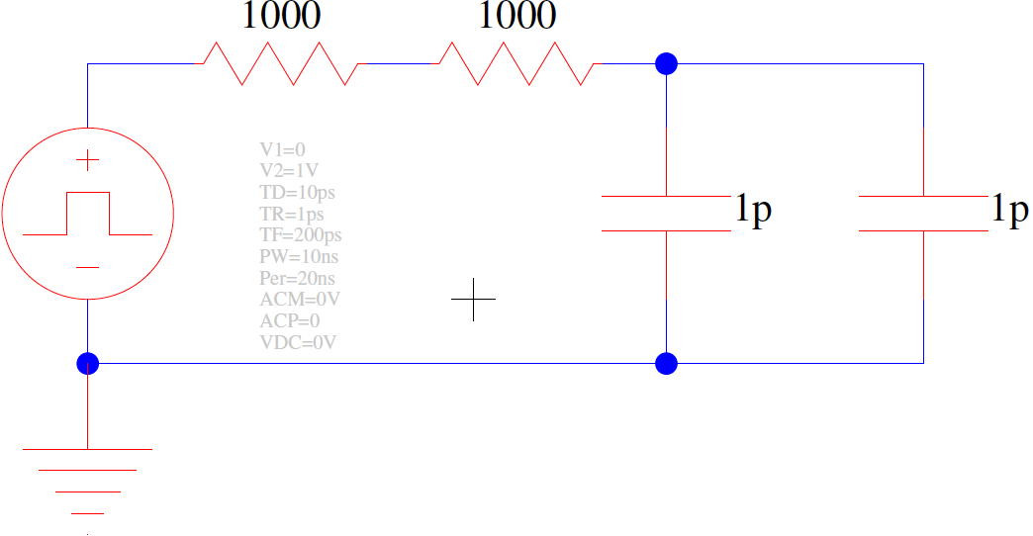
What is response? (Preclass 4)

Slide 29
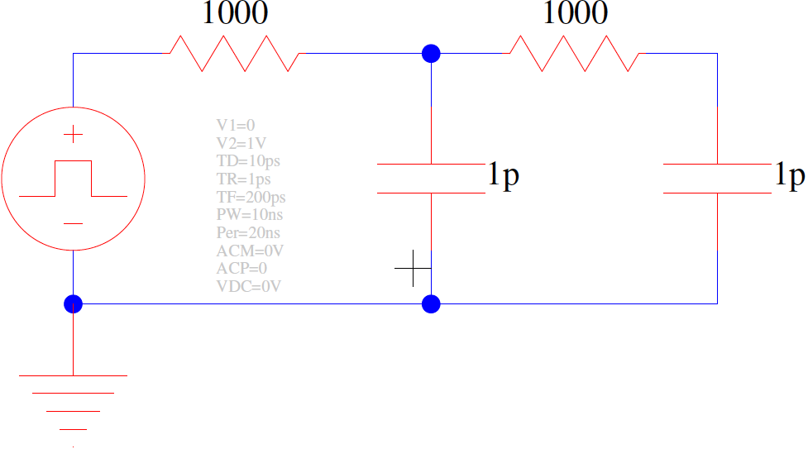
What is response? (Preclass 4)

Slide 30
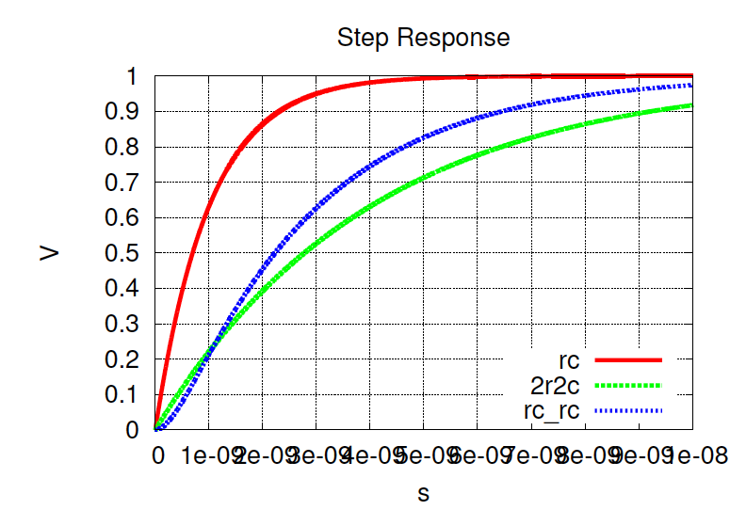
SPICE Response
1 2 3 4 5 6 7 8 9 10 (ns)

Slide 31
SPICE Response
1 2 3 4 5 6 7 8 9 10 (ns)

Slide 32
Intuition
Look at series of R’s on path
Must move Q=V(ΣC) across each R

Slide 33
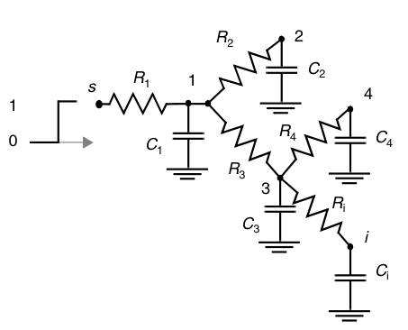
Elmore Delay: Distributed RC network
The delay from source s to node 5
N = number of nodes in circuit
5
C₅

Slide 34
Elmore Delay: Distributed RC network
The delay from source s to node 5
N = number of nodes in circuit
$$R_{5k}=\sum{R_{j}}⇒(R_{j}∈\left[path\left(s→5\right)∩path\left(s→k\right)\right])$$
$$τ_{D5}=\sum_{k=1}^{N}{C_{k}R_{5k}}$$
5
C₅

Slide 35
Elmore Delay: Distributed RC network
The delay from source s to node 5
N = number of nodes in circuit
$$R_{5k}=\sum{R_{j}}⇒(R_{j}∈\left[path\left(s→5\right)∩path\left(s→k\right)\right])$$
$$τ_{D5}=\sum_{k=1}^{N}{C_{k}R_{5k}}$$
5
C₅

Slide 36
Elmore Delay: Distributed RC network
The delay from source s to node 5
N = number of nodes in circuit
k=4
$$R_{5k}=\sum{R_{j}}⇒(R_{j}∈\left[path\left(s→5\right)∩path\left(s→k\right)\right])$$
$$τ_{D5}=\sum_{k=1}^{N}{C_{k}R_{5k}}$$
5
C₅

Slide 37
Elmore Delay: Distributed RC network
The delay from source s to node 5
N = number of nodes in circuit
k=4
$$R_{5k}=\sum{R_{j}}⇒(R_{j}∈\left[path\left(s→5\right)∩path\left(s→k\right)\right])$$
$$τ_{D5}=\sum_{k=1}^{N}{C_{k}R_{5k}}$$
5
C₅

Slide 38
Elmore Delay: Distributed RC network
The delay from source s to node 5
N = number of nodes in circuit
k=4
$$R_{5k}=\sum{R_{j}}⇒(R_{j}∈\left[path\left(s→5\right)∩path\left(s→k\right)\right])$$
$$τ_{D5}=\sum_{k=1}^{N}{C_{k}R_{5k}}$$
$$R_{54}=R_{1}+R_{3}$$
5
C₅

Slide 39
Elmore Delay: Distributed RC network
The delay from source s to node 5
N = number of nodes in circuit
$$R_{5k}=\sum{R_{j}}⇒(R_{j}∈\left[path\left(s→5\right)∩path\left(s→k\right)\right])$$
$$τ_{D5}=\sum_{k=1}^{N}{C_{k}R_{5k}}= ?$$
5
C₅

Slide 40
Elmore Delay: Distributed RC network
The delay from source s to node 5
N = number of nodes in circuit
$$R_{5k}=\sum{R_{j}}⇒(R_{j}∈\left[path\left(s→5\right)∩path\left(s→k\right)\right])$$
$$τ_{D5}=\sum_{k=1}^{N}{C_{k}R_{5k}}= ?$$
5
C₅

Slide 41
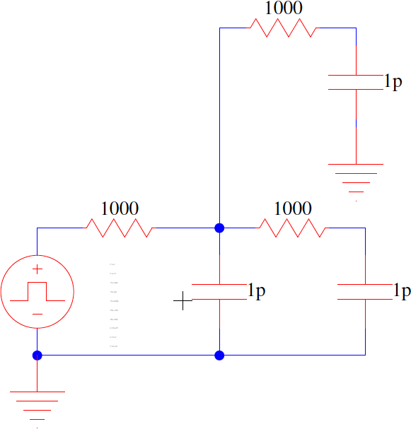
Elmore Delay: Practice
The delay from source s to node O
N = number of nodes in circuit
$$R_{Ok}=\sum{R_{j}}⇒(R_{j}∈\left[path\left(s→O\right)∩path\left(s→k\right)\right])$$
$$τ_{DO}=\sum_{k=1}^{N}{C_{k}R_{Ok}}= ?$$
S
O

Slide 42
Idea
There are other circuit disciplines
Can use pass transistors for logic
Even chains of pass transistors
Mostly gives area win, sometimes gives delay win
Will talk more about delay on Monday
Do not cascade as easily as CMOS
Additional diffusion capacitance leads to distributed RC networks
More next lecture

Slide 43
Logic Types
CMOS Gates
Dual pull-down and pull-up networks, only one enabled at a time
Performance of gate is strong function of the fanin of gate
Techniques to improve performance include sizing, input reordering, and buffering (staging)
Ratioed Gates
Have active pull-down (-up) network connected to load device
Reduced gate complexity at expense of static power asymmetric transfer function
Techniques to improve performance include sizing to improve noise margins and reduce static power
Pass Gates
Implement logic gate as switch network for reduced area and load capacitance
Long cascades of switches result in quadratic increase in delay
Also suffer from reduced noise margins (V_{T} drop)
Use level-restoring buffers to improve noise margins
Dynamic logic … coming up soon

Slide 44
Admin
Project 1
Milestones were mostly all good
Show me the results! Justify all metrics
Use Piazza and office hours
Should be working hard on project
Not enough to know what to do. You have to actually do it.
Rewarding experience and worth the time once you get it
Design and test takes time

