Slide 1
ESE370: Circuit-Level Modeling, Design, and Optimization for Digital Systems
Lec 21: October 27, 2021
Distributed RC Wire and Elmore Delay

Slide 2
Today
Estimate delay in RC Network
Elmore delay calculation
Apply to wire delay
Apply to pass transistor circuits

Slide 3
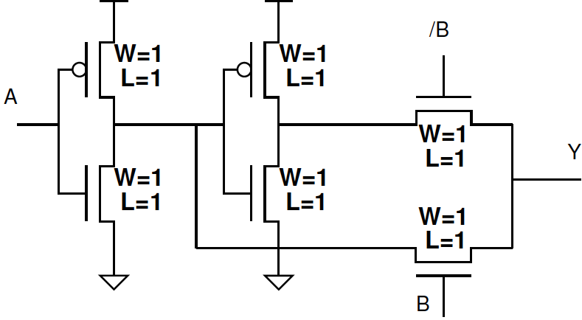
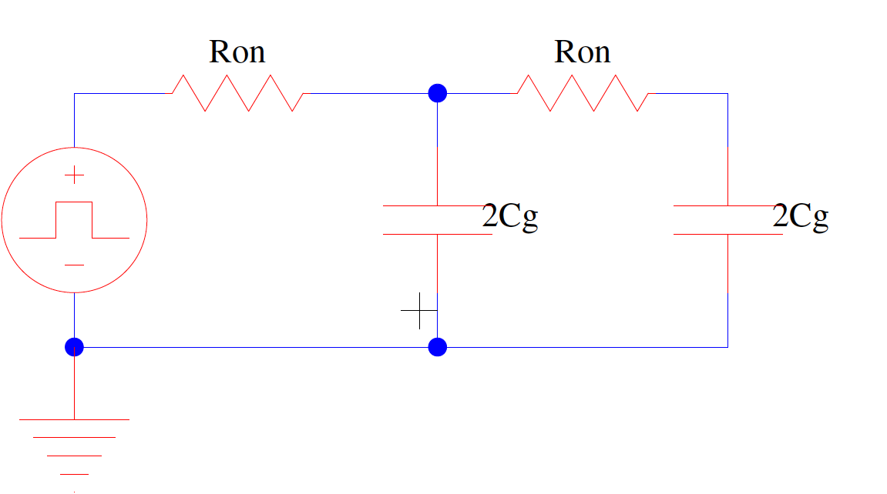
Previously: Equivalent RC
2C₀+3C_{diff0}
2C₀+2C_{diff0}

Slide 4
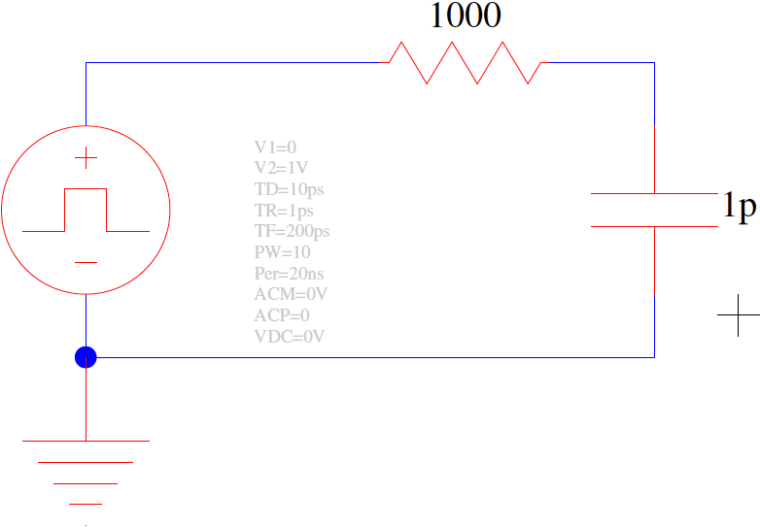
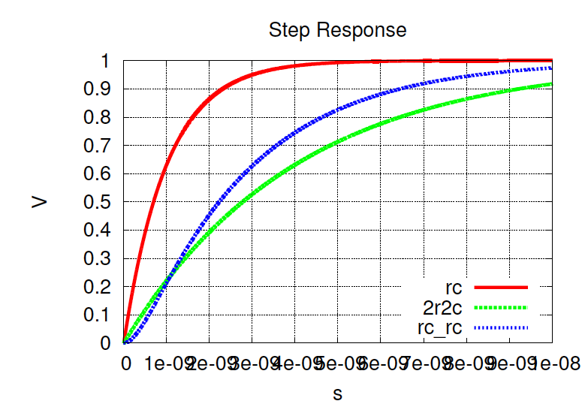
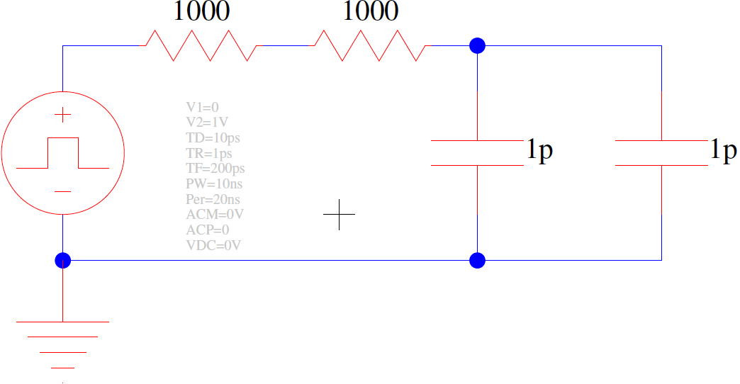
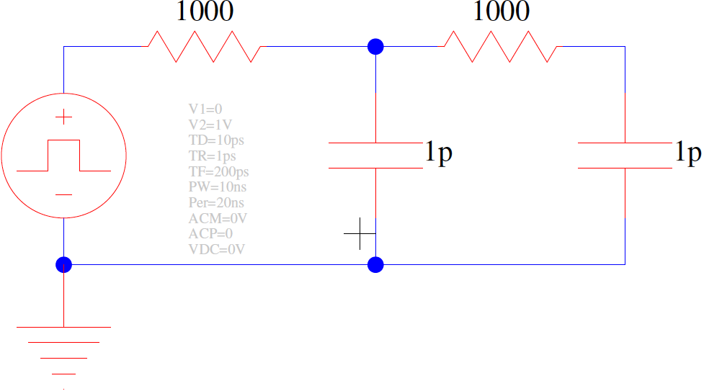
Previously: Distributed RC (preclass 1)
What are the time constants?
1 2 3 4 5 6 7 8 9 10
(ns)

Slide 5
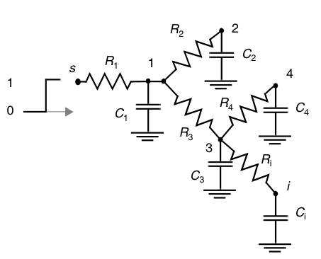
Elmore Delay: Distributed RC network
The delay from source s to node 5
N = number of nodes in circuit
$$R_{5k}=\sum{R_{j}}⇒(R_{j}∈\left[path\left(s→5\right)∩path\left(s→k\right)\right])$$
$$τ_{D5}=\sum_{k=1}^{N}{C_{k}R_{5k}}$$
5
C₅

Slide 6
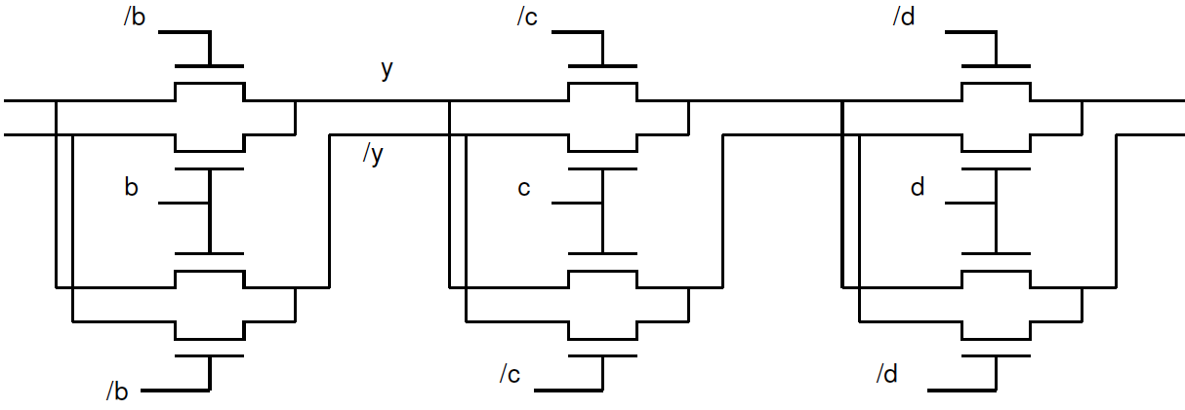
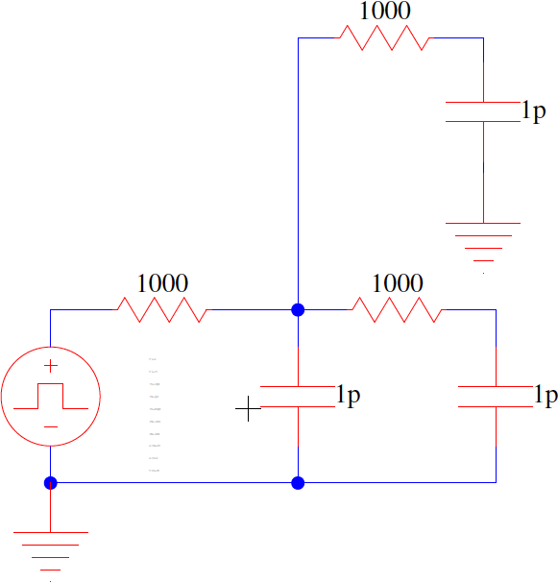
What is response?
P
P
Q
y
Q

Slide 7
Elmore Delay: Practice (preclass 1)
The delay from source s to node i
N = number of nodes in circuit

Slide 8
Apply (preclass 1)
What is Elmore delay?
S → Z
/z
C3
s
y
z
C1
C2

Slide 9
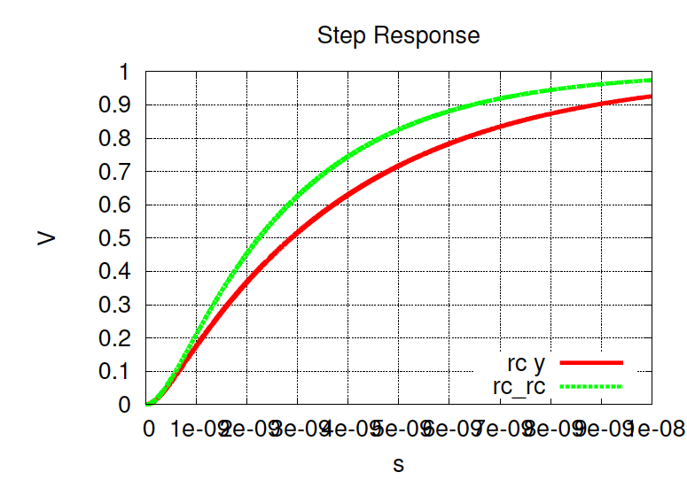
SPICE Response
C3
C1
C2
1 2 3 4 5 6 7 8 9 10
(ns)

Slide 10
Elmore Delay: Special Ladder Case
For each resistor C_{k} in path
Compute R_{kk} = sum of all Rs upstream of C_{k}

Slide 11
Elmore Delay: Special Ladder Case
For each resistor C_{k} in path
Compute R_{kk} = sum of all Rs upstream of C_{k}
C₁*(R₁)+C₂*(R₁+R₂)

Slide 12
Elmore Delay: Special Ladder Case
For each resistor C_{k} in path
Compute R_{kk} = sum of all Rs upstream of C_{k}
C₁*(R₁)+C₂*(R₁+R₂)
=3RC
=3ns

Slide 13
Compare KCL: Setup
Equations from KCL?
@V₁:
@V₂:
V₁
V₂
V_{S}
R1
R2
C1
C2

Slide 14
Compare KCL: Math
@V₁:
@V₂:

Slide 15
Compare KCL: Math

Slide 16
Compare KCL: Math

Slide 17
Compare KCL: Math

Slide 18
Compare KCL: Math

Slide 19
Compare KCL: Math

Slide 20
Compare KCL: Math

Slide 21
Compare KCL: Math
=3RC
=3ns

Slide 22
Elmore Delay: Distributed RC network
The delay from source to node i
N = number of nodes in circuit
Special ladder case

Slide 23
Wire Delay

Slide 24
Wire Resistance
B
100um
1um
A
1um
Penn ESE370 Fall2021 – Khanna

Slide 25
Wire Capacitance
B
4 m
0.1 mm
0.2 mm
A
0.1 mm
dielectric material
metal plate
Penn ESE370 Fall2021 – Khanna

Slide 26
Wire as Distributed RC Ladder
Measure wire length in units
Say λ
Each λ unit has C_{unit}, R_{unit}
Unit capacitance and resistance of wire of length λ

Slide 27
Wire Delay
Delay of Wire N units long:

Slide 28
Wire Delay
Delay of Wire N units long:
R_{unit}C_{unit}

Slide 29
Wire Delay
Delay of Wire N units long:
R_{unit}C_{unit}
+ 2R_{unit}C_{unit}

Slide 30
Wire Delay
Delay of Wire N units long:
R_{unit}C_{unit}
+ 2R_{unit}C_{unit}
+ 3R_{unit}*C_{unit} + … +NR_{unit}*C_{unit}
=(R_{unit}*C_{unit})*(N+(N-1)+(N-2)+….1)

Slide 31
Sum of integers (preclass 2)
What’s the sum of the integer 1 to N?

Slide 32
Sum of integers
What’s the sum of the integer 1 to N?

Slide 33
Wire Delay (preclass 3)
Delay of Wire N units long:
R_{unit}*(N*C_{unit})
+ R_{unit}((N-1)*C_{unit}
+ R_{unit}*(N-2)*C_{unit} + … +R_{unit}*C_{unit}
=(R_{unit}*C_{unit})*(N+N-1+N-2+….1)
~=R_{unit}C_{unit}*N²/2

Slide 34
Lumped RC Wire? (preclass 4)
What would the delay be if we treated the wire as lumped R and C?
R_{wire} = N×R_{unit}
C_{wire} = N×C_{unit}

Slide 35
Wire Delay
R_{wire} = N*R_{unit}
C_{wire}=N*C_{unit}
Lumped RC wire delay = R_{unit}*C_{unit}*N²
Distributed RC Wire delay = R_{unit}*C_{unit}*N²/2
Distributed has half the delay of lumped RC product
Delay is quadratic in length of wire in both cases

Slide 36
Apply to Gates
Pass Transistor and CMOS

Slide 37
Pass Transistor XOR
Delay when A=B=1?
2C₀+3C_{diff0}
2C₀+2C_{diff0}

Slide 38
Pass Transistor XOR (preclass 5)
Delay when A=1, B=0?
Start with equivalent RC circuit

Slide 39
Unbuffered (preclass 6)
Circuit → Delay?
2 stages

Slide 40
Unbuffered (preclass 7)
Circuit → Delay?
3 stages

Slide 41
Unbuffered (preclass 8)
Delay as a function of number of stages, k?
…

Slide 42
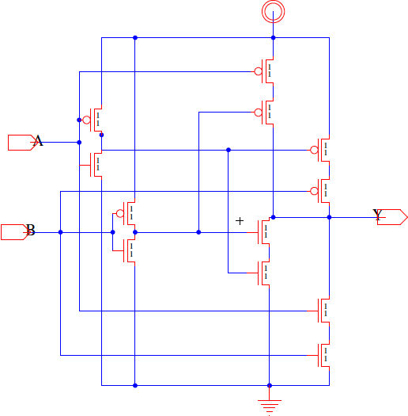
CMOS XOR (preclass 9)
Delay with Cdiff>0?

Slide 43
Idea
Elmore delay calculation allows us to estimate delay for distributed RC network
Necessary for pass transistors
Wires are distributed RC
Half delay lumped calculation
Still quadratic in length

Slide 44
Admin
Project 1
Final report due Friday 10/29 midnight

