Slide 1

ESE370: Circuit-Level Modeling, Design, and Optimization for Digital Systems
Lec 22: October 29, 2021
CMOS Worst Case Analysis and Logic Type Comparisons

Slide 2
Lecture Outline
Pass transistor Round-up
CMOS Gates Review
  CMOS Worst Case Analysis
Logic Type Comparisons

Slide 3
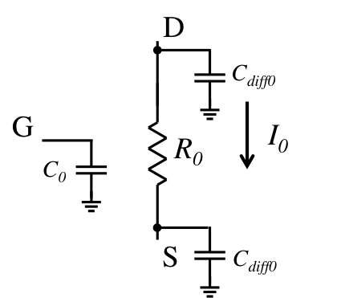
Previously: First Order Delay
R₀ = Resistance of minimum size NMOS device
I₀ = I_{ds} of minimum size NMOS device
C₀ = gate capacitance of minimum size NMOS device
C_{diff0} = diffusion capacitance of minimum size NMOS device
  C_{diff0} = γC₀

Slide 4
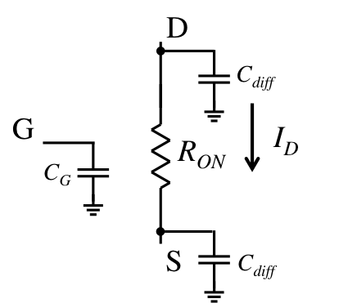
Previously: First Order Delay
For device of width W (multiple of minimum size)
R_{ON} = R₀/W
I_{D} = W*I₀
C_{G} = W*C₀
C_{diff} = W*C_{diff0}
  C_{diff} = W*γC₀

Slide 5
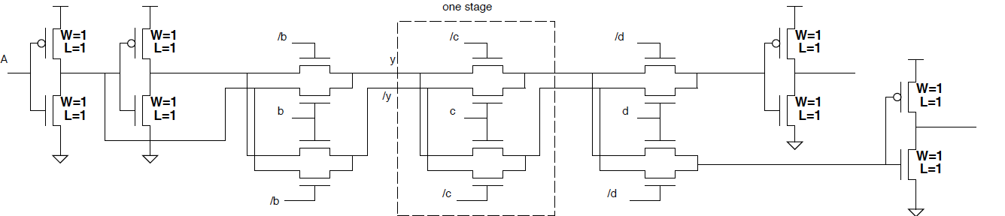
Unbuffered
Circuit → Delay?
  3 stages

Slide 6
Unbuffered
Delay as a function of number of stages, k?
…

Slide 7
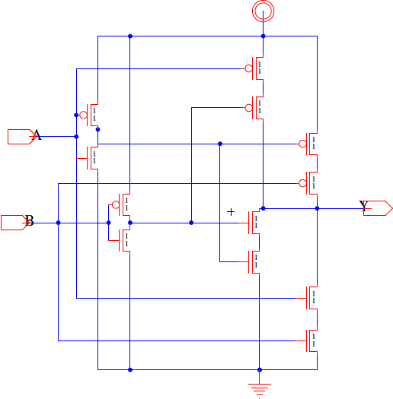
CMOS XOR
Delay with Cdiff>0?

Slide 8
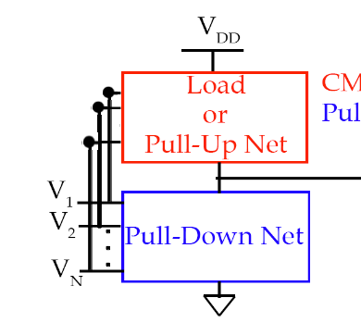
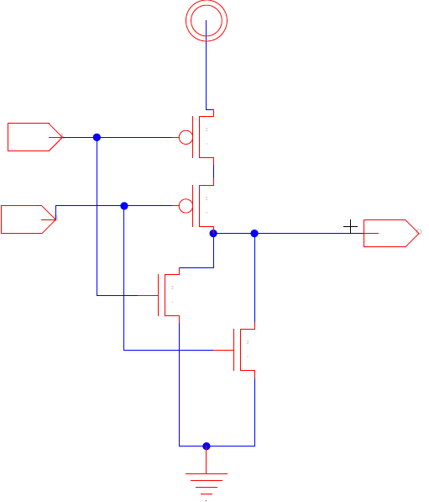
Review: Two-Input NOR Gate (NOR2)
F (V_{F})
A (V_{A})
B (V_{B})
Z (V_{Z})
Worst case delay of NOR2?
  Minimum size, Loaded with itself

Slide 9
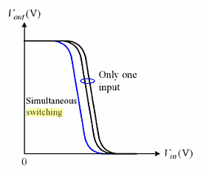
NOR2 Transfer Curve
V_{out}
V_{DD}
only one input switches
simultaneous switching
0
V_{in}
3 VTC Cases
Switching Threshold Voltage:
V₁ = V₂ = V_{out} = V_{t}
V₁ = 0 V; V₂ = 0 → V_{DD}
V₁ = 0 → V_{DD}; V₂ = 0
V₁ and V₂ = 0 → V_{DD} simultaneously

Slide 10
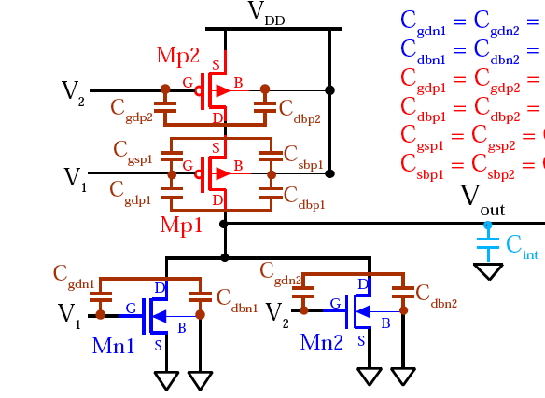
NOR2 Delay (preclass 1)
Worst case delay for Pull-up?
MP2
C_{diff}
V_{x}
C_{diff}
MP1
C_{diff}
C_{load}
C_{diff}
C_{diff}
MN1
MN2
Notes:
Preclass 1

Slide 11
NOR2 Delay
Worst case delay for Pull-up?
MP2
C_{diff}
V_{x}
C_{diff}
MP1
C_{diff}
C_{load}
C_{diff}
C_{diff}
MN1
MN2
Worst Case for Pull-up → V₁ = 0, V₂ = V_{DD}-> 0 @t=0 & V_{x} ≈ V_{out} = 0 -> V_{DD}

Slide 12
NOR2 Delay
Worst case delay for Pull-up?
C_{load-NR2} ≈ 2C_{diff} + 3C_{diff} + C_{load}
R_{EQV} = R_{p2}+R_{p1}
MP2
C_{diff}
Lumped Model
V_{x}
C_{diff}
MP1
C_{diff}
C_{load}
C_{diff}
C_{diff}
MN1
MN2
Worst Case for Pull-up → V₁ = 0, V₂ = V_{DD}-> 0 @t=0 & V_{x} ≈ V_{out} = 0 -> V_{DD}

Slide 13
NOR2 Delay
Worst case delay for Pull-up?
C_{load-NR2} ≈ 2C_{diff} + 3C_{diff} + C_{load}
= 5γC₀ + 2C₀
R_{EQV} = R_{p2}+R_{p1} = 2R₀
MP2
C_{diff}
Lumped Model
V_{x}
C_{diff}
MP1
C_{diff}
C_{load}
C_{diff}
C_{diff}
MN1
MN2
Worst Case for Pull-up → V₁ = 0, V₂ = V_{DD}-> 0 @t=0 & V_{x} ≈ V_{out} = 0 -> V_{DD}
delay = (5γC₀ + 2C₀)(2R₀)=(10γ+4)τ

Slide 14
NOR2 Delay
Worst case delay?
C_{load-NR2} ≈ 2C_{diff} + 3C_{diff} + C_{load}
= 5γC₀ + 2C₀
R_{EQV} = R_{p2}+R_{p1} = 2R₀
MP2
C_{diff}
Elmore Model?
V_{x}
C_{diff}
MP1
C_{diff}
C_{load}
C_{diff}
C_{diff}
MN1
MN2
Worst Case for Pull-up → V₁ = 0, V₂ = V_{DD}-> 0 @t=0 & V_{x} ≈ V_{out} = 0 -> V_{DD}

Slide 15
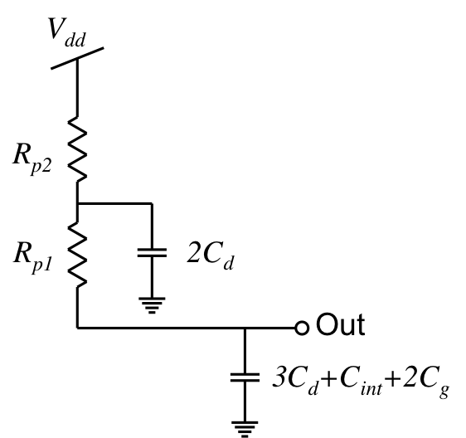
NOR2 Delay
Worst case delay?
C_{load-NR2} ≈ 2C_{diff} + 3C_{diff} + C_{load}
= 5γC₀ + 2C₀
R_{EQV} = R_{p2}+R_{p1} = 2R₀
MP2
C_{diff}
Elmore Model?
V_{x}
C_{diff}
2C_{diff}
MP1
C_{diff}
3C_{diff}+C_{load}
C_{load}
C_{diff}
C_{diff}
MN1
MN2
Worst Case for Pull-up → V₁ = 0, V₂ = V_{DD}-> 0 @t=0 & V_{x} ≈ V_{out} = 0 -> V_{DD}

Slide 16
NOR2 Delay
Worst case delay?
C_{load-NR2} ≈ 2C_{diff} + 3C_{diff} + C_{load}
= 5γC₀ + 2C₀
R_{EQV} = R_{p2}+R_{p1} = 2R₀
MP2
C_{diff}
Elmore Model?
V_{x}
C_{diff}
2C_{diff}
MP1
C_{diff}
3C_{diff}+C_{load}
C_{load}
C_{diff}
C_{diff}
MN1
MN2
Worst Case for Pull-up → V₁ = 0, V₂ = V_{DD}-> 0 @t=0 & V_{x} ≈ V_{out} = 0 -> V_{DD}
delay = (2C_{diff})(R_{p2})+(3C_{diff}+C_{load})(R_{p1}+R_{p2})=(8γ+4)τ

Slide 17
NOR2 Delay
Worst case delay Pull-down?
MP2
C_{diff}
V_{x}
C_{diff}
MP1
C_{diff}
C_{load}
C_{diff}
C_{diff}
MN1
MN2

Slide 18
NOR2 Delay
Worst case delay Pull-down?
MP2
C_{diff}
V_{x}
C_{diff}
MP1
C_{diff}
C_{load}
C_{diff}
C_{diff}
MN1
MN2
Worst case for Pull-down → V₁ = 0, V₂ = 0 ->V_{DD} @t=0 & V_{x} ≈ V_{out}=V_{DD}-> 0

Slide 19
NOR2 Delay
Worst case delay Pull-down?
MP2
C_{diff}
Elmore Model?
V_{x}
C_{diff}
MP1
C_{diff}
C_{load}
C_{diff}
C_{diff}
MN1
MN2
Worst case for Pull-down → V₁ = 0, V₂ = 0 ->V_{DD} @t=0 & V_{x} ≈ V_{out}=V_{DD}-> 0

Slide 20
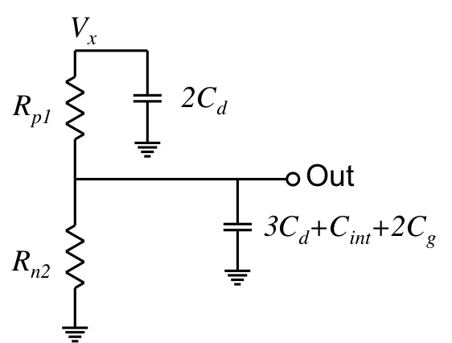
NOR2 Delay
Worst case delay Pull-down?
MP2
C_{diff}
Elmore Model?
V_{x}
2C_{diff}
C_{diff}
MP1
C_{diff}
3C_{diff}+C_{load}
C_{load}
C_{diff}
C_{diff}
MN1
MN2
Worst case for Pull-down → V₁ = 0, V₂ = 0 ->V_{DD} @t=0 & V_{x} ≈ V_{out}=V_{DD}-> 0
delay = (2C_{diff})(R_{p1}+R_{n2})+(3C_{diff}+C_{load})(R_{n2})=(7γ+2)τ

Slide 21
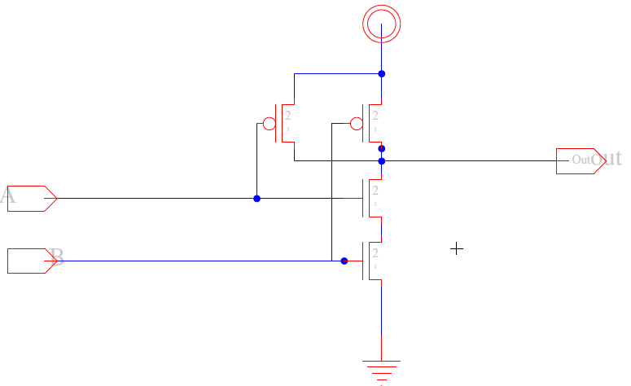
NAND2 Delay (preclass 2)

Slide 22
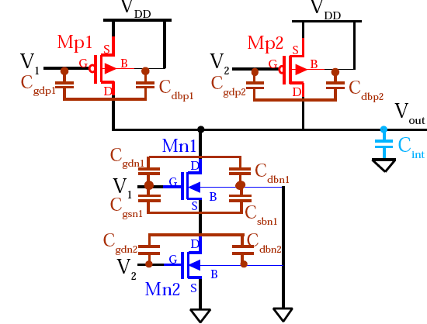
Parasitic Caps for NAND2 (worst case)
C_{diff}
C_{diff}
MP1
MP2
C_{diff}
C_{load}
V₁
MN1
C_{diff}
V_{x}
C_{diff}
V₂
MN2

Slide 23
Parasitic Caps for NAND2 (worst case)
C_{diff}
C_{diff}
MP1
MP2
C_{diff}
C_{load}
V₁
MN1
C_{diff}
V_{x}
C_{diff}
V₂
MN2
Worst case for Pull-up →

Slide 24
Parasitic Caps for NAND2 (worst case)
C_{diff}
C_{diff}
MP1
MP2
C_{diff}
C_{load}
V₁
MN1
C_{diff}
V_{x}
C_{diff}
V₂
MN2
Worst case for Pull-up → V₁ = V_{DD}, V₂ = V_{DD}-> 0 @t=0 & V_{x} ≈ V_{out}= 0 ->V_{DD}

Slide 25
Parasitic Caps for NAND2 (worst case)
C_{diff}
C_{diff}
MP1
MP2
C_{diff}
C_{load}
V₁
MN1
C_{diff}
V_{x}
C_{diff}
V₂
MN2
Worst case for pull down →

Slide 26
Parasitic Caps for NAND2 (worst case)
C_{diff}
C_{diff}
MP1
MP2
C_{diff}
C_{load}
V₁
MN1
C_{diff}
V_{x}
C_{diff}
V₂
MN2
Worst case for pull down → V₁ =V_{DD}, V₂ = 0 ->V_{DD} @t=0 & V_{x}≈ V_{out}=V_{DD}-> 0

Slide 27
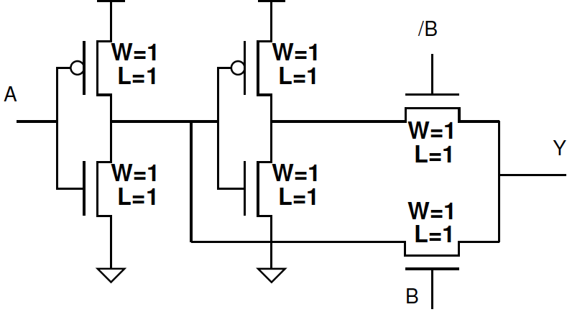
CMOS XOR
Delay with Cdiff>0?

Slide 28
Logic Types
CMOS Gates
  Dual pull-down and pull-up networks, only one enabled at a time
  Performance of gate is strong function of the fanin of gate
    Techniques to improve performance include sizing, input reordering, and buffering (staging)
Ratioed Gates
  Have active pull-down (-up) network connected to load device
  Reduced gate complexity at expense of static power asymmetric transfer function
    Techniques to improve performance include sizing to improve noise margins and reduce static power
Pass Gates
  Implement logic gate as switch network for area and often delay win
  Long cascades of switches result in quadratic increase in delay
  Also suffer from reduced noise margins (V_{T} drop)
    Use level-restoring buffers to improve noise margins
Dynamic logic … next time

Slide 29
Idea
CMOS Logic
  Complimentary dual pull-up/down networks
There are other logic disciplines
  We have the tools to analyze
Ratioed Logic
  Tradeoff noise margin for
    Reduced area? Capacitive load?
  Dissipates static power in one mode
Can use pass transistors for logic
  Sometimes gives area or delay win

Slide 30
Admin
Project 2 due tonight @ midnight
  Leave time to write the report!
Wednesday 11/3 Midterm 2 (next week)
  7-9pm DRLB 3C2
  Lectures 1-22
  Closed note, calculator allowed
  All old exams online
    focus on 2015-2019 ← taught in person by me
    Study them!
  Felicity review session
    Monday 11/1, keep eye on Piazza

Slide 31
Admin: Midterm 2 Topics (up to Lec 22)
Sizing
Tau-model
  Estimation and optimization
Elmore-delay
  Estimation and optimization
Energy and power
  Estimation and optimization
  Dynamic and static
Logic
  CMOS
  Ratioed
  Pass transistor
Transistor
  Regions of operation
  Parasitic Capacitance Model
“idea” slides

