Slide 1
ESE370: Circuit-Level Modeling, Design, and Optimization for Digital Systems
Lec 23: November 1, 2021
Driving Large Capacitive Loads

Slide 2
Today
Back to CMOS today
How do we drive a large capacitive load?
Stages and buffer sizing
Minimum delay

Slide 3
Message
To drive large loads
Scale buffers geometrically
Exponential scale up in buffer size
Scale factor: 3—4 typically
One origin of FO4 target
Drains contribute capacitance too (C_{diff})
Can formulate sizing to optimize

Slide 4
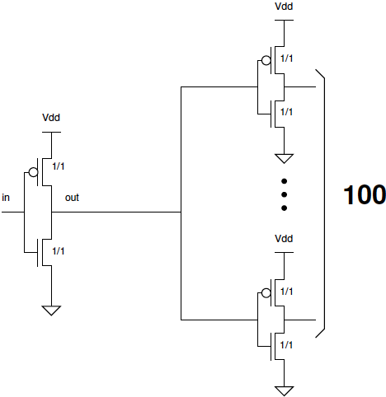
Call back: Large Fanout Delay
What is delay if must drive fanout=100?

Slide 5
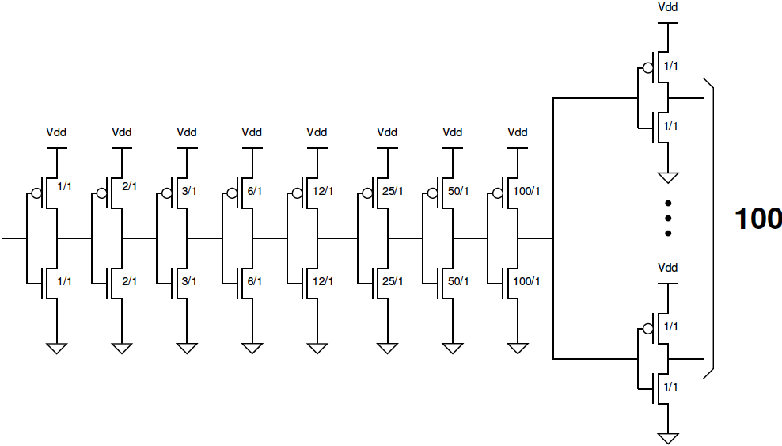
Call back: …and Again
Delay here?

Slide 6
Start C_{diff}=0

Slide 7
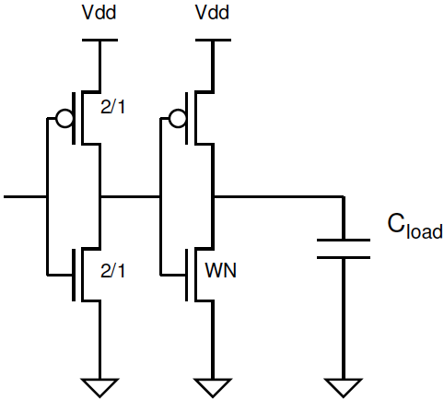
One Stage (Preclass 1)
How do we size to minimize delay?
W_{N}

Slide 8
One Stage (Preclass 1)
Delay equation?
W_{N}

Slide 9
One Stage (Preclass 1)
Delay equation?
W_{N}

Slide 10
Minimize (Preclass 1)
Differentiate and set to zero
What’s W_{N}?

Slide 11
Minimize
Differentiate and set to zero
What’s W_{N}?

Slide 12
Concrete?
What is W_{N} for C_{load}=4x10⁴C₀?
W_{N}

Slide 13
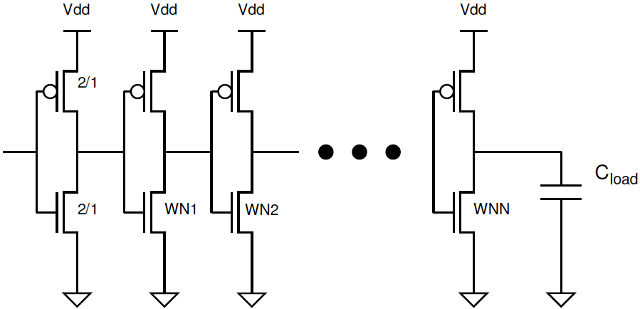
k-stage (Preclass 2)
W_{N1}
W_{N2}
W_{Nk}

Slide 14
k-stage Delay (Preclass 2)
W_{N1}
W_{N2}
W_{Nk}

Slide 15
Size W_{Ni} to minimize delay (Preclass 2)
How do we minimize?

Slide 16
Size W_{Ni} to minimize delay (Preclass 2)
Take partial derivative with respect to W_{Ni} and set = 0

Slide 17
Size W_{Ni} to minimize delay (Preclass 2)
Take partial derivative with respect to W_{Ni} and set = 0

Slide 18
Delay
Conclude: at optimal sizing, ratio of stages is same:

Slide 19
Delay
Call that ratio 𝞺

Slide 20
Stage Delay

Slide 21
Stage Delay

Slide 22
Stage Delay

Slide 23
Stage Delay
Two math simplifications: 1) to relate 𝜌 and k, 2) total delay in terms of 𝜌 and k

Slide 24
Stage Delay

Slide 25
Stage Delay

Slide 26
Total Delay

Slide 27
Total Delay (Preclass 2)

Slide 28
Total Delay

Slide 29
Plot Delay vs. k (C_{load}=4x10⁴C₀)

Slide 30
Zoom: Plot Delay vs. k (C_{load}=4x10⁴C₀)

Slide 31
Minimize (Preclass 3)

Slide 32
Minimize (Preclass 3)

Slide 33
Concrete (Preclass 3)
What is optimal k for C_{load}=4x10⁴C₀?

Slide 34
Zoom: Plot Delay vs. k (C_{load}=4x10⁴C₀)

Slide 35
Optimum Scale Up
For optimum delay
What is ρ?

Slide 36
Optimum Scale Up

Slide 37
Optimum Scale Up

Slide 38
Call Back: Total Delay

Slide 39
Delay at Optimum

Slide 40
Delay at Optimum (Preclass 3)
What is optimal delay for C_{load}=4x10⁴C₀ in tau units?

Slide 41
Zoom: Plot Delay vs. k (C_{load}=4x10⁴C₀)

Slide 42
C_{diff}=γC_{gate}

Slide 43
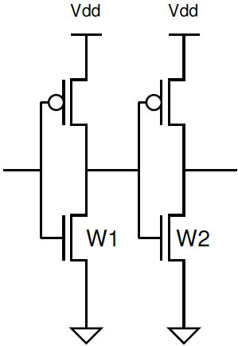
Diffusion Capacitance (Preclass 4)
What does this do to τ model?
Delay of middle stage cascade?

Slide 44
Diffusion Capacitance (Preclass 4)
What does this do to τ model?
Delay of middle stage cascade?

Slide 45
k-stage Delay

Slide 46
k-stage Delay (Preclass 4)

Slide 47
k-stage Delay

Slide 48
k-stage Delay

Slide 49
k-stage Delay

Slide 50
k-stage Delay

Slide 51
Size W_{Ni} to minimize delay
Take partial derivative with respect to W_{Ni} = 0

Slide 52
Impact on Minimum W_{Ni} ?
Partial derivative unchanged
What does this say about ρ?

Slide 53
Stage Delay: ρ unchanged (for fixed k)

Slide 54
Stage Delay: ρ unchanged (for fixed k)

Slide 55
Impact of Gamma
γ=1.5
γ=1.0
γ=0.5
γ=0

Slide 56
Impact of Gamma
γ=1.5
γ=1.0
γ=0.5
γ=0

Slide 57
Minimize

Slide 58
Solve

Slide 59
Solve

Slide 60
Optimal Staging Any γ
$$ρ=e^{\left(\frac{γ}{ρ}+1\right)}$$

Slide 61
ρ and γ? (Preclass 4)
ρ=4 is optimal for what γ?
ρ=3 is optimal for what γ?
$$ρ=e^{\left(\frac{γ}{ρ}+1\right)}$$
$$\ln{ρ}=\frac{γ}{ρ}+1$$
$$ρ\ln{ρ}−ρ=γ$$

Slide 62
Impact of Gamma
γ=1.5
γ=1.0
γ=0.5
γ=0

Slide 63
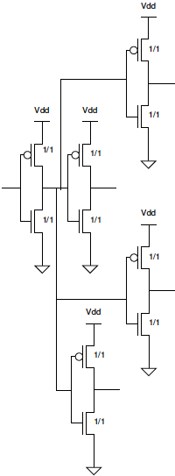
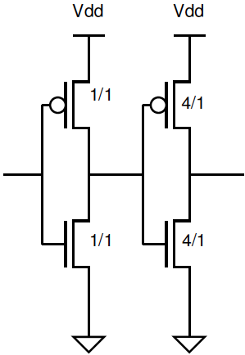
Optimal Fanout
Clearer why we use ρ=4 as our benchmark?

Slide 64
Idea
To drive large loads
Scale buffers geometrically
Exponential scale up in buffer size (ρ = e)
Scale factor: 3—4 typically
One origin of fanout 4 target
Drains contribute capacitance too (C_{diff})
Can formulate sizing to optimize

Slide 65
Admin
Wednesday 11/3 Midterm 2 (next week)
7-9pm DRLB 3C2
Lectures 1-22
Closed note, calculator allowed
All old exams online
focus on 2015-2019 ← taught in person by me
Study them!
Felicity review session
Monday 11/1 @ 3:30, link in Piazza
HW 6 posted 11/3

