Slide 1

ESE370: Circuit-Level Modeling, Design, and Optimization for Digital Systems
Lec 24: November 5, 2021
Synchronous Timing Discipline and Clocking

Slide 2
Today
Managing Timing
Latches
Registers, clocking

Slide 3
Timing Setup (Preclass1&2)
Delay from 3 adder-inputs to 2 adder-outbits is T_{bit}
  i.e single bitslice delay is T_{bit}
Worst-case delay to output?
Shortest delay to output?
  assuming the input switches

Slide 4
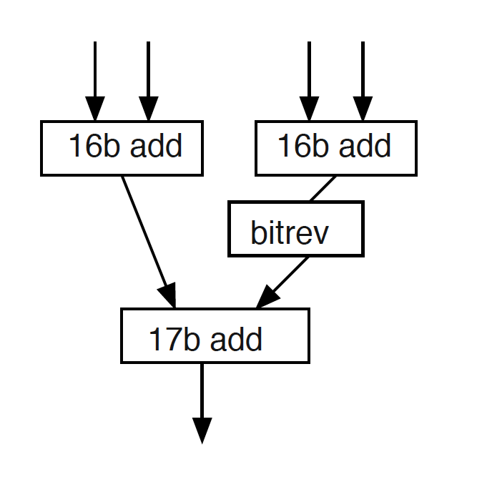
Timing Setup (Preclass 3)
New set of inputs every 20T_{bit}
  How does it behave?
bitrev: Out[i]=In[17-i]
  Assume delay of bitrev<<T_{bit}
1
2
3

Slide 5
Challenge
Logic paths have different delays
  E.g. different output bits in an adder
Delay of signal is data dependent
  E.g. length of carry propagation
Delay is chip dependent
  E.g. Threshold Variation
Delay is environment dependent
  E.g. Temperature

Slide 6
Challenge
Logic paths have different delays
  E.g. different output bits in an adder
Delay of signal is data dependent
  E.g. length of carry propagation
Delay is chip dependent
  E.g. Threshold Variation
Delay is environment dependent
  E.g. Temperature
Proper behavior depends on inputs being coordinated

Slide 7
Logic Timing
How do we fix this?
  Make it possible to input a new value every 20T_{bit}?

Slide 8
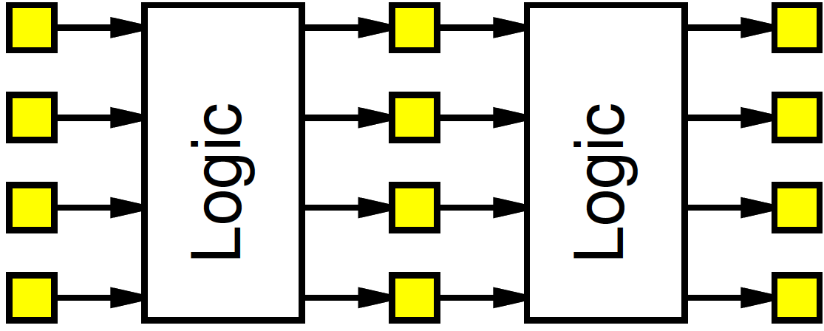
Discipline
Add circuit elements to
  hold values
  and change at coordinated point
    Control when changes seen by circuit
Only have to make sure to
wait long enough for all results
Decouple outputs and inputs
  timing of signal change (settling of output change)…
  …from timing of signal usage (output used as input)

Slide 9
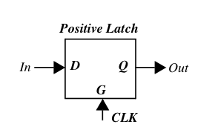
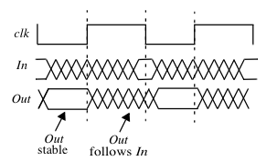
Latch
Level-sensitive device
Positive Latch
  Output follows input if CLK high
Negative Latch
  Output follows input if CLK low

Slide 10
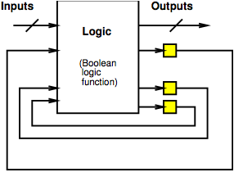
Synchronous Discipline
Add state elements (registers, latches)
Compute
  From state elements
  Through combinational logic
  To new values for state elements

Slide 11
Latch
Build with combinational logic
Build with pass logic

Slide 12
Latch (Preclass 4a)
φ=1 ➔ Out=/In
φ=0 ➔ Out=Out
How do we build a latch from combinational logic?
  At gate level

Slide 13
Muliplexer-based Latch from CMOS Logic
φ=1 ➔ Out=/In
φ=0 ➔ Out=Out
φ
In
1 0
Out

Slide 14
Mux at Transistor Level
φ
CLK
1 0
Out
In₁
Out
In₀
CLK

Slide 15
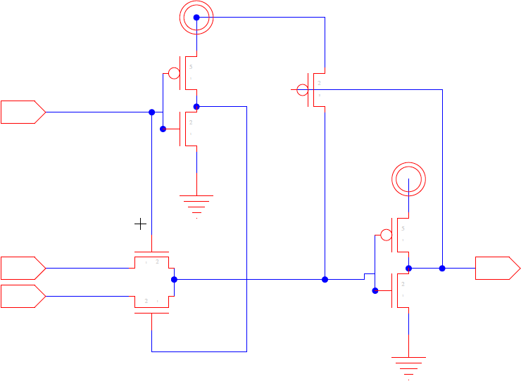
MuxL

Slide 16
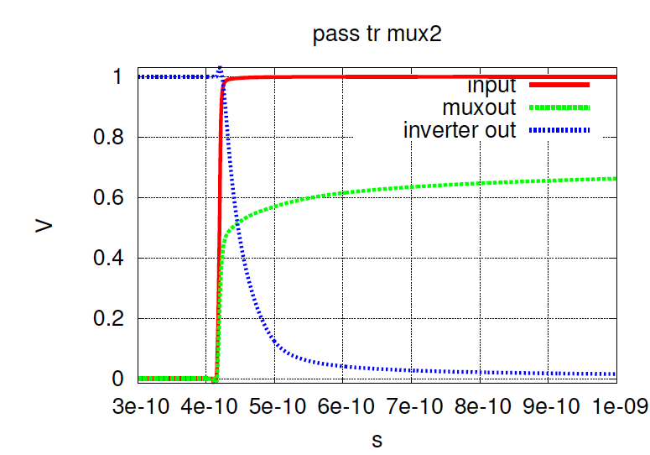
Without level restorer
0→1
1*
0
1
0

Slide 17
MuxL Level Restorer (“Staticizer”)

Slide 18
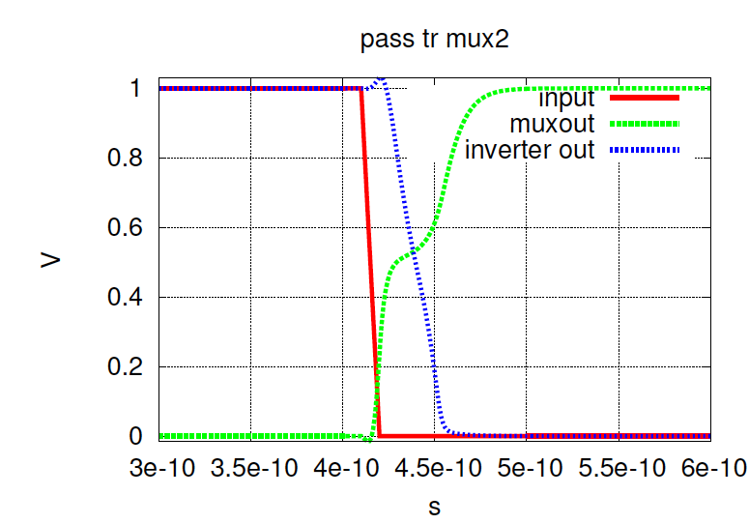
With level restorer

Slide 19
Latch (Preclass 4b)
φ=1 ➔ Out=/In
φ=0 ➔ Out=Out
φ transitions 1→0 Out holds value
How do we build a latch from pass transistors?

Slide 20
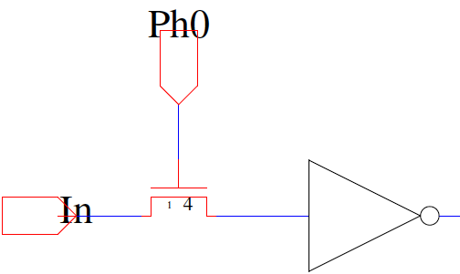
Simple Latch

Slide 21
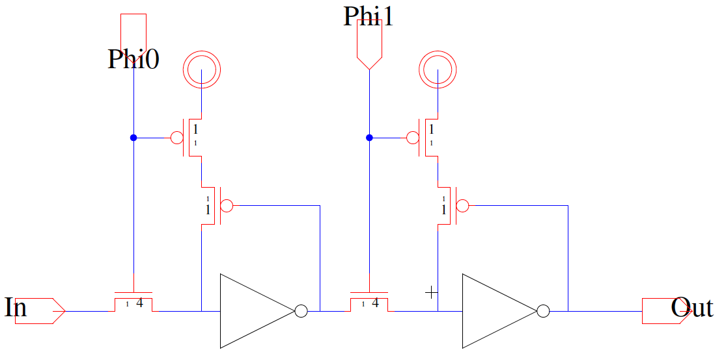
Latch with Level Restore

Slide 22
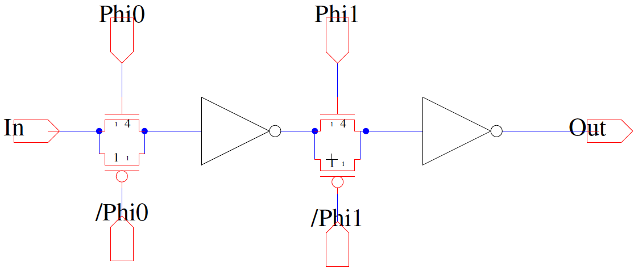
What is the difference?

Slide 23
Typical Static Latch
Advantages: VERY ROBUST
  Static
  Full Rail
  Fast (enough)
Phi0
Isolation inverters:
  Input Cap
  Input/Output Noise
  State Node Noise
/Phi0
Disadvantages:
  Large
  High clock loading

Slide 24
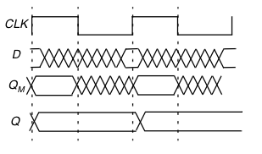
Register
Edge-triggered storage element
Positive edge-triggered
  Input sampled on rising CLK edge
Negative edge-triggered
  Input sampled on falling CLK edge

Slide 25
Latch
Level-sensitive device
Positive Latch
  Output follows input if CLK high
Negative Latch
  Output follows input if CLK low

Slide 26
Shift Register
How do you make a shift register out of latches?

Slide 27
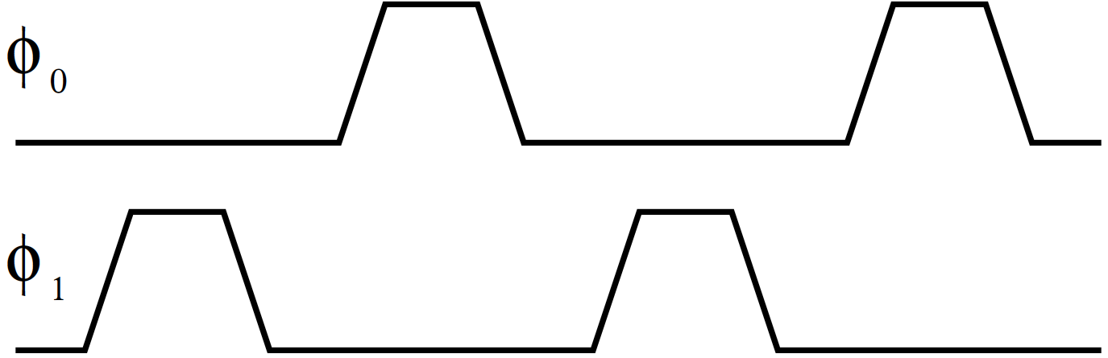
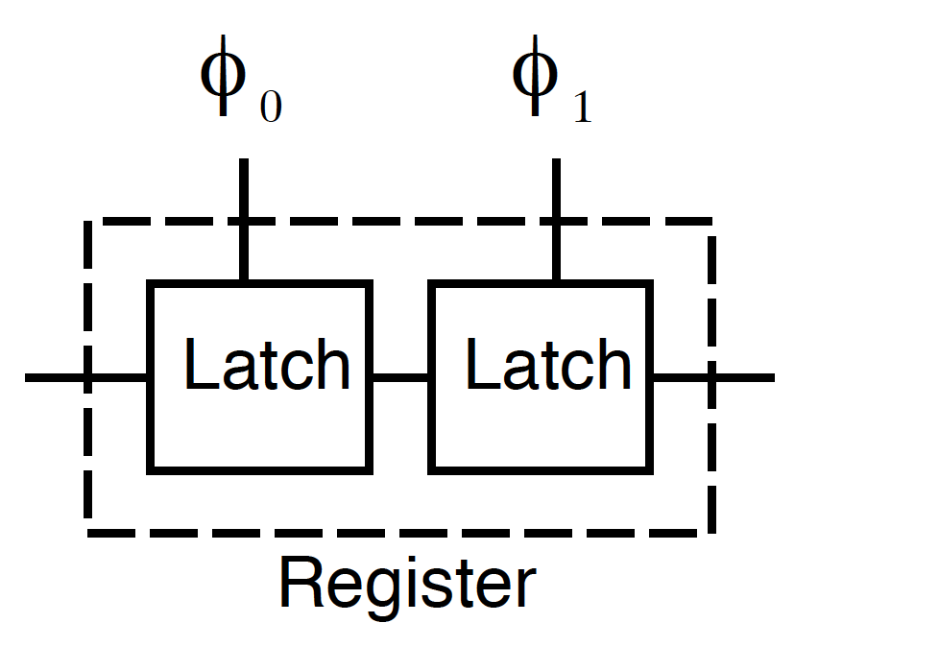
Positive-Edge Triggered Register
Build register from pair of latches
What happens when φ₀ is high?
What happens when φ₁ is high?
Q_{M}

Slide 28
Positive-Edge Triggered Register
Build register from pair of latches
Q_{M}

Slide 29
Positive-Edge Triggered Register
Build register from pair of latches
What could go wrong if clocks overlap?
Q_{M}

Slide 30
Positive-Edge Triggered Register
Build register from pair of latches
Control with non-overlapping clocks

Slide 31
Two Phase Non-Overlapping Clocks
What timing constraints do we have?

Slide 32
Latch Timing Issues
What timing constraints do latches impose?
  When can φ change?
  How long must φ be high?
  Delay when φ is high?

Slide 33
Clocking Discipline
Follow discipline of combinational logic broken by registers
Compute
  From state elements
  Through combinational logic
  To new values for state elements
As long as clock cycle long enough,
  Will get correct behavior

Slide 34
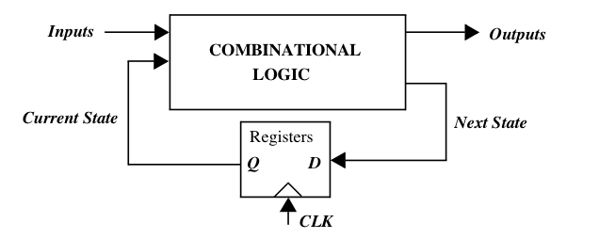


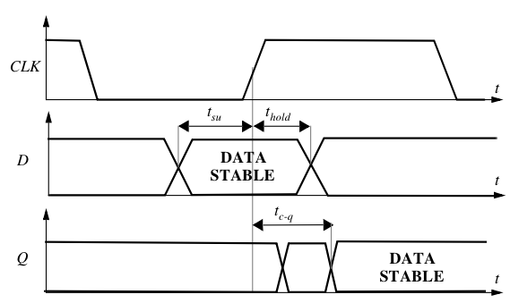
Latch Timing Issues
Worst case delays
Minimum delays

Slide 35
Latch Timing Issues
t_{su} = time data (D) must be valid before CLK edge
t_{plogic} = worst case propagation delay of logic
t_{c-p} = worst case propagation delay of latch

Slide 36
Latch Timing Issues
t_{cdregister} = minimum propagation delay of latch
t_{cdlogic} = minimum propagation delay of logic
t_{hold} = time data (D) must stay valid after CLK edge

Slide 37
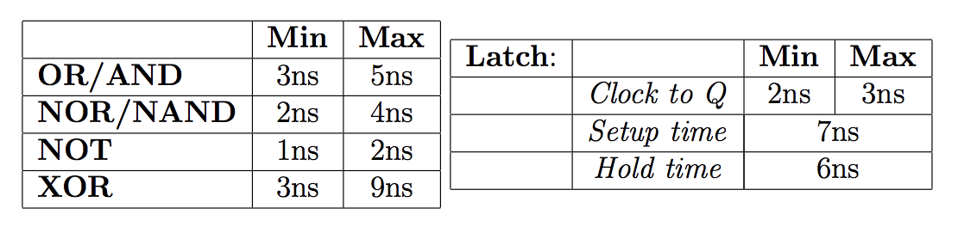
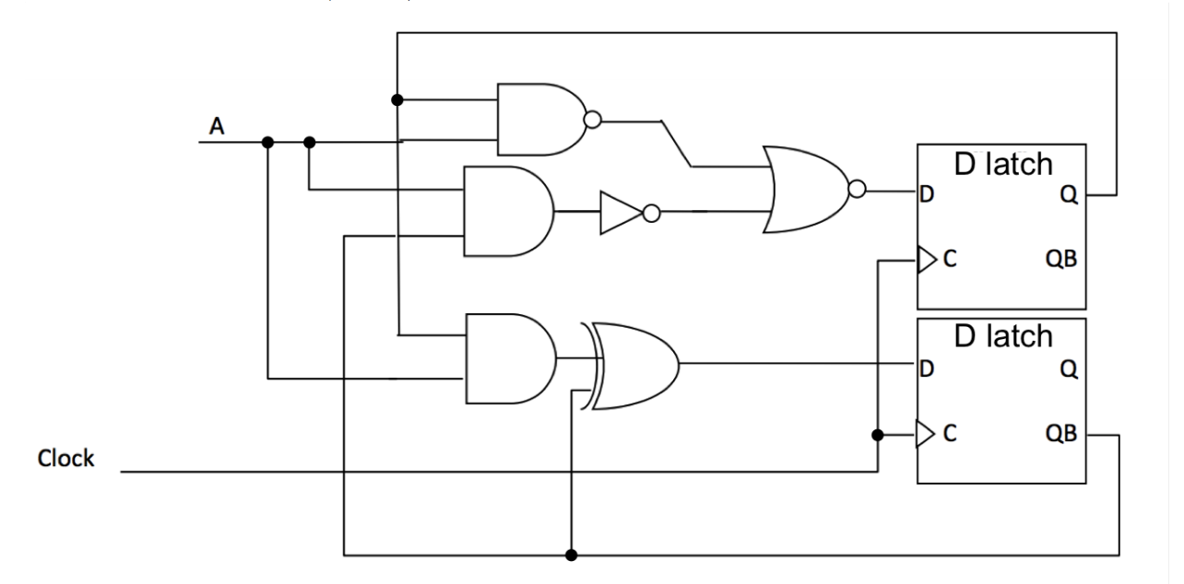
Timing Example (Preclass5)

Slide 38
Timing Example (Preclass5)

Slide 39
Timing Example (Preclass5)

Slide 40
Timing Example (Preclass5)

Slide 41
Timing Example (Preclass5)

Slide 42
Ideas
Synchronize circuits
  to external events
  disciplined reuse of circuitry
Leads to clocked circuit discipline
  Uses state holding element
  Prevents
    Timing assumptions
    (More) complex reasoning about all possible timings

Slide 43
Admin
HW6 posted
  Can do all of it now
  Due Friday 11/12

