Slide 1

ESE370: Circuit-Level Modeling, Design, and Optimization for Digital Systems
Lec 25: November 8, 2021
Dynamic Logic Pt. 1

Slide 2
Today
Dynamic (Clocked) Logic
  Strategy
  Form
  Compare CMOS

Slide 3
Clocking

Slide 4
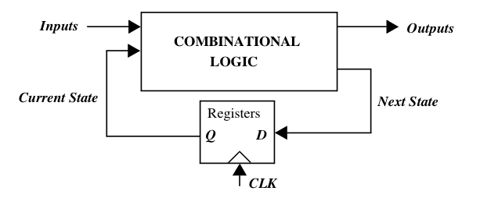


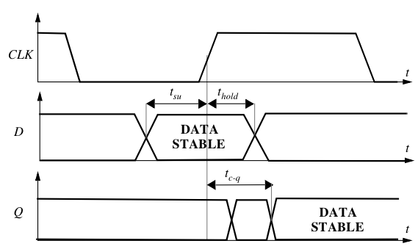
Latch Timing Issues
Notes:
Tsu setup time: time the data inputs must be valid before clock transition
Tplogic combination logic propogation delay worst case
Tcdlogic minimum combination logic delay
Tcdregister minimum combination register delay
Tc-q propogation delay through latch/register worst case
Tsu, thold are latch constraints

Slide 5
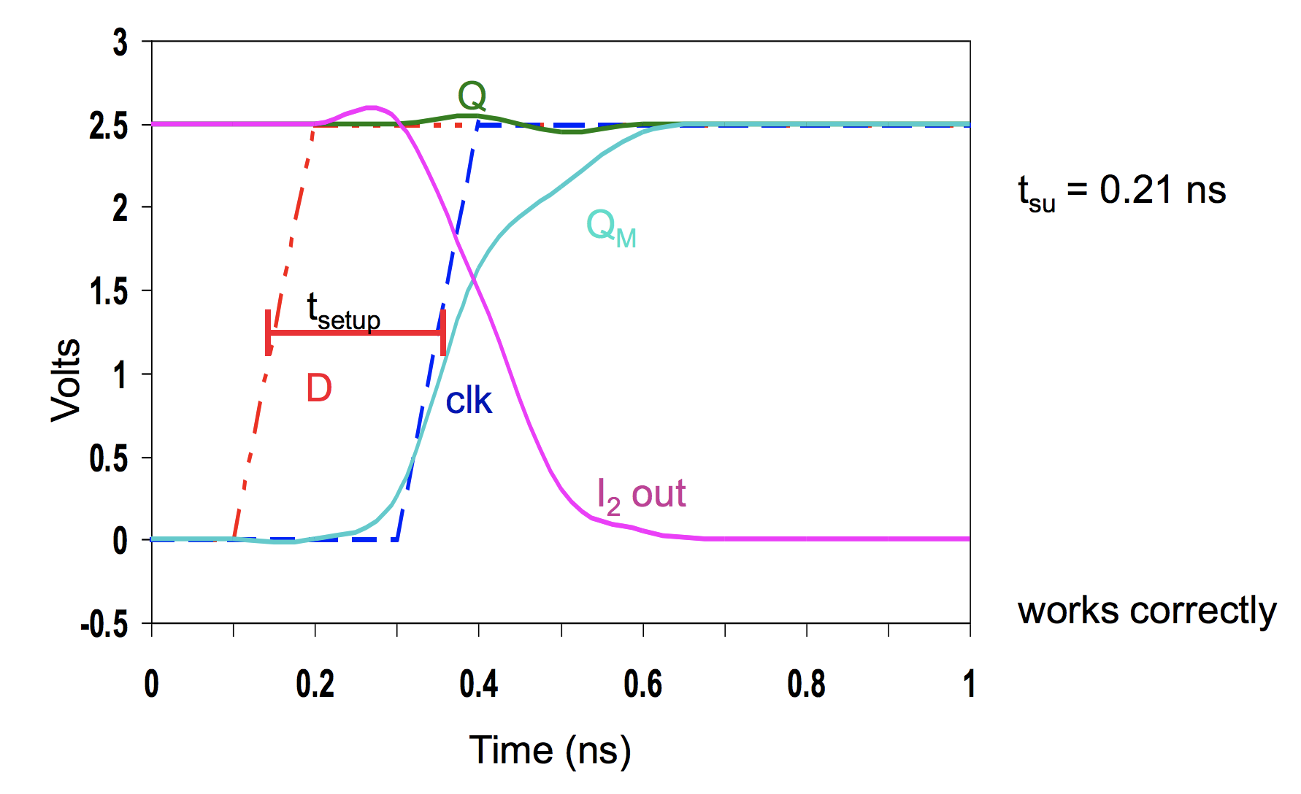
Setup Time Simulation

Slide 6
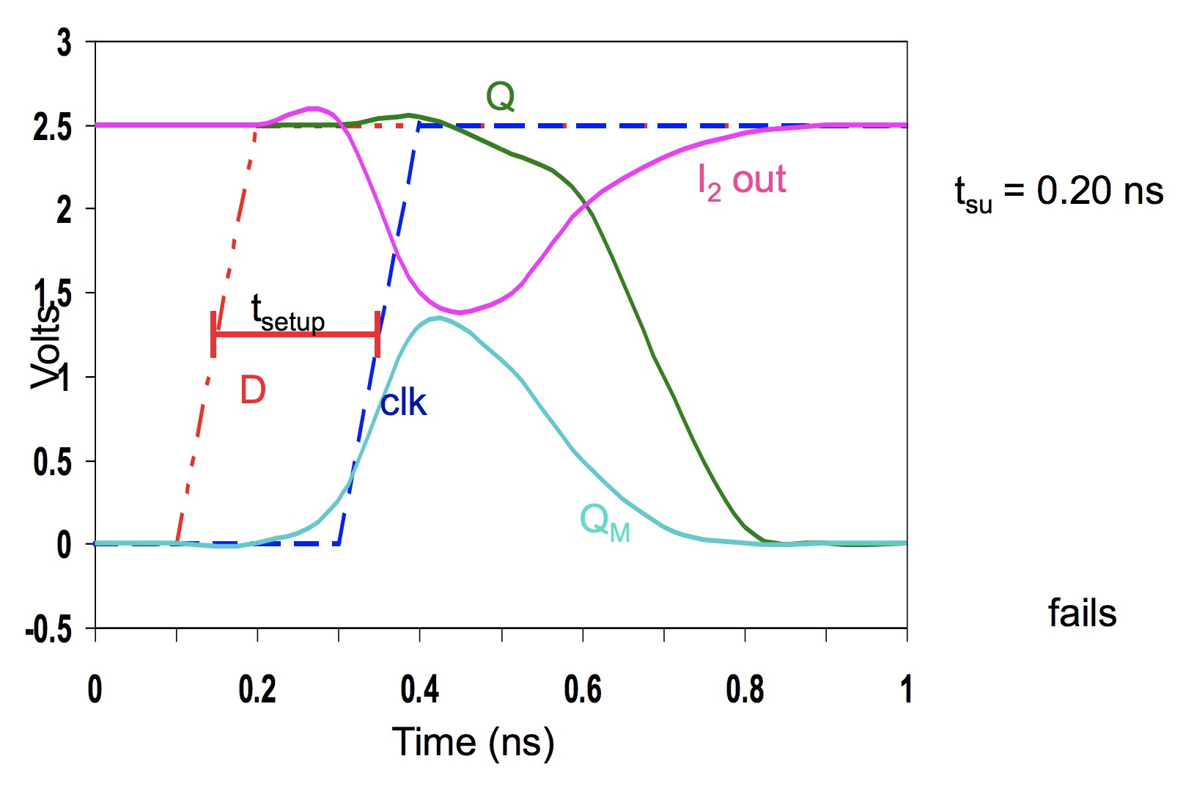
Setup Time Simulation

Slide 7
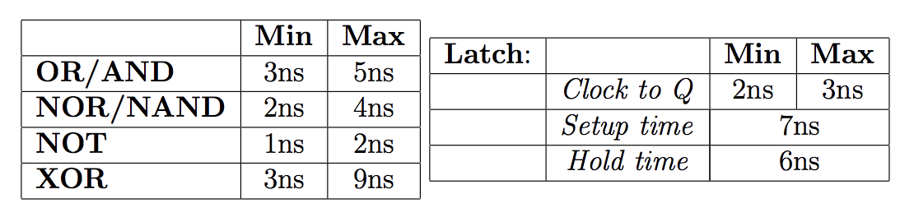
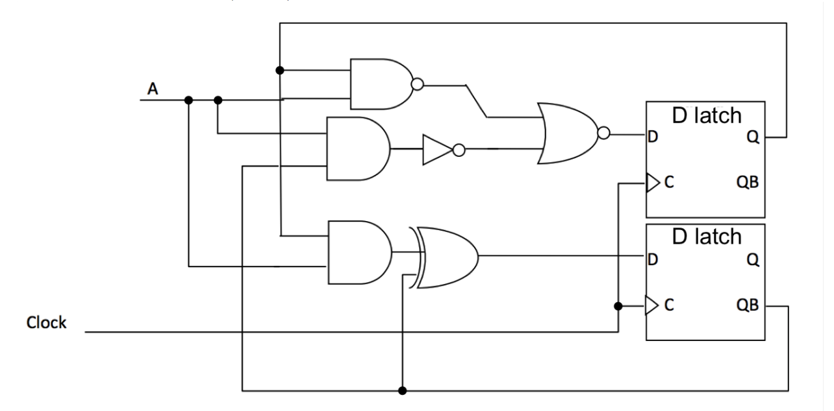
Timing Example (Preclass1)

Slide 8
Timing Example (Preclass1)

Slide 9
Timing Example (Preclass1)

Slide 10
Timing Example (Preclass1)

Slide 11
Timing Example (Preclass1)

Slide 12
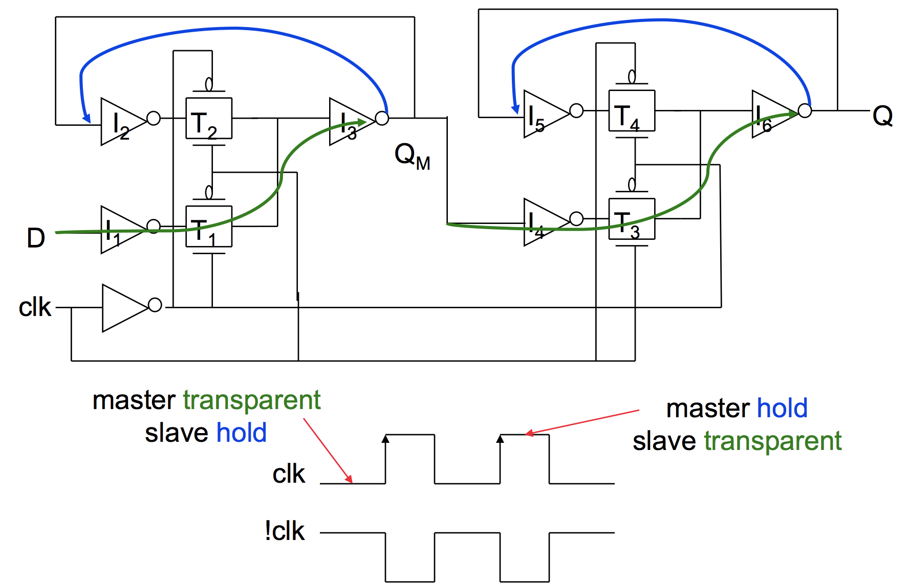
Register Implementation (Preclass 2)
Controller
Controlled
Controller transparent
Controller hold
Controlled hold
Controlled transparent

Slide 13
Timing Properties (Preclass 2)
Assume propagation delays are t_{pd_inv} and t_{pd_tx}, and that the inverter delay to drive !clk is 0
Set-up time? - time before rising edge of clk that D must be valid
Propagation delay? - time from clk → Q
Hold time? - time D must be stable after rising edge of clk
Come to office hours or post on Piazza for discussions/solutions

Slide 14
Clocking Highlights
Breaking logic up with registers allows circuit to run at high frequency
  Inputs decoupled from outputs
Clock discipline simplifies logic composition
  Abstracts many internal timing details
  Just concerned with making clock period long enough
Design Discipline – keeping data stable around clock edge
  Setup, hold time – determined by latch circuit
  Worst case and minimum Clk→Q delay for latch

Slide 15
Clocking
Circuits typically operate in a clocked environment
  Synchronous circuits
Gives some additional structure we can exploit → dynamic logic

Slide 16
Dynamic Logic

Slide 17
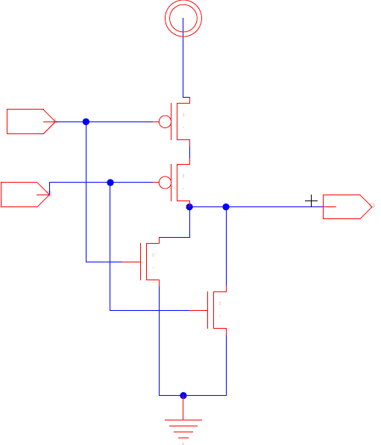
Motivation
We would like to avoid driving both pullup/pulldown networks
  reduce capacitive load
    Power, delay

Slide 18
Motivation
We would like to avoid driving both pullup/pulldown networks
  reduce capacitive load
    Power, delay
Ratioed Logic

Slide 19
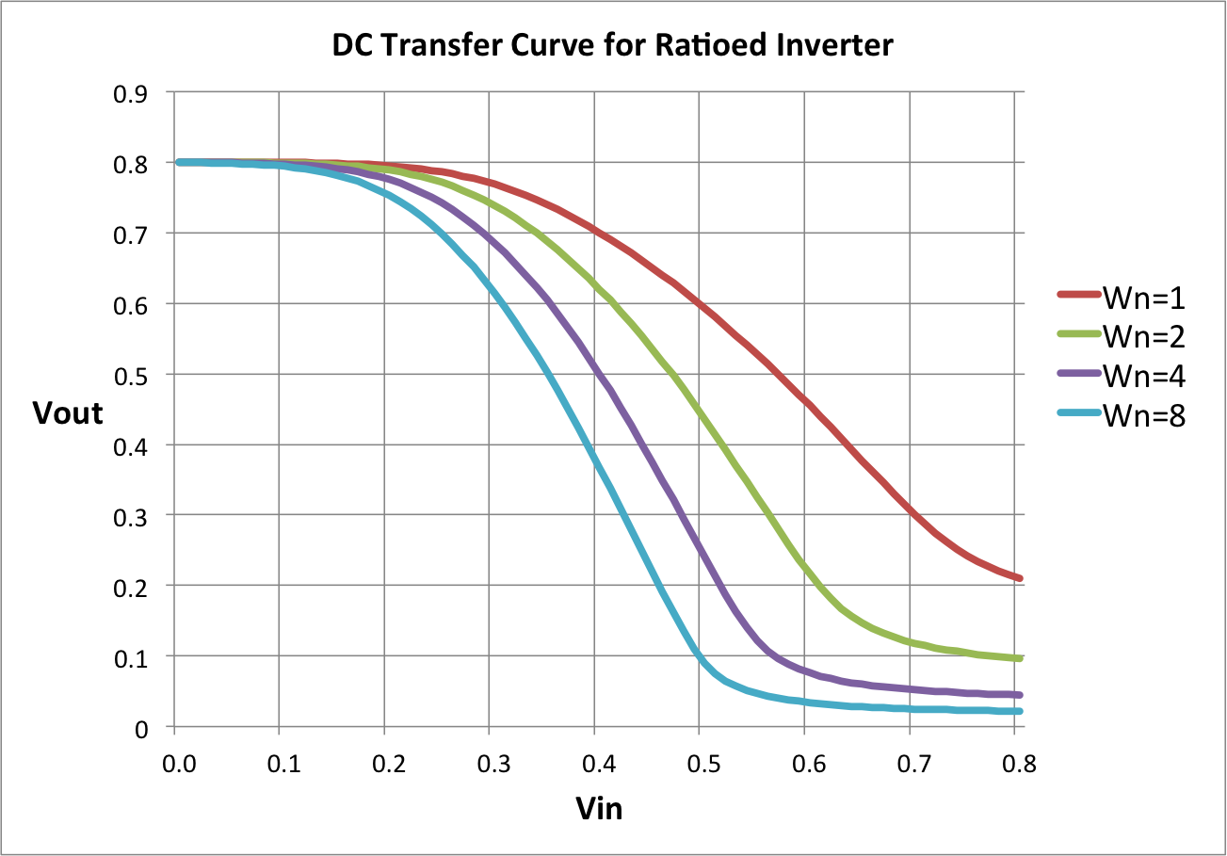
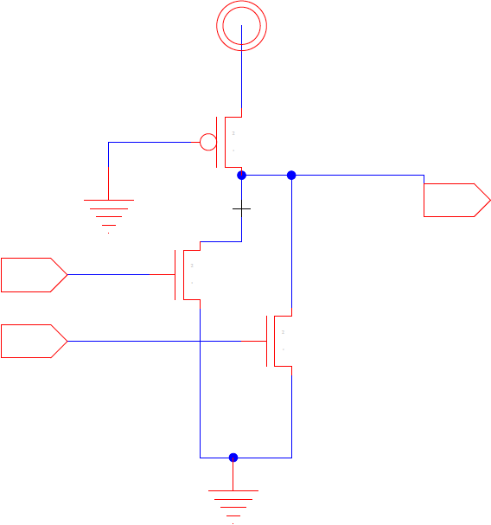
Motivation
We would like to avoid driving both pullup/pulldown networks
  reduce capacitive load
    Power, delay
Ratioed Logic cons:
  Large devices for ratioing
    Meeting noise margins
  Slow pullup
  Static power

Slide 20
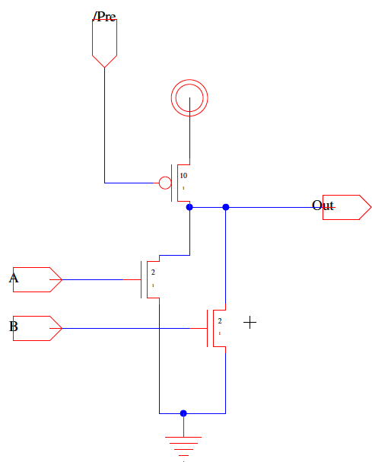
Idea
Use clock to disable pullup network during logic evaluation

Slide 21
Idea
Use clock to disable pullup network during logic evaluation
Define two phases
  Pre-charge
    Output pre-charged
  Evaluation
    Pulldown network evaluates
    gate logic

Slide 22
Discuss (Preclass 3)
Use CLK to disable pullup during evaluation
What is Vout when:
  /Pre=0, A=B=0?
  /Pre=0→1, A=B=0?
  /Pre=1, A=0, B=0→1 ?

Slide 23
Discuss (Preclass 3)
Use CLK to disable pullup during evaluation
What is Vout when:
  /Pre=0, A=B=0?
  /Pre=0→1, A=B=0?
  /Pre=1, A=0, B=0→1 ?
Sizing implication?
Concerns?
Requirements?

Slide 24
Advantages
Large load device
  Driven by CLK—not data
  Can pullup quickly without putting load on logic
Single pulldown network
  Don’t have to size for ratio with pullup
  Swings rail-to-rail

Slide 25
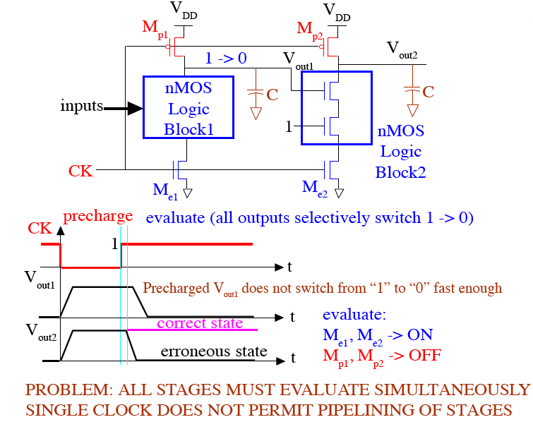
Cascaded Dynamic Logic

Slide 26
Cascaded Dynamic Logic

Slide 27
Cascaded Dynamic Logic

Slide 28
Cascaded Dynamic Logic

Slide 29
Cascaded Dynamic Logic

Slide 30
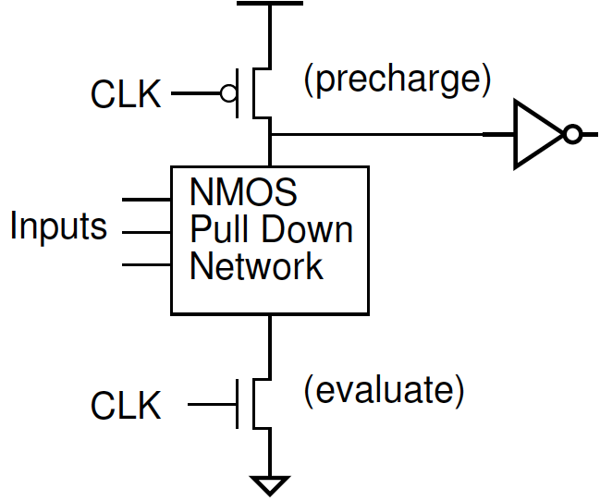
Domino Logic

Slide 31
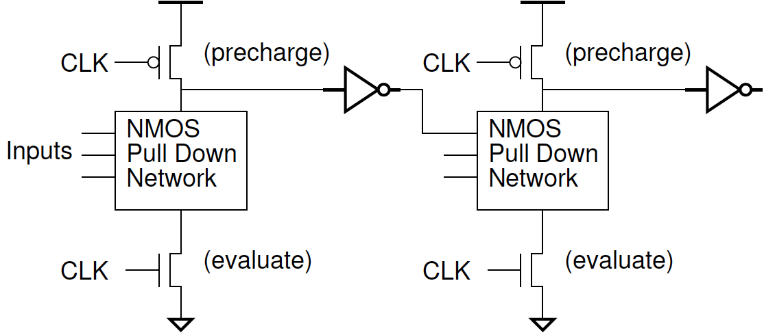
Requirements
Single transition
  Once transitioned, it is done → like domino falling
All inputs at 0 during precharge
  “Outputs” pre-charged to 1 then inverted to 0
Non-inverting gates fundamental gate

Slide 32
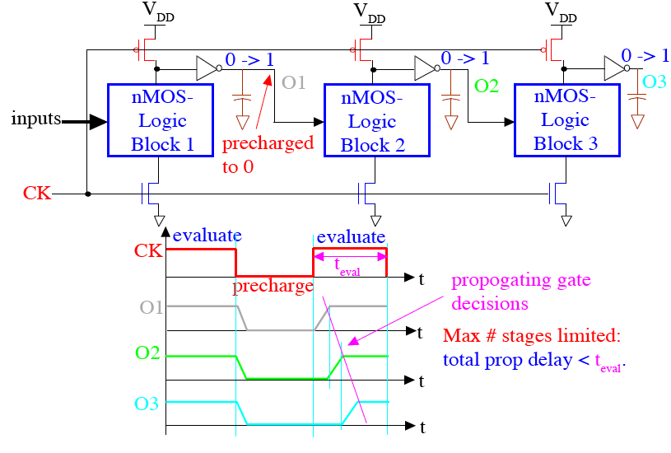
Cascaded Domino CMOS Logic Gates

Slide 33
Cascaded Domino CMOS Logic Gates
propagating

Slide 34
Cascaded Domino CMOS Logic Gates
propagating

Slide 35
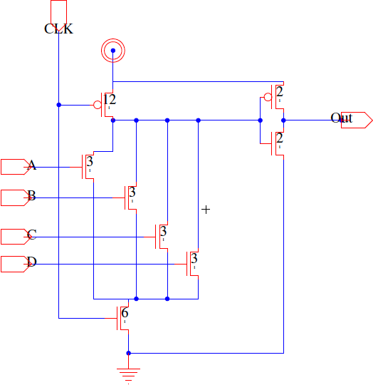
Domino or4 (Preclass 4)

Slide 36
Domino Logic (Preclass 4)
Performance
  R₀/2 input
Compare to CMOS cases?
  nor4
  or4
  nand4

Slide 37
Dynamic OR4 (Preclass 4)
Precharge time?
Driving input
  With R₀/2 inverter
Driving inverter?
Self output Delay?

Slide 38
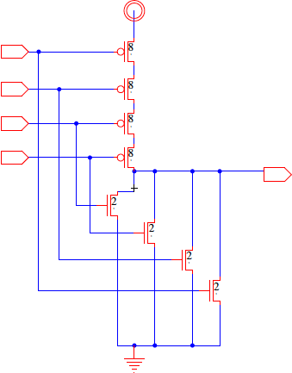
CMOS NOR4 (Preclass 4)
Driving input
  With R₀/2 inverter
Self output Delay?

Slide 39
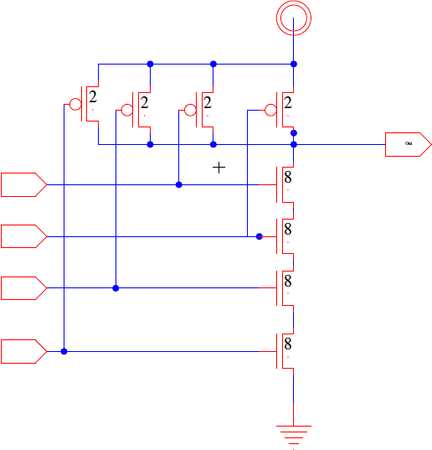
CMOS NAND4 (Preclass 4)
Driving input
  With R₀/2
Driving self cap?

Slide 40
Dynamic Logic Issues
Noise sensitive
  During evaluation phase, when output is high it’s floating and therefore more susceptible to noise
Power
  Eliminates static current
  Higher activity factor—always a 0→1 transition, large pre-charge device dissipates extra switching power

Slide 41
Observe
Better (lower) ratio of input capacitance to drive strength
Particularly good for
  Driving large loads
  Large fanin gates
Harder to design with
  Timing and polarity restrictions
  Avoiding noise
    Especially with today’s high variation tech
Can consume more energy

Slide 42
Idea
Clock discipline simplifies logic composition
  Breaking logic up with registers allows circuit to run at high frequency
  Abstracts many internal timing details
    Setup/Hold time, clk→q delay
  Just concerned with making clock period long enough
Dynamic/clocked logic
  Only build/drive one pulldown network
    Domino Logic
  Fast transition propagation
  Spend delay (capacitance) on pullup of critical path of logic
  More complicated design, power dissipation
    Reserve for when most needed

Slide 43
Admin
Homework 6
  Due Friday 11/12

