Slide 1

ESE370: Circuit-Level Modeling, Design, and Optimization for Digital Systems
Lec 26: November 10, 2021
Dynamic Logic Pt 2, Memory Overview

Slide 2
Today
Dynamic (Clocked) Logic
  Domino Logic
  Compare CMOS
Memory Overview

Slide 3
Dynamic Logic

Slide 4
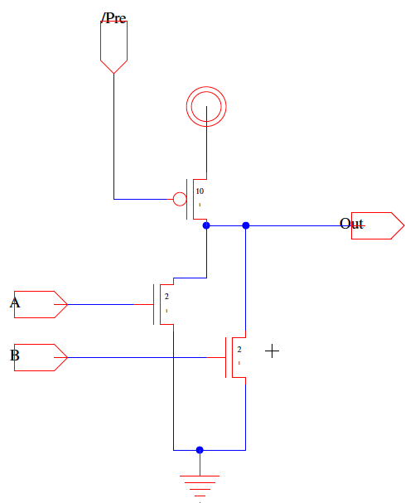
Idea
Use clock to disable pullup network during logic evaluation
Define two phases
  Pre-charge
    Output pre-charged
  Evaluation
    Pulldown network evaluates
    gate logic

Slide 5
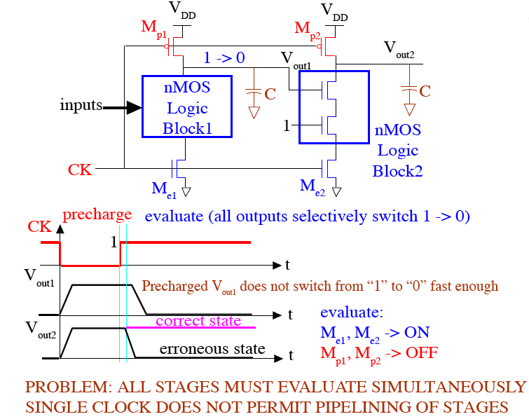
Cascaded Dynamic Logic

Slide 6
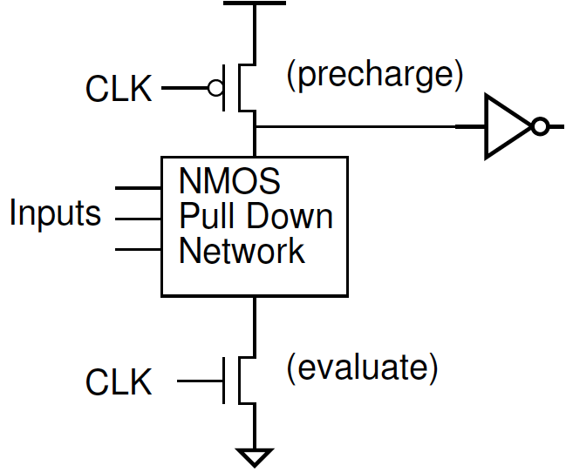
Domino Logic

Slide 7
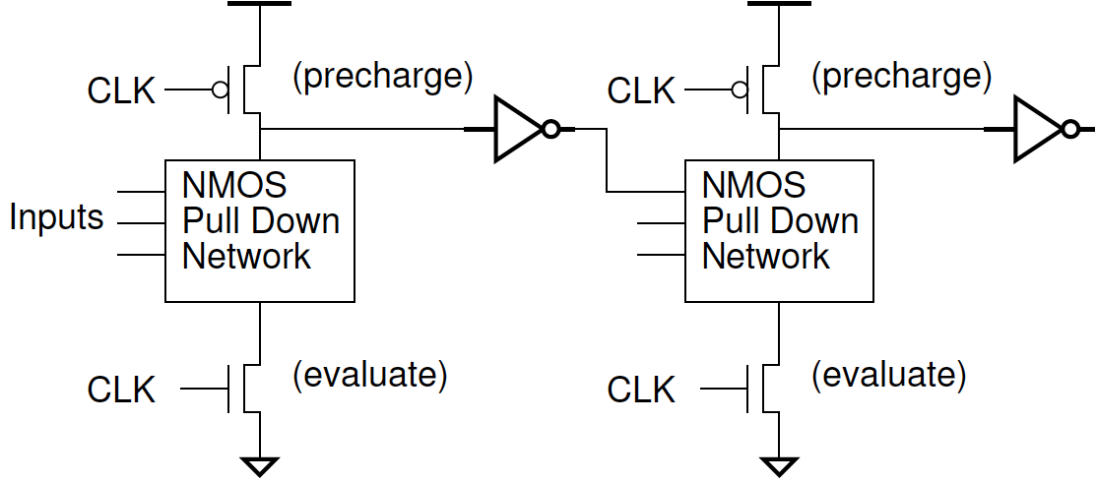
Requirements
Single transition
  Once transitioned, it is done → like domino falling
All inputs at 0 during precharge
  “Outputs” pre-charged to 1 then inverted to 0
Non-inverting gates fundamental gate

Slide 8
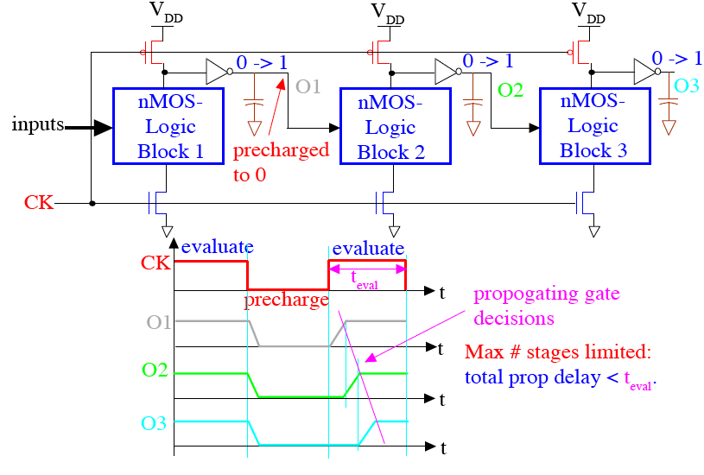
Cascaded Domino CMOS Logic Gates

Slide 9
Cascaded Domino CMOS Logic Gates
propagating

Slide 10
Cascaded Domino CMOS Logic Gates
propagating

Slide 11
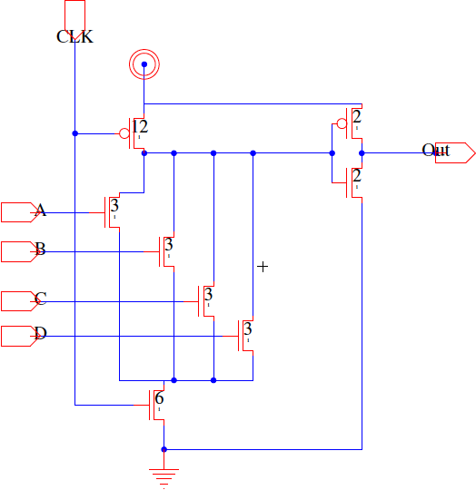
Domino or4 (Preclass 3)

Slide 12
Domino Logic (Preclass 3)
Performance
  R₀/2 input
Compare to CMOS cases?
  nor4
  or4
  nand4

Slide 13
Dynamic OR4 (Preclass 3)
Precharge time?
Driving input
  With R₀/2 inverter
Driving inverter?
Self output Delay?

Slide 14
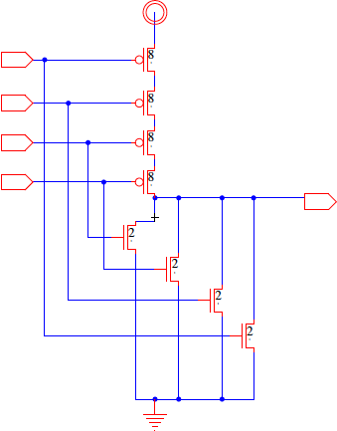
CMOS NOR4 (Preclass 3)
Driving input
  With R₀/2 inverter
Self output Delay?

Slide 15
Dynamic Logic Issues
Noise sensitive
  During evaluation phase, when output is high it’s floating and therefore more susceptible to noise
Power
  Eliminates static current
  Higher activity factor—always a 0→1 transition, large pre-charge device dissipates extra switching power

Slide 16
Observe
Better (lower) ratio of input capacitance to drive strength
Particularly good for
  Driving large loads
  Large fanin gates
Harder to design with
  Timing and polarity restrictions
  Avoiding noise
    Especially with today’s high variation tech
Can consume more energy

Slide 17
Memory Overview

Slide 18
Semiconductor Memory Classification

Slide 19
Memory Architecture: Core

Slide 20
Memory Architecture: Decoders
Notes:
What are some issues we need to address? What will dominate the size, power or our design?
Core.

Slide 21
Array-Structured Memory Architecture

Slide 22
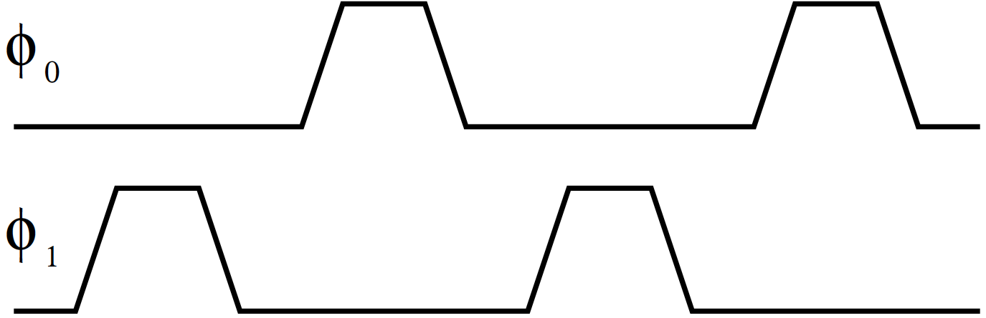
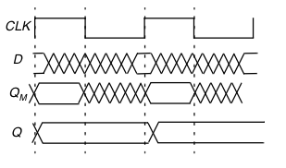
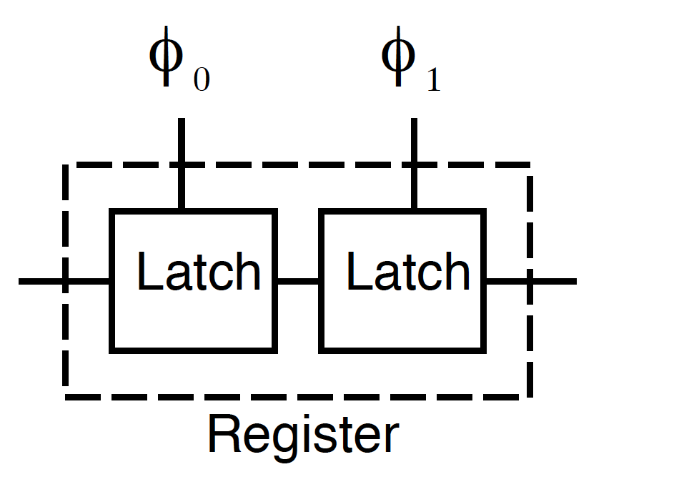
Latches/Register – Can Store a State
Build register from pair of latches
Control with non-overlapping clocks

Slide 23
ROM Memories

Slide 24
MOS NOR ROM

Slide 25
MOS NOR ROM

Slide 26
MOS NOR ROM
1
0
1
1

Slide 27
MOS NOR ROM
1
0
1
1
0
1
1
0
1
0
1
0
1
1
1
1

Slide 28
MOS NAND ROM

Slide 29
MOS NAND ROM
0
1
0
0

Slide 30
MOS NAND ROM
0
1
0
0
1
0
0
1
0
1
0
1
0
0
0
0

Slide 31
Array-Structured Memory Architecture

Slide 32
Idea
Dynamic/clocked logic
  Only build/drive one pulldown network
    Domino Logic
  Fast transition propagation
  Spend delay (capacitance) on pullup of critical path of logic
  More complicated design, power dissipation
    Reserve for when most needed
Memory for compact state storage
  Minimize area per bit → maximize density

Slide 33
Admin
Homework 6
  Due Friday 11/12

