Slide 1

ESE370: Circuit-Level Modeling, Design, and Optimization for Digital Systems
Lec 27: November 12, 2021
Memory Periphery, Serial Access Memories
Notes:
-

Slide 2
Today
Memory
  Classification
  Architecture
  Periphery
  Serial Access Memories
Project 2 is on this

Slide 3
Array-Structured Memory Architecture

Slide 4
ROM Memories

Slide 5
MOS NOR ROM

Slide 6
MOS NOR ROM
1
0
1
1
0
1
1
0
1
0
1
0
1
1
1
1

Slide 7
MOS NAND ROM
Notes:
Active low

Slide 8
MOS NAND ROM
0
1
0
0

Slide 9
MOS NAND ROM
0
1
0
0
1
0
0
1
0
1
0
1
0
0
0
0

Slide 10
Memory Periphery

Slide 11
Periphery
Decoders
Column Circuitry
  Bit-line Conditioning
  Sense Amplifiers
  Input/Output Buffers
Control/Timing Circuitry

Slide 12
Array Architecture
2^{n} words of 2^{m} bits each
Good regularity – easy to design
Very high density if good cells are used

Slide 13
Array Architecture
2^{n} words of 2^{m} bits each
Good regularity – easy to design
Very high density if good cells are used

Slide 14
Decoders

Slide 15
Array Architecture
2^{n} words of 2^{m} bits each
Good regularity – easy to design
Very high density if good cells are used

Slide 16
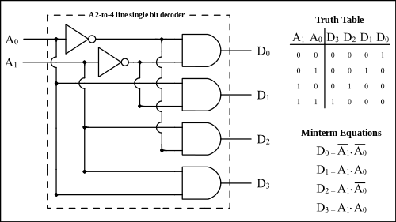
Decoders
n:2^{n} decoder consists of 2^{n} n-input AND gates
  One needed for each row of memory
  Build AND from NAND or NOR gates
Static CMOS

Slide 17
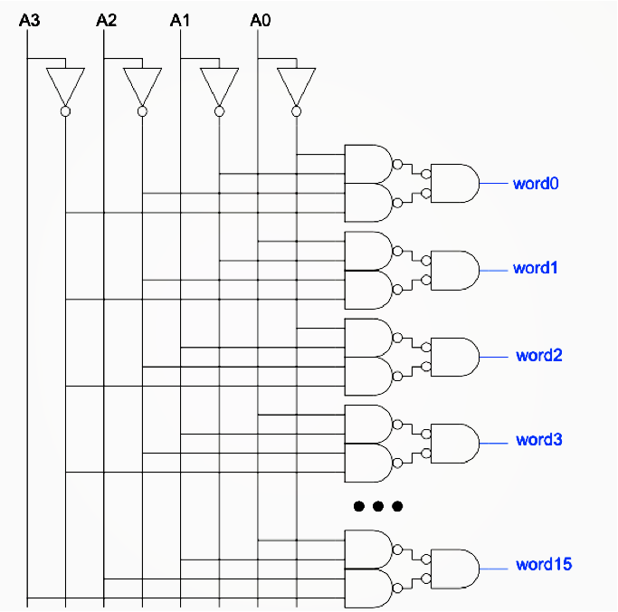
Large Decoders
For n > 4, NAND gates become slow
  Break large gates into multiple smaller gates

Slide 18
Large Decoders
For n > 4, NAND gates become slow
  Break large gates into multiple smaller gates

Slide 19
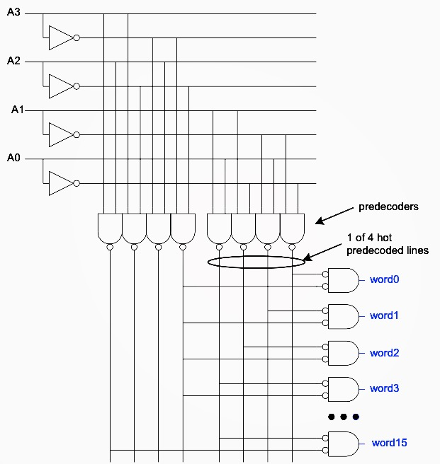
Predecoding
Many of these gates are redundant
  Factor out common
  gates into predecoder
  Saves area
  Same path effort

Slide 20
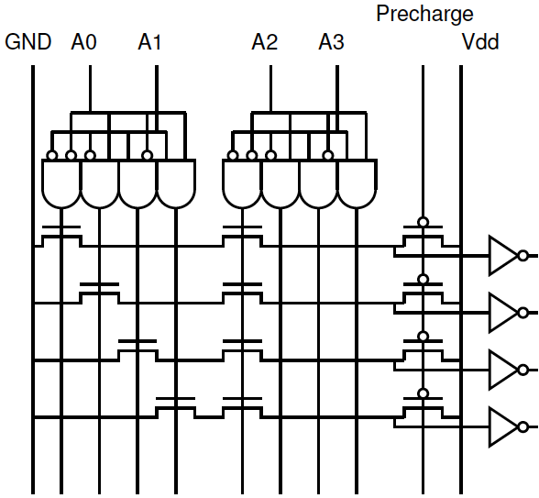
Row Select: Precharge NAND

Slide 21
Row Select: Precharge NAND

Slide 22
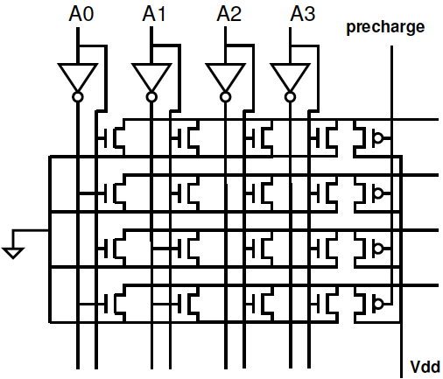
Row Select: Precharge NOR

Slide 23
Column Circuitry
& Bit-line Conditioning

Slide 24
Array Architecture
2^{n} words of 2^{m} bits each
Good regularity – easy to design
Very high density if good cells are used

Slide 25
Array Architecture
2^{n} words of 2^{m} bits each
Good regularity – easy to design
Very high density if good cells are used

Slide 26
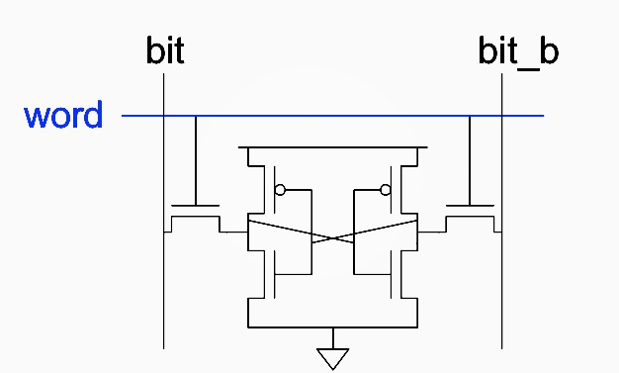
6T SRAM Cell
Cell size accounts for most of array size
  Reduce cell size at expense of complexity
6T SRAM Cell
  Used in most commercial chips
  Data stored in cross-coupled inverters
Read:
  Precharge BL, BL’
  Raise WL
Write:
  Drive data onto BL, BL’
  Raise WL
BL
BL’
WL

Slide 27
Column Circuitry
Some circuitry is required for each column
  Required: Bitline conditioning
    Precharging
    Driving input data to bitline
  Increased speed: Sense amplifiers
  Aspect ratio (square memory): Column multiplexing (AKA Column Decoders)

Slide 28
Bitline Conditioning
Precharge bitlines high before read operations
BL
BL’

Slide 29
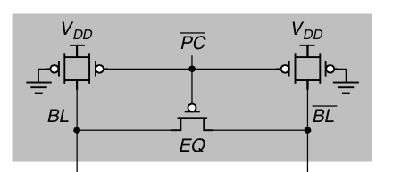
Bitline Conditioning
Precharge bitlines high before reads
BL
BL’

Slide 30
Bitline Conditioning
Precharge bitlines high before reads
What if pre-charged to Vdd/2?
  Pros: reduces read-upset
  Challenge: generate Vdd/2 voltage on chip
BL
BL’

Slide 31
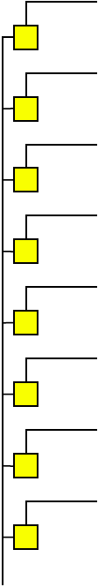
Column Capacitance Consequence
Preclass1: What is capacitance of a bitline?
    W_{access} (pass transistor size), d rows, γ=C_{diff0}/C₀
W_{access}
W_{buf}
W_{buf}

Slide 32
Column Capacitance Consequence
Preclass1: What is capacitance of a bitline?
    W_{access} (pass transistor size), d rows, γ=C_{diff0}/C₀
  Preclass2: What is the delay for the cell to drive the bitline during a read?
    W_{buf} (inverter size in cell), R₀
W_{access}
W_{buf}
W_{buf}

Slide 33
Column Capacitance Consequence
Preclass1: What is capacitance of a bitline?
    W_{access} (pass transistor size), d rows, γ=C_{diff0}/C₀
  Preclass2: What is the delay for the cell to drive the bitline during a read?
    W_{buf} (inverter size in cell), R₀
  Preclass3: Waccess=Wbuf=1, γ=1/2
    Delay for d=32, 512?
W_{access}
W_{buf}
W_{buf}

Slide 34
Column Capacitance Consequence
Preclass1: What is capacitance of a bitline?
    W_{access} (pass transistor size), d rows, γ=C_{diff0}/C₀
  Preclass2: What is the delay for the cell to drive the bitline during a read?
    W_{buf} (inverter size in cell), R₀
  Conclude: Can’t size up cell→driving bitline will be slow
W_{access}
W_{buf}
W_{buf}

Slide 35
Sense Amplifiers
Bitlines have many cells attached
  Ex: 32-kbit SRAM has 128 rows x 256 cols
  128 cells on each bitline
t_{pd} ∝ (C/I) ΔV
  Even with shared diffusion contacts, 64C of diffusion capacitance (big C)
  Discharged slowly through small transistors in each memory cell (small I)
Sense amplifiers are triggered on small voltage swing (ΔV)
V
BL
V(1)
V_{PRE}
ΔV
V(0)
Sense amp activated
t
Word line activated

Slide 36
Differential Pair Amp
Differential pair requires no clock
But always dissipates static power
BL
BL’

Slide 37
Clocked Sense Amp
Clocked sense amp saves power
Requires sense_clk after enough bitline swing
Isolation transistors cut off large bitline capacitance

Slide 38
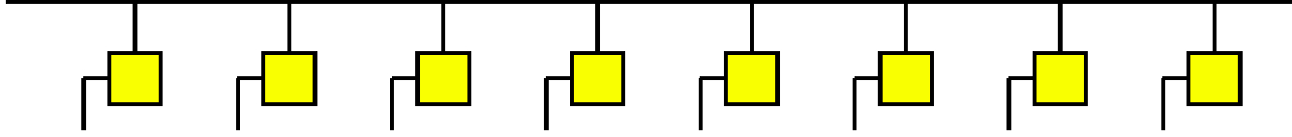
Word Line Capacitance
Preclass4: What is capacitance of word line (row)?
  W_{access}– transistor width of column device
  w columns
  γ=C_{diff0}/C₀
Preclass5: Delay driving word line?
  W_{wldrive} Drive inverter
W_{access}
W_{buf}
W_{buf}

Slide 39
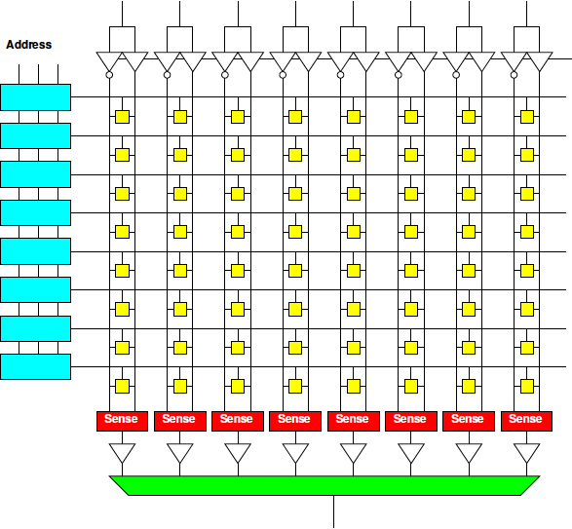
Column Drivers: Memory Bank

Slide 40
Column Drivers: Memory Bank

Slide 41
Tristate Buffer
Typically used for signal traveling, e.g. bus
Ideally all devices connected to a bus should be disconnected except for active device reading or writing to bus
Use high-impedance state to simulate disconnecting
Input | En | Ouptut
0 | 0 | Z
1 | 0 | Z
0 | 1 | 0
1 | 1 | 1
En
Input
Output
Active-high buffer

Slide 42
Tristate Buffer
En
Input
Output
Input
Output
En
Vdd
En
Input
Output
En
CMOS circuit

Slide 43
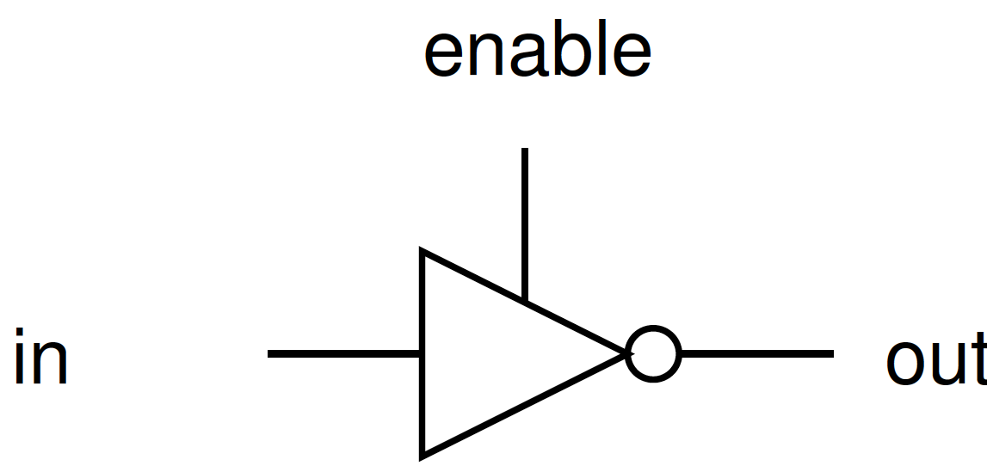
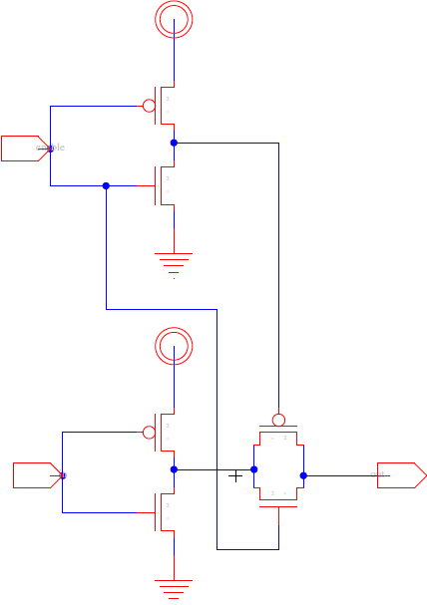
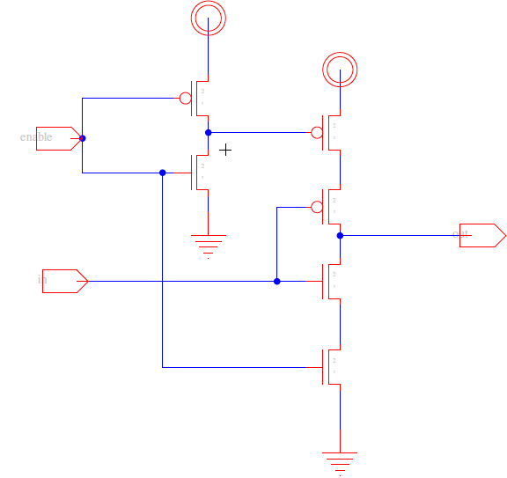
Tristate Inverters
En
En
Output
Input
Input
Output

Slide 44
Serial Access Memories
Serial access memories do not use an address
  Serial In Parallel Out (SIPO)
  Parallel In Serial Out (PISO)
  Shift Registers
  Queues (FIFO, LIFO)

Slide 45
Serial In Parallel Out
1-bit shift register reads in serial data
  After N steps, presents N-bit parallel output

Slide 46
Parallel In Serial Out
Load all N bits in parallel when shift = 0
  Then shift one bit out per cycle

Slide 47
Shift Register
Shift registers store and delay data
Simple design: cascade of registers

Slide 48
Denser Shift Registers
Flip-flops aren’t very area-efficient
For large shift registers, keep data in SRAM instead
Move read/write pointers to RAM rather than move data
  Initialize read address to first entry, write to last
  Increment address on each cycle

Slide 49
Queues
Queues allow data to be read and written at different rates.
Read and write each use their own clock, data
Queue indicates whether it is full or empty
Build with SRAM and read/write counters (pointers) storing read/write address

Slide 50
FIFO, LIFO Queues
First In First Out (FIFO)
  Initialize read and write pointers to first element
  Queue is EMPTY
  On write, increment write pointer
  If write almost catches read, Queue is FULL
  On read, increment read pointer
  If read catches write, Queue is EMPTY
Last In First Out (LIFO)
  Also called a stack
  Use a single stack pointer for read and write

Slide 51
Idea
Memory for compact state storage
Share circuitry across many bits
  Minimize area per bit → maximize density
Aggressively use:
  Pass transistors, Ratioing
  Precharge, Amplifiers to keep area down

Slide 52
Admin
Homework 6 due tonight
Project 2 out Monday 11/15
    Work in teams of up to two
    Milestone due Monday 11/22
    I will give feedback by Wednesday (night) 11/24
    Final report due 12/3

