Slide 1

ESE370: Circuit-Level Modeling, Design, and Optimization for Digital Systems
Lec 28: November 15, 2021
Memory Core Part 1
Notes:
-

Slide 2
Today
Memory Array examples
Serial Access Memories
Memory
  Memory core
    6T SRAM
Project 2 is on this

Slide 3
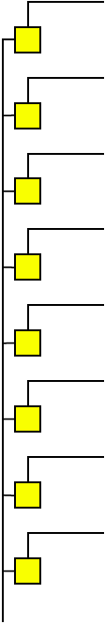
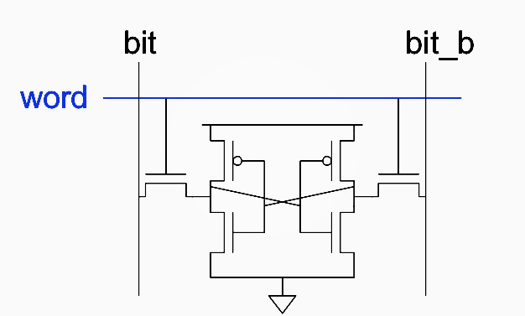
Column Capacitance Consequence
Preclass1: What is capacitance of a bitline?
    W_{access} (pass transistor size), d rows, γ=C_{diff0}/C₀
  Preclass2: What is the delay for the cell to drive the bitline during a read?
    W_{buf} (inverter size in cell), R₀
  Conclude: Can’t size up cell→driving bitline will be slow
W_{access}
W_{buf}
W_{buf}

Slide 4
Sense Amplifiers
Bitlines have many cells attached
  Ex: 32-kbit SRAM has 128 rows x 256 cols
  128 cells on each bitline
t_{pd} ∝ (C/I) ΔV
  Even with shared diffusion contacts, 64C of diffusion capacitance (big C)
  Discharged slowly through small transistors in each memory cell (small I)
Sense amplifiers are triggered on small voltage swing (ΔV)
V
BL
V(1)
V_{PRE}
ΔV
V(0)
Sense amp activated
t
Word line activated

Slide 5
Differential Pair Amp
Differential pair requires no clock
But always dissipates static power
BL
BL’

Slide 6
Clocked Sense Amp
Clocked sense amp saves power
Requires sense_clk after enough bitline swing
Isolation transistors cut off large bitline capacitance

Slide 7
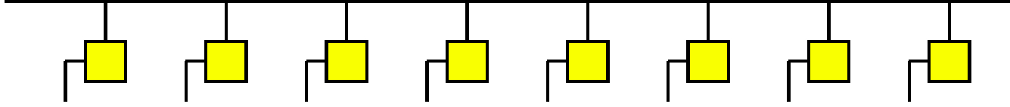
Word Line Capacitance
Preclass4: What is capacitance of word line (row)?
  W_{access}– transistor width of column device
  w columns
  γ=C_{diff0}/C₀
Preclass5: Delay driving word line?
  W_{wldrive} Drive inverter
W_{access}
W_{buf}
W_{buf}

Slide 8
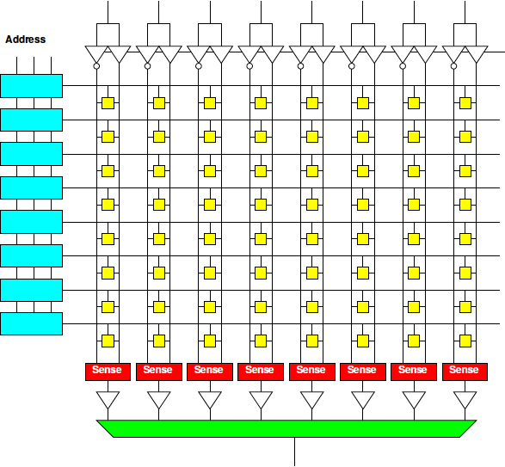
Column Drivers: Memory Bank

Slide 9
Tristate Buffer
Typically used for signal traveling, e.g. bus
Ideally all devices connected to a bus should be disconnected except for active device reading or writing to bus
Use high-impedance state to simulate disconnecting
Input | En | Ouptut
0 | 0 | Z
1 | 0 | Z
0 | 1 | 0
1 | 1 | 1
En
Input
Output
Active-high buffer

Slide 10
Tristate Buffer
En
Input
Output
Input
Output
En
Vdd
En
Input
Output
En
CMOS circuit

Slide 11
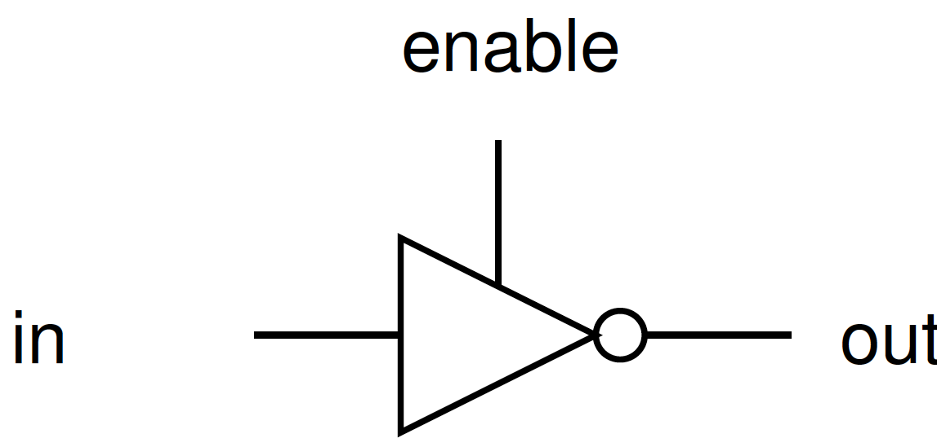
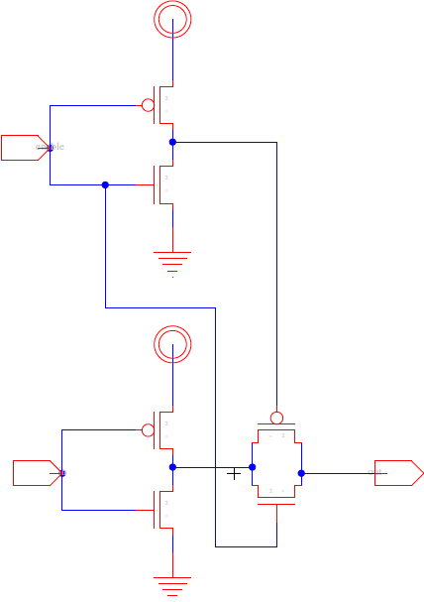
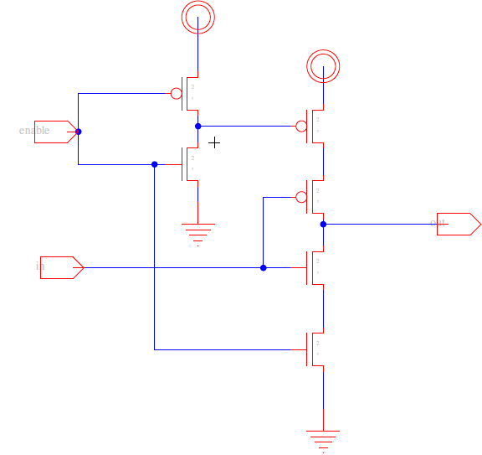
Tristate Inverters
En
En
Output
Input
Input
Output

Slide 12
8x4 Memory with column decoder
8x4 Memory
2-to-4
Decoder
Row
Decoder
0
1-bit
1-bit
1-bit
1-bit
1-bit
1-bit
1-bit
1-bit
A0
1
1-bit
1-bit
1-bit
1-bit
1-bit
1-bit
1-bit
1-bit
2
A1
1-bit
1-bit
1-bit
1-bit
1-bit
1-bit
1-bit
1-bit
3
CS
1-bit
1-bit
1-bit
1-bit
1-bit
1-bit
1-bit
1-bit
Tristate
Buffer
(read)
D0
D1
D2
D3
Column
Select (A2)
0
1
CS
1-to-2 Decoder Column Decoder

Slide 13
Read/Write Memory
8x4 Memory
0
1-bit
1-bit
1-bit
1-bit
1-bit
1-bit
1-bit
1-bit
A0
2-to-4
Row
Decoder
1
1-bit
1-bit
1-bit
1-bit
1-bit
1-bit
1-bit
1-bit
2
A1
1-bit
1-bit
1-bit
1-bit
1-bit
1-bit
1-bit
1-bit
3
CS
1-bit
1-bit
1-bit
1-bit
1-bit
1-bit
1-bit
1-bit
Rd/Wr
D0
D1
D2
Column
Select (A2)
D3
0
1
CS
1-to-2 Column Decoder

Slide 14
Read/Write Memory
8x4 Memory
0
1-bit
1-bit
1-bit
1-bit
1-bit
1-bit
1-bit
1-bit
A0
2-to-4
Row
Decoder
1
1-bit
1-bit
1-bit
1-bit
1-bit
1-bit
1-bit
1-bit
2
1-bit
1-bit
1-bit
1-bit
1-bit
1-bit
1-bit
1-bit
A1
3
CS
1-bit
1-bit
1-bit
1-bit
1-bit
1-bit
1-bit
1-bit
Rd/Wr = 0
D0
D1
D2
D3
Column
Select (A2) = 0
0
1
CS
1-to-2 Column Decoder

Slide 15
Read/Write Memory
8x4 Memory
0
1-bit
1-bit
1-bit
1-bit
1-bit
1-bit
1-bit
1-bit
A0
2-to-4
Row
Decoder
1
1-bit
1-bit
1-bit
1-bit
1-bit
1-bit
1-bit
1-bit
2
1-bit
1-bit
1-bit
1-bit
1-bit
1-bit
1-bit
1-bit
A1
3
CS
1-bit
1-bit
1-bit
1-bit
1-bit
1-bit
1-bit
1-bit
Rd/Wr = 1
D0
D1
D2
D3
Column
Select (A2) = 1
0
1
CS
1-to-2 Column Decoder

Slide 16
Serial Access Memories
Serial access memories do not use an address
  Serial In Parallel Out (SIPO)
  Parallel In Serial Out (PISO)
  Shift Registers
  Queues (FIFO, LIFO)

Slide 17
Serial In Parallel Out
1-bit shift register reads in serial data
  After N steps, presents N-bit parallel output

Slide 18
Parallel In Serial Out
Load all N bits in parallel when shift = 0
  Then shift one bit out per cycle

Slide 19
Shift Register
Shift registers store and delay data
Simple design: cascade of registers

Slide 20
Denser Shift Registers
Flip-flops aren’t very area-efficient
For large shift registers, keep data in SRAM instead
Move read/write pointers to RAM rather than move data
  Initialize read address to first entry, write to last
  Increment address on each cycle

Slide 21
Queues
Queues allow data to be read and written at different rates.
Read and write each use their own clock, data
Queue indicates whether it is full or empty
Build with SRAM and read/write counters (pointers) storing read/write address

Slide 22
FIFO, LIFO Queues
First In First Out (FIFO)
  Initialize read and write pointers to first element
  Queue is EMPTY
  On write, increment write pointer
  If write catches read, Queue is FULL
  On read, increment read pointer
  If read catches write, Queue is EMPTY
Last In First Out (LIFO)
  Also called a stack
  Use a single stack pointer for read and write

Slide 23
Array-Structured Memory Architecture

Slide 24
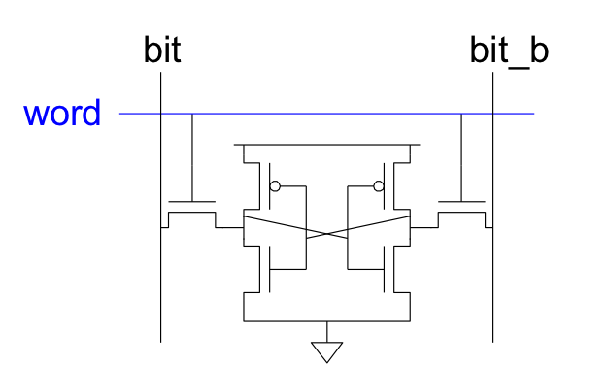
6T SRAM Cell
Cell size accounts for most of array size
  Reduce cell size at expense of complexity
6T SRAM Cell
  Used in most commercial chips
  Data stored in cross-coupled inverters
Read:
  Precharge BL, BL’
  Raise WL
Write:
  Drive data onto BL, BL’
  Raise WL
BL
BL’
WL

Slide 25
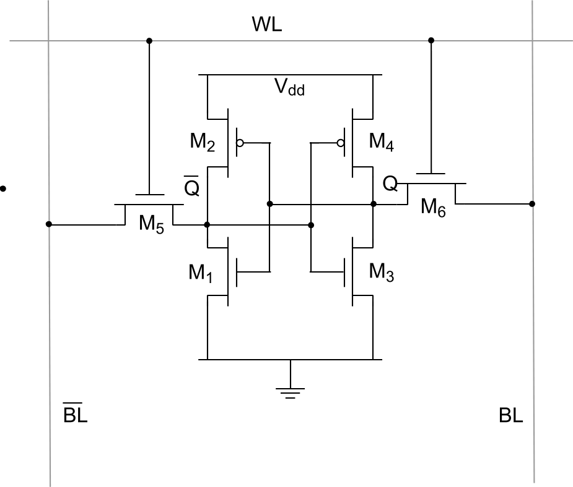
6-transistor CMOS SRAM Cell

Slide 26

6-transistor CMOS SRAM Cell

Slide 27
6-transistor CMOS SRAM Cell (preclass 1)
Assume 1 is stored
(Q=1)
Read Operation:
First bitlines get precharged high (Vdd)
Then wordline goes high (Vdd)
  Precharge disconnected
1
VDD
0
VDD

Slide 28
CMOS SRAM Analysis (Read) (preclass 1)
0
ΔV
1
VDD
VDD
Which two transistors are discharging \BL to Gnd?
What regions of operation are the transistors in?
Write the KCL equation for the two transistors

Slide 29
CMOS SRAM Analysis (Read)
0
ΔV
1
VDD
VDD

Slide 30
CMOS SRAM Analysis (Read)
0
ΔV
1
VDD
VDD

Slide 31

CMOS SRAM Analysis (Read)
0
ΔV
1
VDD
VDD

Slide 32
CMOS SRAM Analysis (Read)
1.2
1
0.8
0.6
Voltage Rise (V)
0.4
0.2
0
0
0.5
1
1.2
1.5
2
2.5
3
Cell Ratio (CR)

Slide 33
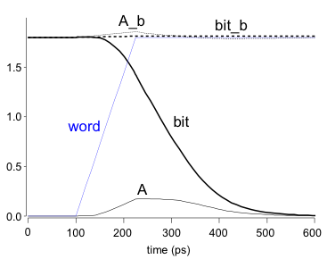
SRAM Read
Precharge both bitlines high
Then turn on wordline, WL
One of the two bitlines will be pulled down by the cell
Ex: A = 0, A_b = 1
  BL discharges, BL’ stays high
  But A bumps up slightly
Read stability
  A must not flip
  N1 > N2
BL
BL’
WL
BL’
WL
BL

Slide 34
6-transistor CMOS SRAM Cell (preclass 2)
Assume 1 is stored
(Q=1)
Write Operation:
Want to write a 0
First drive bitlines with input data
Then wordline goes high (Vdd)
  Still driving bitlines
1
0
VDD
0

Slide 35
CMOS SRAM Analysis (Write) (preclass 2)
0
V_{Q}
1
VDD
0
Which transistor discharges Q to Gnd?
Which transistor must it overpower?
What regions of operation are the transistors in?
Write the KCL equation for the two transistors

Slide 36

CMOS SRAM Analysis (Write)
0
V_{Q}
1
VDD
0
$$k_{p,M4}$$

Slide 37

CMOS SRAM Analysis (Write)
0
V_{Q}
1
VDD
0
$$k_{p,M4}$$

Slide 38

CMOS SRAM Analysis (Write)
0
V_{Q}
1
VDD
0
$$k_{p,M4}$$
$$k_{p,M4}$$

Slide 39
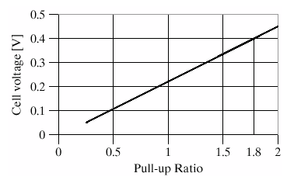
CMOS SRAM Analysis (Write)

Slide 40
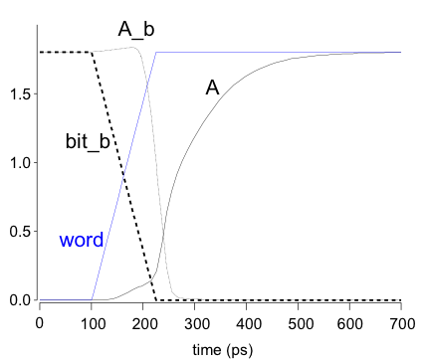
SRAM Write
Drive one bitline high, the other low
  Depending on write data
Then turn on wordline, WL
Bitlines overpower cell with new value
Ex: A = 0, A_b = 1, BL = 1, BL’ = 0
  Force A_b low, then A charges high
Writability
  Must overpower feedback inverter
  N4 >> P2
BL
BL’
WL
BL’
WL

Slide 41
SRAM Column Example
read
write

Slide 42
5T SRAM

Slide 43
Idea
6T SRAM
  Robust cell when sized carefully
5T SRAM
  More sensitive to sizing than 6T SRAM
  More next time…

Slide 44
Admin
Project 2 out - START NOW!
  Work in teams up to 2
  Milestone due Monday 11/22
    I will give feedback by Wed (night) 11/24
  Final report due 12/3

