Slide 1

ESE370: Circuit-Level Modeling, Design, and Optimization for Digital Systems
Lec 29: November 17, 2021
RAM Core Part 2

Slide 2
Today
6T SRAM
5T SRAM
Multiported SRAM
DRAM

Slide 3
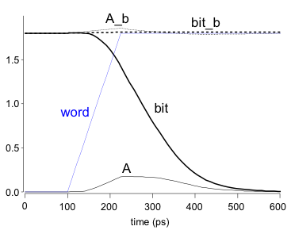
SRAM Read
Precharge both bitlines high
Then turn on wordline, WL
One of the two bitlines will be pulled down by the cell
Ex: A = 0, A_b = 1
  BL discharges, BL’ stays high
  But A bumps up slightly
Read stability
  A must not flip
  N1 > N2
BL
BL’
WL
BL’
WL
BL

Slide 4
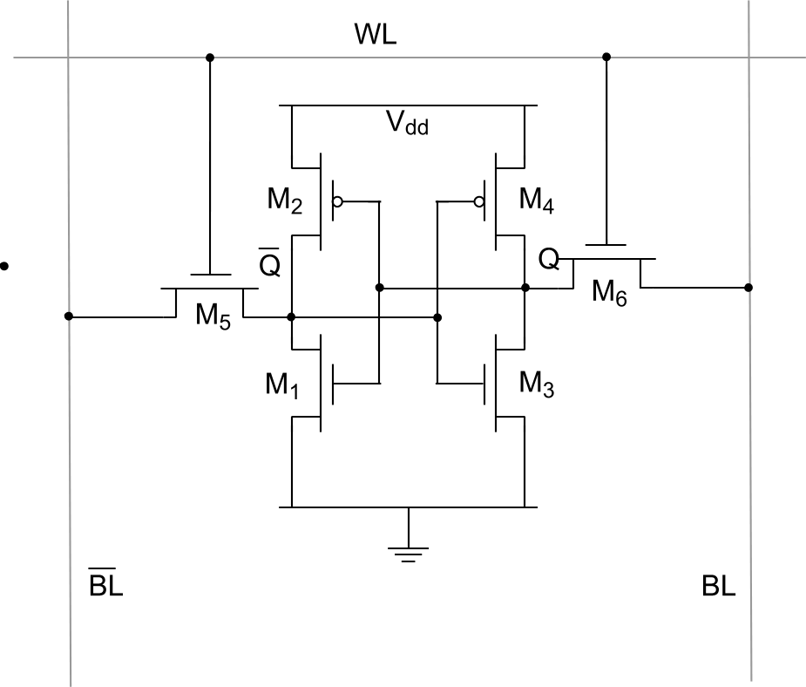
6-transistor CMOS SRAM Cell
Assume 1 is stored
(Q=1)
Write Operation:
Want to write a 0
First drive bitlines with input data
Then wordline goes high (Vdd)
  Still driving bitlines
1
0
VDD
0

Slide 5
CMOS SRAM Analysis (Write)
0
V_{Q}
1
VDD
0
Which transistor discharges Q to Gnd?
Which transistor must it overpower?
What regions of operation are the transistors in?
Write the KCL equation for the two transistors

Slide 6

CMOS SRAM Analysis (Write)
0
V_{Q}
1
VDD
0
$$k_{p,M4}$$

Slide 7

CMOS SRAM Analysis (Write)
0
V_{Q}
1
VDD
0
$$k_{p,M4}$$

Slide 8

CMOS SRAM Analysis (Write)
0
V_{Q}
1
VDD
0
$$k_{p,M4}$$
$$k_{p,M4}$$

Slide 9
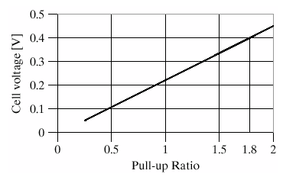
CMOS SRAM Analysis (Write)

Slide 10
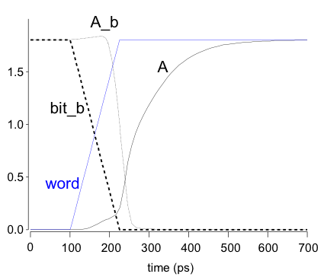
SRAM Write
Drive one bitline high, the other low
  Depending on write data
Then turn on wordline, WL
Bitlines overpower cell with new value
Ex: A = 0, A_b = 1, BL = 1, BL’ = 0
  Force A_b low, then A charges high
Writability
  Must overpower feedback inverter
  N4 >> P2
BL
BL’
WL
BL’
WL

Slide 11
SRAM Column Example
read
write

Slide 12
5T SRAM

Slide 13
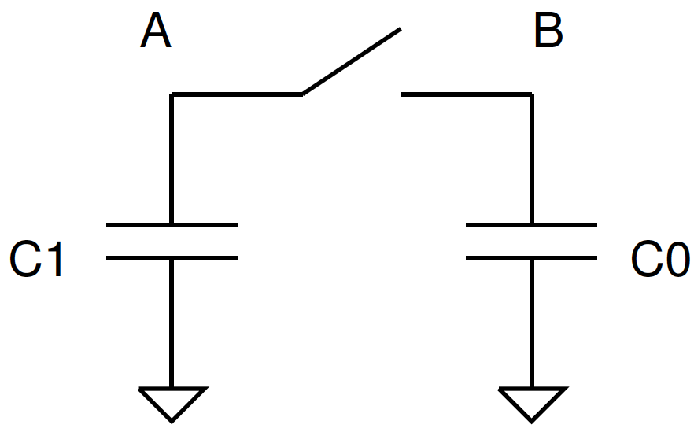
Charge Sharing (Preclass 1)
Initially
  A @ 1V
  B @ 0V
Q_{A}=1V*C1=C1

Slide 14
Charge Sharing (Preclass 1)
Initially
  A @ 1V
  B @ 0V
Q_{A}=1V*C1=C1
Close switch
Q_{tot}=V_{final}*(C1+C0)
Charge conservation
  Q_{A}=Q_{tot}
C1=V_{final}*(C1+C0)

Slide 15
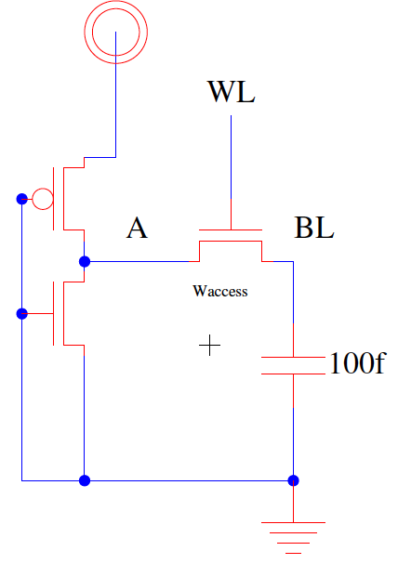
Consider (preclass 2)
Read: What happens to voltage at A when WL turns from 0→1?
  Assume W_{access} large
  W_{access} >> W_{pu}=1
  BL initially 0

Slide 16
Voltage After enable Word Line
Q_{BL} = 0
Q_{A} = (1V)(γ2C₀+γW_{access}C₀)

Slide 17
Voltage After enable Word Line
Q_{BL} = 0
Q_{A} = (1V)(γ2C₀+γW_{access}C₀)
100fF=C_{BL}>>C_{A}=(γ(2+W_{access})C₀)
After enable W_{access} (W_{access} large)
  Total charge Q_{BL} +Q_{A} unchanged
    Charge conservation
  Distributed over larger capacitance~=C_{BL}
  V_{A}=V_{BL}~= C_{A}/C_{BL}

Slide 18
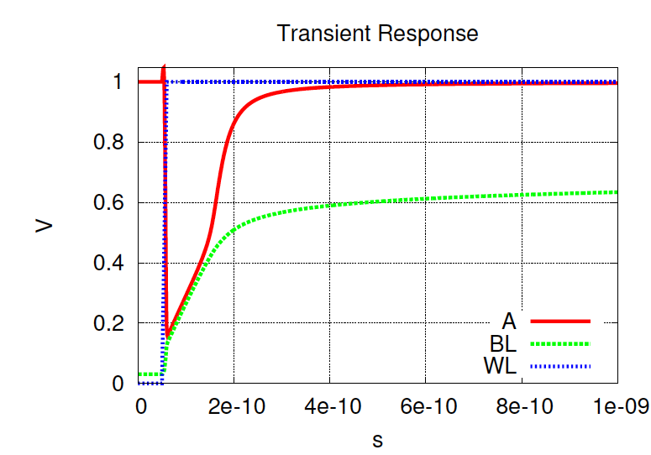
Simulation: W_{access}=100

Slide 19
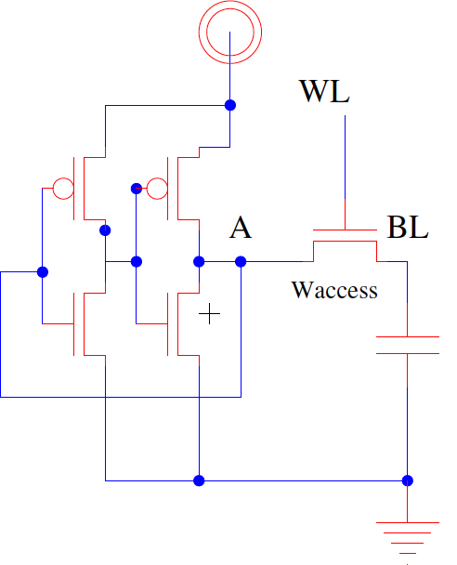
Consider (5T SRAM) (preclass 3)
What happens to voltage at A when WL turns from 0→1?
  Assume W_{access} large
  A initially 1
  BL initially 0

Slide 20
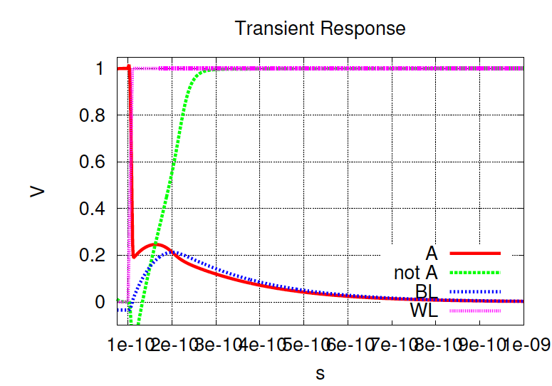
Simulation W_{access}=20

Slide 21
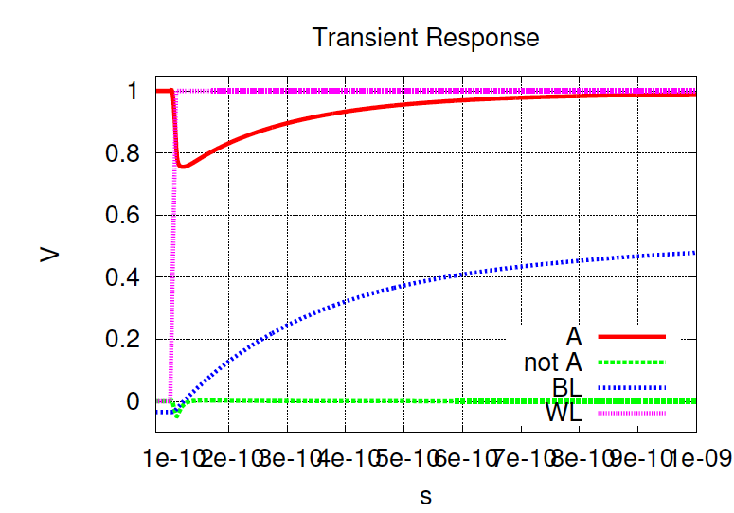
Simulation W_{access}=4

Slide 22
Charge Sharing
Conclude: charge sharing can lead to read upset
  Charge redistribution/sharing adequate to flip state of bit
W_{access}=20
W_{access}=4

Slide 23
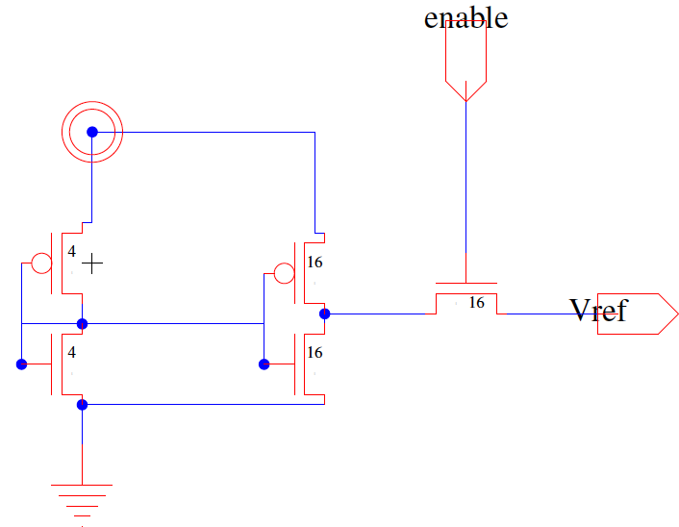
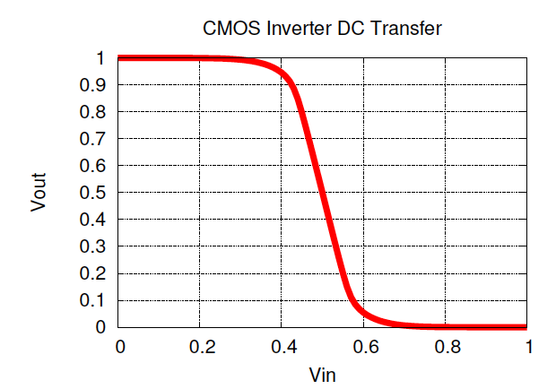
Charge to middle Voltage
Pre-charge bitlines to V_{dd}/2 before begin read operation
Now charge sharing doesn’t swing to opposite side of midpoint

Slide 24
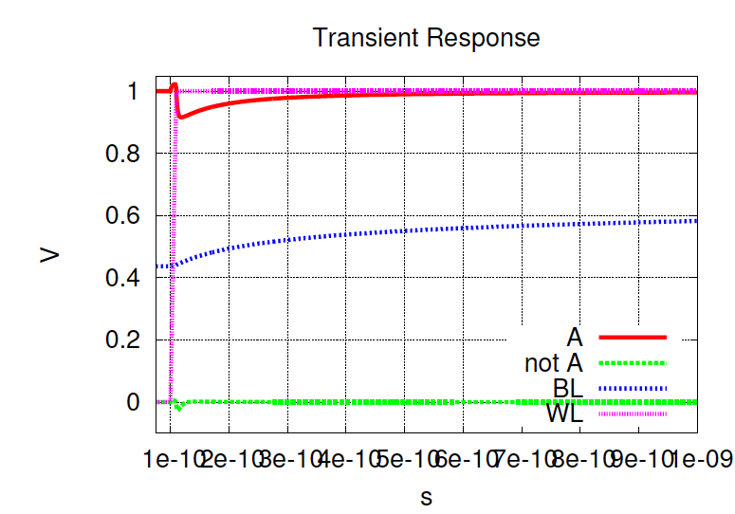
Compare
Both W_{access}=20; vary BL precharge voltage
0 precharge
V_{dd}/2 precharge

Slide 25
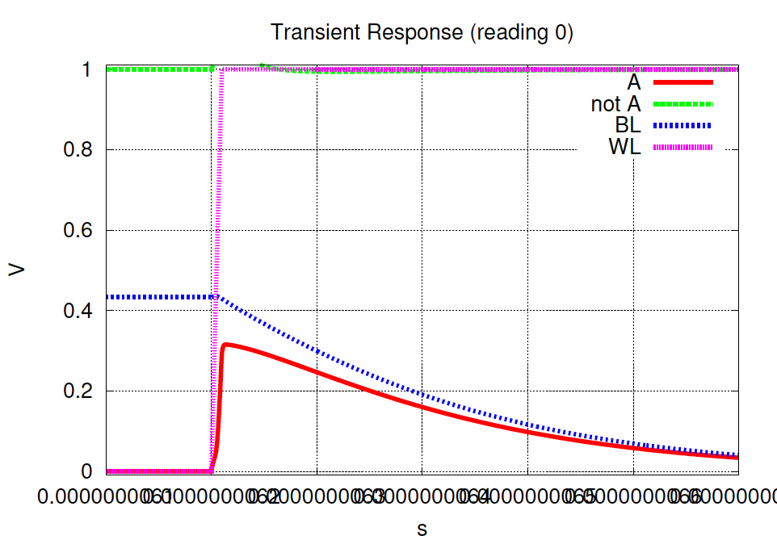
Simulation W_{access}=20 (precharge Vdd/2, reading 0)

Slide 26
Simulation W_{access}=20 (with precharge Vdd/2)
Read 1
Read 0

Slide 27
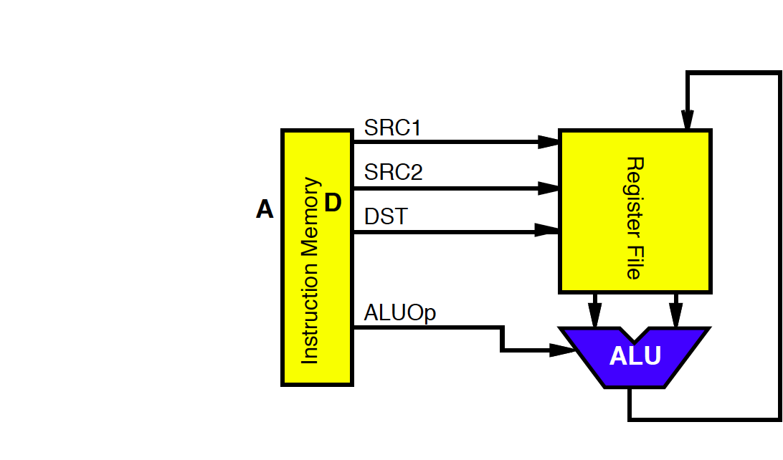
Multiple Ports
We have considered single-ported SRAM
  One read or one write on each cycle
Multiported SRAM are needed for register files
Examples:
  Pipelined ALU register file:
    add r1,r2,r3
    R3←R1+R2
    Requires two
    reads and
    one write

Slide 28
Dual-Ported SRAM
Simple dual-ported SRAM
  Two independent single-ended reads
  Or one differential write

Slide 29
Dual-Ported SRAM
Simple dual-ported SRAM
  Two independent single-ended reads
  Or one differential write
Do two reads and one write by time multiplexing
  Read during ph1, write during ph2

Slide 30
Multi-Ported SRAM
Adding more access transistors hurts read stability
Multiported SRAM isolates reads from state node
Single-ended bitlines save area

Slide 31
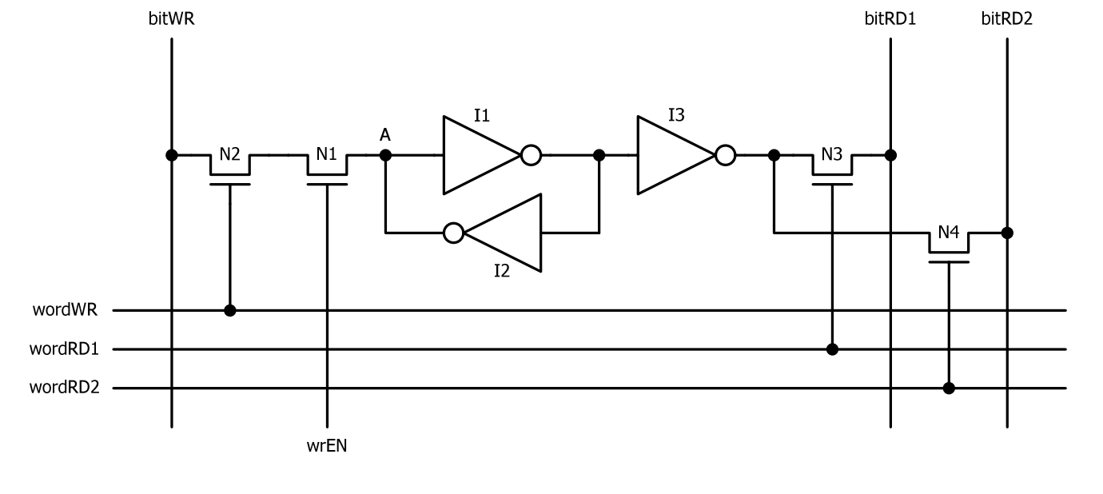
Register File Cell
Single-ended 2-read/1-write ports (Slow-write)

Slide 32
DRAM
Smaller than SRAM
Require data refresh to compensate for leakage

Slide 33
3-Transistor DRAM Cell (preclass 4)
Cell is inverting on read operation
WBL
RBL

Slide 34
3-Transistor DRAM Cell
Cell is inverting on read operation
WBL
RBL
WBL
RBL

Slide 35
3-Transistor DRAM Cell
Cell is inverting on read operation
WBL
RBL
WBL
RBL

Slide 36
3-Transistor DRAM Cell
Cell is inverting on read operation
  No constraints on device ratios
  Reads are non-destructive
  Data stored has a V_{T} drop
    When storing a 1, value at X = V_{WWL}-V_{Tn}
WBL
RBL
WBL
RBL

Slide 37
1-Transistor DRAM Cell (preclass 5)
X

Slide 38
1-Transistor DRAM Cell
X

Slide 39
1-Transistor DRAM Cell
X

Slide 40
1-Transistor DRAM Cell
X

Slide 41
DRAM Cell Observations
1T DRAM requires a sense amplifier for each bit line, due to charge redistribution read-out
DRAM memory cells are single ended in contrast to SRAM cells
The read-out of the 1T DRAM cell is destructive; read and refresh operation are necessary for correct operation
Unlike 3T cell, 1T cell requires presence of an extra capacitance that must be explicitly included in the design
When writing a “1” into a DRAM cell, a threshold voltage is lost. This loss can be circumvented by bootstrapping the word lines to a higher value than V_{DD.}

Slide 42
Idea
Minimize area of repeated cell
  6T/5T SRAM
  Mulitport trade off area for function
  1T/3T DRAM helps but slower
Compensate with periphery
  Decoders
  Bitline (column) drivers
  Sensing/Amplification (regeneration/restoration)

Slide 43
Admin
Project 2 out
  Milestone due Monday 11/22
    I will give feedback by Wed (night) 11/24
  Final report due 12/3

