Slide 1
ESE370: Circuit-Level Modeling, Design, and Optimization for Digital Systems
Lec 31: November 24, 2021
Crosstalk

Slide 2
Today
Crosstalk
Characterization
Magnitude
Avoiding
Design practices

Slide 3
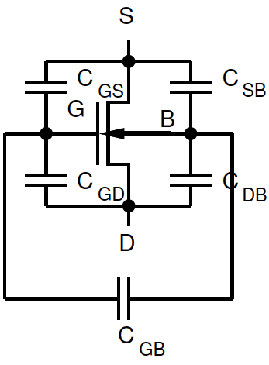
Capacitance
There are capacitors everywhere
Already talked about
Wires modeled as a distributed RC network
Parasitic capacitances between terminals on transistor

Slide 4
Capacitance Everywhere
Potentially a capacitor between any two conductors
On the chip
On the package
On the board
All wires
Package pins
PCB traces
Cable wires
Bit/word lines

Slide 5
Capacitance…
…decreases with conductor separation
…increases with size
…depends on dielectric

Slide 6
Wire Capacitance
Changes in voltage on one wire may couple through parasitic capacitance to an adjacent wire

Slide 7
Crosstalk
A capacitor does not like to change its voltage instantaneously
A wire has high capacitance to its neighbor.
When the neighbor switches from 1-> 0 or 0->1, the wire tends to switch too.
Called capacitive coupling or crosstalk.
Crosstalk effects
Noise on non-switching wires
Increased delay on switching wires

Slide 8
Qualitative

Slide 9
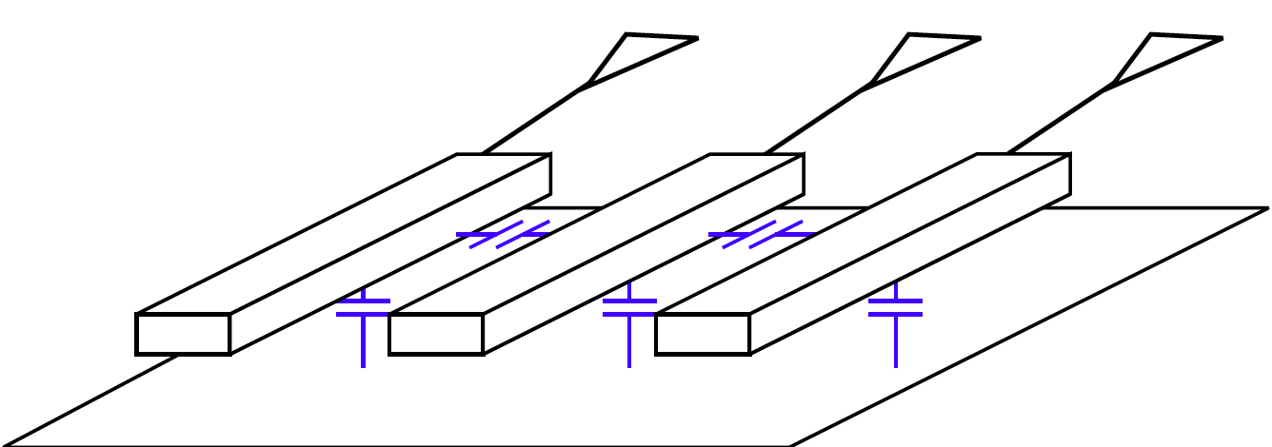
Undriven Wire
What happens to undriven wire?
Where do we have undriven wires?

Slide 10
Driven Wire
What happens to a driven “neighbor” wire?
One wire switches
Neighbors driven but not switch
What happens to neighbors?

Slide 11
Driven Wire
Can this be a problem?
What if switching neighbor is:
Clock line
Non-clock signal used in synchronous system
Asynchronous control

Slide 12
Clocked Logic
CMOS driven lines
Clocked logic
Willing to wait to settle/evaluate
Impact is on delay
May increase delay of transitions

Slide 13
Quantitative

Slide 14
Isolated Wire RC
B
B
4 m
4 m
0.1 mm
0.2 mm
A
0.2 mm
A
0.1 mm
dielectric material
0.1 mm
metal plate

Slide 15
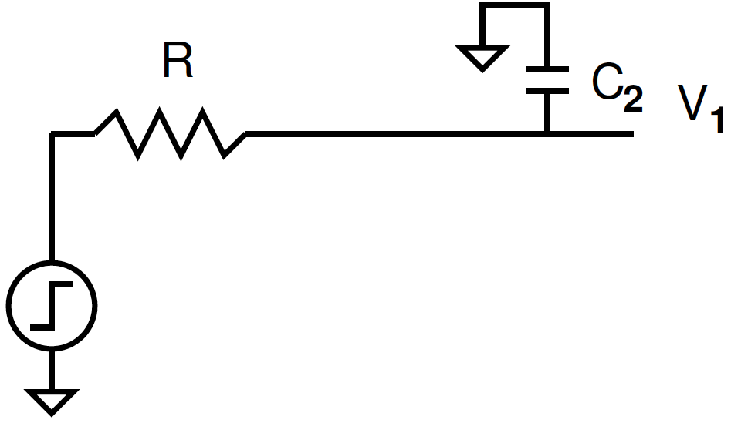
Isolated Wire RC
B
B
4 m
4 m
0.1 mm
0.2 mm
A
0.2 mm
A
0.1 mm
dielectric material
0.1 mm
metal plate

Slide 16
Wire step response (preclass 1)
Step response for isolated wire?

Slide 17
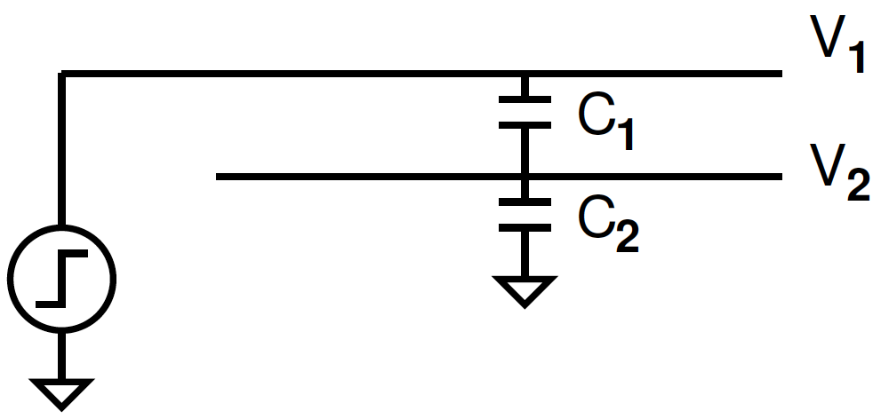
Undriven Adjacent Wire (preclass 2)
V₁ transitions from 0 to V
How big is the noise on V₂?

Slide 18
Undriven Adjacent Wire
V₁ transitions from 0 to V
How big is the noise on V₂?

Slide 19
Undriven Adjacent Wire
V₁ transitions from 0 to V
How big is the noise on V₂?

Slide 20
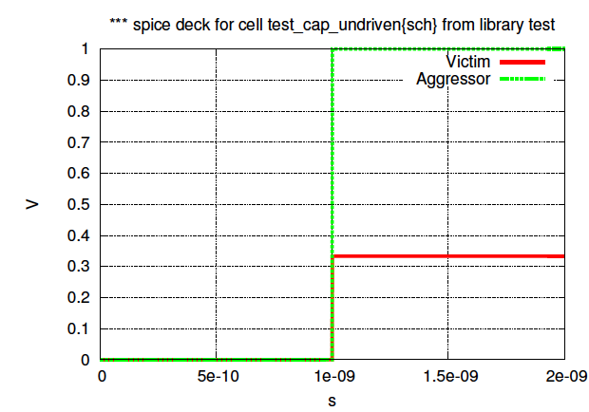
SPICE C₁=10pF, C₂=20pF
V2
V1

Slide 21
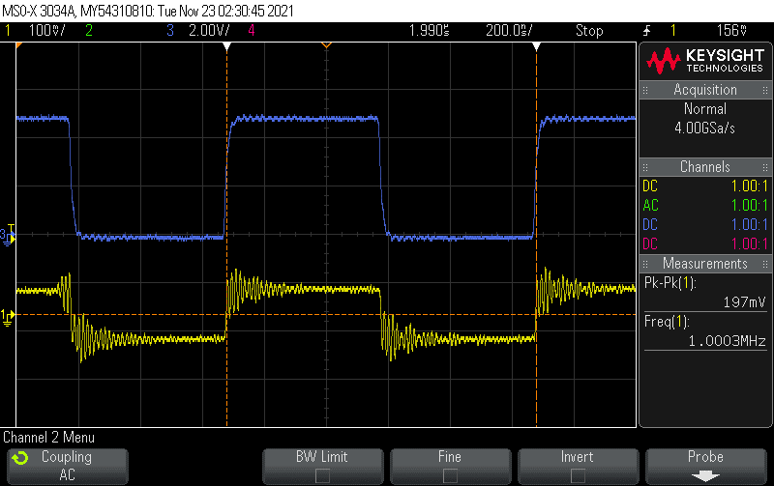
SPICE C₁=10pF, C₂=20pF
V2
V1

Slide 22
Good (?) Capacitance
High capacitance to ground plane (C₂)
Limits node swing from adjacent conductors

Slide 23
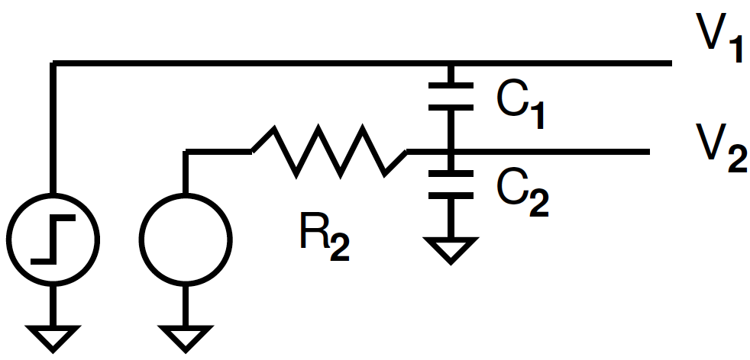
Driven Adjacent Wire (preclass 2)
What happens when neighbor line is driven?

Slide 24
Driven Adjacent Wire
What happens when neighbor line is driven?
Recovers with time constant: R₂(C₁+C₂)

Slide 25
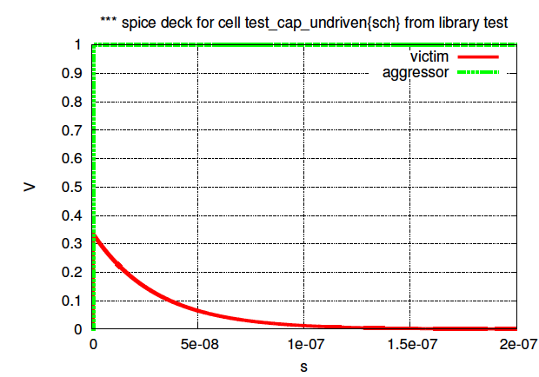
Spice: R₂=1K, C₁=10pF, C₂=20pF
V2
V1
diversion

Slide 26
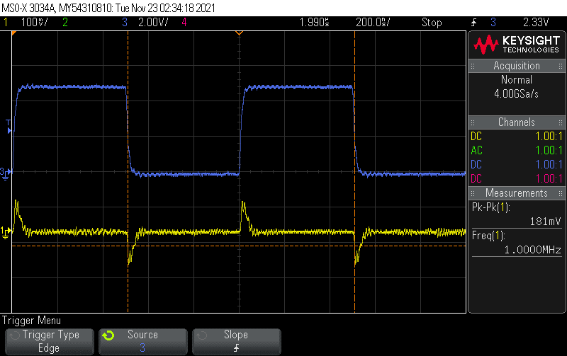
Spice: R₂=1K, C₁=10pF, C₂=20pF
V2
V1
diversion

Slide 27
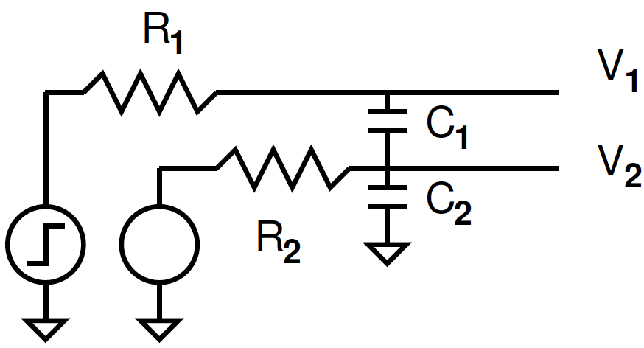
Magnitude of Noise on Driven Line (preclass 3)
Magnitude of diversion depends on relative time constants
τ₁<< τ₂
τ₁>> τ₂
τ₁~= τ₂

Slide 28
Magnitude of Noise on Driven Line
Magnitude of diversion depends on relative time constants
τ₁<< τ₂
full diversion, then recover
τ₁>> τ₂
Drive capacitor (C₂) faster than line 1 can change
little noise
τ₁~= τ₂
Somewhere in between

Slide 29
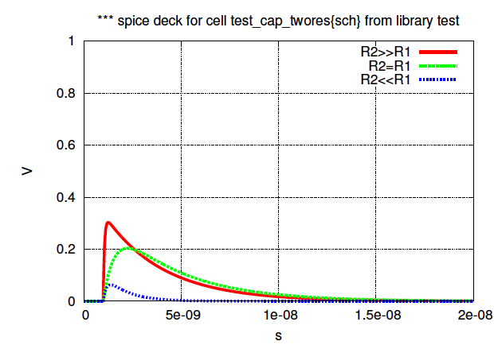
Spice: C₁=1pF, C₂=2pF
τ₁<< τ₂
τ₁= τ₂
τ₁>> τ₂

Slide 30
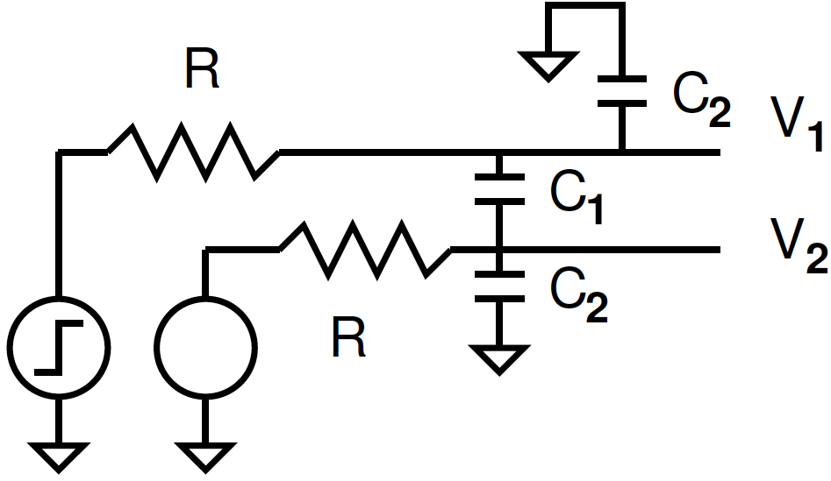
Switching Line with Finite Drive
What impact does the presence of the neighbour line have on the switching line?
All previous questions were about noise on non-switching wire
Finite drive (R)

Slide 31
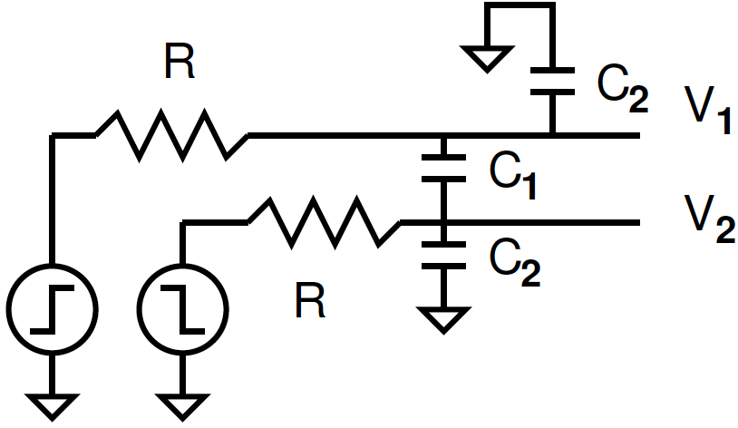
Simultaneous Transition
What happens if lines transition in opposite directions?

Slide 32
Simultaneous Transition
What happens if lines transition in opposite directions?
Must charge C₁ by 2V
Or looks like 2C₁ between wires

Slide 33
Simultaneous Transition
What happens if lines transition in same direction?

Slide 34
Simulation
V₂ switching at ¼ frequency of V₁
No crosstalk reference case where no V₂

Slide 35
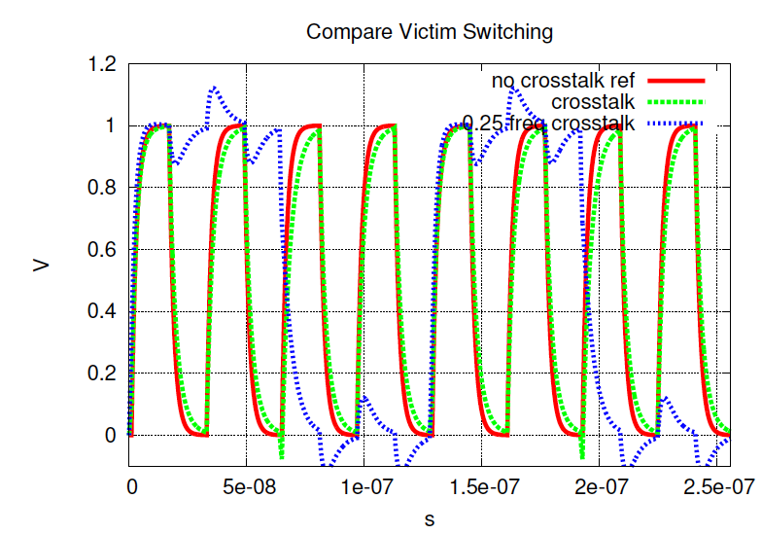
Crosstalk Neighbor Simulations

Slide 36
Crosstalk Neighbor Simulations

Slide 37
Crosstalk Neighbor Simulations

Slide 38
Crosstalk Neighbor Simulations

Slide 39
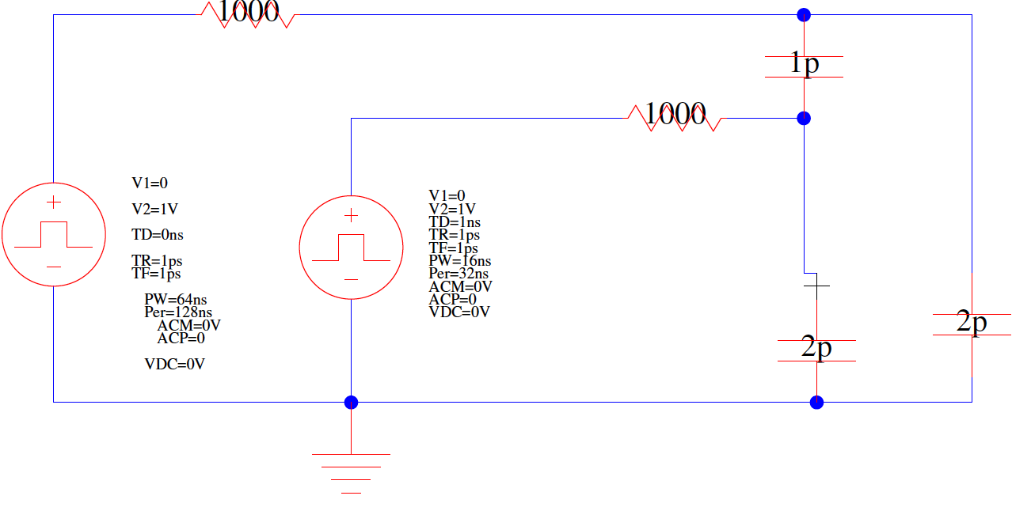
Simulation Setup
V1
C1
V2
C2
C2

Slide 40
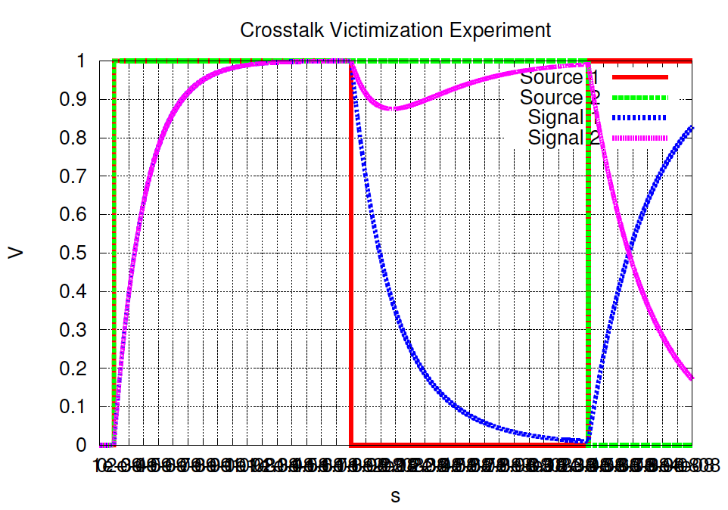
Crosstalk Simulation
V1
V2
1.3ns
1.8ns
2.8ns

Slide 41
Where Does it Arise?

Slide 42
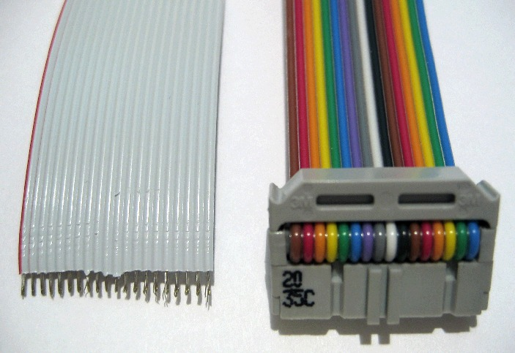
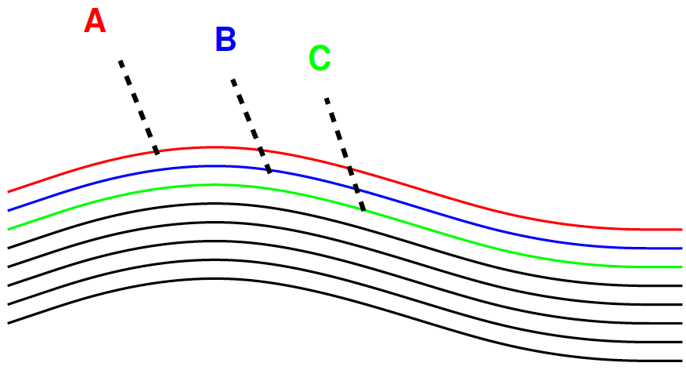
Cables and PCB Wires
Source; http://en.wikipedia.org/wiki/File:Flachbandkabel.jpg

Slide 43
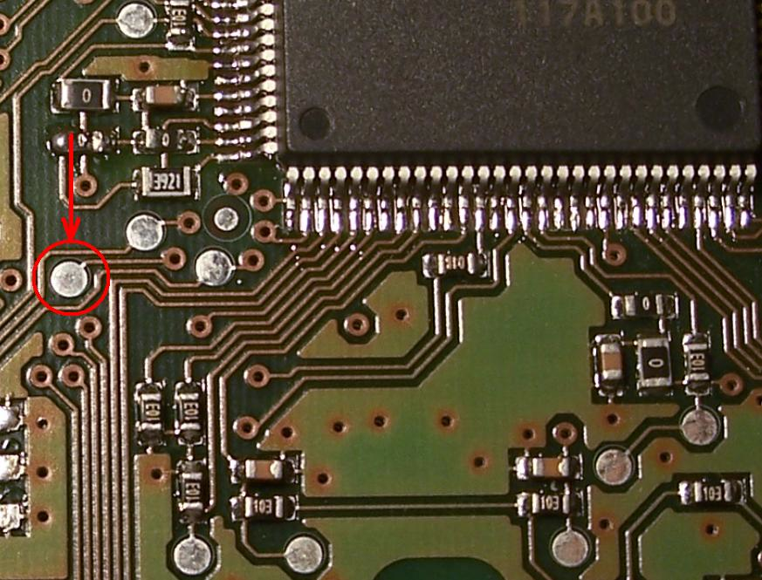
Printed Circuit Board
Source: http://en.wikipedia.org/wiki/File:Testpad.JPG

Slide 44
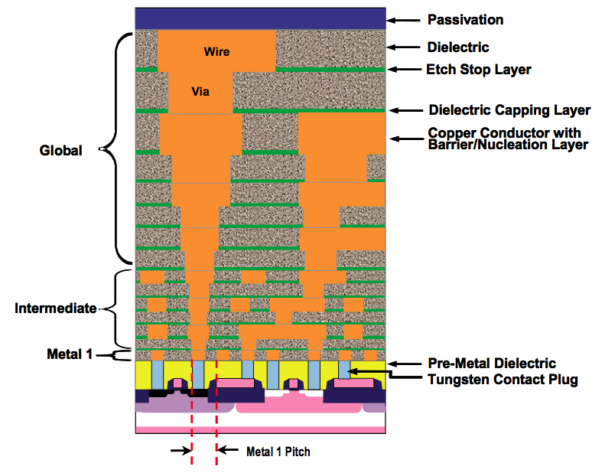
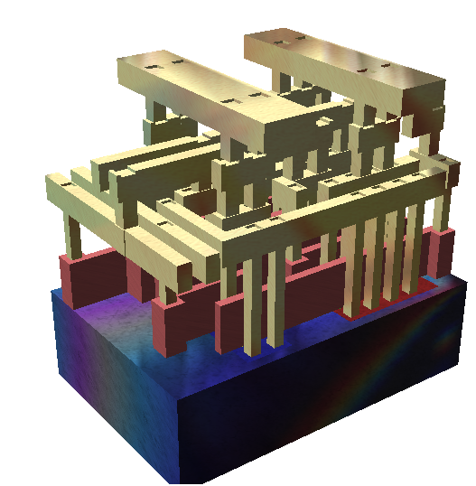
Interconnect Cross Section
Notes:
44

Slide 45
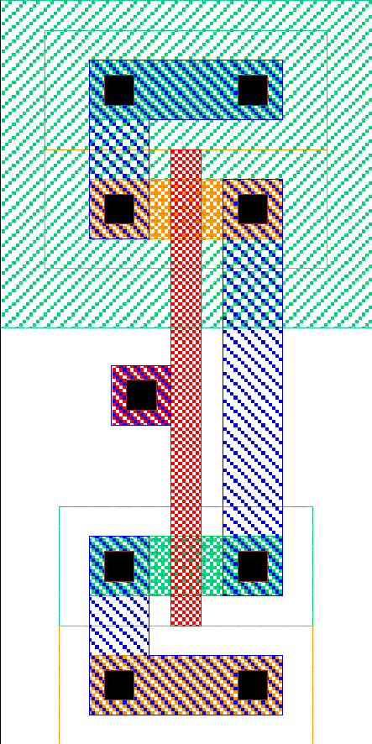
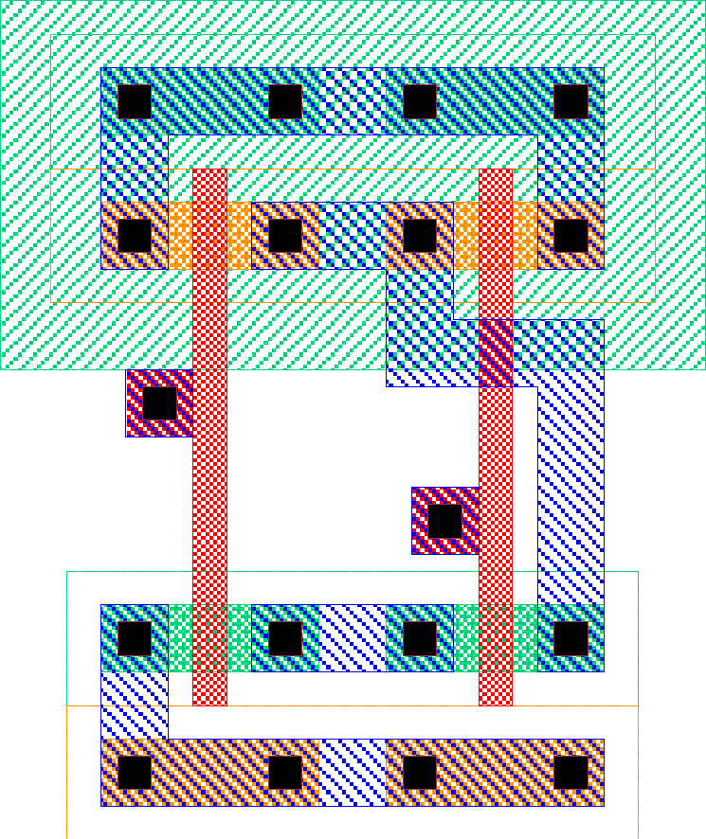
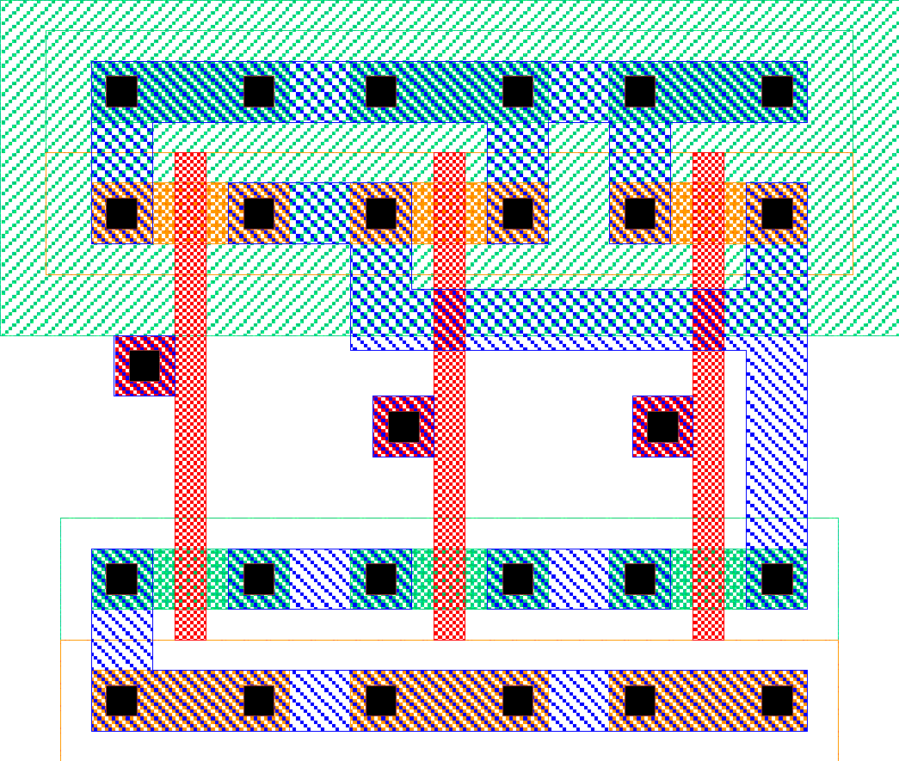
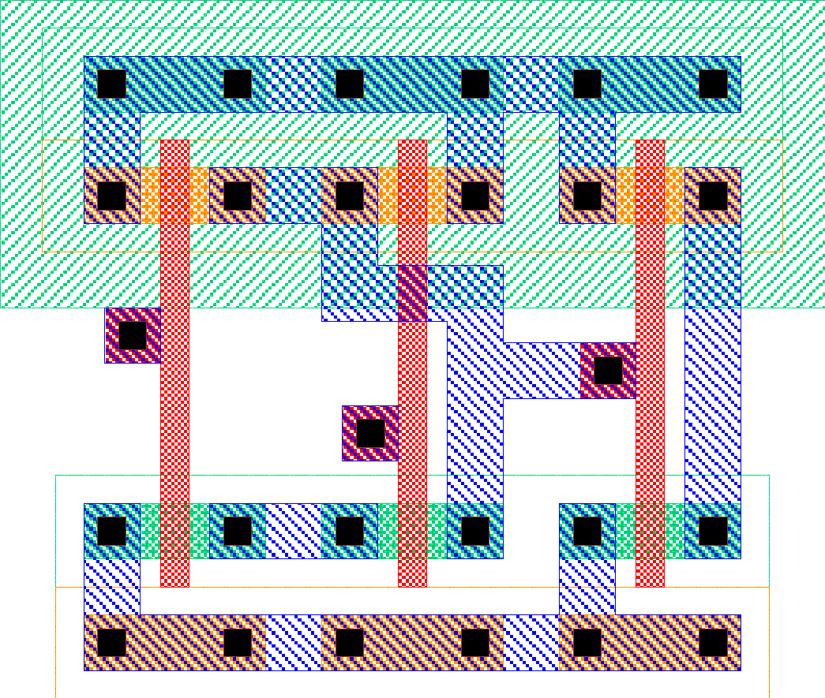
Standard Cell Area
inv
nand3
All cells
uniform
height
Width of
channel
determined
by routing
Cell area

Slide 46
Wires
Will be capacitively coupled to many adjacent wires of varying degrees

Slide 47
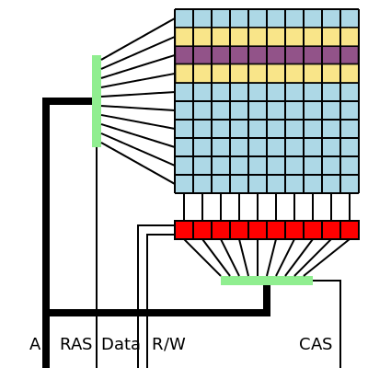
Rowhammer Attack
Smaller and higher density DRAMs leads to increase electromagnetic interactions between memory cells
Rapid wordline switching can affect adjacent words causing them to flip

Slide 48
Noise Implications
So what if we have noise?
If the noise is less than the noise margin, nothing happens
Static CMOS logic will eventually settle to correct output even if disturbed by large noise spikes
But glitches cause extra delay
Also cause extra power from false transitions
Dynamic logic never recovers from glitches
Can’t correct mid-cycle, need precharge nodes
Memories and other sensitive circuits also can produce the wrong result

Slide 49
Wire Engineering
Goal: achieve delay, area, power goals with acceptable noise
Degrees of freedom:

Slide 50
Wire Engineering
Goal: achieve delay, area, power goals with acceptable noise
Degrees of freedom:
Width
Spacing
Layer

Slide 51
Wire Engineering
Goal: achieve delay, area, power goals with acceptable noise
Degrees of freedom:
Width
Spacing
Layer
Shielding

Slide 52
Idea
Capacitance is everywhere
Especially between adjacent wires
Will get “noise” from crosstalk
Clocked and driven wires
Slow down transitions
Undriven wires voltage changed
Can cause spurious transitions

Slide 53
Admin
Monday 11/29 in Ketterer again, no lecture
Project 2
Due Friday 12/3
Milestone feedback:
Don’t forget about the clock
Controls registers to allow inputs to change at any time, but only affect memory at clk edge
Non-overlapping clocks!
Get SRAM column/row working first to make testing/debugging smoother
Can use a min size cell, just have to justify why that sizing

