Slide 1

ESE370: Circuit-Level Modeling, Design, and Optimization for Digital Systems
Lec 32: December 1, 2021
Transmission Line

Slide 2
Next few Lectures
Saw in action in lab
Where transmission lines arise?
General wire formulation
Lossless Transmission Line
End of Transmission Line?
Termination
Discuss Lossy
Implications

Slide 3
Where Transmission Lines Arise

Slide 4
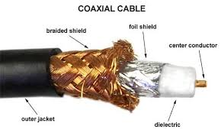
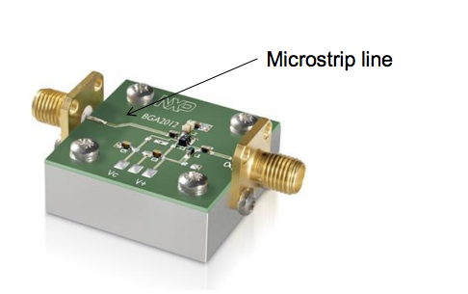
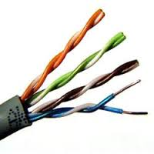
Transmission Lines
Cable: coaxial
PCB
  Strip line
  Microstrip line
Twisted Pair (Cat5)

Slide 5
Transmission Lines
How did the traces behave in lab?
How does this differ from
  Ideal equipotential?
  RC-wire on chip?

Slide 6
Transmission Lines
This is what long wires/cables look like
  Aren’t an ideal equipotential
  Signals take time to propagate
  Maintain shape of input signal
    Within limits
  Shape and topology of wiring effects how signals propagate

Slide 7
Transmission Lines
Need theory/model to support design
  Reason about behavior
  Understand what can cause noise
  Engineer high performance/speed communication

Slide 8
Wire Formulation

Slide 9
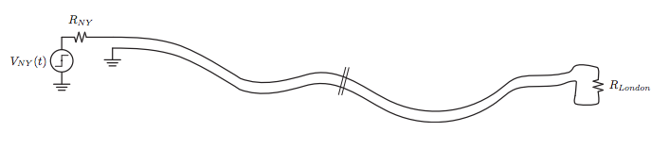
From the Way Way Back
Problem: A long cable – the trans-atlantic telephone cable – is laid out connecting NY to London. We would like analyze the electrical properties of this cable.
For simplicity, assume the cable has a uniform cross-sectional configuration (shown as two wires here)

Slide 10
Trans-Atlantic Cable
Can we do it with circuit theory?
Fundamental problem with circuit theory is that it assumes that the speed of light is infinite. So all signals are in phase: V(z) = V(z + ℓ)
Consequently, all variations in space are ignored: ∂/∂z → 0
This allows the lumped circuit approximation

Slide 11
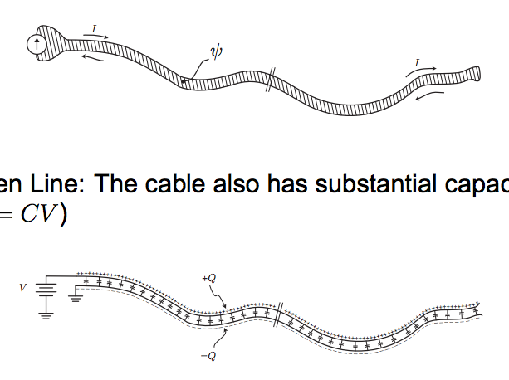
Lumped Circuit Properties of Cable
Shorted Line: The long loop has inductance since the magnetic flux ψ is not negligible (long cable) (ψ = LI)
Open Line: The cable also has substantial capacitance (Q = CV)

Slide 12
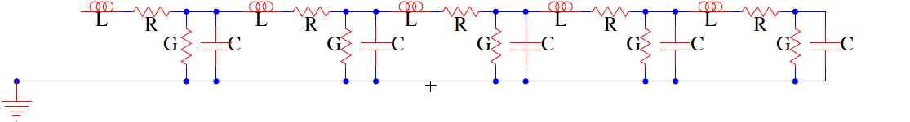
Wires
In general, our “wires” have distributed R, L, C components

Slide 13
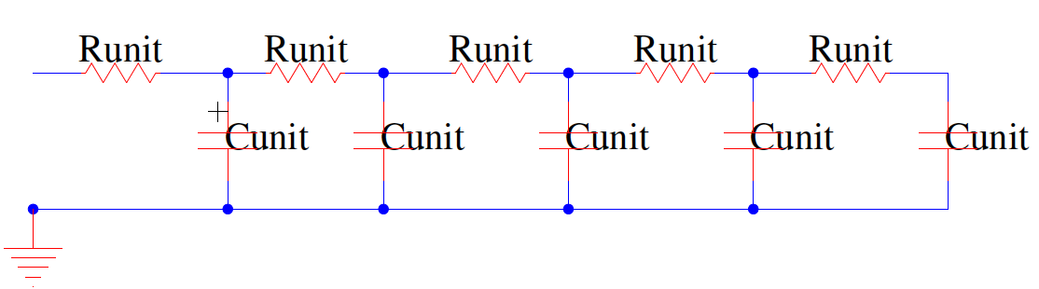
RC Wire (Preclass 1)
When R dominates L
  We have the distributed RC Wires
  Typical of on-chip wires in ICs
  What is RC response to step?

Slide 14
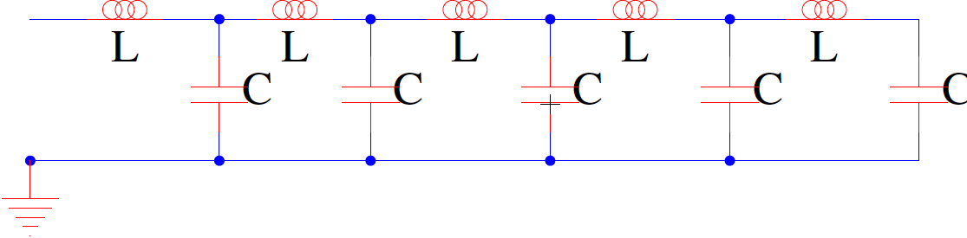
Transmission Line
When resistance is negligible
  Have LC wire = Lossless Transmission Line
    No energy dissipation (loss) through R’s
  More typical of printed circuit board (PCB) wires and bond wires

Slide 15
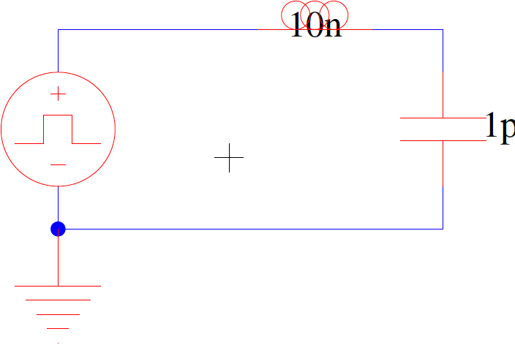
Build Intuition from LC (Preclass 2)
What did one LC do?
What will chain do?

Slide 16
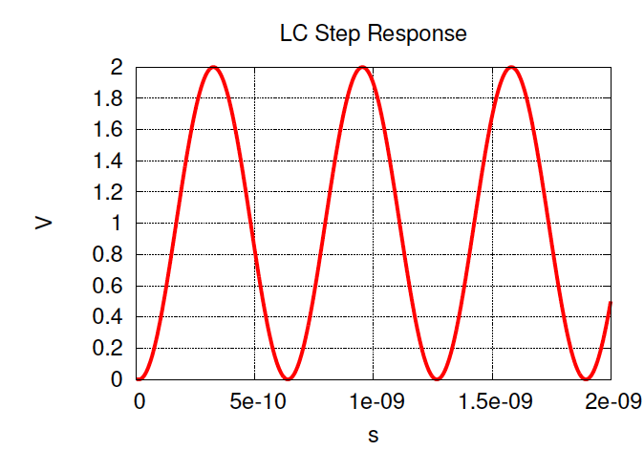
Build Intuition from LC (Preclass 2)
What did one LC do?
What will chain do?

Slide 17
Intuitive: Lossless
Pulses travel as waves without distortion
  (up to a characteristic frequency)

Slide 18
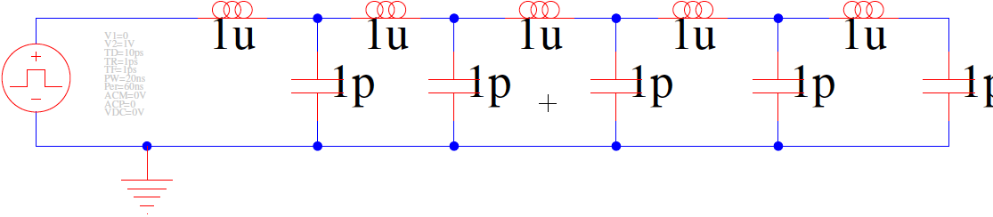
SPICE Simulation

Slide 19
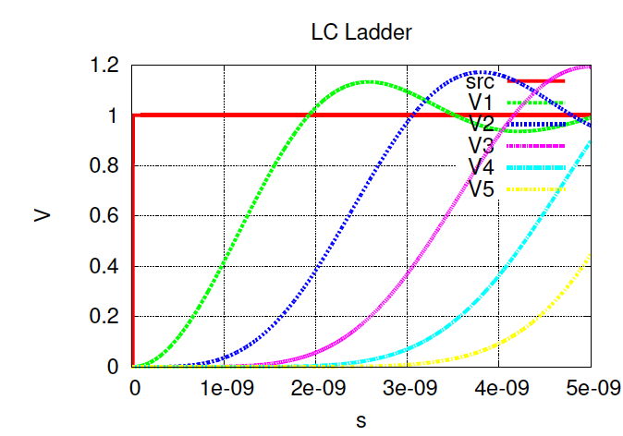
Step Response SPICE

Slide 20
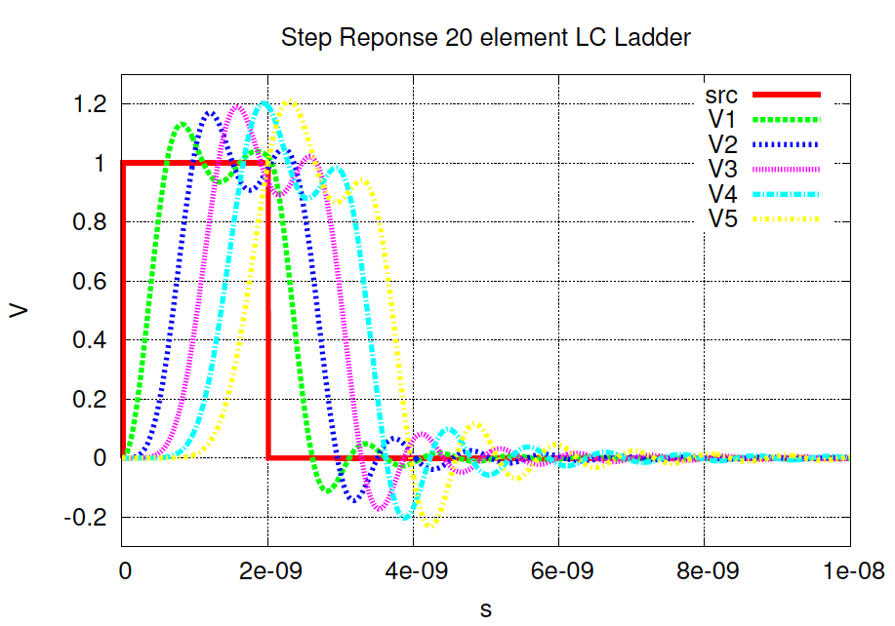
Pulse Response SPICE

Slide 21
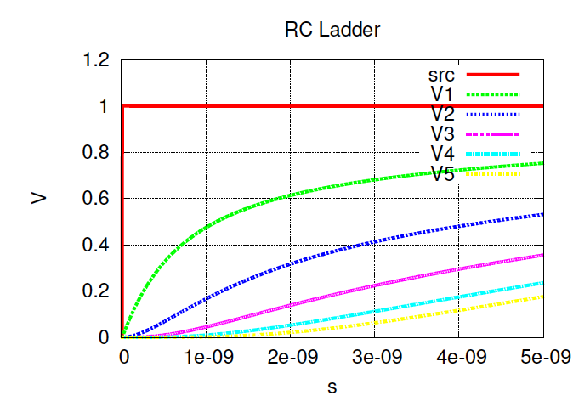
Contrast RC Wire

Slide 22
Contrast

Slide 23
Model
Now voltage is a function of time and position
  Position along wire – distance from source
Want to get V(x,t)
  And I(x,t)

Slide 24
Setup Relations (Preclass 4)
i is a node, x is the distance from source, Δx is distance between nodes
Position along wire: x=i ×Δx
So V_{i}(t) = V(x=iΔx, t)
I_{i}
I_{i+1}
V_{i-1}
V_{i}
V_{i+1}
I_{ci}

Slide 25
Setup Relations (Preclass 4)
a) KCL @ V_{i}: I_{i}-I_{i+1}=
b) I_{ci}=
d) V_{i}-V_{i-1} =
I_{i}
I_{i+1}
V_{i-1}
V_{i}
V_{i+1}
I_{ci}

Slide 26
Setup Relations (Preclass 4)
a) KCL @ V_{i}: I_{i}-I_{i+1}=
b) I_{ci}=
d) V_{i}-V_{i-1} =
i is a node, but has spatial dimension along the Tline
  No longer agnostic of wire length
V_{i} changes at different positions
I_{i}
I_{i+1}
V_{i-1}
V_{i}
V_{i+1}
I_{ci}

Slide 27
Setup Relations (Preclass 4)
a) KCL @ V_{i}: I_{i}-I_{i+1}=
b) I_{ci}=
d) V_{i}-V_{i-1} =
i is a node, but has spatial dimension along the Tline
  No longer agnostic of wire length
V_{i} changes at different positions
I_{i}
I_{i+1}
V_{i-1}
V_{i}
V_{i+1}
I_{ci}

Slide 28
Reduce to Single Equation
Eliminate I? Differential equation in voltage only.
Take derivative with respect to time

Slide 29
Reduce to Single Equation
Eliminate Is ?

Slide 30
Reduce to Single Equation
Eliminate Is ?

Slide 31
Reduce to Single Equation
Eliminate Is ?

Slide 32
Implication
  Wave equation:
  Solution:
  What is w?

Slide 33
Implication
  Wave equation:
  Solution:
  What is w?
w is the rate of propagation

Slide 34
Propagation Rate in Example
L=1uH
C=1pF
What is w?

Slide 35
Signal Propagation

Slide 36
Signal Propagation
  Delay linear in length

Slide 37
Contrast RC Wire
    RC wire delay quadratic in length

Slide 38
Propagation
  Solution:
  Rate of propagation, w:
  Previously:

Slide 39
Propagation
  Solution:
  Rate of propagation, w:
  Previously:

Slide 40
Longer LC (open)
40 Stages
L=100nH
C=1pF
Stage delay? How long to propagate?

Slide 41
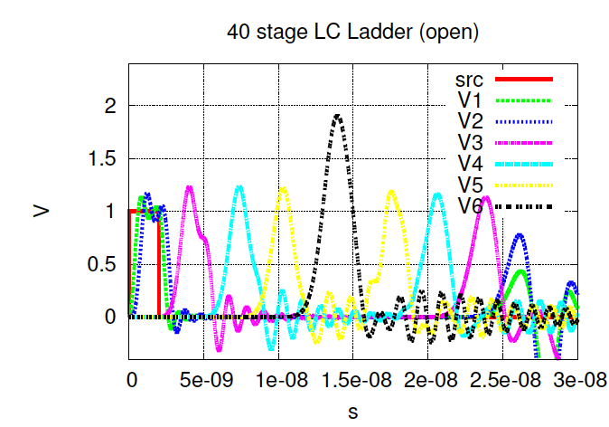
Reflection Teaser: Pulse Travel RC
V1,V3,V4,V5,V6 about 10 stages apart

Slide 42
Wire “Resistance”
  What is the resistance at V_{i} ?
    Q needed to charge C to V_{i}?
    I_{i} given velocity w?
    R = V_{i}/I_{i}?
I_{i}
I_{i+1}
V_{i-1}
V_{i}
V_{i+1}
I_{ci}

Slide 43
Wire “Resistance”
  Q=CV_{i}
  I_{i} = dQ/dt
  Moving at rate w
  I_{i}=wCV_{i}
  R=V_{i}/I_{i}=1/(wC)
I_{i}
I_{i+1}
V_{i-1}
V_{i}
V_{i+1}
I_{ci}

Slide 44
Characteristic Impedance
Z₀ = R
I_{i}
I_{i+1}
V_{i-1}
V_{i}
V_{i+1}
I_{ci}

Slide 45
Impedance
Assuming infinitely long wire, how does the impedance look at V_{i}, V_{i+1}, V_{i+2} ?
I_{i}
I_{i+1}
V_{i-1}
V_{i}
V_{i+1}
I_{ci}

Slide 46
Impedance
Assuming infinitely long wire, how does the impedance look at V_{i}, V_{i+1}, V_{i+2} ?
I_{i}
I_{i+1}
V_{i-1}
V_{i}
V_{i+1}
I_{ci}

Slide 47
Impedance
Transmission lines have a characteristic impedance

Slide 48
Infinite Lossless Transmission Line
Transmission line looks like
resistive load
Input waveform travels down line at velocity
  Without distortion
Z₀

Slide 49
Idea
Signal propagates as wave down transmission line
  Delay linear in wire length, if resistance negligible
  Rate of propagation
  Characteristic impedance

Slide 50
Admin
Project 2 due Friday 12/3
HW 7 out on Friday
  Due 12/10

