Slide 1
ESE370: Circuit-Level Modeling, Design, and Optimization for Digital Systems
Lec 33: December 3, 2021
Transmission Lines Termination

Slide 2
Transmission Line Agenda
See in action in lab
Where transmission lines arise?
General wire formulation
Lossless Transmission Line
Impedance
End of Transmission Line?
Open, short, matched
Termination
Discuss Lossy
Implications

Slide 3
Reminder: Propagation
Signal propagates as wave down transmission line
Delay linear in wire length, if resistance negligible
Solution:
Rate of propagation (characteristic frequency), w:

Slide 4
Infinite Lossless Transmission Line
Transmission line looks like resistive load
Input waveform travels down line at velocity
Without distortion
Z₀

Slide 5
End of Line
What happens at the end of the transmission line?
Short Circuit
Terminate with R=Z₀
Open Circuit
What did the reflections look like in each case in lab?

Slide 6
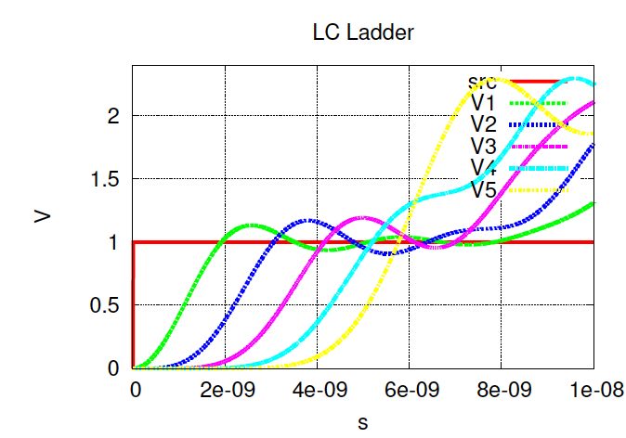
Open

Slide 7
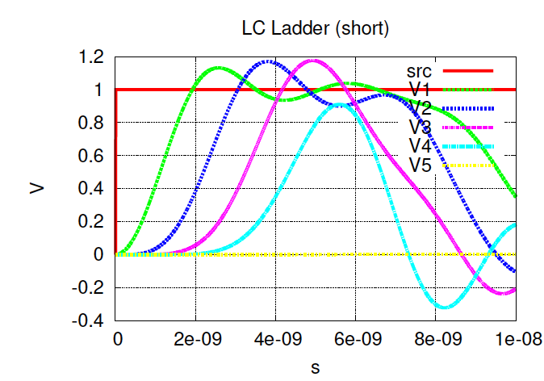
Short

Slide 8
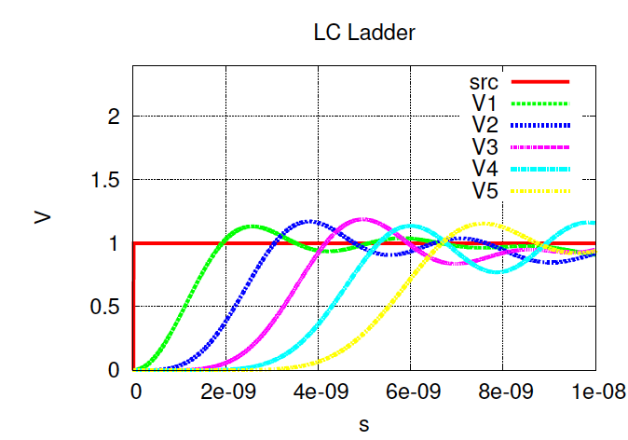
Terminate R=Z₀

Slide 9
Longer LC (open)
40 Stages
L=100nH
C=1pF
Drive with 2ns Pulse
No termination (open circuit)
What reflection do we expect?
Stage delay? How long to propogate?

Slide 10
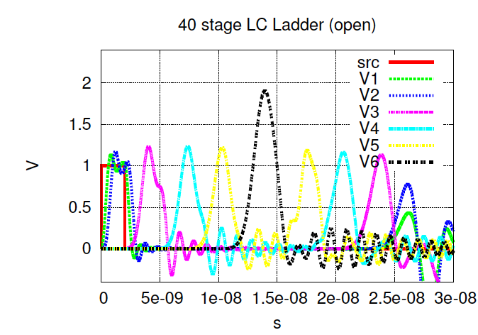
Pulse Travel RC
V1,V3,V4,V5,V6 about 10 stages apart

Slide 11
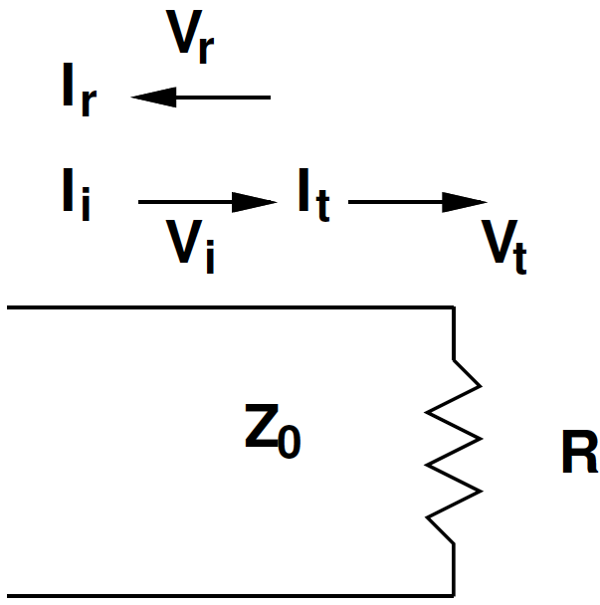
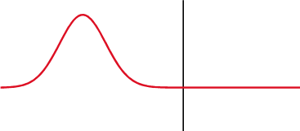
Analyze End of Line
Incident Wave, Reflected Wave, Transverse Wave
Source: https://en.wikipedia.org/wiki/Reflection_coefficient

Slide 12
Analyze End of Line
Incident wave V_{i}=I_{i}×Z₀
@ T-δ V_{i} is voltage on line
V_{t} is what goes forward
Voltage seen by end of line at T
V_{r} is the reflected voltage that starts moving back towards source at T+δ

Slide 13
Analyze End of Line (Preclass 1)
Incident wave V_{i}=I_{i}×Z₀
KCL @ end of line
KVL @ end of line
V=IR relationships?
Which resistances go with each V?
Relate all three V’s using R, Z₀

Slide 14
Analyze End of Line (Preclass 1a)
Incident wave V_{i}=I_{i}×Z₀
KCL @ end of line
KCL: I_{i}=I_{r}+I_{t}

Slide 15
Analyze End of Line (Preclass 1a)
Incident wave V_{i}=I_{i}×Z₀
KCL: I_{i}=I_{r}+I_{t}
KVL @ end of line
KVL: V_{i}+V_{r}=V_{t}

Slide 16
Analyze End of Line (Preclass 1b)
Incident wave V_{i}=I_{i}×Z₀
KCL: I_{i}=I_{r}+I_{t}
KVL: V_{i}+V_{r}=V_{t}
V=IR relationships?
Which resistances go with each V?
V_{r}=I_{r}×Z₀ → I_{r}=V_{r}/Z₀
V_{t}=I_{t}×R → I_{t}=V_{t}/R
V_{i}=I_{i}×Z₀ → I_{i}=V_{i}/Z₀

Slide 17
Analyze End of Line
Incident wave V_{i}=I_{i}×Z₀
KCL: I_{i}=I_{r}+I_{t}
KVL: V_{i}+V_{r}=V_{t}
V_{r}=I_{r}×Z₀ → I_{r}=V_{r}/Z₀
V_{t}=I_{t}×R → I_{t}=V_{t}/R
V_{i}=I_{i}×Z₀ → I_{i}=V_{i}/Z₀

Slide 18
Analyze End of Line (Preclass 1c)
V_{i}+V_{r}=V_{t}
Eliminate V_{t}

Slide 19
Analyze End of Line (Preclass 1c)
V_{i}+V_{r}=V_{t}
Eliminate V_{t}
Reflection coefficient

Slide 20
Analyze End of Line
V_{i}+V_{r}=V_{t}

Slide 21
Reflection
Sanity check with previous
Short
Matched
Open

Slide 22
Pulse Travel RC
V1,V3,V4,V5,V6 about 10 stages apart

Slide 23
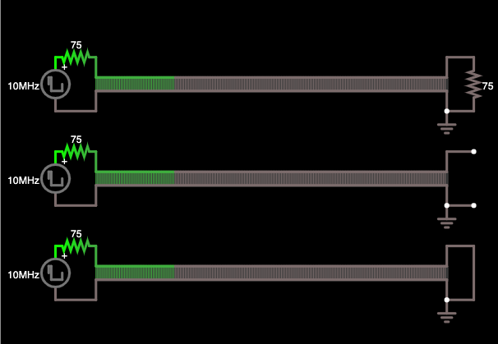
Visualization
https://tinyurl.com/y2jortrq

Slide 25
Back to Source

Slide 26
Back at Source? (Preclass 2)
What happens at source?
Depends on how it’s terminated
Looks like a sink end now

Slide 27
R≠Z₀
What happens?
75 Ω termination on 50 Ω line

Slide 28
Transmission Line Symbol
Specify delay of full Tline and characteristic impedance
Need reference

Slide 29
Simulation (Preclass 3)
For these, with direct drive from voltage source
Source looks like short circuit (not typical of CMOS)
Source cannot be changed

Slide 30
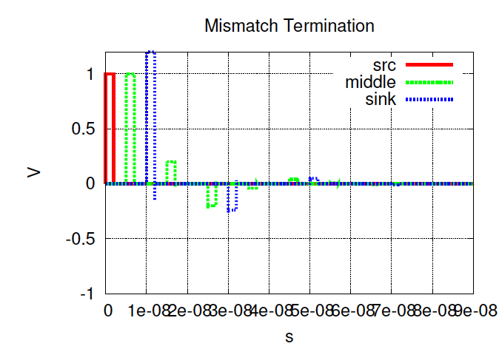
50Ω line, 75Ω termination

Slide 31
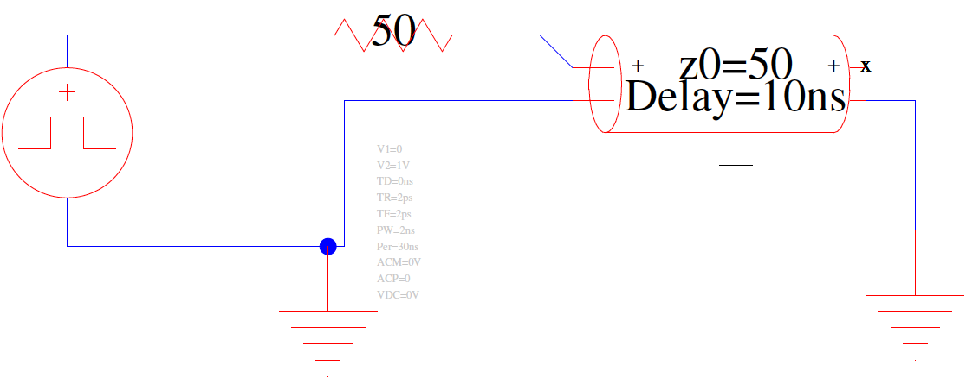
Source Series Termination
What happens here?

Slide 32
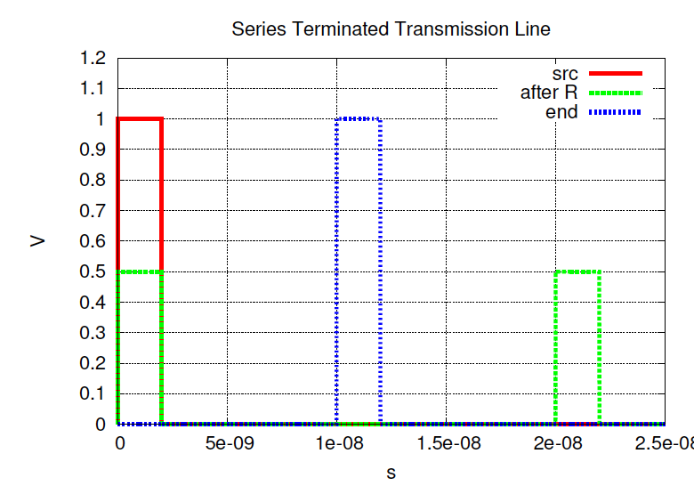
Simulation

Slide 33
Series Termination
R_{series} = Z₀
Initial voltage divider
Half voltage pulse propogates down Tline
End of line open circuit
Sees single transition to full voltage (full reflection)
Reflection returns to source and sees termination R_{series} = Z₀
No further reflections

Slide 34
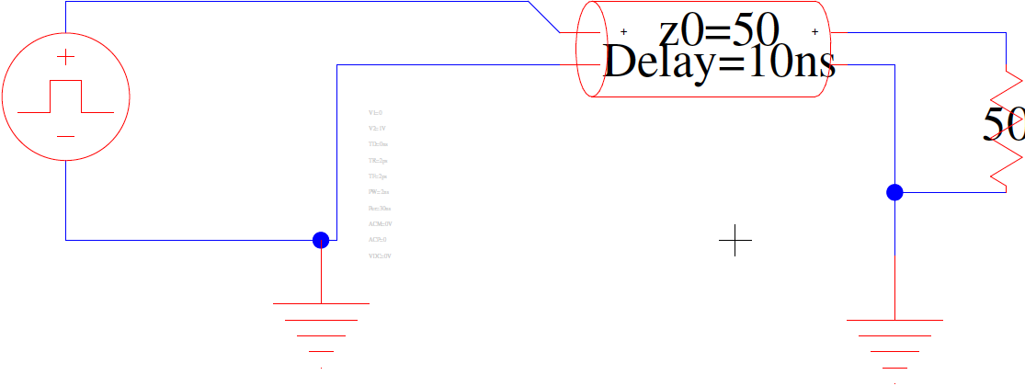
Termination Cases
Termination in parallel at Sink
Termination in series at Source

Slide 35
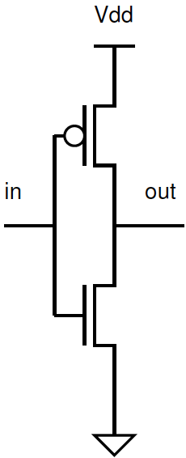
CMOS Driver / Receiver
Driver: What does a CMOS driver look like at the source?
I_{d,sat}=1200μA/μm @ 45nm, V_{dd}=1V
Receiver: What does a CMOS inverter look like at the sink?

Slide 36
CMOS Driver
Driver: What does a CMOS driver look like at the source?
I_{d,sat}=1200μA/μm @ 45nm, V_{dd}=1V
Min size:
I_{drive}=1200μA/μm*45nm=54μA
R_{out}=V_{dd}/I_{drive}=18kΩ

Slide 37
CMOS Driver
Driver: What does a CMOS driver look like at the source?
I_{d,sat}=1200μA/μm @ 45nm, V_{dd}=1V
Min size:
I_{drive}=1200μA/μm*45nm=54μA
R_{out}=V_{dd}/I_{drive}=18kΩ
W=370
I_{drive}=1200μA/μm*45nm*370=20mA
R_{out}=V_{dd}/I_{drive}=50Ω

Slide 38
Idea
Signal propagates as wave down transmission line
Delay linear in wire length
Speed
Impedance
Behavior at end of line depends on termination
Both src and sink are “ends” with reflections

Slide 39
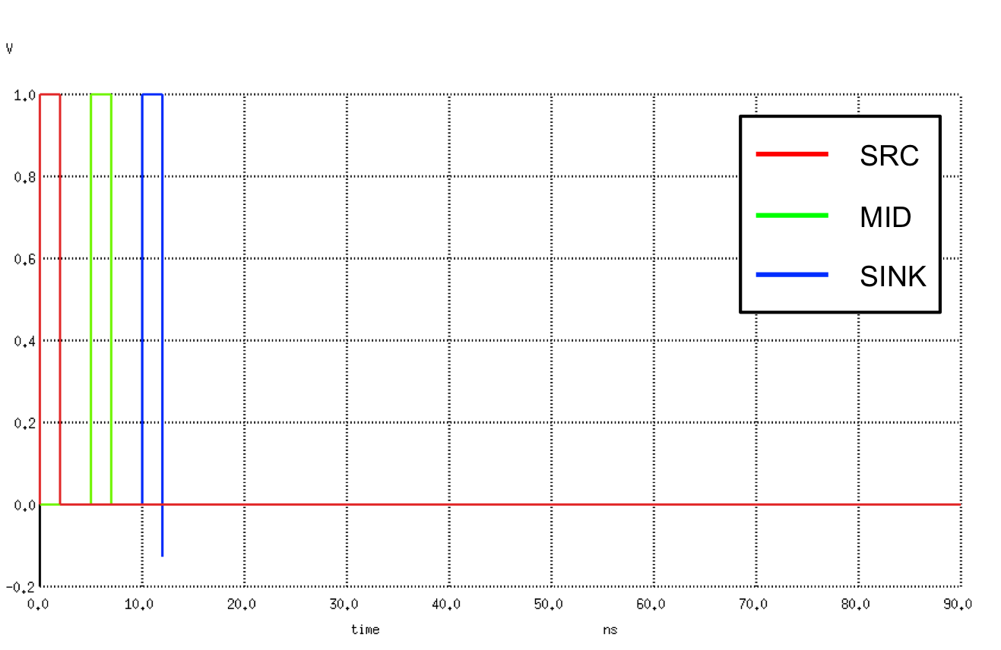
Tline Examples (Preclass 4)
Will start with these next lecture

Slide 40
Admin
Proj 2
EXTENDED: due Sunday 12/5 @ midnight
No late days allowed
HW 7
Due Friday 12/10
Out now

