Slide 1

ESE370: Circuit-Level Modeling, Design, and Optimization for Digital Systems
Lec 34: December 6, 2021
Transmission Lines
Implications

Slide 2
Transmission Line Agenda
See in action in lab
Where transmission lines arise?
General wire formulation
Lossless Transmission Line
Impedance
End of Transmission Line?
  Open, short, matched
Physical Geometry
Discuss Lossy
Implications/Effects

Slide 3
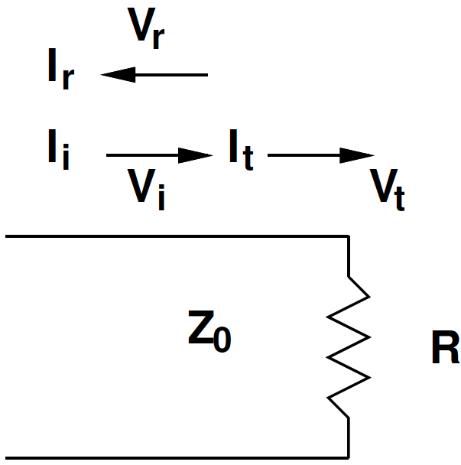
Reminder: Transmission Line
Data travels as waves
Line has Impedance
May reflect at end of line

Slide 4
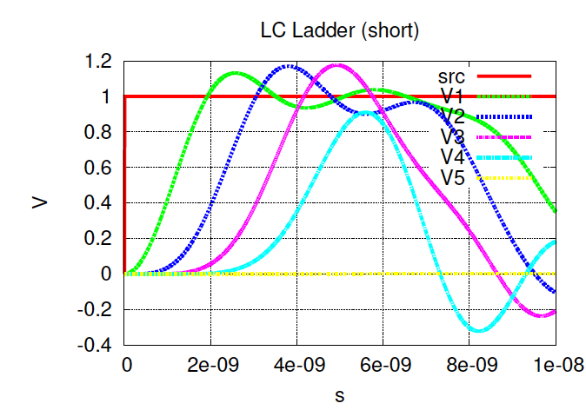
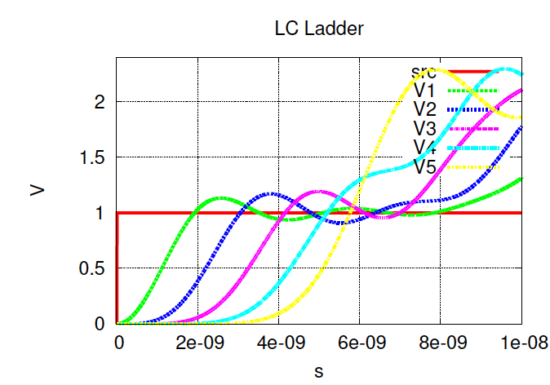
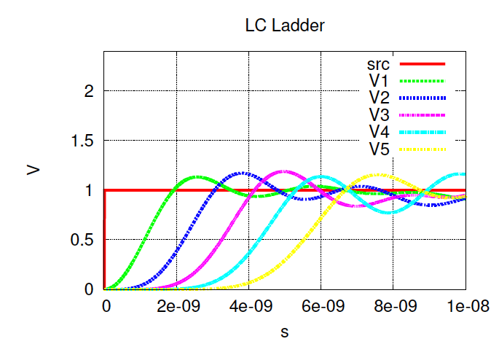
Reminder: End of Line
What happens at the end of the transmission line?

Slide 5
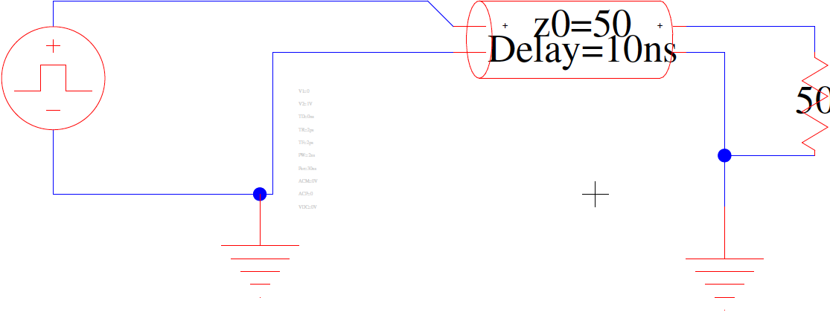
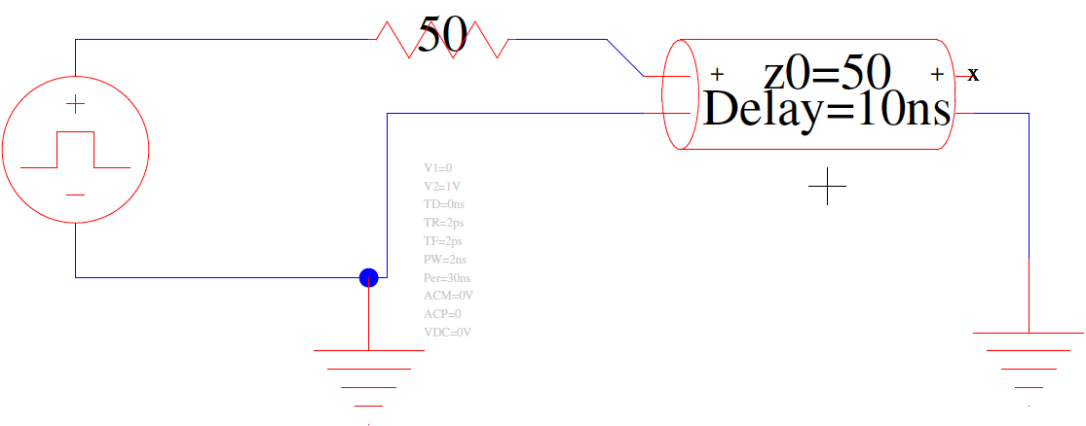
Termination Cases
Termination in parallel at Sink
Termination in series at Source

Slide 6
Transmission Lines Specifics
Characteristics arise form their geometry

Slide 7
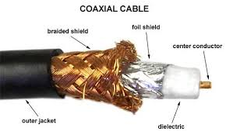
Coaxial Cable
Inner core conductor: radius r
Insulator: out to radius R
Outer core shield (ground)
RG-58 Z₀= 50Ω – networking
RG-59 Z₀= 75Ω – video
HDMI Z₀= 100Ω – video

Slide 8
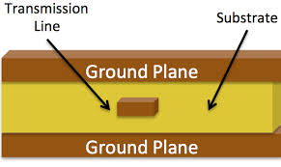
Printed Circuit Board
Stripline
  Trace between ground planes
w
t
b
ε_{r}

Slide 9
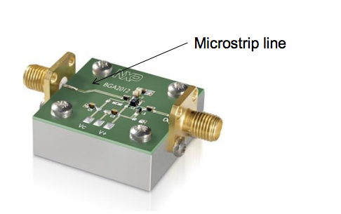
Printed Circuit Board
Microstrip line
  Trace over single supply plane
w
ε₀
t
ε_{r}
h

Slide 10
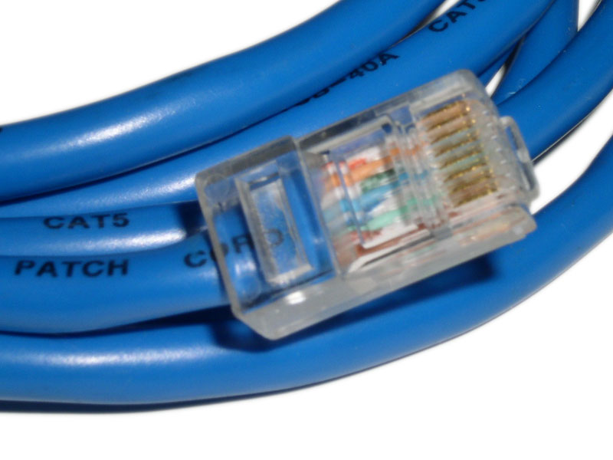
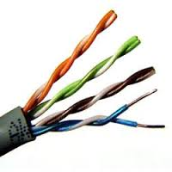
Twisted Pair
Category 5 ethernet cable
  Z₀=100Ω
  w=0.64c₀

Slide 11
Implications
(you should be able to reason about this)

Slide 12
Example (Preclass 2)
25 meter category-5e cable (Z₀=100Ω, w=0.64c)
  c = 3x10⁸ m/s
Supporting 1Gb/s ethernet
  4 pairs at 250Mb/s
a) Time to send data from one end to the other?
b) Time between bits at 250Mb/s?
c) Bits on each pair in the cable?

Slide 13
Pipeline Bits
For properly terminated transmission line
  Do not need to wait for bits to arrive at sink
  Can stick new bits onto wire

Slide 14
Limits to Bit Pipelining (Preclass 3)
What limits? (why only 250Mb/s)

Slide 15
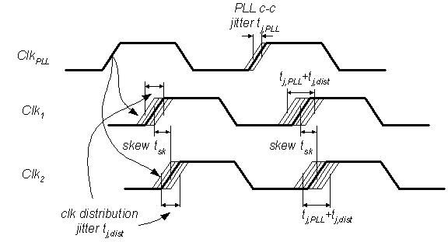
Limits to Bit Pipelining (Preclass 3)
What limits? (why only 250Mb/s)
  Risetime/signal distortion
  Clocking
    Skew
    Jitter
  For bus
    Wire length differences between lines

Slide 16
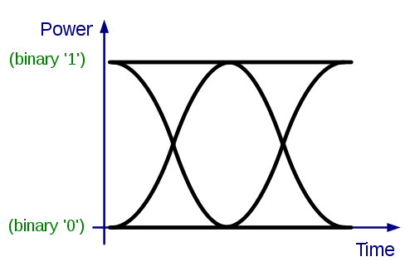
Eye Diagrams
Watch bits over line on scope
  Look at distortion
  “open” eye clean place to sample
    Consistent timing of transitions
    Well defined high/low voltage levels

Slide 17
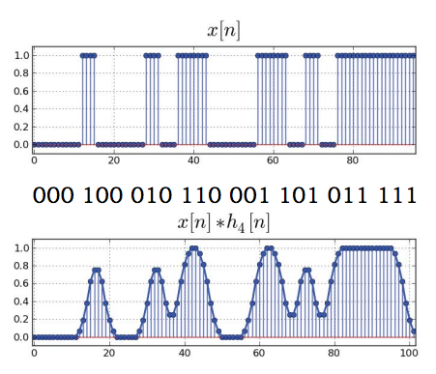
Construct Eye Diagram
Generate an input bit sequence pattern that contains all possible combinations of B bits (e.g., B=3 or 4), so a sequence of 2^{B*}B bits. (Otherwise, a random sequence of comparable length is fine.)
Transmit the corresponding discrete time sequence x[n] over the channel (2^{B*}B*N samples, if there are N samples/bit)
Instead of one long plot of y[n], plot the response as an eye diagram:
  a. break the plot up into short segments, each containing K*N samples, starting at sample 0, K*N, 2K*N, 3K*N, … (e.g., K=2 or 3 # bits at a time)
  b. plot all the short segments on top of each other

Slide 18
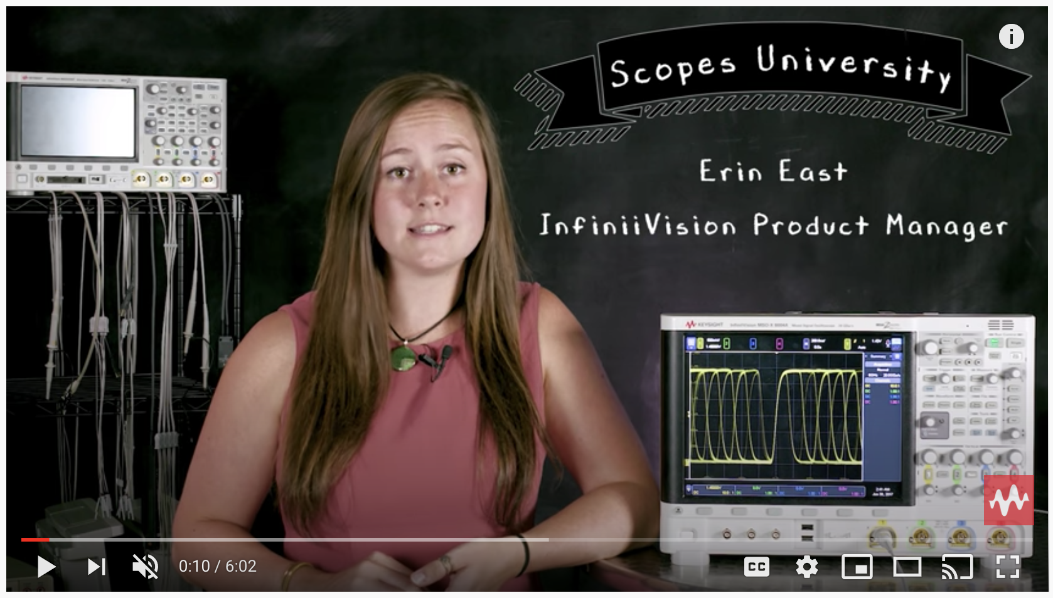
Eye Diagrams
Watch bits over line on scope
  Look at distortion
  “open” eye clean place to sample
    Consistent timing of transitions
    Well defined high/low voltage levels
https://www.youtube.com/watch?v=mnugUjaMN70

Slide 19
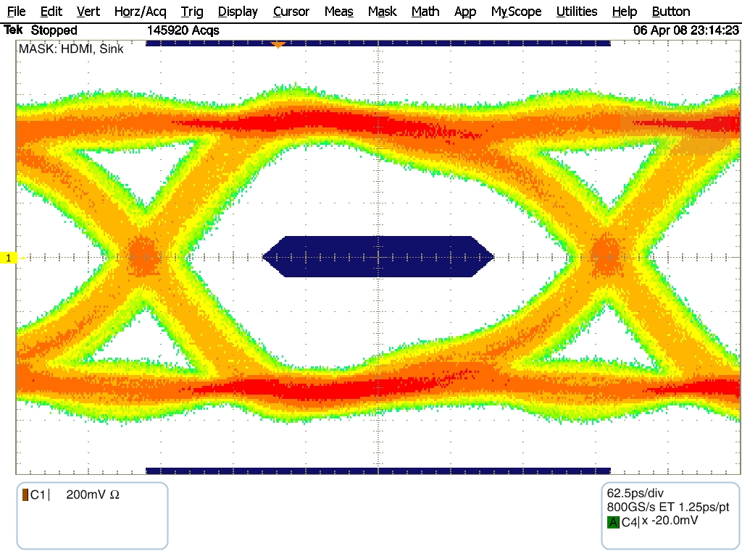
Eye Diagrams
Watch bits over line on scope
  Look at distortion
  “open” eye clean place to sample
    Consistent timing of transitions
    Well defined high/low voltage levels

Slide 20
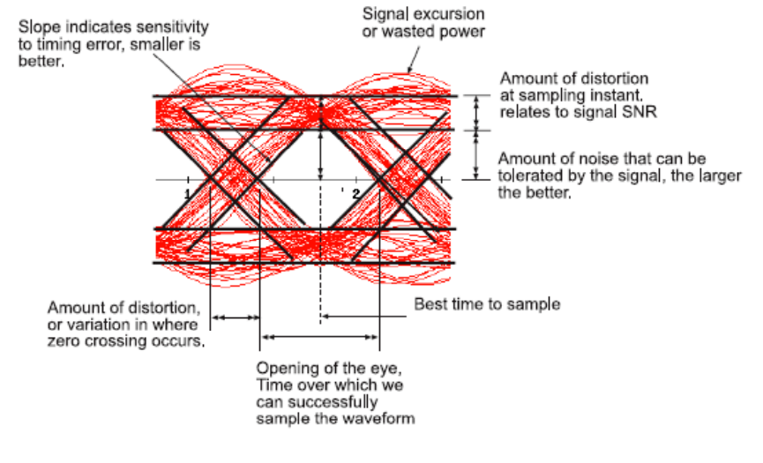
Interpretation of Eye Diagram

Slide 21
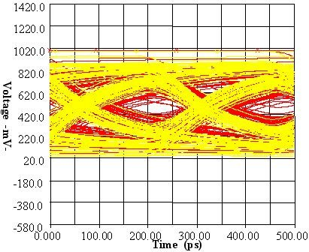
Bad “eye”

Slide 22
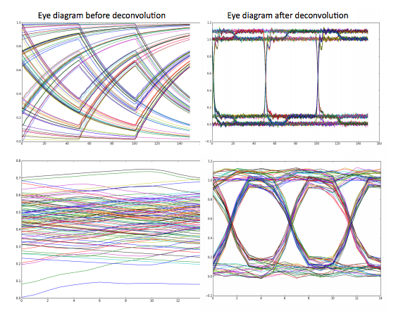
Receiver Deconvolution

Slide 23
Receiver Deconvolution

Slide 24
Termination / Mismatch
Wires do look like these transmission lines
We are terminating them in some way when we connect to chip (gate)
  Need to be deliberate about how terminate,
  if we care about high performance

Slide 25
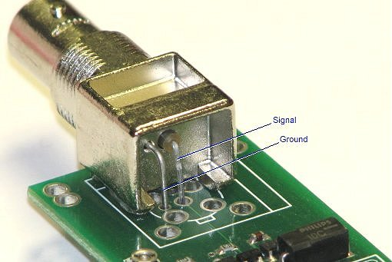
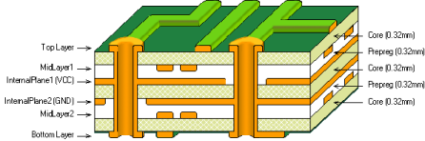
Where is Mismatch?
Vias
Wire corners
Branches
Connectors
Board-to-cable
Cable-to-cable

Slide 26
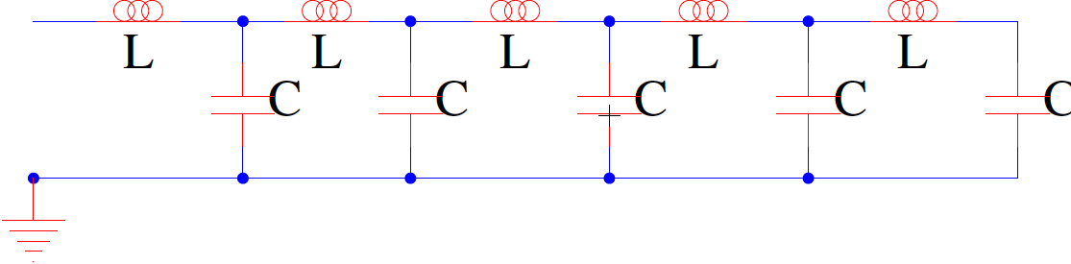
Lossless Transmission Line
What prevents us from having a 500km cat-5 cable?
Z₀

Slide 27
Lossless Transmission Line
How to measure resistance across a cable?
If resistance R across 100m cable,
what is resistance across 200m cable?
Z₀

Slide 28
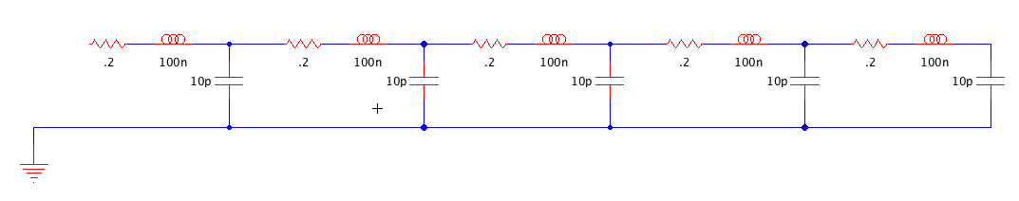
Lossy Transmission Line (Preclass 4)
How do addition of R’s change?
  Concretely, discretely think about
  R=0.2Ω every meter on Z₀=100Ω
    what does each R do? Voltage impact?

Slide 29
Lossy Transmission Line
Each R is a mismatched termination
Each R is a voltage divider

Slide 30
Lossy Transmission Line

Slide 31
Lossy Transmission Line (Preclass 4)
How long before drop voltage by half?
R=0.2Ω every meter on Z₀=100Ω

Slide 32
Lossless Transmission Line
What prevents us from having a 500km cat-5 cable?
  Not actually lossless!
Z₀

Slide 33
More Examples…
Time Permitting

Slide 34
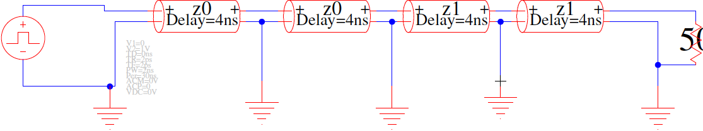
Impedance Change (Preclass 5)
What happens if there is an impedance change in the wire? Z₀=75Ω, Z₁=50Ω
  What reflections and transmission do we get?
75Ω
75Ω
50Ω
50Ω

Slide 35
Z₀=75, Z₁=50 (Preclass 5)
At junction:
  Reflects
    V_{r}=(50-75)/(50+75)V_{i}=-0.2V_{i}
  Transmits
    V_{t}=(100/(50+75))V_{i}=0.8V_{i}

Slide 36
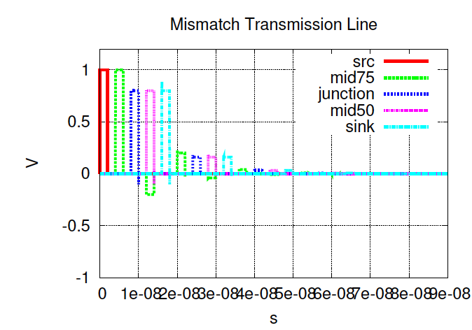
Impedance Change Z₀=75, Z₁=50 (Preclass 5)
At junction:
  Reflects
    V_{r} = -0.2V_{i}
  Transmits
    V_{t} = 0.8V_{i}

Slide 37
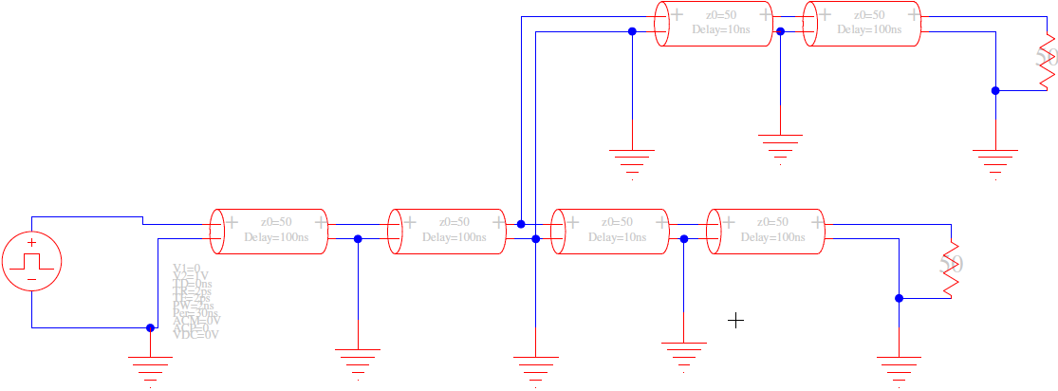
What happens at branch?
Assume all 50Ω
50Ω
50Ω

Slide 38
Branch
Transmission line sees two Z₀ in parallel
  Looks like Z₀/2

Slide 39
Z₀=50, Z₁=25
At junction:
  Reflects
    V_{r}=(25-50)/(25+50)V_{i}=-0.33V_{i}
  Transmits
    V_{t}=(50/(25+50))V_{i}=0.67V_{i}

Slide 40
End of Branch
What happens at end?
If ends in matched, parallel termination
  No further reflections

Slide 41
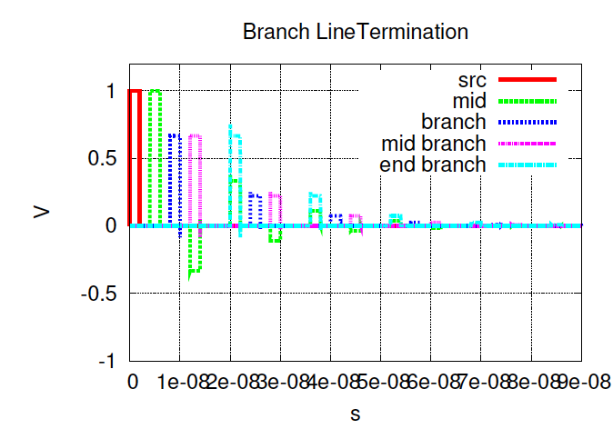
Branch Simulation
At junction:
  Reflects
    V_{r} = -0.33V_{i}
  Transmits
    V_{t} = 0.67V_{i}

Slide 42
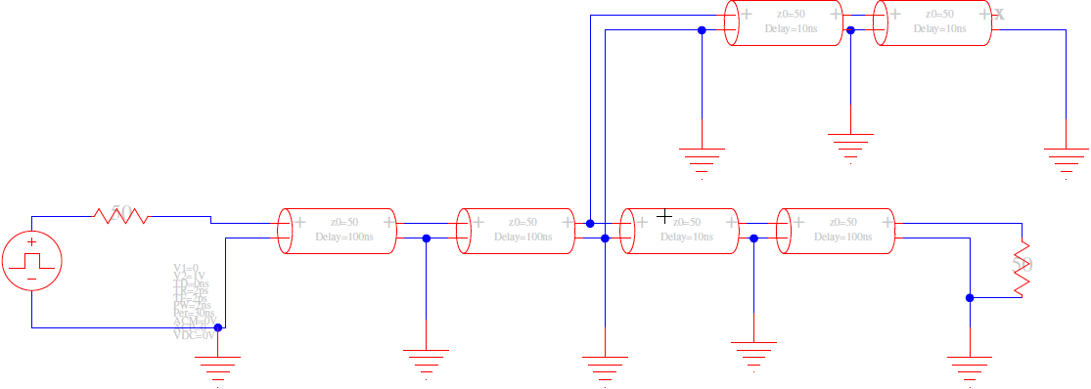
Branch with Open Circuit?
What happens if branch open circuit?
And source termination?

Slide 43
Branch with Open Circuit
Reflects at end of open-circuit stub
Reflection returns to branch
  …and encounters branch again
  Send transmission pulse to both
    Source and other branch
Sink sees original pulse as multiple smaller pulses spread out over time

Slide 44
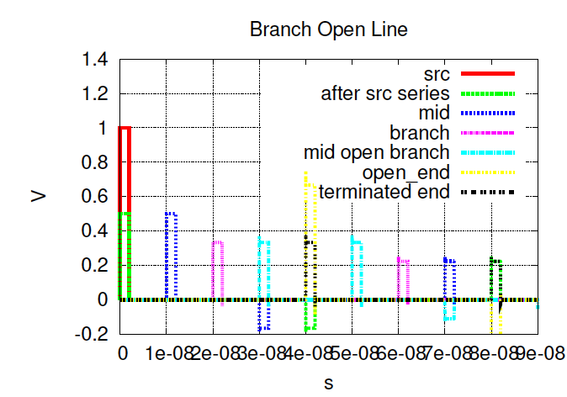
Open Branch Simulation

Slide 45
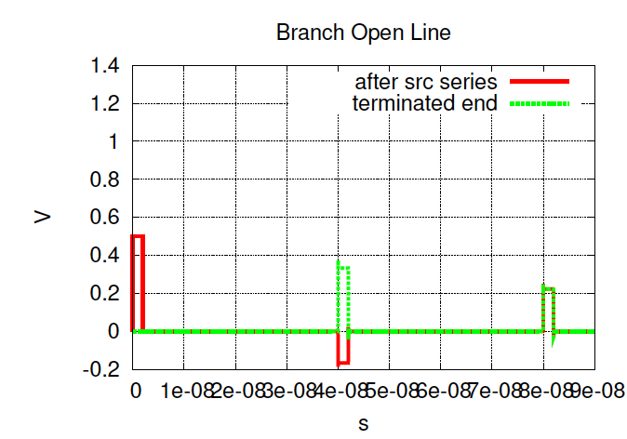
Open Branch Simulation

Slide 46
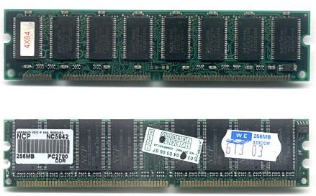
Bus
Common to have many modules on a bus
  E.g. PCI slots
  DIMM slots for memory
High speed → bus lines are trans. lines

Slide 47
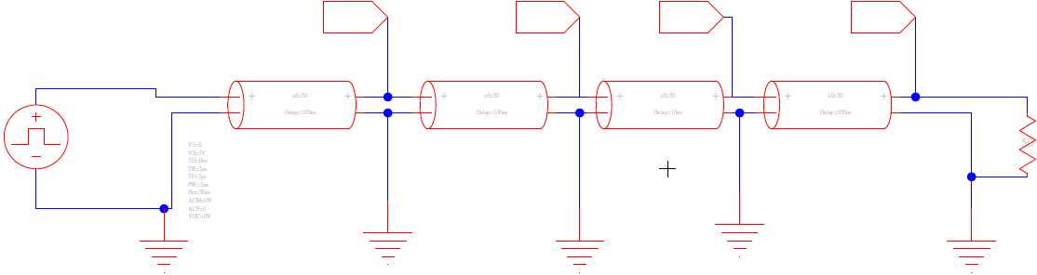
Multi-drop Bus
Ideal
  Open circuit, no load

Slide 48
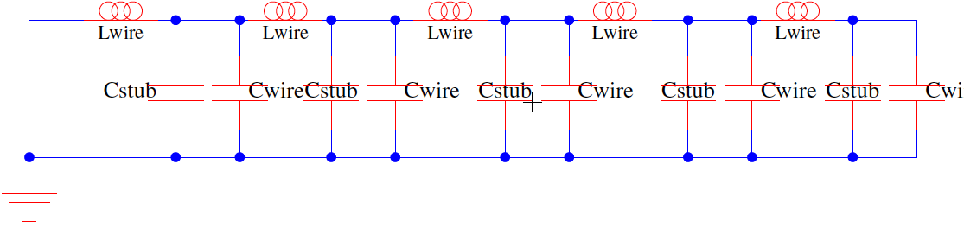
Multi-Drop Bus
Impact of capacitive load (stub) at drop?
  If tight/regular enough, change Z of line

Slide 49
Multi-Drop Bus
Long wire stub?
  Looks like branch
    may produce reflections

Slide 50
Transmission Line Noise
Frequency limits
Imperfect termination
Mismatched segments/junctions/vias/connectors
Loss due to resistance in line
  Limits length

Slide 51
Idea
Transmission lines
  high-speed
  high throughput
  long-distance signaling
Termination
Signal quality losses

Slide 52
Admin
Friday HW 7 due
Final (F 12/17)
  12-2pm in Moore 212
  Cumulative: Lec 1 – 35
    Big Idea slides from each lecture
  Finals 2010—2020 online
  Friday lecture review
  TA review session before exam
    TBD, watch Piazza. Maybe a poll.

