Slide 1

ESE370: Circuit-Level Modeling, Design, and Optimization for Digital Systems
Lec 4: September 13, 2021
Regenerative Property
Penn ESE370 Fall2021 – Khanna

Slide 2
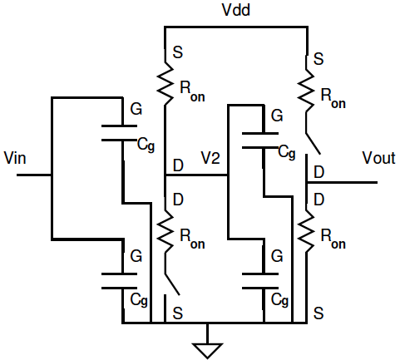
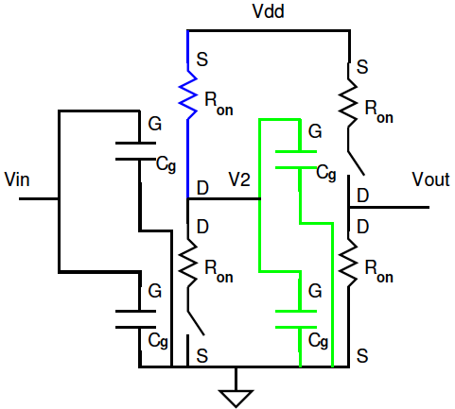
CMOS Buffer Gate - First Order
Stage 1 equivalent circuit for the gate output
Load on V₂
  Capacitive, input of stage 2
Penn ESE370 Fall2021 – Khanna

Slide 3
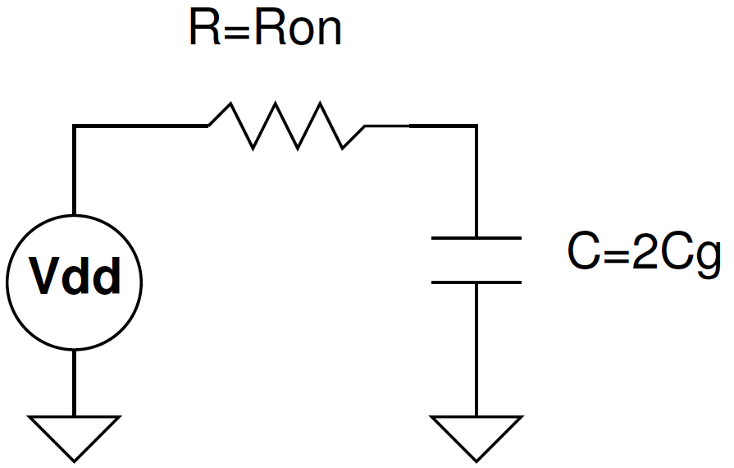
CMOS Buffer Gate - First Order
Stage 1 equivalent circuit for the gate output
Load on V₂
  Capacitive, input of stage 2
Penn ESE370 Fall2021 – Khanna

Slide 4
CMOS Buffer Gate - First Order
What is time constant of V₂ when V_{in} switches from V_{DD} to 0?
  τ= 2R_{on}C_{g}
Penn ESE370 Fall2021 – Khanna

Slide 5
First-Order Model
Includes settling times/delay
Voltage settling with capacitive loads
  At least some basis for reasoning about delay
Penn ESE370 Fall2021 – Khanna

Slide 6
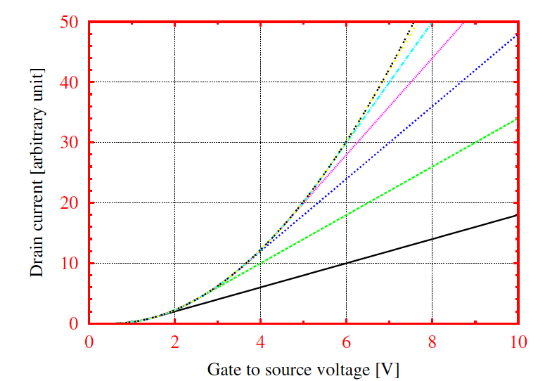
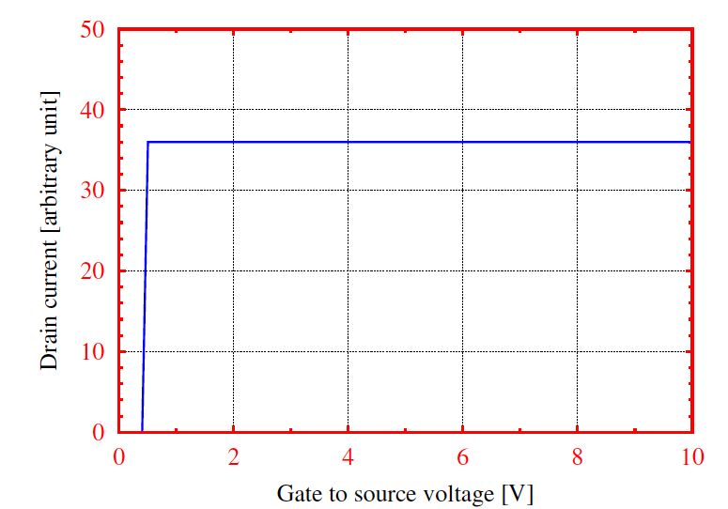
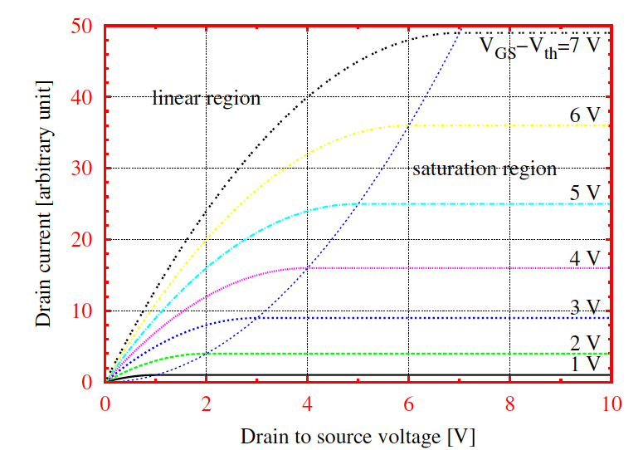
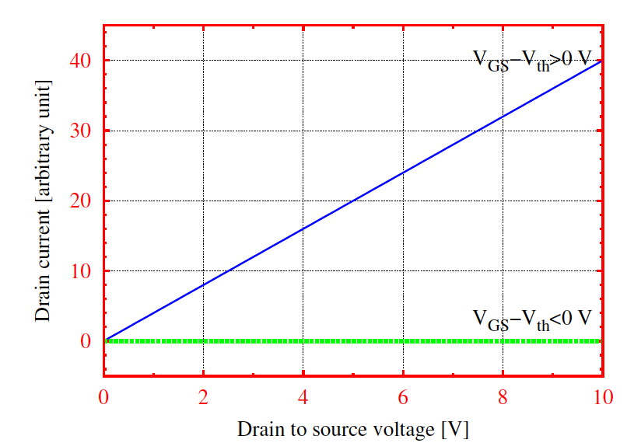
What is still missing?
IV curve
1st Order
Penn ESE370 Fall2021 – Khanna

Slide 7
What is still missing?
What happens at intermediate voltages?
  When the input is not rail-to-rail (not just gnd or V_{dd} inputs)
Details of dynamics, including…
  Input transition is not an ideal step
  Intermediate drive strengths change with V_{GS}
    Drain resistance changes
Sub-threshold operation
  When V_{gs}<V_{th}
Penn ESE370 Fall2021 – Khanna

Slide 8
Design: Engineering Control
V_{th}
  Process engineer
Drive strength (R_{on})
  Circuit engineer
  Control with sizing transistors
Supply voltages (V_{dd})
  Range set by process engineer
  Detail use by circuit engineer
Penn ESE370 Fall2021 – Khanna

Slide 9
Wire Resistance
B
4 m
A
0.2 mm
0.1 mm
Sanity check
  Wire twice as long = resistors in series
  Wire twice as wide = resistors in parallel
Penn ESE370 Fall2021 – Khanna

Slide 10
Wire Capacitance
B
4 m
A
0.1 mm
0.2 mm
0.1 mm
dielectric material
metal plate
Sanity check
  Wire twice as long = capacitors in parallel
  Wire twice as wide = capacitors in parallel
Penn ESE370 Fall2021 – Khanna

Slide 11
There are always Rs and Cs
Every wire (connection) has resistance
Every wire has capacitance
(Every wire has inductance)
  More later
Dominant effects
  R_{big} + R_{small} ≈ R_{big} (R_{wire} << R_{on})?
  C_{big} || C_{small} ≈ C_{big} (C_{wire}<<C_{g}) ?
    Today more likely (C_{wire}>>C_{g})
Penn ESE370 Fall2021 – Khanna

Slide 12
Today
We know how to make our logic functional, but how do we make sure logic is robust?
  To enable design cascading gates into any (feed forward) graph and still tolerate voltage drops and noise, while maintaining digital abstraction
Penn ESE370 Fall2021 – Khanna

Slide 13
Outline
Two signal problems → Gate Cascade failure
Regeneration Solution → Gate Abstraction
  Transfer Curves
  Noise Margins
  Non-linearity
Penn ESE370 Fall2021 – Khanna

Slide 14
Two Signal Problems
Output does not go to rail
  Stops short of V_{dd} or Gnd
Signals may be perturbed by noise
  V_{x} = V_{ideal} ± V_{noise}
Penn ESE370 Fall2021 – Khanna

Slide 15
Wire Resistance (Pg 2 preclass)
Resistance of 100 μm long wire?
B
ρ = 10⁻⁷Ohm•m
100um
1um
A
1um
Penn ESE370 Fall2021 – Khanna

Slide 16
Wire Resistance
100 μm long wire?
B
100um
1um
A
1um
Penn ESE370 Fall2021 – Khanna

Slide 17
Wire Resistance
1 mm long wire?
1 cm long wire?
Length of integrated circuit chip side?
  (we often call an IC chip a “die”)
Penn ESE370 Fall2021 – Khanna

Slide 18
Die Sizes
Chip | #Trans. | Year | Maker | process | mm²
GK10 Kepler | 7B | 2012 | NVIDIA | 28nm | 561
22-core Xeon Broadwell-E5 | 7B | 2016 | Intel | 14nm | 456
GC2 IPU | 23.6B | 2018 | Graphcore | 16nm | 825
Apple A12X Bionic | 10B | 2018 | Apple | 7nm | 122
Tegra Xavier SoC | 9B | 2018 | Nvidia | 12nm | 350
Navi 10 | 10B | 2021 | AMD | 7nm | 251
source: http://en.wikipedia.org/wiki/Transistor_count
Penn ESE370 Fall2021 – Khanna

Slide 19
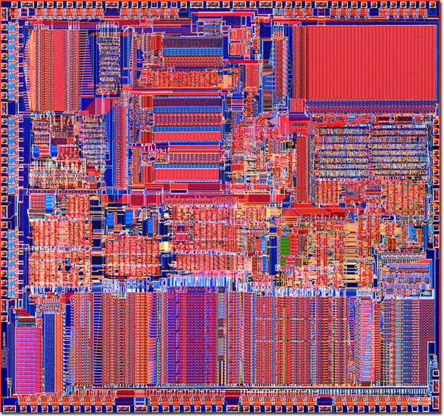
Implications
What does the circuit really look like for an inverter in the middle of the chip?
Penn ESE370 Fall2021 – Khanna

Slide 20
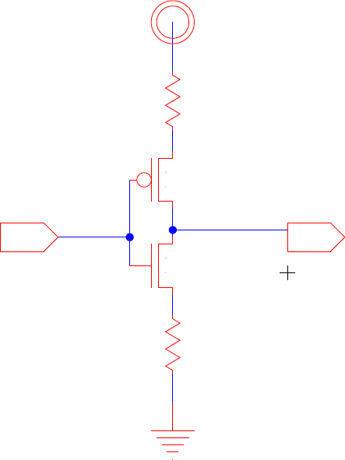
Implications
What does the circuit really look like for an inverter in the middle of the chip?
R_{wire}
R_{wire}
Penn ESE370 Fall2021 – Khanna

Slide 21
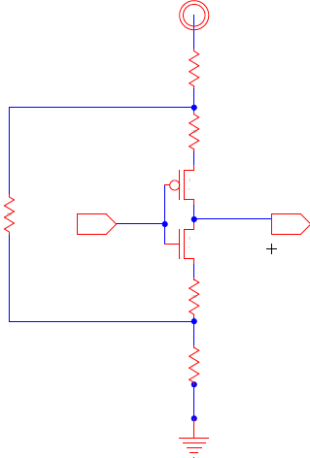
Implications
What does the circuit really look like for an inverter in the middle of the chip?
R_{wire}
R_{rest_of_chip}
R_{wire}
Penn ESE370 Fall2021 – Khanna

Slide 22
IR-Drop
Since interconnect is resistive and gates pull current off the supply interconnect
  The V_{dd} seen by a gate is lower than the supply Voltage by
    V_{drop}=I_{supply} x R_{distribute}
  Two gates in different locations
    See different R_{distribute}
    Therefore, see different V_{drop}
R_{rest_of_chip}
Penn ESE370 Fall2021 – Khanna

Slide 23
Output does not go to Rail
Due to V_{drop}, “rails” for two communicating gates may not match
R_{rest_of_chip}
Penn ESE370 Fall2021 – Khanna

Slide 24
Two Signal Problems
Output not go to rail
  Different swing for gates
Signals may be perturbed by noise
  Voltage seen at input to a gate may be lower/higher than input voltage
Penn ESE370 Fall2021 – Khanna

Slide 25
Noise Sources?
Signal coupling
  Crosstalk
Inductive noise
Leakage
Ionizing particles (shot noise)
Penn ESE370 Fall2021 – Khanna

Slide 26
Signals will be degraded
Output not go to rail
  Is this tolerable?
Signals may be perturbed by noise
  Voltage seen at input to a gate may be lower/higher than expected input voltage
What happens to degraded signals?
Penn ESE370 Fall2021 – Khanna

Slide 27
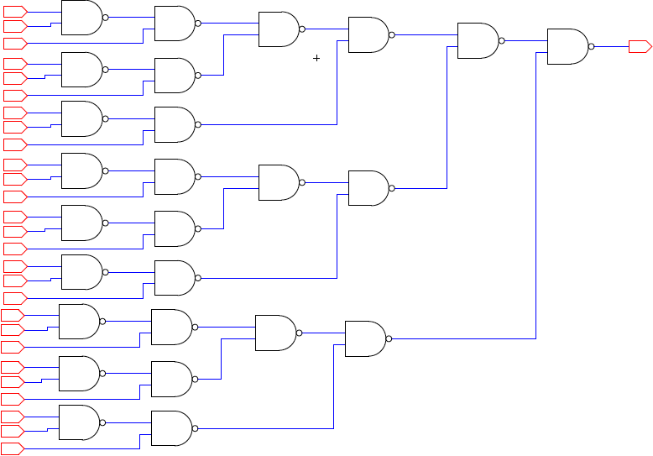
Preclass Pg 1
What is the output when all inputs are all 1s?
Penn ESE370 Fall2021 – Khanna

Slide 28
Preclass Pg 1
What is the output when all inputs are all 1s?

Slide 29
Preclass Pg 1
What is the output when all inputs are all 1.0 and NAND(A, B) = 1-A*B?
Penn ESE370 Fall2021 – Khanna

Slide 30
Preclass Pg 1
What is the output when all inputs are all 0.95 and NAND(A, B) = 1-A*B?
Penn ESE370 Fall2021 – Khanna

Slide 31
Degradation
Cannot have signal degrade across cascaded gates
Want to be able to cascade arbitrary set of gates
  No limit on number of gates to maintain signal integrity
Penn ESE370 Fall2021 – Khanna

Slide 32
Gate Creed
Gates should leave the signal “better” than they found it
  “better” → closer to the rails
Penn ESE370 Fall2021 – Khanna

Slide 33
Regeneration Discipline
Define legal inputs
  Gate works if V_{in} “close enough” to the rail
Penn ESE370 Fall2021 – Khanna

Slide 34
Regeneration Discipline
Define legal inputs
  Gate works if V_{in} “close enough” to the rail
Regeneration
  Gate produces V_{out} “closer to rail”
    This tolerates some drop between one gate and next (between out and in)
    Call this our “Noise Margin”
Regeneration/Restoration/Static Discipline
Penn ESE370 Fall2021 – Khanna

Slide 35
Noise Margin
V_{OH} – output high
V_{OL} – output low
V_{IH} – input high
V_{IL} – input low
NM_{H} = V_{OH}-V_{IH}
NM_{L} = V_{IL}-V_{OL}
“1”
V_{OH}
NM_{H}
V_{IH}
Undefined region
V_{IL}
NM_{L}
V_{OL}
“0”
Gate Output Stage M
Gate Input Stage M + 1
Penn ESE370 Fall2021 – Khanna

Slide 36
Regeneration Discipline (getting precise)
Define legal inputs
  Gate works if V_{in} “close enough” to the rail
  V_{in} > V_{IH} or V_{in} < V_{IL}
Regeneration
  Gate produces V_{out} “closer to rail”
    V_{out} < V_{OL} or V_{out} > V_{OH}
“1”
V_{OH}
NM_{H}
V_{IH}
Undefined region
V_{IL}
NM_{L}
V_{OL}
“0”
Gate Output Stage M
Gate Input Stage M + 1
Penn ESE370 Fall2021 – Khanna

Slide 37
Transfer Function
Describes what the output is given logic gate input
  V_{out}=f(V_{in})
Penn ESE370 Fall2021 – Khanna

Slide 38
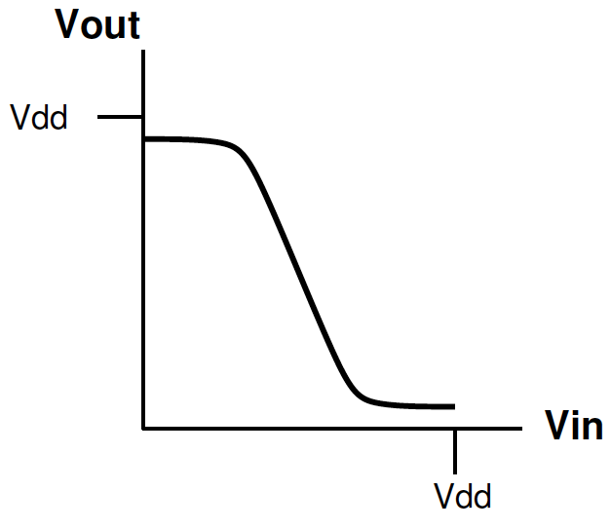
Transfer Function
What gate is this?
Penn ESE370 Fall2021 – Khanna

Slide 39
Transfer Function
What gate is this?
High gain region
Penn ESE370 Fall2021 – Khanna

Slide 40
Regenerating Transfer Function
Use gain (i.e. slope) to define noise margins
V_{OH}
V_{OL}
V_{IL}
V_{IH}
Penn ESE370 Fall2021 – Khanna

Slide 41
Regenerating Transfer Function
Use gain (i.e. slope) to define noise margins
≈V_{OH}
≈V_{OL}
V_{IL}
V_{IH}
Penn ESE370 Fall2020 – Khanna

Slide 42
Regenerating Transfer Function
Use gain (i.e. slope) to define noise margins
≈V_{OH}
NM_{H}
V_{IH}
V_{IL}
NM_{L}
≈V_{OL}
V_{IL}
V_{IH}
Penn ESE370 Fall2021 – Khanna

Slide 43
Decomposing
What is gain?
  |ΔVout/ΔVin|
V_{OH}
NM_{H}
V_{IH}
V_{IL}
NM_{L}
V_{OL}
V_{IL}
V_{IH}
Penn ESE370 Fall2021 – Khanna

Slide 44
Decomposing
What is gain?
  |ΔVout/ΔVin|
Where is there high gain?
  |ΔVout/ΔVin| > 1
V_{OH}
NM_{H}
V_{IH}
V_{IL}
NM_{L}
V_{OL}
V_{IL}
V_{IH}
Penn ESE370 Fall2021 – Khanna

Slide 45
Decomposing
What is gain?
  |ΔVout/ΔVin|
Where is there high gain?
  |ΔVout/ΔVin| > 1
Where is there
low gain?
  |ΔVout/ΔVin| < 1
V_{OH}
NM_{H}
V_{IH}
V_{IL}
NM_{L}
V_{OL}
V_{IL}
V_{IH}
Penn ESE370 Fall2021 – Khanna

Slide 46
Decomposing
What is gain?
  |ΔVout/ΔVin|
Where is there high gain?
  |ΔVout/ΔVin| > 1
Where is there
low gain?
  |ΔVout/ΔVin| < 1
Dividing point?
-1
V_{OH}
NM_{H}
V_{IH}
V_{IL}
NM_{L}
V_{OL}
-1
V_{IL}
V_{IH}
Penn ESE370 Fall2021 – Khanna

Slide 47
Decomposing
An input closer to rail than V_{IL}, V_{IH} doesn’t make much difference on V_{out}
  i.e transfer function is flat for input close to rails
Defining V_{IL} lower (or V_{IH} higher) would reduce NMs and increase our undefined region
-1
V_{OH}
NM_{H}
V_{IH}
V_{IL}
NM_{L}
V_{OL}
-1
V_{IL}
V_{IH}
Penn ESE370 Fall2021 – Khanna

Slide 48
Transfer Function for Multiple Inputs
?
Penn ESE370 Fall2021 – Khanna

Slide 49
Controlling Input
Consider a nand2 gate
  If want A to control the output
  What value should B be?
We call B the non-controlling input since it does not determine the output
Penn ESE370 Fall2021 – Khanna

Slide 50
Controlling Input
Consider a nand2 gate
  If want A to control the output
  What value should B be?
We call B the non-controlling input since it does not determine the output
A | B | NAND
0 | 0 | 1
0 | 1 | 1
1 | 0 | 1
1 | 1 | 0
Penn ESE370 Fall2021 – Khanna

Slide 51
Controlling Input
Consider a nand2 gate
  If want A to control the output
  What value should B be?
We call B the non-controlling input since it does not determine the output
What should the non-controlling input value be for a nor2 gate?
A | B | NOR
0 | 0 | 1
0 | 1 | 0
1 | 0 | 0
1 | 1 | 0
A | B | NAND
0 | 0 | 1
0 | 1 | 1
1 | 0 | 1
1 | 1 | 0
Penn ESE370 Fall2021 – Khanna

Slide 52
Controlling Input for Worst Case
Consider a nor2/nand2 gate
  If want A to control the output
  What value should B be?
Penn ESE370 Fall2021 – Khanna

Slide 53
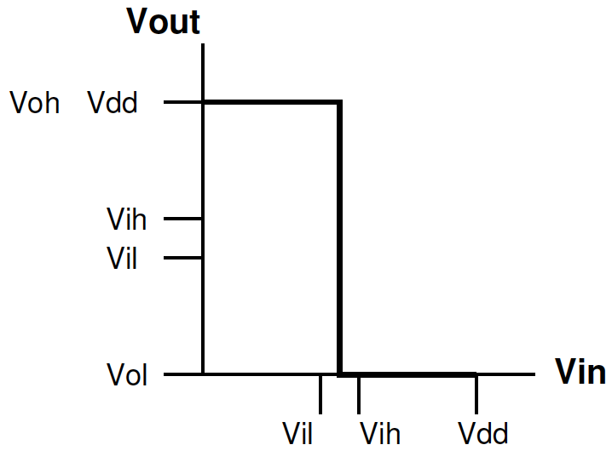
Ideal Transfer Function for Inverter
Penn ESE370 Fall2021 – Khanna

Slide 54
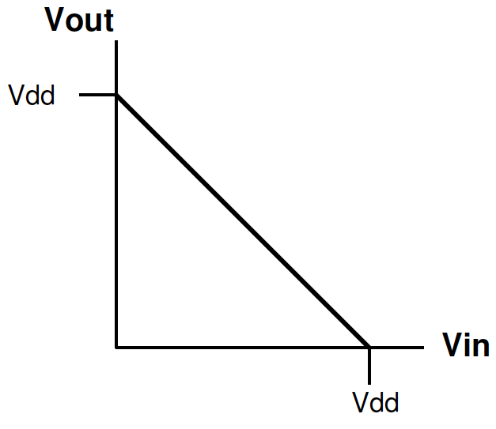
Linear Transfer Function?
V_{out}=V_{dd}-V_{in}
Noise Margin?
Penn ESE370 Fall2021 – Khanna

Slide 55
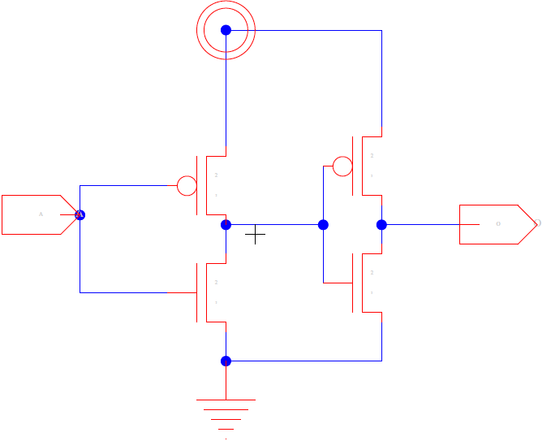
Linear Transfer Function?
Consider two in a row (buffer)
  V_{out1}=V_{dd}-V_{in1}
What is transfer function to buffer output V_{out2}?
  V_{out2}=V_{dd}-V_{out1} = V_{dd}-(V_{dd}-V_{in1})=V_{in1}
Penn ESE370 Fall2021 – Khanna

Slide 56
Linear Transfer Function?
For buffer: V_{out2}=V_{in1}
Consider a chain of buffers
What happens if V_{in1} drops Δ volts between each buffer?
  A_{i+1} = A_{i} - Δ
Conclude: Linear transfer functions
do not provide restoration.
Penn ESE370 Fall2021 – Khanna

Slide 57
Non-linearity
Need non-linearity in transfer function
Could not have built restoring gates with R, L, C circuit
  R, L, C are all linear elements
Penn ESE370 Fall2021 – Khanna

Slide 58
Transistor Non-Linearity
Penn ESE370 Fall2021 – Khanna

Slide 59
All Gates
If we hope to assemble design from collection of gates,
  Voltage levels must be consistent and supported across all gates
  Must adhere to a V_{IL}, V_{IH}, V_{OL}, V_{OH} that is valid across entire gate set of digital circuit
Penn ESE370 Fall2021 – Khanna

Slide 60
Big Idea
Need robust logic
  Can design into any (feed forward) graph with logic gates and tolerate loss and noise, while maintaining digital abstraction
Regeneration and noise margins
  Every gate makes signal “better”
  Design level of noise tolerance
V_{OH}
-1
V_{IH}
NM_{H}
V_{IL}
V_{OL}
NM_{L}
-1
V_{IL}
V_{IH}
Penn ESE370 Fall2021 – Khanna

Slide 61
Admin
HW 1 due Tuesday (tomorrow)
  Leave enough time to submit on Canvas
    If it records as after midnight will use up a late day
Homework 2 out now due Monday 9/20
  Will take time to install and learn ngspice
    START EARLY!!! For troubleshooting
    Use Piazza and office hours for technical difficulty questions
    Highly recommend you work in study groups/pairs for trouble shooting
  Tool guides/tutorials on course webpage for help
    https://www.seas.upenn.edu/~ese370/#tools
  Get your design workflow setup now
    EVERYONE will be required to verify this on HW 3
Penn ESE370 Fall2021 – Khanna

