Slide 1

ESE370: Circuit-Level Modeling, Design, and Optimization for Digital Systems
Lec 5: September 15, 2021
Delay and RC Response
Penn ESE370 Fall2021 – Khanna

Slide 2
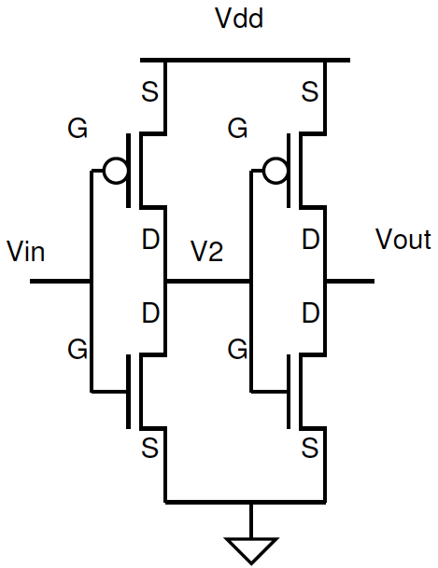
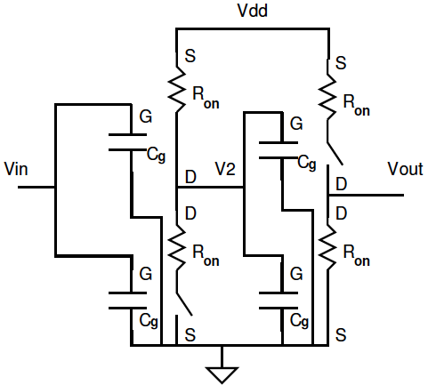
Delay is RC Charging
Penn ESE370 Fall2021 – Khanna

Slide 3
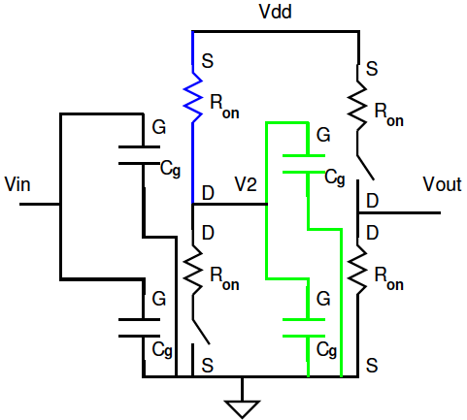
Gate Delay is RC Charging
Strategy:
Use zero-order model to understand switch state
Break into output/input stages
For each stage
  Understand R_{drive}
  Understand C_{load}
Penn ESE370 Fall2021 – Khanna

Slide 4
Today
RC Charging
  RC Step Response Curve
What is the C?
  Capacitive load on logic gate output node
What is the R?
  Equivalent output resistance on the current path driving the output node
Approximating and Measuring Delay
  Tau estimate!
Penn ESE370 Fall2021 – Khanna

Slide 5
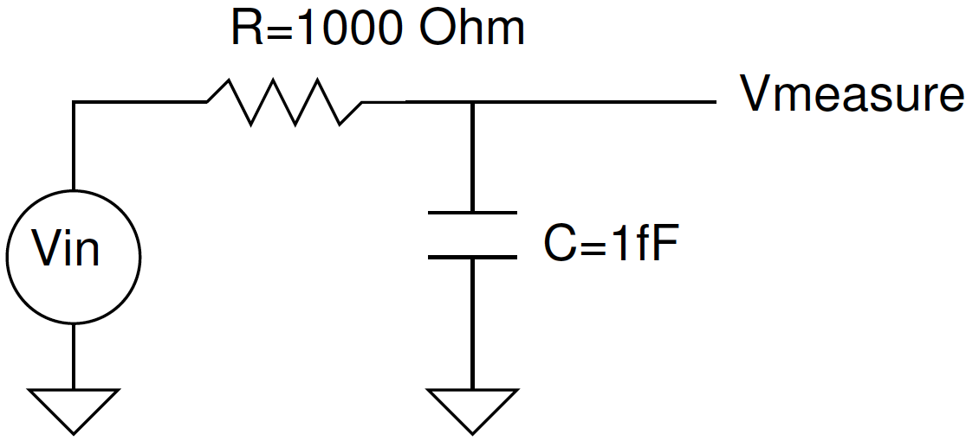
90% Rise Time? (preclass 1ab)
What is final V_{measure}?
What is time constant, τ?
Penn ESE370 Fall2021 – Khanna

Slide 6
Governing Equations? (KCL)
I_{R}
I_{C}
KCL @ V_{measure}
  Kirchoff’s Current Law
    Sum of all currents into a node = 0
    Current entering a node = current exiting a node
  I_{R}=I_{C}
Penn ESE370 Fall2021 – Khanna

Slide 7
Governing Equations? (KCL)
I_{R}
I_{C}
Penn ESE370 Fall2021 – Khanna

Slide 8
Governing Equations? (KCL)
I_{R}
I_{C}
Penn ESE370 Fall2021 – Khanna

Slide 9
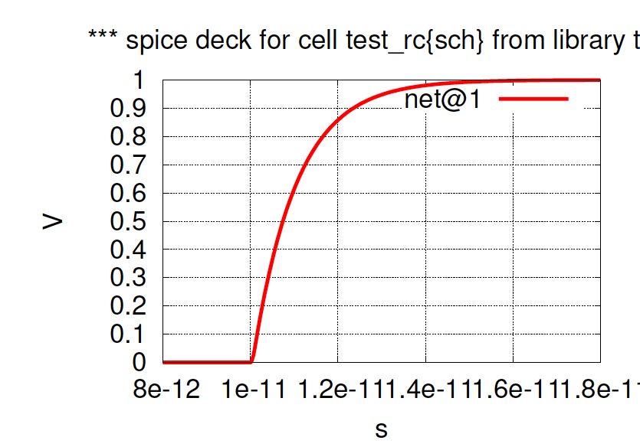
What does look like?
Penn ESE370 Fall2021 – Khanna

Slide 10
Shape of Curve (preclass 1c)
t (in ps) | e^{-t/RC} | 1-e^{-t/RC}
0
0.1
1
2
2.3
V_{in}=1
Penn ESE370 Fall2021 – Khanna

Slide 11
Rise Time: 10—90%
t_{rise} ~= 2.2ps ~= 2.2τ
Penn ESE370 Fall2021 – Khanna

Slide 12
Shape of Curve (preclass 1d)
t (in ps) | e^{-t/RC} | 1-e^{-t/RC}
0
0.1
1
2
2.3
V_{in}=1
At what time is V_{measure} 50% of its value?
Penn ESE370 Fall2021 – Khanna

Slide 13
Delay Time: 50% (in)—50% (out)
t_{PLH} ~= .69ps ~= .69τ
Penn ESE370 Fall2021 – Khanna

Slide 14
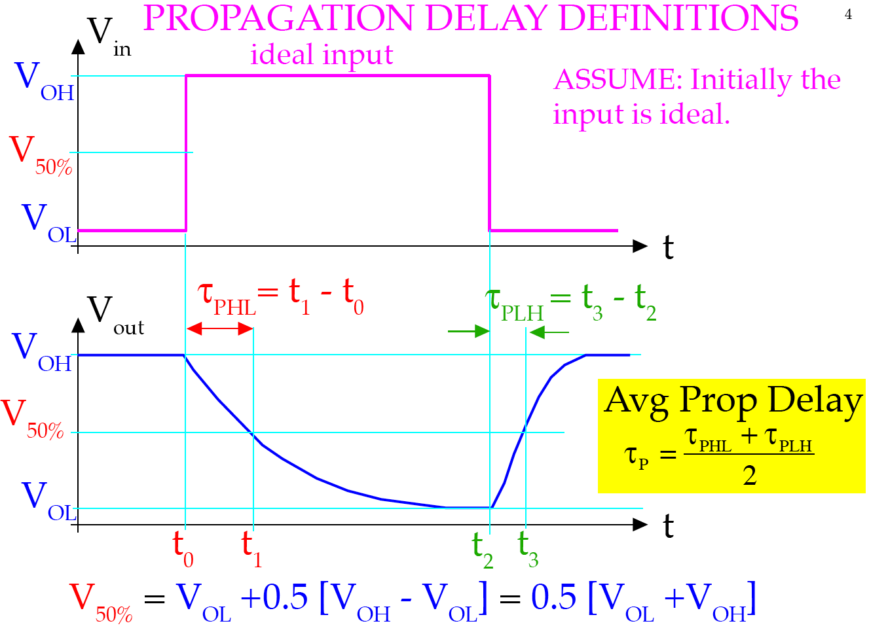
Propagation Delay Definitions
t
Penn ESE370 Fall2021 – Khanna

Slide 15
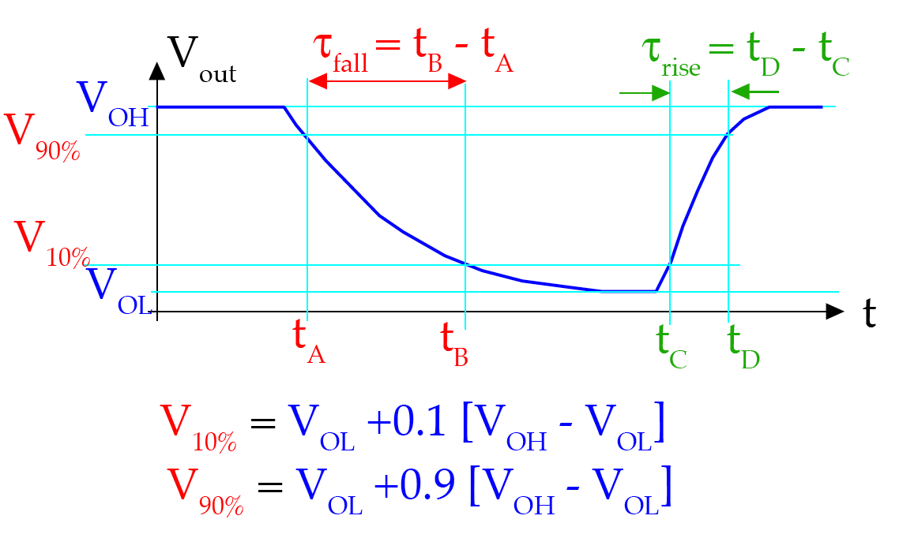
Rise/Fall Times
Penn ESE370 Fall2021 – Khanna

Slide 16
Delay Time: 50% (in)—50% (out)
τ = RC
t_{PLH} ~= .69ps ~= .69τ
Penn ESE370 Fall2021 – Khanna

Slide 17
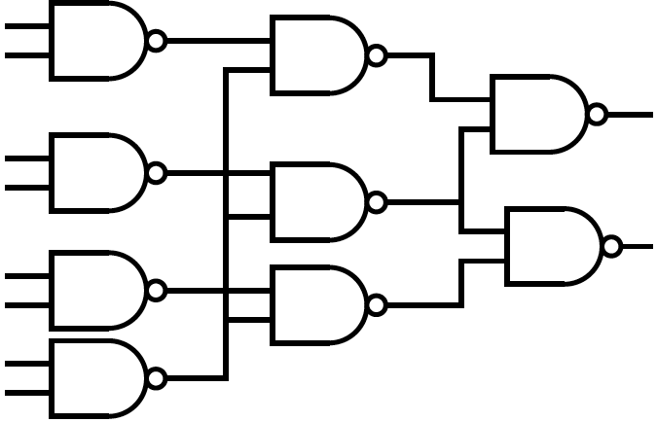
Voltage Waveform at Output/Input Node
R_{drive} from looking into output stages
C_{load} from looking into input stages
Penn ESE370 Fall2021 – Khanna

Slide 18
Voltage Waveform at Output/Input Node
R_{drive} from looking into output stages
and wires
C_{load} from looking into input stages
and wires
Penn ESE370 Fall2021 – Khanna

Slide 19
What is C?
Penn ESE370 Fall2021 – Khanna
19

Slide 20
Capacitance
Wire
Fanout -- Total gate load
  Logical Gate
    MOSFET gate
Penn ESE370 Fall2021 – Khanna

Slide 21
Fanout
Number of things to which a gate output connects
Penn ESE370 Fall2021 – Khanna

Slide 22
Fanout in Circuit
Output routed to many gate inputs
Penn ESE370 Fall2021 – Khanna

Slide 23
Fanout in Circuit (preclass 2)
Maximum fanout?
Second?
Min?
Penn ESE370 Fall2021 – Khanna

Slide 24
MOSFET Capacitance
“load of 1”?
  Capacitive
Penn ESE370 Fall2021 – Khanna

Slide 25
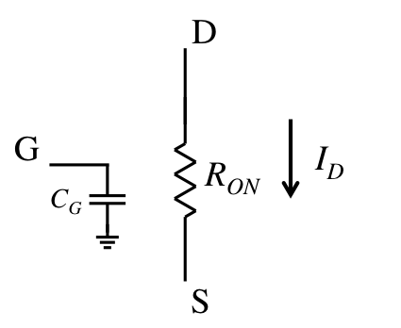
MOSFET Capacitance
“load of 1”?
  Capacitive
Penn ESE370 Fall2021 – Khanna

Slide 26
Lumped Capacitive Load
Penn ESE370 Fall2021 – Khanna

Slide 27
What is R?
Penn ESE370 Fall2021 – Khanna
27

Slide 28
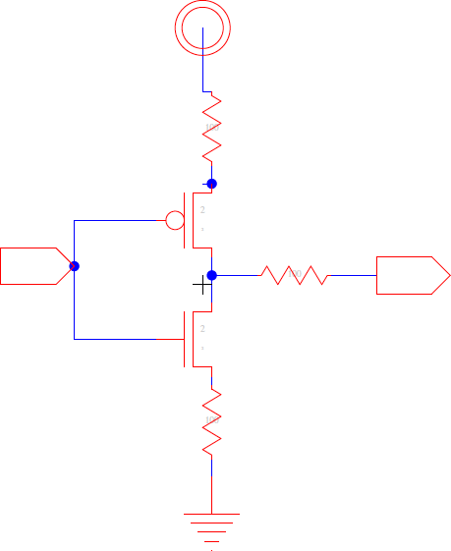
Resistance
Wire resistance
  From supply (Vdd or Gnd) to transistor source
  From transistor output to gate it is driving
Transistor equivalent resistance (R_{on})
Penn ESE370 Fall2021 – Khanna

Slide 29
Equivalent Resistance
Penn ESE370 Fall2021 – Khanna

Slide 30
Equivalent Resistance (prelcass 3)
What resistances might transistors contribute?
  How many cases?
  Assume R_{on}=R_{on,p}=R_{on,n}
Penn ESE370 Fall2021 – Khanna

Slide 31
Equivalent Resistance (prelcass 3)
What resistances might transistors contribute?
  How many cases?
  Assume R_{on}=R_{on,p}=R_{on,n}
Input | Rout
00
01
10
11
Penn ESE370 Fall2021 – Khanna

Slide 32
Rise/Fall Times
Rise and Fall time may differ
  Why?
  What is worst case?
  What is best case?
Input | Rout
00
01
10
11
Penn ESE370 Fall2021 – Khanna

Slide 33
Lumped Resistive Source
R_{tr,net} = transistor network resistance = parallel and
series combination of R_{tr}
Penn ESE370 Fall2021 – Khanna

Slide 34
Voltage Waveform at Output/Input Node
R_{drive} from output stages and wires
C_{Load} from input stages and wires
Penn ESE370 Fall2021 – Khanna

Slide 35
Measuring Delay
Penn ESE370 Fall2021 – Khanna
35

Slide 36
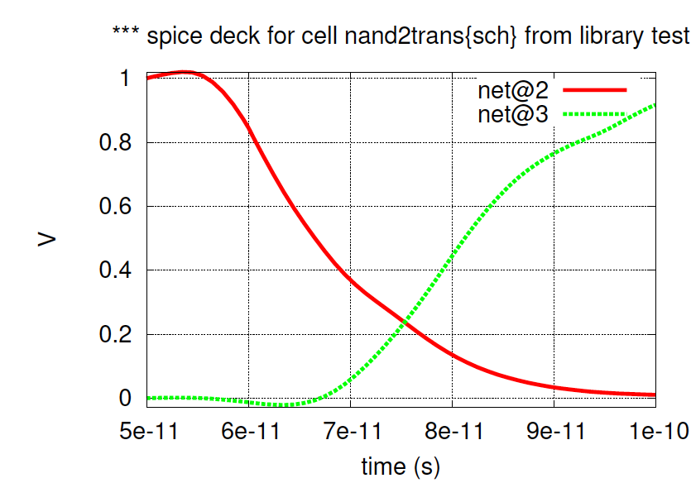
Measuring Gate Propagation Delay
t_{plh} = 13ps
67ps
80ps
Next stage starts to switch before first finishes
Measure from 50% of input swing to 50% of output swing
Penn ESE370 Fall2021 – Khanna

Slide 37
Characterizing Gate/Technology
Delay measure of a logic gate will be
  Function of load on logic gate
  Function of input signal rise time
    Which, in turn, may be a function of input loading from the driving logic gate
Penn ESE370 Fall2021 – Khanna

Slide 38
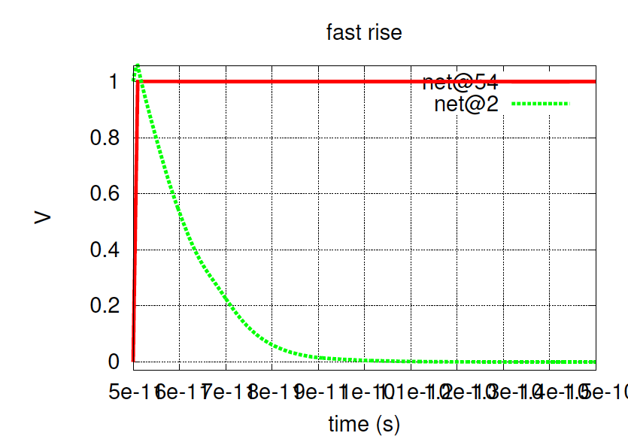
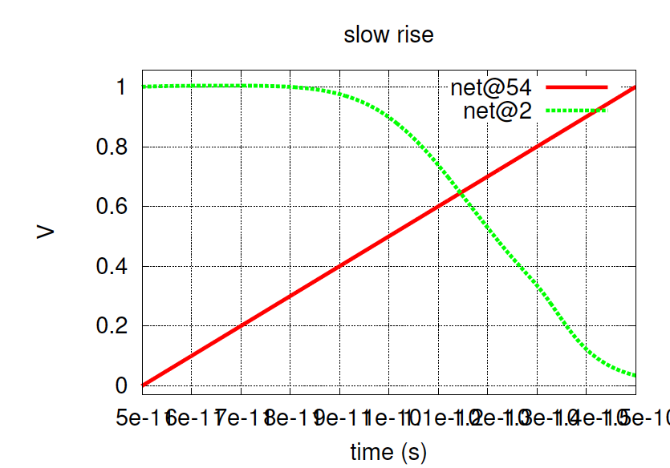
Delay vs. Risetime
1ps input rise
100ps input rise
10ps delay
20ps delay
If we didn’t know the input rise time, we wouldn’t know what a 13ps delay meant
Penn ESE370 Fall2021 – Khanna

Slide 39
Characterizing Gate/Technology
Delay measure will be
  Function of load on gate
  Function of input signal rise time
    Which, in turn, may be a function of input loading
Want to understand typical delay times
  Allows us to compare designs with a (somewhat) normalized delay metric
Penn ESE370 Fall2021 – Khanna

Slide 40
Standard Measurement for Characterization
Drive with a gate
  Not an ideal source
  Input rise time typically would see in circuit
Measure loaded gate
  Typical loading – FO4
Function Generator
Oscilloscope
Not realistic measurement
Penn ESE370 Fall2021 – Khanna

Slide 41
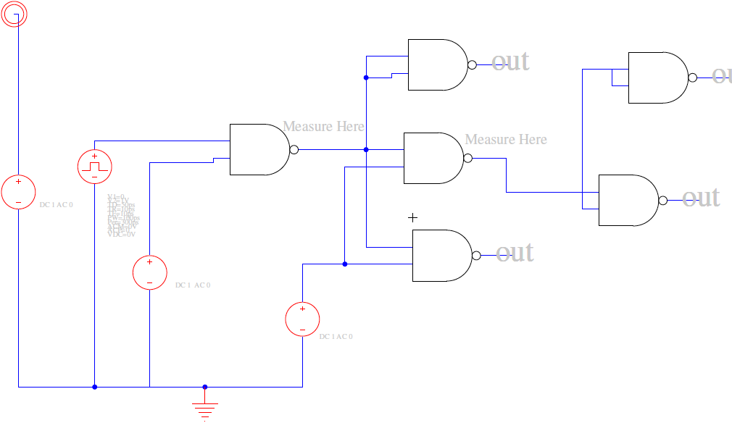
HW2 Measurement Setup
Loading gate
Driving gate
Gate under test
Loading gate
Penn ESE370 Fall2021 – Khanna

Slide 42
Measurement for Characterization
Drive with a gate
  Not an ideal source (how does delay change if drive is ideal?)
  Input rise time typically would see in circuit
Measure loaded gate
  Typical loading – FO4
Penn ESE370 Fall2021 – Khanna

Slide 43
Measurement for Characterization
Drive with a gate
  Not an ideal source
  Input rise time typically would see in circuit
Measure loaded gate
  Typical loading – FO4 (how does delay change if gate is unloaded?)
Penn ESE370 Fall2021 – Khanna

Slide 44
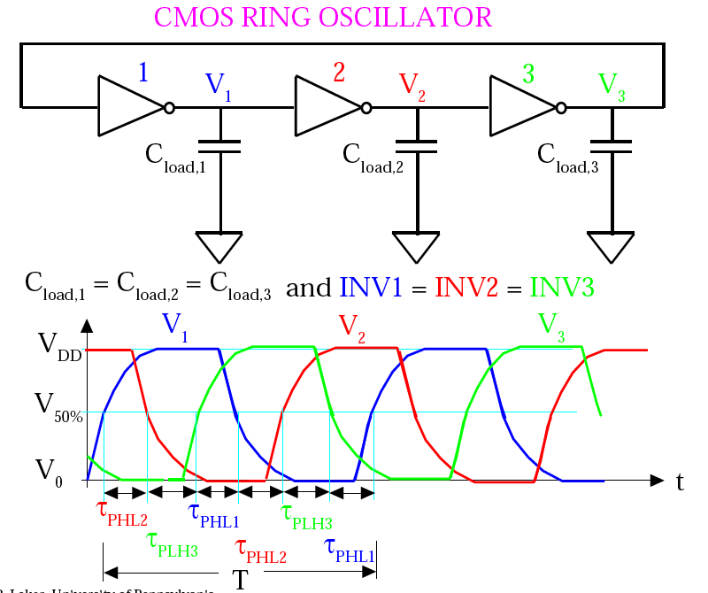
Ring Oscillator (If time)
Penn ESE370 Fall2021 – Khanna

Slide 45
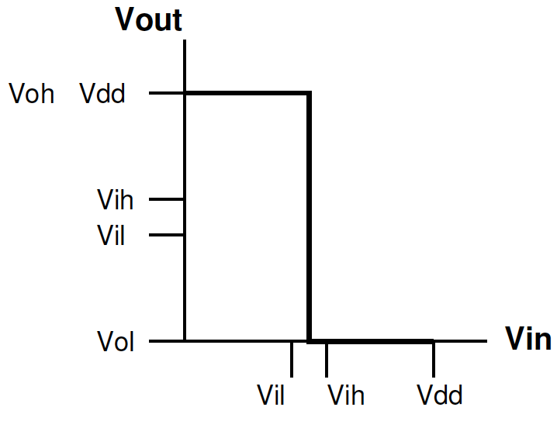
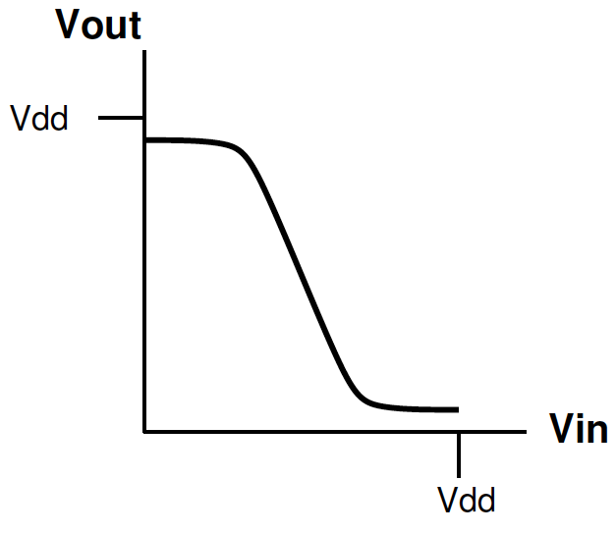
Ring Oscillator (If time)
Penn ESE370 Fall2021 – Khanna

Slide 46
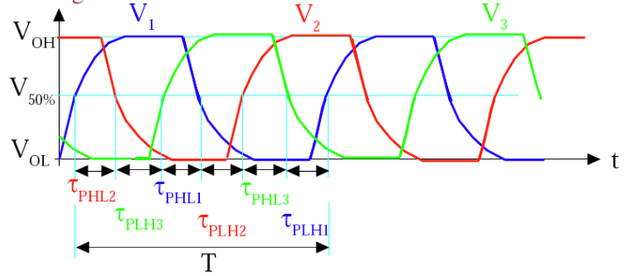
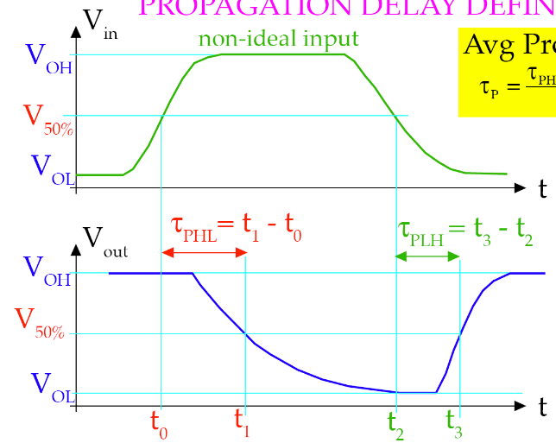
Ring Oscillator (If time)
= SYM INV
t
τ_{PHL2}
τ_{PHL1}
τ_{PHL3}
τ_{PLH3}
τ_{PLH2}
τ_{PLH1}
SYM INV => τ_{PHL} = τ_{PLH}
Penn ESE370 Fall2021 – Khanna

Slide 47
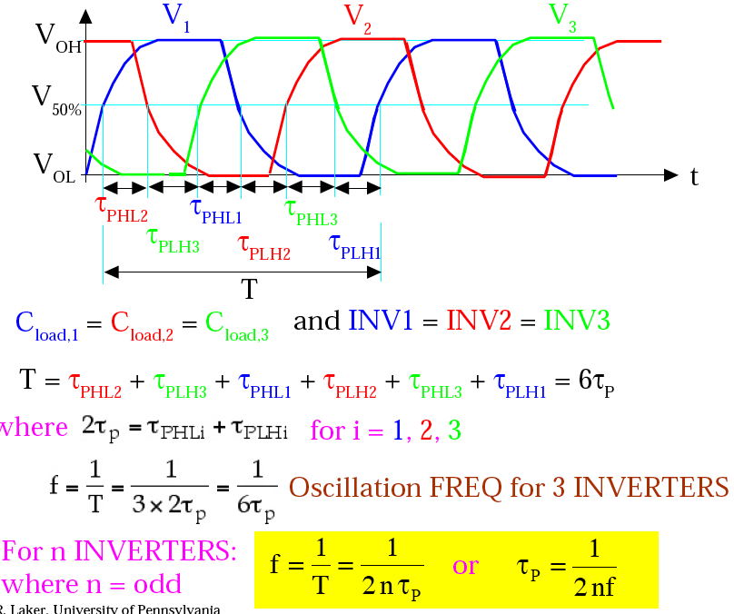
Ring Oscillator (If time)
SYM INV => τ_{PHL} = τ_{PLH} = τ_{p}
Penn ESE370 Fall2021 – Khanna

Slide 48
Admin
HW 2 due 9/20
  If you haven’t started, start now!
  Office hours on every weekday
Setup Spice Work Flow
    access to electric, setup for spice, run ngspice
      See tool guides on website
      https://www.seas.upenn.edu/~ese370/#tools
    read spice style guide on webpage:
      https://www.seas.upenn.edu/~ese370/fall2021/handouts/spice_style_guide.pdf
Penn ESE370 Fall2021 – Khanna

