Slide 1
ESE370: Circuit-Level Modeling, Design, and Optimization for Digital Systems
Lec 6: September 17, 2021
MOS Model
Penn ESE370 Fall2021 – Khanna

Slide 2
You are Here: Transistor Edition
Previously: simple models (0th and 1st order)
Comfortable with basic functions and circuits
This lecture and next week(4 lectures)
Detailed semiconductor discussion
MOSFET phenomenology
Don’t Blink!
Rest of term
Implications of the MOS device
Penn ESE370 Fall2021 – Khanna

Slide 3
Today
MOS Structure
Basic Fabrication
Semiconductor Physics
Metals, insulators
Silicon lattice
Band gaps
Doping
Field Effects
Penn ESE370 Fall2021 – Khanna

Slide 4
MOS
Metal Oxide Semiconductor
Penn ESE370 Fall2021 – Khanna

Slide 5
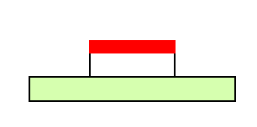
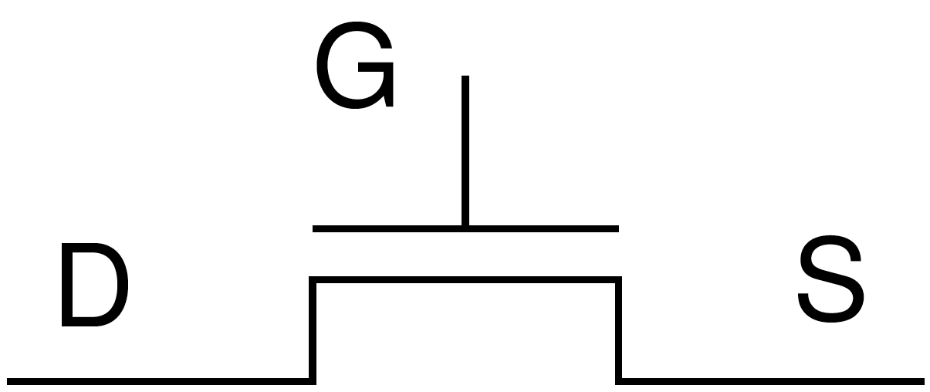
MOS
Metal – gate
Oxide – insulator separating gate from semiconductor
Ideally: no conduction from gate to semiconductor
Semiconductor – between source and drain
See why gate input is capacitive?
gate
drain
source
semiconductor
Penn ESE370 Fall2021 – Khanna

Slide 6
(MOS) Capacitor (preclass 1)
Charge distribution and field?
How much charge on plates?
gate
drain
source
semiconductor
1F
Penn ESE370 Fall2021 – Khanna

Slide 7
Idea
Semiconductor – can behave as metal or insulator
Voltage on gate induces an electrical field
Induced field attracts (repels) charge in semiconductor to form a channel
Semiconductor can be switched between conducting and not conducting
Hence “Field-Effect” Transistor
gate
drain
source
semiconductor
Penn ESE370 Fall2021 – Khanna

Slide 8
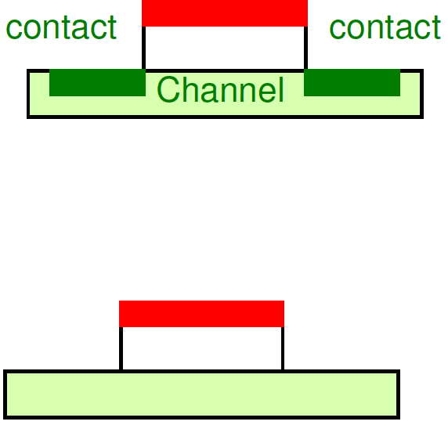
Source/Drain Contacts
Contacts: Conductors → metallic
Connect to metal wires that connect transistors
Penn ESE370 Fall2021 – Khanna

Slide 9
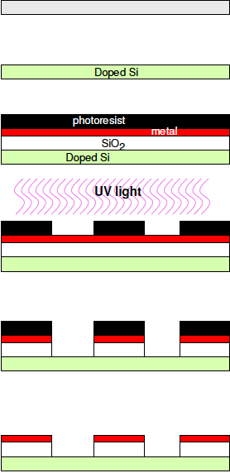
Fabrication
Start with Silicon wafer
Dope silicon
Grow Oxide (SiO₂)
Deposit Metal
Photoresist mask and etch to define where features go
https://youtu.be/35jWSQXku74?t=119
Time Code: 2:00-4:30
Penn ESE370 Fall2021 – Khanna
Notes:
https://youtu.be/35jWSQXku74?t=119
From sand to silicon (intel) - https://www.youtube.com/watch?v=Q5paWn7bFg4
How microchips are made - https://www.youtube.com/watch?v=F2KcZGwntgg

Slide 10
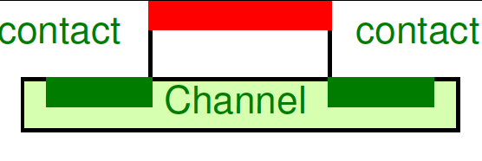
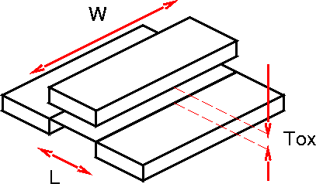
Dimensions
Channel Length (L)
Channel Width (W)
Oxide Thickness (T_{ox})
Process named by minimum length
22nm → L=22nm
Penn ESE370 Fall2021 – Khanna

Slide 11
Semiconductor Physics
Penn ESE370 Fall2021 – Khanna
11

Slide 12
Conduction
Metal – conducts
Insulator – does not conduct
Semiconductor – can act as either
Penn ESE370 Fall2021 – Khanna

Slide 13
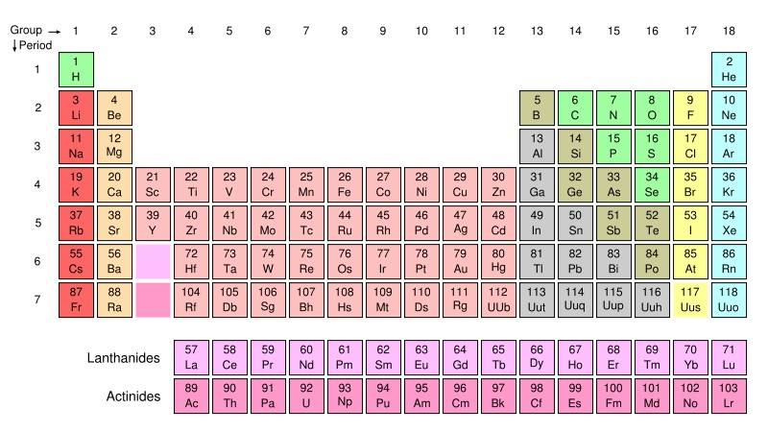
Why does metal conduct? (preclass 2)
(periodic table)
http://chemistry.about.com/od/imagesclipartstructures/ig/Science-Pictures/Periodic-Table-of-the-Elements.htm
Penn ESE370 Fall2021 – Khanna

Slide 14
Why does metal conduct? (preclass 2)
Gold
Silver
Copper
Zinc

Slide 15
Conduction
Electrons move
Must be able to “remove” electron from atom or molecule
Penn ESE370 Fall2021 – Khanna

Slide 16
Atomic States
Quantized Energy Levels (bands)
Valence and Conduction Bands
Must have enough energy to change level (state)
Penn ESE370 Fall2021 – Khanna

Slide 17
Thermal Energy
Except at absolute 0
There is always free energy
Causes electrons to hop around
….when there is enough energy to change states
Energy gap between states determines energy required
Penn ESE370 Fall2021 – Khanna

Slide 18
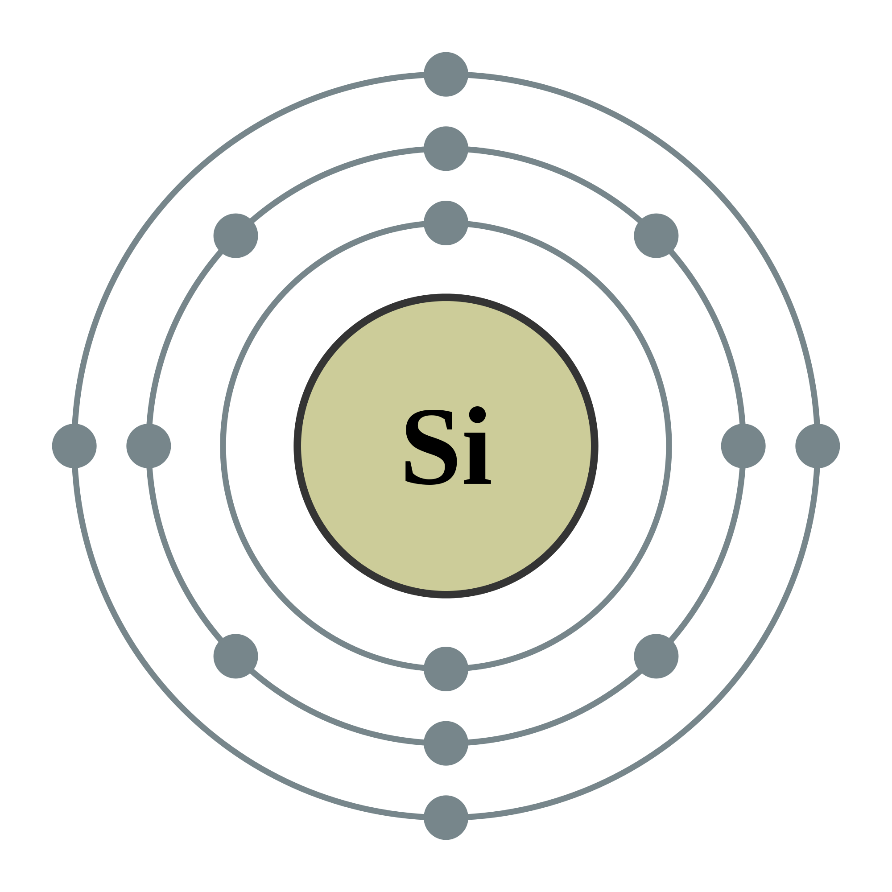
Silicon Atom (preclass 3)
How many valence electrons?
Penn ESE370 Fall2021 – Khanna

Slide 19
Silicon
4 valence electrons
Inner shells filled
Only outer shells contribute to chemical interactions
Penn ESE370 Fall2021 – Khanna

Slide 20
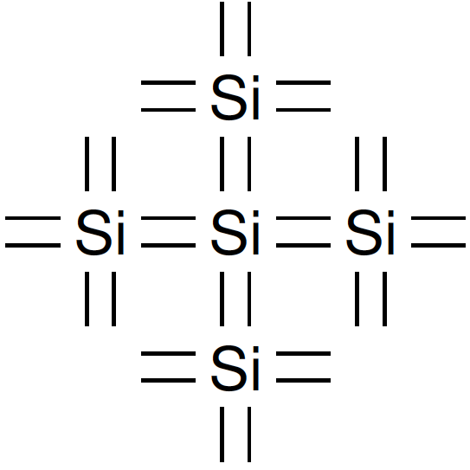
Silicon-Silicon Bonding
Can form covalent bonds with 4 other silicon atoms
Penn ESE370 Fall2021 – Khanna

Slide 21
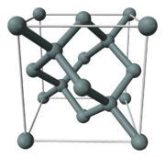
Silicon Lattice
Forms into crystal lattice
Penn ESE370 Fall2021 – Khanna

Slide 22
Silicon Ingot
1 impurity atom per 10 billion silicon atoms
Penn ESE370 Fall2021 – Khanna
22

Slide 23
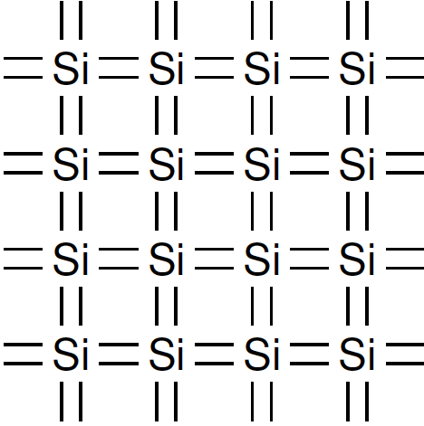
Silicon Lattice
Cartoon two-dimensional view
Penn ESE370 Fall2021 – Khanna

Slide 24
Outer Orbital?
What happens to outer shell in Silicon lattice?
Penn ESE370 Fall2021 – Khanna

Slide 25
Energy?
What does this say about energy to move electron?
Penn ESE370 Fall2021 – Khanna

Slide 26
Energy State View
Energy
Valance Band – all states filled
Penn ESE370 Fall2021 – Khanna

Slide 27
Energy State View
Conduction Band– all states empty
Energy
Valance Band – all states filled
Penn ESE370 Fall2021 – Khanna

Slide 28
Energy State View
Conduction Band– all states empty
Energy
Band Gap
Valance Band – all states filled
Penn ESE370 Fall2021 – Khanna

Slide 29
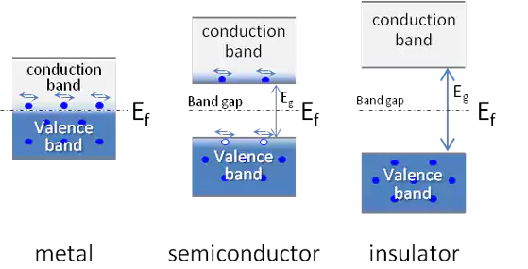
Band Gap and Conduction
Penn ESE370 Fall2021 – Khanna

Slide 30
Band Gap and Conduction
Penn ESE370 Fall2021 – Khanna

Slide 31
Band Gap and Conduction
Semiconductor
E_{c}
1.1ev
E_{v}
1eV = 160 zeptojoules (10⁻²¹ J)
Penn ESE370 Fall2021 – Khanna

Slide 32
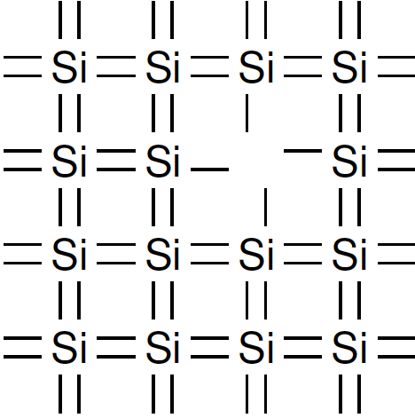
Doping
Add impurities to Silicon Lattice
Replace a Si atom at a lattice site with another
Penn ESE370 Fall2021 – Khanna

Slide 33
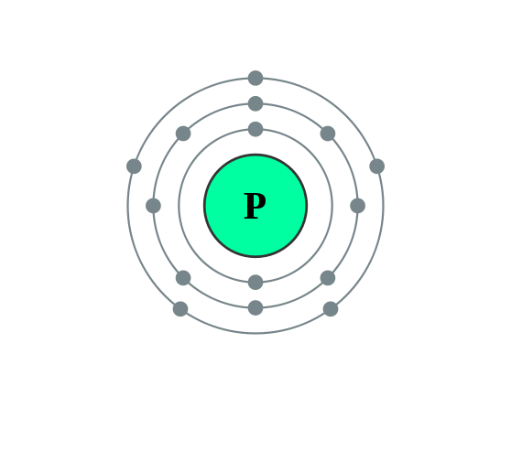
Doping
Add impurities to Silicon Lattice
Replace a Si atom at a lattice site with another
Add a Group 15 element
E.g. P (Phosphorus)
How many valence electrons?
Penn ESE370 Fall2021 – Khanna

Slide 34
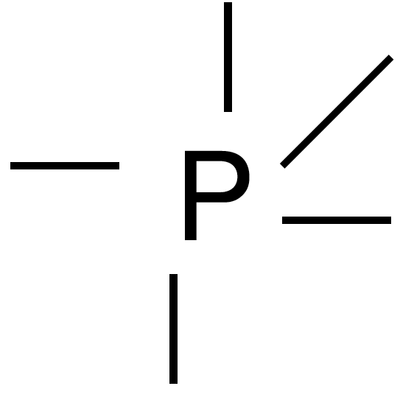
Doping
Add impurities to Silicon Lattice
Replace a Si atom at a lattice site with another
Add a Group 15 element
E.g. P (Phosphorus)
How many valence electrons?
Penn ESE370 Fall2021 – Khanna

Slide 35
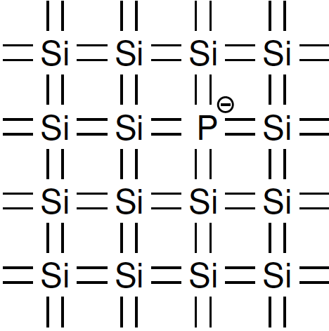
Doping with P
Penn ESE370 Fall2021 – Khanna

Slide 36
Doping with P
End up with extra electrons
Donor electrons
Not tightly bound to atom
Low energy to displace
Easy for these electrons to move
Penn ESE370 Fall2021 – Khanna

Slide 37
Doped Band Gaps
Addition of donor electrons makes more metallic
Easier to conduct
Semiconductor
E_{c}
0.045ev
E_{D}
1.1ev
E_{v}
Penn ESE370 Fall2021 – Khanna

Slide 38
Localized
Donor electron is localized
Won’t go far if no low energy states nearby
Increasing doping concentration
Ratio of P atoms to Si atoms
Decreases energy to conduct
Penn ESE370 Fall2021 – Khanna

Slide 39
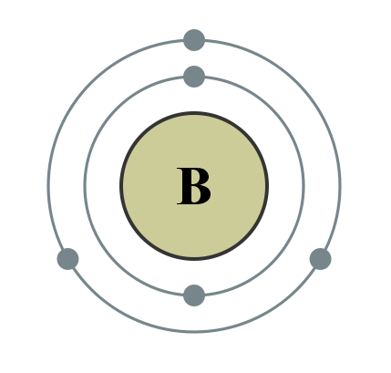
Doping
What happens if we replace Si atoms with group 13 atom instead?
E.g. B (Boron)
Valance band electrons?
Penn ESE370 Fall2021 – Khanna

Slide 40
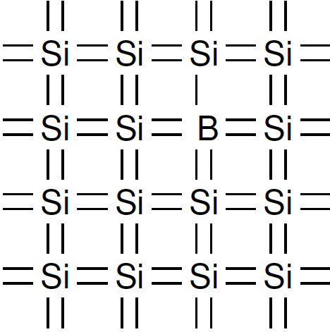
Doping
What happens if we replace Si atoms with group 13 atom instead?
E.g. B (Boron)
Valance band electrons?
B
Penn ESE370 Fall2021 – Khanna

Slide 41
Doping with B
End up with electron vacancies -- Holes
Acceptor electron sites
Easy for electrons to shift into these sites
Low energy to displace
Easy for the electrons to move
Movement of an electron best viewed as movement of hole
Penn ESE370 Fall2021 – Khanna

Slide 42
Doped Band Gaps
Addition of acceptor sites makes more metallic
Easier to conduct
Semiconductor
E_{c}
0.045ev
1.1ev
E_{A}
E_{v}
Penn ESE370 Fall2021 – Khanna

Slide 43
MOSFETs
Donor doping
Excess electrons
Negative or N-type material
NFET
Acceptor doping
Excess holes
Positive or P-type material
PFET
Penn ESE370 Fall2021 – Khanna

Slide 44
Capacitor Charge
Remember capacitor charge
+ + + + + + + +
gate
drain
source
- - - - - - - - -
semiconductor
Penn ESE370 Fall2021 – Khanna

Slide 45
MOS Field?
What does “capacitor” field do to the doped semiconductor channel?
V_{gs}=0
No field
- -
- -
- -
+ +
+ +
+ +
+ +
Penn ESE370 Fall2021 – Khanna

Slide 46
MOS Field?
What does “capacitor” field do to the doped semiconductor channel?
V_{gs}=0
No field
+
+ + +
V_{cap}>0
- -
- -
- - -
- -
+ +
+ +
+ +
+ +
Penn ESE370 Fall2021 – Khanna

Slide 47
MOS Field?
What does “capacitor” field do to the doped semiconductor channel?
V_{gs}=0
No field
+
+ + +
V_{cap}>0
- -
- -
- - -
- -
+ +
+ +
+ +
+ +
V_{gs}>0
Conducts
+ + + + +
=
- - - - - -
+ + + + + + + +
Penn ESE370 Fall2021 – Khanna

Slide 48
MOS Field?
What does “capacitor” field do to the doped semiconductor channel?
V_{gs}=0
No field
+
- - -
V_{cap}<0
- -
- -
+ + +
- -
+ +
+ +
+ +
+ +
Penn ESE370 Fall2021 – Khanna

Slide 49
MOS Field?
What does “capacitor” field do to the doped semiconductor channel?
V_{gs}=0
No field
+
- - -
V_{cap}<0
- -
- -
+ + +
- -
+ +
+ +
+ +
+ +
V_{gs}<0
Conducts
- - - - - -
=
- -
+ + + + +
- -
- -
- -
Penn ESE370 Fall2021 – Khanna

Slide 50
MOS Field Effect
Charge on capacitor
Attract or repel charges to form channel
NMOS: Positive field on p-type substrate
Attracts electrons to surface to form conducting channel
PMOS: Negative fiend on n-type substrate
Attracts holes to surface to form conducting channel
+ + + + +
- - - - - -
+ + + + + + + + + + +
- - - - - -
- -
- -
+ + + + +
- -
- -
- -
Penn ESE370 Fall2021 – Khanna

Slide 51
PN Junction

Slide 52
Doped Silicon
=hole
=electron
-
-
-
-
-
-
-
-
-
-
-
P-type
N-type
Excess holes
Excess electrons

Slide 53
PN Junction
=hole
=electron
Hole Diffusion
-
Electron Diffusion
-
-
-
-
-
-
-
-
-
-
-
-
-
-
-
-
-
-
-
-
-
-
-
-
-
-
-
-
-
-
-
-
-
-
-
-
P-type
N-type
PN junction causes a depletion region to form
Electrons diffuse from N-type to P-type
Holes diffuse from P-type to N-type
Diffusion current caused by diffusion of carriers

Slide 54
PN Junction
Hole Drift
=hole
=electron
Hole Diffusion
-
Electron Drift
Electron Diffusion
-
-
-
-
-
-
-
-
-
-
-
-
-
-
-
-
-
-
-
-
-
-
-
-
-
-
-
-
-
-
-
-
-
-
-
-
P-type
N-type
PN junction causes a depletion region to form
Electrons diffuse from N-type to P-type
Holes diffuse from P-type to N-type
Diffusion current caused by diffusion of carriers
Equilibrium achieved when V_{bi}, built-in potential, is formed across the depletion region
Drift current cause by E-field due to V_{bi} to counteract diffusion current

Slide 55
Drift/Diffusion Currents
Diffusion current
Current caused by semiconductor diffusion of holes and electrons
Drift current
Current due to movement of holes and electrons caused by force from potential difference induced e-field

Slide 56
PN Junction – Forward Biasing
Applied E-field
=hole
=electron
-
Depletion E-field
-
-
-
-
-
-
-
-
-
-
-
-
-
-
-
-
-
-
-
-
-
-
-
-
-
-
-
-
P-type
N-type
+
-
Forward biasing connect positive terminal to p-type and negative terminal to n-type
Holes/electrons pushed towards depletion region, causing it to narrow
The applied voltage e-field continues to narrow the depletion region (i.e reduce the depletion e-field)
current flows through the device from p-type to n-type

Slide 57
PN Junction – Reverse Biasing
=hole
=electron
-
Depletion E-field
-
-
-
-
-
-
-
-
-
-
-
-
-
-
-
-
-
-
-
-
-
-
-
-
-
-
-
-
-
-
-
-
-
-
-
-
-
-
-
-
-
-
-
-
P-type
N-type
+
-
Reverse biasing connect positive terminal to n-type and negative terminal to p-type
Holes/electrons attracted away from depletion region, causing it to widen
No current flows through the device
If reverse bias increases past breakdown voltage, the depletion e-field increases until breakdown occurs and reverse biased current flows causing thermal damage to junction

Slide 58
Big Ideas: MOSFET
Semiconductor can act like metal or insulator
Use electric field to modulate conduction state of semiconductor
- - - - - -
+ + + + +
Penn ESE370 Fall2021 – Khanna

Slide 59
Admin
HW 2 due Monday
More Fabrication Videos:
From sand to silicon (intel) - https://www.youtube.com/watch?v=Q5paWn7bFg4
How microchips are made - https://www.youtube.com/watch?v=F2KcZGwntgg
Penn ESE370 Fall2021 – Khanna

