Slide 1
ESE370: Circuit-Level Modeling, Design, and Optimization for Digital Systems
Lec 8: September 22, 2021
MOS Transistor Operating Regions
Part 2
Penn ESE370 Fall 2021 – Khanna
1

Slide 2
Today
Operating Regions (continued)
Resistive
Saturation
Subthreshold
Velocity Saturation
Short Channel Effects
V_{th}
Drain Induced Barrier Lowering
Penn ESE370 Fall 2021 – Khanna

Slide 3
Last Time…
Above Threshold
Penn ESE370 Fall 2021 – Khanna
3

Slide 4
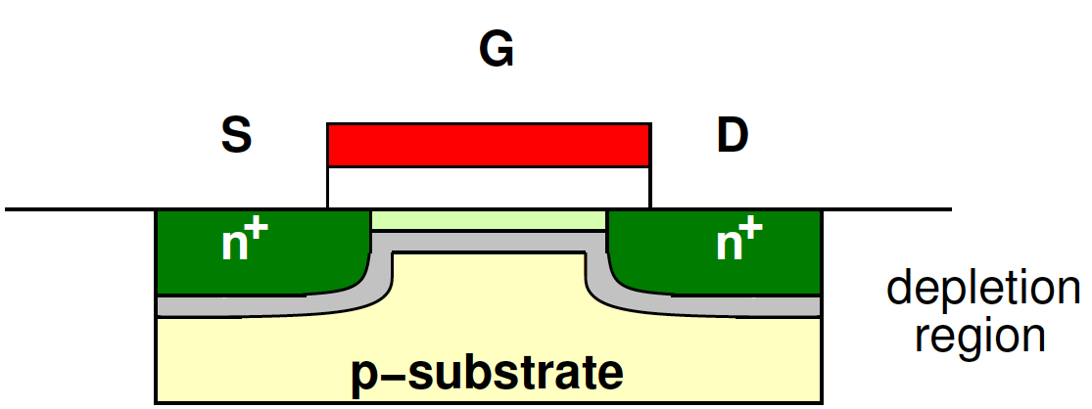
Linear Region
V_{GS}>V_{th} and V_{DS} small
Penn ESE370 Fall 2021 – Khanna

Slide 5
Saturation
In saturation, V_{DS-effective}=V_{x}= V_{GS}-V_{T}
Becomes:
Penn ESE370 Fall 2021 – Khanna

Slide 6
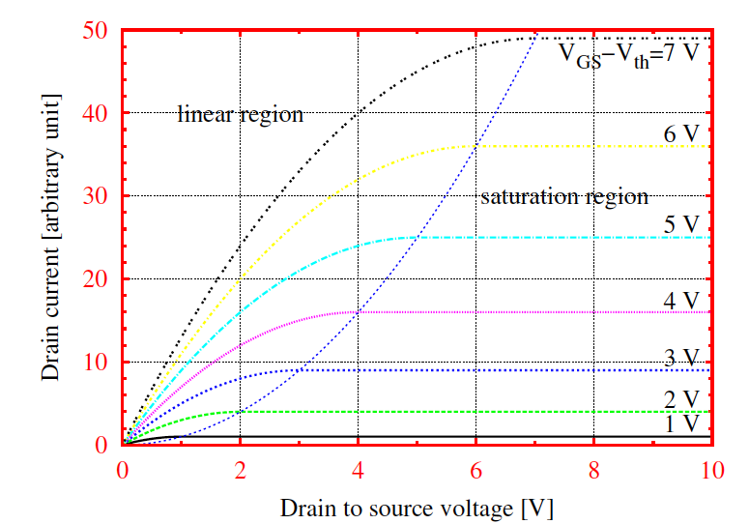
MOSFET – IV Characteristics
V_{DS} <V_{GS} -V_{TH}
V_{GS} -V_{th}
I_{DS}
V_{DS} ≥V_{GS} -V_{TH}
V_{DS}
Penn ESE370 Fall 2021 – Khanna

Slide 7
Subthreshold
Penn ESE370 Fall 2021 – Khanna
7

Slide 8
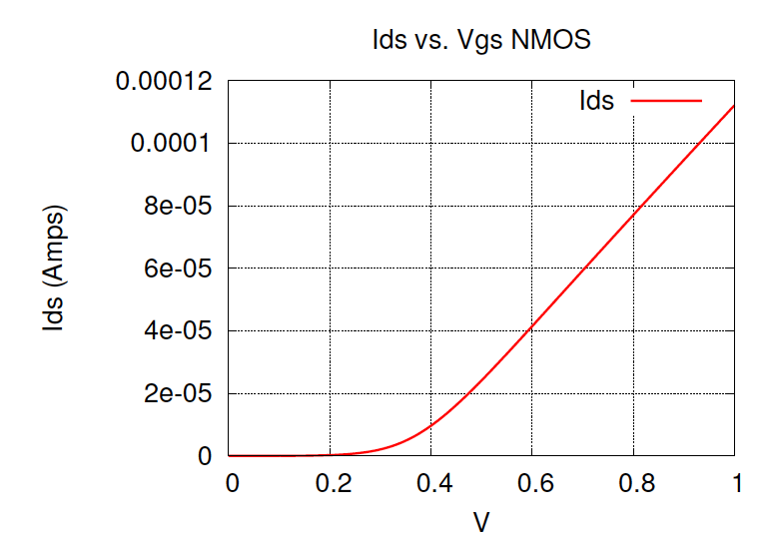
Below Threshold
Transition from insulating to conducting is non-linear, but not abrupt
Current does flow
But exponentially dependent on V_{GS}
Penn ESE370 Fall 2021 – Khanna

Slide 9
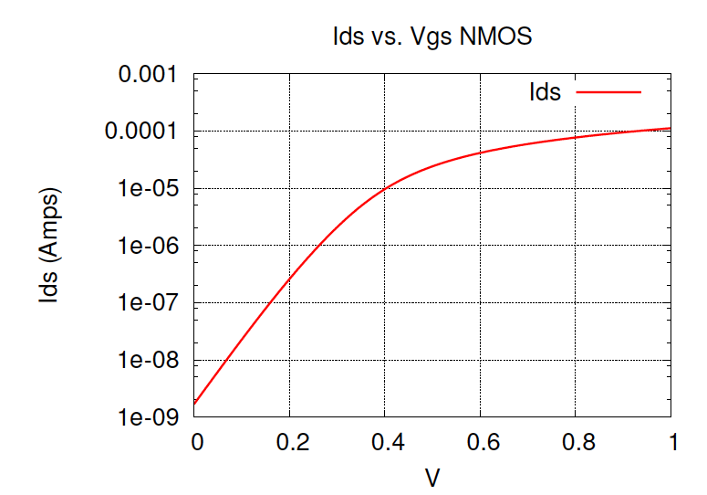
Below Threshold
Transition from insulating to conducting is non-linear, but not abrupt
Current does flow
But exponentially dependent on V_{GS}
Penn ESE370 Fall 2021 – Khanna

Slide 10
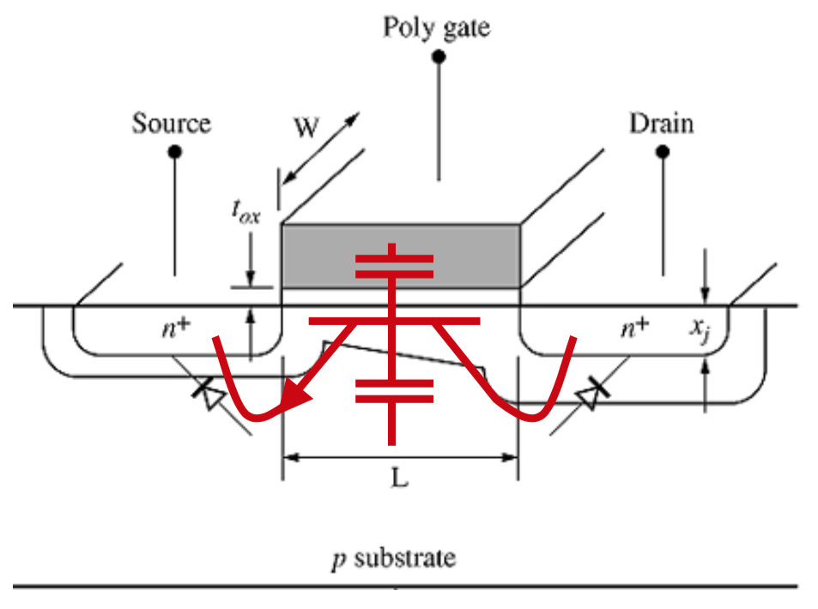
Parasitic NPN BJT
We have an NPN sandwich, mobile minority carriers in the P region
This is a BJT!
Except that the base potential is here controlled through a capacitive divider, and not directly an electrode

Slide 11
Subthreshold
Current is from the parasitic NPN BJT transistor when gate is below threshold and there is no conducting channel
n is the capacitive divider between parasitic capacitances
Typically 1 < n < 1.5
Penn ESE370 Fall 2021 – Khanna

Slide 12
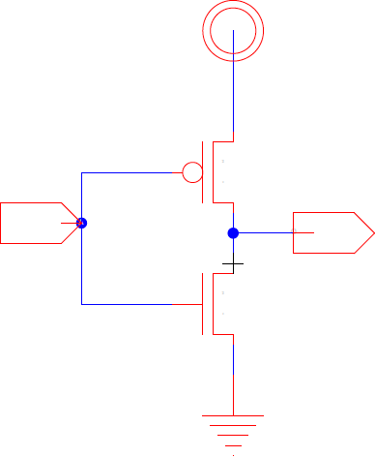
Steady State (Preclass 1)
What current flows in steady state?
What causes (and determines) the magnitude of current flow?
Which device?
Penn ESE370 Fall 2021 – Khanna

Slide 13
Leakage
Call this steady-state current flow leakage
I_{ds,leakage}
Penn ESE370 Fall 2021 – Khanna

Slide 14
Subthreshold Slope Factor
Exponent in V_{GS} determines how steep the turnon is
Units: V/decade
Every S Volts, I_{DS} is scaled by factor of 10
Penn ESE370 Fall 2021 – Khanna

Slide 15
I_{DS} vs. V_{GS}
(Logscale)
Penn ESE370 Fall 2021 – Khanna

Slide 16
Subthreshold Slope Factor
Exponent in V_{GS} determines how steep the turnon is
Units: V/dec
Every S Volts, I_{DS} is scaled by factor of 10
n – depends on parasitic capacitance divider
n=1 → S=60mV at Room Temp. (ideal)
n=1.5 → S=90mV
Single gate structure showing S=90-110mV
Penn ESE370 Fall 2021 – Khanna

Slide 17
Subthreshold Slope Factor (Preclass 2)
If S=100mV and V_{th}=300mV, what is Ids(Vgs=300mV)/Ids(Vgs=0V) ?
What if S=60mV?
Penn ESE370 Fall 2021 – Khanna

Slide 18
Velocity Saturation

Slide 19
Carrier Velocity
Model assumes carrier velocity increases with field
Increases with voltage proportionally to mobility

Slide 20
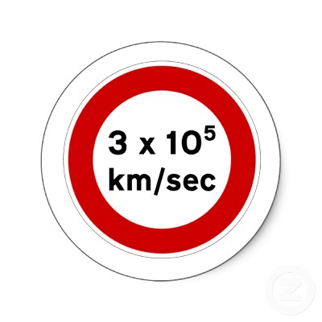
Carrier Velocity
Model assumes carrier velocity increases with field
Increases with voltage proportionally to mobility
(3x10⁸ m/sec)

Slide 21
Preclass 3
(a) What is the electrical field in the channel?
Velocity:
Electron mobility:
(b) What is the electron velocity?
Penn ESE370 Fall 2021 – Khanna

Slide 22
Moving Charge
I increases linearly in V
What’s I?
Penn ESE370 Fall 2021 – Khanna

Slide 23
Moving Charge
I increases linearly in V
What’s I?
ΔQ/Δt
Speed at which charge moves
Penn ESE370 Fall 2021 – Khanna

Slide 24
Moving Charge
I increases linearly in V
What’s I?
ΔQ/Δt
Speed at which charge moves
Velocity increases linearly in V
What’s a moving electron?
Penn ESE370 Fall 2021 – Khanna

Slide 25
Carrier Velocity
Velocity –
increases for increasing field with slope of mobility

Slide 26
Carrier Velocity
Velocity –
increases for increasing field with slope of mobility
saturates for increasing field
More likely to hit the critical field in short channel

Slide 27
Short Channel
Model assumes carrier velocity increases with field
Increases with voltage proportionally to mobility
There is a limit to how fast carriers can move
Limited by scattering effects
~ 10⁵m/s
Encounter velocity saturation when channel short
Modern processes, L is short enough to reach this region of operation

Slide 28
Velocity Saturation (Preclass 3)
(c) At what voltage do we hit the speed limit 10⁵m/s?
L_{eff}=25nm, V_{ds}=1V
V_{DSAT} = voltage at which velocity (current) saturates
Penn ESE370 Fall 2021 – Khanna

Slide 29
Velocity Saturation
Our current model equation:
Once velocity saturates:
Penn ESE370 Fall 2021 – Khanna

Slide 30
Velocity Saturation
Our current model equation:
Once velocity saturates:
Penn ESE370 Fall 2021 – Khanna

Slide 31
Velocity Saturation
Our current model equation:
Once velocity saturates:
Penn ESE370 Fall 2021 – Khanna

Slide 32
Velocity Saturation
Our current model equation:
Once velocity saturates:
Penn ESE370 Fall 2021 – Khanna

Slide 33
Velocity Saturation
Long Channel
Penn ESE370 Fall 2021 – Khanna

Slide 34
Velocity Saturation
Long Channel
Short Channel
Penn ESE370 Fall 2021 – Khanna

Slide 35
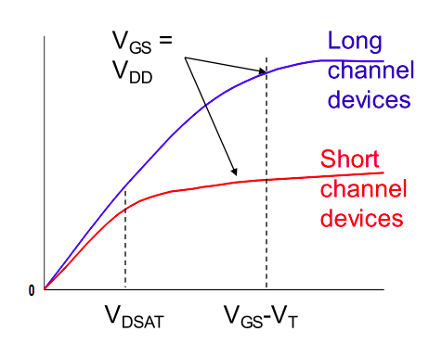
Velocity Saturation
I_{d}
V_{ds}
Penn ESE370 Fall 2021 – Khanna

Slide 36
Velocity Saturation
Once velocity saturates we can still increase current with parallelism
Effectively make a wider device
Penn ESE370 Fall 2021 – Khanna

Slide 37
Threshold
Penn ESE370 Fall 2021 – Khanna
37

Slide 38
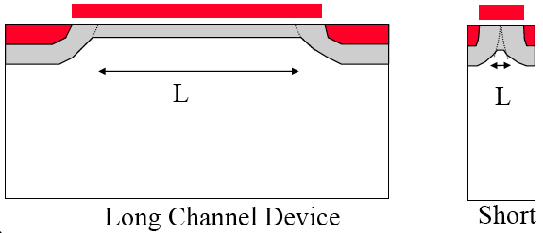
Short Channel Effects – V_{T} Reduction
G
G
S
D
S
D
n+
n+
x_{j}
n+
n+
Q_{B0}
pn+
depletion region
L_{eff}
pn+
depletion region
L_{eff}
Q_{B0(sc)}
V_{GS} induced
depletion region
V_{T0} (short channel) = V_{T0} - ΔV_{T0}

Slide 39
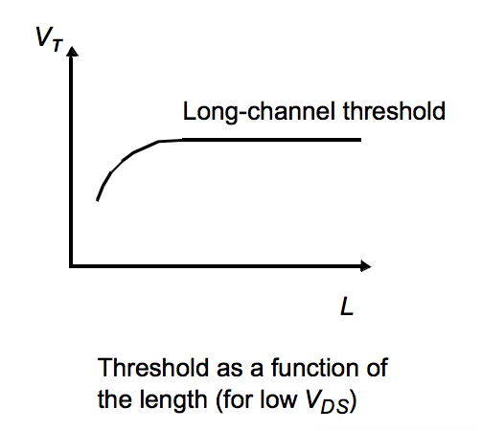
Short Channel Effects – V_{T} Reduction
G
G
S
D
S
D
n+
n+
x_{j}
n+
n+
Q_{B0}
pn+
depletion region
L_{eff}
pn+
depletion region
L_{eff}
Q_{B0(sc)}
V_{GS} induced
depletion region
V_{T0} (short channel) = V_{T0} - ΔV_{T0}

Slide 40
Short Channel Effects - DIBL
Drain Induced Barrier Lowering
V_{T} Reduction with Drain Bias

Slide 41
Short Channel Effects - DIBL
Drain Induced Barrier Lowering
V_{T} Reduction with Drain Bias
V_{T}
V_{DS}

Slide 42
Threshold Reduction Impact
Penn ESE370 Fall 2021 – Khanna
42

Slide 43
In a Gate?
What does it impact most?
Which device, has large V_{ds}?
How does this effect operation?
Speed of switching?
Leakage?
Penn ESE370 Fall 2021 – Khanna

Slide 44
Big Idea
3+ Regions of operation for MOSFET
Subthreshold
Linear
Saturation
Pinch Off
Velocity Saturation, DIBL
Short channel
Penn ESE370 Fall 2021 – Khanna

Slide 45
Admin
HW3 due Monday
Takes time! Learning curve for how to debug
Don’t forget the demo/video of SPICE workflow
Midterm 1 Review session
Midterm 1 Friday 10/1 (next week)
7-9pm in Towne 309
No Lecture, virtual office hours
(use my OH link on Piazza)
Midterms from 2010-2019
All online with and without answers
Suggest start without answers
Conflicts must let me know ASAP
Penn ESE370 Fall 2021 – Khanna

