Slide 1
ESE370: Circuit-Level Modeling, Design, and Optimization for Digital Systems
Lec 9: September 24, 2021
MOS Transistor Details
Capacitance
Penn ESE370 Fall2021 – Khanna
1

Slide 2
Threshold
Penn ESE370 Fall 2021 – Khanna
2

Slide 3
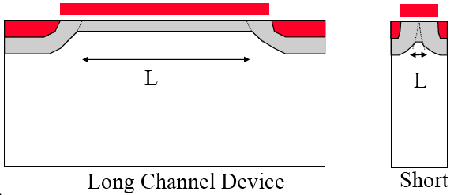
Short Channel Effects – V_{T} Reduction
G
G
S
D
S
D
n+
n+
x_{j}
n+
n+
Q_{B0}
pn+
depletion region
L_{eff}
pn+
depletion region
L_{eff}
Q_{B0(sc)}
V_{GS} induced
depletion region
V_{T0} (short channel) = V_{T0} - ΔV_{T0}

Slide 4
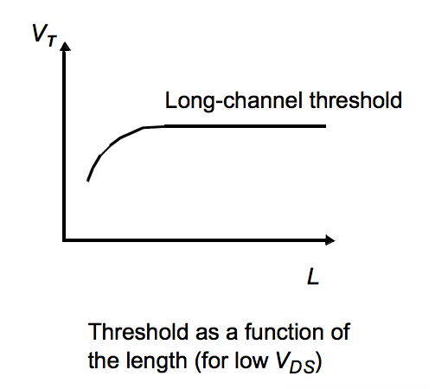
Short Channel Effects – V_{T} Reduction
G
G
S
D
S
D
n+
n+
x_{j}
n+
n+
Q_{B0}
pn+
depletion region
L_{eff}
pn+
depletion region
L_{eff}
Q_{B0(sc)}
V_{GS} induced
depletion region
V_{T0} (short channel) = V_{T0} - ΔV_{T0}

Slide 5
Short Channel Effects - DIBL
Drain Induced Barrier Lowering
V_{T} Reduction with Drain Bias

Slide 6
Short Channel Effects - DIBL
Drain Induced Barrier Lowering
V_{T} Reduction with Drain Bias

Slide 7
Short Channel Effects - DIBL
Drain Induced Barrier Lowering
V_{T} Reduction with Drain Bias
V_{T}
V_{DS}

Slide 8
Threshold Reduction Impact
Penn ESE370 Fall 2021 – Khanna
8

Slide 9
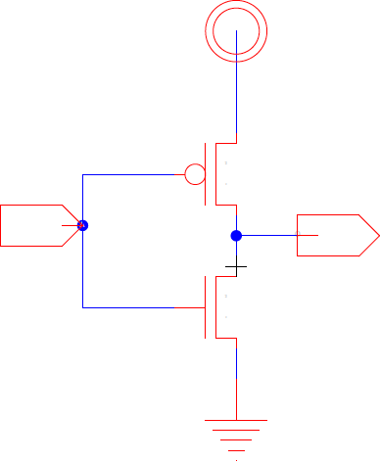
In a Gate?
What does it impact most?
Which device, has large V_{ds}?
How does this effect operation?
Speed of switching?
Leakage?
Penn ESE370 Fall 2021 – Khanna

Slide 10
Simplified Design Flow
Design a circuit to perform a function with specified minimum speed and optimized power (minimized with an upper bound)
Zero order model to design topology
First order model to meet speed spec
Rise/fall times, propagation delay, gate capacitance, output stage equivalent resistance
Transistor IV curves
Iterative SPICE simulation – tweak knobs to optimize for power (switching (dynamic), leakage (static), etc.)
today

Slide 11
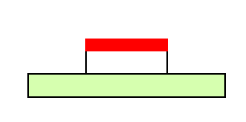
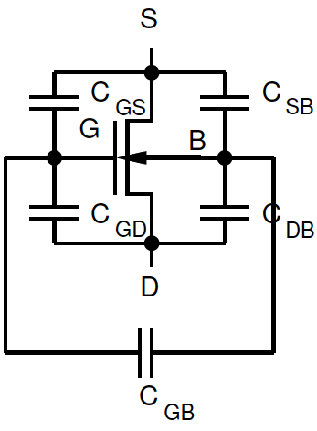
Capacitance
First order: gate input looks like a capacitor
Today:
Capacitance is not constant
Capacitance not physically to gnd
Modeled as such
D
gate
G
drain
source
R_{ON}
I_{D}
channel
C_{G}
S

Slide 12
Capacitance Setup

Slide 13
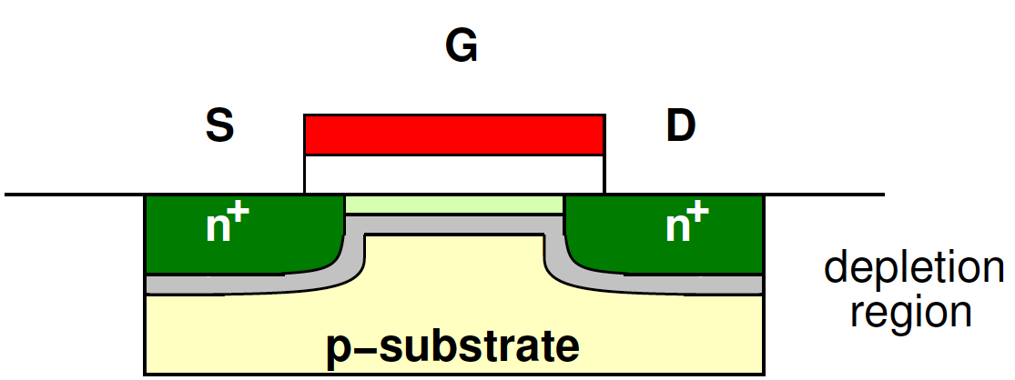
Capacitance
Modeled gate with a capacitor to ground
…but ground isn’t really one of our terminals
Don’t connect directly to it
…source and body are often at ground…
D
G
R_{ON}
I_{D}
C_{G}
S

Slide 14
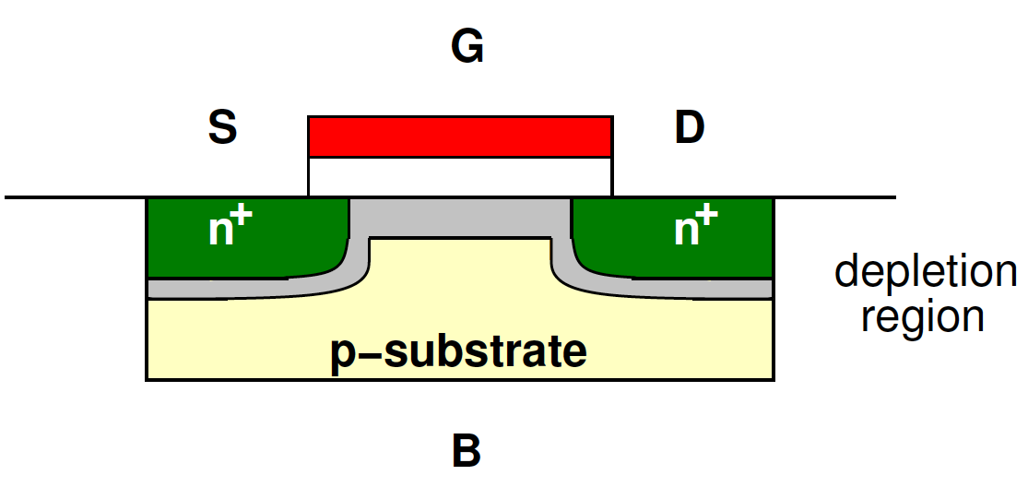
Capacitance (Preclass 1)
Four Terminals
How many combinations?
4 things taken 2 at a time?
D
G
B
S

Slide 15
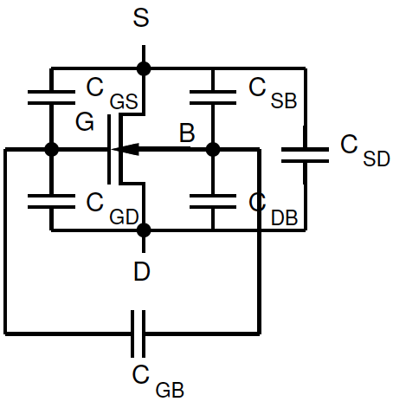
Capacitances
GS, GB, GD, SB, DB, SD

Slide 16
Capacitance Decomposition

Slide 17
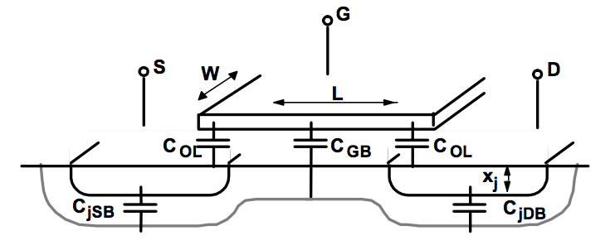
MOSFET Parasitic Capacitance
Any two conductors separated by an insulator form a parallel-plate capacitor
Two types
Extrinsic – Outside the box (e.g. junction, overlap)
Intrinsic – Inside the box (e.g. gate-to-channel)

Slide 18
Overlap Capacitance

Slide 19
Overlap
What is the capacitive implication of gate/source and gate/drain overlap?

Slide 20
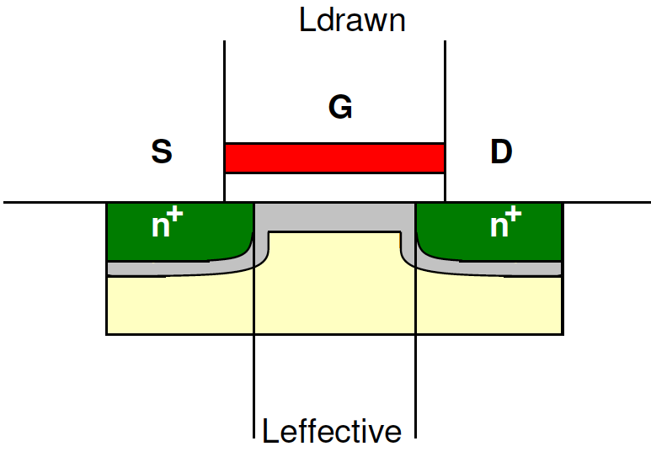
Overlap
Length of overlap?

Slide 21
Overlap Capacitance

Slide 22
Overlap Capacitance

Slide 23
Overlap Capacitance

Slide 24
Junction Capacitances
24

Slide 25
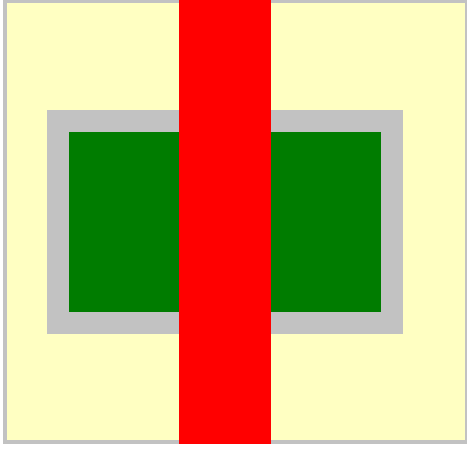
Junction (diffusion) Capacitance
n⁺ contacts are formed by doping = diffusion
Depletion under diffusion region (bottom-plate)
Due to reverse biased PN junction
Bottom-plate junction capacitance, C_{j}
Depletion around perimeter (sidewall) of diffusion region
Sidewall junction capacitance, C_{jsw}

Slide 26
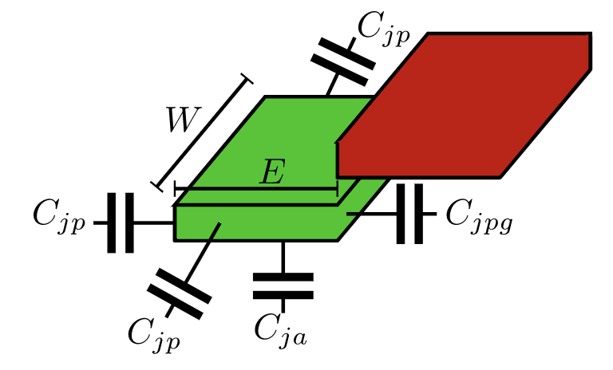
Junction (Diffusion) Capacitance
C_{j} – Bottom-plate junction capacitance (F/Area)
C_{jsw} – Sidewall junction capacitance (F/Length)
L_{S} – length of diffusion region
W
L_{S}
L_{S}

Slide 27
Junction (Diffusion) Capacitance
C_{j} – Bottom-plate junction capacitance (F/Area)
C_{jsw} – Sidewall junction capacitance (F/Length)
L_{S} – length of diffusion region
W
L_{S}
L_{S}

Slide 28
Gate-to-channel

Slide 29
MOSFET Parasitic Capacitance
Any two conductors separated by an insulator form a parallel-plate capacitor
Two types
Extrinsic – Outside the box (e.g. junction, overlap)
Intrinsic – Inside the box (e.g. gate-to-channel)

Slide 30
Gate-to-Bulk Capacitance
Looks like parallel plate capacitance
Two components:
What is C_{GC}? (C_{GCS,} C_{GCD})
What is C_{GCB}?

Slide 31
Gate-to-Channel Capacitance
Looks like parallel plate capacitance
Two components: Case: Strong Inversion (small Vds)
C_{GC}
C_{GCB}

Slide 32
Gate-to-Channel Capacitance
Looks like parallel plate capacitance
Two components: Case: Strong Inversion
C_{GC}
C_{GCB}=0

Slide 33
Gate-to-Channel Capacitance
Looks like parallel plate capacitance
Two components: Case: Strong Inversion
C_{GC} – Split evenly between S and D
C_{GB}=0

Slide 34
Gate-to-Source Capacitance
Channel + Overlap

Slide 35
Gate-to-Source Capacitance
Channel + Overlap

Slide 36
Gate-to-Drain Capacitance
Channel + Overlap

Slide 37
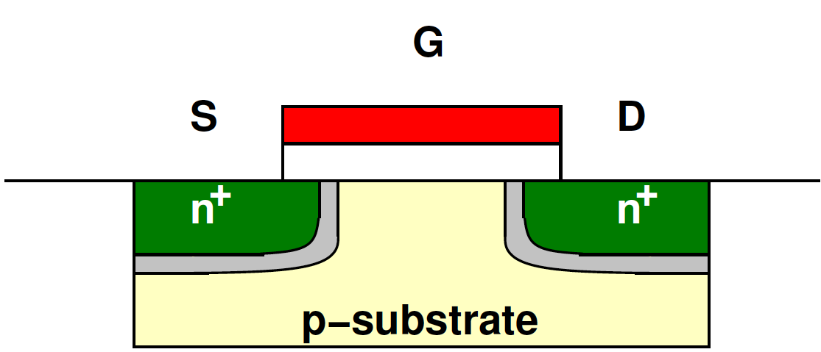
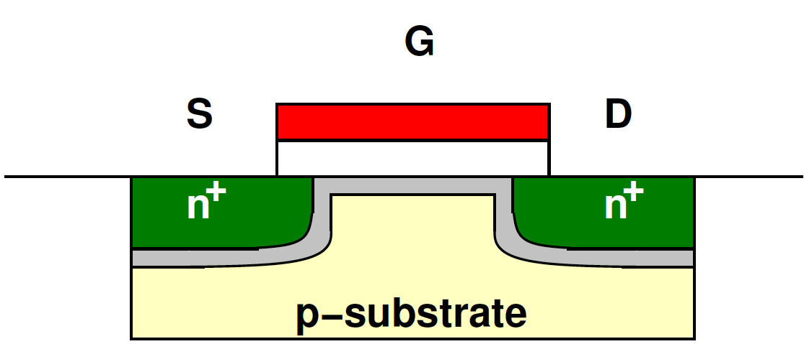
Channel Evolution: Weak Inversion

Slide 38
Channel Evolution: Weak Inversion
V_{GS}= 0 → C_{GC}=0, C_{GCB}=WLC_{ox}

Slide 39
Channel Evolution: Weak Inversion
What happens to capacitance here as V_{GS} increases?
Capacitor plate distance?

Slide 40
Channel Evolution: Weak Inversion
Capacitance is initially dominated by Gate-to-bulk capacitance (C_{GCS,D}=0)
Gate-to-bulk capacitance drops as V_{GS} increases toward V_{th}

Slide 41
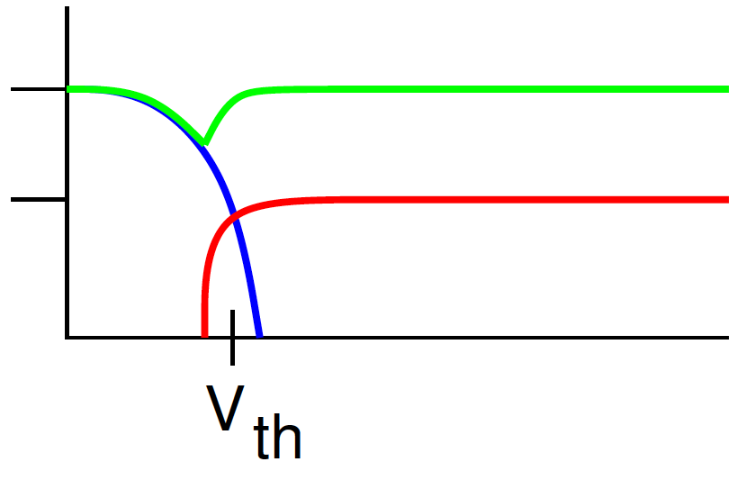
Capacitance vs V_{GS} (V_{DS}=0)
WLC_{OX}
C_{GC}
0.5WLC_{OX}
C_{GCS}=C_{GCD}
C_{GCB}
V_{GS}
Increasing V_{GS}

Slide 42
Saturation Capacitance?

Slide 43
Saturation Capacitance?
Source end of channel in inversion
Voltage at drain end of channel at or below threshold
Capacitance shifts to source
Total capacitance reduced

Slide 44
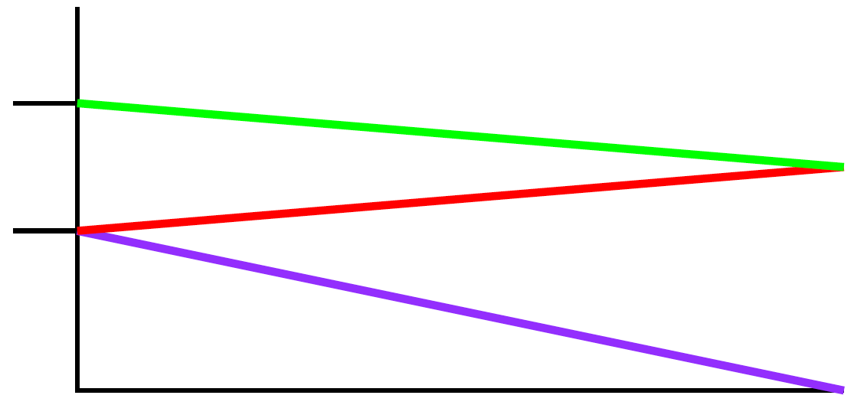
Saturation Capacitance
WLC_{OX}
C_{GC}
(2/3)WLC_{OX}
0.5WLC_{OX}
C_{GCS}
C_{GCD}
0
1
V_{DS}/(V_{GS}-V_{T})

Slide 45
Saturation Capacitance
WLC_{OX}
C_{GC}
(2/3)WLC_{OX}
0.5WLC_{OX}
C_{GCS}
(Tsividis 1987)
C_{GCD}
0
1
V_{DS}/(V_{GS}-V_{T})

Slide 46
Capacitance Roundup
C_{GS}=C_{GCS}+C_{GSO}
C_{GD}=C_{GCD}+C_{GDO}
C_{GB}=C_{GCB}
C_{SB}=C_{diff}
C_{DB}=C_{diff}

Slide 47
First Order Capacitance Summary
Operation Region | C_{GCB} | C_{GCS} | C_{GCD} | C_{GC} | C_{G}
Subthreshold
Linear
Saturation

Slide 48
First Order Capacitance Summary
Operation Region | C_{GCB} | C_{GCS} | C_{GCD} | C_{GC} | C_{G}
Subthreshold
Linear | 0 | C_{OX}WL/2 | C_{OX}WL/2
Saturation

Slide 49
First Order Capacitance Summary
Operation Region | C_{GCB} | C_{GCS} | C_{GCD} | C_{GC} | C_{G}
Subthreshold | C_{OX}WL | 0 | 0
Linear | 0 | C_{OX}WL/2 | C_{OX}WL/2
Saturation
WLC_{OX}
C_{GC}
0.5WLC_{OX}
C_{GCS}=C_{GCD}
C_{GCB}
V_{GS}

Slide 50
First Order Capacitance Summary
Operation Region | C_{GCB} | C_{GCS} | C_{GCD} | C_{GC} | C_{G}
Subthreshold | C_{OX}WL | 0 | 0
Linear | 0 | C_{OX}WL/2 | C_{OX}WL/2
Saturation | 0 | (2/3)C_{OX}WL | 0
WLC_{OX}
C_{GC}
(2/3)WLC_{OX}
0.5WLC_{OX}
C_{GCS}
C_{GCD}
0
1
V_{DS}/(V_{GS}-V_{T})

Slide 51
First Order Capacitance Summary
+
+
=
Operation Region | C_{GCB} | C_{GCS} | C_{GCD} | C_{GC} | C_{G}
Subthreshold | C_{OX}WL | 0 | 0 | C_{OX}WL
Linear | 0 | C_{OX}WL/2 | C_{OX}WL/2 | C_{OX}WL
Saturation | 0 | (2/3)C_{OX}WL | 0 | (2/3)C_{OX}WL

Slide 52
First Order Capacitance Summary
Operation Region | C_{GCB} | C_{GCS} | C_{GCD} | C_{GC} | C_{G}
Subthreshold | C_{OX}WL | 0 | 0 | C_{OX}WL | C_{OX}WL+2C_{O}
Linear | 0 | C_{OX}WL/2 | C_{OX}WL/2 | C_{OX}WL | C_{OX}WL+2C_{O}
Saturation | 0 | (2/3)C_{OX}WL | 0 | (2/3)C_{OX}WL | (2/3)C_{OX}WL +2C_{O}

Slide 53
One Implication
Feedback Capacitance C_{gd}
53

Slide 54
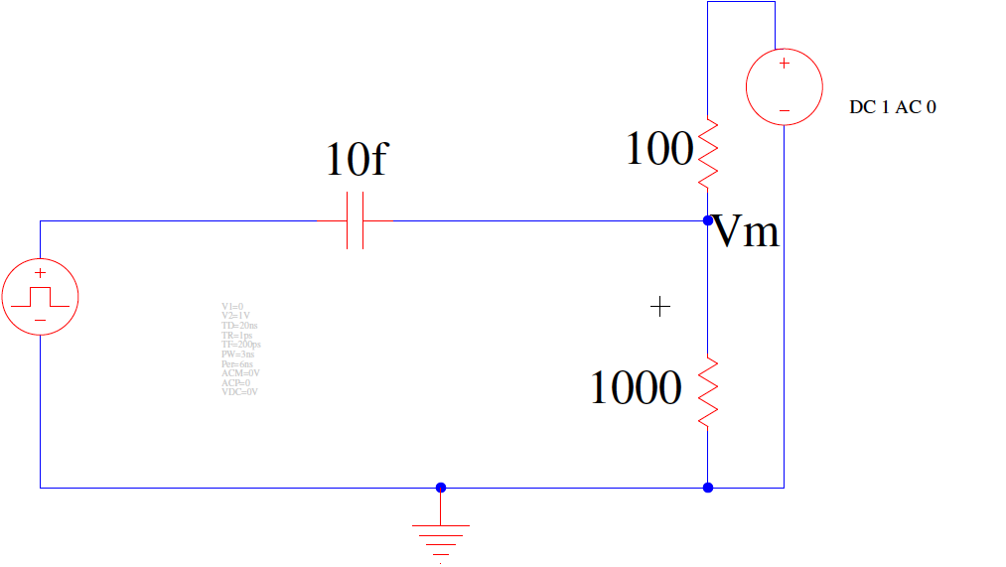
Step Response? (Preclass 2)
Vin steps from 0 to 1, what does Vout look like as a function of time
Initial voltage?
Steady state voltage?
Vin
Vout

Slide 55
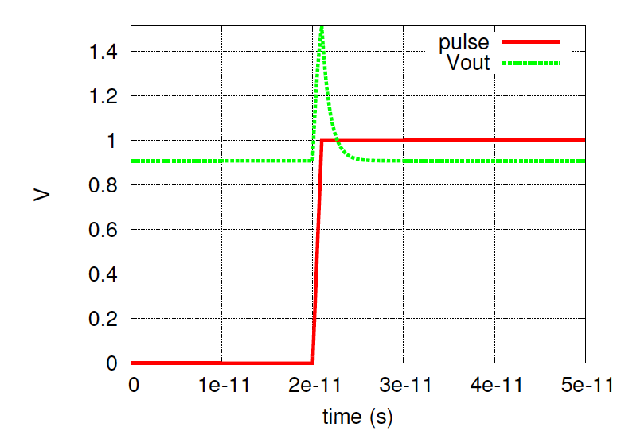
Step Response
Voltage peaking!

Slide 56
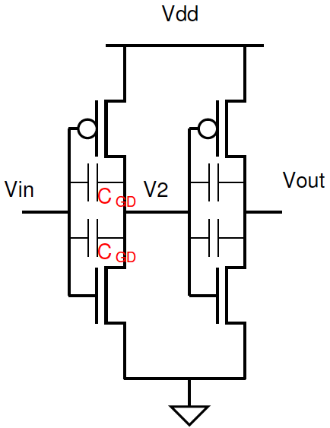
Impact of C_{GD}
What does C_{GD} do to the switching response here?
V₂
V_{out}

Slide 57
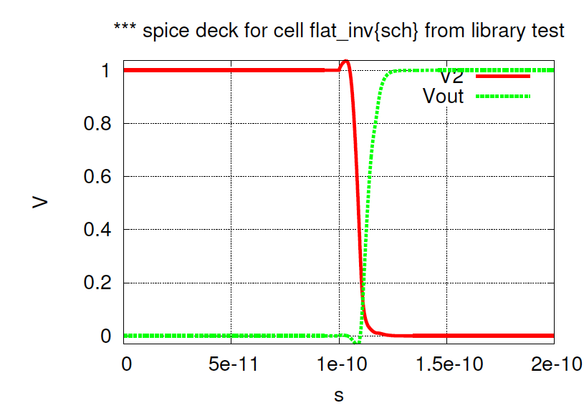
Impact of C_{GD}

Slide 58
Big Idea
Capacitance
To every terminal
Voltage dependent
WLC_{OX}
C_{GC}
0.5WLC_{OX}
C_{GCS}=C_{GCD}
C_{GCB}
V_{GS}
WLC_{OX}
C_{GC}
C_{GCS}
(2/3)WLC_{OX}
0.5WLC_{OX}
C_{GCD}
0
1
V_{DS}/(V_{GS}-V_{T})

Slide 59
Admin
HW 3
Due Monday
Midterm 1 Friday 10/1 (next week)
7-9pm in Towne 309
No Lecture, virtual office hours
Midterms from 2010-2019 (and Project 1 from 2020)
All online with and without answers
Midterm 1 Review virtual session next week
See Piazza for poll coming soon
Conflicts must let me know ASAP

Slide 60
Midterm 1 - Content
Lec 1 - 9
Identify CMOS/non-CMOS
Identify CMOS function
Any logic function → CMOS gate
Noise Margins / Restoration
Circuit first order switching rise/fall times
Output equivalent resistance
Load capacitance
MOS Model
Identify transistor region of operation
Analysis with transistor IV models
MOS capacitance models

