Slide 1
ESE532: System-on-a-Chip Architecture
Day 10: October 4, 2017
Coding HLS for Accelerators

Slide 2
Previously
We can describe computational operations in C
Primitive operations (add, sub, multiply, and, or)
Dataflow graphs primitives
To bit level
Conditionals and loops
Memory reads/writes
Function abstraction
Need to avoid
Recursive function calls, dynamic allocation

Slide 3
Perspectives
Here’s a computation we want to describe
How can we use C to describe
What do we need to watch to avoid getting tangled up in sequential C semantics
Here’s an arbitrary piece of C code
What will the compiler be able to do with it?
What would it take to write a C-to-gates compiler
What are pitfalls inherent in the C language?

Slide 4
Today
Pipelining loops
Pragmas in Vivado HLS C
Avoiding bottlenecks feeding data in Vivado HLS C
Streaming hardware operations

Slide 5
Message
Can specify HW computation in C
Vivado HLS gives control over how design mapped (area-time, streaming…)
Code may need some care and stylization to feed data efficiently
Read Design Productivity Guide (UG 1197)
C-based IP development
Reference Vivado HLS Users Guide (902)
Design Optimization

Slide 6
Finish up Mux Conversion
(about what compiler will do;
Not much about what developer does)

Slide 7
Mux conversion for simple conditionals
a
max=a;
min=a;
if (a>b)
{min=b;
c=1;}
else
{max=b;
c=0;}
May (re)define many values on each branch.
a>b
b
1
0
min
max
c

Slide 8
Mux Conversion and Memory
What might go wrong if we mux-converted the following:
If (cond)
*a=0
Else
*b=0

Slide 9
Mux Conversion and Memory
What might go wrong if we mux-converted the following:
If (cond)
*a=0
Else
*b=0
Don’t want memory operations in non-taken branch to occur.

Slide 10
Mux Conversion and Memory
If (cond)
*a=0
Else
*b=0
Don’t want memory operations in non-taken branch to occur.
Conclude: cannot mux-convert blocks with memory operations (without additional care)

Slide 11
Optimizations can expect compiler to do
Constant propagation: a=10; b=c[a];
Copy propagation: a=b; c=a+d; → c=b+d;
Constant folding: c[10*10+4]; → c[104];
Identity Simplification: c=1*a+0; → c=a;
Strength Reduction: c=b*2; → c=b<<1;
Dead code elimination
Common Subexpression Elimination:
C[x*100+y]=A[x*100+y]+B[x*100+y]
t=x*100+y; C[t]=A[t]+B[t];
Operator sizing: for (i=0; i<100; i++) b[i]=(a&0xff+i);

Slide 12
Pipelining
i<MAX
+
x
i
for (i=0;i<MAX;i++)
o[i]=(a*x[i]+b)*x[i]+c;
If know memory operations independent
What II?
read
a
*
b
+
*
c
+
o
write

Slide 13
Loop Interpretations
What does a loop describe?
Sequential behavior [when execute]
Spatial construction [when create HW]
Data Parallelism [sameness of compute]
We will want to use for all 3
Sometimes need to help the compiler understand which we want

Slide 14
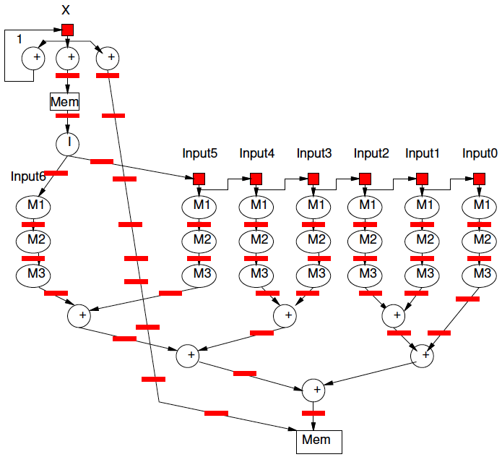
C Loops
Adequate to define hardware pipelines

Slide 15
Vivado HLS Mapping Control

Slide 16
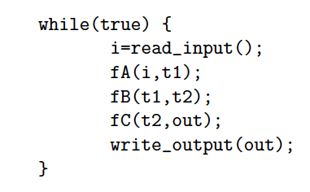
Preclass 1
What dataflow graph does this describe?

Slide 17
Vivado HLS Pragma DATAFLOW
Enables streaming data between functions and loops
Allows concurrent streaming execution
Requires data be produced/consumed sequentially
Useful to use stream data type between functions
hls::stream<TYPE>

Slide 18
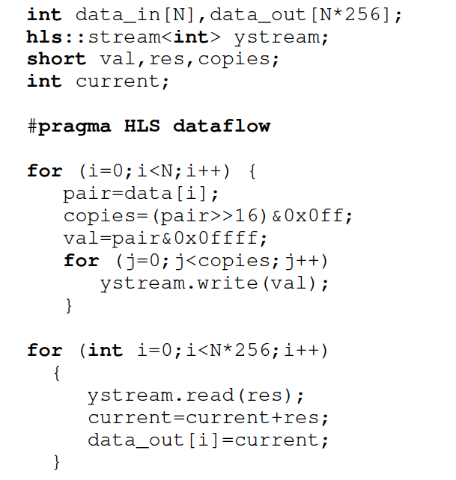

Slide 19
Vivado HLS Pragma PIPELINE
Direct a function or loop to be pipelined
Ideally start one loop or function body per cycle
Can control II

Slide 20
for (i=0;i<N;i++)
yout=0;
#pragma HLS PIPELINE
for (j=0;j<K;j++)
yout+=in[i+j]*w[j];
y[i]=yout;
Which solution
from preclass 2?

Slide 21
Dataflow and pipelining
Dataflow allows coarse-grained pipelining among loops and functions
Pipeline causes loop bodies to be pipelined

Slide 22
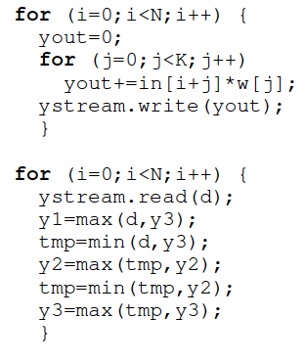
Dataflow and Pipelining
Cycles with no dataflow, no pipelining?
Dataflow only?
Pipeline only?
Dataflow and pipeline?

Slide 23
Vivado HLS Pragma UNROLL
Unroll loop into spatial hardware
Can control level of unrolling
Any loops inside a pipelined loop gets unrolled by the PIPELINE directive

Slide 24
for (i=0;i<N;i++)
yout=0;
#pragma HLS UNROLL
for (j=0;j<K;j++)
yout+=in[i+j]*w[j];
y[i]=yout;
Which solution
from preclass 2?

Slide 25
Dataflow and Pipelining
Cycles unroll K-loop, dataflow, pipeline?

Slide 26
Unroll
Can perform partial unrolling
#pragma HLS UNROLL factor=…
Use to control area-time points
Use of loop for spatial vs. temporal description

Slide 27
Vivado HLS Pragma INLINE
Collapse function body into caller
Eliminates interface code
Allows optimization of inline code
recursive option to inline a hierarchy
Maybe useful when explore granularity of accelerator

Slide 28
Vivado HLS Pragma ARRAY_PARTITION
Spread out array over multiple BRAMs
By default placed in single BRAM
Use to remove memory bottleneck that prevents pipelining (limits II)

Slide 29
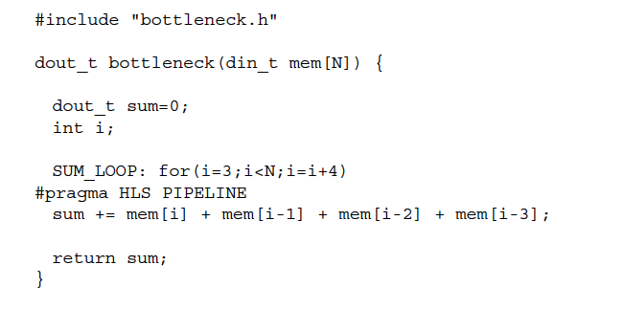
Memory Bottleneck Example
902 example p. 91-92
What problem if put mem
in single BRAM?
Xilinx UG1197 (2017.1) p. 50

Slide 30
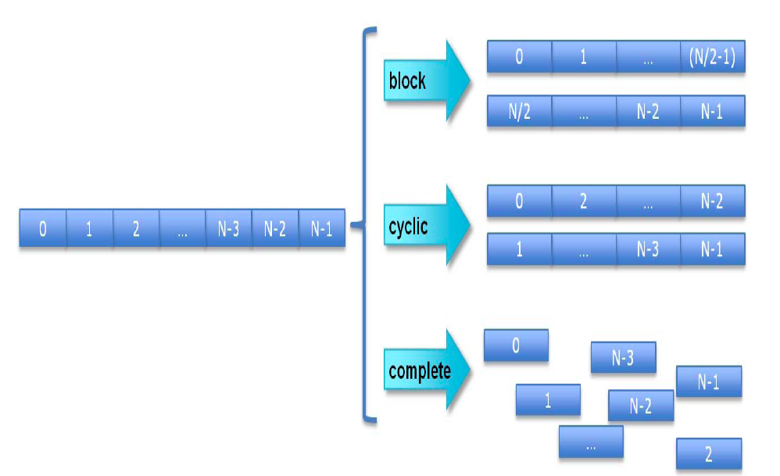
Array Partition
Xilinx UG902 p. 195 (145 in 2017.1 version)

Slide 31
Array Partition Example
#pragma ARRAY_PARTITION variable=mem cylic factor=4
Xilinx UG902 p. 91

Slide 32
Vivado HLS Pragma ARRAY_RESHAPE
Pack data into BRAM to improve access (reduce BRAMs)
May provide similar benefit to partitioning without using more BRAMs

Slide 33
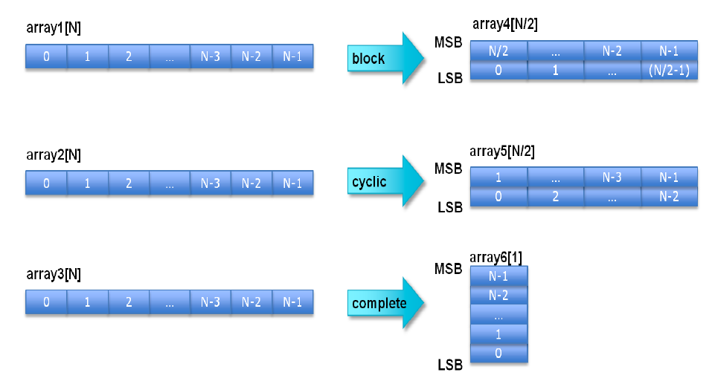
Xilinx UG902 (2017.1) p. 173

Slide 34
902 example p. 91-92
How fix if dint_t is 16b?
Xilinx UG902 p. 91

Slide 35
Array Reshape Example
#pragma ARRAY_RESHAPE variable=mem cylic factor=4 dim=1
(if din_t 16b)
Xilinx UG902 p. 91

Slide 36
Summary
pragmas allow us to control hardware mapping
How interpret loops
Turn area-time knobs
Specify how arrays get mapped to memories

Slide 37
Streaming Operations

Slide 38
Streaming Operations
Functions can have stream inputs and outputs
Must pass a pointers
hls::stream<Type> &strm
Have expressiveness to define hardware streaming operation pipelines

Slide 39
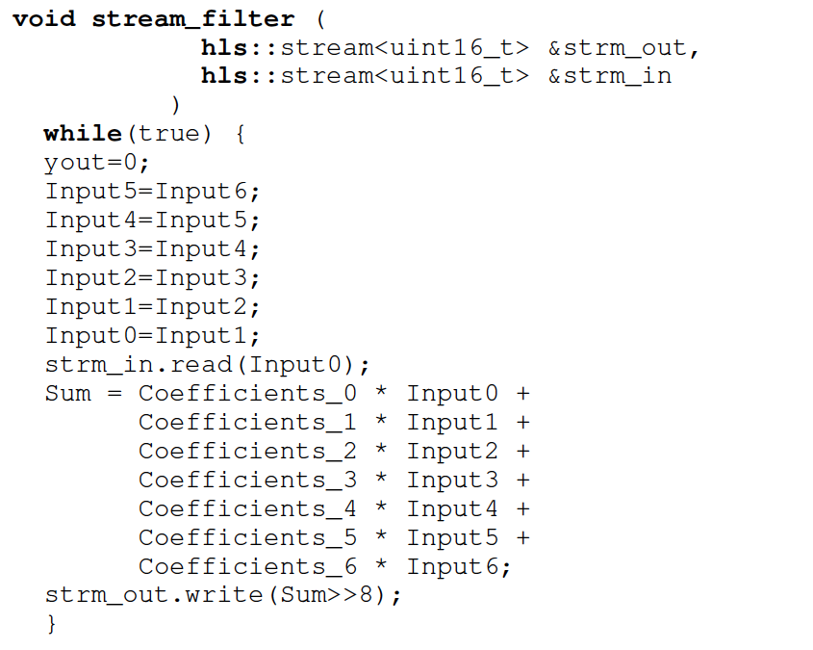

Slide 40
Big Ideas
Can specify HW computation in C
Create streaming operations
Run on processor or FPGA
Vivado HLS gives control over how map to hardware
Area-time point

Slide 41
Admin
Fall Break
Back on Monday
HW5 due 10/13

