Slide 1
ESE532: System-on-a-Chip Architecture
Day 11: October 9, 2017
Data Movement
(Interconnect, DMA)

Slide 2
Preclass 1
N processors
Each: 1 read, 10 cycle, 1 write
Memory: 1 read or write per cycle
How many processors can support?

Slide 3
Bottleneck
Sequential access to a common memory can become the bottleneck

Slide 4
Previously
Want data in small memories
Low latency, high bandwidth
FPGA has many memories all over fabric

Slide 5
Embedded Memory in FPGA
Logic
Cluster
Memory
Bank
Memory
Frequency
XC7Z020 (Zed Board) has 140 36Kb BRAMs

Slide 6
Previously
Want data in small memories
Low latency, high bandwidth
FPGA has many memories all over fabric
Want C arrays in small memories
Partitioned so can perform enough reads (writes) in a cycle to avoid memory bottleneck

Slide 7
Today
Interconnect Infrastructure
Data Movement Threads
Peripherals
DMA

Slide 8
Message
Need to move data
Shared interconnect to make physical connections
Useful to move data as separate thread of control
Dedicating a processor is inefficient
Useful to have dedicated data-movement hardware: DMA

Slide 9
Memory and I/O Organization
Architecture contains
Large memories
For density, necessary sharing
Small memories local to compute
For high bandwidth, low latency, low energy
Peripherals for I/O
Need to move data
Among memories and I/O
Large to small and back
Among small
From Inputs, To Outputs

Slide 10
How move data?
Abstractly, using stream links.
Connect stream between producer and consumer.
Ideally: dedicated wires

Slide 11
Dedicated Wires?
Why might we not be able to have dedicated wires?

Slide 12
Making Connections
Cannot always be dedicated wires
Programmable
Wires take up area
Don’t always have enough traffic to consume the bandwidth of point-to-point wire
May need to serialize use of resource
E.g. one memory read per cycle
Source or destination may be sequentialized on hardware

Slide 13
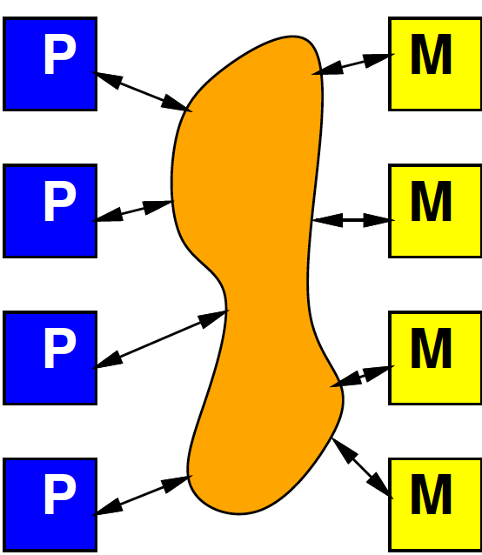
Model
Programmable, possibly shared interconnect

Slide 14
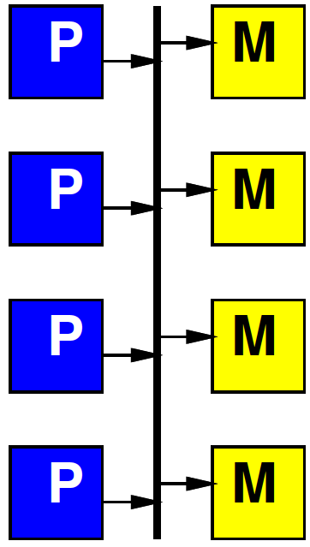
Simple Realization
Shared Bus
Write to bus with address of destination
When address match, take value off bus
Pros?
Cons?

Slide 15
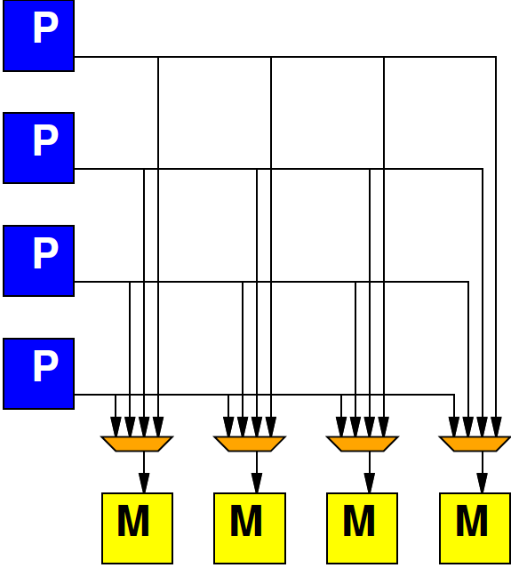
Alternate: Crossbar
Provide programmable connection between all sources and destinations
Any destination can be connected to any single source

Slide 16
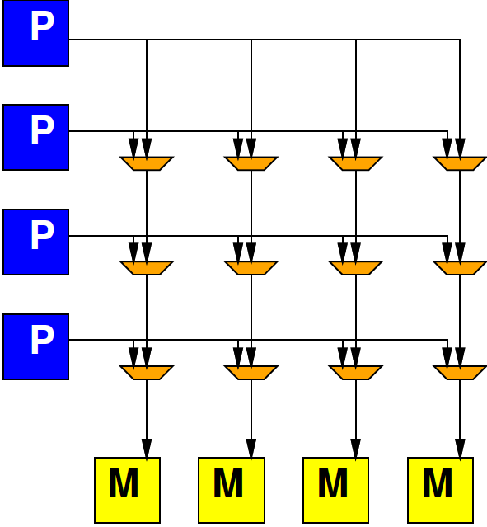
Crossbar

Slide 17
Preclass 2
K-input, O-output Crossbar
How many 2-input muxes?

Slide 18
Crossbar
Provides high bandwidth
Minimal blocking
Costs large amounts of area
Grows fast with inputs, outputs

Slide 19
General Interconnect
Generally, want to be able to parameterize designs
Here: tune area-bandwidth
Control how much bandwidth provide

Slide 20
Interconnect
How might get design points between bus and crossbar?

Slide 21
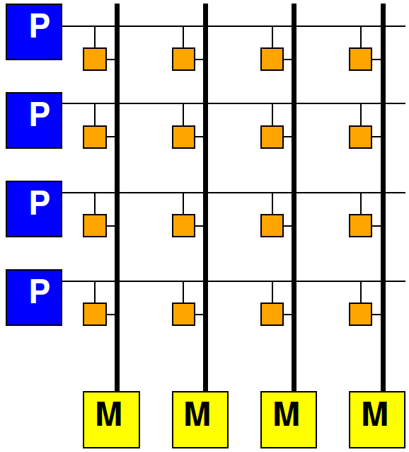
Multiple Busses
Think of crossbar as one bus per output
Simple bus is one bus total
In between,
How many simultaneous busses support?

Slide 22
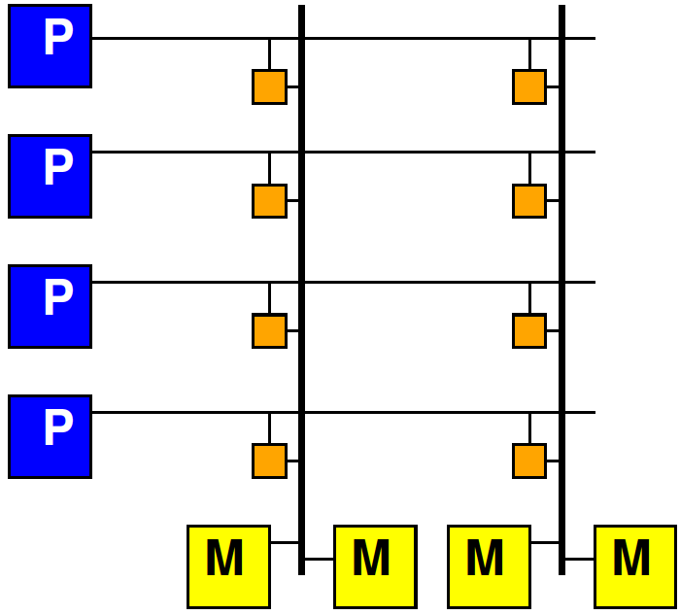
Share Crossbar Outputs
Group set of outputs together on a bus

Slide 23
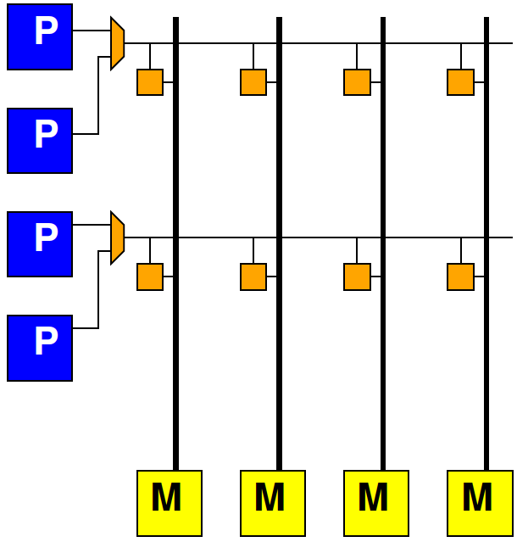
Share Crossbar Inputs
Group number of inputs together on an input port to crossbar

Slide 24
Locality in Interconnect
How allow physically local items to be closer?

Slide 25
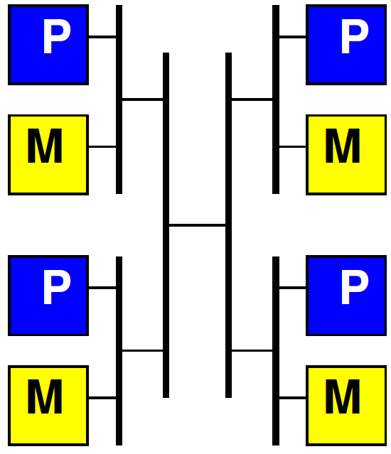
Hierarchical Busses

Slide 26
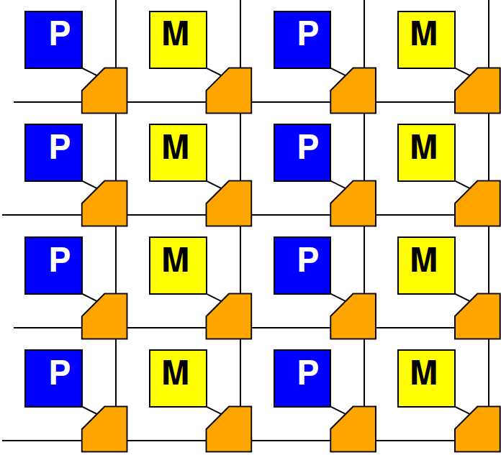
Mesh

Slide 27
Interconnect
Will need an infrastructure for programmable connections
Rich design space to tune area-bandwidth-locality
Will explore more later in course

Slide 28
Masters and Slaves
Regardless of form, potentially have two kinds of entities on interconnect
Master – can initiate requests
E.g. processor that can perform a read or write
Slaves – can only respond to requests
E.g. memory that can return the read data from a read requset

Slide 29
Long Latency Memory Operations

Slide 30
Day 3
Large memories are slow
Latency increases with memory size
Distant memories are high latency
Multiple clock-cycles to cross chip
Off-chip memories even higher latency

Slide 31
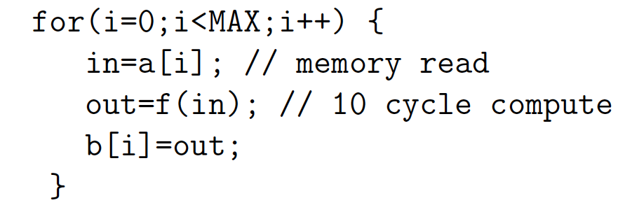
Day 3, Preclass 2
10 cycle latency to memory
If must wait for data return, latency can degrade throughput
10 cycle latency + 10 op + (assorted)
More than 20 cycles / result

Slide 32
Preclass 3
Throughput using 3 threads?

Slide 33
Fetch (Write) Threads
Potentially useful to move data in separate thread
Especially when
Long (potentially variable) latency to data source (memory)
Useful to split request/response

Slide 34
Peripherals

Slide 35
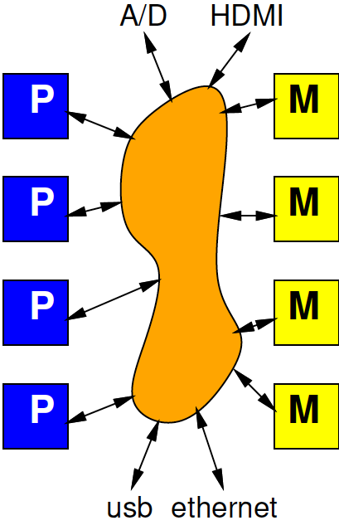
Input and Output
Typical SoC has I/O with external world
Sensors
Actuators
Keyboard/mouse, display
Communications
Also accessible from interconnect

Slide 36
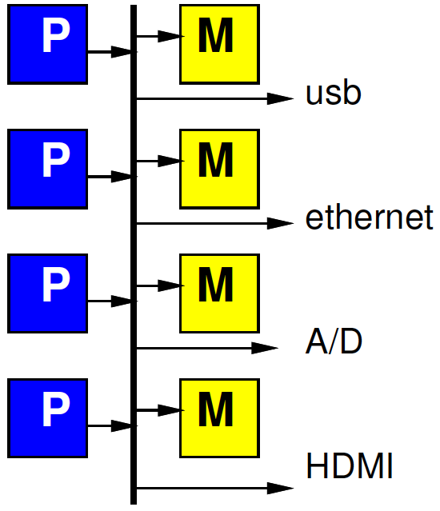
Simple Peripheral Model
Peripherals are slave devices
Masters can read input data
Masters can write output data
To move data, master (e.g. processor) initiates

Slide 37
Simple Model Implications
What implication to processor grabbing/moving each input (output) value?

Slide 38
Timing Demands
Must read each input before overwritten
Must write each output within real-time window
Must guarantee processor scheduled to service each I/O at appropriate frequency
How many cycles between inputs for 1Gb/s network and 32b, 1GHz processor?

Slide 39
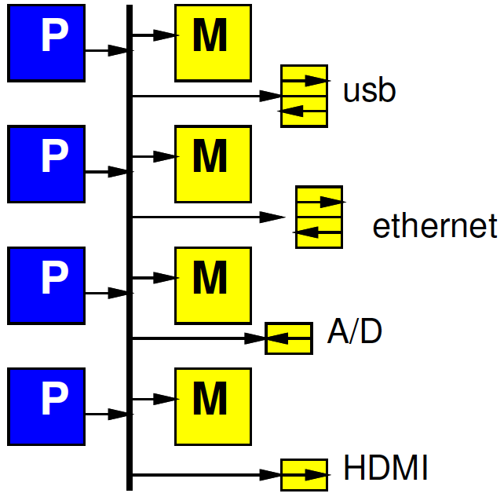
Refine Model
Give each peripheral local FIFO
Processor must still move data
How does this change requirements and impact?

Slide 40
DMA

Slide 41
Preclass 4
How much hardware to support fetch thread:
Counter bits?
Registers?
Comparators?
Other gates?
Compare to MicroBlaze
(minimum config 630 6-LUTs)

Slide 42
Observe
Modest hardware can serve as data movement thread
Much less hardware than a processor
Offload work from processors
Small hardware allow peripherals to be master devices on interconnect

Slide 43
DMA
Direct Memory Access (DMA)
Peripheral as Master
Can write directly into (read from) memory
Saves processor from copying
Reduces demand to schedule processor to service

Slide 44
DMA Engine
Data Movement Thread
Specialized Processor that moves data
Act independently
Implement data movement
Can build to move data between memories (Slave devices)
E.g., Implement P1, P3 in Preclass 3

Slide 45
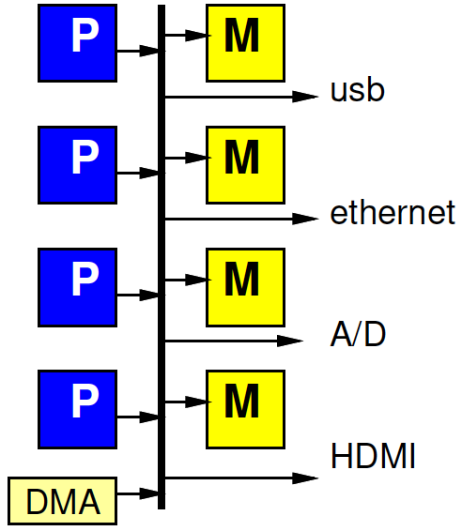
DMA Engine

Slide 46
Programmable DMA Engine
What copy from?
Where copy to?
Stride?
How much?
What size data?
Loop?
Transfer Rate?

Slide 47
Multithreaded DMA Engine
One copy task not necessarily saturate bandwidth of DMA Engine
Share engine performing many transfers (channels)
Separate transfer state for each
Hence thread (or channel)
Swap among threads
E.g., round-robin

Slide 48
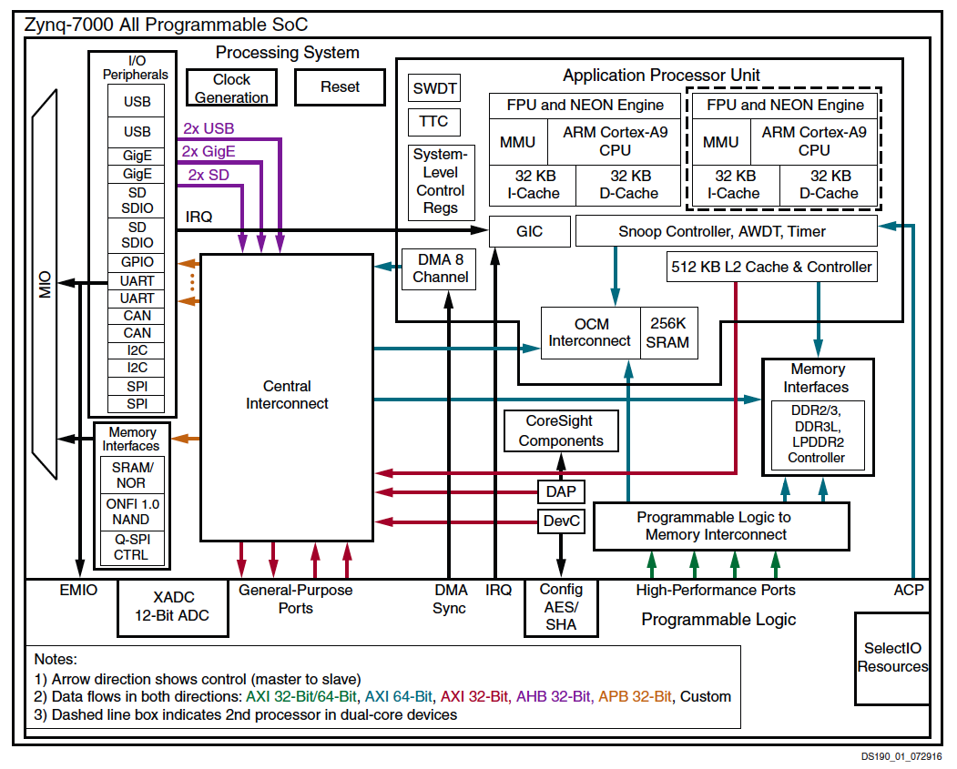

Slide 49
Hardwired and Programmable
Zynq has hardwired DMA engine
Can also add data movement engines (Data Movers) in FPGA fabric

Slide 50
Example
Networking Application
Header on processor
Payload (encrypt, checksum) on FPGA
DMA from ethernet→main memory
DMA main memory→BRAM
Stream between payload components
DMA from chksum to ethernet out
header
Payload encrypt
chksum
ethernet
ethernet

Slide 51
Big Ideas
Need to move data
Shared Interconnect to make physical connections – can tune area/bw/locality
Useful to
move data as separate thread of control
Have dedicated data-movement hardware: DMA

Slide 52
Admin
Day 12
DRAM reading if not read on Day 3
HW5 due Friday

