Slide 1

ESE532:
System-on-a-Chip Architecture
Day 12: October 11, 2017
Orchestrating Data in Memories

Slide 2
Today
DRAM
DRAM Implications
Tricks for working with DRAM
and generally minimizing use of large
memories

Slide 3
Message
How we access data matters
Reuse data to avoid access to large memories
Encourage think about how organize computation and data to minimize
  Use of large memory
  Data movement
…and to think about what you expect, so can diagnose unnecessary data bottlenecks

Slide 4
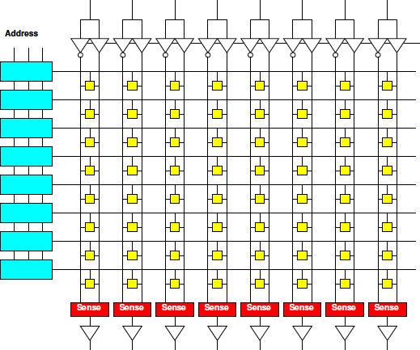
Day 3: Memory Scaling
Small memories are fast
  Large memories are slow
Small memories low energy
  Large memories high energy
Large memories dense
  Small memories cost
  more area per bit
Combining:
  Dense memories
  are slow

Slide 5
Day 3: Lesson
Cheaper to access wide/contiguous blocks memory
  In hardware
  From the architectures typically build
Can achieve higher bandwidth on large block data transfer
  Than random access of small data items

Slide 6
DRAM
Usually the largest memory

Slide 7
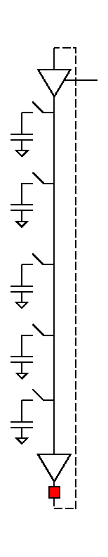
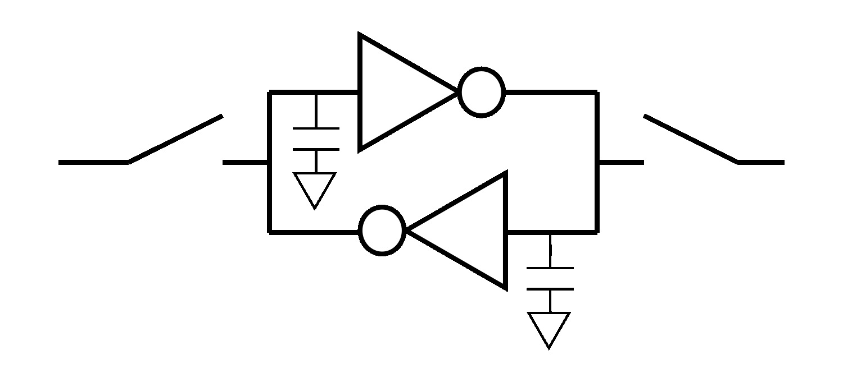
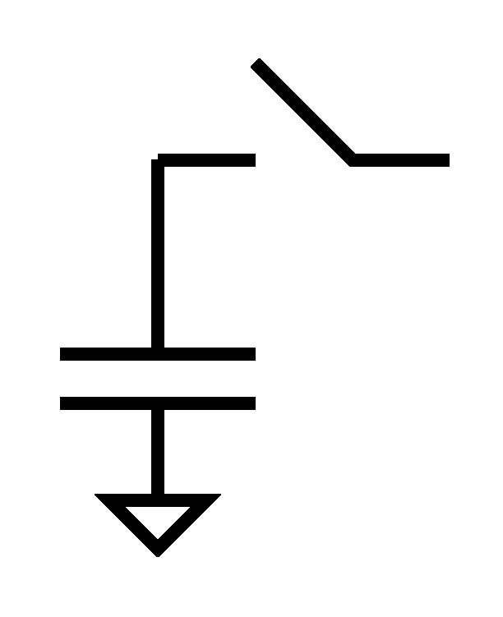
Dynamic RAM
Shares even more logic among bits
Share refresh/restoration logic as well
Minimal storage is a capacitor
“Feature” DRAM process is ability to make capacitors efficiently
Denser, but slower

Slide 8
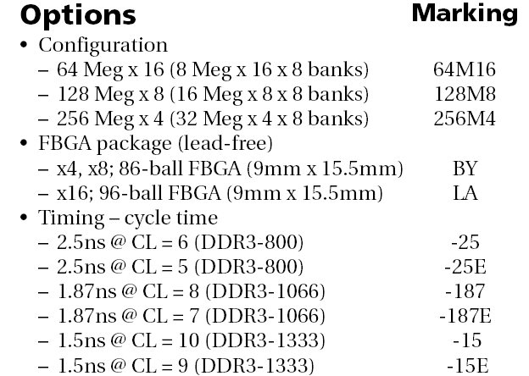
DRAM
1GB DDR3 SDRAM from Micron
  http://www.micron.com/products/dram/ddr3/
  96 pin pakage
  16b datapath IO
  Operate at 500+MHz
  37.5ns random access latency

Slide 9
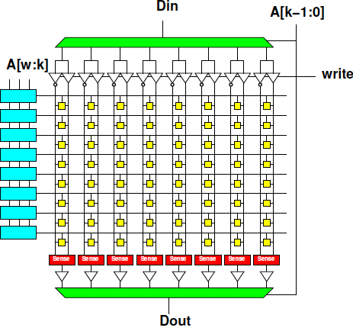
Memory Access Timing
Access:
  Address (RCD)
  Row fetch (RP)
  Column select (CL)
  writeback/refresh
Optimization for access within a row

Slide 10
Memory Access Timing
Access
  Address (RCD)
  Row fetch (RP)
  Column select
    CL: Can repeat
  writeback/refresh
Row
1024b—8192b
Faster to access within row

Slide 11
DRAM
1GB DDR3 SDRAM from Micron
  http://www.micron.com/products/dram/ddr3/
  96 pin pakage
  16b datapath IO
  Operate at 500+MHz
  37.5ns random access latency

Slide 12
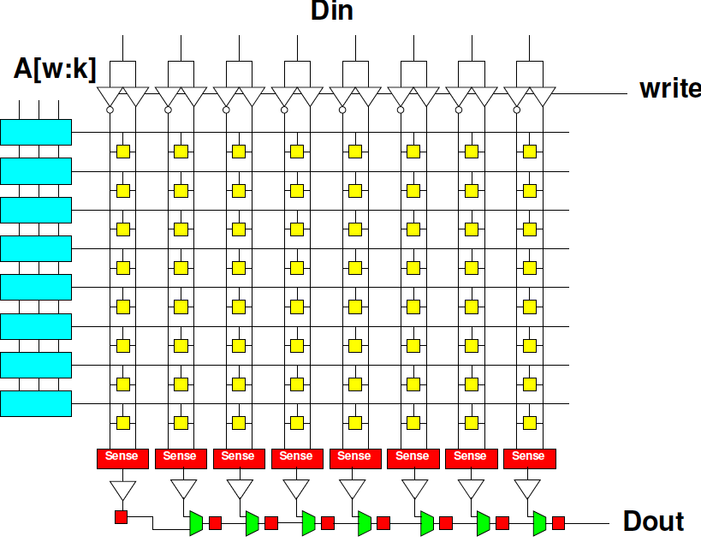
DRAM Streaming
Reading row
is 15ns
16b @ 500MHz
1024b row
1024/16
  64 words
  per row
How supply 16b/2ns

Slide 13
DRAM
1GB DDR3 SDRAM from Micron
  http://www.micron.com/products/dram/ddr3/
  96 pin pakage
  16b datapath IO
  Operate at 500+MHz
  37.5ns random access latency

Slide 14
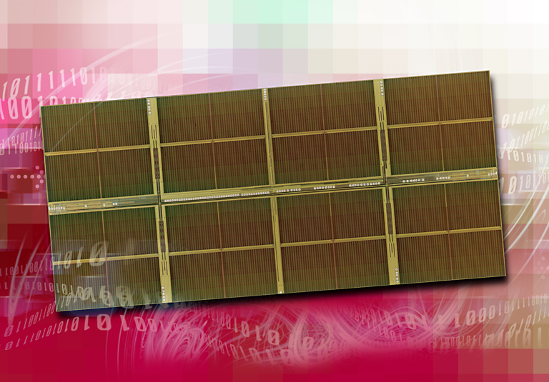
1 Gigabit DDR2 SDRAM
[Source: http://www.elpida.com/en/news/2004/11-18.html]

Slide 15
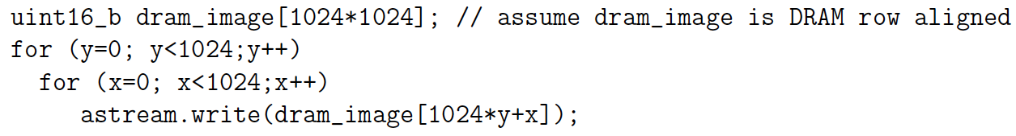
Preclass 1
How many cycles to run loop?

Slide 16
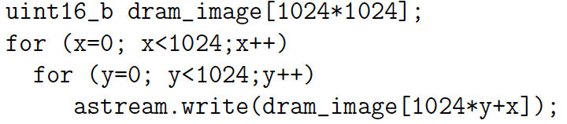
Preclass 2
How many cycles to run loop?

Slide 17
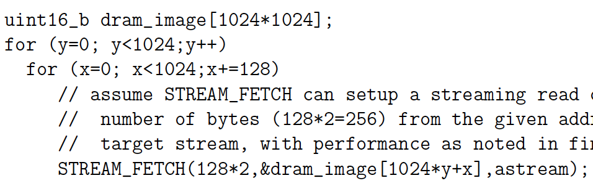
Preclass 3
How many cycles to run loop?

Slide 18
DRAM
Latency is large (10s of ns)
Throughput can be high (GB/s)
  If accessed sequentially
  If exploit wide word block transfers
Throughput low on random accesses
  As we saw for random access on wide-word memory

Slide 19
Maximize Reuse
Minimize need to go to large memory

Slide 20
Data Management
Large, central memory
  Bottleneck
  High energy
Minimize need to return to it

Slide 21
Window Filter
Compute based on neighbors
  F(d[y-1][x-1],d[y-1][x],d[y-1][x+1],
  d[y][x-1],d[y][x],d[y][x+1],
  d[y+1][x-1],d[y+1][x],d[y+1][x+1])
Common idiom
  Image filtering
  Numerical simulation
  Cellular automata
  Search, matching

Slide 22
Window Filter
Compute based on neighbors
  F(d[y-1][x-1],d[y-1][x],d[y-1][x+1],
  d[y][x-1],d[y][x],d[y][x+1],
  d[y+1][x-1],d[y+1][x],d[y+1][x+1])
Generalize for different neighborhood sizes
  For (yoff=YMIN; yoff<YMAX;yoff++)
  For (xoff=XMIN; xoff<XMAX;xoff++)
  res=fun(res,d[y+yoff][x+xoff]);

Slide 23
Window Filter
Compute based on neighbors
For (y=0;y<YMAX;y++)
For (x=0;x<XMAX;x++)
  o[y][x]=F(d[y-1][x-1],d[y-1][x],d[y-1][x+1],
  d[y][x-1],d[y][x],d[y][x+1],
  d[y+1][x-1],d[y+1][x],d[y+1][x+1])
How work with image in DRAM?

Slide 24
Window Filter
Compute based on neighbors
For (y=0;y<YMAX;y++)
For (x=0;x<XMAX;x++)
  o[y][x]=F(d[y-1][x-1],d[y-1][x],d[y-1][x+1],
  d[y][x-1],d[y][x],d[y][x+1],
  d[y+1][x-1],d[y+1][x],d[y+1][x+1])
How work with image in DRAM?
  As written references
  Reads per row

Slide 25
Window Filter
Compute based on neighbors
For (y=0;y<YMAX;y++)
For (x=0;x<XMAX;x++)
  o[y][x]=F(d[y-1][x-1],d[y-1][x],d[y-1][x+1],
  d[y][x-1],d[y][x],d[y][x+1],
  d[y+1][x-1],d[y+1][x],d[y+1][x+1])
Data reused between inner loop invocations when x increments?

Slide 26
Window Filter
Compute based on neighbors
For (y=0;y<YMAX;y++)
For (x=0;x<XMAX;x++)
  o[y][x]=F(d[y-1][x-1],d[y-1][x],d[y-1][x+1],
  d[y][x-1],d[y][x],d[y][x+1],
  d[y+1][x-1],d[y+1][x],d[y+1][x+1])
Data reused between y values in outer loop?
  Reuse distance?

Slide 27
Window Filter
Compute based on neighbors
For (y=0;y<YMAX;y++)
For (x=0;x<XMAX;x++)
  o[y][x]=F(d[y-1][x-1],d[y-1][x],d[y-1][x+1],
  d[y][x-1],d[y][x],d[y][x+1],
  d[y+1][x-1],d[y+1][x],d[y+1][x+1])
What need to do to store old y offsets so not need to reread from large memory?

Slide 28
Line Buffers
Only need to save last 2 (window_height-1) rows (d[y][*])
Store in local buffers
  Type dy[XMAX], dym[XMAX];
    dym for dy minus 1
  Stick value there between uses.

Slide 29
Window Filter
With line buffers dy, dym
For (y=0;y<YMAX;y++)
For (x=0;x<XMAX;x++)
  dypxm=dypx; dypx=dnew; dnew=d[y+1][x+1];
  o[y][x]=F(dym[x-1],dym[x],dym[x+1],
  dy[x-1],dy[x],dy[x+1],
  dypxm,dypx,dnew);
  dym[x-1]=dy[x-1];dy[x-1]=dypxm;

Slide 30
Window Filter
With line buffers dy, dym
For (y=0;y<YMAX;y++)
For (x=0;x<XMAX;x++)
  dypxm=dypx; dypx=dnew; dnew=d[y+1][x+1];
  o[y][x]=F(dym[x-1],dym[x],dym[x+1],
  dy[x-1],dy[x],dy[x+1],
  dypxm,dypx,dnew);
  dym[x-1]=dy[x-1];dy[x-1]=dypxm;
Avoid multiple read dy, dym?

Slide 31
Window Filter
Single read and write from dym, dy
For (y=0;y<YMAX;y++)
For (x=0;x<XMAX;x++)
  dypxm=dypx; dypx=dnew; dnew=d[y+1][x+1];
  dyxm=dyx; dyx=dyxp; dyxp=dy[x+1];
  dymxm=dymx; dymx=dymxp; dymxp=dym[x+1];
  o[y][x]=F(dymxm,dymx,dymxp,
  dyxm,dyx,dyxp,
  dypxm,dypx,dnew);
  dym[x-1]=dyxm;dy[x-1]=dypxm;

Slide 32
Window Filter
Convert to stream … use Preclass 3 load
For (y=0;y<YMAX;y++)
For (x=0;x<XMAX;x++)
  dypxm=dypx; dypx=dnew; astream.read(dnew);
  dyxm=dyx; dyx=dyxp; dyxp=dy[x+1];
  dymxm=dymx; dymx=dymxp; dymxp=dym[x+1];
  o[y][x]=F(dymxm,dymx,dymxp,
  dyxm,dyx,dyxp,
  dypxm,dypx,dnew);
  dym[x-1]=dyxm;dy[x-1]=dypxm;

Slide 33
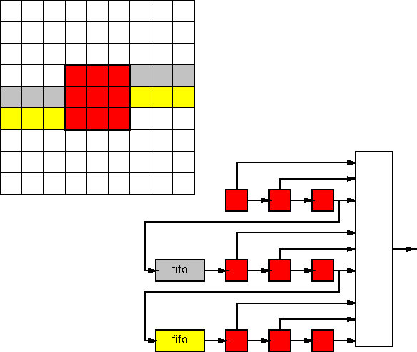
Pipelined Circuit
Single read from big memory (DRAM) per result
Shift registers
Line buffers

Slide 34
Multiple Filters
What if want to run multiple filters?
for (f=0;f<FMAX;f++)
for (y=0;y<YMAX;y++)
for (x=0;x<XMAX;x++)
  o[f][y][x]=fun[f](d[y-1][x-1],d[y-1][x],d[y-1][x+1],
  d[y][x-1],d[y][x],d[y][x+1],
  d[y+1][x-1],d[y+1][x],d[y+1][x+1]);
Forces multiple reads through d
Avoidable?

Slide 35
Sort

Slide 36
Sort
Order data
  7 3 4 2 1 9 8 0 → 0 1 2 3 4 7 8 9
Data movement can be challenging
  Last value may become first (vice-versa)
  Especially when not fit in small memories
Many sequential sort solutions access data irregularly
  Want to avoid with DRAM

Slide 37
Observation: Merge
Merging two sorted list is a streaming operation
Int aptr; int bptr;
For (i=0;i<MCNT;i++)
  If ((aptr<ACNT) && (bptr<BCNT))
  If (a[aptr]>b[bptr])
  { o[i]=a[aptr]; aptr++; }
  Else
  { o[i]=b[bptr]; bptr++; }
  Else // copy over remaining from a or b

Slide 38
Merge using Streams
Merging two sorted list is a streaming operation
Int ptr; int bptr;
astream.read(ain); bstream.read(bin)
For (i=0;i<MCNT;i++)
  If ((aptr<ACNT) && (bptr<BCNT))
  If (ain>bin)
  { ostream.write(ain); aptr++; astream.read(ain);}
  Else
  { ostream.write(bin) bptr++; bstream.read(bin);}
  Else // copy over remaining from astream/bstream

Slide 39
Merge and DRAM
How streaming merge work with DRAM row?
For (i=0;i<MCNT;i++)
  If ((aptr<ACNT) && (bptr<BCNT))
  if (ain>bin)
  { ostream.write(ain); aptr++; astream.read(ain);}
  else
  { ostream.write(bin) bptr++; bstream.read(bin);}

Slide 40
Building from Merge
Know how to get sorted data of length N given two, independently sorted lists of length N/2
How get sorted lists of length N/2?
How get sorted lists of length N/4?
What happens when have lists of length 1?

Slide 41
Merge Sort
Strategy
  For i=1 to passes
    Pass over data creating merged sequences of length 2^{i} from pairs of length 2^{i-1}
  What is passes?
Can, at least, limit to passes reads through data from large memory.

Slide 42
On-chip Merge
As long as can fit sequence (2^{i}) on chip, can stream merge stages without going back to big memory (DRAM)
2^{i-1}
2^{i}
2^{i}
merge
alternate

Slide 43
On-chip Merge
As long as can fit sequence (2^{i}) on chip, can stream merge stages without going back to big memory (DRAM)
  E.g. with 36Kb BRAMs ~ first 10-12 stages
    Up to ~16 using multiple BRAMs
merge+alt
merge+alt
merge+alt

Slide 44
On-chip Merge
For sorts up to ~100K elements may be able to cover in one read/write stream to/from DRAM
Larger: ~log₂(N)-15 read/writes
merge+alt
merge+alt
merge+alt

Slide 45
Big Ideas
Must pay attention to orchestrate data movement
  How we access and reuse data
Minimize use of large memories
Regular access to large memories higher performance
  Easier to get bandwidth on wide-word reads

Slide 46
Admin
Reading for Monday on web
HW5 due Friday
HW6 out
  Does into 8 full FPGA builds
  Plan for that build time

