Slide 1
ESE532: System-on-a-Chip Architecture
Day 13: October 16, 2017
VLIW
(Very Long Instruction Word Processors)

Slide 2
Today
VLIW (Very Large Instruction Word)
Demand
Basic Model
Costs
Tuning

Slide 3
Message
VLIW as a Model for
Instruction-Level Parallelism (ILP)
Customizing Datapaths
Area-Time Tradeoffs

Slide 4
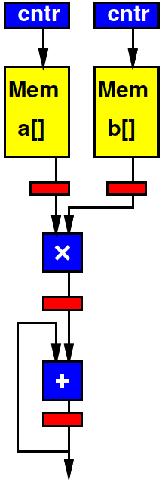
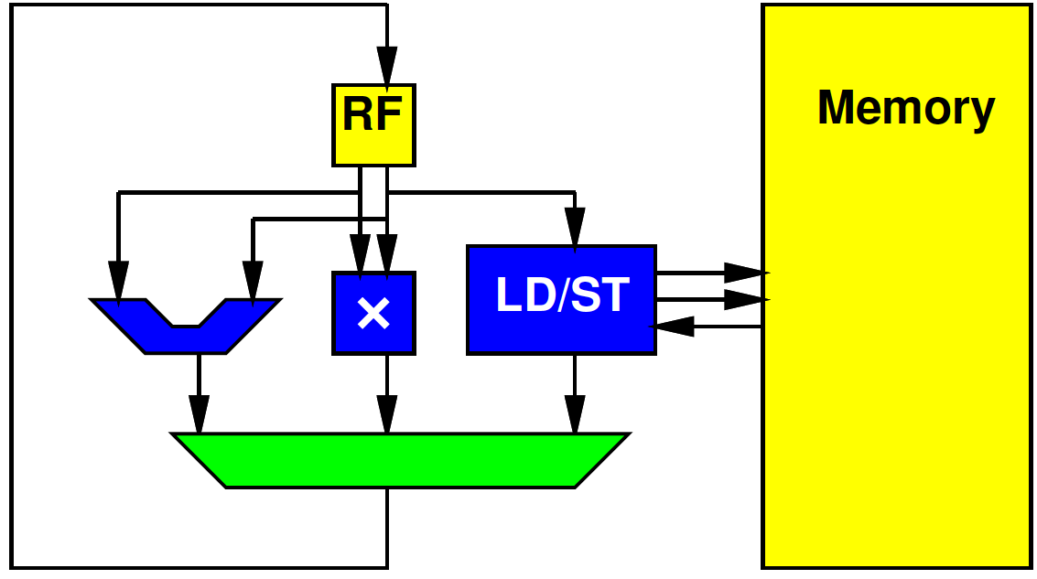
Preclass 1
Cycles per multiply-accumulate
Spatial Pipeline
Processor

Slide 5
Preclass 1
How different?

Slide 6
Computing Forms
Processor – does one thing at a time
Spatial Pipeline – can do many things, but always the same
Vector – can do the same things on many pieces of data

Slide 7
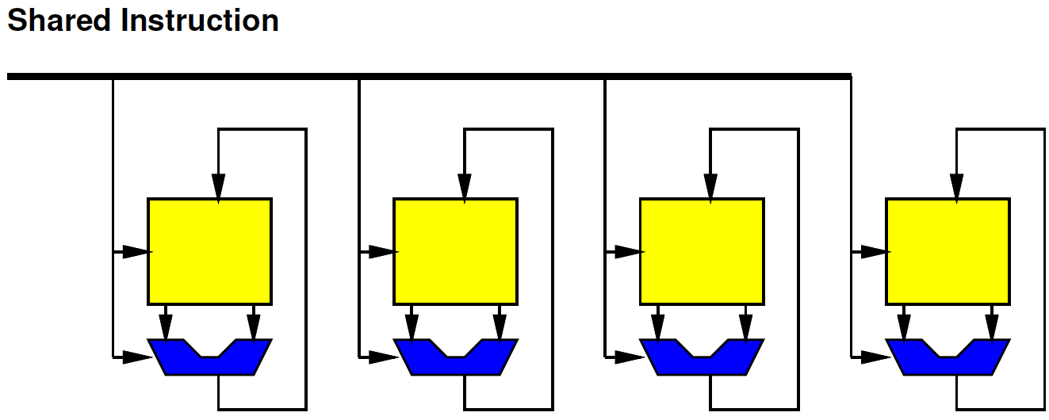
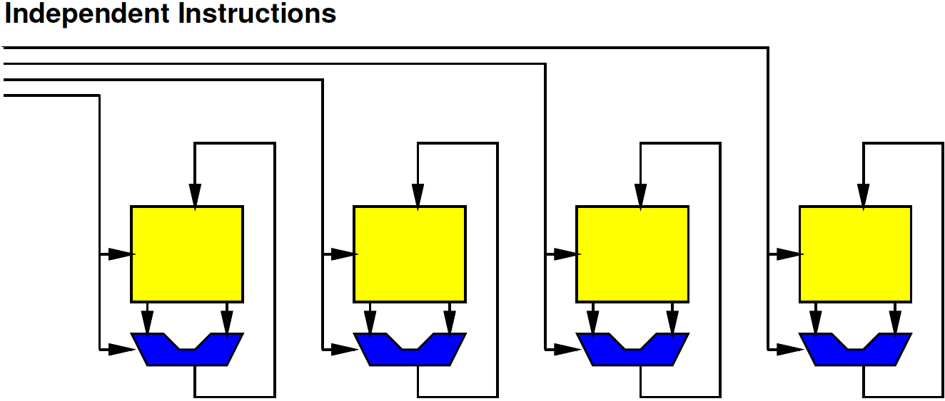
In Between
What if…
Want to
Do many things at a time (ILP)
But not the same (DLP)

Slide 8
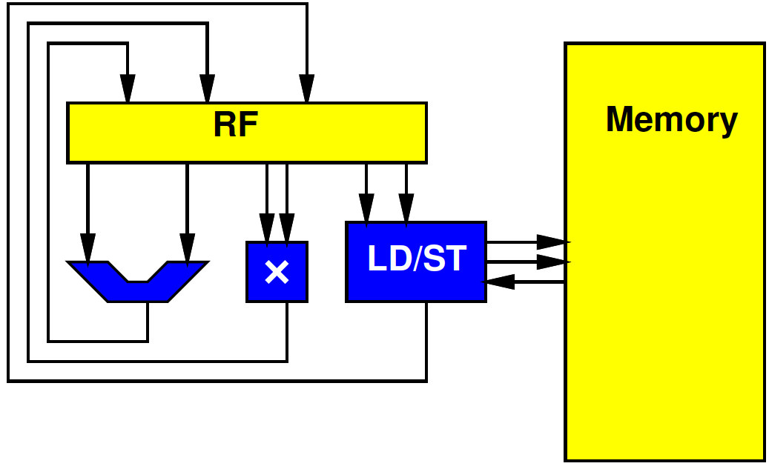
In between
What if…
Want to
Do many things at a time (ILP)
But not the same (DLP)
Want to use resources concurrently

Slide 9
In between
What if…
Want to
Do many things at a time (ILP)
But not the same (DLP)
Want to use resources concurrently
Want to
Accelerate specific task
But not go to spatial pipeline extreme

Slide 10
Supply Independent Instructions
Provide instruction per ALU
Instructions more expensive than Vector
But more flexible

Slide 11
Control Heterogeneous Units
Control each unit simultaneously and independently
More expensive than processor
Memory ports and/or interconnect
But more parallelism

Slide 12
VLIW
The “instruction”
The bits controlling the datapath
…becomes long
Hence:
Very Long Instruction Word (VLIW)

Slide 13
VLIW
Very Long Instruction Word
Set of operators
Parameterize number, distribution (X, +, sqrt…)
More operators→ less time, more area
Fewer operators→ more time, less area
Memories for intermediate state
X
X
+

Slide 14
VLIW
Very Long Instruction Word
Set of operators
Parameterize number, distribution (X, +, sqrt…)
More operators→ less time, more area
Fewer operators→ more time, less area
Memories for intermediate state
Memory for “long” instructions
Instruction
Memory
Address
X
X
+

Slide 15
VLIW
Instruction
Memory
Address
X
X
+

Slide 16
VLIW
Very Long Instruction Word
Set of operators
Parameterize number, distribution (X, +, sqrt…)
More operators→ less time, more area
Fewer operators→ more time, less area
Memories for intermediate state
Memory for “long” instructions
General framework for specializing to problem
Wiring, memories get expensive
Opportunity for further optimizations
General way to tradeoff area and time

Slide 17
VLIW
Instruction
Memory
Address
X
X
+

Slide 18
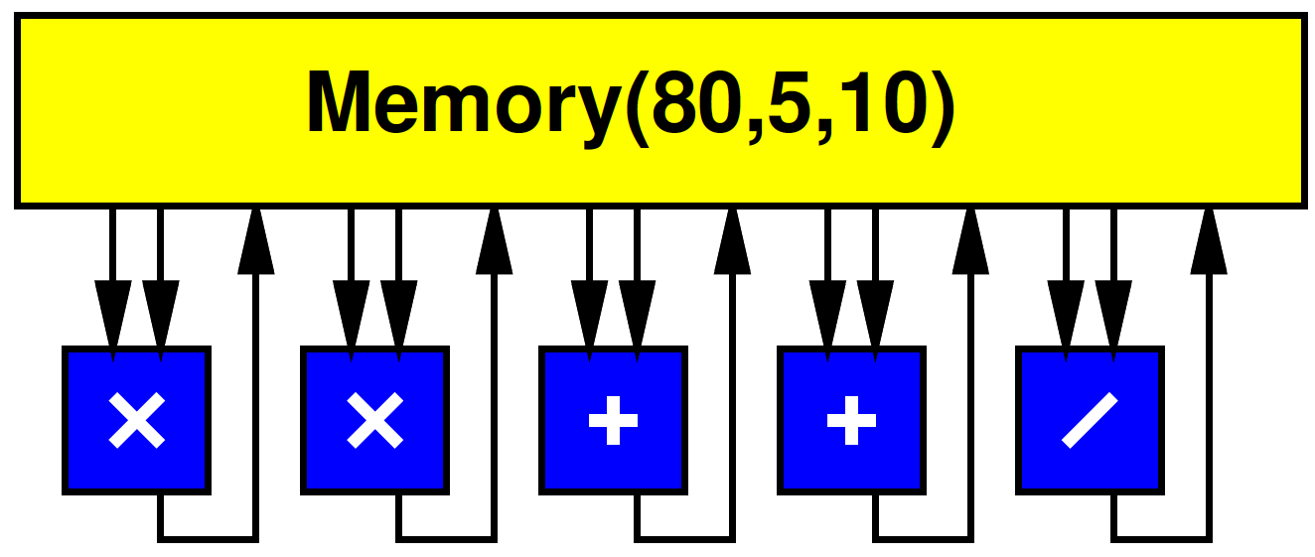
VLIW w/ Multiport RF
Simple, full-featured model use common Register File
Memory(Words, WritePorts, ReadPorts)

Slide 19
Processor Unbound
Can (design to) use all operators at once

Slide 20
Processor Unbound
Implement Preclass 1

Slide 21
VLIW Operator Knobs
Choose collection of operators and the numbers of each
Match task
Tune resources

Slide 22
Preclass 2
res[i]=sqrt(x[i]*x[i]+y[i]*y[i]+z[i]*z[i]);
II with one operator of each?
Minimum II achievable?
Latency lower bound
How many operators of each type?
Area comparison?

Slide 23
Critical Path
Increment pointers / branch
Load
Multiplies
Add
Add
Squareroot
Writeback

Slide 24
Preclass 2d
res[i]=sqrt(x[i]*x[i]+y[i]*y[i]+z[i]*z[i]);
res[i+1]=sqrt(x[i+1]*x[i+1]+y[i+1]*y[i+1]+z[i+1]*z[i+1]);
res[i+2]=sqrt(x[i+2]*x[i+2]+y[i+2]*y[i+2]+z[i+2]*z[i+2]);
res[i+3]=sqrt(x[i+3]*x[i+3]+y[i+3]*y[i+3]+z[i+3]*z[i+3]);

Slide 25
Time Points
4 iterations in 10 cycles = 2.5 cycles/iter
Compared to 1 iteration in 7
Compared to 1 iteration in 8

Slide 26
Multiport RF
Multiported memories are expensive
Need input/output lines for each port
Makes large, slow
Simplified preclass model:
Area(Memory(n,w,r))=n*(w+r+1)/2

Slide 27
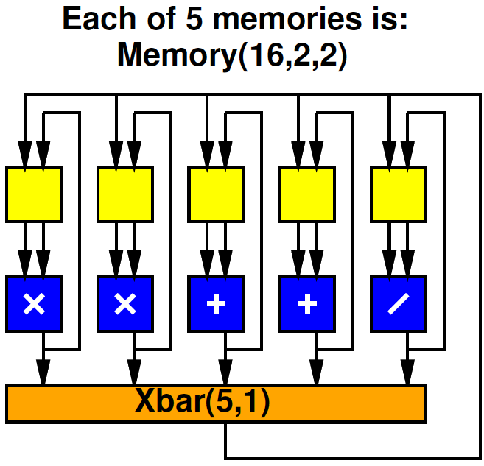
Preclass 3
Compare total area
Multiport 5, 10
5 x Multiport 2, 2 with 5x1 Xbar
How does area of memories, xbar compare to datapath operators in each case?

Slide 28
Split RF Cheaper
At same capacity, split register file cheaper
2R+1W → 2 per word
5R+10W → 8 per word

Slide 29
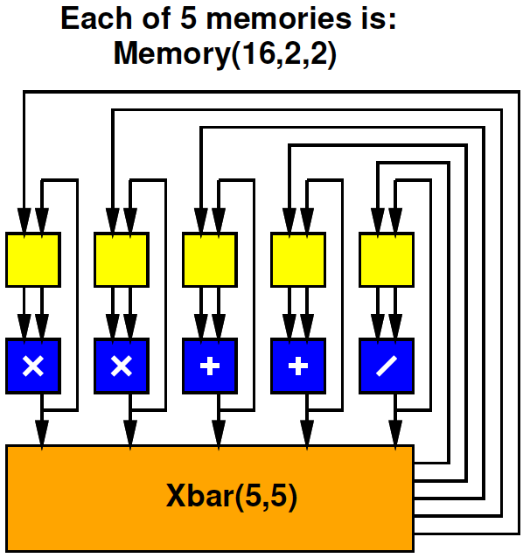
Split RF
Split RF with Full (5, 5) Crossbar
Cost?

Slide 30
Split RF Full Crossbar
What restriction/limitation might this have versus multiported RF version?

Slide 31
VLIW Memory Tuning
Can select how much sharing or independence in local memories

Slide 32
Split RF, Limited Crossbar
What limitation does the one crossbar output pose?

Slide 33
VLIW Schedule
Need to schedule Xbar output(s) as well as operators.
cycle | * | * | + | + | / | Xbar
0
1
2
3
4

Slide 34
Pipelined Operators
Often seen, will have pipelined operators
E.g. 3 cycles multiply
How complicate?

Slide 35
Accommodating Pipeline
Schedule for when data becomes available
Dependencies
Use of resources
cycle | * | * | + | + | / | Xbar
0 | X*X
1 | Y*Y
2 |  |  |  |  |  | X*X
3 |  |  |  |  |  | Y*Y
4 |  |  | X²+Y² |  |  | X²+Y²
5 |  |  |  |  | X²+Y²/Z
6

Slide 36
Accommodating Pipeline
Schedule for when data becomes available
Dependencies
Use of resources
Impossible
schedule;
Conflict on
single Xbar
output
cycle | * | * | + | + | / | Xbar
0 | X*X
1 | Y*Y
2 |  |  |  |  |  | X*X
3 |  |  | Q+R |  |  | Y*Y,Q+R
4 |  |  | X²+Y² |  |  | X²+Y²
5 |  |  |  |  | X²+Y²/Z
6

Slide 37
VLIW Interconnect Tuning
Can decide how rich to make the interconnect
Number of outputs to support
How to depopulate crossbar
Use more restricted network

Slide 38
Loop Overhead
Can handle loop overhead in ILP on VLIW
Increment counters, branches as independent functional units

Slide 39
VLIW Loop Overhead
Can handle loop overhead in ILP on VLIW
…but paying a full issue unit and instruction costs overhead

Slide 40
Zero-Overhead Loops
Specialize the instructions, state, branching for loops
Counter rather than RF
One bit to indicate if counter decrement
Exit loop when decrement to 0

Slide 41
Simplification

Slide 42
Zero-Overhead Loop Simplify
Share port – simplify further

Slide 43
Zero-Overhead Loop Example (preclass 1)
repeat r3:
addi r4,#4,r4;
addi r5,#4,r5; ld r4,r6
ld r5,r7
mul r6,r7,r7
add r7,r8,r8

Slide 44
Zero-Overhead Loop
Potentially generalize to multiple loop nests and counters
Common in highly optimized DSPs, Vector units

Slide 45
VLIW vs. SuperScalar
Modern, high-end processors
Do support ILP
Issue multiple instructions per cycle
…but, from a single, sequential instruction stream
SuperScalar – dynamic issue and interlock on data hazards – hide # operators
Must have shared, multiport RF
VLIW – offline scheduled
No interlocks, allow distributed RF
Lower area/operator – need to recompile code

Slide 46
Big Ideas:
VLIW as a Model for
Instruction-Level Parallelism (ILP)
Customizing Datapaths
Area-Time Tradeoffs
Customize VLIW
Operator selection
Memory/register file setup
Inter-functional unit communication network

Slide 47
Admin
Reading for Wed. online
HW6 due Friday
Remember many slow builds
Midterm next Monday
See Spring 2017 syllabus for
Last semesters midterm and final
…with solutions

